Slide 1
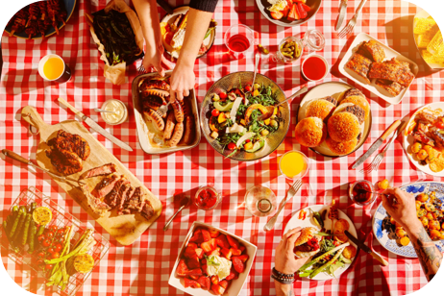
Why Do People Eat What They Eat?
Food and Nutrition

Slide 2
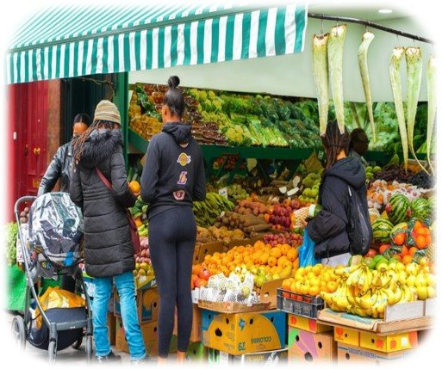
Why Do We Choose the Food We Eat?
Biological Factors
Physical and Practical Factors
Social Factors
Social and Religious Factors
Physiological Factors
Attitudes and Beliefs
Ethical and Environmental Factors
Future Dietary and Drinking Trends
Economic Factors
Contents

Slide 3
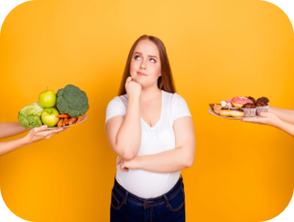
Why Do We Choose the Food We Eat?
Food is often a fun, enjoyable and interesting part of daily life and an important part of our celebrations and cultures.
Many factors influence our food choices including:
Social
Age
Biological
Psychological
Marketing & Advertising
Economic
Physical
Attitudes & Beliefs
Factors That Influence Our Food Choices | Eufic

Slide 4
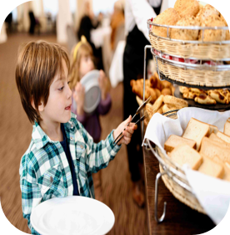
Why Do We Choose the Food We Eat?
Think about how your own food choices might differ in the following scenarios:
It's lunchtime in school, you eat with your friends and have just 20 minutes to buy and eat your food before you go to your next lesson
It's the weekend, you've been revising for your exams at home alone, you feel hungry but it's not lunchtime yet
It's your sister's birthday, you go out for a meal at a restaurant with your family in the evening
It's Sunday morning, you have a sports tournament today and you need to eat breakfast before you leave.
What are food choices? - KS2 - BBC Bitesize

Slide 5

Biological Factors
Check out the 'where food comes from' Knowledge Bank to find out more about processed foods
Hunger and Fullness
Our bodies tell us when we need to eat and when we're full. We need food for energy and nutrients to stay alive.
Carbohydrates, proteins and fats make us feel full in different ways. Fats make us feel the least full, simple carbohydrates make us feel a bit more full and complex carbohydrates and proteins make us feel fuller for longer.
Some processed foods can contain less fibre and protein compared to whole foods, which can affect the feeling of fullness after eating. This means that people may not feel as full after eating processed foods and might end up eating more as a result.
Taste and Enjoyment
How much we like the taste of food affects how much we eat. Different textures, smells, and looks of food also make us want to eat more.

Slide 6
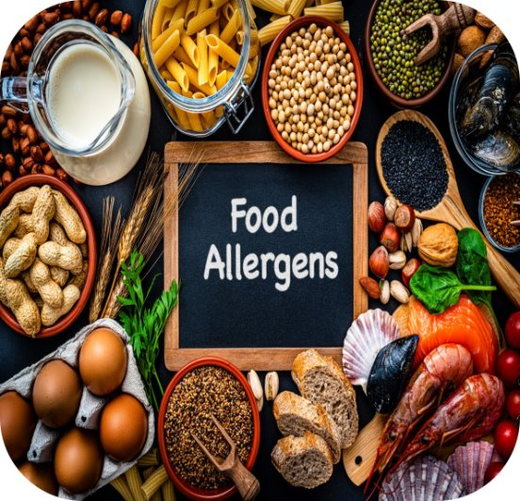
Biological Factors
Sensory Aspects
"Taste" includes how food smells, looks, and feels, not just the flavour. From a young age, we learn to like certain tastes and dislike others. What we think about food can change how much we like it.
Allergies or Intolerance
Certain foods can cause some people to feel unwell or their body to react. This is known as a food allergy or a food intolerance.
A food allergy can be very dangerous and make some people very ill. Some people can be allergic to things such as milk, nuts or shellfish.
A food intolerance is not usually as serious as a food allergy, but it can still make people feel unwell.
It is important to be aware of other food allergies or intolerances, not only because they can potentially be dangerous but also because it can limit the choices that people have.
What are food choices? - KS2 - BBC Bitesize

Slide 7
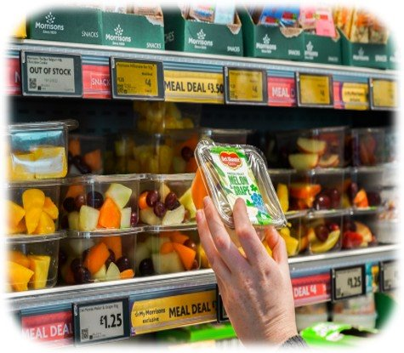
Physical Factors
Time
Many people say they don't follow healthy eating advice in the Eat Well Guide because they don't have enough time.
Those living alone or cooking just for themselves often choose convenience foods instead of cooking from scratch.
Shops have recognised this gap in the market and are now selling more prepacked, prepared convenience foods that are often more expensive and may be less nutrient dense.
Creating more tasty and convenient healthy foods and providing tips and tools can support people to prepare and consume healthier foods.
For example, chopping up fruits and vegetables can be a great way to save money, plastic and be a healthier way of snacking.

Slide 8
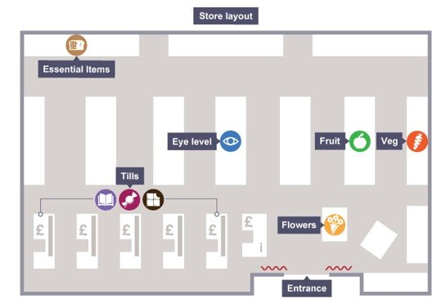
Practical Factors
Accessibility/Food environment
Where you live and how easy it is to get to a shop also affect what food you can buy. Healthy food is often more expensive in a town than at big supermarkets outside of town. Some areas have lots of fast-food outlets selling foods high in fat, sugar and salt.
Supermarket Layout
Stores use clever tricks to make you buy more things. When you enter the store, a warm blast of air slows you down, making you look around more. Fruits, vegetables and flowers are often at the entrance to make you think of freshness.
Expensive brands are placed at eye level so you see them first and might buy them. Items targeted at children and young people are on lower shelves so they can spot them and ask their parents to buy them.
Essential items like bread and milk are at the back of the store and far apart. This makes you walk past lots of other items and maybe buy more things.
Marketing strategies - Factors affecting food choice – CCEA - GCSE Home Economics: Food and Nutrition (CCEA) Revision - BBC Bitesize

Slide 9
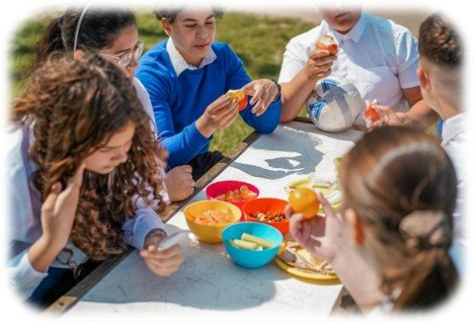
Social Factors
Check out the 'Laws and Regulations' Knowledge Bank to find out more about regulations around school meals
Social Context
What people around us eat can influence our food choices.
Even when eating alone, we are influenced by what we've learned from others.
Social support from family and friends can help people make healthier food choices.
Families play a big role in deciding what we eat.
Social Setting
Most food is eaten at home, but more and more is eaten at places like schools, work and restaurants.
Where we eat can affect what we choose to eat, based on what's available.
Having healthy food options at home and other places helps people eat better.

Slide 10

Psychological Factors
Stress
Stress is common and can influence what and how much we choose to eat.
Some people may have less of an appetite and some people may eat more.
Long-term stress can affect whether people eat a healthy balanced diet.
Mood
Sometimes hunger is not the main reason we eat.
Food can change how we feel and how we feel can change what we eat.
Some people turn to specific food for comfort when they feel low, stressed, bored or happy and excited.
Eating a balanced diet and being active is good for mental wellbeing.

Slide 11

Check out the 'Industry, Marketing and Advertising' Knowledge Bank to find out more
Marketing Strategies
Financial Incentives
Supermarkets use financial incentives to attract and keep customers. Here are some examples:
Special offers: Supermarkets often have deals like "buy one get one free" to influence you to buy more.
Loyalty cards: Give you the opportunity to earn points or vouchers for money off when you shop. This makes people want to shop there more often.
Price checking: Stores advertise that their prices are as good as or better than other big stores, making you think you’ll save money by shopping there.
Own brand products: Big stores have their own cheaper brands that you can’t get anywhere else. This can encourage people to shop at these stores for the exclusive deals.
Marketing strategies - Factors affecting food choice – CCEA - GCSE Home Economics: Food and Nutrition (CCEA) Revision - BBC Bitesize

Slide 12
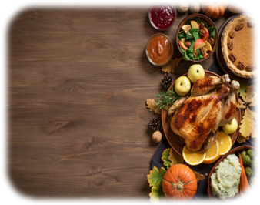
Social and Religious Factors
Check out the 'how is food an important part of our culture and society' Knowledge Bank to find out more
Food is often a fun, enjoyable and interesting part of daily life, and an important part of our celebrations and cultures. Food often brings us together and helps us to build memories.
Social Influence
What people eat is affected by their social and cultural backgrounds. The food (and drink) you eat during childhood develops your life-long food and drink habits. This is important because what we eat long-term affects our health and wellbeing throughout our lives.
The media also plays a part in what foods and drinks we consume. If we see somebody that we find influential eating a certain way, this can affect our food choice.
Cultural Influences
Culture affects what foods people usually eat and how they prepare them.
Some cultures avoid certain foods, like meat or milk.
Notes:
Religious factors can have a major influence on what foods we buy.
For example, Muslims will not eat meat such as beef or lamb that has not been slaughtered by the halal method, while those of the Jewish religion will only eat foods that are Kosher.
Religious beliefs often dictate certain diet restrictions, fasts, feasts, and specific food preparation methods.
Buddhism – Many Buddhists follow a lacto-vegetarian diet abstaining from meat, poultry, fish and eggs. Some might also avoid strong-smelling plants like garlic and onions.
Hinduism – Many Hindus follow a lacto-vegetarian diet, and beef is strictly prohibited, as cows are considered sacred.
Islam – Muslim dietary laws, known as Halal, prohibit the consumption of pork and alcohol. Animals must be slaughter according to certain rules.
Judaism – Jewish dietary law, known as Kosher, prohibits the consumption of pork and shellfish. Dairy and meat products cannot be consumed together.
Christianity – Certain Christian groups, such as Catholics, may abstain from meat on Fridays during Lent
Turkey dinner plate hi-res stock photography and images - Alam

Slide 13
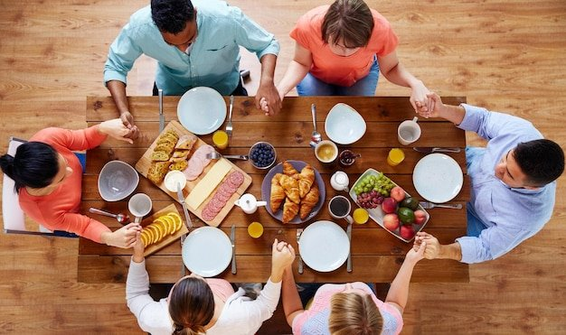
Social and Religious Factors
Food choices play a significant role in many religious practices, shaping not only what is consumed but also how it is prepared, shared and celebrated. These dietary customs reflect deeper spiritual values, ethical beliefs and cultural traditions that vary across different faiths.
Dietary Restrictions: Many religions have specific guidelines on what is permissible to eat (halal, kosher, vegetarianism, fasting).
Sacred Foods: Certain foods are considered holy or spiritually significant (e.g., bread and wine in Christianity, prasad in Hinduism).
Fasting and Abstinence: Periods of fasting are observed (e.g., Ramadan in Islam, Lent in Christianity).
Cultural and Ethical Impact: Religious beliefs often influence ethical food choices, such as avoiding meat or practicing sustainable farming.
Symbolic Meaning: Food rituals and ceremonies often have spiritual or symbolic meanings (e.g., communal meals during religious festivals).

Slide 14
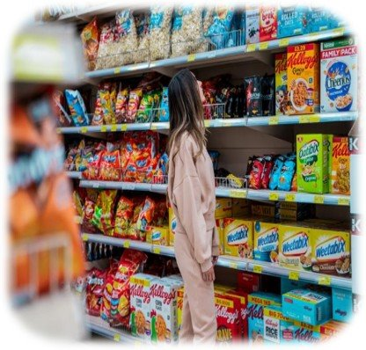
Attitudes and Beliefs
Within the UK people may choose to follow a certain diet and this can be based on their attitudes, beliefs, health reasons, culture or religion.
On the next slide it shows some of the most popular diets people in the UK tend to follow. It is important to note that these diets don't restrict any part of the eatwell guide. For example, vegetarians don't eat meat, but it doesn't mean they don't eat protein. They supplement the food group with foods such as beans, pulses and nuts to achieve their protein recommendations.
Have a look at the next slide and see which of these diets you've heard of and what the main differences are.

Slide 15
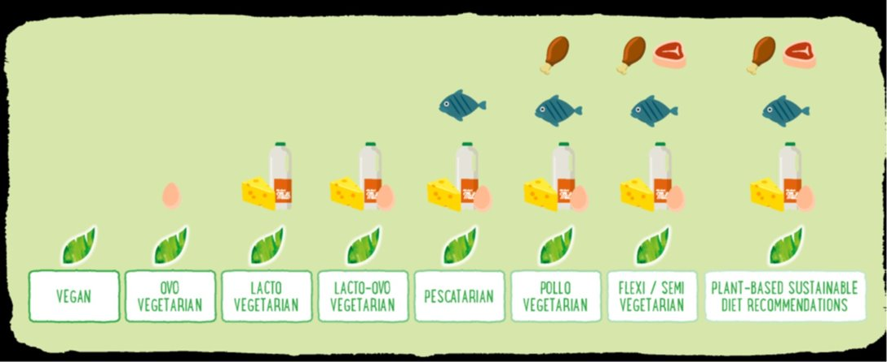
Popular Diets in the UK
MyNutriWeb: Ensuring Nutritional Adequacy of Plant based Diets for Children. Vanessa Clarkson

Slide 16
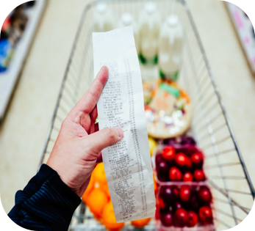
Other Factors
Cost
The cost of food is a big factor in what people buy. People with less access to resources and opportunities often eat fewer fruits and vegetables. People may be hesitant to try new foods as they may see it as a waste if their family doesn't like it.
Education and Knowledge
How much money and education people have affects what they eat and can lead to food related ill health. To help people with less access to resources and opportunities eat a healthy balanced diet, educating people on both what to eat and how to prepare and cook food, but also how to access foods can be a positive way to overcome these barriers.

Slide 17
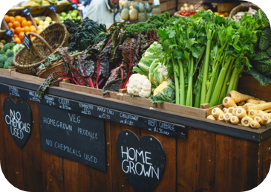
Ethical and Environmental Factors
An ethical consumer will care deeply about where their food comes from and the welfare of the animals and people involved in making that food.
They will look for the following factors:
Organic produce – ethical consumers tend to buy organic produce as it is produced in a way that protects the environment.
Fairtrade produce – ethical consumers tend to buy Fairtrade produce, for example bananas or chocolate, as the farmers responsible for producing the product have been given a fair price for their produce.
Local produce – ethical consumers often like to support local farmers. For example, people from Wales may like to buy Welsh Lamb that have been farmed in Mid Wales compared to Lamb from New Zealand as this reduces food miles.
Ethical and environmental factors - Factors affecting food choice – CCEA - GCSE Home Economics: Food and Nutrition (CCEA) Revision - BBC Bitesize

Slide 18
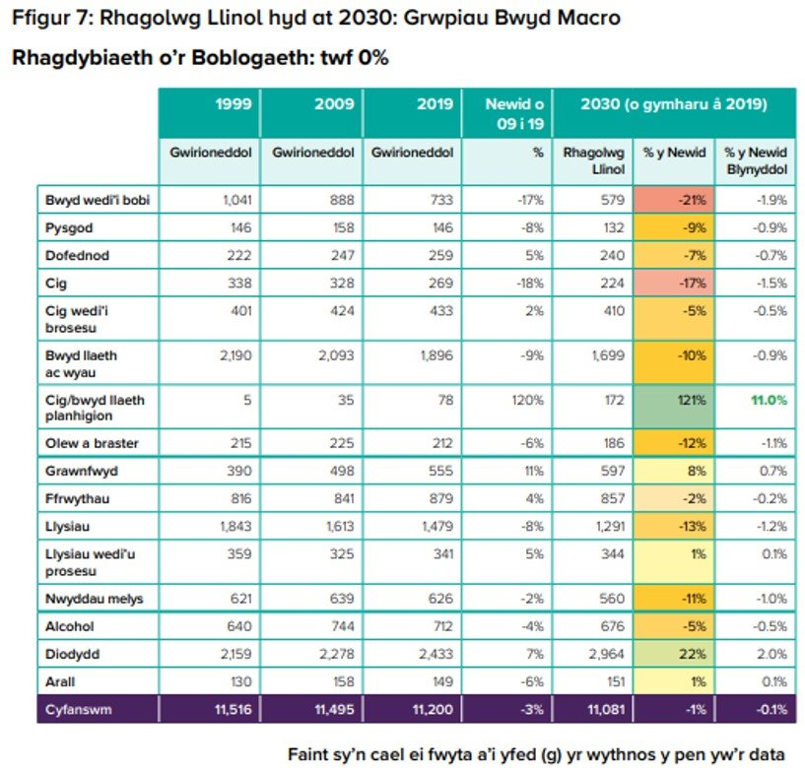
Future Dietary and Drinking Trends
People usually pick foods and drinks that are cheap and easy to get as this fits into their busy lifestyles.
This habit is strong, but new technology is making it even easier for people to find convenient food options. While it's nice to have food that's quick and affordable, it can often be bad for the environment and our health.
Most people focus on what's best for them right now, rather than thinking about how their choices will affect their health, their family or the world in the future.
The following table shows how our diets have changed over previous years and how the next 5 years will look.
Do you think these trends effect our health?
Shaping Our Health - Chief Medical Officer for Wales Annual Report 2023 (gov.wales)
Notes:
Shaping Our Health - Chief Medical Officer for Wales Annual Report 2023 (gov.wales) page 31

Slide 19
Thank You For Listening

