Slide 1

Toothbrushing in Schools and Nurseries
Dewi is returning!

Slide 2
Introduction
This presentation is delivered by a member of your local Designed to Smile Team
INSERT CONTACT DETAILS

Slide 3

Anticipated Learning Outcomes
Participants will be:-
aware of the new guidelines in response to COVID-19
aware of the cross infection protocols for D2S & the “dry method” of brushing
aware of the level of commitment necessary, including staff training, to deliver D2S
aware of the benefit of participating in D2S as a link to Health & Well-being educational standards
Notes:
The purpose of this presentation is to share an update of the infection prevention and control aspects of the supervised toothbrushing programme as we restart following the COVID-19 pandemic.
The risk of COVID-19 should be managed by good hygiene measures and physical distancing.

Slide 4
Why the need for oral health promotion in early childhood?
Common chronic childhood disease but preventable!
Poor dental attendance rates in young children, especially those most in need
High levels of untreated disease, yet decay can be halted if treated early enough!
Severe disease leads to overuse of antibiotics and hospital admissions
Often first sign of ill- health and wider unhealthy behaviours in children- marker of parental knowledge and care-giving
Indicator of future poor oral health through life

Slide 5
The benefits of Designed to Smile
The daily fluoride in toothpaste strengthens teeth
If decay can be prevented, toothache and the need for emergency dental appointments may be avoided
It helps maintain the baby teeth and avoid unnecessary general anaesthetics
It can be an opportunity to learn about personal care and form healthy habits ( WG educational standards)
Children can see that toothbrushing is an activity which can be fun, and should be part of daily routines

Slide 6

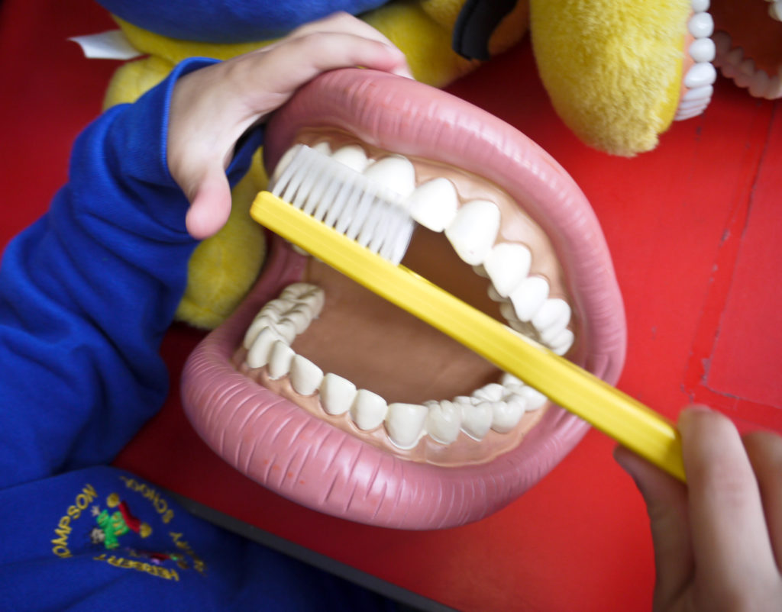
New Curriculum
The Health and Well-being Area of Learning and Experience provides a holistic structure for understanding health and well-being. It is concerned with developing the capacity of learners to navigate life's opportunities and challenges.
Developing physical health and well-being has lifelong benefits.
This Area can help learners to understand the factors that affect physical health and well-being. This includes health-promoting behaviours such as physical activity, including but not limited to sport; balanced diet; personal care and hygiene; sleep; and protection from infection. It also includes an understanding of health-harming behaviours.
Designed to Smile is an integral part of the Healthy Schools Scheme

Slide 7


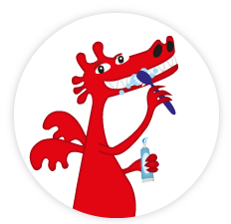

Holistic Key Messages
Healthy eating – balanced diet which sees a reduction in refined carbohydrates and sugary drinks
Daily brushing - using a fluoride toothpaste, especially at bedtime
Visiting the dentist – which helps to establish relationships with health professionals and avoid emergency visits
Notes:
There is already research from Wales showing that during the COVID-19 pandemic, children’s routines were disrupted, particularly the toothbrushing routine of brushing twice a day, especially last thing before bed. Also the research shows children ate more unhealthily. These two aspects of unhealthy eating and irregular toothbrushing habits forecast a major step back in the progress we had made to improve children’s dental health. There is even more need for the work of Designed to Smile and the toothbrushing scheme than before the pandemic.

Slide 8
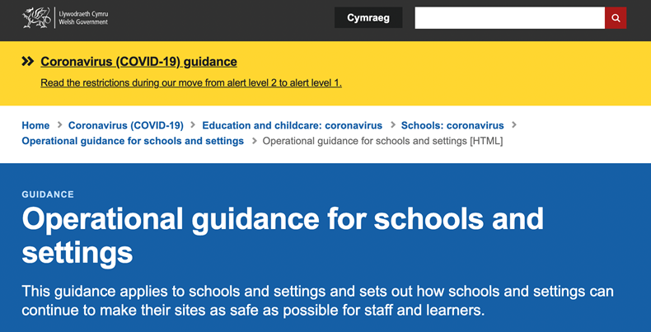
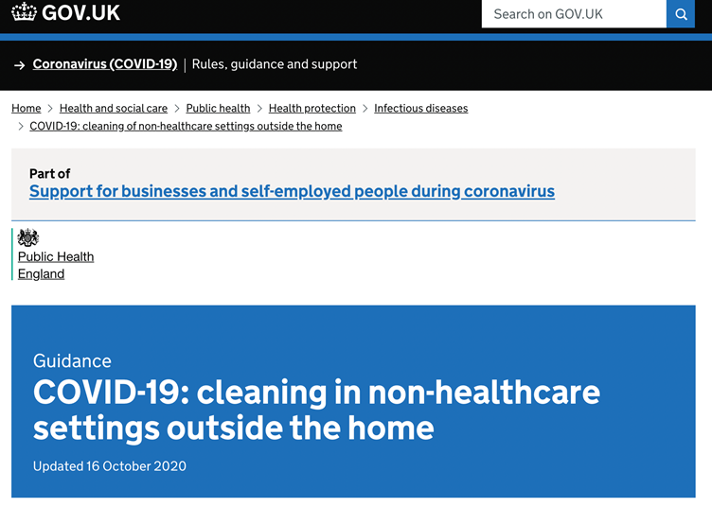
Reinstating Designed to Smile
Delivered by school/nursery staff
All settings should have a designated lead person who is responsible for the programme
All staff will receive training by a D2S team member. This will be recorded and monitored. This will include infection control procedures, incorporating COVID-19 guidelines.
Children must be supervised at all times
Responsible for safe running of the programme and cleaning of equipment
Notes:
I am going to summarise the detail of the Quality Standards for Toothbrushing document that are the foundation of the programme, and need to be read by all those involved in the programme. The most up-to-date Welsh Government Operational Guidance for schools and settings and UK Government guidance on cleaning in non-healthcare settings outside the home should also be understood.
Firstly, I will describe the different roles of those involved:
School and nursery staff….(info on slide)

Slide 9
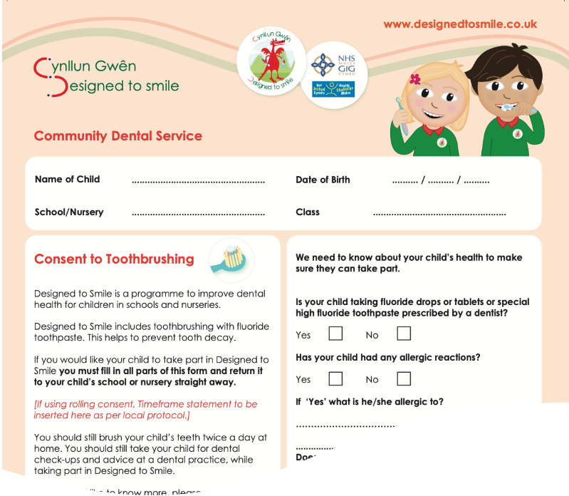

Reinstating Designed to Smile
Parental consent
Appropriate arrangements of consent must be in place and records maintained
Parents are consenting to daily brushing, so settings need to brush 5 days every week
Children participating will receive home packs to encourage brushing at home. Parents should supervise brushing at home, especially before bed
Notes:
Parents have an important role, in both giving consent for their child to brush at nursery and school, but also to supervise brushing at home.
Appropriate arrangements for consent must be in place and records maintained.
Only those children with positive consent can participate.
We need to agree a local place where received consents will be stored and everyone knows this is where they will be.
The Designed to Smile team will support parent and guardian engagement and the consent process.
Children should brush their teeth on all the days that they attend the setting.
Toothbrushing can take place at a time which is most suitable for each setting.

Slide 10
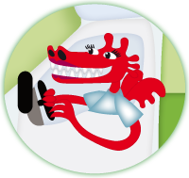
Reinstating Designed to Smile
Designed to Smile staff support
Work with staff to assess how toothbrushing will run in each classroom
Provide and organise the equipment and paperwork
Establish good record keeping with the consent forms
Be on site when first starting to help get into the routine
Visit at least once a term to carry out an observation of toothbrushing in practice, using a checklist measured against Standards
Available for advice over the phone
Notes:
Designed to smile teams are here to support every setting. We will… (info on slide)

Slide 11
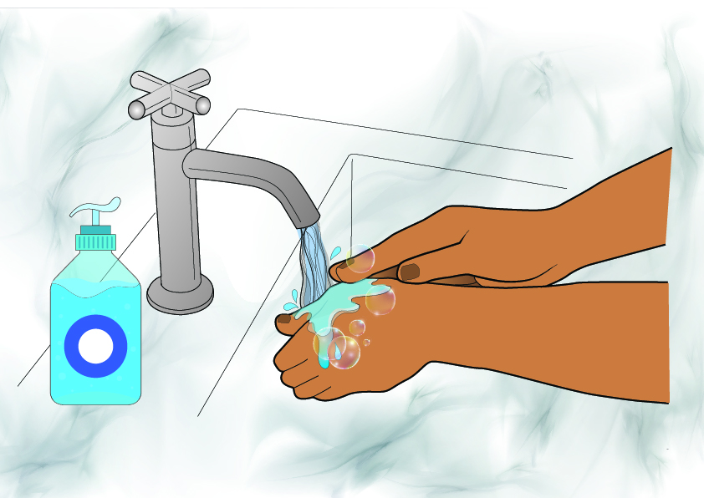
Let’s get brushing!
Everyone should wash their
hands before and after brushing
Hand sanitisers can be used
Supervisors should cover any cuts
And abrasions with waterproof plasters
Notes:
The supervisors and children should wash their hands with soap and warm water, and thoroughly dry them before and after the toothbrushing session. If hand washing is not possible, use an alcohol-based hand sanitiser.
Supervisors should cover any cuts, abrasions or breaks in their skin with a waterproof dressing prior before commencing. PPE needs to worn in line with Welsh Government operational guidance for schools, if the level of supervision would be considered personal care.
If, particularly for young children, or children in Additional learning needs settings, staff feel they are providing personal care, Welsh Government COVID-19 guidance should be followed in relation to PPE.

Slide 12
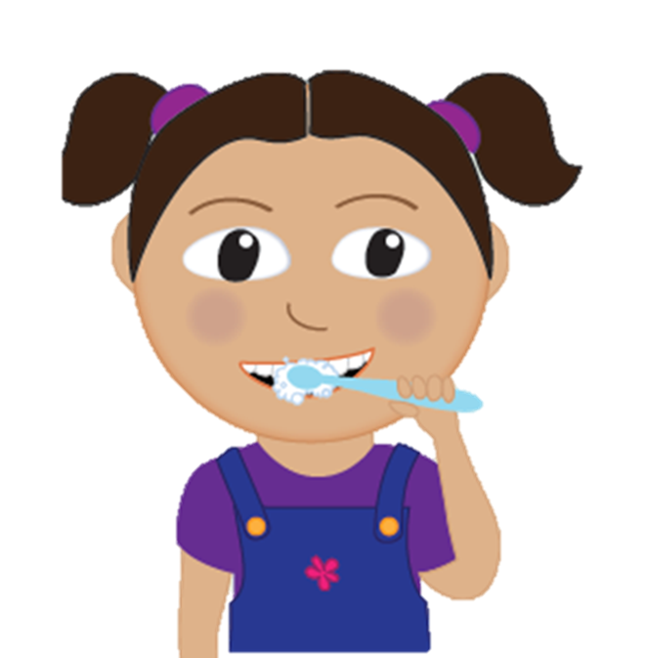
The ‘Dry Brushing’ Method
Children should brush their teeth with toothpaste without the use of water or sinks; children could be seated or standing.
What do we need?
Hand hygiene facilities (sink/sanitiser)
Toothbrushes
Toothpaste
Storage systems
Paper towels
Cleaning equipment and facilities
Notes:
Going forward, all settings will follow the ‘dry’ toothbrushing model where children brush their teeth without the use of water or sinks; children can be seated or standing when brushing.
We are no longer using the wet brushing model where children brush their teeth using water, usually stood at sinks.
Children must be supervised throughout the toothbrushing routine.
If the children are organised into groups or ‘bubbles’, then each bubble should brush separately from any other bubble.
There should be good ventilation of the area where toothbrushing takes place.

Slide 13
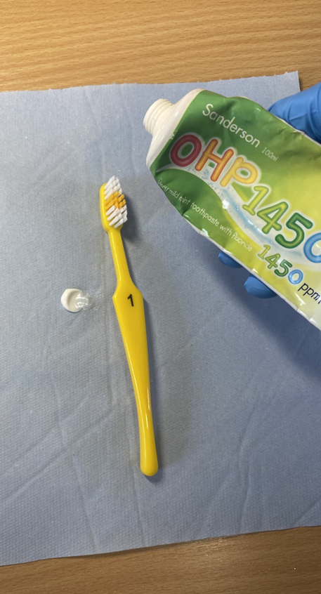
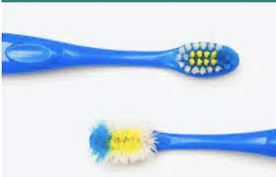
Each child uses their own brush and paste
Brushes should be individually identifiable for each child, usually with a symbol / picture / number and colour coded to match the storage system (bus / train / rack)
Brushes should be replaced every half term, or sooner if in poor condition, dropped on floor or contaminated
Notes:
Supervisors should dispense the toothpaste onto an individual paper towel to allow each child to apply toothpaste to their brush. Toothpaste must only be dispensed at the time the children are ready to brush.
Each child, under supervision, should collect their own toothbrush (clean and dry) from the storage system and their portion of toothpaste on a paper towel.
The toothbrushes will be individually identifiable for each child, enabling the child and the supervisor to recognise their brush.
The list to cross check names with symbols/numbers should be readily available in the classroom and cleaning area.
Care must be taken to ensure that toothbrushes do not cross-contaminate when being removed or replaced in storage systems.
Storage racks should not be in the vicinity of the children whilst toothbrushing takes place in order to prevent contamination.

Slide 14
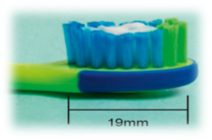
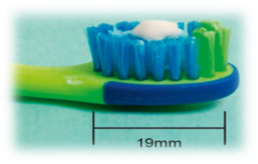
How much toothpaste?
Children under 3 years old
A small smear of toothpaste containing 1000ppm fluoride
Children aged 3 years and over
A pea-sized amount of toothpaste
containing 1450ppm fluoride
Toothpaste must stored safely where children can’t access it
Notes:
The supervisor is responsible for dispensing the correct amount of toothpaste.
Children under 3 should use a smear of toothpaste whilst children aged 3 and over should used a pea-sized amount.
Toothpaste containing 1000ppm (parts per million) fluoride is used for children under the age of 3 years. Toothpaste containing 1450ppm (parts per million) fluoride is used for children aged 3 years and over.
Toothpaste must be stored safely where children cannot access it.

Slide 15

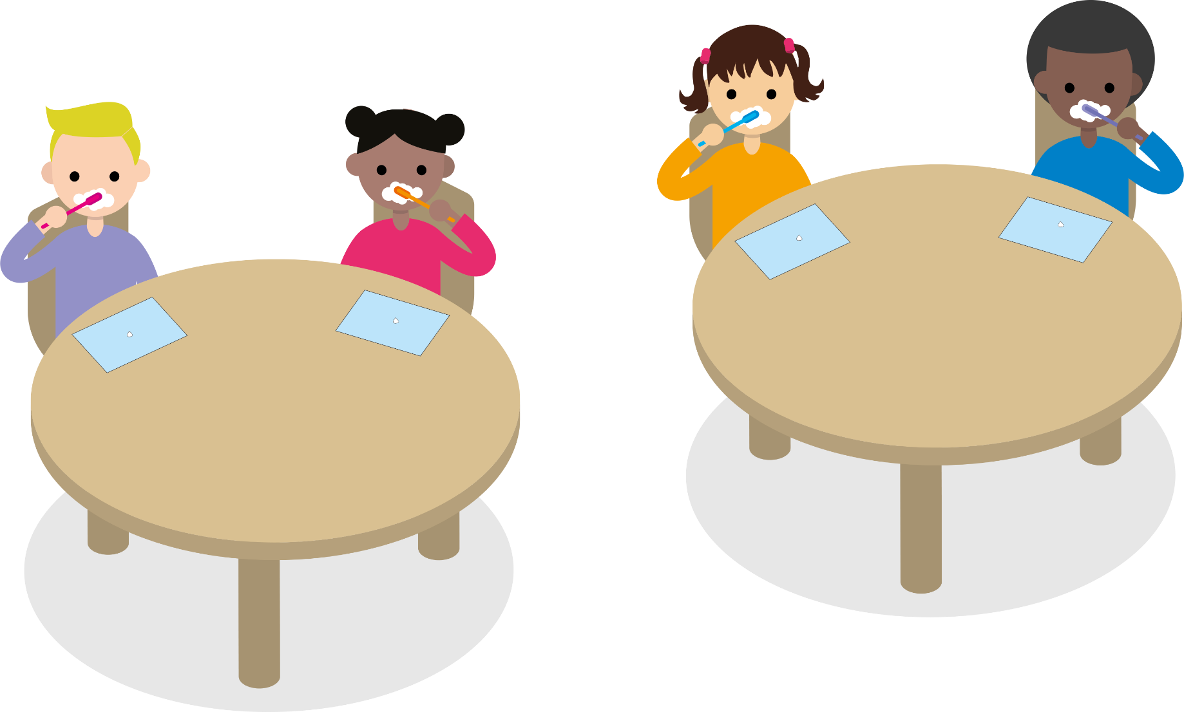
Brush for two minutes
Notes:
Children may be seated or standing still whilst toothbrushing takes place.
They should scoop up the toothpaste from their paper towel onto their brush, and start brushing with their dry brush.
Any toothbrushes dropped on the floor are immediately discarded in water-resistant refuse bag, within a bin with a lid.

Slide 16



After brushing
Notes:
Children are discouraged from swallowing toothpaste but instead encouraged to raise the paper towel to their mouth if they need to spit out excess toothpaste, and to wipe their mouth.
Supervisors should direct children to dispose of any paper towels immediately in a water-resistant refuse bag, within a bin with a lid.

Slide 17
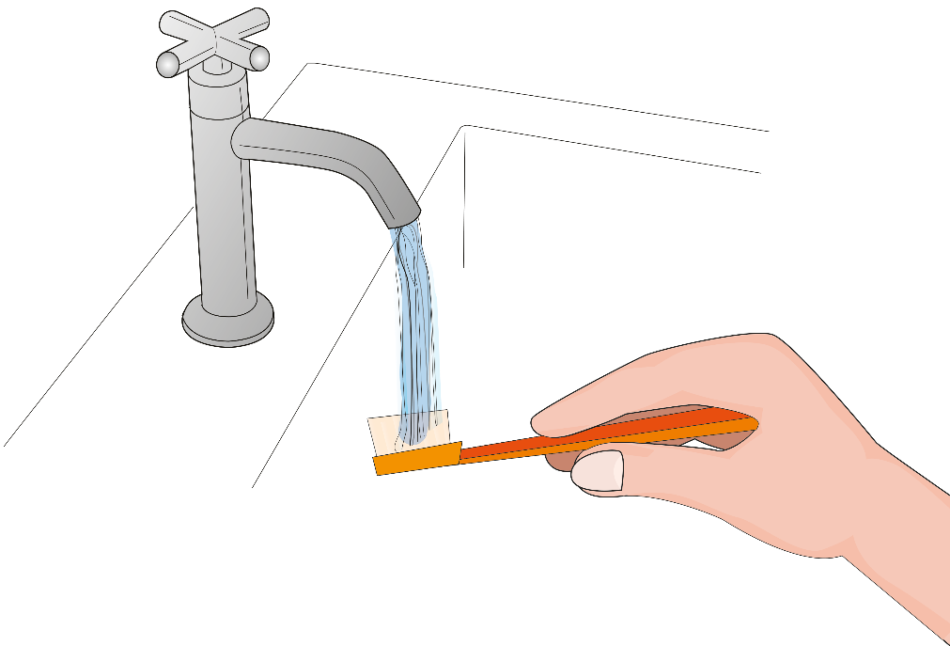
Rinsing the brushes
Either:
Rinsed by the children individually at a designated sink, patted dry and return to the storage system
Or:
Returned to the storage system by each child, then supervisor takes to sink area, rinses the brushes individually, cleans the storage system, before returning brushes to their places in the system
We’ll come back to the cleaning process in a bit!
Notes:
Toothbrushes should be rinsed straight after use- the toothpaste should not be allowed to dry on the brush.
The method for rinsing brushes will be decided by discussion with the Designed to Smile staff member helping to set-up the toothbrushing scheme in each classroom. It will take into account the age/maturity of the children, and availability and height/suitability of the sink. One of these two options will be agreed for the classroom.
Staff should always supervise this. The tap should be left running to reduce the amount of times and people touching the tap.
( The classroom assessment should have already identified issues with push taps and assessed alternatives/duration of flow/ techniques to address)
Toothbrushes should not come into contact with the sink or tap. Toothbrushes must not be washed together in the sink, and must not be soaked in bleach or other cleaner/disinfectant.
Toothbrushes should be rinsed thoroughly- the bristles and then all the way down the handle.
Cleaning of the storage racks should occur when the toothbrushes are in use during the toothbrushing session or as the brushes are rinsed.
Brushes should be returned to the storage system i.e. bus, to air-dry. The supervisor is responsible for ensuring that the brush is placed in the correct location (matching names/symbol of brush to the storage system.
There should be no contact between brushes. Care should be taken to ensure that the toothbrushes do not cross-contaminate when being removed or replaced in the storage system.
Storage system lids should be replaced at this stage, provided that there is sufficient air circulation to allow the toothbrushes to dry before next use.

Slide 18
After brushing, wash your hands!
Notes:
After their part in the process, all children and staff should wash their hands with soap and warm water and thoroughly dry them (or use an alcohol-based hand sanitiser) after the toothbrushing session.
The area where toothbrushing occurred and the sink area should be cleaned immediately after the session.

Slide 19
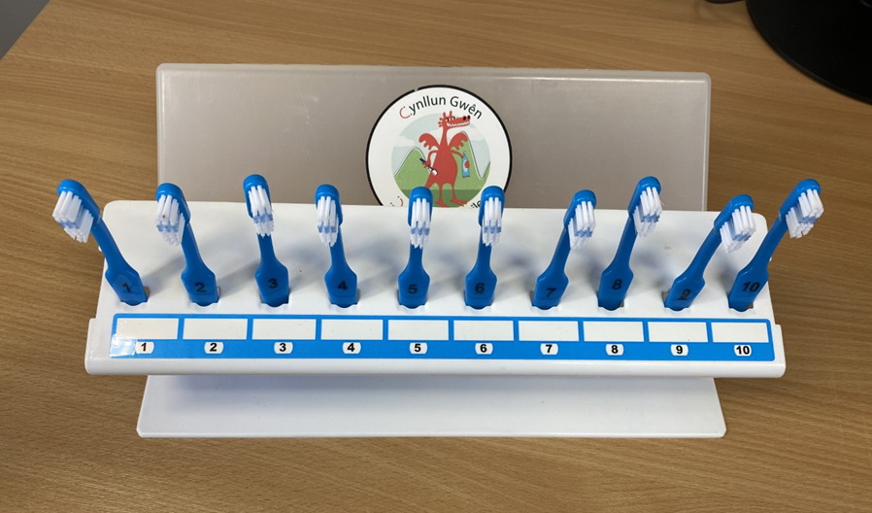
The Brush Storage System
Called: Buses / Trains / Racks
Display symbols and colours corresponding to the brushes for each group or “bubble” of children. There is a space to write names.
Enable the brushes to stand upright
Should allow air flow around the toothbrush heads to enable the toothbrushes to dry
Any covers used should allow sufficient ventilation to allow drying or only be placed on the system once the brushes have dried
If covers are not used, the storage system will be placed in a designated trolley or an appropriate cupboard, after brushes have been allowed to dry. Systems should never be stored in toilet area
Notes:
Use the storage racks provided by Designed to Smile, which hold the toothbrushes in an upright position, with sufficient distance between brushes to avoid cross contamination.
Storage racks should allow air flow around the toothbrush heads to enable the toothbrushes to dry.
Covers should allow sufficient ventilation to allow drying or should only be used once brushes have dried.
Storage racks which do not have covers should be stored within a designated trolley or in a clean, dry cupboard.
There should be a separate storage system for each group or ‘bubble’ of children where applicable.
The toothbrushing storage systems should be stored out of reach of children in between brushing sessions.

Slide 20
Cleaning the Equipment
Staff should clean the equipment wearing appropriate PPE and household gloves
Desk surfaces should be wiped clean after brushing if children brush sitting down
Toothpaste tubes can be cleaned with a damp disposable tissue
When cleaning the storage system, brushes need to be removed individually, laid on clean paper towel with no touching between brushes
To clean the storage system, trolleys and work surfaces, use hot water and standard household cleaning products active against bacteria and viruses
Rough/damaged equipment needs replacing
Rinse with water
Clean with detergent
Dry thoroughly
Notes:
Storage systems, trolleys and storage areas must be cleaned, rinsed and dried by nursery/school staff.
For supervisors involved in cleaning, appropriate PPE: disposable aprons, fluid-resistant surgical masks, and eye protection (if there is a risk of splashing to the eyes) should be worn in line with Welsh Government guidance.
Desk surfaces should be wiped clean after brushing if children brush sitting down
Tubes of toothpaste can be cleaned with a damp, disposable cloth/tissue.
Paper towels should be used to mop up any drips visible on the storage system in between washes. The agreed process for rinsing the brushes will affect when and how frequently the storage system needs cleaning, and will be covered in the hands-on element of the training.
Cleaning of the storage racks: They should be rinsed with hot water then cleaned using standard household cleaning products (for example a detergent or disinfectant which is active against bacteria and viruses) using warm water.
Dedicated household gloves must be worn when cleaning storage systems and sinks, as the person should use hot water. Disposable aprons, masks and eye protection should be used in line with Welsh Government guidance for schools/nurseries. Thorough hand hygiene should be performed before and after. All cuts, abrasions and breaks in the skin should be covered with a waterproof dressing before cleaning.
After toothbrushing is complete, supervisors are responsible for cleaning sinks following the environmental decontamination guidance for non-healthcare settings.
Please inform the Designed to Smile team about any damaged items that need replacing.
There is additional guidance about cleaning in the full document describing these quality standards, which should be referred to, and we will go over this in practice.

Slide 21
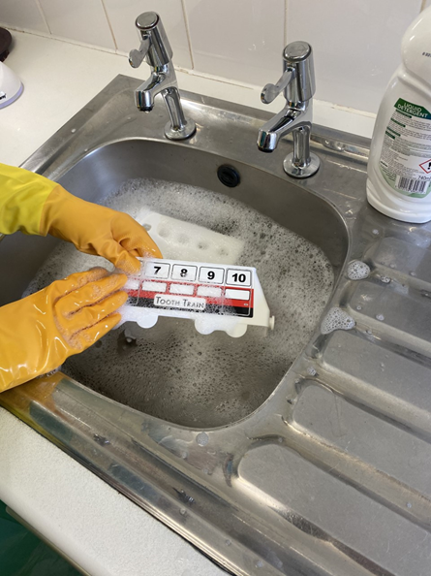
Trolleys and sinks
Trolleys will accommodate the storage system and also provide space to store toothpaste, spare brushes, and other sundries / paperwork. They will require cleaning regularly, using a similar method to the storage system.
Sinks
Ideally, settings should have designated sinks, used only for brushing and handwashing.
Sinks should be cleaned after every toothbrushing session.
Notes:
(info on slide)
After toothbrushing is complete, supervisors are responsible for cleaning sinks following the environmental decontamination guidance for non-healthcare settings. https://www.gov.uk/government/publications/covid-19-decontamination-in-non-healthcare-settings
The trolleys also require cleaning regularly.

Slide 22
We are here to help!
STAFF SUPERVISION IS ESSENTIAL FOR ALL PARTS OF THE
TOOTHBRUSHING PROCESS
CROSS-CONTMAINATION CAN BE AVOIDED IF STAFF FOLLOW THE D2S GUIDELINES
HEALTH INEQUALITIES & POVERTY HAVE NOT GONE AWAY DURING THE COVID PANDEMIC
HEALTHY HABITS & PERSONAL CARE ARE PART OF THE WELSH GOVERNMENTS EDUCATION PLAN
Notes:
In quick summary:
(info on slide)
It is important to read the full quality standards for toothbrushing document, and to ask any questions about aspects you are uncertain about. We will go over how it will work in each classroom with hands-on training and support during the first few sessions.

Slide 23

Thank you for listening
Thank you for your continued support!
If you would like more information on any of the subjects covered, please visit the Designed to Smile website:
www.designedtosmile.co.uk

