Slide 1
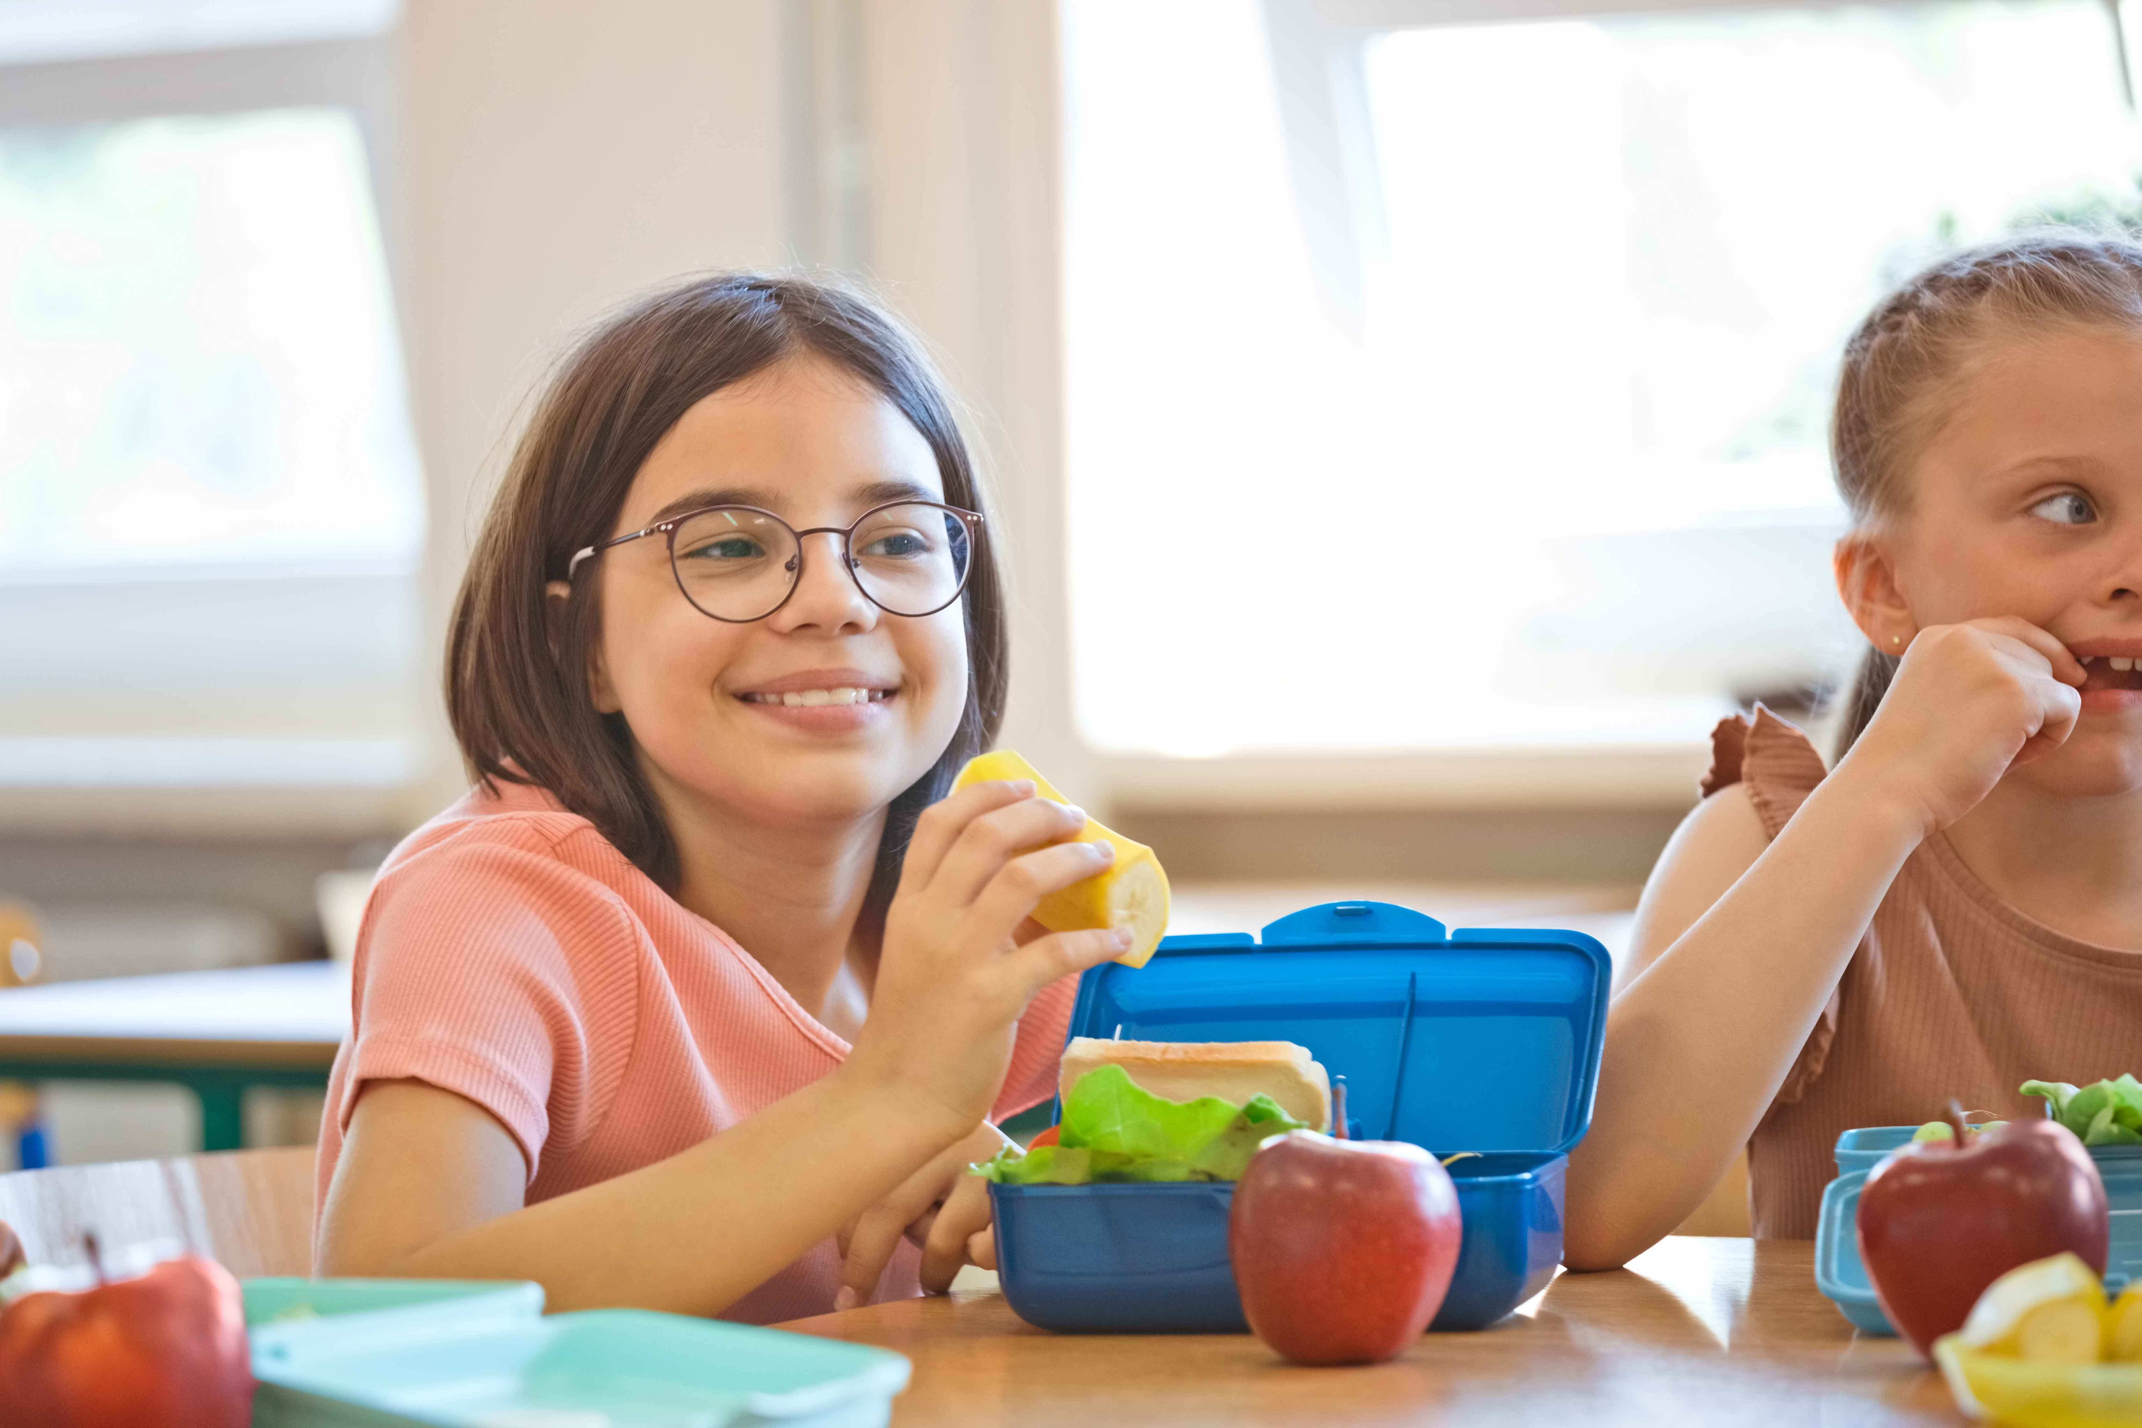
Curriculum Guidance and Resource Bank
for Teachers and Learners in Wales
Health Promoting Behaviour:
Focus on Food
and Nutrition

Slide 2
Introduction
This toolkit has been co-constructed with teachers for use with both primary and secondary learners. It should be used flexibly and can be adapted to meet the identified needs of your learner(s) within the context of your school or setting. The toolkit has been developed following the principles of curriculum design. Further information is available here Designing your curriculum - Hwb (gov.wales).
This toolkit focuses on food and nutrition as a key theme within the Health and Well-being Area of Learning and Experience. Teaching and learning about food and nutrition should link to all of the statements of what matters within the Health and Well-being AoLE, where possible. In particular, Developing physical health and well-being has lifelong benefits.
This will support learners to develop their skills in critical thinking, decision-making and risk assessment when it comes to food and nutrition and will empower them to better navigate the food environment and make informed, healthier choices that promote their growth and development.
The toolkit explores health promoting behaviour, specifically focusing on food and nutrition. It includes:
Guidance which includes key messages for teachers and learners, learning concepts and suggested big questions.
Food and nutrition Knowledge Banks for teachers and a collection of resources that can be used as is or adapted to encompass broader themes within this topic depending on the needs of your learners.
This resource focuses on how you might explore this health and well-being theme within your curriculum. This is best delivered as part of a whole school approach and your local health and well-being promoting school team can support you to embed whole school approaches according to your priority health and well-being needs. Whilst the role of schools and education is important, we recognise the themes you will be exploring will also have many influences outside the school's control.

Slide 3
How Is This Toolkit Organised?
Teacher Guidance
Resources
Section One is designed to support classroom teachers to plan and prepare lessons. It includes:
The resources element of this toolkit comprises of two components:
Key messages for teachers including why these messages are important.
Key messages for learners including: - Understanding - What do we want learners to understand and why? - Skills - What do we want learners to be able to demonstrate? - Values - How do these values contribute to realisation of the 4 purposes?
Theme specific knowledge, information and context to support teacher planning.
Teachers should make themselves familiar with this guidance prior to planning for delivery.
Teacher Facing Resources
Knowledge Banks - provide the key information relating to food and nutrition. This will support learners' knowledge acquisition and teachers' knowledge/confidence in teaching this topic.
Learner Facing Resources
Activities to Support Understanding – provide a way to engage learners in thinking, discussion and deepening understanding.
Teachers should assess the prior knowledge and understanding of their learners when determining the most effective resources to support their progression. All resources are adaptable and editable, encouraging a 'pick and mix' approach. It's important to note that not every resource will be suitable for all learners, and we are not recommending ALL resources are used in tandem as this would result in duplication and reduce your ability to consider the broader context.

Slide 4
Key Food and Nutrition Messages
Food and water are essential for life. We need different types and amounts of food to achieve good health and wellbeing. The types and amounts of food changes depending on our age and needs. Foods are made up of different nutrients, and each nutrient has a specific job in the body to help us to grow, develop and maintain good health. When we don't get enough of the nutrients we need, or when we consume too much, it can cause health issues. The food (and drink) we eat affects our health and wellbeing now and over time. Eating a healthy balanced diet lowers our risk of diseases including obesity, type-2 diabetes, heart disease and some cancers. Food can be a fun, enjoyable and interesting part of our daily lives and is embedded into our cultures, social interactions and celebrations. Developing a healthy relationship with food in childhood can lay the foundation for lifelong healthy eating habits. Some influences, such as cost, availability and food marketing can make it harder to maintain a balanced diet. Understanding how to navigate these influences is an important lifelong skill. Food skills like planning, shopping, growing and cooking can help us to maintain a healthy balanced diet. The food we eat can impact the environment. A healthy and environmentally sustainable diet is better for our health and the planet.
Key Messages for Teachers
Prior to planning for curriculum delivery, teachers will need to know these key messages.

Slide 5

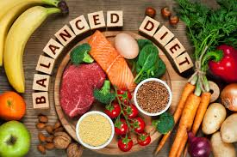
Why is this important for schools? (How it has been identified, e.g. SHRN data)
The majority of children and young people are not eating a healthy balanced diet, as indicated by studies such as the National Diet and Nutrition Survey and the School Health Research Network (SHRN) Student Health and Wellbeing Survey in Wales. These studies reveal that most children eat inadequate amounts of fruits, vegetables, oily fish and key nutrients including fibre, while also consuming excessive saturated fat, salt and sugar. Less than half of primary and secondary learners report consuming at least one portion of fruit or vegetables per day. Additionally, less than half of secondary-age learners eat breakfast every weekday, with 16% consuming a sugary soft drink daily and 4% consuming an energy drink daily. The impact of our diets on food-related ill health is significant. The Child Measurement Programme in Wales, shows approximately a quarter of reception-aged children are overweight or obese. Furthermore, data shows that rates of overweight and obesity have risen over the past decade. Evidence suggests that the food and drink consumed by a baby, child and young person can impact their health and wellbeing both now and in the future. Good nutrition supports early development during this period and lays the foundation for a healthy, happy future. This can also include food and drink consumed during pregnancy, breastfeeding, introducing solid foods and beyond. Long term studies consistently demonstrate a strong association between childhood obesity and adult obesity, underscoring the importance of early education. This evidence emphasises the need to address childhood obesity to mitigate its long-term impact on health and reduce the burden of food-related ill health in both childhood and adulthood.
Key Messages for Teachers

Slide 6

Key Food and Nutrition Messages
We all need to eat because food and water are essential for life. The type and amount of food (and drink) we eat is important because it provides us with the nutrients we need to grow, develop and stay healthy. When we don't get enough of the nutrients we need, or when we consume too much, it can cause health issues. The food (and drink) we eat affects our health and wellbeing now and throughout our lives. Eating a healthy balanced diet makes us less likely to develop diseases including obesity, type-2 diabetes, heart disease and some cancers. Food can be a fun, enjoyable and interesting part of daily life and is an important part of our culture, celebrations and social lives. The food and drink we eat as children and young people can influence the type of food (and drink) we have when we are adults. What we eat can be influenced by lots of factors; what food we can afford to buy, the type of food sold in the shops where we live and food company adverts trying to persuade us to buy their products. Our kitchen appliances and lack of kitchen utensils may also make it difficult to prepare and cook different types of food. Food skills, including budgeting, shopping, growing, preparing and cooking are important because they can make it easier for us to have healthy balanced diets. The food we eat can impact the environment. A healthy and environmentally sustainable diet is better for our health and for the planet.
Key Messages for Learners
Understanding - What do we want learners to understand and why?
Skills - What do we want learners to be able to demonstrate?
Values - How do these values contribute to the realisation of the 4 purposes?

Slide 7
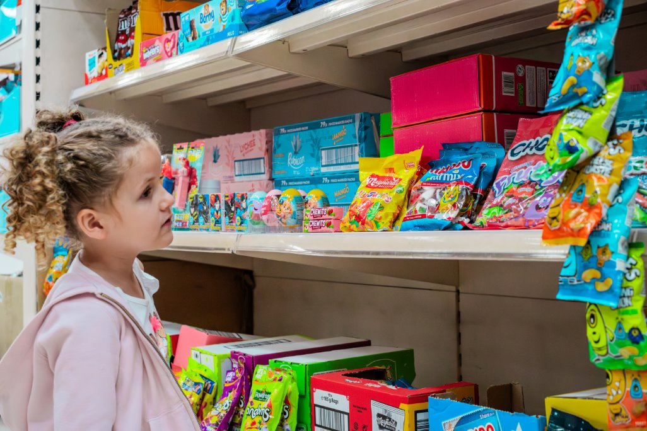
Why is this important for children and young people? (to and for the learner, school and community)
Children have a right to live without hunger, with access to healthy nutritious food. However, many children and young people are not eating a healthy balanced diet. Most children do not eat enough fruits, vegetables, oily fish and key nutrients including fibre. This is important because how children and young people are growing and developing is being affected by what they eat and drink. The food and drink babies, children and young people eat, and drink can affect their health now and as they get older. Good nutrition supports early development and lays the building blocks for future health and wellbeing too. This can also include food and drink consumed during pregnancy, breastfeeding, introducing solid foods and in early years. Some food and drink products are designed and advertised to look attractive to young people using packaging and targeted marketing techniques, such as the use of celebrities and influencers, which may affect what children and young people eat. Learners need to understand how they are being directed through marketing and influenced so they can make informed decisions. A young person may not be able to recognise which foods and drinks are high in fat, sugar, and/or salt. Young people need to be aware of what to look out for and which healthier options might be accessible for them. Having a range of food skills can support young people to maintain a healthy balanced diet. Recognising where our food comes from is important because it has an environmental impact. Following a healthy, balanced diet, as outlined in the Eatwell Guide, also supports the health of the planet. Children and young people require the information they need to help them to make healthier choices, understand and consider the impact of their choices and actions for their health.
Key Messages for Learners

Slide 8
Resource Overview
This guidance and resource for teaching and learning on Food and Nutrition has identified the following key concepts, related health topics and considerations. Resources are organised in knowledge banks under each 'Big Question'. These questions can, and should, be posed to learners as a vehicle for curriculum delivery.
Health promoting behaviours
Decision making
Social influences
Considerations
Key Concepts
The following resources may work...​
With primary and secondary aged learners
In whole-class or group settings​
In assemblies or with large groups of learners of similar ability/ age​
​
You should consider...​
Whether the content of these resources are developmentally appropriate for your learner(s)
The appropriateness of the content of the resources and its relevance to your learner(s) in your context​
Adapting resources for your learner(s) and context​
How this resource may support prior learning for food and nutrition
How learning is complemented by the wider environment, policies and practices of the school
Physical Activity
Personal care
Mental wellbeing
Protection from Infection and disease
Related Health
Themes
1. What are the personal impacts of the food we eat? 2. Why do people eat what they eat? 3. What are the wider societal impacts of the food we eat?
Big Questions
Supporting learners toward realisation of the Four Purposes:
Healthy, confident individuals who: | Ambitious, capable learners who: | Ethical, informed citizens who: | Enterprising, creative contributors who:
apply knowledge about the impact of diet and exercise on physical and mental health in their daily lives know how to find the information and support to keep safe and well take measured decisions about life-style and manage risk have the skills and knowledge to manage everyday life as independently as they can | are building up a body of knowledge and have the skills to connect and apply that knowledge in different contexts can explain the ideas and concepts they are learning about understand how to interpret data and apply mathematical concepts undertake research and evaluate critically what they find | find, evaluate and use evidence in forming views engage with contemporary issues based upon their knowledge and values understand and consider the impact of their actions when making choices and acting are knowledgeable about their culture, community, society and the world, now and in the past show their commitment to the sustainability of the planet | connect and apply their knowledge and skills to create ideas and products think creatively to reframe and solve problems express ideas and emotions through different media

Slide 9
Big Question | Knowledge Bank | Links to Statements of What Matters
1. What are the personal impacts of the food we eat? - physical and mental health - social interactions | What is a healthy balanced diet? How do food choices affect our physical and mental wellbeing? Vitamins and minerals | HWB: health promoting and health harming behaviours HWB: decision-making and critical thinking HWB: social influences, social norms and values Science and Technology: understanding factors which affect our health
2. Why do people eat what they eat? - food to survive and thrive - social context - access and availability - culture; personal preferences, taste and beliefs -industry, marketing and advertising - the law and regulations | Why do people eat what they eat? How is food an important part of our culture and society? Industry, Marketing and Advertising Food labels The Law and Regulations | HWB: decision making and critical thinking HWB: social influences, social norms and values HWB: connections between experiences and emotions Humanities: develop an appreciation of belonging LLC: use and adapt languages in a range of roles Mathematics and Numeracy: explore and support positive decision making Science and Technology: understanding factors which affect our health
3. What are the wider societal impacts of the food we eat? - health inequalities - where food comes from - environment | Where food comes from Environmental Impact Food, Health and Inequality | HWB: impact of actions on wider society and decision making Humanities: ethical action and responsible consumers Humanities: understanding our impact on the natural world
Activity Title | Overview of Content | Guidance for Teachers ‘You could use this resource...’ | Opportunities for Cross Curricular Skills | Links to Statements of What Matters (HWB and other)
News Reports and Articles | Links to reports and articles with questions for discussion and debate | As part of wider engagement with contemporary issues | [for schools to complete] | [for schools to complete]
How Are We Influenced? | Explores the factors that influence our decision making | As part of wider engagement with social influences | [for schools to complete] | [for schools to complete]
See, Think, Wonder | Images to provoke critical thinking and questioning | To promote oracy and expression | [for schools to complete] | [for schools to complete]
Always, Sometimes, Never | Statements to promote discussion and debate | As a starter activity or plenary to check understanding | [for schools to complete] | [for schools to complete]
What's in This? | Explores considered decision making and promote questioning | To support the connection between social influence and decision making | [for schools to complete] | [for schools to complete]
This or That? | Explores considered decision making and critical thinking | To support understanding and consider the impact of actions | [for schools to complete] | [for schools to complete]
Recipes | Explores considered decision making and critical thinking | To support the connection between applying knowledge and forming views | [for schools to complete] | [for schools to complete]
Data and Statistics | Data sources to promote discussion, questioning and critical thinking | As part of wider engagement with interpreting data and assessing impact | [for schools to complete] | [for schools to complete]

Slide 10
Sources of Further Information to Support Teaching and Learning
•The Eatwell Guide (food.gov.uk) – pictorial image and supporting guidance document​
•Food & Health (bda.uk.com) – factsheets on variety of topics including food labelling, fluids, adolescent food facts etc​
•Guide-To-Food-Labelling-2019-WEB.pdf – food labelling guidance documents and visual aids​
•Home (foodfoundation.org.uk) ​
•One Blue Dot - Sustainable Diets (bda.uk.com) / AT-Lancet Commission Brief for Everyone - EAT (eatforum.org) / Sustainable healthy diets: guiding principles (who.int) – food and the environment ​
•Enticing-Effective-Everywhere-FINAL_1.pdf (contentfiles.net) / 180507_Marketing Report.indd (unicef.org) – industry influences​
•SACN statement on processed foods and health - summary report - GOV.UK (www.gov.uk) – ultra-processed foods​
•PHW opportunities for improving children’s health in Wales. The potential of school food - background on school food. ​
•FSN+Eating+well+recipe+book_Oct+2023_DIGITAL.pdf (squarespace.com) – family recipes​
•Reframing how we talk about children’s health and food - support on how to frame health messages to children and young people ​
Data Sources​
•SHRN: National Data - School Health Research Network (shrn.org.uk)​
•Welsh Government (2019) National Diet and Nutrition Survey: National Diet and Nutrition Survey: results for years 1 to 9 | GOV.WALES​
•PHW Child Measurement Programme for Wales 2020: Child Measurement Programme - Public Health Wales (nhs.wales)​
•Welsh Oral Health Information Unit: Welsh Oral Health Information Unit - Research - Cardiff University​

