Slide 1
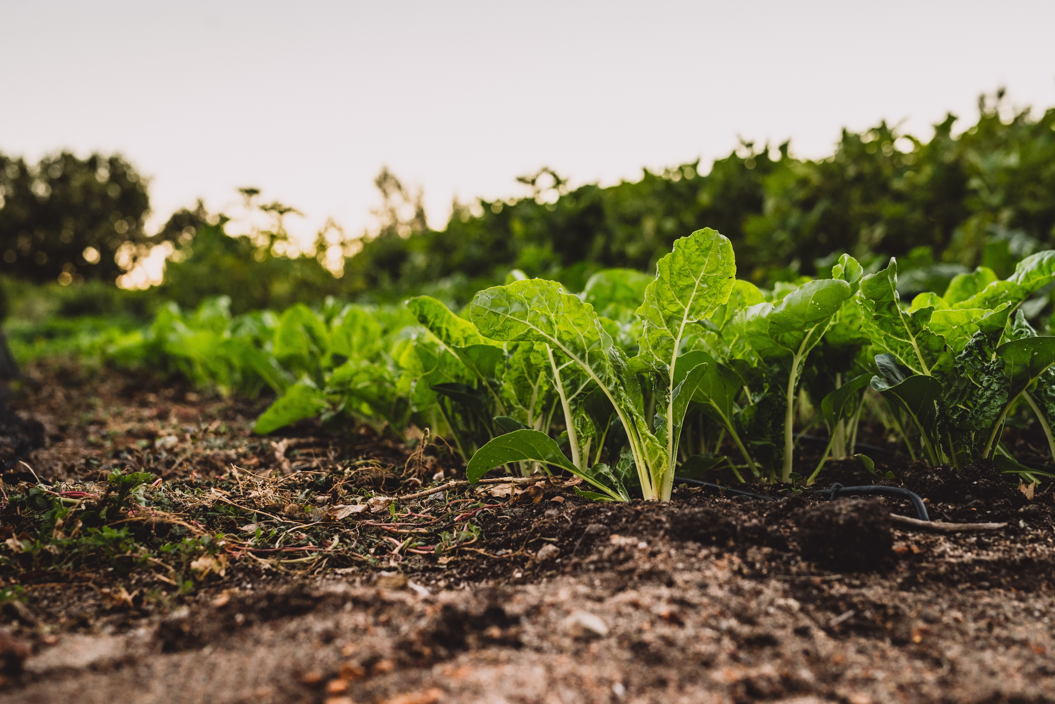
Where Food Comes From
Food and Nutrition

Slide 2
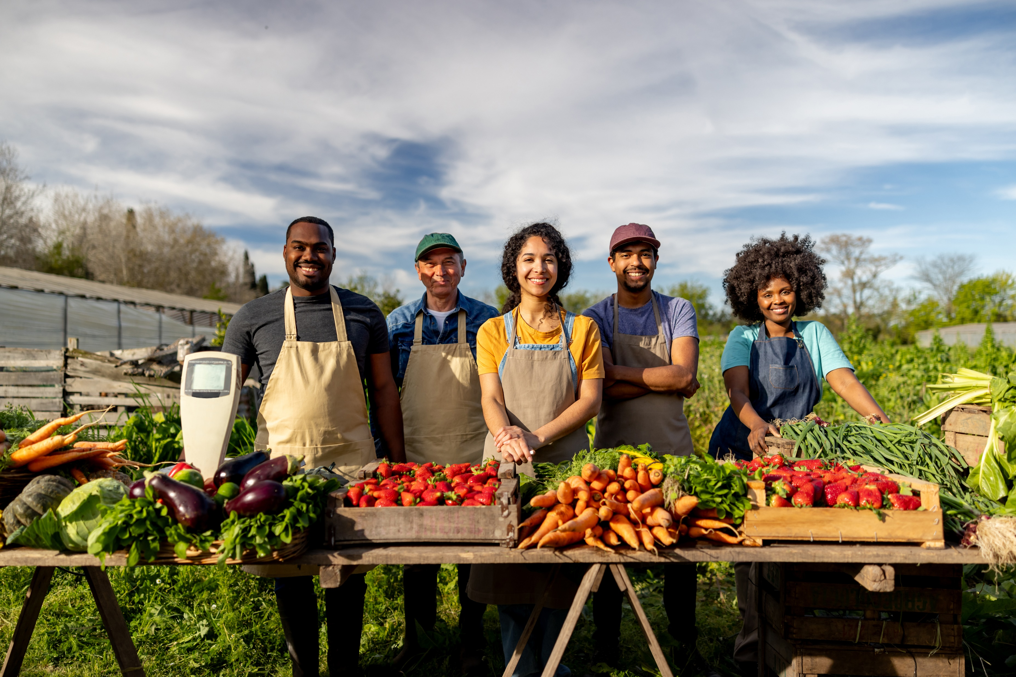
Contents
Where Food Comes From
What Is Food Production?
Farming in Wales
Food Trade and the Welsh Economy
From Farm to Factory
Food Processing
How Does Freezing Preserve Food and Maintain Quality?
Processed vs Ultra Processed
What makes Some Ultra-Processed Less Healthy?
How can we get the Balance Right?
Challenges and Opportunities

Slide 3
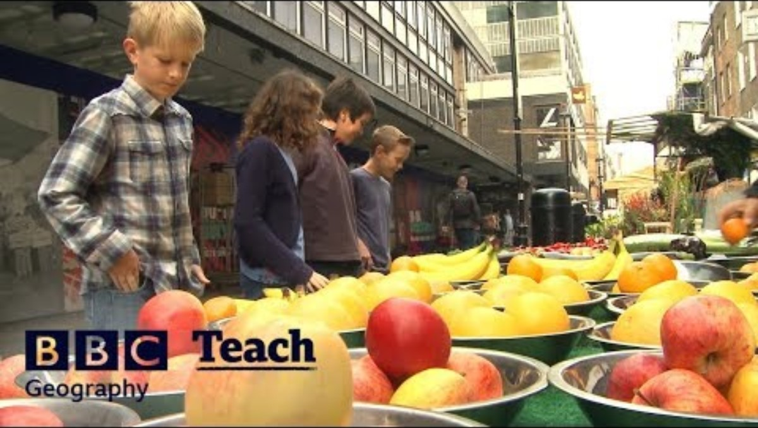
Where Does Food Come From?

Slide 4
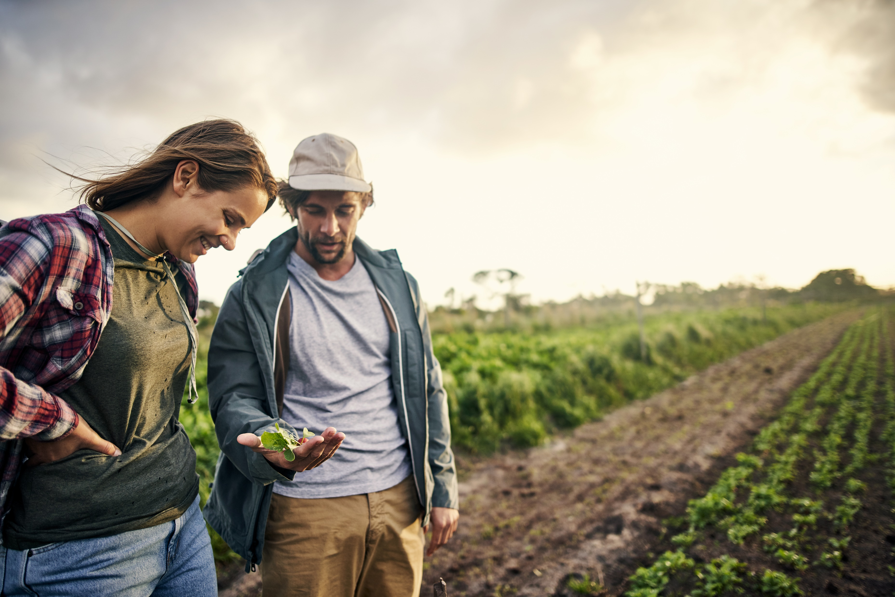
What is Food Production
Food production means growing and making the food we eat. It includes farming, processing and distribution.
Most of the food we eat comes from a few key plant crops like cereals, potatoes, roots and legumes. Farmers aim to enhance these crops by choosing the strongest ones that have the best nutrition, are more resistant to diseases and can grow well in different places. All food production, whether plant or animal, relies on photosynthesis.
Food production can be affected by:
Weather and Climate: Droughts, floods and storms can impact crops.
Soil Quality: Good soil is needed for healthy plants. Farmers may choose to use fertilisers to provide extra minerals.
Water Availability: Crops and animals need water to grow and live.
The area available to grow crops is limited. Simply growing more crops is not the answer. Increasing food production can only be achieved by improving efficiency.

Slide 5
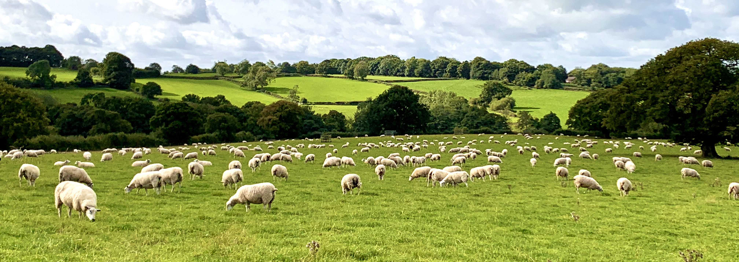
Farming in Wales
In Wales, local farms are very important. Over 15,000 people work on farms in Wales.
Farms grow fruits, vegetables and raise animals, providing fresh food.
Types of farming include:
Livestock - Raising sheep, cows, chicken and pigs. (Raising animals for meat requires much more energy per unit area than growing crops)
crop production - Growing vegetables, fruits and grains
dairy - Producing milk, cheese and other dairy products
These farms also create jobs for people who love nearby, helping the local economy. Buying food from local farms supports these farmers and the community and helps preserve our beautiful countryside.
Wales is known for producing local specialties like lamb and dairy produce.
Why do you think it is important for a country to produce its own food?

Slide 6

Food Trade and the Welsh Economy
Food trade impacts the Welsh economy. When food is bought and sold, it helps businesses grow and provides money for the community. This is called the economy. A strong economy means there are more jobs and better opportunities for everyone. Farming contributes significantly to the Welsh economy, bringing in around £1.6 billion each year.
Brexit, which is when the United Kingdom, including Wales, decided to leave the European Union, has changed how food is traded. New trade deals with other countries can change the prices of food and how much of it is available in stores. Sometimes, these changes make certain foods more expensive or harder to find.
Ethical consumers often like to support local farmers. For example, people from Wales may like to buy Welsh Lamb that have been farmed in Wales compared to Lamb from New Zealand as this reduces food miles.(Find out more about this in Enviromental impact)

Slide 7
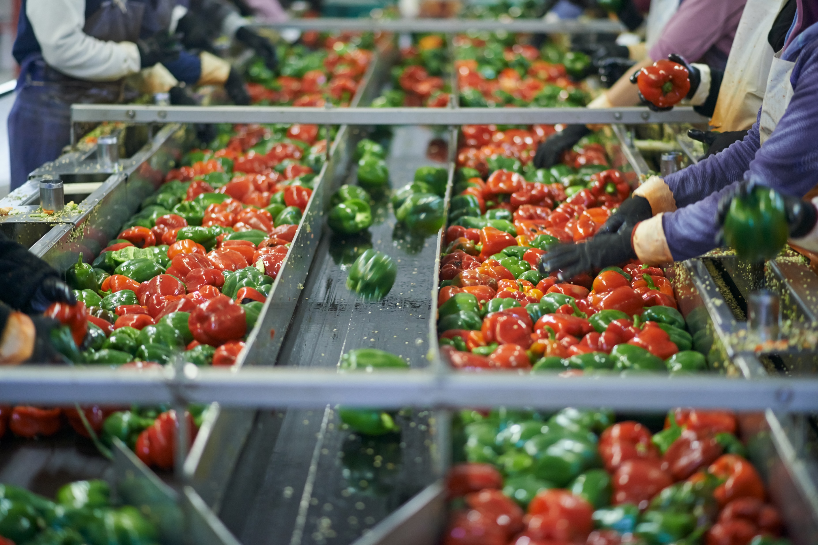
From Farm to Factory
The "Animal Welfare Act 2006" ensures that animals are treated well in farming, which directly impacts the quality and safety of food products from animals. These laws and regulations ensure that food in Wales is safe, clean and environmentally sustainable.
After farming, food goes to factories to be processed.
First, it is cleaned to remove dirt and contaminants. Then, it is packaged to ensure it stays safe and fresh for longer on shop shelves.

Slide 8
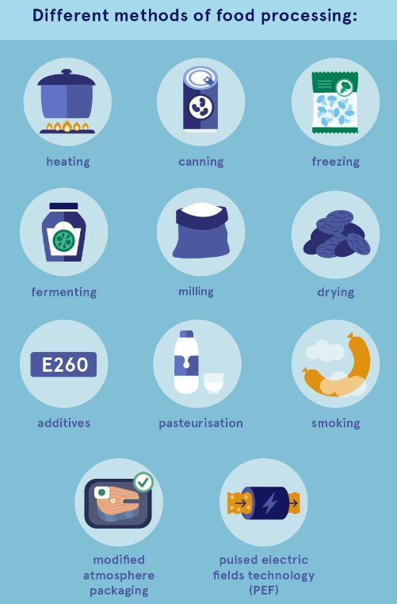
Food Processing
Food processing involves any method that turns food into products for us to eat. Foods can be processed in many ways, whether it is at home or on an industrial scale.
We process foods to give us lots of variation in what we are eating and to make raw foods stay fresher for longer.
Examples of food processing can include:
Transforming raw ingredients such as wheat into bread or milk into cheese.
Adding preservatives to keep food and drink fresh for longer. For example, sodium benzoate is often added to soft drinks to prevent the growth of bacteria and yeast.
Some foods need processing to make them safe, such as milk, which needs to be pasteurised to remove harmful bacteria.
Other foods need processing to make them suitable for use, such as pressing seeds to make oil.
Source: eufic​

Slide 9
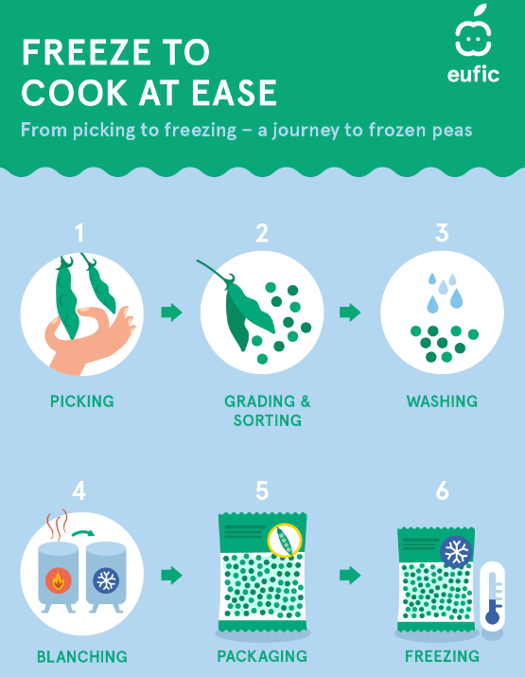
Freezing is a well-known, traditional method of food processing for preservation. Most foods freeze well. Freezing can take place at home and at an industrial level.
Freezing delays spoilage and slows the loss of nutrients. It keeps foods safe by preventing microorganisms from growing and by slowing down the enzyme activity that causes food to spoil.
Benefits of freezing food include;
Nutrient-Rich: Industries often freeze produce at peak ripeness. Some fruits and vegetables are blanched (immersed in boiling water for a short period) before freezing to inactivate enzymes and yeasts that would continue to cause food spoilage, even in the freezer.
Convenient: Long shelf life - retains the quality of food over long storge periods and ready to use.
Cost-Effective: Typically, cheaper than fresh and saves on transport and storage.
Reduce waste: Portion control and longer shelf life.
Allows us to eat foods from all over the world.
How Does Freezing Preserve Food and Maintain Quality?
How do you think frozen, dried and tinned fruits and vegetables help busy families eat healthily?

Slide 10
There is a difference between food that has been processed and foods we classify as being ultra processed.
Processed vs Ultra-Processed
Processed Food | Ultra- Processed Foods
This category includes foods that have been altered from their natural state through methods like cooking, freezing, canning, or fermentation. | These are foods that have undergone significant industrial processing and often contain ingredients not typically found in a home kitchen, such as artificial flavors, colours, emulsifiers, and sweeteners.
Examples include canned vegetables, cheese, and bread. These foods may have added ingredients like salt, sugar, or preservatives, but they still retain some characteristics of whole foods | They are usually ready-to-eat or easy to prepare, often found in snacks, sugary drinks and fast food. Examples include packaged snacks, sugary cereals and instant meals.
In summary, while all ultra-processed foods are processed, not all processed foods are ultra-processed. The key difference lies in the degree of processing and the types of ingredients used.

Slide 11
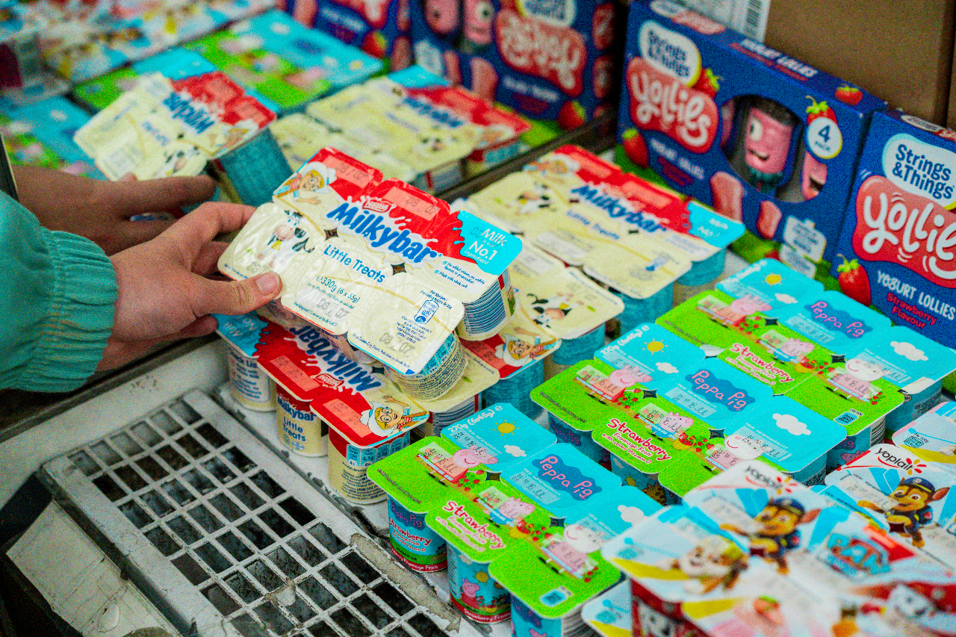
What Makes Some Ultra-processed Food Less Healthy?
Ingredients such as salt, sugar and fat are sometimes added to processed foods to make their flavour more appealing and to extend their shelf life, or in some cases to contribute to the food's structure, such as salt in bread or sugar in cakes.​
​
Buying processed foods can lead to people eating more than the recommended amounts of sugar, salt and fat as they may not be aware of how much has been added to the food they are buying and eating.​
​
These foods can also be higher in calories due to the high amounts of added sugar or fat in them.​
​
Some processed foods can contain less fibre and protein compared to whole foods, which can affect satiety, the feeling of fullness after eating. This means that people may not feel as full after eating processed foods and might end up eating more as a result.​

Slide 12
How Can I Get the Balance Right?
You have no control over the amount of salt, sugar and fat in processed food but you do have some control over what you choose to buy.
Looking at food labels can help you choose between processed products and keep a check on fat, salt and sugar content.
All pre-packed foods have the nutrition information on the front, back or side of the packaging.
If the processed food you want to buy has a nutrition label that uses colour-coding, you will often find a mixture of red, amber and green.
When you're choosing between similar products, try to go for more greens and ambers, and fewer reds, if you want to make a healthier choice (You can read more about food labelling in Law & Regulations).
The number of items on the ingredients list can help you tell how processed the food is. For example, a loaf of bread with 5 ingredients is less processed compared to one with 15 ingredients.

Slide 13
How can we overcome these challenges to ensure a healthy, sustainable food supply?
Challenges and Opportunities
Challenges | Opportunities
Climate change | Sustainable farming practice
Resources and availability | Innovation in processing
Health Impacts | Technology Integration
Sustainability | Local and Urban Farming
Advertising and Marketing | Food Waste Reduction
 | Collaboration and Partnership: Farmers, businesses and consumers
 | Advertising and Marketing

Slide 14
Thank You For Listening

