Slide 1
What is a Healthy Balanced Diet?
Food and Nutrition

Slide 2
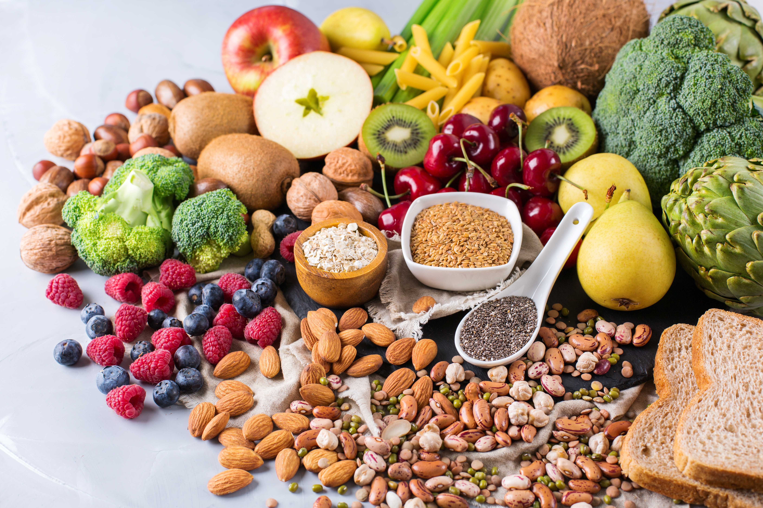
Contents
The Importance of a Healthy Diet
The Eatwell Guide
Fruits and Vegetables
Potatoes, Bread, Rice, Pasta and other Starchy Carbohydrates
Beans, Pulses, Fish, Eggs, Meat and other Proteins
Dairy and Alternatives
Oils and Spreads
Foods High in Fat, Salt and Sugar
Energy in vs Energy Out
Undernutrition vs Overnutrition; Causes and Overview

Slide 3
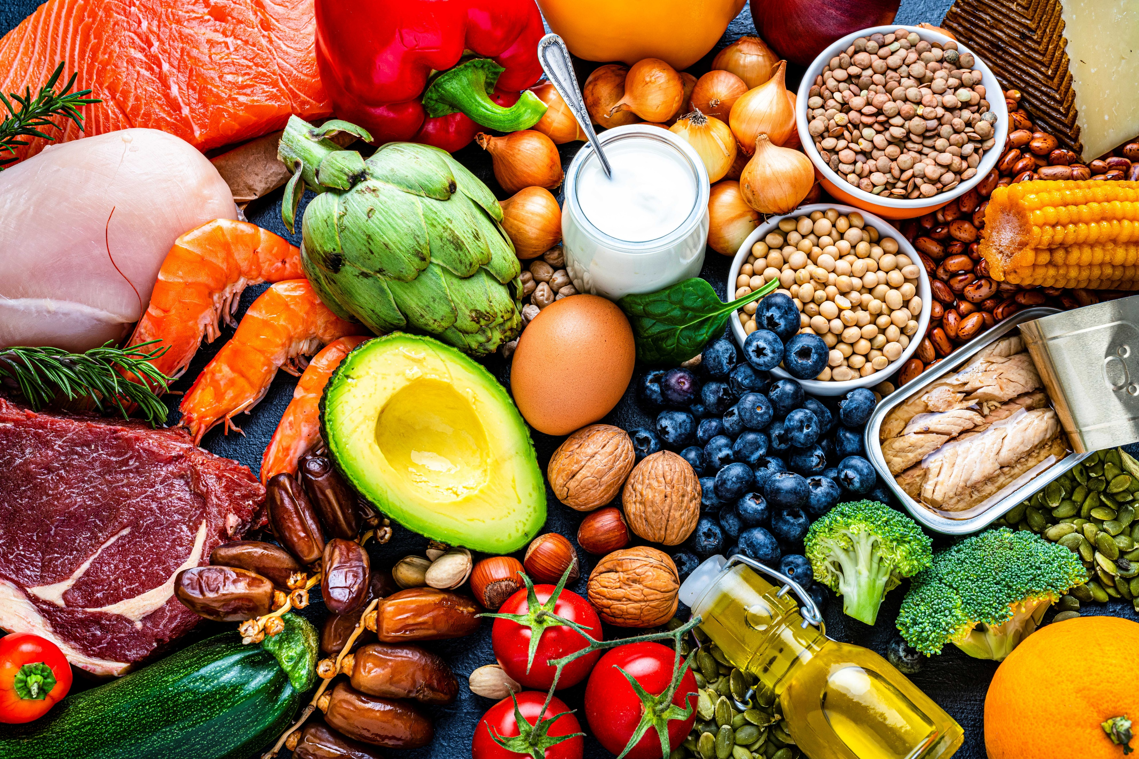
The Importance of a Healthy Diet
A healthy balanced diet means eating a wide variety of foods, in the right amounts, for good health.
This is important for us to get the range of nutrients, vitamins and minerals which are needed for our health, well-being, growth and development.
Eating from all the different food groups and in the right portion sizes can help us to:
Maintain good health
Help us feel our best, avoid illness and prevent diseases
Provide us with the energy we need throughout the day
Provide us with the nutrients we need for growth, repair and development
Help us to achieve and maintain a healthy weight

Slide 4
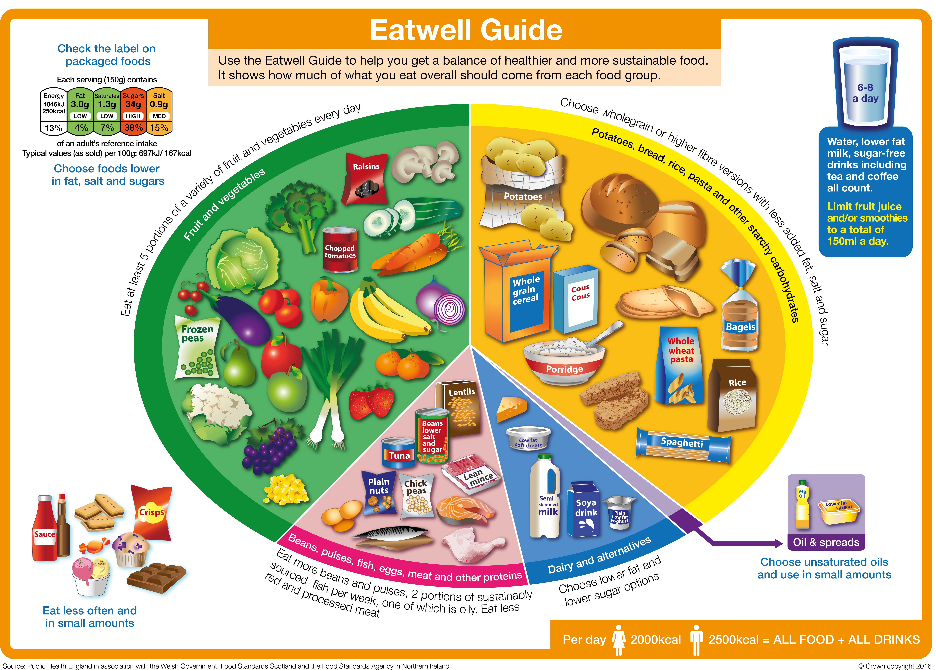
Eatwell Guide
The Eatwell Guide shows the different food groups that are needed within our diets. It also shows us how much of these food groups should be eaten across the day or a couple of days to achieve a good balance of nutrients. For example: 1/3 of our diets should be fruits and vegetables.
Try to choose a variety of different foods from each of the food groups to help you get the wide range of nutrients your body needs.
The Eatwell Guide can be modified and changed depending on food preferences, allergies and beliefs but the food groups and proportions, will remain the same.
The Eatwell Guide shows us what our diets should look like over the day or even a couple of days - not every plate needs to look like this.

Slide 5
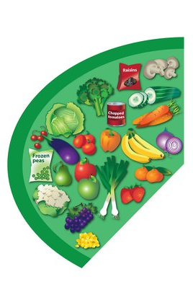
Fruits and Vegetables
Most of us are still not eating enough fruit and vegetables. They should make up just over
a third of the food we eat each day and are one of the most important parts of our diets.
Fruits and vegetables are a good source of vitamins, minerals and fibre; by eating a variety of different types, ensures the body receives all the essential nutrients we need.
We should aim to eat at least 5 different portions of fruits and vegetables each day and these can be fresh, tinned, dried and frozen. Fruit juices and smoothies do count although these should be kept to a minimum of 150ml per day and if possible, should be consumed at mealtimes.
Eating with the seasons can be a great way to consume variety and can also be tastier, fresher and more nutritious as it may not have travelled so far!
But don't forget that tinned, frozen and dried count towards your 5 a day here and always try to choose tinned in juice and vegetables with no added sugar and salt.

Slide 6

Potatoes, Bread, Rice, Pasta and Other Starchy Carbohydrates
Starchy foods are the main source of carbohydrate and have an important role in a healthy diet.
They are a good source of fibre and are the best energy providers for the body.
Starchy food should make up just over a third of the food we eat.
Where possible we should try to include wholegrain or higher fibre carbohydrates such as brown rice, pasta and even leaving the skin on potatoes can help to increase dietary fibre and nutrients.

Slide 7
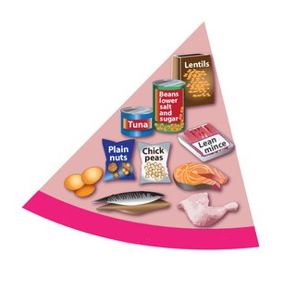
Beans, Pulses, Fish, Eggs, Meat and Other Proteins
These foods are rich in protein and provide other very important vitamins and minerals such as iron.
Foods from this group should be eaten daily. Choosing to eat beans and pulses more often can be beneficial to our health and be cost effective too!
Fish is also a great source of protein alongside essential fatty acids and omega 3 which is great for brain growth and development. We should aim to choose fish at least twice per week with one of those being oily fish such as salmon or mackerel.
Red and processed meats such as bacon and ham should be eaten less often as they're often higher in fat, salt, can be detrimental to our health and are linked to developing some cancers.

Slide 8
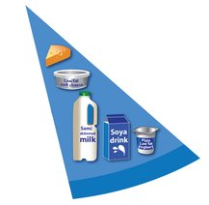
Dairy and Alternatives
Milk, cheese, yoghurt and fromage frais are a good source of protein and essential vitamins within our diets such as calcium.
Eating foods high in calcium is important for our teeth and bones especially in childhood and later life.
Unsweetened calcium enriched alternatives, made from plants such as soya, coconuts or oats also count within this food group and are a great alternative to dairy.
Making healthier dairy choices can be done by checking the nutritional information on the label. Try to choose lower fat, saturated fat, sugar and salt options.

Slide 9
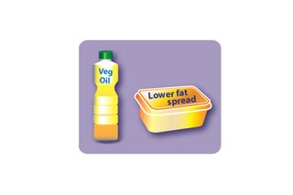
Oils and Spreads
We all need some fat in our diet to stay healthy, they provide energy and essential fatty acids that our body cannot produce. Fats also help with absorption of vitamin A, D and E.
As part of a healthy diet we should choose unsaturated fats where possible, these include: olive, rapeseed, sunflower and vegetable oil.
We should try to limit saturated fats within our diets and cut down on foods containing high saturated and trans fats (liquid oils turn into fat). This is due to saturated fats being higher in energy and eating too much can lead to health complications such as obesity and heart disease.

Slide 10
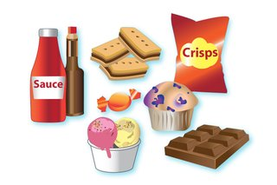
Foods High in Fat, Salt and Sugar
These aren't needed as part of our diet, so they should be eaten in smaller amounts and less often.
These including chocolate, cakes, biscuits, sugary soft drinks, butter and ice-cream.
Eating too many foods high in fat, salt and sugar can increase the risk of developing cardiovascular disease and other health problems.

Slide 11
Energy In vs Energy Out
Energy in
Energy out
The food and drink we consume is ENERGY IN.
We need to make sure we consume enough energy as this powers our bodies.
Energy helps us to stay active, fight infection and live our daily lives.
We burn energy in daily living, even through the night when we're asleep this is known as ENERGY OUT.
We burn more energy when we're active through sports or physical activity.
Those who are more active physically typically burn more calories.
More IN than OUT over time = weight gain
More OUT than IN over time = weight loss
Your ENERGY IN and OUT don't have to balance every day. It's about having balance over time that will help you maintain a healthy weight throughout your life.

Slide 12
Undernutrition vs Overnutrition
Under nutrition
Over nutrition
Under nutrition is a serious condition that can happen when your diet does not contain the right amount of nutrients. Symptoms often involve weight loss, reduced appetite, tiredness, irritability, reduced immunity and potential disease.
Causes of undernutrition include:
Unsuitable dietary choices
Having a low income
Difficulty obtaining food
Various physical and mental health conditions
Conditions of famine
Due to war and conflict
The impact of natural disasters on accessibility.
Overnutrition is a form of malnutrition in which the intake of nutrient and energy is oversupplied. Overnutrition happens when you take in more nutrient (or nutrients) and food than you need every day.
While many people think malnutrition means a lack of nutrients, overconsumption is also considered malnutrition because it has negative health consequences and over time can result in rapid weight gain leading to obesity and other health conditions such as type 2 diabetes, heart disease and some cancers.

Slide 13
Thank You For Listening

