Slide 1
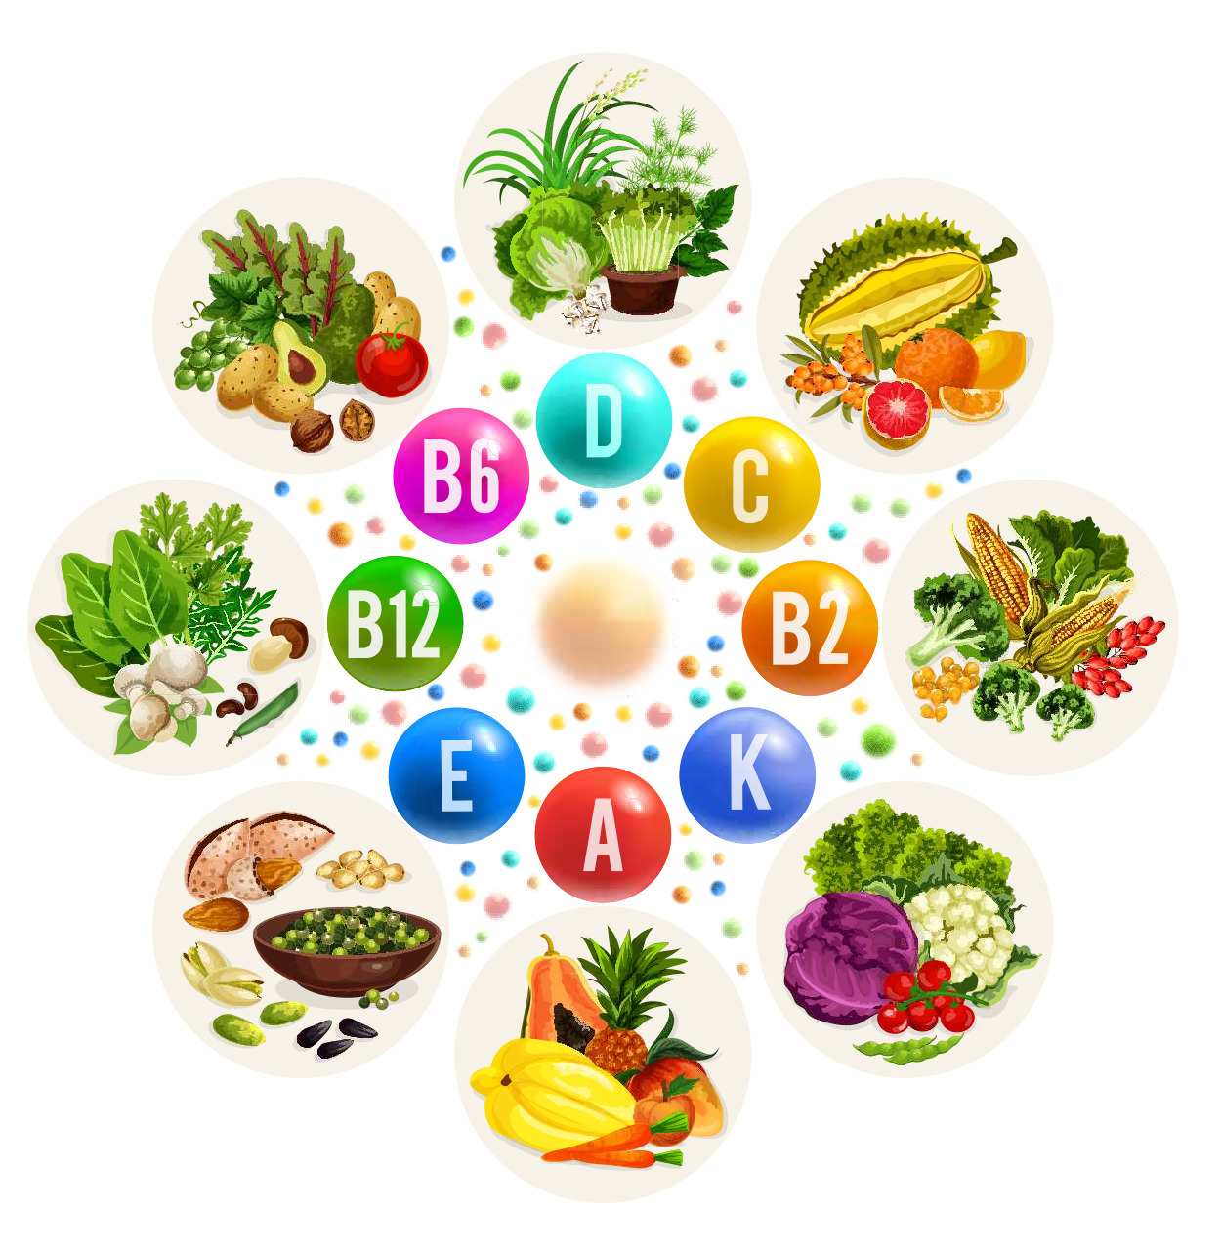
Nutrients: Vitamins & Minerals
Food and Nutrition

Slide 2
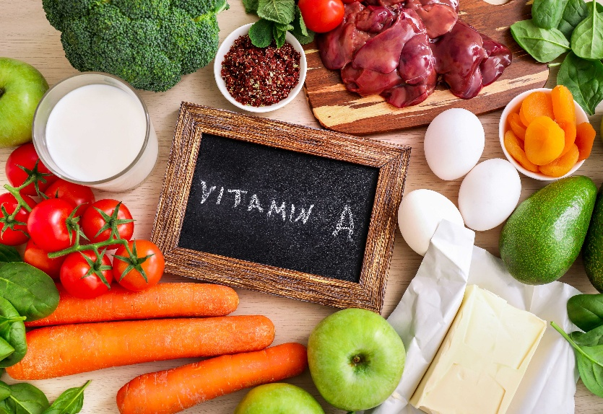
Vitamin A
Beta-Carotene is converted into vitamin A in the body, Vitamin A has several important functions, these include:
Helping your body's natural defence against illness and infection (the immune system) work properly
Helping vision in low light
Keeping skin and the lining of some parts of the body, such as the nose healthy
Good sources of vitamin A (retinol) include:
Cheese
Eggs
Oily fish

Slide 3
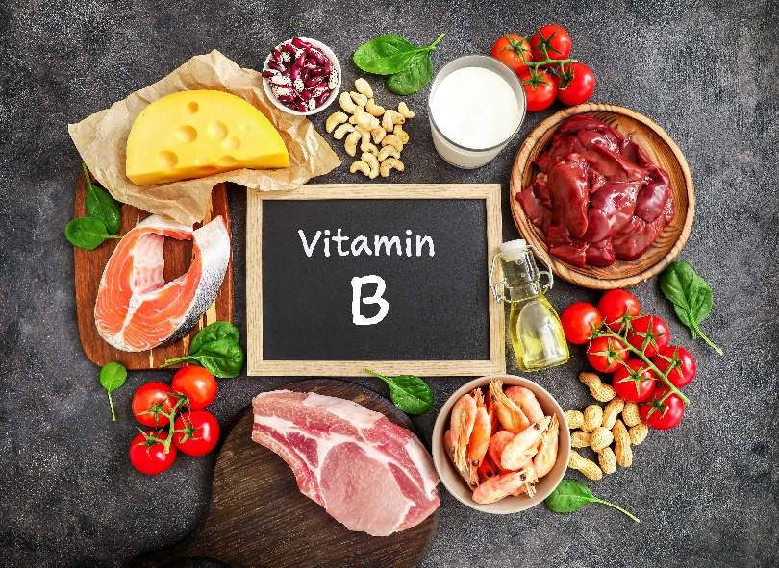
B Vitamins and Folic Acid
There are eight well-known B vitamins that play a role in the body. They support metabolism and contribute to the body's ability to produce energy from food.
Good sources of B vitamins include:
Peas
Fresh fruits
Nuts.
Wholegrain breads
Fortified breakfast cereals
Liver
Folic acid is important in red blood cell formation and for healthy cell growth and function. Good sources include: Leafy green vegetables, beans, citrus fruits, eggs and fortified foods.

Slide 4
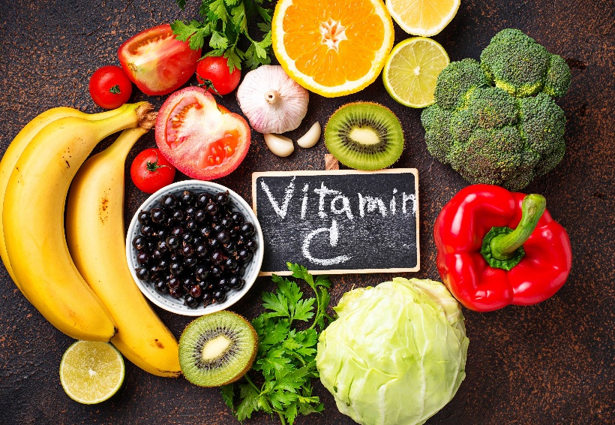
Vitamin C
Vitamin C has several important functions.
These include:
helping to protect cells and keeping them healthy
maintaining healthy skin, blood vessels, bones and cartilage
helping with wound healing
Supports our body to fight infection and support a healthy immune system.
Good sources include:
citrus fruit, such as oranges and orange juice
peppers
strawberries
blackcurrants
broccoli

Slide 5
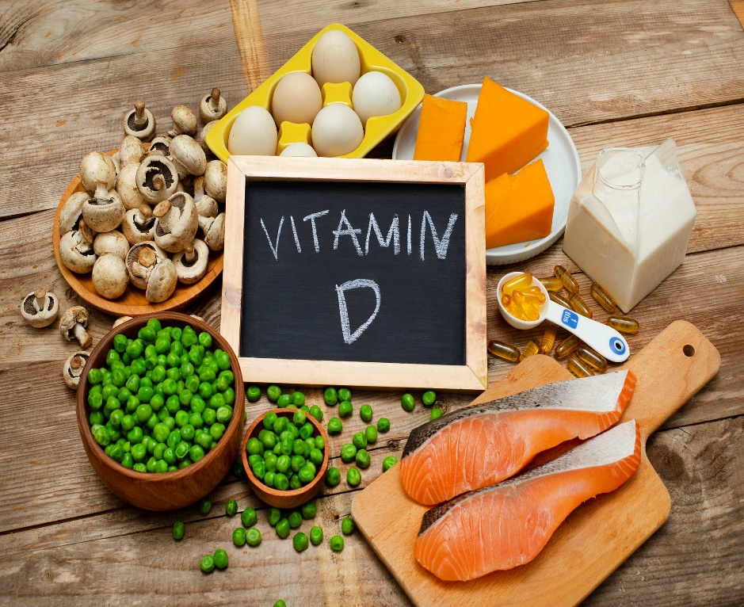
Vitamin D
Vitamin D helps regulate the amount of calcium and phosphate in the body.
These nutrients are needed to keep bones, teeth and muscles healthy.
The main source of vitamin D is sunlight, but can also be found in:
oily fish – such as salmon, sardines, herring and mackerel
red meat
liver (avoid liver if you are pregnant)
egg yolks

Slide 6
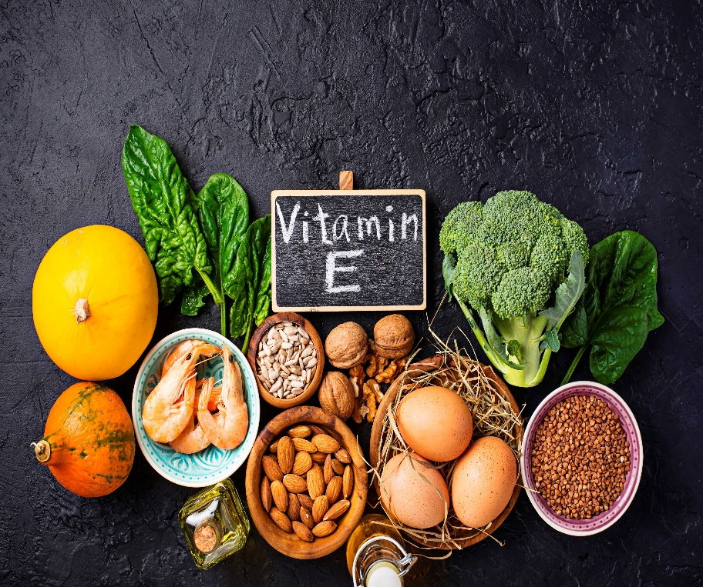
Vitamin E
Vitamin E helps maintain healthy skin and eyes and strengthen the body's natural defence against illness and infection (the immune system).
Good sources include:
plant oils – such as rapeseed (vegetable oil), sunflower, soya, corn and olive oil
nuts and seeds
wheatgerm – found in cereals and cereal product

Slide 7
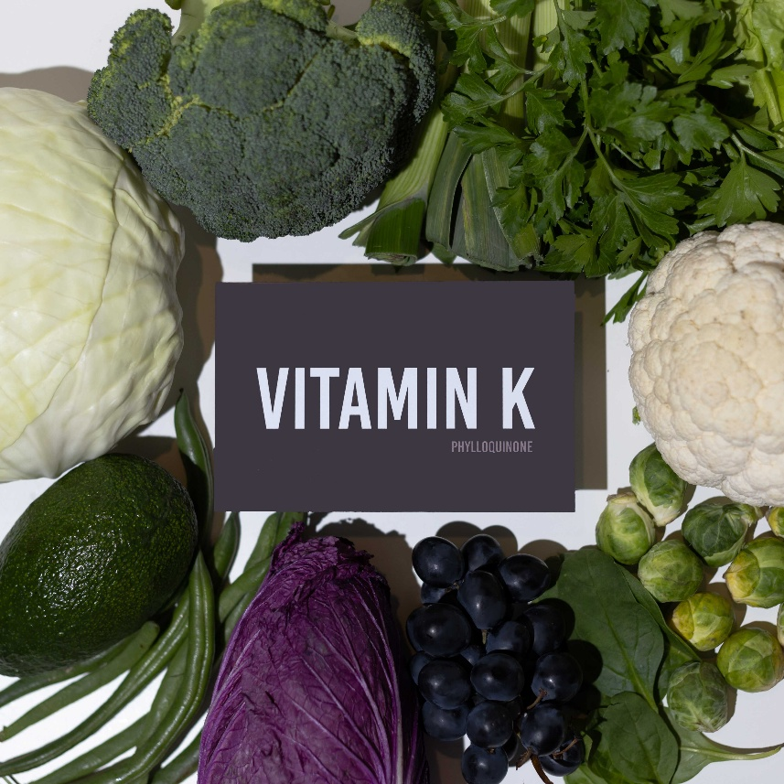
Vitamin K
Vitamin K is a group of vitamins that the body needs for blood clotting, helping wounds to heal.
Vitamin K is found in:
green leafy vegetables – such as broccoli and spinach
vegetable oils
cereal grains
Small amounts can also be found in meat and dairy foods.

Slide 8
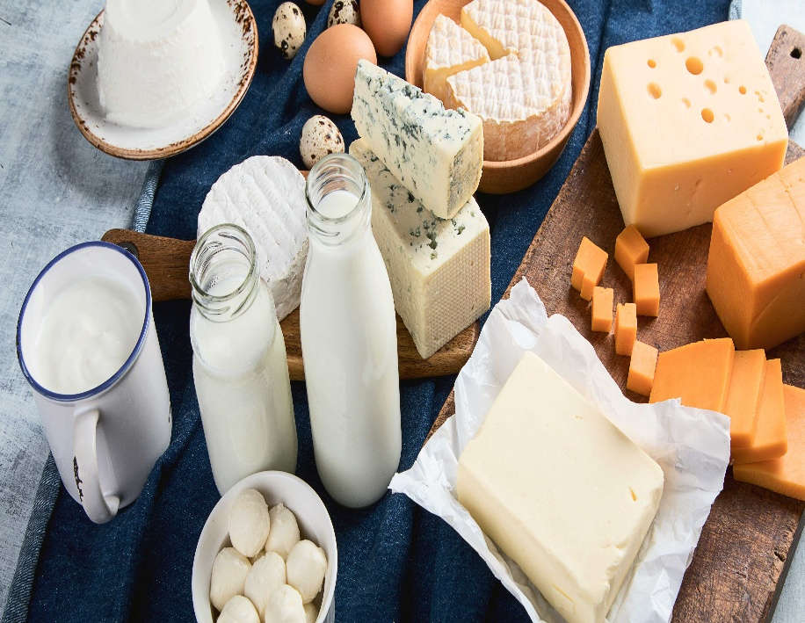
Calcium
Calcium has several important functions
These include:
helping build bones and keep teeth healthy
regulating muscle contractions, including your heartbeat
making sure blood clots normally
Sources of calcium include:
milk, cheese and other dairy foods
green leafy vegetables – such as kale and okra
soya drinks with added calcium

Slide 9
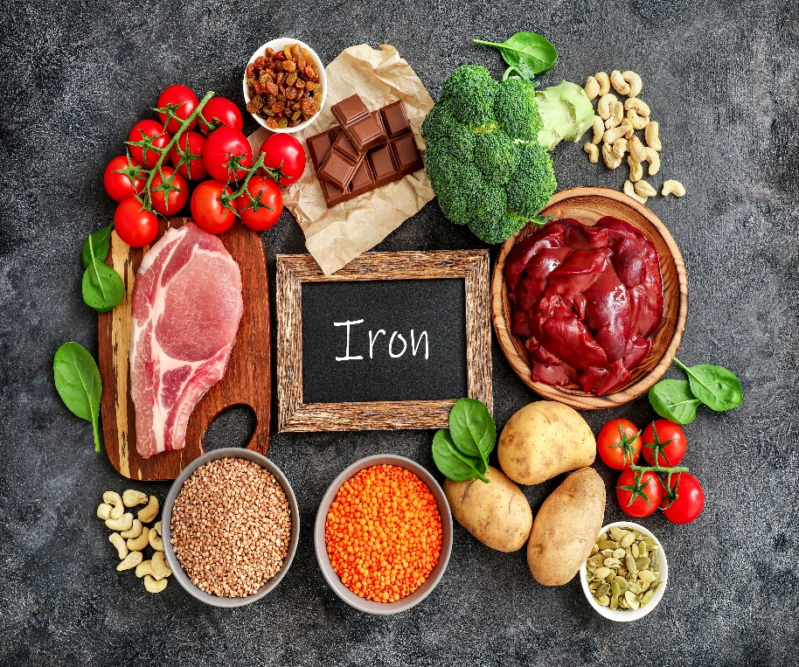
Iron
Iron is important in making red blood cells, which carry oxygen around the body.
A lack of iron can lead to iron deficiency known as anaemia
Good sources of iron include:
Liver, red meat
beans, such as red kidney beans, edamame beans and chickpeas
nuts

Slide 10
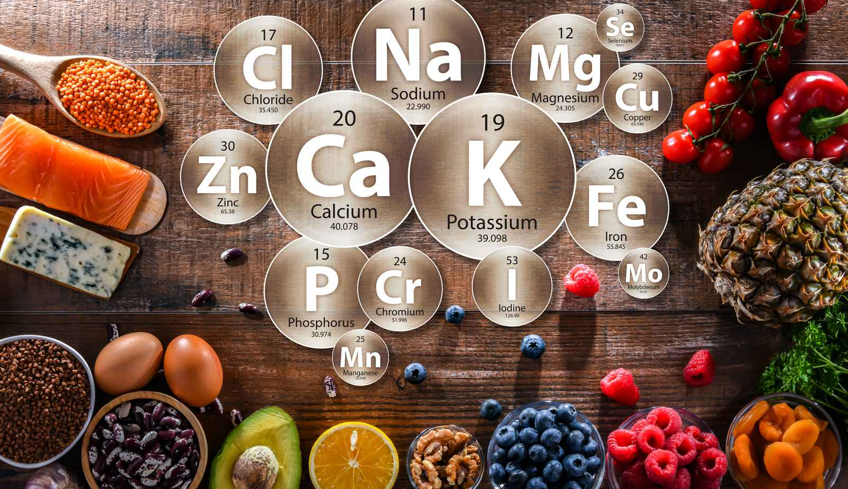
Trace Minerals
Trace minerals or micro-minerals are essential for human health and development, they are needed in smaller amounts and can be found in a balanced diet. These include:
Chromium: Wholegrains, nuts, seeds and cheese.
Copper: Beef, fruits, vegetables, nuts and beans.
Fluoride: fish, some teas and water.
Magnesium: Plants.
Iodine: Seafood and dairy products.
Selenium: Grains, meat and seafood.
Zinc: Meat, fish, vegetables and some grains.

Slide 11
Vitamins and Minerals
Vitamins and minerals are nutrients your body need to work properly and stay healthy.
If we aim to eat a balanced diet with plenty of variety, we should consume all the vitamins and minerals we need to live a healthy life. In some cases, we may need to take vitamin supplements to support us to maintain good health, such as:
Some health conditions can make vitamin absorption very difficult.
Age: In later life especially those who are disabled or chronically ill may need to take supplements to support them.
Pregnancy: Pregnant women should take folic acid to support the growth of their babies.
Sun Exposure: Individuals who don't have much sun exposure or have darker skin should be encouraged to take vitamin D as usually it is absorbed through sun exposure.
Other factors such as heavy menstrual cycles, lifestyle choices and dietary choices may require supplementation.

Slide 12
Thank You For Listening

