Slide 1
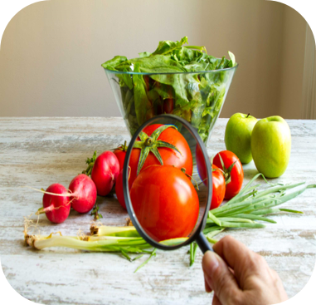
The Law and Regulations
Food and Nutrition

Slide 2

Contents
Why are Laws and Regulations Important?
Food Standards and Hygiene
Food Safety, Information and Environment
Public Health Law and Regulations
Legislation and Schemes in Schools
Food Hygiene
Advertising to Children
Advertising to Children: Nutrition and Health Claims
Food Allergies and Labelling
Public Health Interventions
Restrictions on High Fat, Salt and Sugar Products

Slide 3
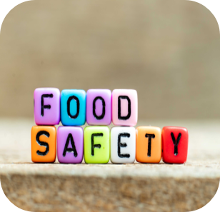
Why are Laws and Regulations
Important?
Laws are there to protect our safety, collectively and individually, and guarantee our basic freedoms. Laws can apply to both consumers and organisations.
Law and regulations play a key role in reducing rates of harm caused by purchasing and consuming food in the UK. It does so by:
Limiting access to certain foods or drinks, particularly for children and young people
Providing information so potential consumers can make informed choices (for example food labels and nutrition claims)
Implementing standards for the products that are available (for example banned ingredients)
Limiting how industry can promote their products to encourage uptake (for example restrictions on advertising)
Ensuring food is safe to eat and doesn't contain things it shouldn't.

Slide 4
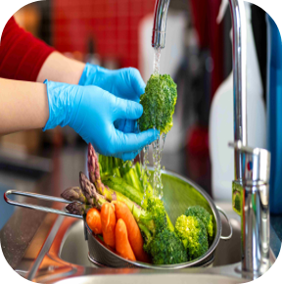
Food Standards & Food Hygiene
Food Standards:
"Food Standards Act 1999" establishes the Food Standards Agency (FSA), responsible for protecting public health in relation to food. The FSA is a government department that ensures food is safe and is what it says it is.
Food Hygiene:
"Food Hygiene Regulations 2006 (Wales)" require that food is prepared, stored, and sold in clean conditions to ensure it is safe to eat.
"Wales Food Hygiene Rating (Wales) Act 2013" and "Food Hygiene Rating Regulations 2013 (Wales)" require that food businesses are rated from 0 to 5 based on their hygiene standards.
"Food Hygiene Rating (Promotion of Food Hygiene Rating) (Wales) Regulations 2016" require businesses to display their food hygiene ratings prominently, helping consumers make informed choices.

Slide 5

Food Safety, Information & Environment
Food Safety:
"Food Safety Act 1990" ensures that all food is safe to eat, not misleadingly labelled and of the nature, substance and quality demanded.
Food Information:
"Food Information Regulations 2014 (Wales)" require clear labelling on food products, so people know what they are eating, including information on allergens.
Food Environment:
"Environment Act 2016 (Wales)" ensures that food production and farming protect nature and reduce pollution.
Environmental Protection (Single-use Plastic Products) (Wales) Bill 2020 aims to reduce the use of single-use plastics, including items like straws and stirrers. It seeks to limit their availability and promote the use of sustainable alternatives to protect the environment.

Slide 6
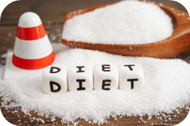
Public Health Law and Regulations
Public Health Legislation:
"Soft Drinks levy" was introduced in 2017, it was designed to encourage manufacturers to reduce the amount of sugar in their drinks. By doing this it helps to support rising obesity levels.
"Public Health Wales Act (2007)" ensures the Welsh government has the power to set nutritional standards for food and drinks that are provided across the public sector such as hospitals, schools and more. This helps to promote healthier diets and tackle obesity.
"Energy drink age restriction" - The UK government is currently discussing a legal restriction of energy drinks to those under 16. Many large supermarkets already abide to a voluntary ban.

Slide 7

School schemes to reduce the impact of health inequalities
Free School Meals
All primary school children in Wales will get free school meals as of 2024, this is part of the agreement between Welsh Government and Plaid Cymru.
Free Breakfast Clubs:
All children who go to a primary school which is maintained by local authority can have a free breakfast at school, if their school provides free breakfasts.
School Milk:
All pupils in Wales up to the age of 7 are eligible for School Milk Scheme Strategy - GOV.UK funded by the Welsh government. Students above this age are able to purchase cheaper milk and dairy products. This is through the school milk subsidy scheme where the government will help towards the cost of these products.

Slide 8
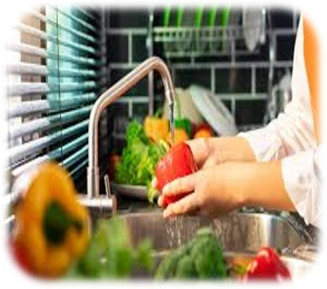
Food Hygiene
Environmental Health Officers
Each local area in Wales has an environmental health department run by the council that supports consumers in relation to food safety. They are responsible for the following:
Inspecting food businesses and auditing their food safety practices to ensure they comply with legislation.
Enforcing actions if required, such as issuing improvement notices, prohibition orders or penalty notices.
Investigating food complaints and allegations of food poisoning, as well as complaints about labelling to ensure labels do not mislead consumers.
Educating and advising food businesses on correctly following food safety laws.
Responding to food alerts from the Food Standards Agency.
https://www.bbc.co.uk/bitesize/guides/zndnsrd/revision/5 ​

Slide 9
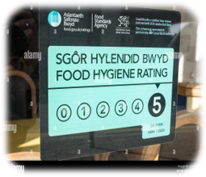
In Wales, the Food Hygiene Rating (Wales) Act 2013 is a mandatory piece of legislation that ensures all food businesses display their hygiene rating. It is the responsibility of the local council to inspect and rate food premises.
This supports consumers by allowing them to make informed choices on where to buy their food. It applies to any outlet selling food.
When a food safety officer is rating a food business, they will check:
The hygiene standards when the food is prepared, cooked, cooled, reheated and stored.
The conditions of the building's structure, including cleanliness, layout, lighting, ventilation and other facilities.
The food hygiene management and how the business records what it does to make sure food is safe.
The business is then given a rating from 0 to 5, with 5 being the highest rating.
A rating of 5 indicates that the food premises' hygiene standards are 'very good.'
A rating of 0 indicates 'urgent improvement necessary.'
The Food Standards Agency's
Food Hygiene Rating Scheme

Slide 10

A HFSS product is a food or soft drink that is high in fat, salt or sugar.
Advertisements for HFSS products are not allowed in media specifically targeting under-16s (e.g., children’s magazines or websites aimed at children), OR where under-16s make up over 25% of the audience (e.g., advert content featuring an influencer with broad appeal but a substantial child audience).
Given the global reach of many websites and social media channels, the large numbers mean adverts that may appeal to children can still be seen by large numbers of children.
Advertising to Children
Marketing and Advertising High Fat, Sugar, Salt (HFSS) Foods

Slide 11
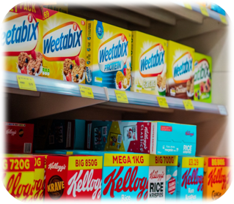
Companies can say certain things about their food, like it being 'healthy' or 'good for you'.
"Nutrition" claims are things that tell you how good a food is for your body, like "high in fibre" or "low in sugar." These claims must be approved and accurate.
"Health" claims are things that say how a food or ingredient can help you stay healthy. For example, "Calcium is needed for normal growth and development of bone in children”."
Nutrition and Health claims can helps people make better choices about what they eat. The rules make sure that when a company says something about their food, it's honest and easy to understand.
Advertising to Children
Nutrition and Health Claims

Slide 12
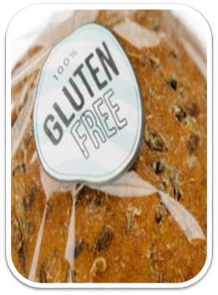
Food Allergies and Labelling
Food Safety:
Food businesses need to tell customers if any food they provide contains any of the listed allergens as an ingredient. Consumers may be allergic or have intolerance to other ingredients, but only the 14 allergens are required to be declared as allergens by food law:
Celery | Molluscs (Muscles and oysters)
Cereals containing gluten (wheat, rye, barley and oats) | Mustard
Crustaceans (Prawns, crab and lobster) | Peanuts
Eggs | Sesame
Fish | Soybeans
Lupin | Sulphur dioxide and sulphites
Milk | Tree nuts (Almonds, hazlenuts, walnuts, Brazil nuts, cashew, pecans, pistachios and macadamia nuts

Slide 13
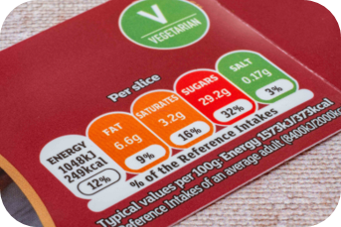
Food Labelling
Some front-of-pack nutrition labels use red, amber and green colour coding also known as traffic light labelling.
Traffic light nutritional information tells you at a glance if the food has high, medium or low amounts of fat, saturated fat, sugars and salt:
Red means high
Amber means medium
Green means low
In general, a food or drink that has all or mostly green on the label is a healthier choice.
It is always good to check the serving size for the product, for example the traffic light is for 1 burger – if you were to have more, the traffic lights may change.
Food labels - NHS (www.nhs.uk)

Slide 14
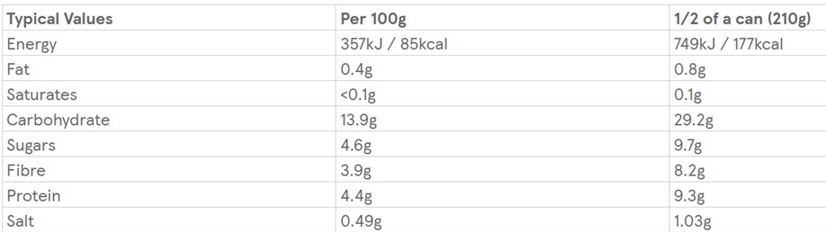
Food Labelling
Back of packaging labelling is presented on all pre-packaged food and tells us the amount of nutrient per 100g and per serving.
This type of labelling can give us a good idea and good comparison between two individual products if there is no traffic light on the front.
The typical nutrients you will see are:
Energy
Fat
Saturates
Carbohydrates
Sugars
Fibre
Protein
Salt
Food labels - NHS (www.nhs.uk)

Slide 15
One of the most successful public health interventions has been the Soft Drink Industry Levy, which encouraged many manufacturers to reduce sugar in soft drinks.
The levy was 18p per litre on soft drinks containing between 5g and 8g of sugar per 100ml, and 24p per litre on soft drinks containing more than 8g of sugar per 100ml.
The policy has been highly effective, reducing the total sugar sold in soft drinks by retailers and manufacturers by 35.4% between 2015 and 2019, from 135,500 tonnes to 87,600 tonnes.
Recent research shows that the tax on sugary drinks may have prevented more than 5,000 cases of obesity every year among girls in their final year of primary school. Yet we know that decades of attempts to work on voluntary measures have not yielded the pace and scale of change required around reformulation.
Public Health Interventions

Slide 16

Restrictions on High Fat, Sugar and Salt Products ​Product Placement and Promotions
In Wales, we are looking at new rules to restrict the product placement and promotion of foods with lots of fat, sugar, or salt. This could mean taking a similar stance to the existing measures in England.
These rules:
Prevent or limit volume based special offers like 'buy one get one free'
Put these products in places that aren't easily found, like at the ends of aisles in the shop
Make these foods cheaper for a short time
Put them together in meal deals
These rules are to help people make healthier choices when they shop.

Slide 17
Thank You For Listening

