Slide 1
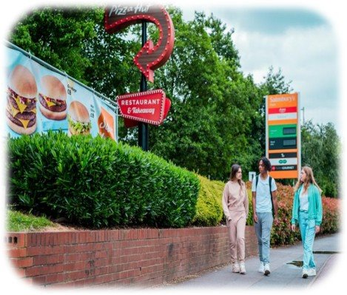
Industry, Marketing and Advertising
Food and Nutrition

Slide 2
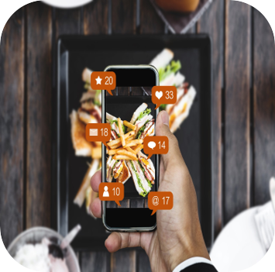
Contents
The Food Environment
Our Food Environment and Industry
The Food Industry
Industry Strategy
Industry and Marketing

Slide 3

The Food Environment
The food environment is the food available around us and that we buy and consume.
How easy it is to get and how much it costs can make it harder or easier to maintain a balanced diet, because it influences what food and drink we choose.
The food industry is a complex, world-wide network of businesses that supplies most of the food consumed by the world's population.
The food industry includes those who farm foods to those who process, package, distribute and sell food and drinks.
Big companies make lots of the snacks, drinks and meals we see in shops and online. They want us to buy their products, so they use fun packaging, cool ads and sometimes even give out toys with their food to make it seem more exciting.
You will be familiar with many large food and drink businesses such as Nestle, Coca-Cola, Cadbury's, Braces and many more.
Notes:
For more information, please visit: Shaping Our Health - Chief Medical Officer for Wales Annual Report 2023 (gov.wales)

Slide 4
Our Food Environment and Industry
There are 4 main sectors within the food industry, these include:
Marketing & Advertising This is how companies promote their products, using tools such as online, TV, magazines, billboards and more.
Supply Chain & Global Influence:
Large/global companies have large networks that allow them to promote and sell their products everywhere. They can decide what to make, how much it costs and how to market it.
Corporate Social Responsibility:
This is when large or even global companies give back to societies, this can include giving money to charity or providing sports equipment to schools. The responsibilities also include things like sustainability, fair trading and workplace diversity.
Lobbying, Laws & Rules:
Many rules and regulations surround the food industry. This includes food labelling, allergy laws, age restrictions and can even say what time of day food can be advertised on TV!
Notes:
Shaping Our Health - Chief Medical Officer for Wales Annual Report 2023 (gov.wales)

Slide 5
The Food Industry
The food industry has grown at a rapid rate which means our food culture has changed and developed over time. There are more food choices available to us now than ever before, some being positive and others having a potential negative effect. The major changes in the food industry are:
More choice
Increased Convenience Food
Technology and Innovation
Ethics
Online shopping
Price
Sustainability
Health and wellness Focused
Consumer expectation
Pre-packaged foods

Slide 6
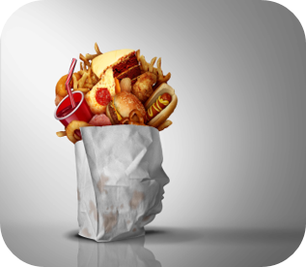
Industry Strategies
Food and drink companies have the flexibility to set their own prices for products. However, some pricing decisions are influenced by regulations, such as the sugar tax levy, which is governed by specific laws and regulations.
Here are some examples of the factors that influence their pricing decisions:
Fast Food Chains: Fast food places usually charge less for basic items like regular burgers and more for special items like premium burgers or meals.
Specialty Coffee Shops: The prices are based on how much it costs to make the coffee, including the ingredients and the work involved in preparing it. It may also include where products have come from, such an imported coffee.
Supermarkets: Supermarkets use special deals like discounts, multi-buy offers, and loyalty cards to make certain products more appealing to young people and families. These deals help increase sales, especially for products that make the store more money.

Slide 7
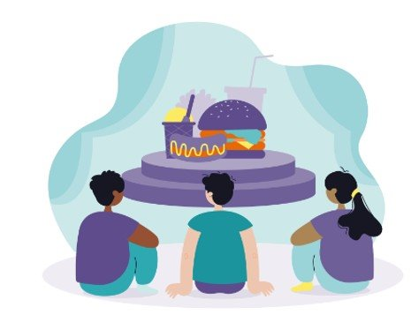
Junk Food's Spotlight:
The Unseen Show Stealing Young Peoples' Attention
Imagine a big stage where junk food plays the star, dressed in bright colors and flashy wrappers, with a spotlight shining directly on it. The sugary snacks and greasy treats take the leading role, dancing and singing to grab everyone’s attention. Meanwhile, the healthy fruits and veggies are hidden in the shadows, pushed to the back, barely noticed.
Children are the audience, eyes glued to the stage, unaware that they’re being drawn in by the lights and sounds. The pandemic pulled up more chairs, giving junk food an even bigger stage and brighter spotlight, making it harder to see anything else.
Source: https://urbanhealth.org.uk/our-work/childrens-health-and-food/framing-toolkit-talking-about-childhood-obesity

Slide 8
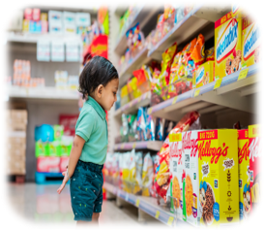
Marketing Tactics
Many products that are ultra processed are presented in bright packaging with large brand logos. Often, characters or animals are used alongside product names that are attractive to children and young people such as 'Barny Bear', 'Monster Munch', 'Penguin', 'Coco Pops' and many more.
The food industry will also often use catchy slogans or tag lines to make their products stand out. You may recognise some of these:
'Kids and grown-ups love it so, the happy world of Haribo'
'I'm lovin' it!'
'Finger-licking good'
'Snap, crackle, pop!'

Slide 9
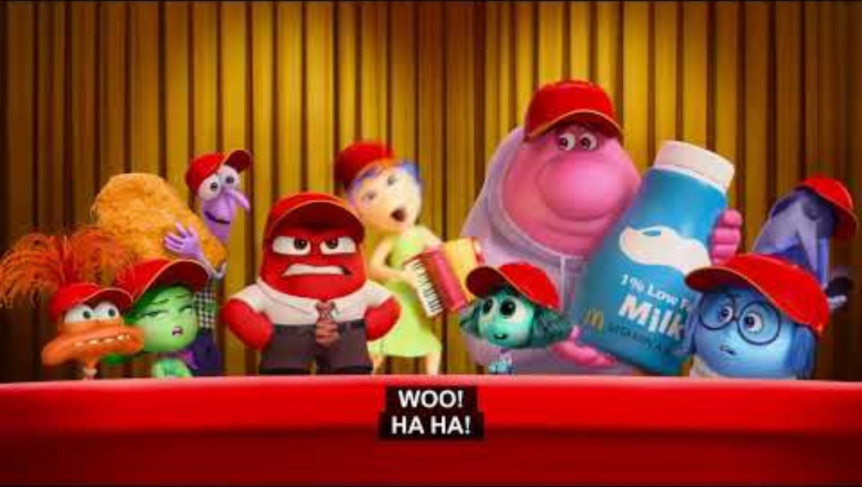
Advertising and Marketing: Television and Online Ads
Have a think about the TV and Online ads you have seen recently. You may have noticed companies create colourful and engaging ads, often featuring popular characters, music or themes that appeal to children and teenagers.
McDonald's frequently airs television ads featuring Happy Meals with themes or characters from popular films, aiming to make the meals more appealing to children. These ads often highlight the toy included with the meal, which may increase children’s enthusiasm for buying a Happy Meal.
Snack brands such as Pringles or Doritos might run short, engaging advertisements on YouTube before videos that are popular with children. These ads often present the products in a fun and playful manner to resonate with young viewers.
Although HFSS product ads are not permitted to appear in media specifically for under-16s, many ads are still appealing and can be seen by children.

Slide 10
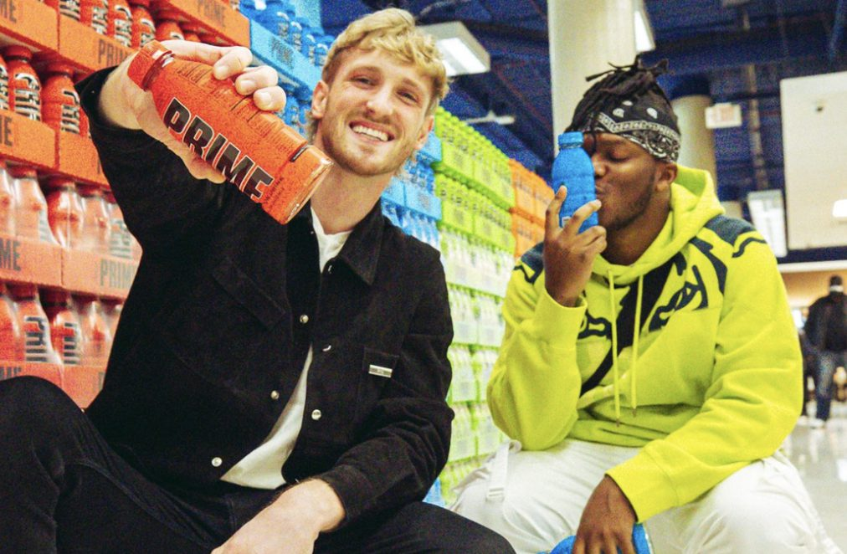
Advertising and Marketing:
Social Media Influencers
You may have noticed that brands partner with influencers who are popular among young people to promote their products, making them seem more desirable. For example;
TikTok Challenges Sponsored by Food Brands: A sweet company might launch a viral challenge on TikTok, where influencers show creative or entertaining ways to enjoy a new sweet. This challenge encourages young followers to try the sweet and join in the trend.
Instagram Endorsements by Influencers: An influencer popular with teenagers may post about trying a new flavoured drink or snack, tagging the brand and encouraging their followers to do the same. This can create a sense of trendiness around the product.
Who Owns Prime Hydration? (watcher.guru)

Slide 11
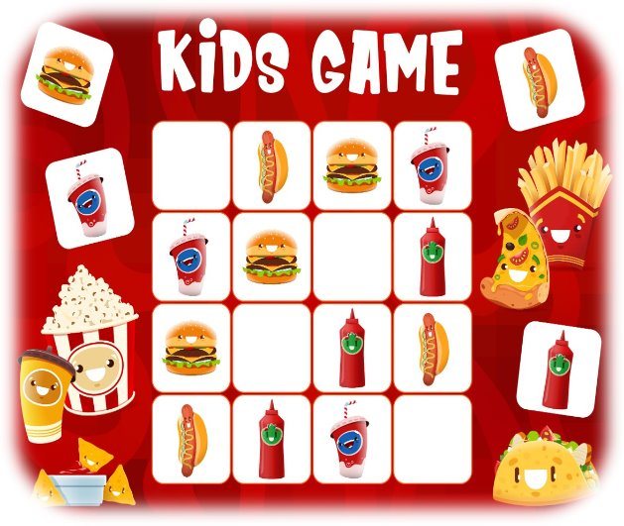
Marketing Tactics - ​
Product Placement
Children and young people are especially at risk of being influenced by advertisements and celebrity promotion of products. Food and drink brands place their products in movies, TV shows and video games that are popular with young audiences.
Some brands create online games that integrate their products, making the brand experience fun and interactive. Some video games popular with young people may feature virtual billboards or vending machines displaying real-life snacks or drinks, such as Pepsi or Skittles. This exposure helps make these products more familiar and appealing to young players.
Energy drinks, which have high levels of caffeine and sugar are associated with a range of adverse outcomes and risky behaviours. However, research has found that energy drinks are often marketed on gaming sites and linked to sports and an athletic lifestyle and are particularly aimed at younger males.

Slide 12
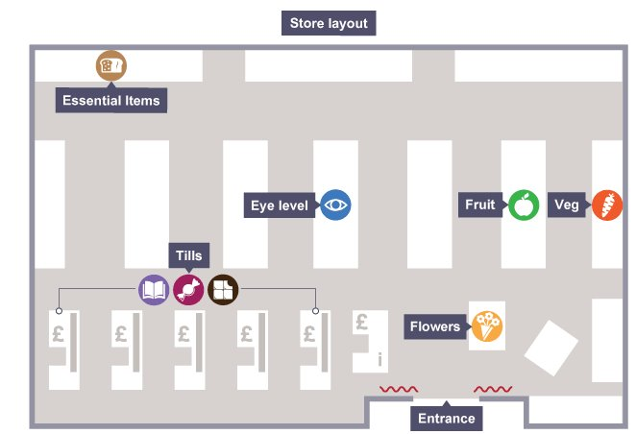
Essential items are at the back of the store and far apart. This makes you walk past other items and maybe buy more things.
In Store Marketing
Big supermarket brands use clever marketing tactics to make us spend more time and money in their shops.
Eye-Level Placement: Products targeted at young people are often placed at their eye level to make them more noticeable and easier to pick.
End Caps: Popular snacks and sugary drinks are placed in high-traffic areas like ends of aisles and are often on offer.
Checkouts: You’ll find items like magazines, sweets and chocolate here where young people are more likely to ask for them. This is the store's last chance to get you to buy a few more items.
Check out the Laws and Regulations Knowledge Bank for more information on Restrictions on HFSS product placement and promotions.

Slide 13
Thank You For Listening

