Slide 1
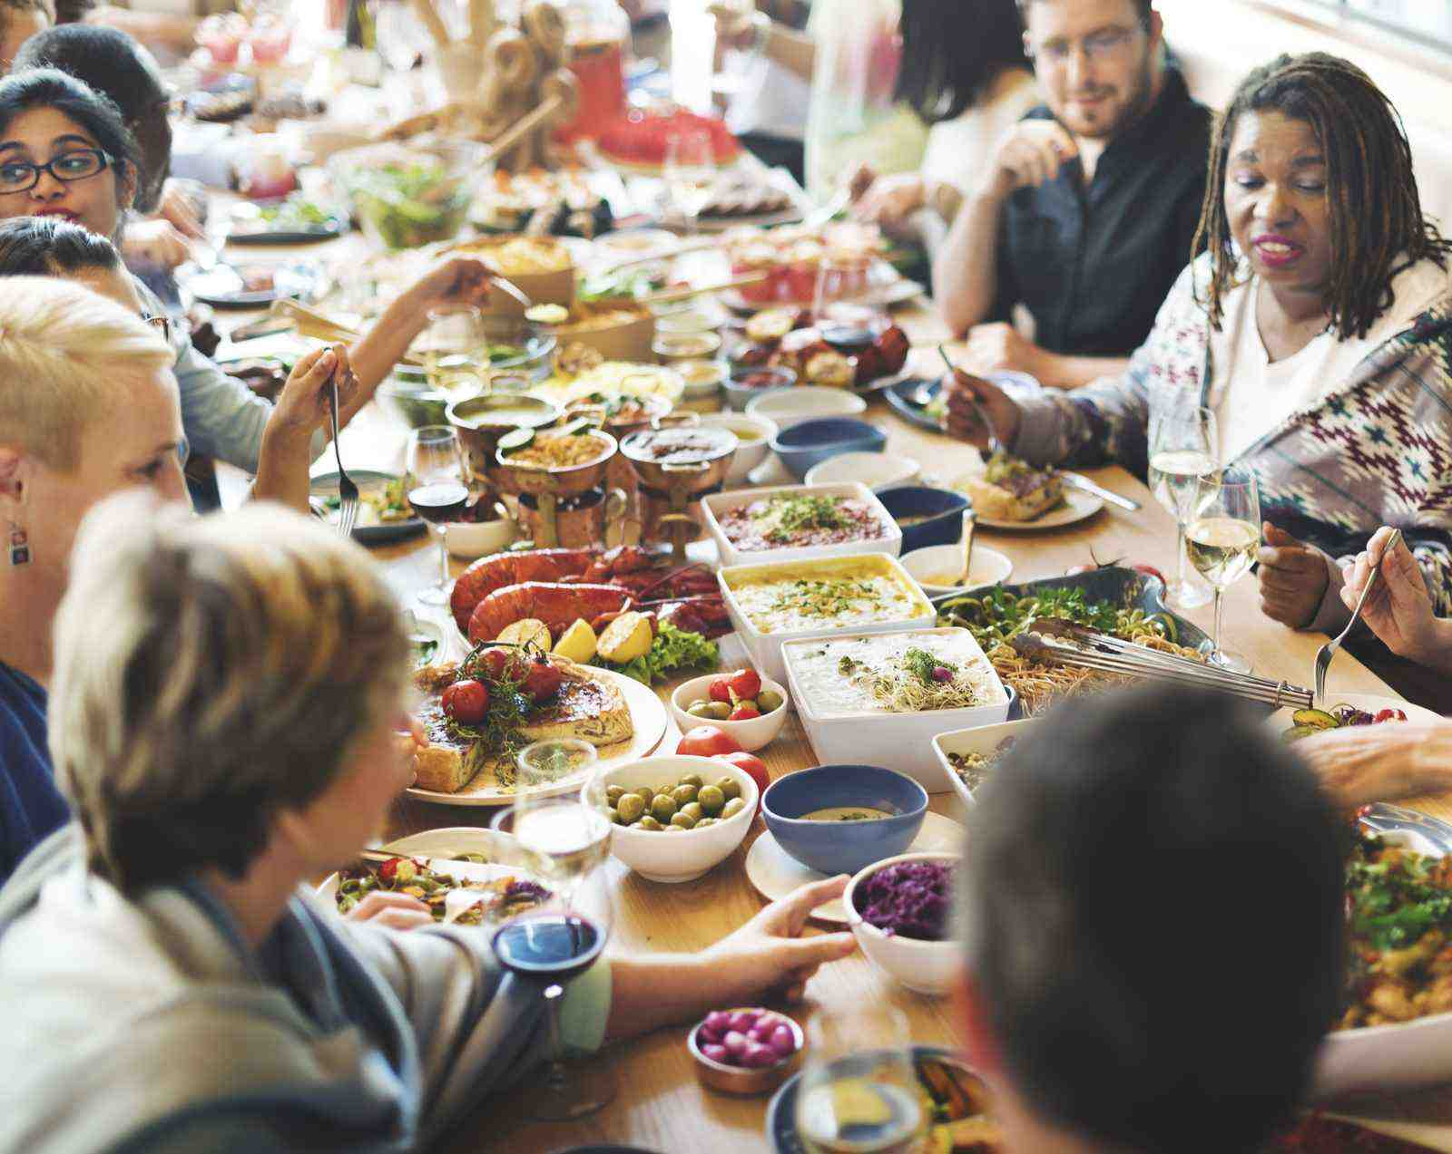
Food, Culture and Society
Food and Nutrition

Slide 2
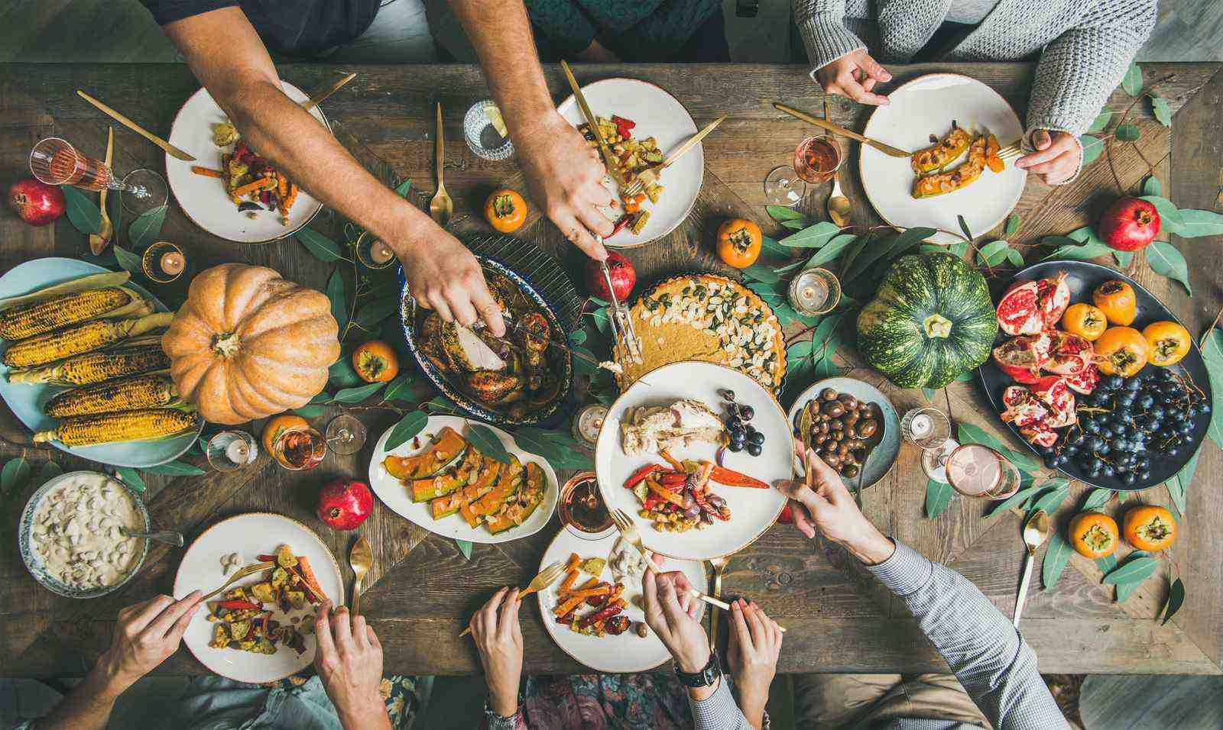
Contents
How is food an important part of our culture and society?
Food and Family Traditions
Socialising with Food
Celebrations and Festivals
Food from Around the World
Food and Traditions in Stories and Media
Food as Art
Religious and Cultural Food Choices
Food and Community Support

Slide 3
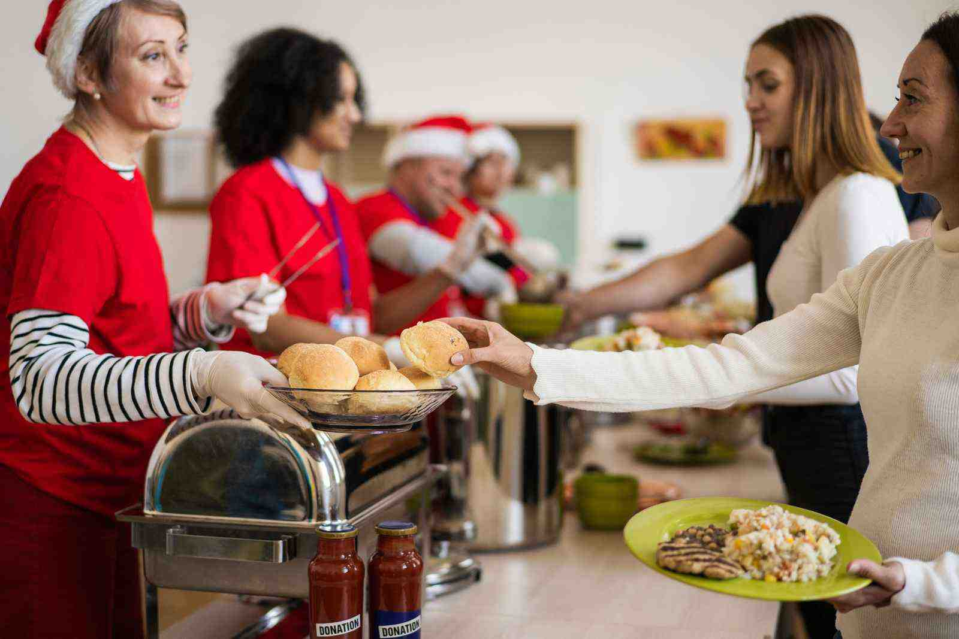
How is Food an Important Part of Our Culture and Society?
Food isn't just for eating; it's often a fun, enjoyable and interesting part of daily life, and an important part of our celebrations and cultures.
Food can often take centre stage within our celebrations and special events. We regularly choose to celebrate positive events in our life which can involve food and meals together.
Food is embedded into daily lives, culture, religion and social activities.
What are food choices? - KS2 - BBC Bitesize

Slide 4
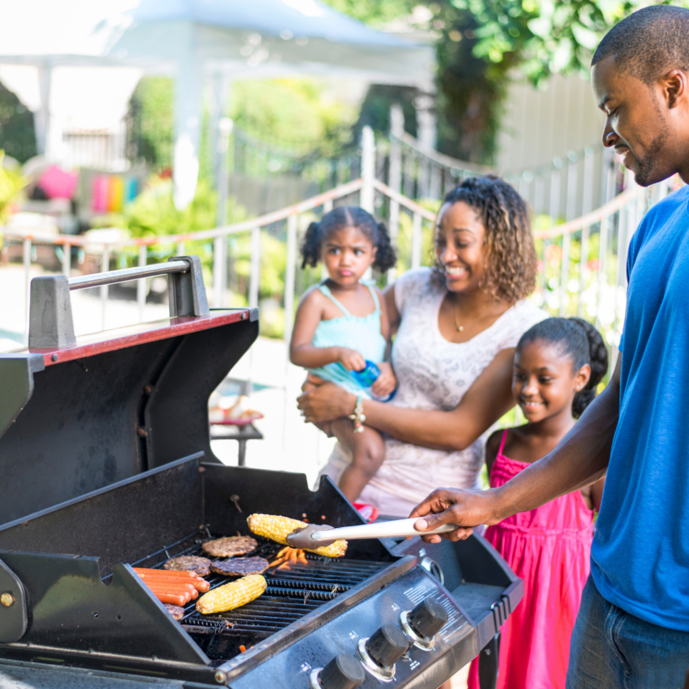
Food and Family Traditions
Sharing food with friends and family is a way to connect with others.
The preparation and making of foods can often be a special time to share with family.
There are lots of different events where food is shared such as parties, BBQ's, religious events, picnics, celebrations and even our normal family meals.
Many families have special meals or recipes passed down through generations. These meals help bring families together and should be celebrated and encouraged throughout society.

Slide 5
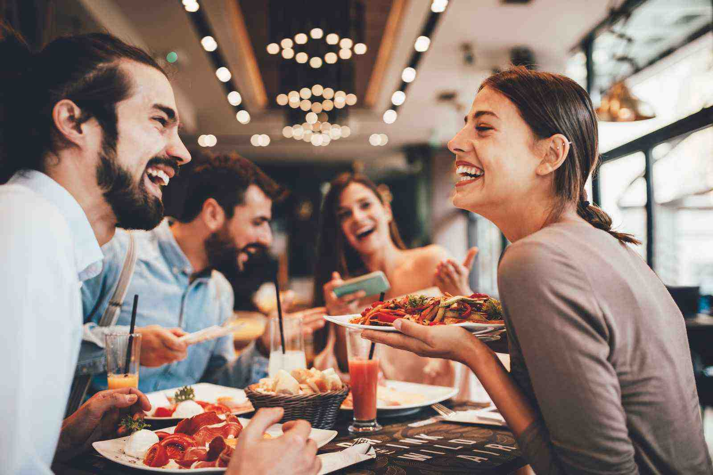
Socialising with Food
Think about the last time you ate a meal with friends or family.
What were you doing apart from eating and drinking? Maybe talking, sharing stories about your day, laughing, telling jokes.
When we sit down to eat with others it allows us to connect. Sharing a meal with others can help to strengthen relationships. Whether it's with family, friends or new acquaintances, eating together provides an opportunity to talk, share experiences and bond.
When people come together over food, they can learn about each other's cultures and traditions. This helps broaden our understanding and appreciation of different ways of life.
Eating together can make people feel more relaxed and comfortable, encouraging open and honest communication. This is especially important for families and friends to maintain strong connections.
Offering food is a way to show care and hospitality for some people. It can be a simple way to support others, making them feel valued and included.

Slide 6
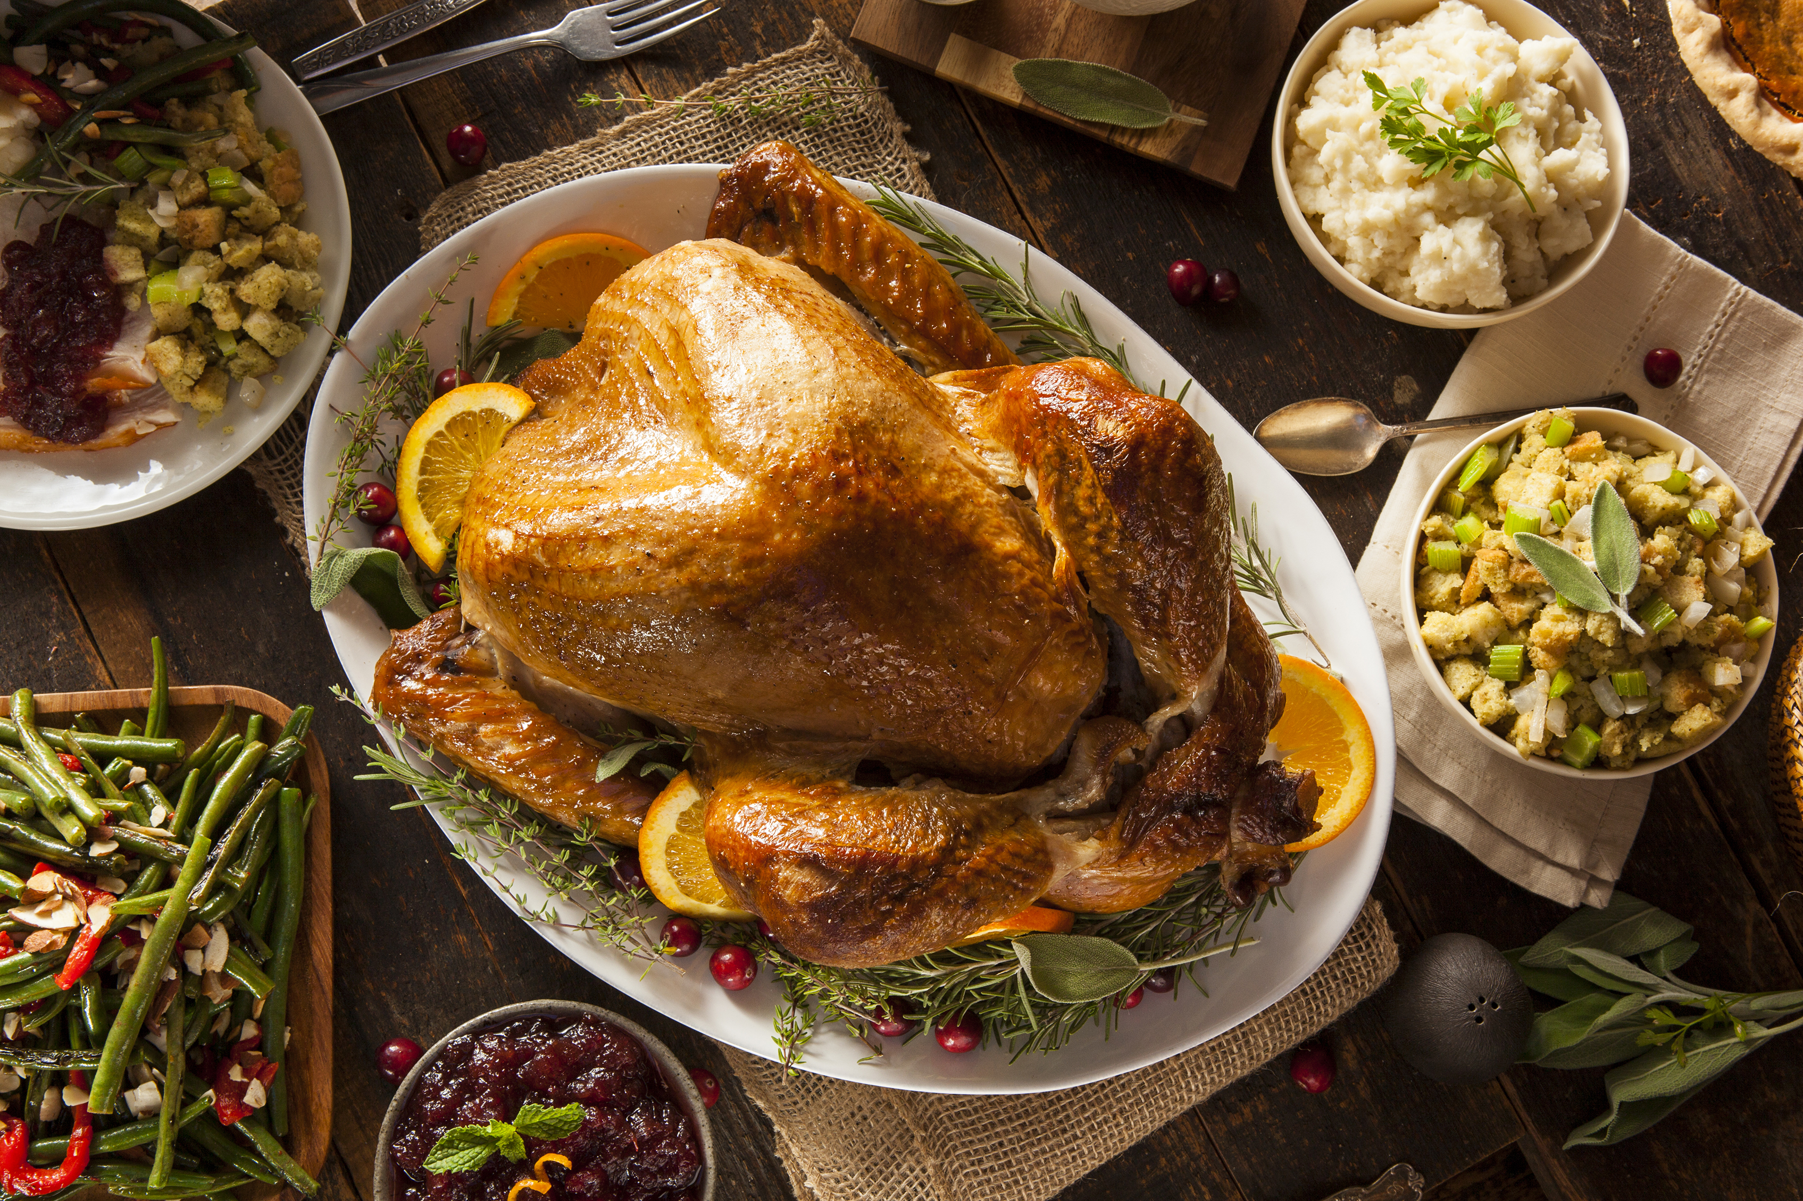
Celebrations and Festivals
Food is a big part of our celebrations and special events. Different cultures have special dishes they enjoy during these times.
For example, we might have a traditional meal like a Christmas dinner or seder plates in Passover. There are many other traditions which should be celebrated and enjoyed.
Sharing these moments over food creates lasting memories that people cherish.

Slide 7
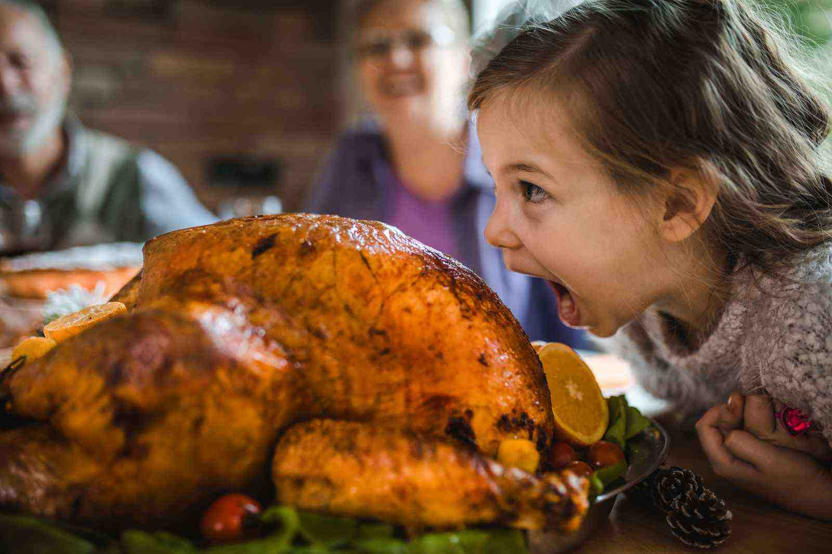
Celebration Foods
Some foods are eaten as a part of special celebrations. Do you associate certain foods with specific special celebration events?
When you think of the following celebrations, which foods (and drinks) do you think of? Remember, this can be different in every family or household:
Birthdays, New Year, Christmas, Hannnukah, Eid-al-Fitr, Passover...and more!
Often, celebrations have a strong association with certain foods such as Turkey at Christmas, cake for birthdays or Matzah bread on Passover.
These foods can form part of the enjoyment of our celebrations and symbolise the importance and meaning of the event.

Slide 8
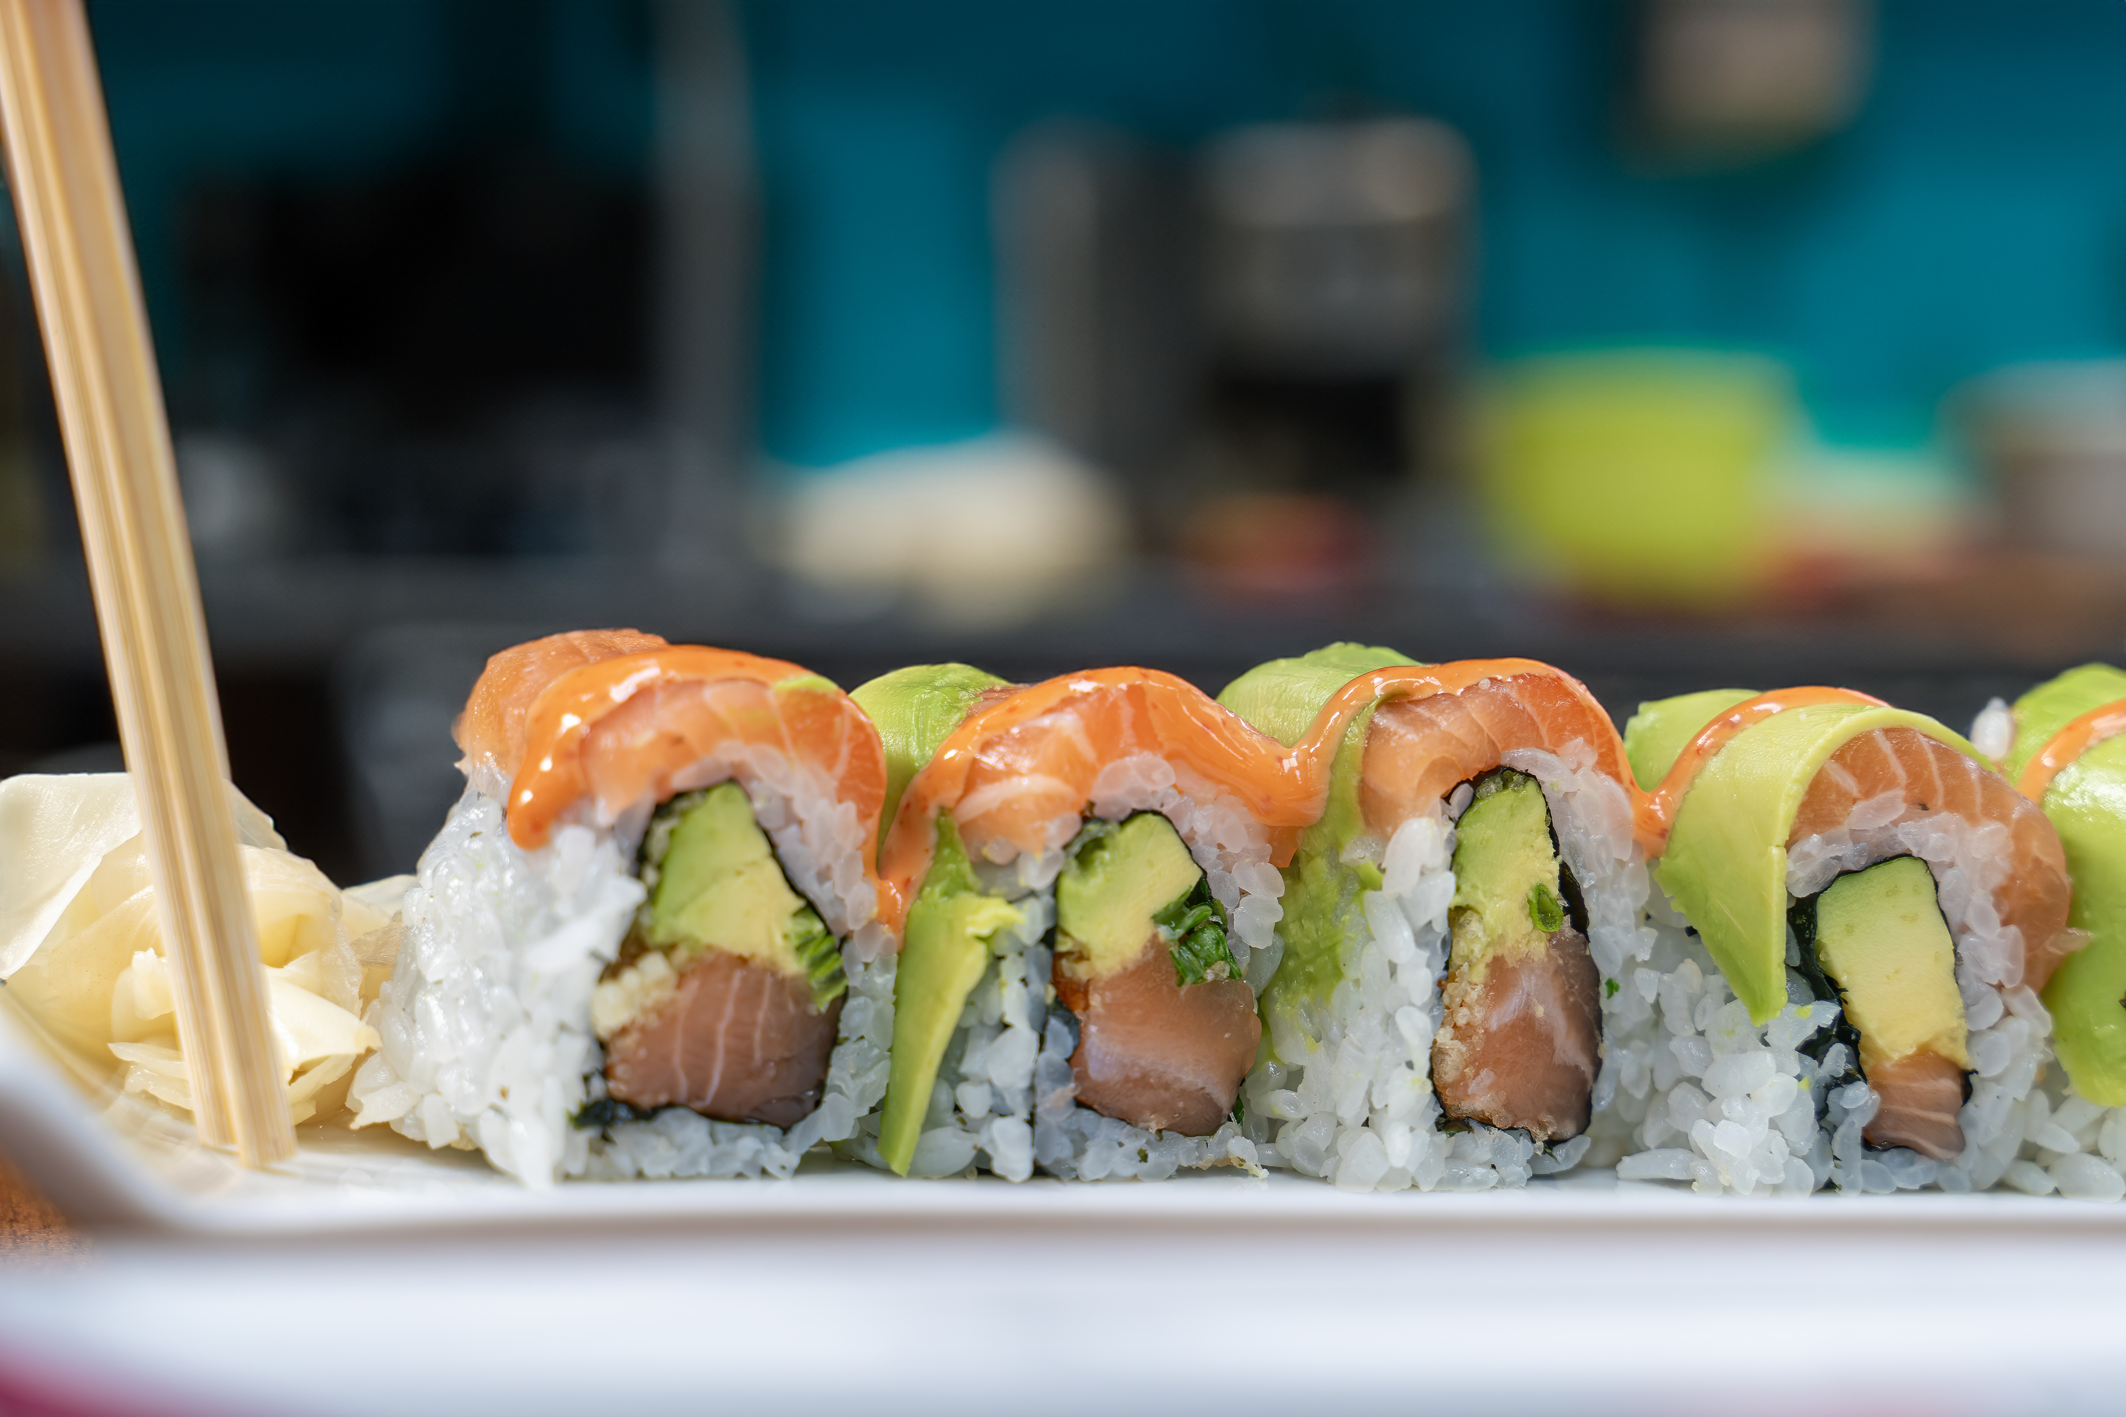
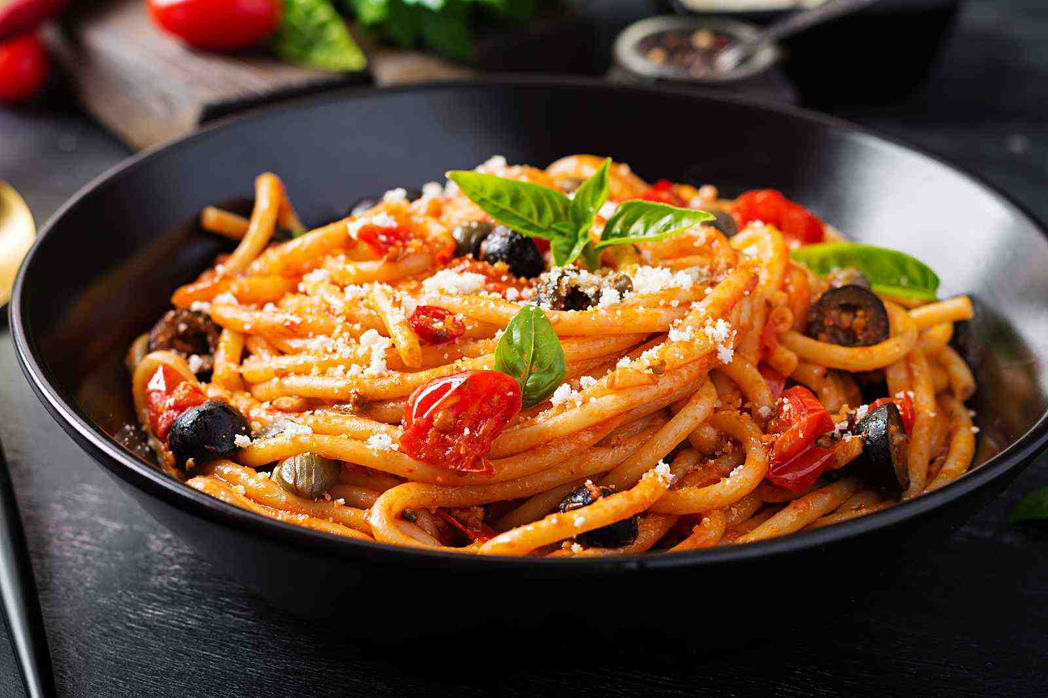
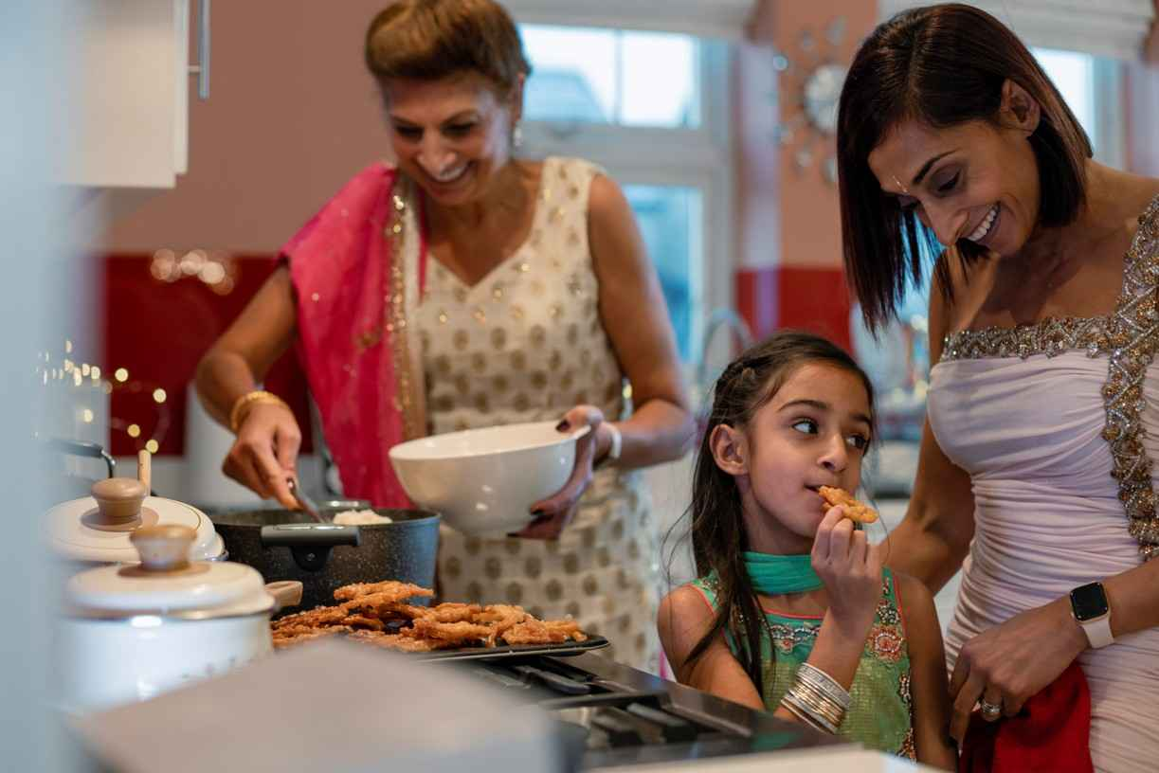
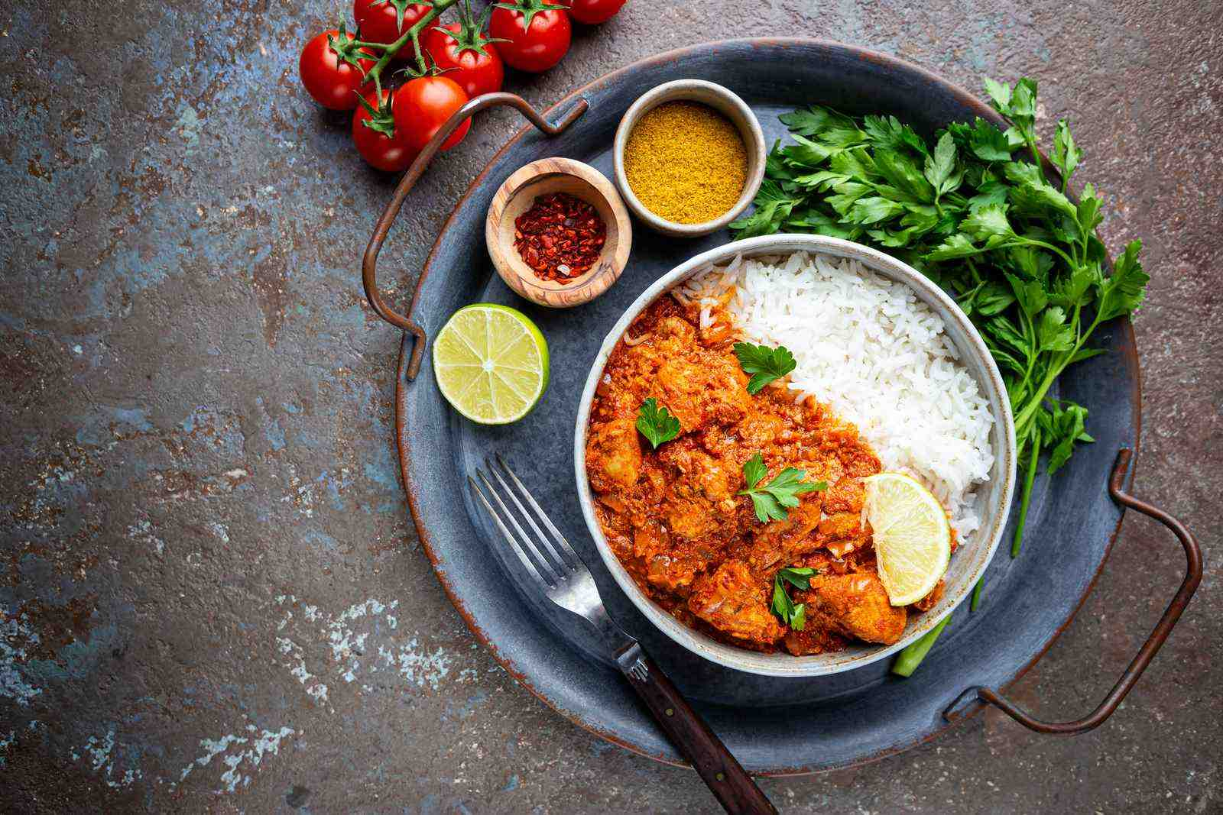
Do you know where these foods are from? ​
Food from Around the World
Every country has its own special foods. Trying foods from other cultures is a fun way to learn about the world.
The meals we prepare at home reveal much about our origins and cultural backgrounds. They serve as a celebration of our heritage.

Slide 9
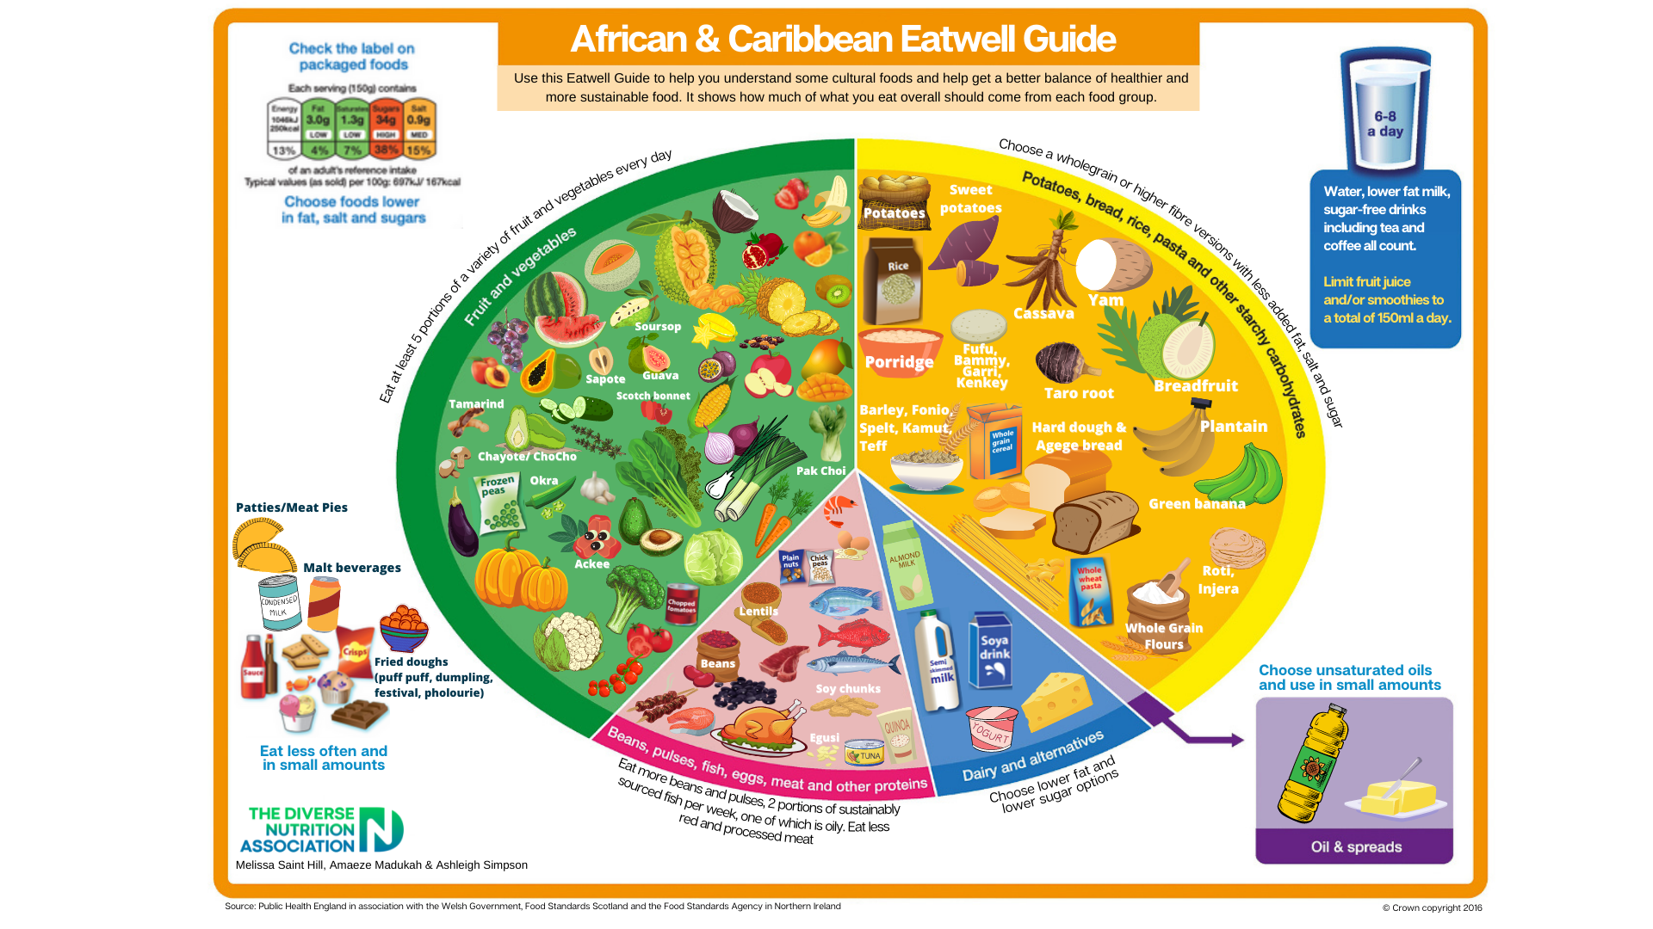
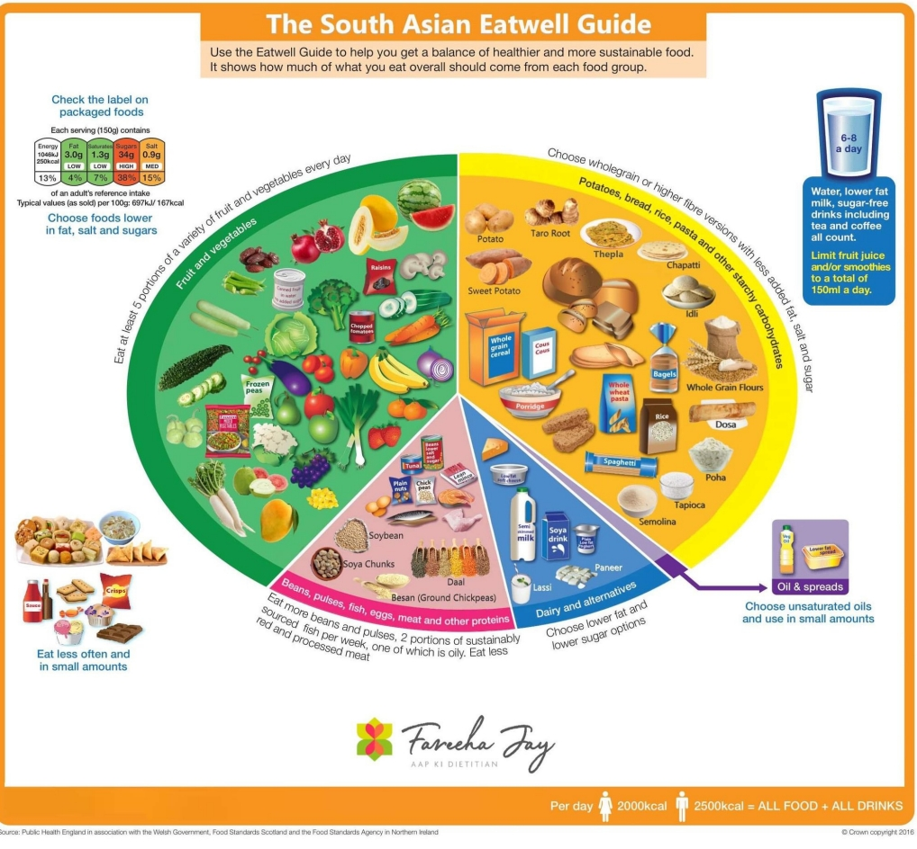
These Eatwell guides show typical foods eaten as part of a South Asian and African and Caribbean diet. The main messages and healthier eating recommendations are the same for all diets across the world.
Check out the 'What is a healthy balanced diet?' Knowledge Bank for more information on a healthy balanced diet.

Slide 10

Food and Traditions in Stories and Media
Food often appears in books, films, online and TV shows. It can be a fun way to explore different cultures and stories.
From magical feasts to famous dishes, food plays a key role in bringing stories to life and connecting us to the characters.
Shows such as The Great British Bake Off or Masterchef, can encourage others to have a go at learning a new skill and enjoy taking part in food preparation, baking and cooking.
This animated movie celebrates French cuisine through the journey of Remy, a rat who dreams of becoming a chef in Paris, highlighting the passion and artistry of cooking.
Notes:
Ratatouille: This animated movie celebrates French cuisine through the journey of Remy, a rat who dreams of becoming a chef in Paris, highlighting the passion and artistry of cooking.

Slide 11
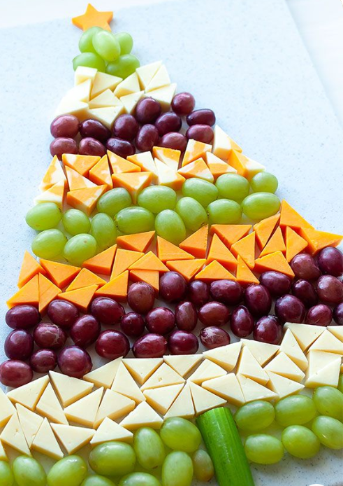
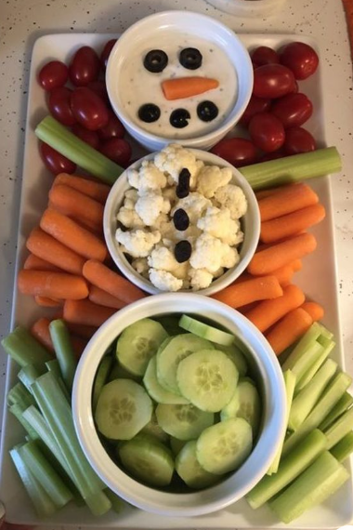
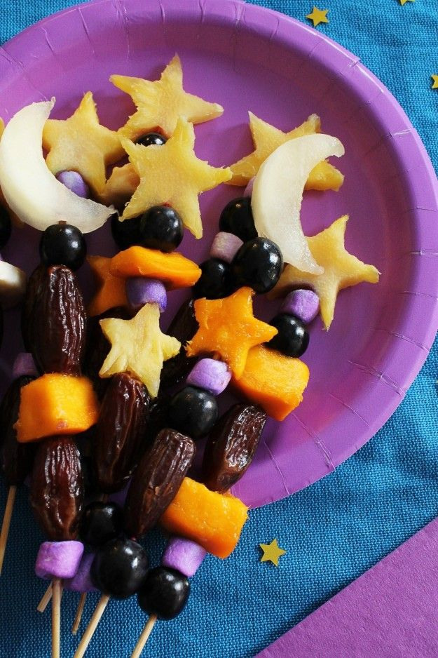

Food as Art
Cooking can be creative! Chefs and home cooks alike use food to make beautiful and delicious dishes.
Creating a themed buffet for a celebration with friends or family is a great way to be creative and have fun with food.

Slide 12
Religious and Cultural Food Choices
Some people may choose foods that are special to them in their religion.
In some religions, people eat foods that have been prepared in a special way. Some people might also have rules about not eating certain foods because of their beliefs or culture.
Islam
In Islam, halal is the name given to foods that are permitted or that have been prepared in a certain way following Islamic teachings.
For example, certain foods like pork are forbidden in Islam.
Judaism
In Judaism, Jewish people cannot eat anything that isn't kosher.
'Kosher' describes a food that adheres to a set of rules called kashrut. These rules inform Jewish people how to prepare and eat food following Jewish teachings.
For example, Jewish people who follow a kosher diet are not allowed to eat pork or shellfish.
Hinduism
Many Hindus avoid eating beef because cows are considered very important in Hinduism.
What are food choices? - KS2 - BBC Bitesize

Slide 13
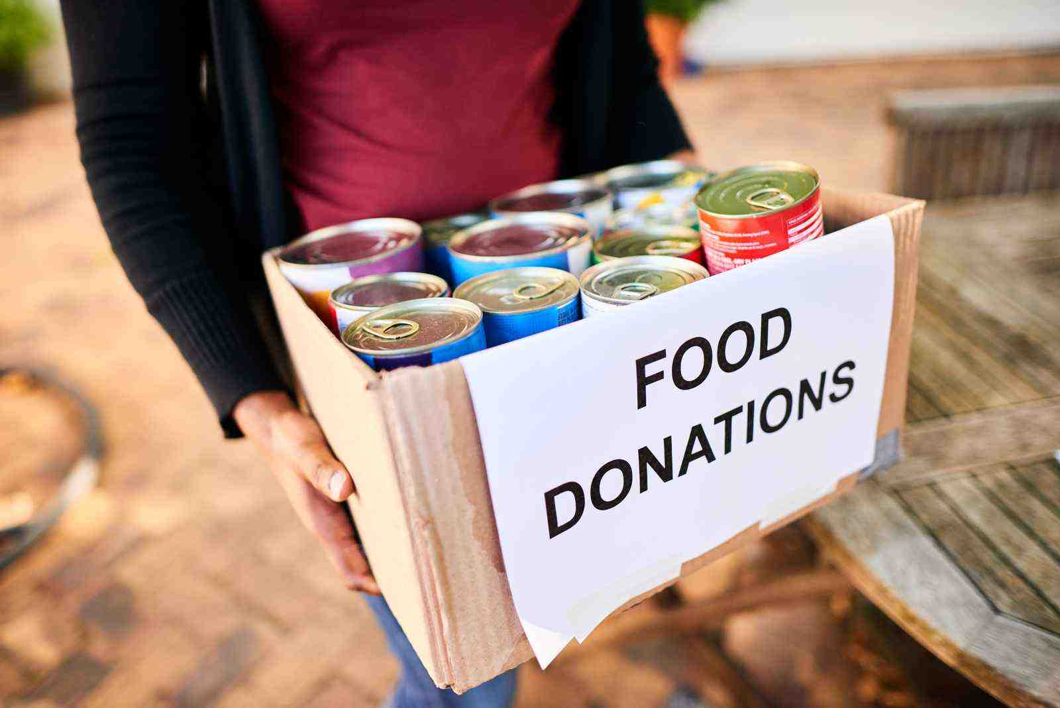
Food and Community Support
Food can be a way to help people in need. Soup kitchens, food banks and community gardens are important in supporting communities and helping people.
Sikh temples, known as Gurdwaras, provide free food to everyone through a community kitchen called "Langar". This tradition is an integral part of Sikhism and is based on the principles of selfless service (seva) and equality.
Open to All: The Langar is open to people of all backgrounds, religions, and social status. It is a symbol of the Sikh commitment to equality and community.
Free of Charge: The food served in the Langar is always free. It is funded by donations from the Sikh community and prepared by volunteers.
Simple and Vegetarian: The meals are usually simple, nutritious, and vegetarian, making them accessible and acceptable to people of all dietary restrictions.
Community Service: Preparing and serving the Langar is considered an act of community service and a way for Sikhs to practice humility and service to others.
Check out the societal impacts Knowledge Bank for more information on the unfair and avoidable reasons why some children and young people have more health problems related to food than others. ​

Slide 14
Thank You For Listening

