Slide 1
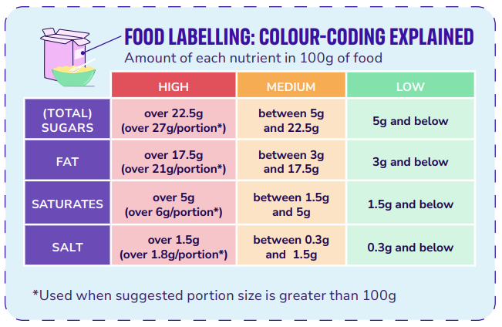
Food labels
Food and Nutrition

Slide 2

Contents
Food Labels
Understanding Food Labelling Claims
Understanding Price Labels

Slide 3
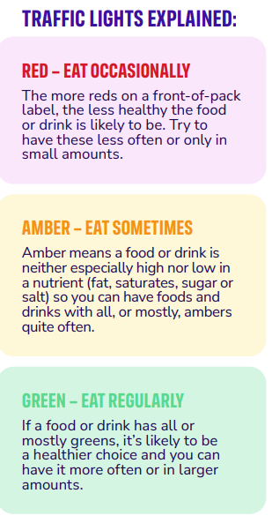
Food Labels
There are different types of nutrition information included on packaging.
Nutrition tables – found on all pre-packaged food and drink, usually on the side or back of the packaging.
Ingredients – listed in order of amount (by weight), from highest to lowest.
Front-of-pack labels – simplified nutrition information found on the front of packaging. These are voluntary, but the Government is trying to get food manufacturers to use the same design as much as possible.
Some companies may choose to include a traffic light label on the front of the pack. This can make it easier to see if a food is a healthier choice. You can use them to compare products at a glance. The labels usually include traffic light colours which show you if the product is high (red), medium (amber) or low (green) in fat, saturates, sugar and salt.
Why do you think some companies may not choose to include these labels?
Source: Guide to food Labelling (wcrf-uk.org)

Slide 4
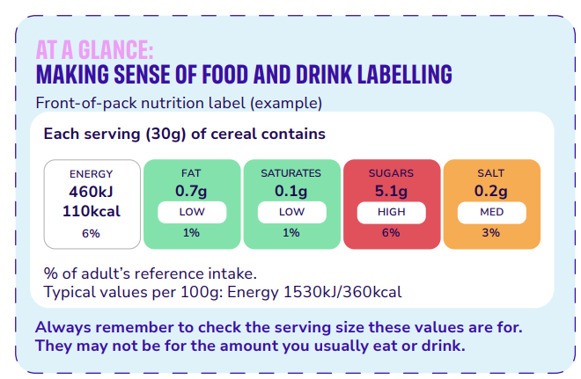
Food Labels – front of pack
Check out this example of a front of pack label
and how to use it:
Understanding food labels | World Cancer Research Fund
The ‘reference intake’ tells you how much energy, fat, saturates, sugar and salt a food or drink has compared to what is recommended for a typical adult following a healthy, balanced diet. The reference intake will vary by age group.

Slide 5
Food Labels – back of pack
Check out an example of a back of pack label
and how to use it:
Food labels - NHS
If the label doesn’t include traffic light labelling, you can check the amount of each nutrient in 100g (100ml for drinks).

Slide 6
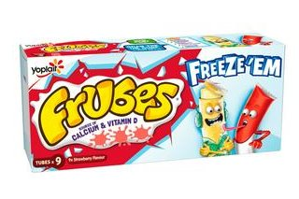
Understanding Food Labelling Claims
Products that are high in sugar are sometimes marketed at children as being healthy, even if they are not particularly nutritious, by highlighting certain ingredients or using terms like "source of calcium and vitamin D". All yoghurts will be a source of calcium and vitamin D, however the amount of sugar added and the way products are marketed can vary massively.
Reduced fat means that the product has at least 30% less fat than the original version of the product. It’s important to remember even if it says reduced fat, it could still be high in fat if it has more than 17.5g of fat per 100g of food or per 100ml of drink.
Low fat means that the product contains no more than 3g of fat per 100g of food or per 100ml of drink.

Slide 7
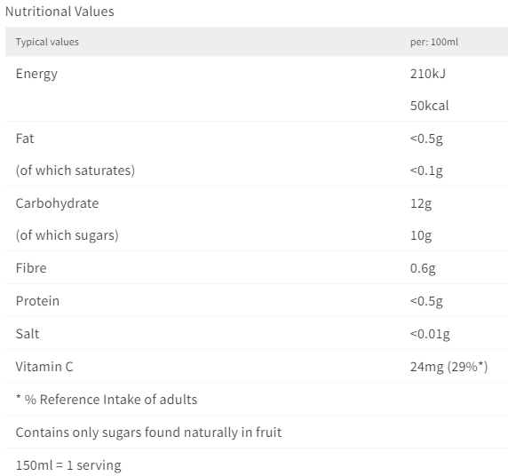
Understanding Food Labelling Claims
‘No added sugar’ means that manufacturers haven’t added any sugar to the food or drink. But this doesn’t mean that there is no sugar. For example, fruit contains natural sugars, meaning that dried fruit and fruit juices may have amber or even red labels for sugar.
You can check if sugar has been added by reading the ingredients list. As well as ‘sugar’, look out for syrup, honey and words ending in ‘–ose’ (for example, sucrose, glucose and fructose) as these can be other words for sugar. Ingredients are listed in weight order, so if any of these appear near the top of the list, the product is likely to be very sugary.
A front of packet traffic light label was not provided on these smoothies. Can you use the nutritional information provided and the information tools on slide 15 to work out what colour this product would score for 'sugar'.
Always remember to check the serving size these values are for. They may not be for the amount you usually eat or drink.

Slide 8
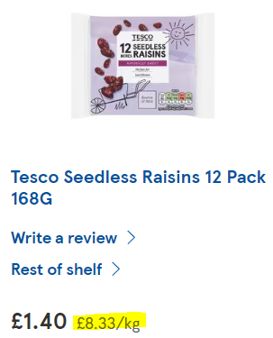
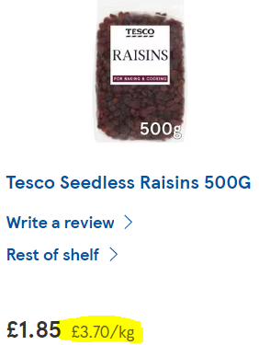
Understanding Price Labels
How Price Labels Work in UK Stores?
Cost Per Weight: Shops in the UK need to show how much a product costs per weight, like per 100 grams. This helps shoppers make better choices.
Why It's Important: Knowing the cost per weight makes it easier to compare prices between different brands and sizes of products.
How Does This Impact Advertising and Marketing?
Honest Advertising: Companies need to be clear about their prices, so they can’t trick you with fancy packaging.
Better Choices: You can pick the best deal, not just the one that looks the most fun or has the coolest ad.
Example:
If you see two bags of raisins, one costing £1 for 100 grams and another costing £1.50 for 200 grams, the price label helps you see which one is cheaper per 100 grams.
Remember, always check the price labels to make smart shopping choices!

Slide 9
Thank You For Listening

