Slide 1
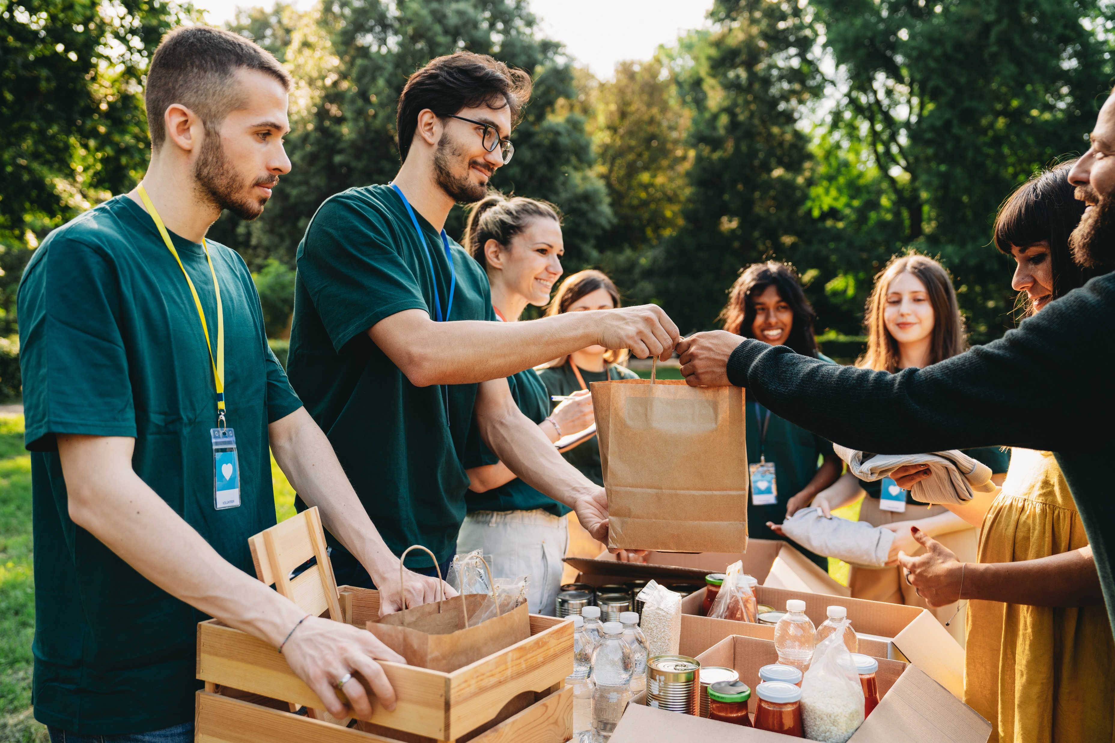
Food, Health and Inequality
Food and Nutrition

Slide 2

Contents
What are Health Inequalities
What are the effects of Health Inequalities
Food-related inequalities
Why Some Children have More Food Related Ill Health
What is Being Done About Inequalities?
Getting the Best Start in Life: Pregnancy
Getting the Best Start in Life: Babies & Childhood

Slide 3
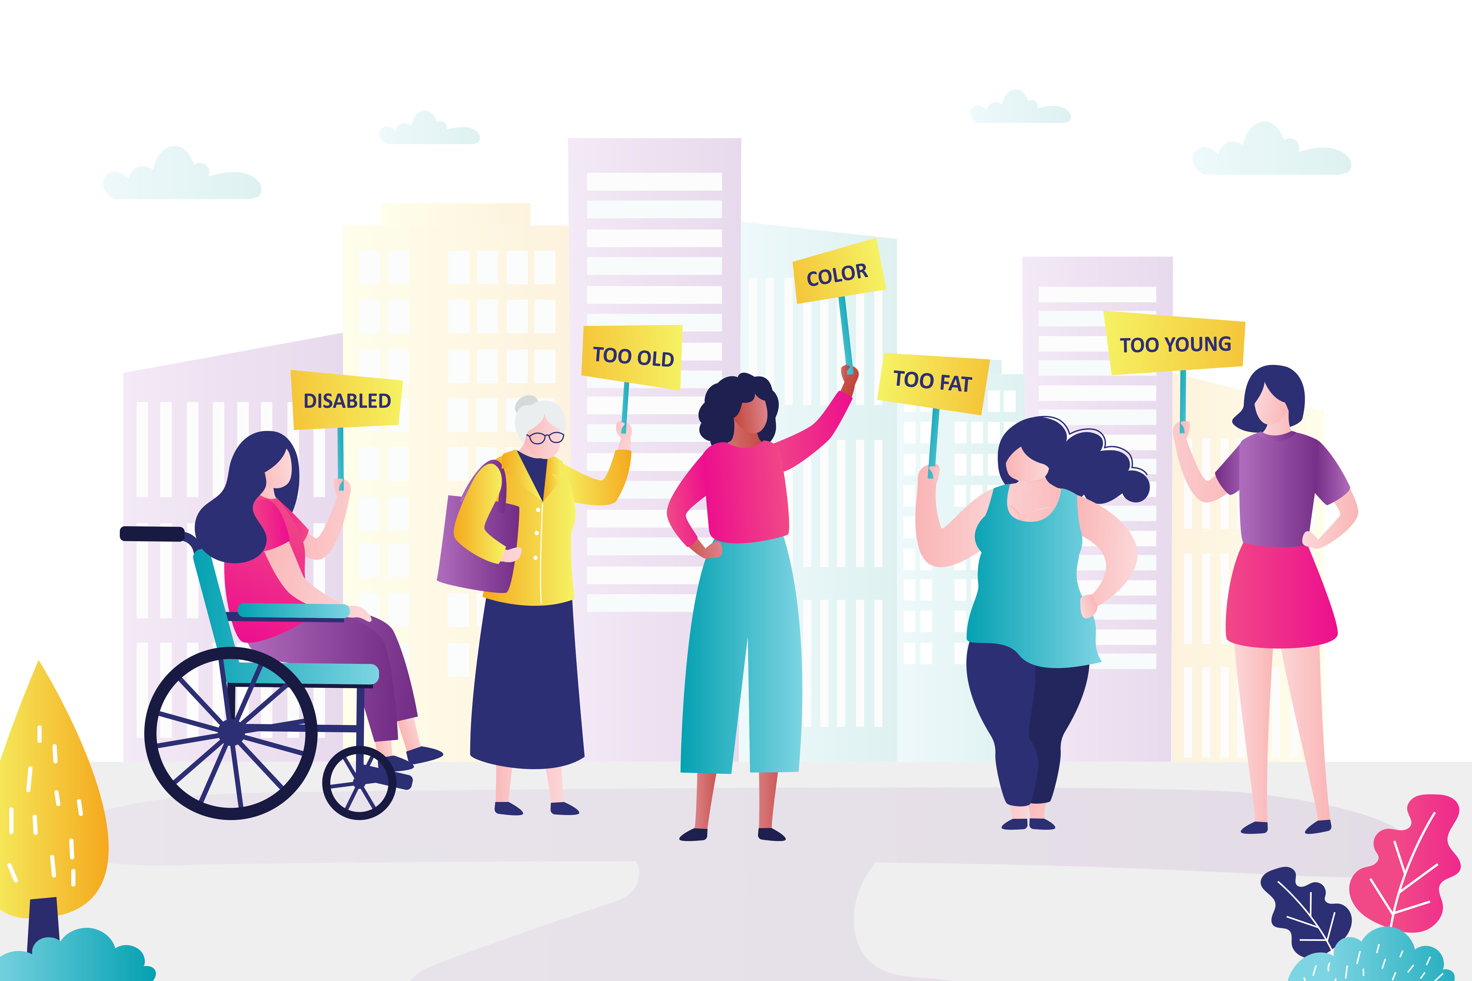
What Are Health Inequalities?
Health inequalities are differences in health across the population and between different groups in society, that are systematic, unfair and avoidable.
They are caused by the conditions in which we are born, live, work and grow. These conditions influence how we think, feel and act and can affect both our physical and mental health and well-being.
Definition taken from the National Institute for Health and Care Excellence

Slide 4

https://urbanhealth.org.uk/our-work/childrens-health-and-food/framing-toolkit-talking-about-childhood-obesity
What Are the Effects of Health Inequalities?
When we don’t have the things we need, like warm homes and a healthy balanced diet, it puts a strain on our bodies which can result in greater stress and poorer health.
To create a society where everybody can thrive, we need all of the right building blocks in place:
stable jobs
good pay
quality housing
good education.
To try and reduce inequalities between different areas in Wales, work is being done to identify our communities where blocks are missing. This is to make sure those at most risk have the best access to support.
Notes:
https://urbanhealth.org.uk/our-work/childrens-health-and-food/framing-toolkit-talking-about-childhood-obesity

Slide 5
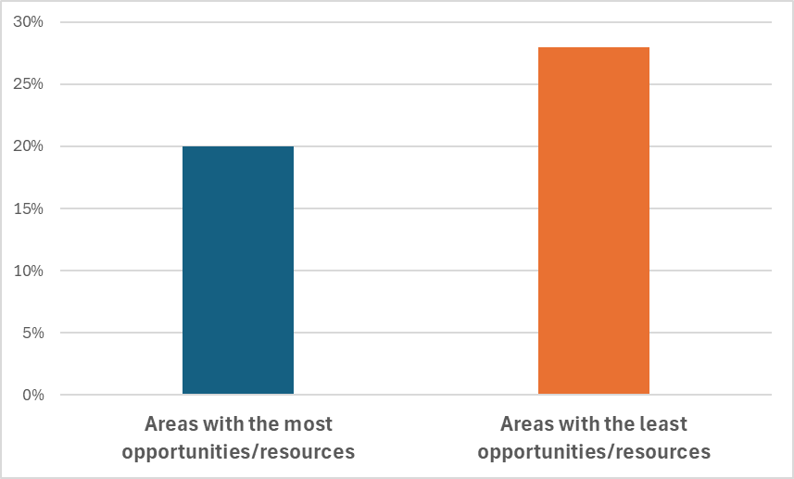
Food-related inequalities
Percentage of children with overweight or obesity, difference between areas with the most and least opportunities/resources in Wales, 2022/23
Obesity and overweight are examples of food-related ill-health where there are inequalities.
There are differences in the % of children living with overweight or obesity depending on where they live.
Across Wales:
20% of children who live in areas with access to the most resources and opportunities live with overweight or obesity*, compared with
28% of children who live in areas with access to the fewest resources and opportunities live with overweight or obesity*.
This is a difference of over 8%.
Similar patterns can be seen across all the Health Board areas in Wales. Information on different Health Boards can be found here.
Source: Child Measurement Programme 2022/23​
* This is measured by the Welsh Index of Multiple Deprivation which combines information sources relating to people's living, working and education experiences.

Slide 6

https://www.gov.wales/sites/default/files/publications/2019-10/healthy-weight-healthy-wales-youth-community.pdf
Why Some Children Have More Food Related Ill Health
In Wales, some children and young people have more health problems related to food than others. This is unfair and avoidable. Here are some of the reasons:
Income and Resources: The food available around us and how much it costs can make it harder or easier to maintain a balanced diet because it influences what food and drink we can access and the choices we make. Families with more resources can buy healthier foods like fruits and vegetables. Families with fewer opportunities and resources often eat more sugary drinks and less healthy food, which isn't good for their health.
Deprivation and Diet Related Ill Health: Children who live in more wealthy areas are more likely to have a healthy weight. In many places in Wales, children who don’t have as much money may have more problems with tooth decay and might not be as healthy.
Environmental Factors: Where children live can affect their health. Some places have more shops with healthy food and parks with safe areas to play. Other places have many fast-food outlets, making it harder for children to stay healthy. This can be fixed by effective planning and sharing resources fairly.
By understanding these reasons, we can see the importance of creating fair and supportive environments for all children and young people in Wales. This can lead to better health for everyone.
Notes:
https://urbanhealth.org.uk/our-work/childrens-health-and-food/framing-toolkit-talking-about-childhood-obesity

Slide 7

What is Being Done about Health Inequalities?
The "Healthy Weight: Healthy Wales" plan
This plan is about helping everyone in Wales be healthier. It focuses on four big ideas:
Healthy Places: Making sure where we live has healthier food and places to play and exercise.
Healthy Choices: Helping people choose healthier food and activities easily.
Healthy People: Giving everyone the chance to eat well and stay active.
Strong Leadership: Making sure leaders help everyone stick to healthy habits.
This plan is to help children and young people, as well as adults, be healthy by making good food choices and activities easy to find. (GOV.WALES)
Notes:
https://www.gov.wales/sites/default/files/publications/2019-10/healthy-weight-healthy-wales-youth-community.pdf

Slide 8
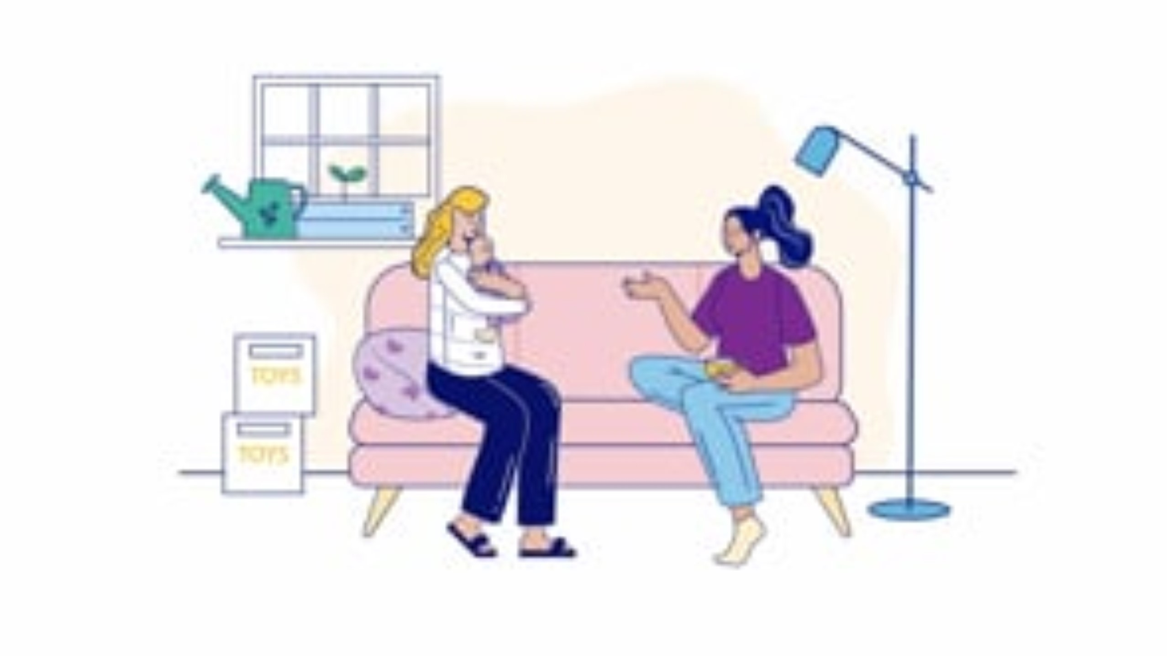
What is being done about Health Inequalities?
Helping babies and children get the best start in life
Evidence suggests that during pregnancy and up to a child’s second birthday can have a life-long impact on health and wellbeing. This is when babies and children start to become who they will be when they grow up.
Early experiences and the love and care babies receive shapes their development for life. A healthy balanced diet and reducing obesity/undernutrition during pregnancy helps babies and children to stay healthy later in life.
Babies’ brains and bodies are built during pregnancy and the first years of life. Having a healthy balanced diet will support the growth and development of the baby during pregnancy and once born, helping them have the best start in life.
This short animation helps all of us think about the different roles needed to help families thrive and give babies the best start in life. https://phw.nhs.wales/topics/the-first-1000-days-programme/.
Notes:
https://www.gov.wales/sites/default/files/publications/2019-10/healthy-weight-healthy-wales-youth-community.pdf

Slide 9
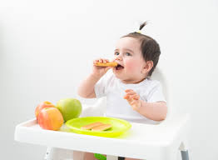
The Importance of food and nutrition during infancy & childhood
Food and nutrition are essential for getting the best start in life. Foods that make up a healthy balanced diet support:
Growth and Development: through providing the essential nutrients needed for physical and cognitive development.
The Immune System: by helping the body fight off infection and illness.
Brain Health: by helping the brain develop, improving cognitive function, learning and memory.
Establishing Healthy Habits: through helping children and young people to make healthier choices about food when they’re older, preventing problems like obesity or becoming unwell with chronic diseases later in life, such as diabetes.
Giving babies and children the best start provides them with a strong foundation to grow, learn and develop.
Notes:
https://www.gov.wales/sites/default/files/publications/2019-10/healthy-weight-healthy-wales-youth-community.pdf

Slide 10
Thank You For Listening

