Slide 1

How do Food Choices affect our physical and mental wellbeing?
Food and Nutrition

Slide 2
How Do Food Choices Affect Us Physically and Mentally?
The type of food (and drink) you eat now is important because it affects healthy growth and development. A healthy balanced diet can fuel the body for daily activities, help you feel at your best and support your education.
The food (and drink) you eat now can also impact your life-long food and drink habits. This is important because what we eat long-term affects our health and wellbeing throughout our lives.
The types of food and drink we consume affect our body, the way it works and our health status.
That's why it is important to understand how the food and drink choices we make can affect us both physically and mentally.
What are food choices? - KS2 - BBC Bitesize

Slide 3
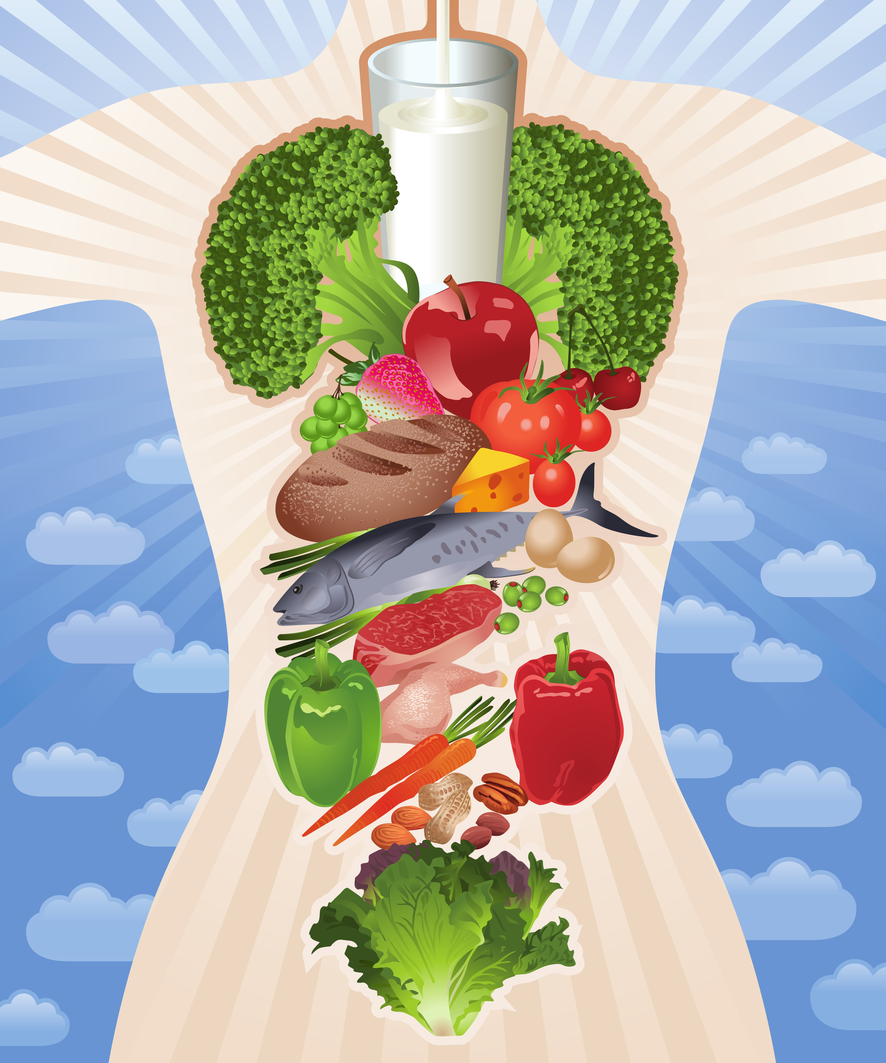
Contents
Food and Energy
The physical benefits
Food Related Disease Prevention
Healthy Eating and mental wellbeing

Slide 4

Food Gives Us Energy
Energy is what our bodies need to move, think and grow. We get energy from food and drinks. All food releases energy when it's eaten and digested and the way our body is fueled is different depending on what we eat.
When we are growing, or being active, we need more energy. Children and young people have higher energy needs because they are still growing and developing compared to adults.
Our bodies get the energy it requires from the food (and drink) we eat. That means we all need to eat the right amount for our own needs, with the types and proportions of foods (and drinks) as shown in the Eatwell Guide. This gives us an outline of the types and amounts of nutrients our bodies need to be at its best.
Fast releasing foods give us an instant quick burst of energy that does not last for long, these can include foods high in sugar.
Slow releasing foods release energy gradually throughout the day including foods such as porridge or wholemeal bread.
If we don't get enough energy throughout the day we can’t perform at our best.
What are food choices? - KS2 - BBC Bitesize

Slide 5
Food Gives Us Energy
When we talk about the foods we eat and the energy this gives us, we also often use words like protein, calories, carbohydrates and sugar. Do you know what each of these words mean?
Protein | A nutrient that makes our bodies strong and healthy.
Calories | A calorie is a unit of energy. Just as we could measure length in centimeters, energy contained in food is measured in calories.
Complex Carbohydrate | A group of healthy foods that release energy slowly. They take longer to digest so they help make your tummy feel fuller for longer. For example, brown rice, sweet potatoes and green peas are all complex carbohydrates.
Sugar | Sugar comes from plants and often makes food taste sweeter. It gives our bodies a big burst of energy. It can be found naturally in fruits and vegetables or it can be processed, like the sugar granules some people add to their tea or coffee.

Slide 6
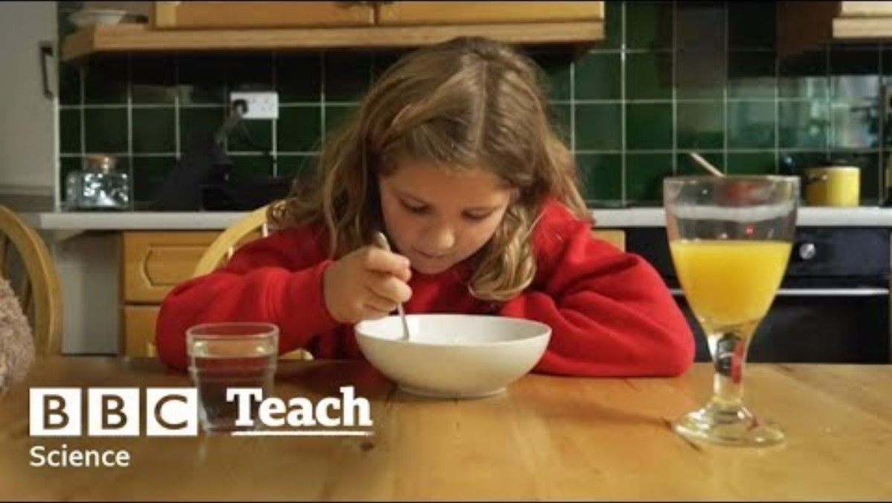
Food Gives Us Energy
All foods and drinks give us energy. Sometimes you might hear the terms energy dense and nutrient dense.
Energy Dense | Food or drink that is high in calories due to their sugar and/or fat content, but are often low in vitamins, minerals and fibre.
Nutrient Dense | foods are high in vitamins, minerals and fibre but are often lower calories due to lower sugar and/or fat content.
​Eating more nutrient dense foods can fill us up, keeping us satisfied for longer whilst providing us with the energy and nutrients our bodies need to feel at our best.​
Having a regular eating routine and not skipping meals is also an important part of making sure we have enough energy throughout the day. ​
What are food choices? - KS2 - BBC Bitesize

Slide 7
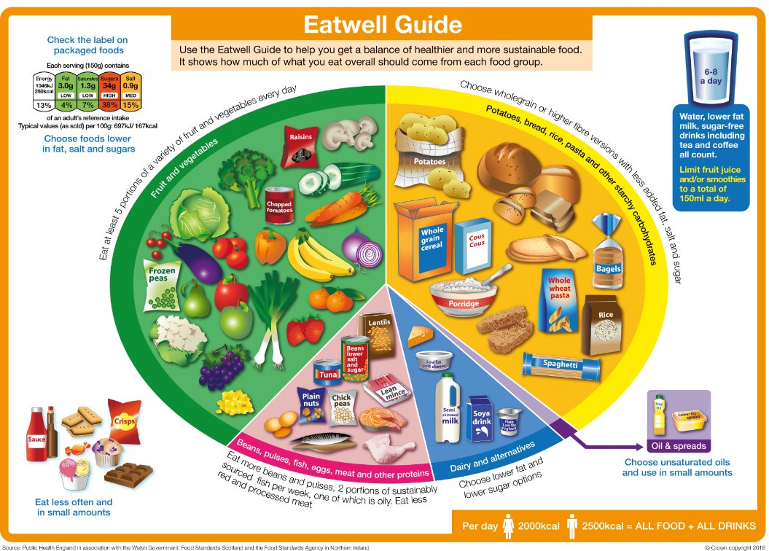
Physical Benefits of Healthy Eating
Check out 'what is a healthy balanced diet' Knowledge Bank for more information
Good nutrition supports muscles, bones, teeth and overall growth and development.
Nutrients like proteins, vitamins, and minerals are essential for our growth. They help us develop properly and stay active.
For example, proteins found in foods like chicken, fish or beans help build and repair muscles. Vitamins, such as vitamin C, help boost our immune system, while minerals like calcium in milk strengthen our bones and teeth helping to improve our dental health.

Slide 8
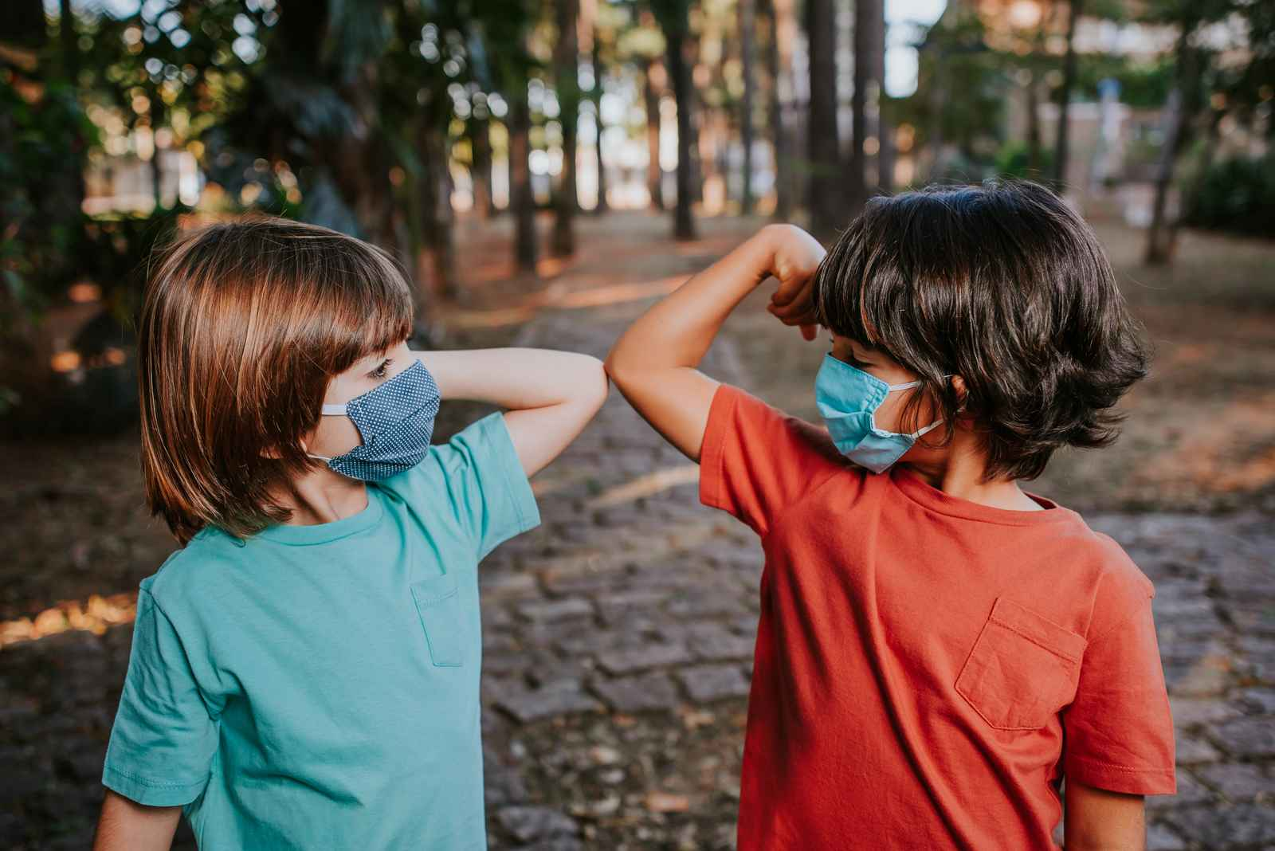
Food Related Disease Prevention
Eating a healthy diet is important to help prevent diseases. If we don’t eat the right foods, in the right amounts, we can become unwell with problems like malnutrition, obesity, type 2 diabetes, heart disease and some types of cancer.
For example, it's important we get enough iron in our diets from foods like meat, leafy green vegetables, beans or nuts. If you're not getting enough iron it can lead to anaemia, a condition where you feel very tired and weak because your blood can’t carry enough oxygen around the body.
Or when we consume too much of certain nutrients such as free sugars found in items like sweets, biscuits and fizzy drinks, this can lead to obesity, dental health issues and type 2 diabetes.
Health benefits of eating well - Food and nutrition | NHS inform

Slide 9
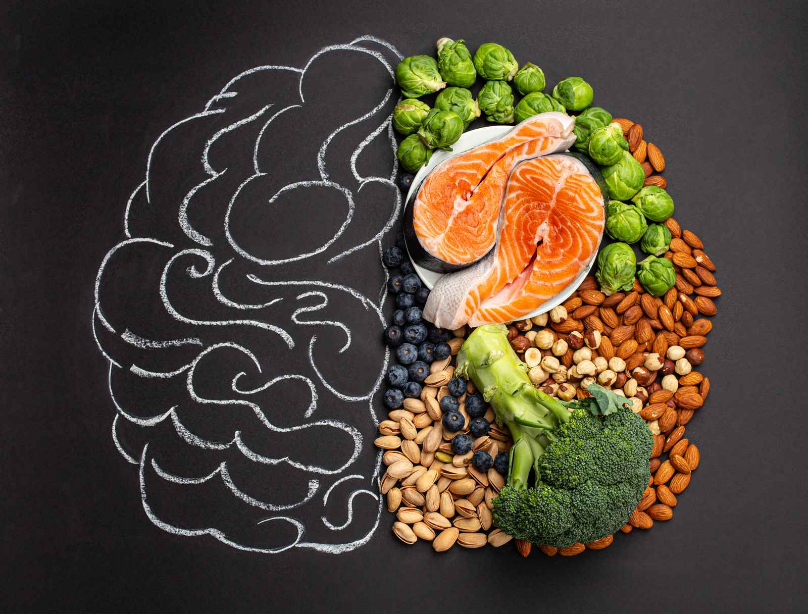
How Does a Healthy Balanced Diet Impact Mental Wellbeing?
Consuming a healthy diet helps us feel ready for the things we love, which in turn supports our mental health.
Enjoying meals with others can be fun and gives us an opportunity to feel connected to those around us!
A balanced diet plays a key role in supporting mental wellbeing. Nutrients such as B vitamins, minerals from fruits and vegetables, and fatty acids found in fish and nuts contribute to the proper functioning of both the brain and body.
Carbohydrates provide energy for the body for us to do the things we enjoy, while proteins have been shown to help regulate mood.
Health benefits of eating well - Food and nutrition | NHS inform

Slide 10
Thank You For Listening

