Slide 1
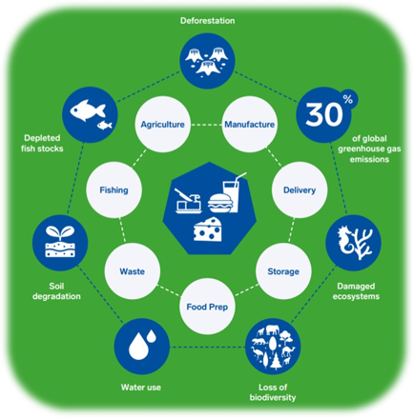
The Environmental Impact of Our Food Choices
Food and Nutrition

Slide 2

Contents
Why our Food Choices Matter
Importance of Sustainability
Food and Greenhouse Gases
Food and Air Miles
Packaging
Microplastics
Food Chains
Recycling
Food Waste
Taking Action
How a Healthy Balanced Diet Aligns with a Sustainable Diet

Slide 3
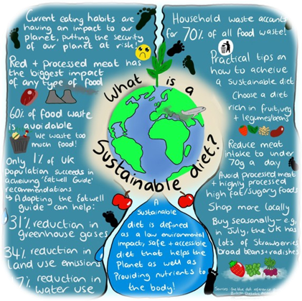
Why Our Food Choices Matter
Our food choices have a big effect on the planet.
The types of food we consume, along with how and where they are produced, influence water usage, land use, and pollution.
Understanding these impacts helps us make better decisions that are kinder to the planet.
Adding more fruits and vegetables to our meals, and opting for locally grown produce, can minimize our environmental footprint by reducing carbon emissions linked to food production and transportation.
Making mindful food choices helps safeguard the Earth for current and future generations.

Slide 4
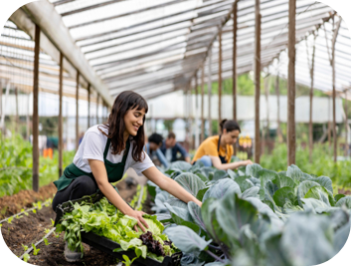
Importance of Sustainability
Sustainable practices help make sure we have the resources we need; like clean water, healthy soil and energy, for a long time. This way, future generations like our children, grandchildren and beyond—can also enjoy these resources.
Sustainable farming is a way of growing food that takes care of the Earth. It uses less water, keeps the soil healthy and saves energy. By farming this way, we can continue to grow enough food without harming the planet and wildlife.

Slide 5
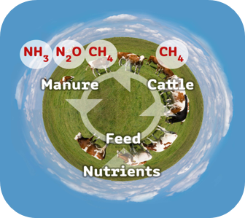
Food and Green House Gases
Food has a big effect on the environment. Globally, food production is responsible for about a third of all greenhouse gas emissions. Here, in the UK, food and drinks are responsible for 17% of the greenhouse gases we produce, which warm up the planet.
To help fix this, experts say we need to make changes to how we eat, like wasting less food and choosing better diets.
A recent study in Europe found that eating more sustainable foods can help in many ways. It can cut down on greenhouse gases, save land, lower our carbon footprint and even make us healthier.
Shaping Our Health - Chief Medical Officer for Wales Annual Report 2023 (gov.wales)

Slide 6
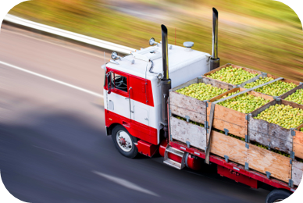
Food and Air Miles
Much of the foods we eat travel long distances to reach our plates. This distance is called "food miles." The further food must travel, the more fuel is used to transport it.
When food is transported, it often requires trucks, ships or planes, which burn fuel and release greenhouse gases. These gases contribute to climate change by trapping heat in the atmosphere.
By buying food that is grown locally and in season, we can reduce food miles. This means less fuel is needed, which helps lower greenhouse gas emissions.
Plus, buying local food supports nearby farmers and helps our community.

Slide 7
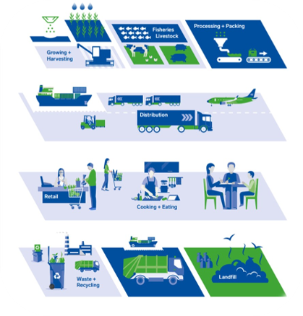
Packaging
Many snack items, like crisps or sweets, come individually wrapped. These wrappers are convenient but create a lot of waste.
Most of this waste ends up in landfills, where it just sits and doesn’t break down easily. Some of it even ends up in our oceans, where it can harm animals and pollute the water.
For example, a single-use plastic snack wrapper can take hundreds of years to decompose. That means it will be around for a very long time, even after we’re done with it. Making choices that use less plastic can help protect our planet and keep it clean for everyone.

Slide 8
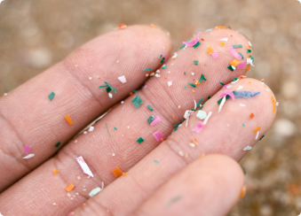
Microplastics
Food packaging can contain metals and plastics which can take many years to decompose.
Rather than decomposing, plastic turns into “microplastics” which continue to pollute the environment, our food and drinking water.
Microplastics are tiny fragments of plastic smaller than 0.5 cm. These plastics break down slowly but do not decompose fully.
Overtime microplastics become small enough to be accidentally consumed by living things. They 'bioconcentrate' in food chains because they cannot be excreted. The effects of this build-up are not fully yet understood*.
*Bioaccumulation - KS3 Biology - BBC Bitesize

Slide 9
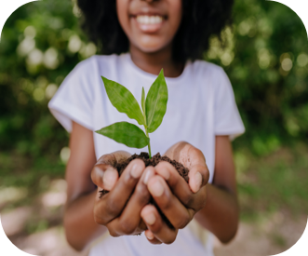
Food Chains
Pollution and waste can seriously disrupt natural food chains. When harmful chemicals or plastics enter the environment, they can affect the plants and animals that make up these food chains. For example, if small fish eat plastic, larger fish that eat them can also be harmed. This can upset the balance of the entire ecosystem.
Healthy ecosystems are essential for growing nutritious food. In a balanced ecosystem, plants get the nutrients they need from the soil, and animals help pollinate crops and control pests. When food chains are disrupted, it can lead to weaker ecosystems that struggle to support the growth of healthy food.
Protecting food chains helps maintain biodiversity, which means having a wide variety of plants and animals. Biodiversity is important because it makes ecosystems stronger and more resilient. When we protect food chains, we ensure that all living things, including humans, can thrive together.

Slide 10
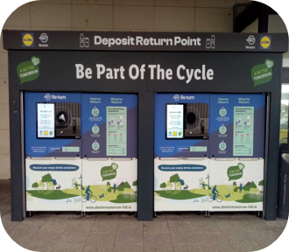
Recycling
Not all food packages can be recycled at home. For example, crisp packets can’t go in your regular recycling bin.
This is because these packages are often made from special materials that are tricky to recycle with regular home recycling systems.
Many supermarkets have special bins for these items. So, when you see one, you can drop your crisp packets or snack wrappers there.
You can also help by choosing foods with packaging that is easier to recycle. This helps make sure more of the packaging gets recycled and doesn’t end up in a landfill, which is a big pile where rubbish goes. By doing this, you’re helping to take care of our planet!

Slide 11
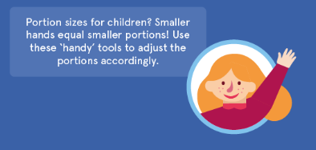
Food Waste
When we serve too much food on our plates, a lot of it can end up being wasted. It’s important to serve just the right amount of food for each person. This helps make sure we don’t throw away food that could still be enjoyed.
When food gets thrown away, it often ends up in a landfill. As the food breaks down, it produces a gas called methane. Methane is a strong greenhouse gas that can make the Earth warmer, which isn’t good for our planet.
To help reduce waste, try serving smaller portions and saving any leftovers for later. You can also plan your meals ahead of time, so you know exactly what and how much to cook. This way, you can enjoy all your food and help keep our planet healthy!
Check out this video for more information: https://www.bbc.co.uk/bitesize/topics/zjr8mp3/articles/zyjytrd#zx3y9ty
Check out this handy infographic on how to measure portions sizes with your hands: How to Measure Portion Sizes with your Hands (Infographic) | Eufic

Slide 12
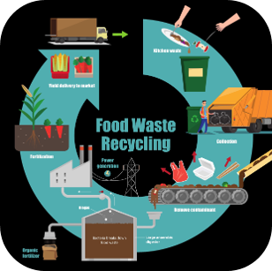
Take Action
Choose Foods with Less Packaging
Pick foods with little or no wrapping to cut down on rubbish and make recycling easier.
Recycle Properly and Reduce Single-Use Plastics
Put recyclables in the right bins and use reusable items like bags and bottles instead of single-use plastics.
Buy Local and Seasonal Produce
Choose fruits and vegetables grown nearby and in season to help the environment and support local farmers.
Tips to Reduce Food Waste
To make sure you don’t waste food, try serving smaller portions and saving leftovers for later meals. You can also plan your meals ahead of time, so you only buy what you need. Remember to store food properly so it stays fresh longer and use up any food before it goes bad. This way, you can enjoy all your food and help the environment at the same time!

Slide 13
How a Healthy Balanced Diet Aligns with a Sustainable Diet
Healthier Diets | Sustainable Diets
Eat more fruit and vegetables. Choose / eat more wholegrains. Eat more legumes (beans / pulses). Reduce red and processed meat consumption. Moderate dairy consumption. Eat two portions of fish a week, one of which one should be oily. Eat less high fat, sugar and salt products. Appropriate portion sizes. | Plant based Reduce consumption of animal products; Less meat. Less dairy. Eat more fruit, veg and legumes. Choose foods in season. Choose local. Choose sustainable fish. Reduce overconsumption; food production, waste packaging.

Slide 14
Further Information
The EAT-Lancet Commission on Food, Planet, Health - EAT Knowledge (eatforum.org)​
Livewell - choosing sustainable diets | WWF​
Sustainable healthy diets (fao.org) WHO Sustainable Healthy Diets Guiding Principles.​
The path to Net Zero and progress on reducing emissions in Wales - Climate Change Committee (theccc.org.uk)​
One Blue Dot - the BDA's Environmentally Sustainable Diet Project | British Dietetic Association (BDA)​
Eatwell Guide (gov.wales)​

Slide 15
Thank You For Listening

