Slide 1
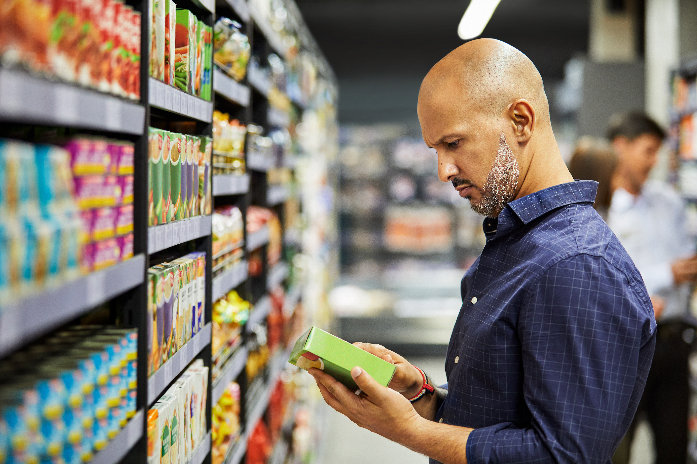
This or that?
Food and Nutrition

Slide 2
These activities have been developed for use with both primary and secondary aged learners. They should be used
flexibly and can be adapted to meet the identified needs of your learners within the context of your school or setting.
This or that? Why do people eat what they eat, Where food come from, Food labels and The Laws and Regulations
Knowledge Banks
These activities explore considered decision making and critical thinking regarding food choices.
At the end of the activities are further possible learning suggestions.
Links to Statements of what matters
Health and Wellbeing: Developing physical health has lifelong benefits (health-promoting and health-harming behaviours)
Health and Wellbeing: Our decision-making impacts on the quality of our lives and the lives of others (making informed decisions)
Science and Technology: The world around us is full of living things which depend on each other for survival (an understanding of the factors which affect our health allows us to make informed decisions about our physical health)
Descriptions of learning (possible)
Progression step 1 I have developed an awareness that my decisions can affect me and others. | Progression step 2 I can recognise that my decisions can impact on me and others, both now and in the future. | Progression step 3 I can recognise that some decisions I make will have a long-term impact on my life and the lives of others. | Progression step 4 I can consider relevant factors and implications when making decisions individually and collectively. | Progression step 5 I can critically evaluate factors and implications, including risks, when making decisions individually and collectively.

Slide 3
Food and Nutrition Labels
Nutrition information labels can help you choose between products and keep a check on the amount of foods you're eating that are high in fat, salt and added sugars.
Pre-packed foods must have a nutrition information label on the back or side of the packaging. You can use nutrition information labels to help you eat a balanced diet.
We need information that can help support us to make better food choices that provide our bodies with the nutrients it needs to grow and stay healthy.
How can we use nutrition information labels to help us make a choice between two products or recipes?
Food labels - NHS

Slide 4
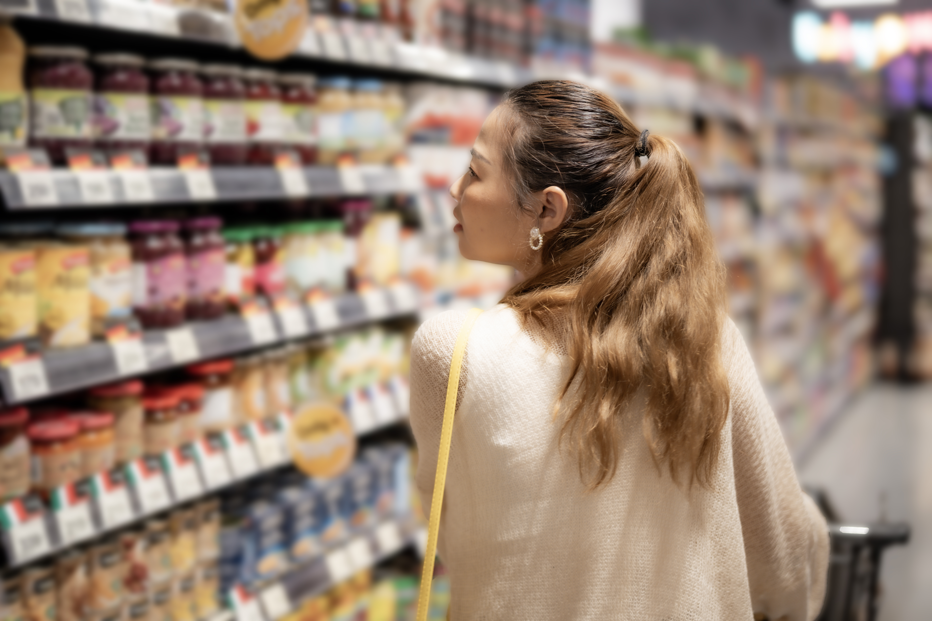
There are many other factors that also influence what we eat, including:
Your food skills such as budgeting, shopping, preparing and cooking
The food available around you and how much it costs
The food marketing and advertising you see
Habits – household/ family/ individual
Your culture
Your preferences, what you like and dislike
Food Allergies and intolerances
Check out the 'Why do people eat what they eat?' Knowledge bank for more information on this.
Food labels - NHS

Slide 5
This or That?
Discuss the two choices given on each slide.
Which option would you choose and why?
What does the packaging tell you about each option?
What factors would influence your decision to choose one over another?
Consider the following factors in your decision making:
size, packaging, labelling, appearance, brands, cost...
Use the hyperlinks on each slide if you would like to find out more information about each of the products

Slide 6
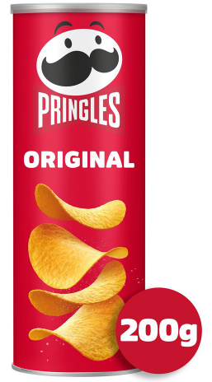
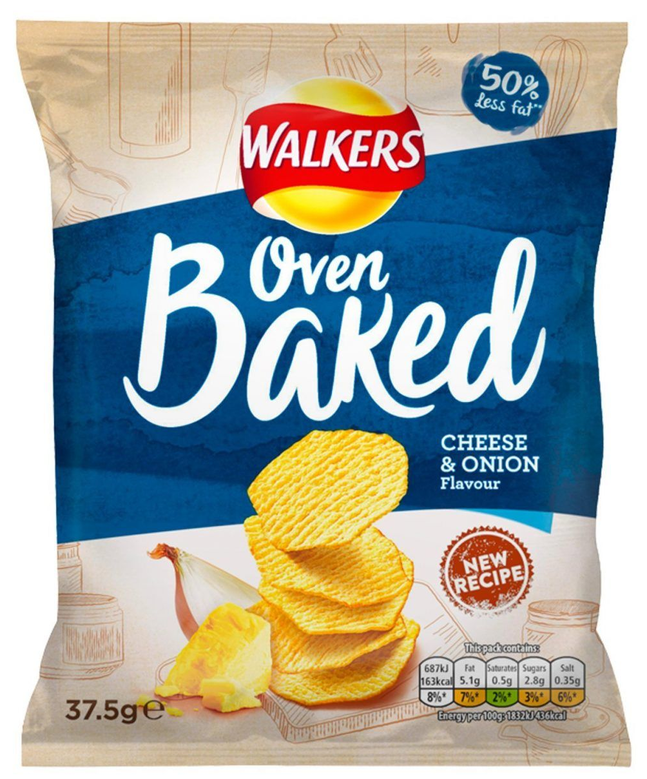
Discuss the Two Products:
Why would you choose one or the other?
Pringles Original Crisps 200G
Walkers Baked Cheese & Onion
Grab Bag Crisps 37.5g

Slide 7
What Choice Would You Make?
Why would you choose one or the other?
Does the size effect your choice?
Do you think one product is better for you than the other?
Does the labelling effect your choice?
What are the pros and cons to making a choice based on how a
product looks?
Notes:
1. why: Making a choice about which products we choose can be down to a lot of different reasons as discussed in slide three. Why did you make the choice you did?
2. Size, the pringles are a larger/ sharing size compared to the individual packet of crisps. We can be inclined to purchase larger products due to factors such as cost and maybe that it will last longer. But sometimes when we do this we end up consuming larger portions which can have effects on our health.
3. Why do you think one is better for your than the other? On the smaller packet it makes claims of being 50% lower in fat, does this mean it's better for you? How else could we check this?
4. How does the branding of the product effect your choice? Are you more familiar with one brand than the other?

Slide 8
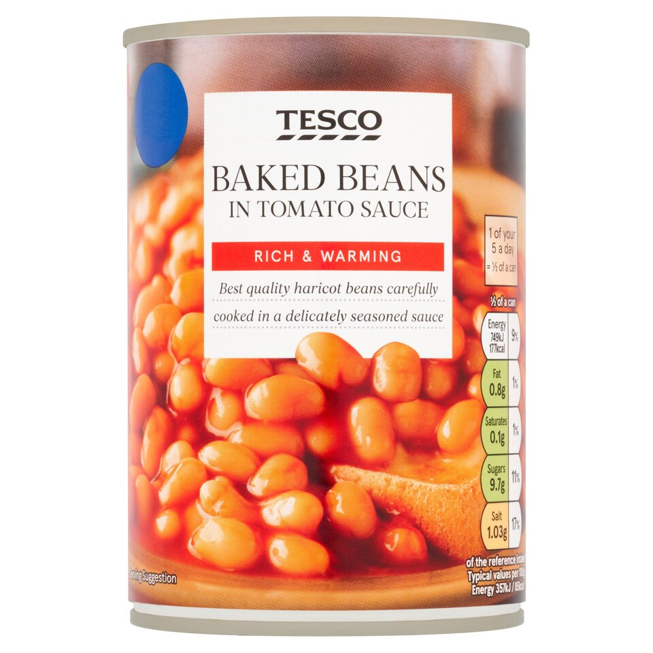
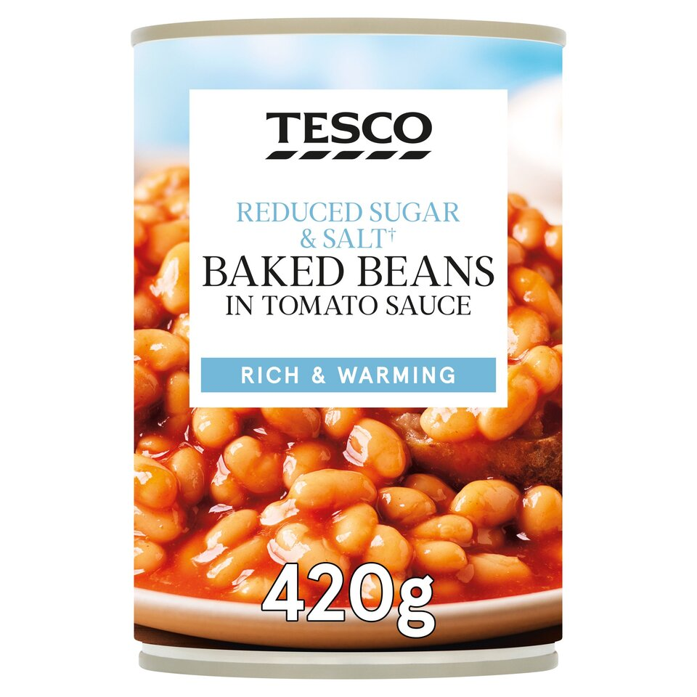
Discuss the Two Products:
Why would you choose one or the other?
Baked beans Baked beans reduced salt/ sugar

Slide 9
What Differences Do You Notice?
What are the main differences in the products?
How much does the packaging effect your choice?
Which one would you think is a better choice?
Which would you choose and why?
Notes:
Packaging/ branding/ nutritional claims.
How much do the nutritional claims effect choice here?

Slide 10
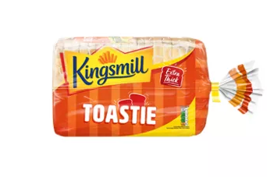
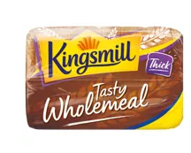
Discuss the Products:
Kingsmill Extra Thick Toastie Bread 800g
Kingsmill Tasty Wholemeal Medium Bread 800g

Slide 11
Which Would You Choose and Why?
Which do you think is a better choice?
Why do you think this?
Where would we find this information?
Notes:
Wholemeal high in fibre, keeps you fuller for longer, and has more vitamins and minerals than white.
White lower in fibre, but it is fortified in Calcium, Iron, Niacin (B3) and Thiamin (B1).

Slide 12
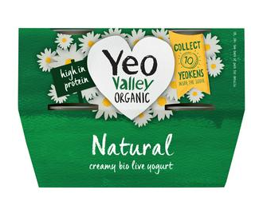
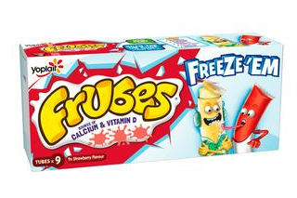
Discuss the Products:
Yeo Valley Organic Natural Yogurt 4x110g
Frubes Kids Strawberry Yoghurt Tubes 9x37g
Check out the 'nutrition claims' section in 'The Laws and Regulations' Knowledge Bank

Slide 13
Which Would You Choose and Why?
Who do you think these different yoghurts are marketed at?
Does the packaging make it easy to tell which is the healthier choice?
What do you think the main differences are between the two yoghurts?
Which yoghurt do you think contains more sugar?
Have you ever seen natural high-protein yoghurt sold in convenient lunchbox sized tubes?
Notes:
Natural is lower in sugar (no free sugars). Frubes higher in free sugars (twice as much), includes added flavourings but much more colourful, appealing packaging. Frubes promotes source of calcium and vitamin D however this is misleading as all yoghurts will be sources of calcium and vitamin D. The most important aspect is the amount of sugar in this product, which is disguised.

Slide 14
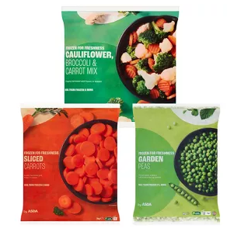
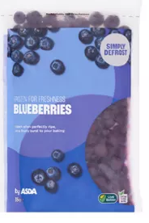
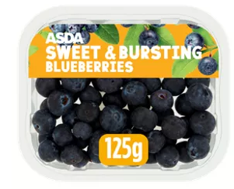
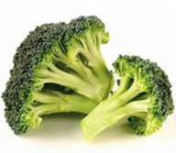
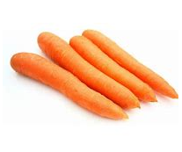
Discuss the Products: Frozen vs Fresh
Frozen
Fresh

Slide 15
What is the Difference?
Do you think one is better than the other?
What are the benefits of frozen fruit and vegetables?
What is the difference in cost?
Which one would you choose?
Check out the 'Where food comes from' Knowledge Bank for some tips
Notes:
Very similar nutritional value in both products.
Frozen fruit benefits: Lasts longer, reduces food waste, is available all year round.
Frozen fruit can be a lot cheaper.

Slide 16
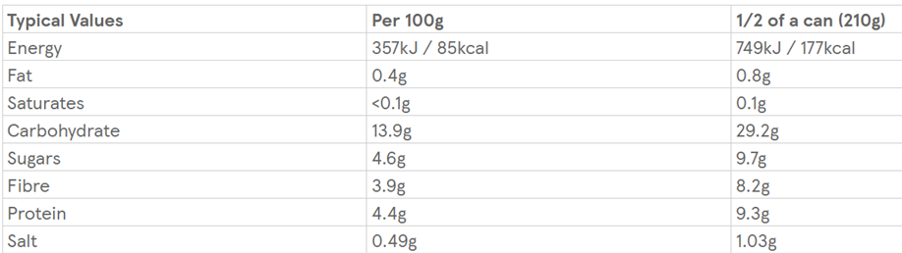
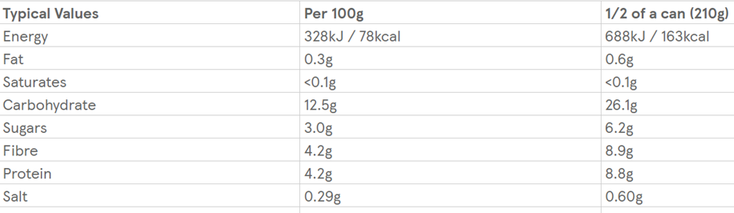
Food Labels
These are 2 labels from similar products, which is better?
Option 1:
Option 2:

Slide 17
Food Labels
What did you notice about the two food labels?
Which one do you think could be a better choice?
Why is this?
Notes:
Reduced fat, sugar and salt.
Please note that in option 2 there is an increase in fiber which is a positive when making choices.

Slide 18
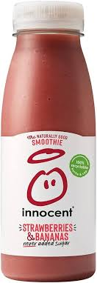
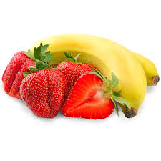
Smoothie or Whole Fruit?

Slide 19
Smoothie Vs Whole Fruit
Which one of these products would do you think is a better choice?
Why is this?
Which one has more sugar?
Which product do you think has more fibre?
How many of your 5 a day does the smoothie contain?
Notes:
The smoothie contains higher amounts of free sugars and the whole fruit contains higher portions of fibre.
Smoothie only counts as one portion per day max. A portion is 150ml - bottles are usually more than this. Same applies to veg smoothie

Slide 20
Further possible learning suggestions:
Ready meal vs home-cooked
Provide learners with ready meal labels (Can be found on supermarket websites) and task them with finding a homemade version of the same ready meals (BBC Good Food provides the nutritional values).
How do the nutritional values change?
How could this be better or worse for your health?
Does it effect the cost? And why?
Why might people choose the ready meal or the homemade version?
Example: Tomato Soup
Baxters Favourites, Cream Of Tomato Soup 400g | Sainsbury's https://www.bbcgoodfood.com/recipes/tomato-soup

Slide 21
Thank You For Listening

