Slide 1
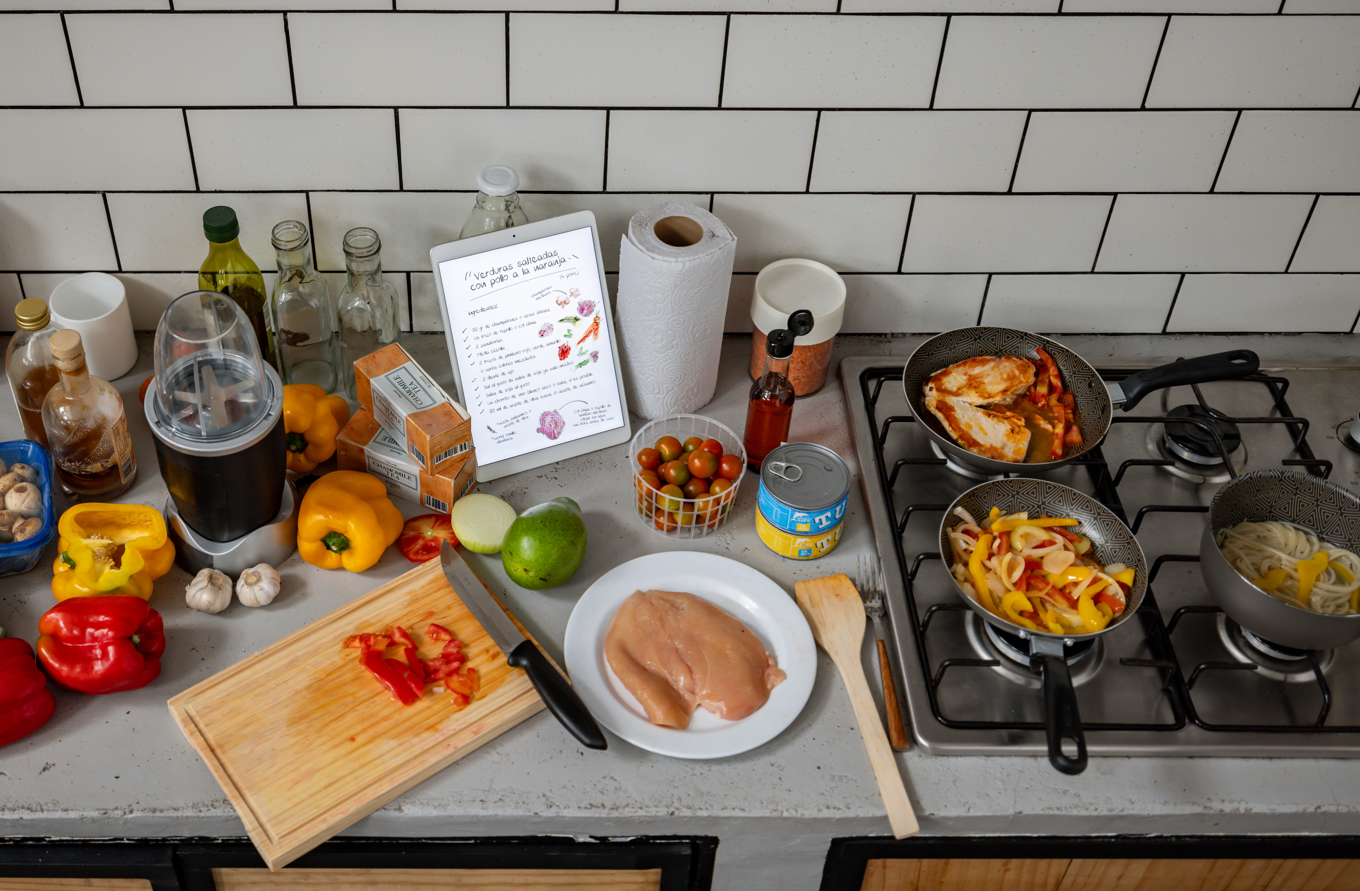
Recipes
Food and Nutrition

Slide 2
These activities have been developed for use with both primary and secondary aged learners. They should be used
flexibly and can be adapted to meet the identified needs of your learners within the context of your school or setting.
Recipes: What is a healthy balanced diet? Knowledge Bank
These activities explore considered decision making and critical thinking relating to food preparation and food choices.
At the end of the activities are further possible learning suggestions.
Links to Statements of what matters
Health and Wellbeing: Developing physical health has lifelong benefits (health-promoting and health-harming behaviours)
Health and Wellbeing: Our decision-making impacts on the quality of our lives and the lives of others (making informed
decisions)
Science and Technology: The world around us is full of living things which depend on each other for survival (an understanding of the factors which affect our health allows us to make informed decisions about our physical health)
Descriptions of learning (possible)
Progression step 1 I am beginning to make connections between my diet and my physical health and well-being. | Progression step 2 I have developed an understanding that I need a balanced diet and I can make informed choices about the food I eat and prepare to support my physical health and well-being. | Progression step 3 I can explain the importance of a balanced diet and nutrition and the impact my choices have on my physical health and well-being. I can plan and prepare basic, nutritious meals. | Progression step 4 I can apply my knowledge and understanding of a balanced diet and nutrition to make choices which will allow me to maintain my physical health and well-being. I can plan and prepare a variety of nutritious meals. | Progression step 5 I can adjust my diet in response to different contexts and apply my knowledge and understanding of a balanced diet and nutrition to support others. I can apply a range of techniques to prepare a variety of nutritious meals.

Slide 3
Compare and Contrast Recipes
Food skills, including planning, budgeting, shopping, preparing and cooking are important so that we can include food as a healthy, positive and fun part of life.
The food available around us and how much it costs can make it harder or easier to maintain a balanced diet because it influences what food and drink we can access and the choices we make.
Discuss the home-made recipes and shop-bought processed options on each slide.
Which one would you choose and why?

Slide 4

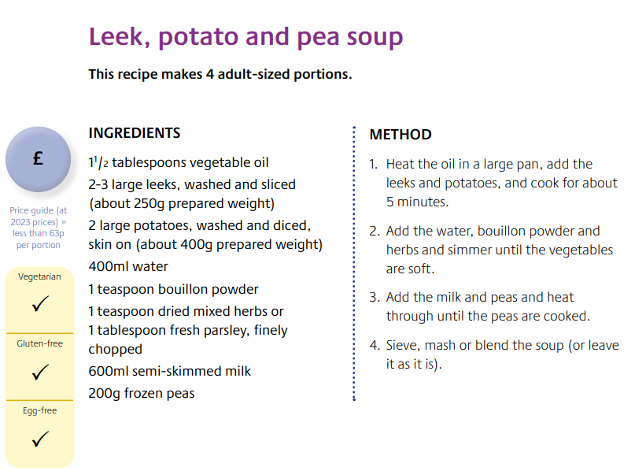
£1.70
(42.5p/100g)
Cooking Guidelines:
Hob - From Ambient: HOB: Heat gently in a pan.
Microwave - From Ambient 850W: Use a covered microwaveable bowl. Heat for 2 minutes, stir. Heat for a further 1 minute.
Ingredients
Water, Potatoes (23%), Leeks (8%), Onions (7%), Whipping Cream (Milk), Modified Cornflour, Cornflour, Salt, Black Pepper
Allergy Information:
Contains milk
Heinz Potato & Leek Soup - ASDA Groceries
FSN Eating well recipe book_Oct 2023_DIGITAL.pdf

Slide 5

Cost?
Taste?
What Influenced Your Choice?
Time?

Slide 6
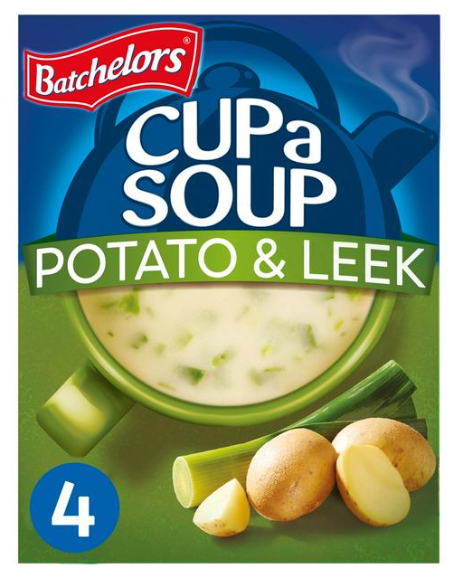
£1.60
(1.50/100g)
Cooking Guidelines:
1 Empty a sachet into a cup 2 Add 230ml of boiling water 3 Stir well, wait a few moments
Ingredients
Water, Potato (20%), Leek (10%), Glucose Syrup, Palm Oil, Salt, Lactose (Milk), Yeast Extract (contains Barley), Flavour Enhancers (Monosodium Glutamate, Disodium 5'-Ribonucleotides), Milk Proteins, Emulsifiers (Citric Acid Esters of Mono- and Diglycerides of Fatty Acids, Mono- and Diglycerides of Fatty Acids), Flavourings (contain Milk)
Allergy Information:
Contains milk and barley
Batchelors Cup a Soup, Potato & Leek x4 107g | Sainsbury's (sainsburys.co.uk)
FSN Eating well recipe book_Oct 2023_DIGITAL.pdf

Slide 7
Convenience?
How Do the Following Influence Us?
Ingredients?
Cooking appliance?

Slide 8
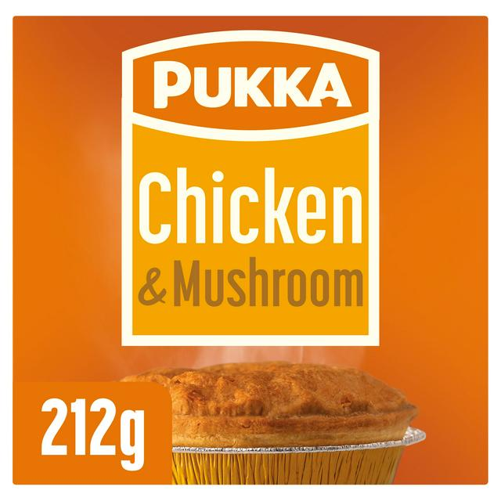
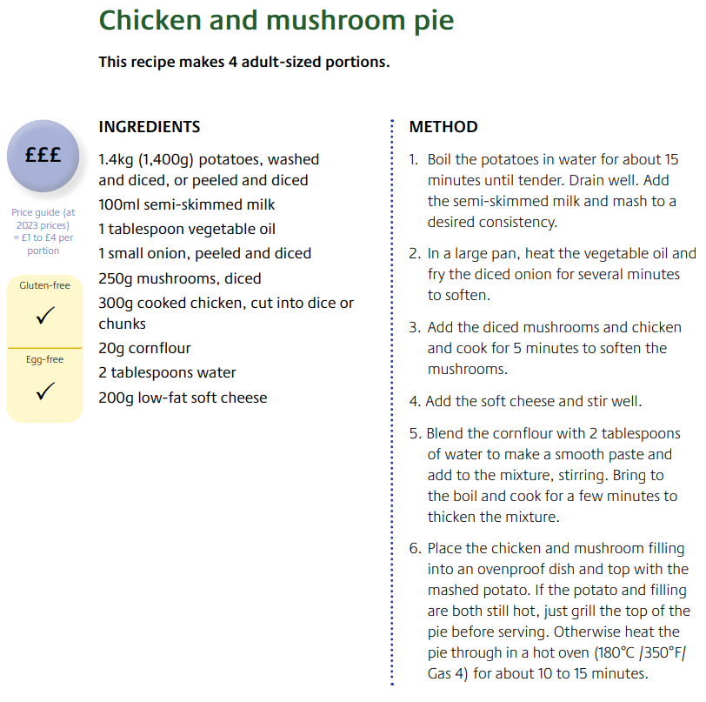
£2.00
94p / 100g
Oven cook: From Frozen
In a pre-heated fan assisted/gas oven: Heat for 50 minutes at 180°C/gas mark 6. From Chilled: In a pre-heated fan assisted/gas oven: Heat for 25-30 minutes at 190°C/gas mark 6 1/2.
Whilst due care is taken in the preparation of this product, it may contain chicken bones.
Ingredients
Water, Wheat Flour (contains: Wheat Flour, Calcium Carbonate, Iron, Niacin, Thiamine), Margarine (contains: Palm & Rapeseed Fats & Oils, Water, Salt),
Chicken (18%) (contains: Chicken, Modified Maize Starch, Salt), Mushrooms (5%), Modified Maize Starch, Chicken Stock, Double Cream (contains: Milk), Salt, Flavour Enhancer: Monosodium Glutamate, Onion Powder, White Pepper, Butter (Milk), Wheat Protein
Allergy Information:
Contains milk. May also contain (traces of): Barley, Soya.
Pukka Pies Chicken & Mushroom Pie 212g | Sainsbury's (sainsburys.co.uk)
FSN Eating well recipe book_Oct 2023_DIGITAL.pdf

Slide 9
Skill?
Cost?
How Do the Following Influence Us?
Time?

Slide 10
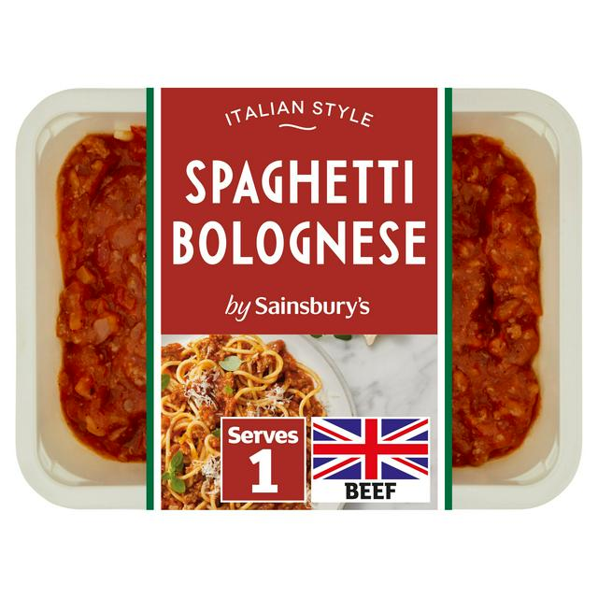
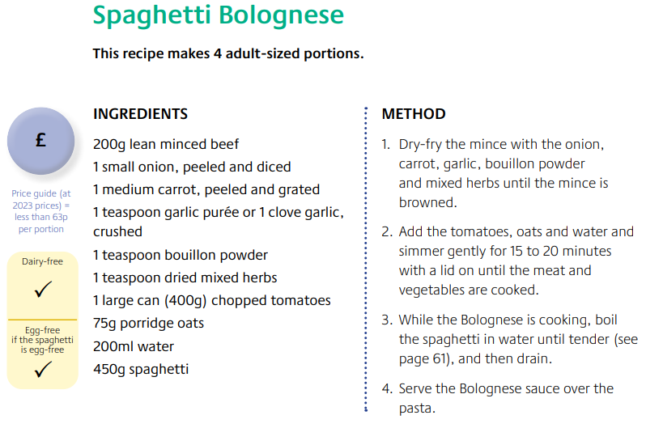
£3.30
£8.25 / kg
Instructions: Oven cook from chilled: 190°C / Fan 170°C / Gas 5. 30 mins. From frozen: 190°C / Fan 170°C / Gas 5. 50 mins.
Microwave full power from chilled: 800w 4m 30s / 900w 4 mins. From Frozen: 800w 7m 30s / 900w 7 mins
Stir thoroughly before serving. Check food is piping hot.
Ingredients
Cooked Spaghetti Pasta (Water, Durum Wheat Semolina), British Beef (20%), Tomato, Water, Onion, Mushroom, Red Wine (3%), Tomato Purée, Carrot, Cornflour, Garlic Purée, Sugar, Beef Stock (Water, Beef Extract, Salt, Yeast Extract), Salt, Rapeseed Oil, Oregano, Black Pepper, Rosemary
Allergy Information:
Contains wheat.
Sainsbury's Spaghetti Bolognese Ready Meal For 1 400g | Sainsbury's (sainsburys.co.uk)
FSN Eating well recipe book_Oct 2023_DIGITAL.pdf

Slide 11
Cost?
Convenience?
How Do the Following Influence Us?
Ingredients?

Slide 12
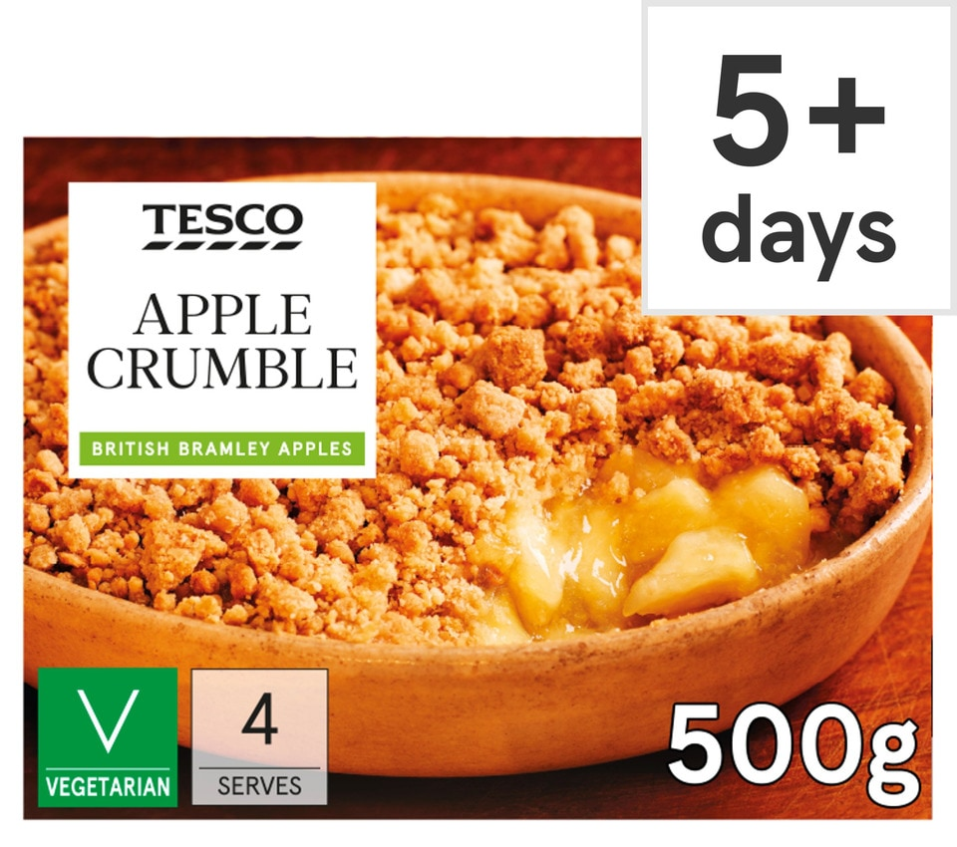
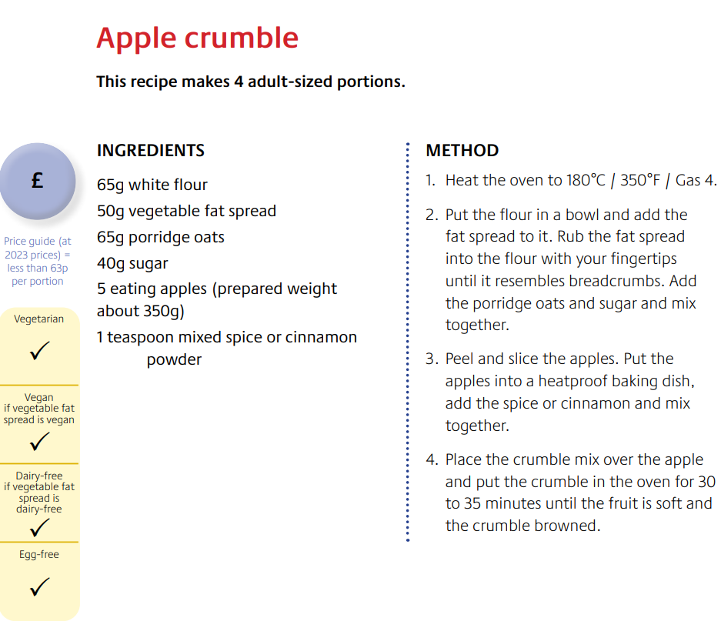
£3.90
£0.78/100g
Instructions: 190°C/Fan 170°C/Gas 5 20 mins Remove outer packaging. Place on a baking tray in the centre of a pre-heated oven. Leave to stand for 5 minutes after heating
Ingredients
Bramley Apple (35%), Wheat Flour [Wheat Flour, Calcium Carbonate, Iron, Niacin, Thiamin], Apple Purée (14%), Sugar, Butter (Milk) (4%), Water, Oats, Palm Oil, Cornflour, Rapeseed Oil, Light Brown Soft Sugar, Invert Sugar Syrup, Honey, Pasteurised Egg White, Salt, Raising Agent (Sodium Bicarbonate).
Allergy Information:
May contain peanuts and nuts. For allergens, including cereals containing gluten, see ingredients in bold.
Tesco Apple Crumble 500G - Tesco Groceries
FSN Eating well recipe book_Oct 2023_DIGITAL.pdf

Slide 13
Allergies?
Family Time?
How Do the Following Influence Us?
Fun to Make?

Slide 14
Healthy Recipes
You can find many recipes and food preparation ideas online. Here are a few websites where you can find healthy recipes or look for ideas for lunches and snacks:
Recipes - Healthier Families - NHS (www.nhs.uk)
https://www.bhf.org.uk/informationsupport/support/healthy-living/healthy-eating/recipe-finder
https://www.firststepsnutrition.org/reports-gallery-1/vtn8vy3cjvpjn8fap1dz3we9u5uny1
https://www.bda.uk.com/food-health/lets-get-cooking/recipes/all-recipes.html

Slide 15
Further possible learning suggestions
Recipe Modification Challenge
Divide learners into small groups and give them a common recipe (for example chocolate chip cookies or pizza etc). Ask them to modify the recipe to make it healthier, more sustainable or more suitable for a specific dietary need (for example gluten-free, vegan, low-sodium).
Examples:
Healthy Pizza: Swap white flour for whole wheat or cauliflower crust, use less cheese, add more vegetables.
Vegan Cookies: Replace eggs with flax seeds or applesauce, use coconut oil instead of butter and add in nuts or seeds.
Discussion: Have each group present their modified recipe and discuss the benefits of their changes (for example reducing calories, increasing fibre, or making it more inclusive for dietary restrictions).
Discuss access to kitchen facilities – present a scenario with limited appliances for example no oven and ask the learners to create a recipe.

Slide 16
Thank You For Listening

