Slide 1
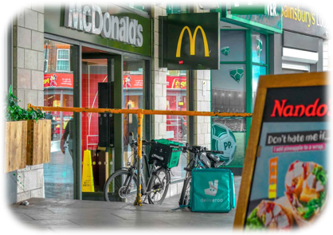
How Are We Influenced?
Food and Nutrition

Slide 2
These activities have been developed for use with both primary and secondary aged learners. They should be used flexibly and can be adapted to meet the identified needs of your learners within the context of your school or setting.
How are we influenced? Industry, Marketing and Advertising Knowledge Bank
These activities explore the factors that influence our decision making when choosing which food and drink to buy.
At the end of the activities are further possible learning suggestions.
Links to Statements of what matters
Health and Wellbeing: Developing physical health has lifelong benefits (health-promoting and health-harming behaviours)
Health and Wellbeing: Our decision-making impacts on the quality of our lives and the lives of others (making informed decisions)
Languages, Literacy and Communication: Expressing ourselves through languages is key to communication (use and adapt languages in a range of roles)
Science and Technology: The world around us is full of living things which depend on each other for survival (an understanding of the factors which affect our health allows us to make informed decisions about our physical health)
Descriptions of learning (possible)
Progression step 1 I have developed an awareness that my decisions can affect me and others. | Progression step 2 I can recognise that my decisions can impact on me and others, both now and in the future. | Progression step 3 I can recognise that some decisions I make will have a long-term impact on my life and the lives of others. | Progression step 4 I can consider relevant factors and implications when making decisions individually and collectively. | Progression step 5 I can critically evaluate factors and implications, including risks, when making decisions individually and collectively.

Slide 3

The Definition of Influence:
'The capacity to have an effect on the character, development or behaviour of someone or something, or the effect itself'.
Just about anything can influence your decision-making, behaviour and values but the more we are exposed to something, the more normal it can seem. For example, you may be influenced to wear certain types of clothes, drink certain drinks or eat certain foods.
Consider how you are influenced by your friends, family, social media, music, reels and adverts.
What influences you?

Slide 4
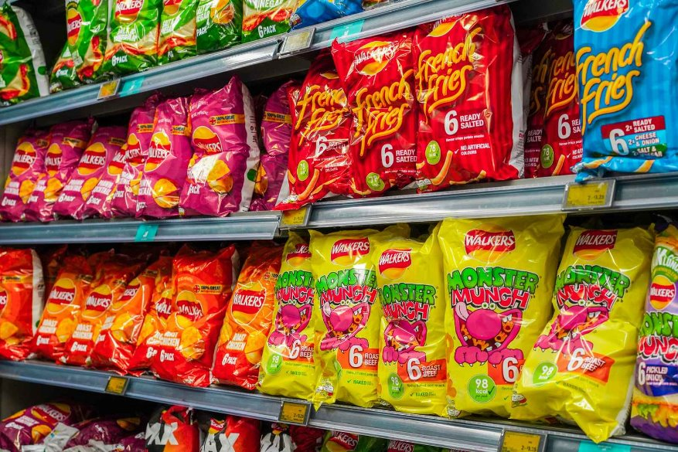
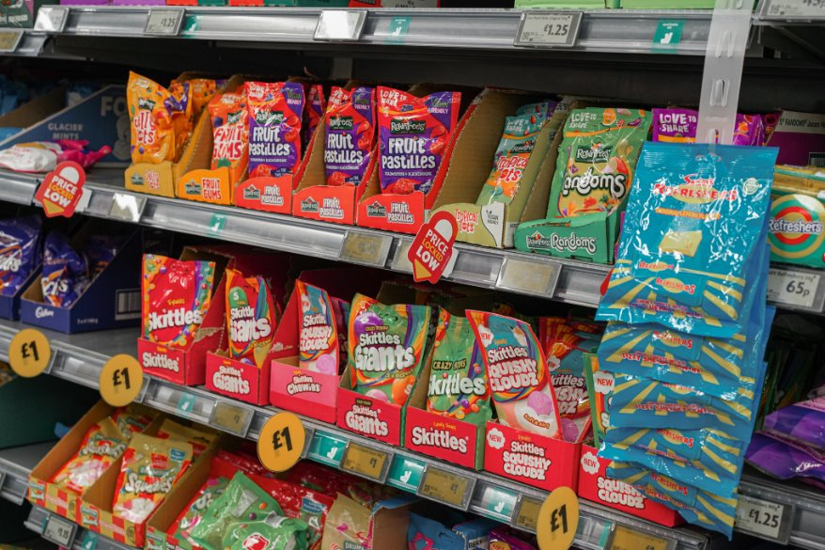
Discuss What You See in These Images

Slide 5
The foods in the image are classed as Ultra Processed Foods or UPFs.
Ultra Processed Foods are defined as those with 5 or more ingredients and tend to go through lots of different processes taking it away from its original form (e.g. potatoes).
These foods are often heavily marketed and are high in fat, sugar and salt.

Slide 6

Companies who produce these UPFs want to persuade you to buy their products.
How do you think they do this?
Why do you think they want us to buy it?

Slide 7
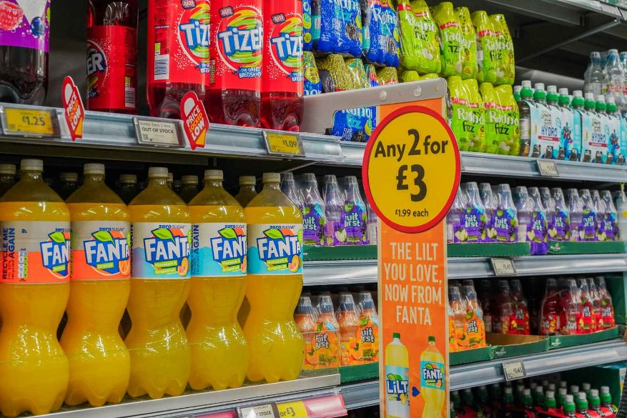
How are Ultra Processed Food and drinks displayed in shops?
Why do you think bright colours, large text and branded logos are used?
Why do you think special offers or discounts are advertised?
Notes:
How are Ultra Processed Food and drinks displayed in shops?
Why do you think bright colours, large text and branded logos are used?
Why do you think special offers or discounts are advertised?

Slide 8
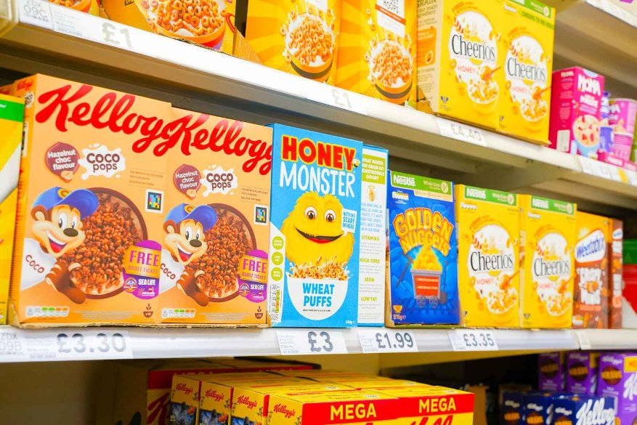
Why do you think some food and drink products use 'cartoon' or 'animal' logos
such as these?
Who are these products being marketed to?
Does the brand or logo affect your decision making when choosing a product? Why?
GSTTF asset library (canto.global)
Notes:
Why do you think some food and drink products use 'cartoon' or 'animal' logos such as these?
Who are these products being marketed to?
Does the brand or logo affect your decision making when choosing a product? Why?

Slide 9
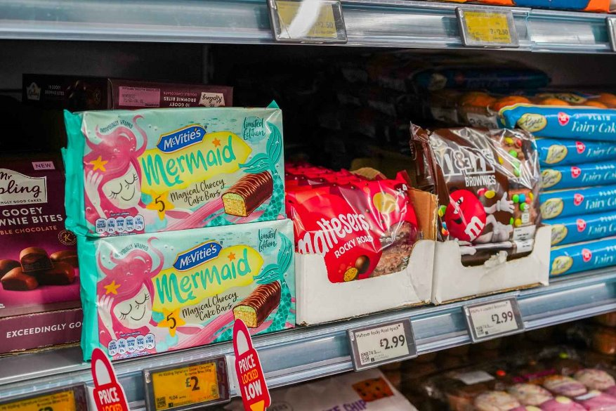
Why do you think McVities have branded these as 'Mermaid Magical Choccy Cake Bars'?
Why do you think McVities have included 'limited edition' on the packaging?
How might this packaging and image influence young children?
Notes:
Why do you think McVities have branded these as 'Mermaid Magical Choccy Cake Bars'?
Why do you think McVities have included 'limited edition' on the packaging?
How might this packaging and image influence young children?

Slide 10
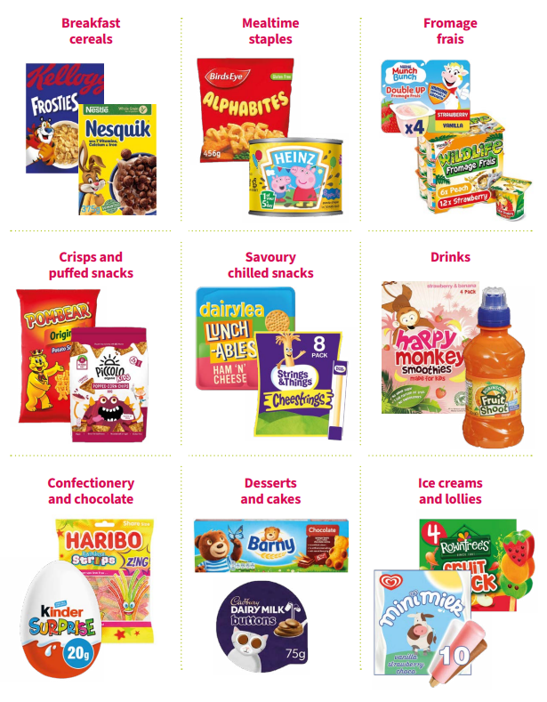
This image shows examples of Ultra Processed Foods marketed for
children here in the UK.
What tactics do these companies use to make their products appealing to small children?
How many of these have you tried?
Do you know what ingredients are in any of these products?
FSN_UPF+Report_Digital+for+web,+June+2023.pdf
(squarespace.com)
Notes:
This image shows examples of Ultra Processed Foods marketed for pre-school children here in the UK.
What tactics do these companies use to make their products appealing to small children?
How many of these have you tried?
Do you know what ingredients are in any of these products?
Do you know what ingredients are in any of these products?

Slide 11
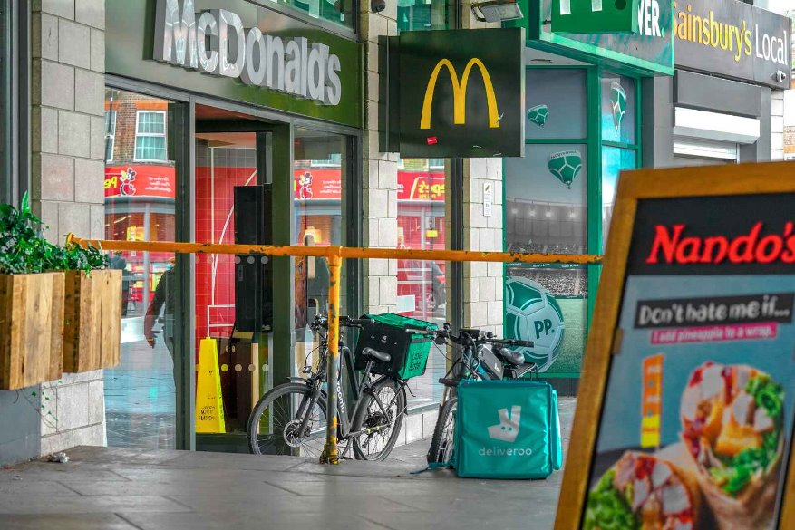
Which brands and logos do you recognise in this image?
Why do you think people choose to eat 'fast food' such as McDonalds?
What advertising and marketing tactics do companies like Nandos and McDonalds use to ensure people continue to buy their food and drink products?
Notes:
Which brands and logos do you recognise in this image?
What advertising and marketing tactics do companies like Nandos and McDonalds use to ensure people continue to buy their food and drink products?
Why do you think people choose to eat 'fast food' such as McDonalds?
Why do you think people choose to eat 'fast food' such as McDonalds?

Slide 12
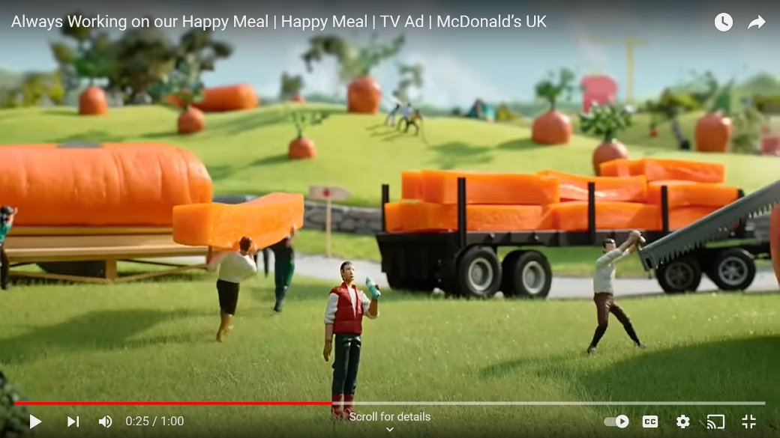
Watch the following clip and discuss the tactics used to persuade children, young people and adults to buy and consume these products.
Why is it called a 'happy meal'?
Always Working on our Happy Meal | Happy Meal | TV Ad | McDonald’s UK - YouTube
Do all McDonalds ingredients come from farms as shown in the clip?
Why would McDonalds include story books in their happy meals?
The advert states fries can be swapped out for carrots and apples. Do you think many children choose this?

Slide 13
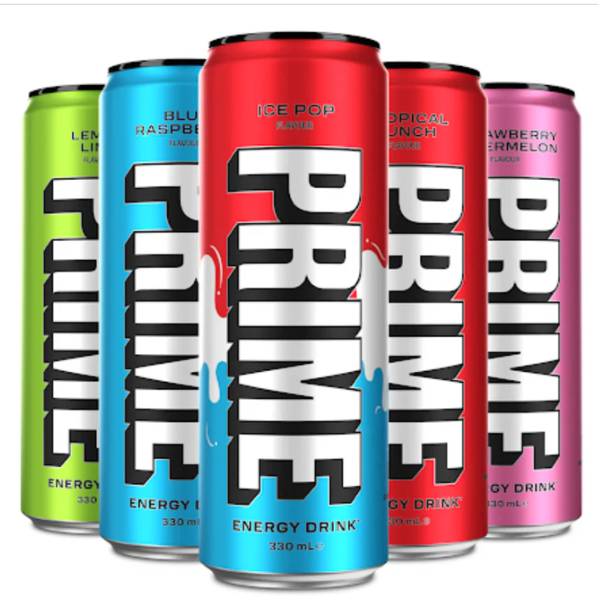
Prime energy drinks, a brand created by influencers Logan Paul and KSI, has seen remarkable success since its launch in early 2022. By the end of 2023, Prime was projected to reach £950 million in annual sales and had sold its one billionth bottle. The brand’s valuation has soared to at least £2.5 billion.
Why do you think this is?
What are the ingredients?
Is it suitable for children and young people?
PRIME By Logan Paul x KSI. (drinkprime.uk)
(FOODBEAST) (Techie + Gamers)
(Techie + Gamers) (Just Drinks)
Why did so many children and young people want to buy it?
Have you bought it?
How much did it cost?
Notes:
Why do you think is? Influencer - not always large companies due to its strategic marketing and partnerships with major sports teams and events .

Slide 14
Things to Consider:​
​
Be aware of who and what influences you​
Think critically about the source of information and their motivations​
Ask questions​
Build your own understanding by exploring the facts​
Make decisions based on your own beliefs and not those of others, even when influencers and ads try to sway you ​
Look at the ingredients and nutritional values, how many ingredients do you recognise?
Further possible learning suggestions
The Power of Advertising: Creating a Commercial
Learners research and analyse popular food advertisements. They create their own food commercials, using the persuasive techniques they’ve learned (for example, appealing to emotions, using celebrities, creating a sense of urgency). Compare their commercials to real ones and discuss which tactics could be effective and why.
Healthy Food Swap
Learners are tasked with swapping a popular junk food product with a healthier alternative and redesigning the packaging of the healthier product to make it just as appealing as the junk food version. Learners will think critically about who the less healthy products are marketed at and why and what the healthier alternatives are.

Slide 15
Thank You For Listening

