Slide 1

Data and Statistics
Food and Nutrition

Slide 2
These activities have been developed for use with both primary and secondary aged learners. They should be used
flexibly and can be adapted to meet the identified needs of your learners within the context of your school or setting.
Data and Statistics: What is a healthy balanced diet? Knowledge Bank
These activities provide data sources to promote discussion, questioning and critical thinking regarding food and nutrition.
At the end of the activities are further possible learning suggestions.
Links to Statements of what matters
Health and Wellbeing: Developing physical health has lifelong benefits (health-promoting and health-harming behaviours)
Health and Wellbeing: Our decision-making impacts on the quality of our lives and the lives of others (making informed
decisions)
Science and Technology: The world around us is full of living things which depend on each other for survival (an understanding of the factors which affect our health allows us to make informed decisions about our physical health)
Descriptions of learning (possible)
Progression step 1 I have developed an awareness that my decisions can affect me and others. | Progression step 2 I can recognise that my decisions can impact on me and others, both now and in the future. | Progression step 3 I can recognise that some decisions I make will have a long-term impact on my life and the lives of others. | Progression step 4 I can consider relevant factors and implications when making decisions individually and collectively. | Progression step 5 I can critically evaluate factors and implications, including risks, when making decisions individually and collectively.

Slide 3
Over the next couple of slides we will look at data and statistics around food and nutrition. See if you can predict the answer!
Data and Statistics
What are they? And what do we use them for?
Data refers to the facts, figures or information that can be collected, stored and analysed. On its own, data may not have much meaning, but when organised or processed it can provide us with insights and support decision making.
In health we can use data that is collected to predict trends and problem solve. This can help to improve services and plan health interventions.
Statistics are a way to summarise or describe the data we collect. For example, 'the average number of people who are a healthy weight' or 'the percentage of people who are vegetarian' are both statistics.
Statistics help us to understand and compare different sets of information.

Slide 4
For children aged 11-18, on average how many portions of fruit and vegetables do they consume?
2.7
4
2.7
How many 11–18-year-olds meet the national fibre recommendations?
10%
50%
70%

Slide 5
For children aged 11-18, on average how many portions of fruit and vegetables do they consume?
2.7
4
2.7
How many 11–18-year-olds meet the national fibre recommendations?
10%
50%
70%

Slide 6
How many children meet the recommended guidelines for free sugars (Sugar added to food and drink)?
3%
50%
10%
On average, do you think there has been an increase or decrease in sodium intake?
Increase
Decrease

Slide 7
How many children meet the recommended guidelines for free sugars (Sugar added to food and drink)?
3%
50%
10%
On average, do you think there has been an increase or decrease in sodium intake?
Increase
Decrease
Notes:
Over 90% of children consume over the recommended guidelines for free sugars. Meaning less that 10% meet the recommendation.
There has been an over all yearly reduction in sodium intake – in all age groups!

Slide 8
Where Do We Find This Information?
In the next slides we will look at more sources of data and statistics. Think about how these might influence decisions for the future.
By gaining data and forming statistics!
We know from studies such as the National Diet and Nutrition Survey that the majority of children and young people are not eating a healthy balanced diet. (National Diet and Nutrition Survey: results for years 1 to 9 | GOV.WALES)
Now that we have the data, we can make decisions based on the statistics. For example: Educating children on the importance of fruit and vegetables.

Slide 9

The School Health Research Network: SHRN
The Student Health and Wellbeing Survey in Wales also suggests children and young people are not eating a healthy balanced diet. (publichealthwales.shinyapps.io/SHRN_Dashboard/)
Less than half of school aged children say they eat at least one portion of fruit or vegetables per day
Less than half of secondary-aged learners eat breakfast every weekday
16% consume a sugary soft drink daily
- 4% consume an energy drink daily
What do you think of these statistics?

Slide 10
Fruit and Vegetables
SHRN Primary
As you can see, statistics can be formed by age group, gender and affluence.
How do you think these statistics may be used?
Year 3 learners were most likely to report eating fruit at least daily across the age groups
Year 5 and 6 learners were more likely to report eating vegetables daily than younger learners
Girls (40%) were more likely to eat one portion of vegetables a day than boys (34%)
Secondary aged learners from more affluent* families were more likely to eat one portion of vegetables (48%) than those from less affluent families (31%)
* SHRN use the ‘Family Affluence Scale’ to estimate young people’s social-economic status. This is a well-established measure used internationally.

Slide 11
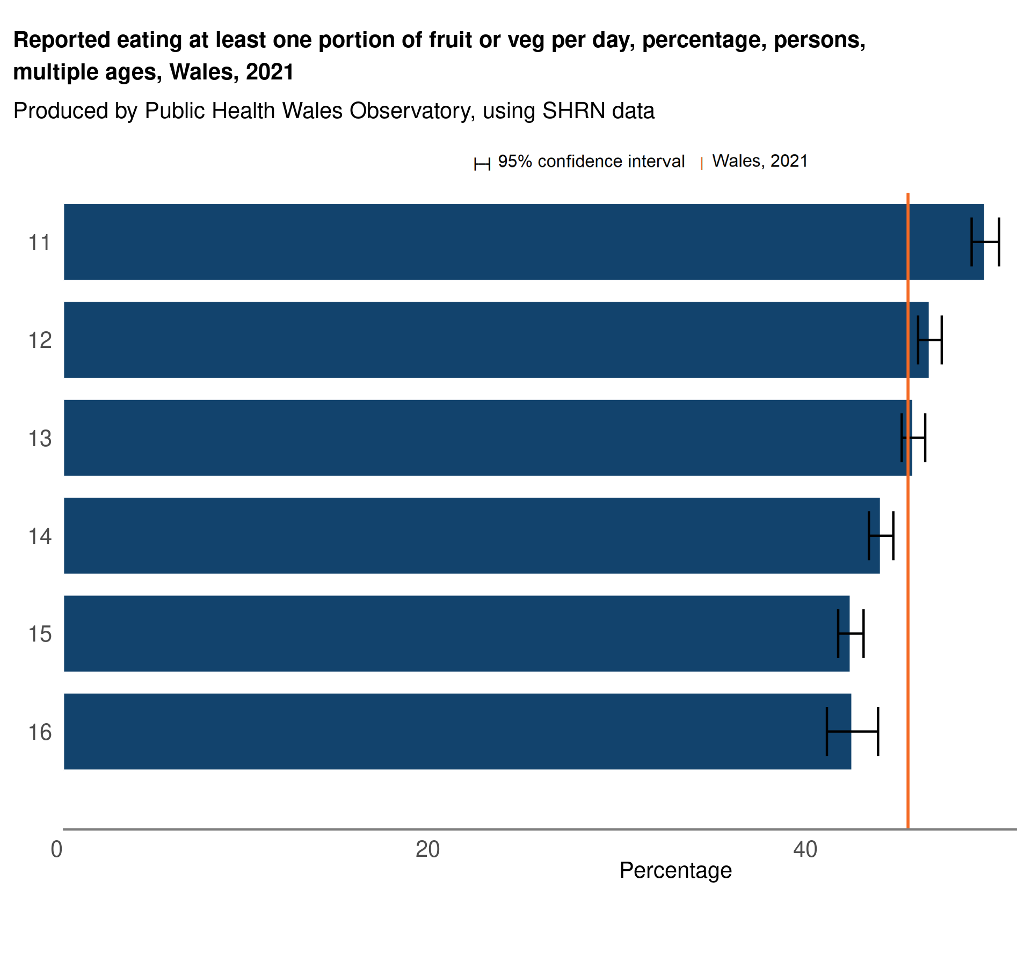
Fruit and Vegetables
SHRN Secondary
Less than half of secondary aged learners report eating at least one portion of fruit or vegetables per day (44.8%)
The proportion eating one portion of fruit or vegetables per day decreases with age, ranging from 49% of 11 year olds to 42% of 16 year olds
Girls (46%) were more likely to eat one portion of fruit or vegetables a day than boys (44%)
Secondary aged learners from more affluent* families were more likely to eat one portion of fruit or vegetables (51%) than those from less affluent families (38%)
Age
* SHRN use the ‘Family Affluence Scale’ to estimate young people’s social-economic status. This is a well-established measure used internationally.

Slide 12
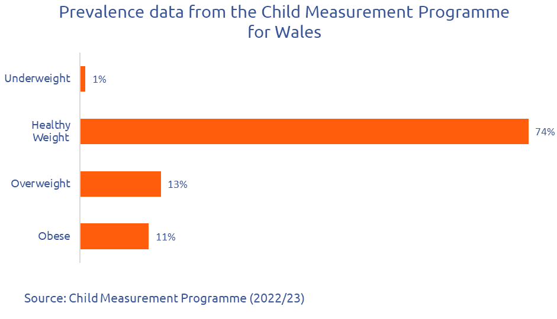
Data and statistics can also be gained by taking body measurements. What do you think the positives and negatives are of this?
Child Measurement Programme
In Wales, children aged 4-5 years old in reception class have their height and weight measured by school nurses. Here's what they found in 2022/23:
About three quarters (74.3%) of children have a healthy weight
13.4% of children were overweight
Over 1 in 10 children in reception class (11.4%) had obesity
The number of children with obesity in Wales was higher than in England and Scotland.

Slide 13
Child Measurement Programme
Child Measurement Programme
Why do you think resources and opportunities could affect someone's weight?
Children who live in areas with access to the most resources and opportunities were much less likely (19.7%) to have overweight or obesity compared to those living in areas with the fewest resources and opportunities (27.8%).*
This is a difference of over 8%
Similar patterns can be seen across all of the Health Board areas in Wales
* This is measured by the Welsh Index of Multiple Deprivation which combines information sources relating to people's living, working and education experiences.

Slide 14
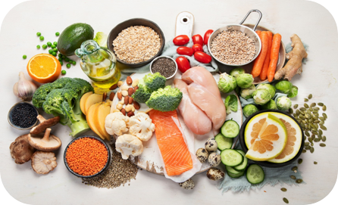
National Diet and Nutrition Survey (NDNS)
Young people aged 11 to 18 often don't get enough important vitamins and minerals like magnesium, potassium, selenium and zinc.
A lot of people in all age groups don't get enough folate, which can lead to anemia. About 6% of young people aged 11 to 18 have anemia.
Many young people aged 11 to 18 don't get enough vitamin B12.
A lot of people, including 23% of young people aged 11 to 18, don't get enough vitamin D.
Over half of girls aged 11 to 18 (56%) don't get enough iron and calcium.
Why is it important to get a wide range of vitamins and minerals in your body?

Slide 15

National Diet and Nutrition Survey (NDNS)
Over nine years, there hasn't been a lot of change in how much fruit, vegetables, oily fish or fibre children and young people eat.
Fewer young people are drinking sugary soft drinks now. In 9 years, the number of young people drinking these drinks has dropped significantly: 38% less for ages 4 to 10 and 42% less for ages 11 to 18.
Young people aged 11 to 18 are drinking fewer sugary soft drinks over time.
But everyone is still eating too much sugar, more than the recommended limit of 5% of their daily energy.
Intake of most vitamins and minerals has gone down for many age groups.
People are eating less red and processed meat over time.
Salt (sodium) intake has also decreased.
What do you think may have contributed to young people drinking fewer sugary soft drinks?

Slide 16
Further possible learning suggestions
School data analysis and action
Provide learners with relevant data on food and nutrition from their most recent SHRN survey report and any additional data produced by the school. Learners to analyse the data/report and develop an action plan to improve healthy eating habits across the school.
Identify – what does the report/data tell us?
Engage – who do we need to involve?
Plan – what are we going to do?
Action – how are we going to do it?
Review – what did we learn?

Slide 17
Key Sources of Data
School Health Research Network (SHRN) student Health and Well-being Surveys in Wales are undertaken every two years and provide a regular snapshot of children and young people in Wales' health behaviours.
An interactive data dashboard is available which shows patterns of food and drink consumption and other health behaviours relating to age, gender and family affluence at local authority, health board and All Wales level.
A national report is also available.
Schools can currently access their SHRN data via a bespoke school report sent directly to participating schools. A school-level interactive dashboard is currently in development and will be active February 2025.
The Child Measurement Programme for Wales measures the height and weight of children in Reception class. This data is reported to help us understand the proportion of children with a healthy weight relating to age and gender at local authority, health board and All Wales level.
The Welsh Government conducts a National Diet and Nutrition Survey that provides data on food and drink consumption National Diet and Nutrition Survey: results for years 1 to 9 | GOV.WALES
The Dental Epidemiological Inspection of school year one in Wales (2022/23) by Cardiff University provides a picture of oral health in Wales

Slide 18
Thank You For Listening

