Slide 1

Why Do People Vape?
Vaping

Slide 2
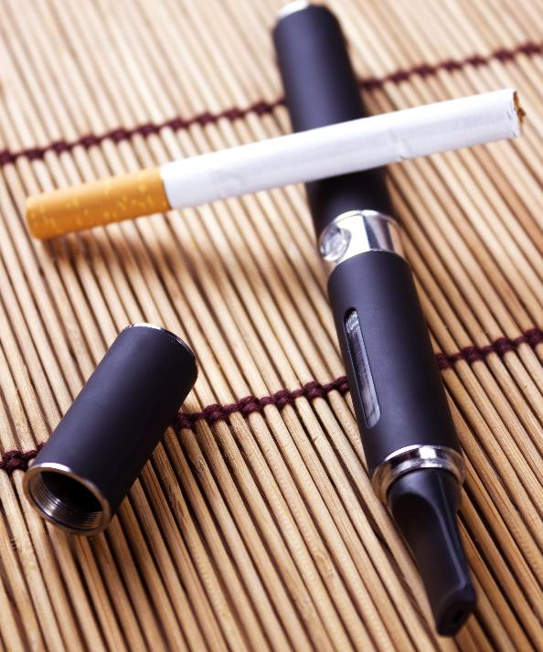
Vaping to quit smoking
Vaping devices should not be used by children and young people because vaping is not harmless, and we do not yet know the long-term health effects of vaping.
Vapes are often used by adult smokers to help them quit smoking cigarettes. Smokers who switch completely to vaping can reduce their risk of harm from smoking. This is because vaping is less harmful than smoking although it is not completely harmless.

Slide 3
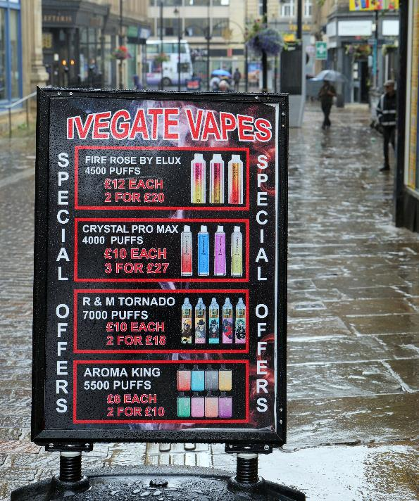
Perceptions about vaping
Vaping devices should not be used by non-smokers. Research exploring young people's motivations to vape identifies several possible factors:
Peer influence
Social image
Perceived lower health risks compared with cigarettes
To give it a try
Flavours
Perceived as being more discreet/socially acceptable than cigarette smoking (e.g. less smell associated with vaping)
Source: Information and Guidance on Vaping for Schools in Wales (nhs.wales)

Slide 4

Vaping to relieve stress/anxiety: Dispelling the myth
A common motivation young people give for vaping is to support mental health, reduce stress levels and address low self-esteem where vapes are used as a perceived coping mechanism.
However, it is a misconception that vaping reduces stress and anxiety. In fact, young people who vape for stress relief report having higher stress levels than young people who don't vape.
Nicotine creates an immediate sense of relaxation, but this feeling is temporary and quickly replaced by increased anxiety, tension, cravings and withdrawal symptoms.
Withdrawal symptoms can be temporarily managed by further doses of nicotine, but this will not reduce underlying feelings of anxiety or address why an individual feels anxious in the first place.
There is no benefit to using vaping as a coping mechanism for stress and anxiety and nicotine dependency may get in the way of you taking part in activities that are effective coping mechanisms (such as participating in clubs).

Slide 5
Vaping due to nicotine dependency or addiction
Vaping devices are designed to be used continuously. Often a single-use device can contain hundreds of puffs. This compares to a cigarette which usually takes 10-15 puffs.
Because of the continuous nature of vaping, this behaviour can often become habitual and can lead to nicotine dependency and/or addiction.
Young people are sensitive to nicotine because their brains are still developing, this makes it easier to get hooked – you can become addicted within days of using it.
The symptoms of nicotine dependency or addiction can make it harder for you to concentrate, learn and control your impulses.
To relieve the symptoms of nicotine withdrawal, people spend more time vaping to relieve their symptoms.
Nicotine is a toxin and poisoning can happen if larger doses are taken. Symptoms are usually quite mild including nausea and vomiting, headaches and stomach pains, but in more severe cases it can lead to convulsions, depressed breathing and heartbeat, and even death. Serious nicotine poisonings are rare. Source: 'Talk to Frank'
To find out more about nicotine dependency and addiction check out the 'What is Dependency and Addiction?' Knowledge Bank.

Slide 6
What are the concerns about vaping?
Although we know vaping is less harmful than smoking tobacco, the long-term effects of vaping are still unknown.
Vaping is often considered more common or normal than it actually is (especially amongst young people). This results in vaping being normalised and more people who are non-smokers potentially taking it up*.
Young people who have never smoked but who use vapes are more likely to start tobacco smoking and potentially become regular smokers than those who have not used vapes.
Increasing numbers of children and young people are experiencing symptoms of nicotine dependency and this is affecting their health and well-being (see Dependency and Addiction Knowledge Bank).
The Tobacco Industry has entered the UK vaping market in recent years. There are concerns about the marketing and promotion of vaping devices and how these may appeal to children and young people (see Industry, Marketing and Advertising Knowledge Bank).
*What percentage of children and young people do you think vape? Check out the 'Data and Statistics' Knowledge Bank to see if you were right!

