Slide 1
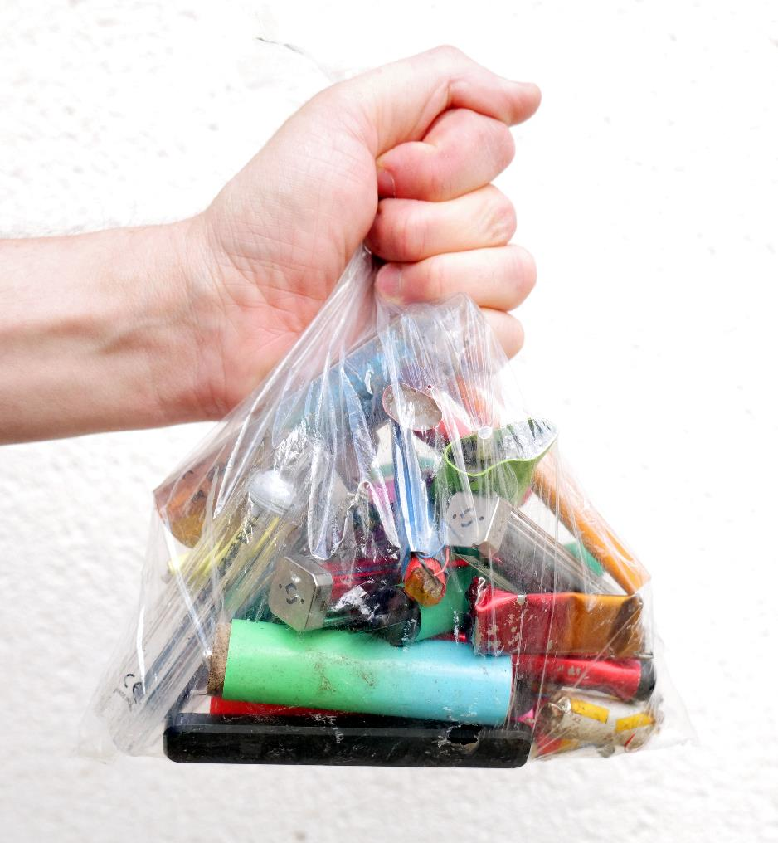
What are vaping devices?
Vaping

Slide 2


What are vaping devices?
The terms ‘vaping device(s)’ and ‘vaping product(s)’ are used to describe e-cigarettes, ENDS (electronic nicotine delivery systems) or vapes and refill containers (e-liquids) intended for nicotine vaping.
Vaping devices do not always contain nicotine.
We use the term ‘vapers’ to refer to people who regularly use vaping devices and ‘vaping’ as the act of using a vaping product.

Slide 3
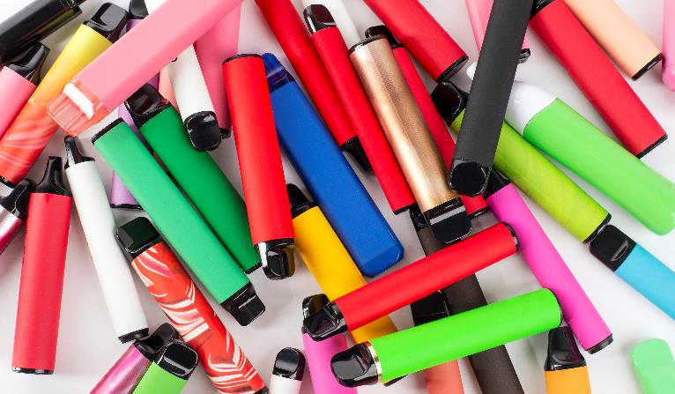
Facts:
Vaping devices are battery-powered devices that heat a liquid to produce an aerosol that is inhaled (breathed into the lungs).
The liquid usually contains nicotine, although some vapes are available without nicotine.
Vapes contains different levels (or strengths) of nicotine depending on the brand. The Tobacco and Related Products Regulations (2016) places restrictions on the amount of nicotine a vape should contain (see Law and Regulations Knowledge Bank).
Vapes can either be rechargeable or disposable.
Vapes come in a variety of flavours.
Vaping devices are sometimes made to look like everyday items such as pens and USB memory sticks.
Vaping devices should not be used by children and young people.

Slide 4
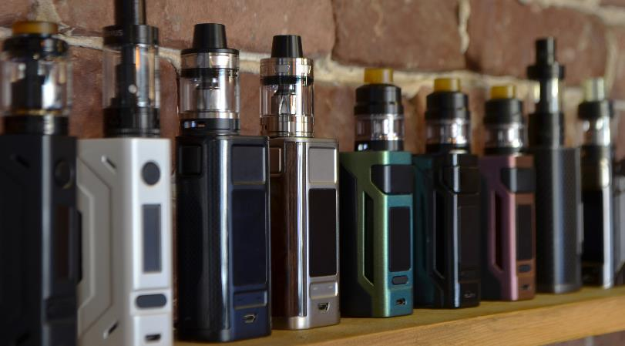
Facts:
Vapes were originally marketed as an alternative to smoking cigarettes and have gained popularity amongst some adults trying to quit smoking.
Unlike cigarettes, there is no combustion (burning) involved in vaping devices, so there is no smoke and no other harmful products of combustion, such as tar and carbon monoxide.
This does not mean they are entirely safe, but they are understood to be less harmful than smoking as they do not contain the tar, carbon monoxide and other products that cause many smoking related illnesses.
Switching completely from smoking to vaping significantly reduces the health harm for smokers who are unable or unwilling to quit.

Slide 5
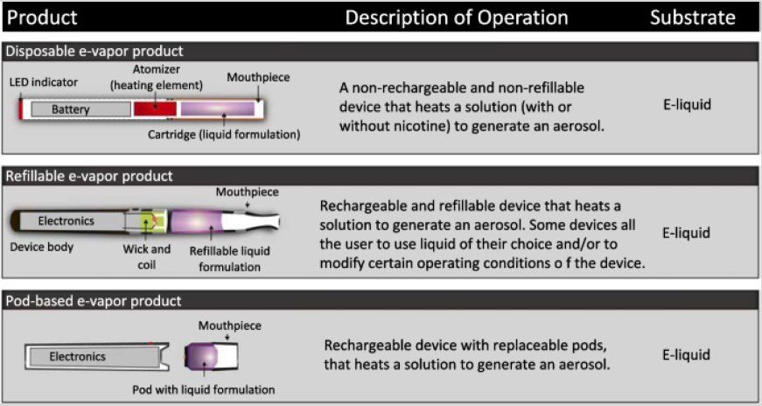
Types of vape
The variety of different vaping products available has increased overtime.
The industry have developed innovative ways to further develop the market.
This had led to changes such as:
- Using different flavours to encourage users to vape more frequently and therefore increase sales
- Adding products such as nicotine salts to improve nicotine delivery making vapes more addictive
- Reducing costs and barriers to uptake, for example introducing cheaper disposable vapes
Source: Smith M, Peitsch MC, Maeder S. Electronic nicotine delivery products. Chapter 2 in: Toxicological​ evaluation of electronic nicotine delivery products [Internet]. ISBN 978 0 12 820490 0, doi :​https://doi.org/10.1016/C2019 0 02209 1 . London: Academic Press; 2021. 17 22.

Slide 6
Timeline of vaping devices
2003: Modern vaping devices first patented in China
~ 2008: Enter UK market
Early devices look like cigarettes: ‘cig a like’
Marketed at smokers as cessation device
Relatively poor at delivering nicotine compared to tobacco
2009: Pen devices
2015: Law to prevent sales to under 18s
2025: Likely ban on sale of disposable vapes
2011: Tanks
Early 2020s: Rise in disposable/single use vapes
Vapes and vaping devices were first introduced into the UK market around 16 years ago.
Initially, these devices were designed to look like cigarettes.
Over time, designs have become increasingly sophisticated with many devices now designed to be more attractive.
Vaping devices have also become more efficient at delivering nicotine.

Slide 7
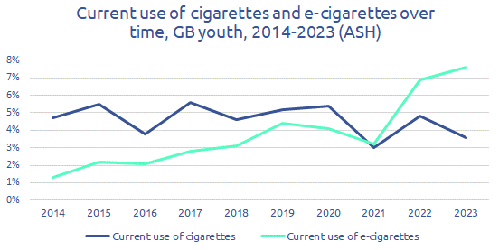
The change in cigarette and e-cigarette use over time
The proportion of young people using cigarettes over time is decreasing however the proportion using e-cigarettes is increasing.
As the SHRN survey is relatively new we do not currently have enough years' worth of data to show trends like the one above. As times goes on and more data is collected trend charts will be able to be produced using SHRN data.

Slide 8
Questions for discussion
Why are some vapes designed to be attractive in colour and design?
What is contained in the liquid?
Why do you think some manufacturers make vapes that cannot be recharged?
How do you know if a device contains nicotine?
How do you know if a device contains an illegal substance such as Cannabis?

