Slide 1


Health Concerns
Vaping

Slide 2

Vaping: The Facts

Slide 3

The health harms of smoking are well known. Vaping is substantially less harmful than smoking and smokers who switch to vapes will be at much lower risk of these health harms.
However, vaping is not harmless. For people who don't smoke, or who have never smoked, there are no benefits to vaping and they should not vape.
Evidence regarding the long-term health effects resulting from the use of vaping devices is very limited.
There is substantial evidence that using nicotine-containing vapes results in symptoms of dependence in non-smokers (see What is Dependency and Addiction Knowledge Bank).
Young people using vapes are more likely to become addicted to nicotine, have more difficulty quitting and are at higher risk of addiction to other substances in the future.
Dependence on nicotine can negatively affect mental health and well-being.
There is recent evidence that vapes containing nicotine can cause poisoning if ingested and immediate inhalation toxicity (including seizures) particularly in children and adolescents, although this is very rare.
Malfunctioning vaping devices can also cause injuries and burns.
Source: Information and Guidance on Vaping for Schools in Wales (nhs.wales)

Slide 4
Vaping devices containing nicotine
Nicotine intake from vaping devices can vary and is dependent on a number of product and user characteristics. It may not always be clear to users when a vape contains nicotine.
Symptoms of nicotine intake may include:
Headache
Cough
Throat irritation
Dizziness
Nausea
If you are not used to taking nicotine, you may also feel:
Dizziness, headache, racing heart, nausea/possible vomiting, stomach cramps, weakness
Nicotine exposure from vaping tends to increase when​
Using e-liquids with higher nicotine concentration ​
Using tank or modular type vaping devices which provide more exposure than disposable models ​
People have been vaping for longer, as they have more effective 'puffing behaviour' (for example puffing more frequently or taking longer puffs )

Slide 5
Vaping devices containing nicotine
People who use nicotine regularly build up a tolerance to the immediate short-term effects so they might feel a more intense relief from the discomfort of withdrawal when they vape.
Higher tolerance will mean more nicotine is required to deliver the same sensation. This can result in nicotine dependance or addiction.
Signs and symptoms of nicotine dependency may include:
  cravings
  mood changes
  irritability
  poor behavior
  hyperactivity
  finding it hard to stop vaping
Further research is needed to increase our understanding of the potential short-and long-term health effects of nicotine for children and young people.

Slide 6
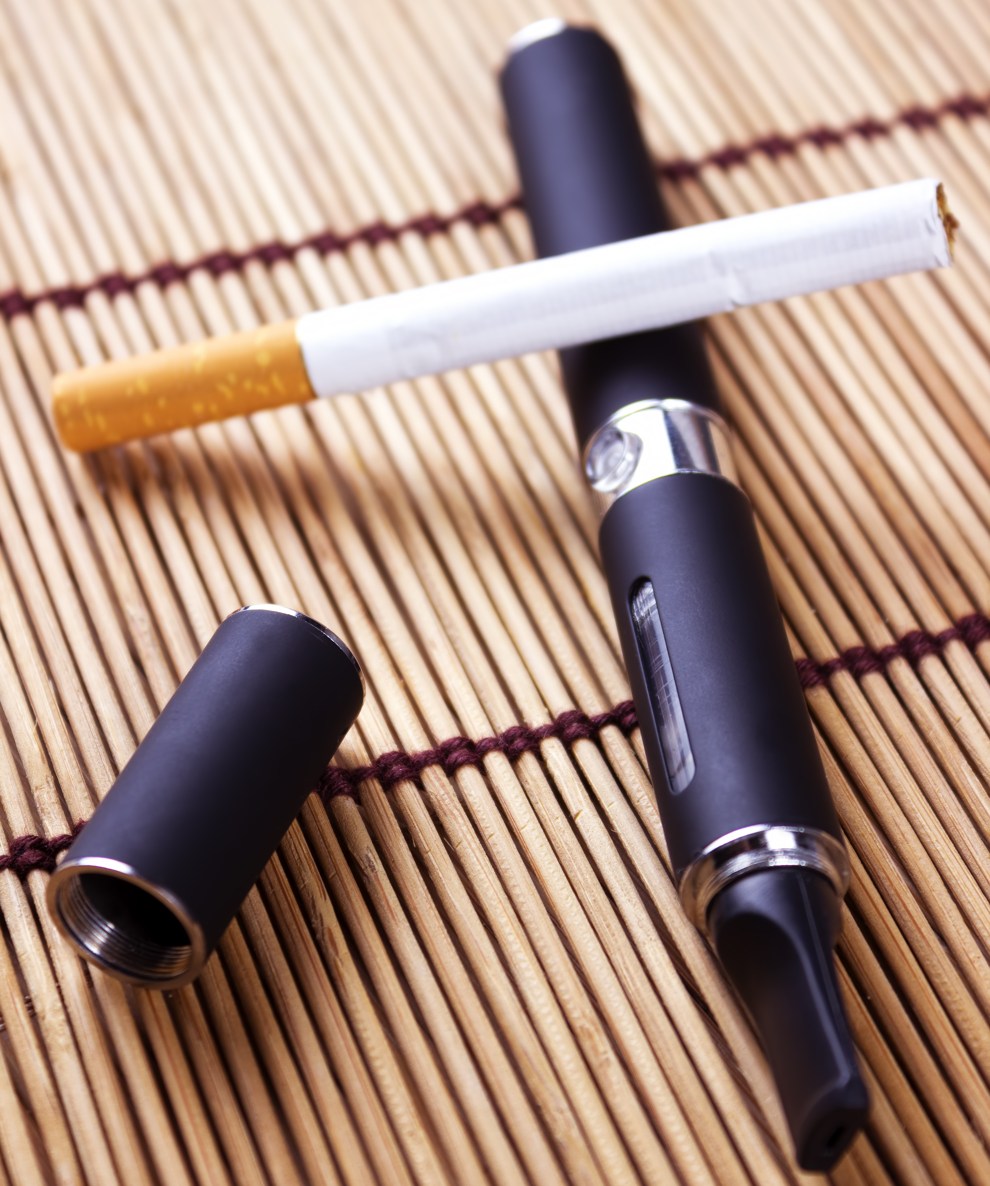
Vaping and use of other health harming substances
Most young people do not vape or smoke.
Most young people who vape do not smoke or use other substances.
However
Long-term studies have found that young people who start vaping are more likely to also start tobacco smoking and become regular smokers than those who have not used vapes. Smoking is incredibly harmful and is the greatest cause of disease in Wales.
There is also emerging evidence that suggests young people who vape are at an increased risk of addiction to other illegal and health harming substances in the future.

Slide 7
Vaping and other substances
Research in Wales has found a range of substances, including cannabis-based substances, present in vaping devices.
There are concerns around the potential use of vapes to consume cannabis or other synthetic cannabinoid substances as the nicotine consumed through vaping devices can enhance the addictive properties of these substances.
A young person may not be able to detect if a vape contains cannabis or other substances.
For information and support on the harms of illegal substances available via DAN 24/7.

Slide 8

Mental Health and Emotional Well-being
Vaping can lead to dependence on nicotine. Dependence on nicotine can negatively affect mental health and well-being and can be disruptive to life and learning.
It is a misconception that vaping reduces stress and anxiety. In fact, young people who vape for stress relief report having higher stress levels than young people who don't vape.
Nicotine creates an immediate sense of relaxation, but this feeling is temporary and quickly replaced by increased anxiety, tension, cravings and withdrawal symptoms.
Withdrawal symptoms can be temporarily managed by further doses of nicotine but this will not reduce underlying feelings of anxiety or address why an individual feels anxious in the first place.
There is no benefit to using vaping as a coping mechanism for stress and anxiety and nicotine dependency may get in the way of you taking part in effective coping mechanisms (such as participating in clubs).

