Slide 1

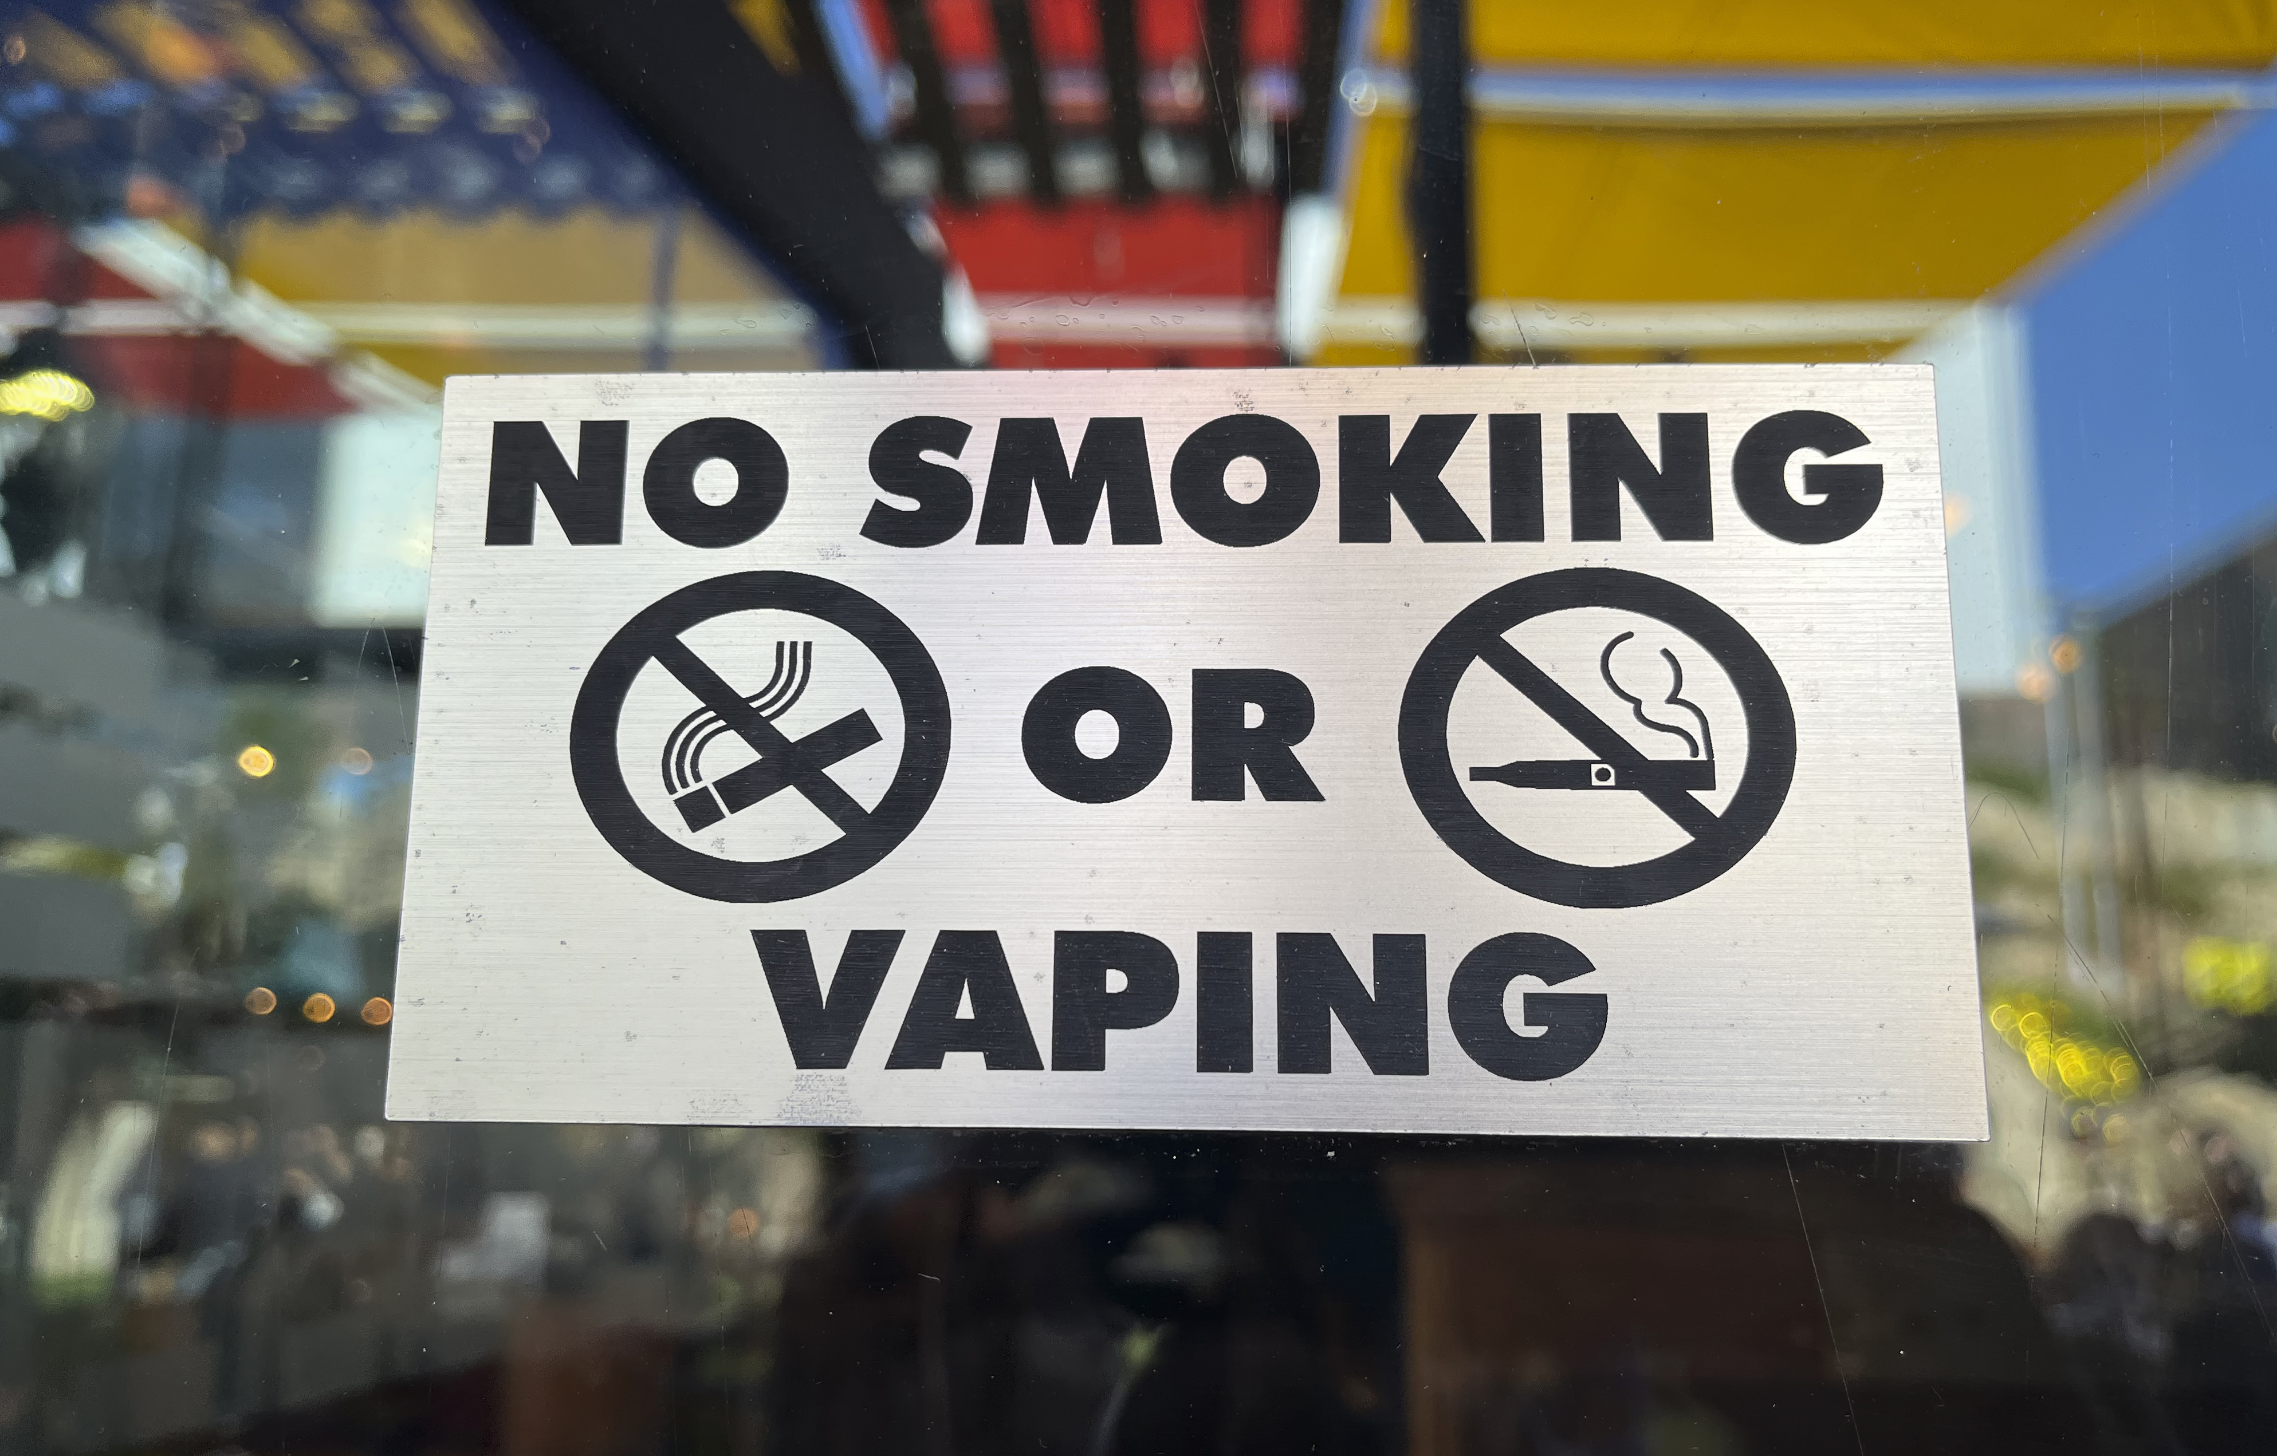
The Law and Regulations
Vaping

Slide 2
Why is law and regulation
important?
Laws are there to protect our safety, collectively and individually, and guarantee our basic freedoms. Laws can apply to citizens and organisations.
Law and regulation plays a key role in reducing rates of harm caused by smoking and vaping. It does so by:
limiting access, particularly for children and young people
providing information so potential consumers can make informed choices
implementing standards for the products that are available (for example nicotine concentration, banned ingredients)
limiting how industry can promote their products to encourage uptake (for example restrictions on advertising)
limiting where people can smoke (for example Smokefree schools, hospitals and playgrounds)

Slide 3
The law relating to vapes and
vaping
The laws relating to vaping and vaping products in Wales and the rest of the UK are usually linked to tobacco legislation.
It is illegal in Wales and the rest of the UK to:
Sell tobacco or vaping devices (vapes), electronic cigarettes (e-cigarettes) or e-liquids containing nicotine to anyone under 18.
For adults to buy (or try to buy) these products for anyone under 18. This is known as ‘proxy purchase’.
If found breaking the law, retailers or individuals can be prosecuted.
Trading Standards Wales provide examples where legal action has been taken against retailers.

Slide 4
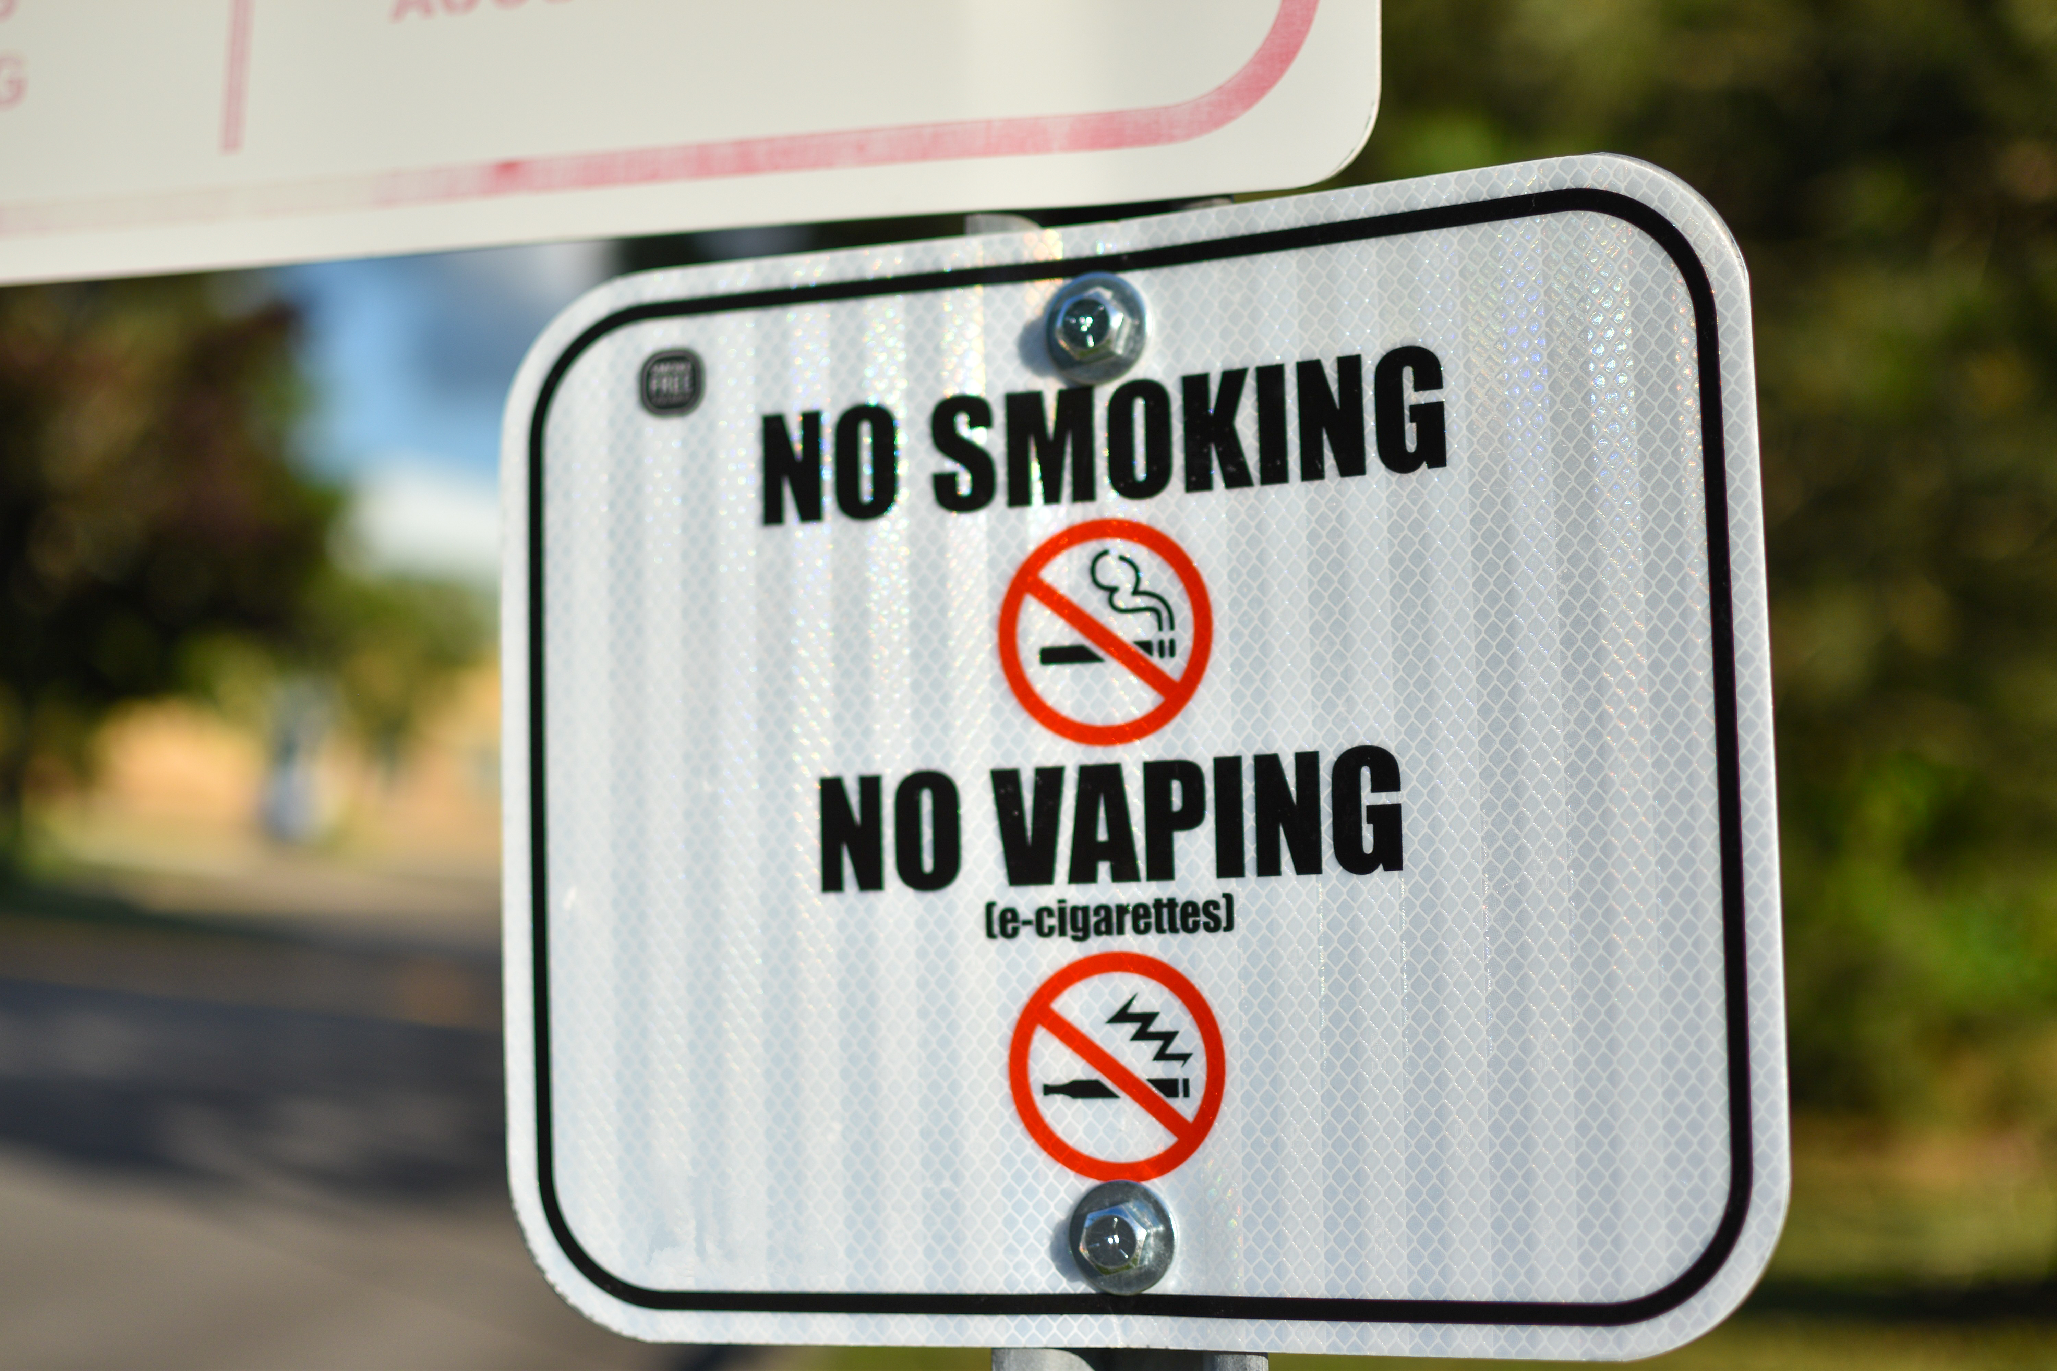
Tobacco and Related Products
Regulations 2016 (TRPR)
The majority of restrictions for tobacco and vaping products in England and Wales are part of the TRPR which aims to:
- Implement standards for safety and quality
- Make sure consumers have information so that they can make informed choices
- Protect children from starting to use these products

Slide 5
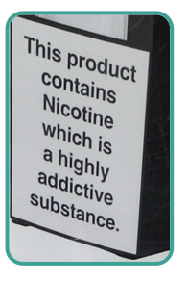
The TRPR rules for vapes:
• E-cigarette tanks must be no larger than 2ml
• Maximum volume of e-liquid limited to 10ml
• Nicotine strength must be no more than 20mg/ml
• Products and packaging must be child-resistant and tamper evident
• Certain ingredients including banned (for example colourings, caffeine and taurine)
• Include labelling requirements and warnings: “This product contains nicotine which is a highly addictive substance.”
These restrictions reduce the risk of harm but they do not remove the risk entirely.

Slide 6
The law relating to tobacco products
Requirements of the law relating to tobacco include:
A packet of cigarettes must contain a minimum of 20 cigarettes and must only be sold in its original packaging.
Products are subject to a minimum excise duty.
Shops selling tobacco must display notice that states 'it is illegal to sell tobacco products to anyone under the age of 18' (they are encouraged but not required to have a similar notice for vaping products).
Products must not be on display in-store.
Tobacco products must be sold in standardised (plain) packaging which include graphic health warnings. This measure effectively bans branding on packaging.
A ban on flavours (including menthol).
There are additional laws and regulations in place designed to reduce the appeal of tobacco products (particularly to young people), to prevent misleading claims about the benefits of tobacco products and to make the required health warnings more noticeable. The overall aim is to reduce rates of smoking.
There is further regulation to address the problem of illegal trade in tobacco products, for example all products must be marked with a unique identifier so they can be tracked.

Slide 7
Advertising and Promotion Restrictions
The advertising and promotion of tobacco and vaping products are subject to restrictions. This includes how companies can promote their products and to whom.
The Tobacco Advertising and Promotion Act 2002 banned advertising and promotion (including sponsorship) of tobacco products in the UK.
Similar restrictions were placed on the promotion of vapes in 2016. However, the restrictions for vapes aren’t as extensive as they are for tobacco (where all forms of advertising and sponsorship are prohibited).
The UK Advertising Code provide advertising and marketing codes to industry that should be followed for Vaping and Tobacco Products. What are the differences?

Slide 8
Smoke free places and the law
The public places required to be smoke-free by law include:
Indoor/enclosed public places
Indoor/enclosed workplaces
School grounds
Playgrounds
Hospital grounds
Vehicles carrying under 18s or being used for work
Holiday accommodation
Smoke-free legislation introduced in Wales in 2007 (updated in 2021) aimed to save lives and prevent disease caused by second-hand smoke (“passive smoking”).
The law means that smoking is not allowed in certain public places and spaces.
It is an offence to smoke tobacco in these places and people responsible for them must take reasonable steps to prevent people smoking within them.
The smoke-free legislation in Wales only covers smoking tobacco and does not include e-cigarettes/vapes.
However, those responsible for places or spaces can introduce voluntary restrictions on vaping if they wish.

Slide 9
Planned changes to laws in Wales
In January 2024 the Welsh Government, along with the UK and Scottish governments, announced plans to enact a law banning disposable (single use) vapes.
The law is expected to come into force in April 2025. Government consultation showed strong public support for this measure.
The UK and Welsh Governments are also considering other options to address children and young people vaping including:
Restricting flavours designed to appeal to children
Restricting packaging
Restricting the visibility of vapes in shops
Increasing the cost of vapes
The UK Government has also announced plans to make it an offence to sell tobacco to anyone born on or after 1 January 2009. This means a young person aged 14 today will never be able to legally by tobacco in the UK.

Slide 10
Illegal tobacco and vapes
Illegal tobacco and vapes do not comply with tobacco control laws.
Because it bypasses laws there to protect you the risk of harm from illegal tobacco and vapes is far higher.
Trading Standards Officers in Wales and across the UK report that the market is being flooded with unregulated vapes aimed at children and young people.
This is a concern as these products are often sold in places such as homes and via social media as well as in small retailers.
The illegal trade of vapes and tobacco can put young people at risk of exposure to criminal activity and criminal groups.

Slide 11

Illegal products: health implications
Illegal tobacco and vaping products pose additional health risks because they are not regulated and may not meet UK standards.
Studies of illegal vapes have found them to:
• Contain ingredients dangerous metals such as lead as well as other ingredients banned in the UK
• Contain a much higher concentration of nicotine that can lead to an increase in nicotine addiction and associated adverse health effects
• Be sold in packaging which does not comply with UK Regulations i.e. does not have any nicotine warnings on it
• Have an oversized tank capacity

Slide 12
How to spot illegal tobacco or vaping products:
If someone is selling cigarettes or vapes to children and young people this is illegal.
If products do not contain health warnings about nicotine it is illegal.
If a vape has an oversized tank or ‘puff’ capacity this is illegal.
If cigarettes are being sold individually this is illegal.
If products are being sold at unusually cheap prices it is probably illegal.
If products are being sold from places likes houses or via social media they are likely to be illegal.

Slide 13


Talk to someone you trust!
You can anonymously report Illegal tobacco or vapes sales in Wales through:
Crimestoppers (0800 555 111)
Contact Trading Standards at your local council
Call 101 (non-emergency police enquiries)
Report online at noifs-nobutts.co.uk

