Slide 1

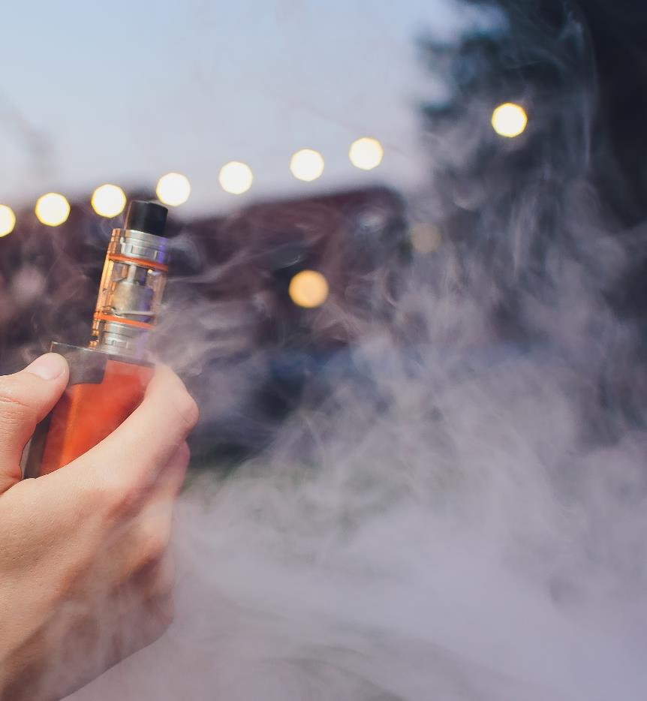
Societal Impact
Vaping

Slide 2
What are health inequalities?
Health inequalities are differences in health across the population, and between different groups in society, that are systematic, unfair and avoidable.
They are caused by the conditions in which we are born, live, work and grow. These conditions influence how we think, feel and act and can affect both our physical and mental health and well-being.
Definition taken from the National Institute for Health and Care Excellence

Slide 3
What are the effects of health inequalities?
In parts of Wales, people are dying years earlier than they should. When we don’t have the things we need, like warm homes and healthy food, it puts a strain on our bodies which can result in greater stress and poorer health. It can also mean we turn to behaviours such as smoking or drug and alcohol use which harm our health.
To create a society where everybody can thrive, we need all of the right building blocks in place: stable jobs, good pay, quality housing and good education. To try and reduce inequalities between different areas in Wales, work is being done to identify our communities where blocks are missing. This is to make sure those at most risk have the best access to support.

Slide 4
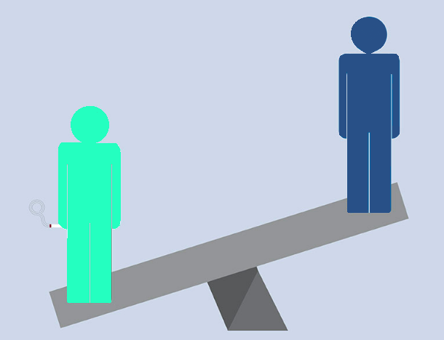
Smoking and Inequality
One way health inequalities can be seen and measured is through differences in behavioural risks to health such as smoking.
Smoking rates in adults are almost three times higher in areas of Wales with access to fewer resources and opportunities*
Young people with access to fewer resources and opportunities are also more likely to smoke.
* This is measured by the Welsh Index of Multiple Deprivation which combines information sources relating to peoples living, working and education experiences.
Notes:
To find out more about the WIMD ranking for the area where you school is based click here: https://apps.dataunitwales.gov.uk/welshindexofmultipledeprivation/

Slide 5
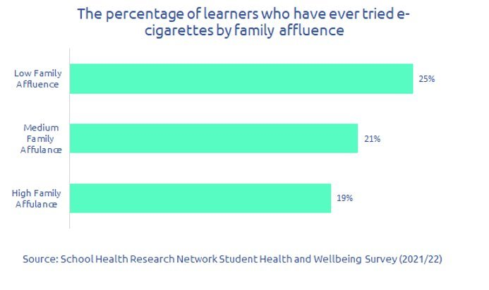
Vaping and Inequality
Vaping is more common amongst adults in areas with access to fewer resources and opportunities. Similarly young people with access to fewer resources and opportunities* are more likely to try vaping.
This represents a complicated health inequalities picture; vaping is substantially less harmful than smoking. When smokers switch completely to vaping, it significantly reduces the health risks for those unable or unwilling to quit. Because smoking is the biggest cause of disease in Wales, if adults smokers switch to vapes and quit smoking successfully, it can help reduce health inequalities.
However, if non-smokers, including young people, start vaping, it creates new health risks and will not help reduce smoking rates. Therefore an increase in vaping amongst young people and non-smokers could make inequalities worse.
*Measured using the Family Affluence Scale: To try and understand the conditions in which young people live they are asked questions as part of the SHRN survey. A total Family Affluence Score was calculated for each student who answered questions on bedroom occupancy; car, computer, and dishwasher ownership; and number of household bathrooms.

Slide 6
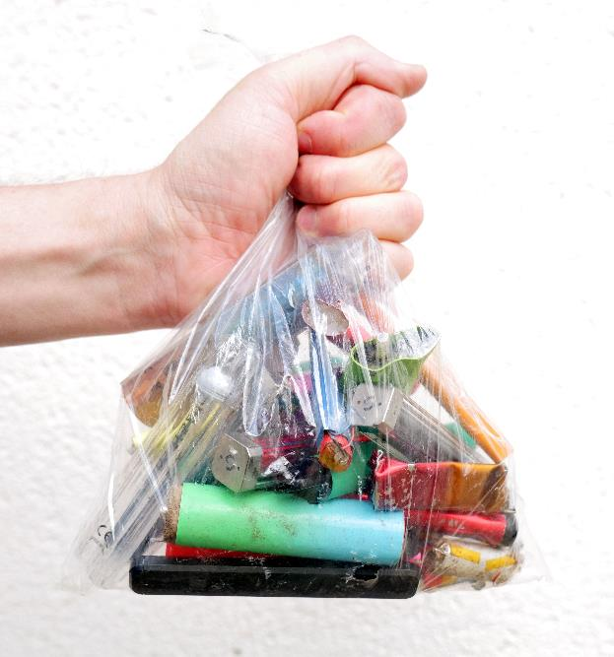
Societal Impact of Illegal Trade
The Law and Regulation Knowledge Bank explores why vapes and tobacco sold or sourced illegally is more dangerous to your health. But there are big implications for society too:
Criminal activity
The illegal vape and tobacco trade has strong links with organised crime and criminal gangs and income from illegal sales can be used to fund wider criminal activity. Many of the people smuggling, distributing and selling illegal produces are involved in drug dealing, money laundering, people trafficking and even terrorism.
The illegal trade targets young people because they are a new market to exploit for money. This increases the risk to young people, not only from the products but exposure to criminals and potentially other, sometimes dangerous, criminal activities.
Increasing inequality
Illegal trade targets people living in areas of Wales with fewer resources and opportunities, further increasing health inequalities.
Providing public services
Because the illegal trade bypasses the UK tax system it means the country will not receive the correct amount of tax which is used to help pay to for public services that help those at greatest risk of harm such as health services and schools.

