Slide 1

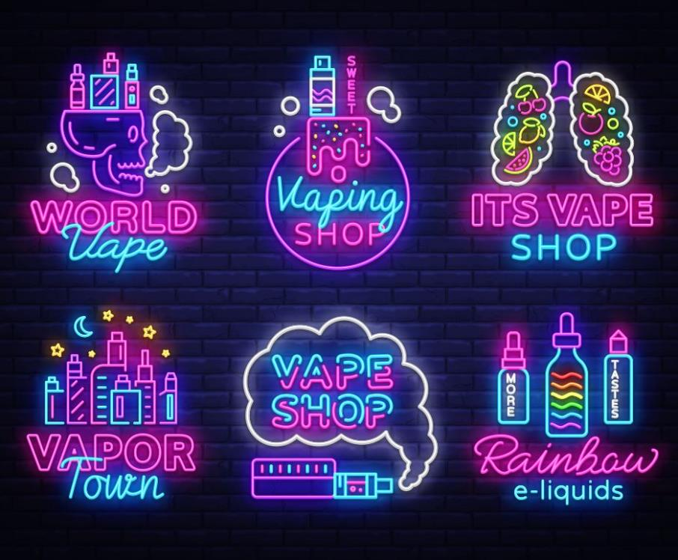
The Industry, Marketing and Advertising
Vaping

Slide 2

The Marketing and Promotion of Vapes
There are concerns about the marketing and promotion of vaping devices and how these may appeal to children and young people.
Vaping devices may be offered in flavours and colours with packaging and designs (to look like a highlighter pen for example) that can be particularly attractive to young people.
New market innovations such as disposable vapes are often cheaper and therefore more affordable to young people and are widely sold.
This can be confusing as it may look like the product is suitable for children and young people. However, vaping devices should not be used by children and young people, and it is illegal to sell nicotine containing vapes to anyone under 18.

Slide 3
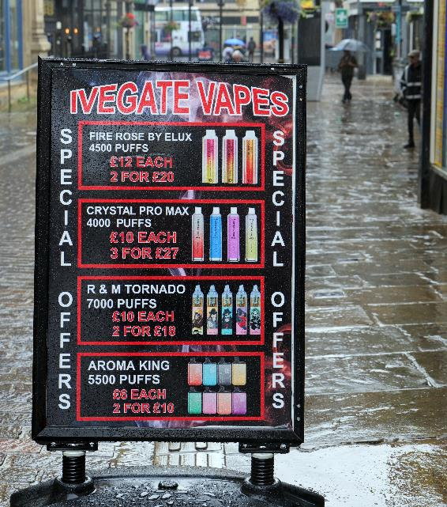

Marketing Tactics
Vape and e-cigarette advertising on television, radio, and in newspapers and magazines is restricted (see 22 Electronic cigarettes - ASA | CAP) However these restrictions are not as extensive as those applied to Tobacco (see Section 21 of the ASA code)
Vape and tobacco companies use media influencers to advertise to younger users and non-smokers. You may have seen reels on social media sites such as TikTok and Instagram introducing new flavours and designs.
The e-cigarette industry also targets young people by giving free samples, e.g., handing out ‘Vype’ e-cigarettes at music festivals in the UK.

Slide 4

Industry Tactics
During the COVID-19 pandemic, tobacco and vape companies donated medical equipment and PPE to hospitals.
This meant the factories could stay open and continue to produce cigarettes and vapes.
To help secure the Tobacco industry’s long-term future, transnational tobacco companies (TTCs) have invested in, developed and marketed various new nicotine and tobacco products including e-cigarettes/vapes.
Tobacco companies have referred to newer products such as vapes as ‘next generation products’.

Slide 5

What are the links between tobacco companies and vape companies?
As the harms of cigarettes have become better understood and laws and regulations have been tightened, tobacco company profits have started to shrink.
Tobacco companies began buying existing e-cigarette brands and developing their own e-cigarette products from 2012.
Tobacco companies are well placed to take advantage of the fast-growing vaping market. They have established distribution points and the money to resource and cover the costs of marketing.

