Slide 1

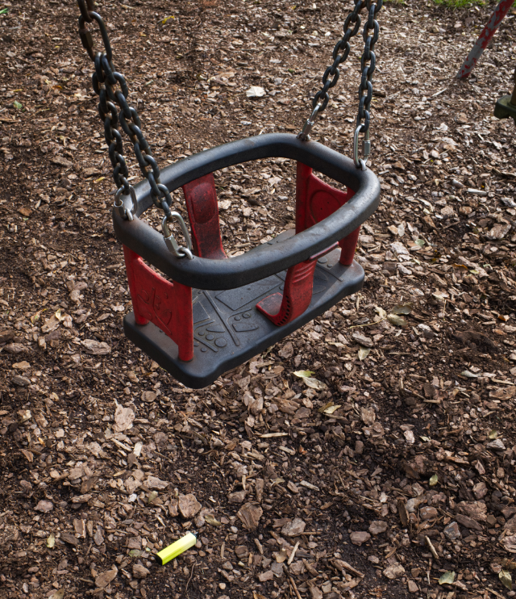
Environmental Impact
Vaping

Slide 2
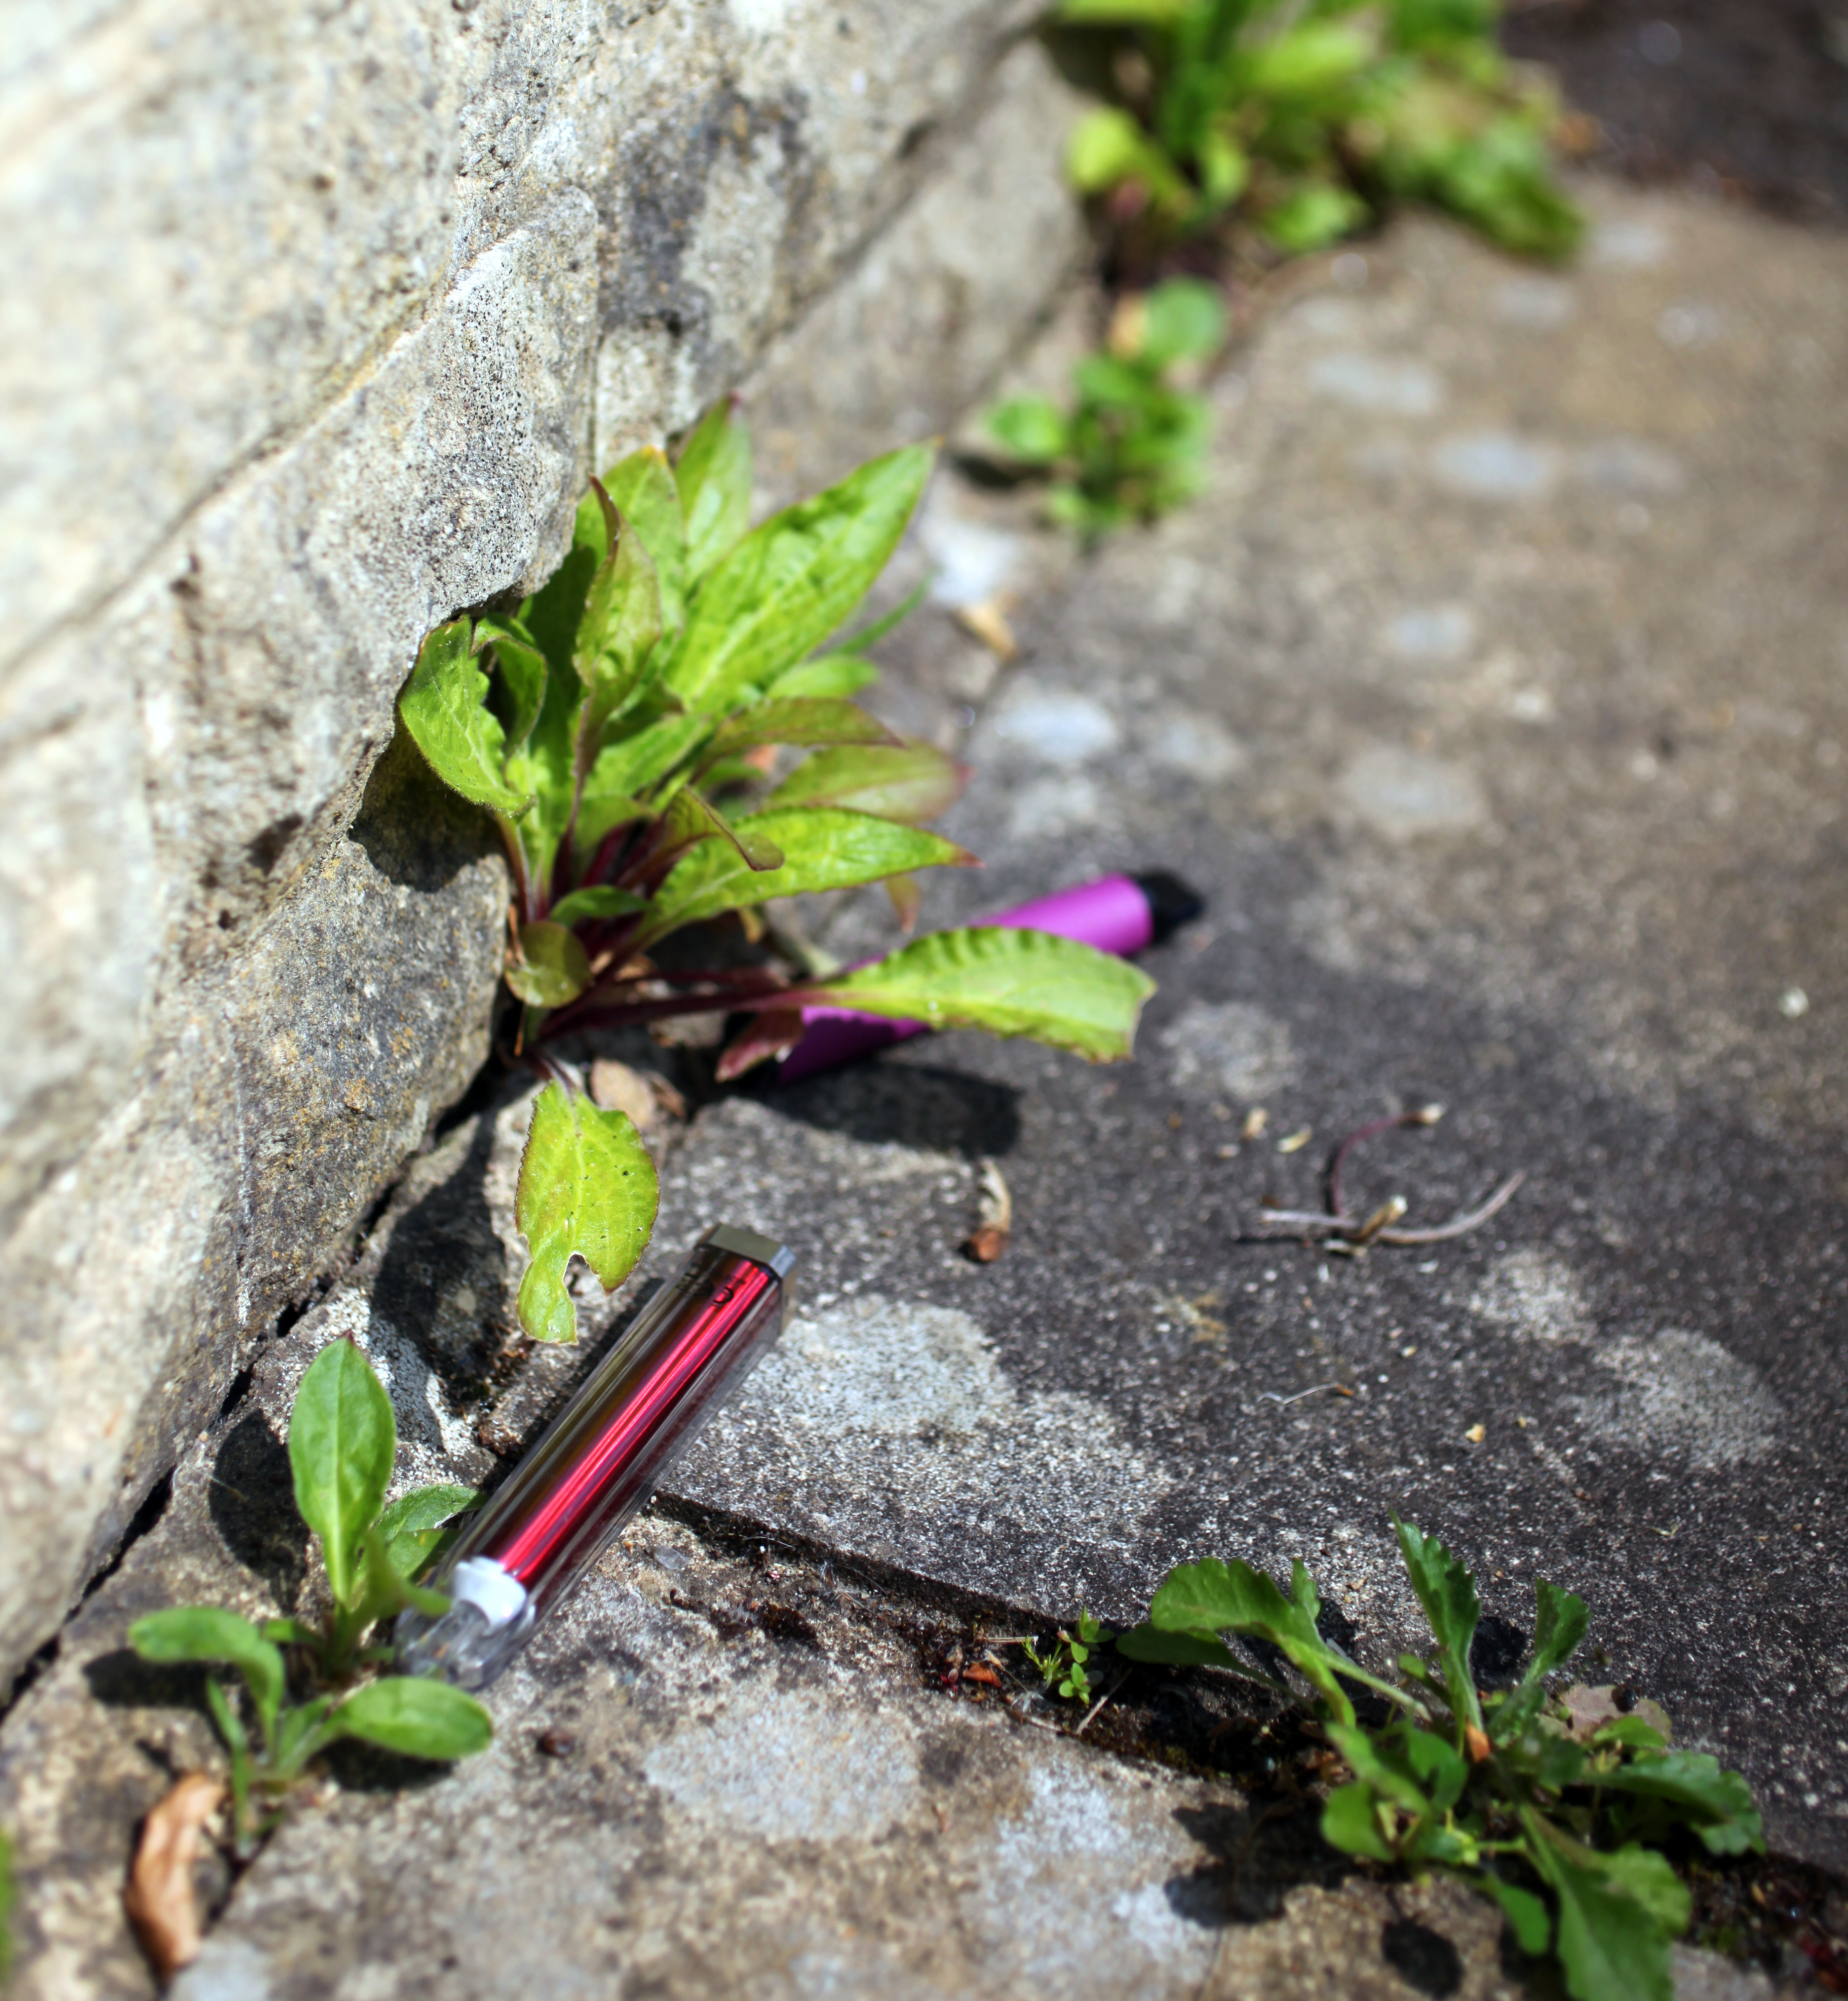

Disposable Vapes
A disposable vape is designed to be used one time then discarded once the e-liquid has run out. The devices are not refillable nor rechargeable.
These products contain, plastic, copper, rubber, and a lithium battery which are valuable and scarce materials.
Disposable vapes can and should be recycled. However, because they are classed as Waste Electrical and Electronic Equipment (WEEE), this can be more complicated than standard household waste. This results in a higher amount of disposable vapes being littered or thrown away.

Slide 3
Disposable Vapes
Facts about disposable vapes and the environment:​
Research from Material Focus found that 5 million disposable vapes are thrown away every single week That's enough to fill 22 football pitches!
The number of disposable vapes thrown away has quadrupled since 2022
Disposable vapes contain difficult to recycle components and plastics which do not decompose​
Littered vapes cause dangerous chemicals to pollute soil and water which can be harmful to humans, animals and the environment ​
Lithium batteries contained in vapes can be a fire hazard when disposed of incorrectly​
Disposable vapes result in significant littering of the environment because they cannot be reused or recharged
Information about how to safely recycle vapes and other electrical waste in your area is available on the Recycle Your Electricals website.

Slide 4
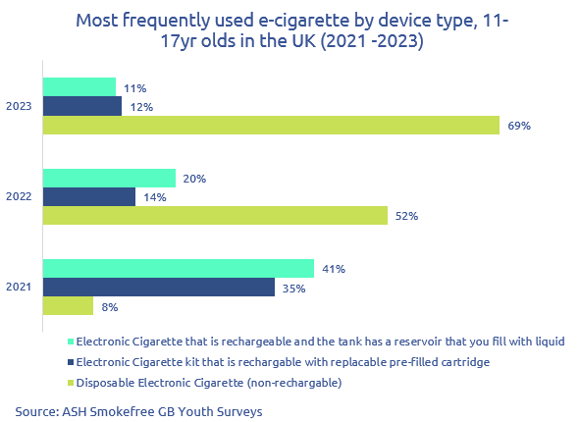
Disposable Vapes
The use of disposable vaping devices and products has increased substantially amongst young people, with 69% of current vapers using disposable vaping devices in 2023 compared with 8% in 2021. (Source: ASH Survey: use of e-cigarettes among young people in Great Britain 2023)
This is thought to be because disposable vapes, also known as single use vapes, are cheaper and more likely to be accessible to young people.

Slide 5
Disposable Vapes - Government Action
Because of the effects single-use vapes are having on children and young people and the environment, The Welsh Government, along with the UK and Scottish governments plan to introduce legislation to ban disposable vapes.
The legislation will apply to nicotine and non-nicotine containing products and should be in place by the end of 2025.
There has been an overwhelmingly positive response to the government’s consultation about banning disposable vapes, with nearly 70% of parents, teachers, healthcare professionals and the general public supporting restricting the sale and supply of disposable vapes.

Slide 6
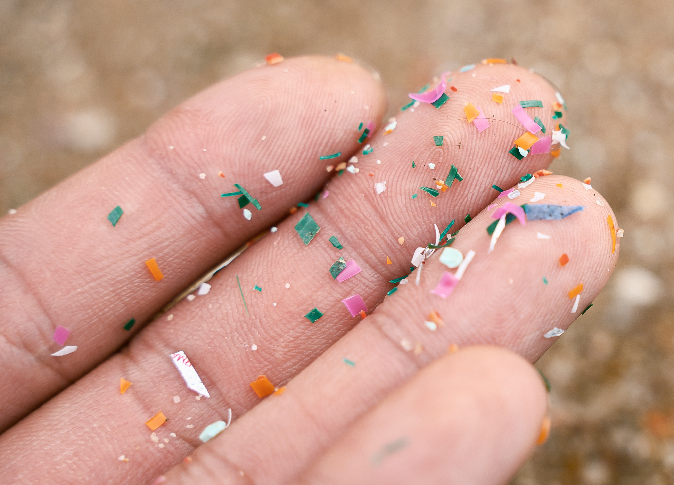
Microplastics
Vaping devices contain metals and plastics which can take many years to decompose.
Rather than decomposing, plastic turns into “microplastics” which continue to pollute the environment, our food and drinking water.
Microplastics are tiny fragments of plastic smaller than 0.5 cm. These plastics break down slowly but do not decompose fully.
Overtime microplastics become small enough to be accidentally consumed by living things. They 'bioconcentrate' in food chains because they cannot be excreted. The effects of this build-up are not fully yet understood*.
*Bioaccumulation - KS3 Biology - BBC Bitesize

Slide 7
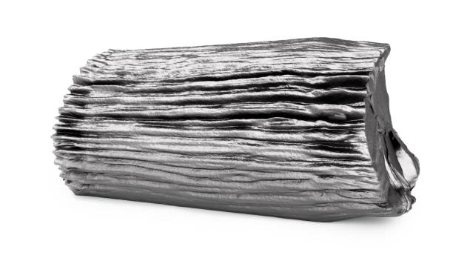
Lithium
Lithium is a light, soft and low-density metal that can be found in many batteries.
Disposable vaping devices contain lithium batteries which, if damaged, can pose a fire hazard when thrown away in general waste or recycling.
Lithium is also a very valuable metal but tonnes of it is being thrown away each year and ends up in landfill or waste incinerators.
Material Focus estimate 5,000 electric car batteries worth of lithium in vapes is being thrown away every year.
The lithium polymer batteries used in some of the most popular vapes could be recharged 500 times if the product was designed to allow for recharging.

