Slide 1
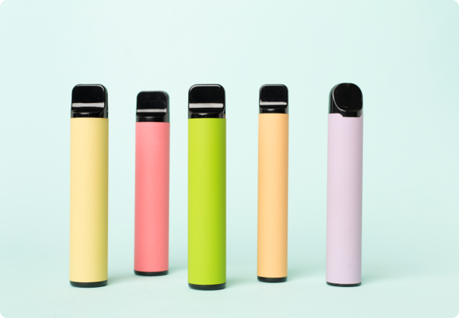
True or False
Vaping

Slide 2
Read the statements below.
Discuss whether you think they are true or false.
Vaping devices should not be used by children and young people.
Young people using vaping devices are more likely to become addicted to nicotine have more difficulty quitting and are at higher risk of addiction to other substances in the future.
Vapes and cigarettes are equally as harmful to health.
Vapes are available in a variety of flavours because they are suitable for children and young people.
It is illegal to sell nicotine-containing vaping devices to anyone under 18 or for adults to buy them on behalf of under-18s.
Vaping is harmless and will not damage your health.
Sharing or passing around a vape with others is safe if it’s with people you know.
1 in 5 secondary aged learners from Year 7 – 11 have tried vapes.
Disposable vapes are best because they are cheap.
Illegal vapes containing ingredients banned in the UK have been found in secondary schools in Wales.
Boys are more likely to vape regularly (at least weekly) than girls.
It is illegal for an adult to buy (or try to buy) vaping devices or e-cigarettes on behalf of anyone under 18.
Vaping helps reduce stress levels and are good for stress relief.

Slide 3
True
False
Vaping devices should not be used by children and young people.
Boys are more likely to vape regularly (at least weekly) than girls.
It is illegal to sell nicotine-containing vaping devices to anyone under 18 or for adults to buy them on behalf of under-18s.
Disposable vapes are best because they are cheap.
It is illegal for an adult to buy (or try to buy) vaping devices or e-cigarettes on behalf of anyone under 18.
Sharing or passing around a vape with others is safe if it’s with people you know.
Young people using vaping devices are more likely to become addicted to nicotine, have more difficulty quitting and are at higher risk of addiction to other substances in the future.
Vapes are available in a variety of flavours because they are suitable for children and young people.
Illegal vapes containing ingredients banned in the UK have been found in secondary schools in Wales.
Vapes and cigarettes are equally as harmful to health.
1 in 5 secondary aged learners from Year 7 – 11 have tried vapes.
Vaping is harmless and will not damage your health.
Vaping helps reduce stress levels and are good for stress relief.

Slide 4
False
Boys are more likely to vape regularly (at least weekly) than girls.
Disposable vapes are best because they are cheap.
The statements on the left are false.
What are the truths?
Sharing or passing around a vape with others is safe if it’s with people you know.
Vapes are available in a variety of flavours because they are suitable for children and young people.
Vapes and cigarettes are equally as harmful to health.
Vaping is harmless and will not damage your health.
Vaping helps reduce stress levels and are good for stress relief.

