Slide 1
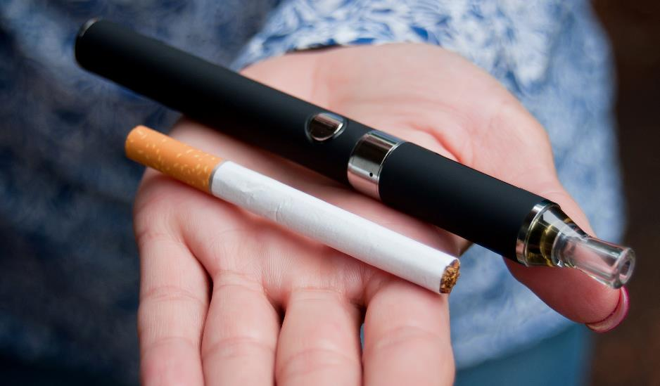
Smoking to Vaping
Timeline
Vaping

Slide 2
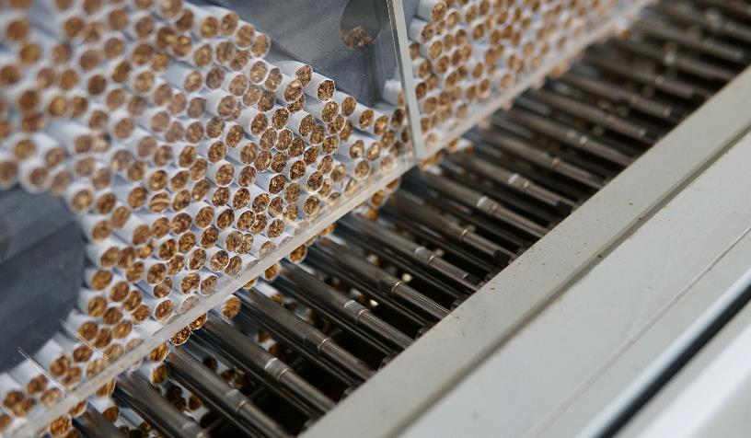
The history of tobacco
    Tobacco was first introduced to the UK in 17th century from the Americas.
    The growth of tobacco use in in 18th / 19th centuries is a factor that underpinned the slave trade.
    In the late 19th century the introduction of machines to cigarette production enabled tobacco products to be mass produced at a cheaper price.
    Commercial strategies to promote cigarette use developed very fast, for example provision of tobacco to soldiers during WW1 contributed to a generation with high rates of nicotine addiction.

Slide 3
The tobacco industry and advertising
    The link between smoking and lung cancer was first shown in 1950, but although clear evidence of the harms of smoking continued to emerge in subsequent decades, serious action to reduce smoking rates only began in the UK in the 1980s.
    Beginning with clear public health campaigns and increased taxation to recover some of the health costs of smoking, the UK government then regulated smoking to reduce uptake and encourage people to quit.
    The Tobacco Industry deployed extensive efforts to counter public understanding of these harms.
    Legal action and investigation has since established that tobacco companies knew the harms their products were doing but kept denying them publicly.
    The ‘tobacco industry playbook’ has been used by companies from alcohol to fossil fuel to deny the harms of their products and create uncertainty and disinformation.
Check out the Law and Regulations resource for further information on regulation of use today.

Slide 4
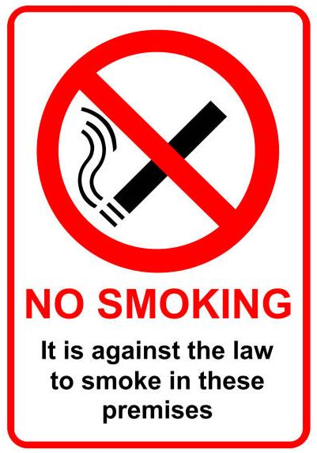
How has tobacco consumption changed over time?
    In 1970s, the proportion of adults smoking was around 40%
    From the 1980s, the UK began to address this through policies of
    ‘denormalisation’ which included:
      Warnings on packs
      Further age restrictions to sales
      Tax rises for tobacco products
      Restrictions on advertising and other marketing
      Restrictions on smoking in public places
    These were all very successful in reducing smoking
    From the early 2000s media campaigns and large health warnings
    In 2007 smoke bans in public places were introduced across the UK (e.g. pubs and restaurants)
    Smoking rates declined overtime with changes in law and regulations

Slide 5
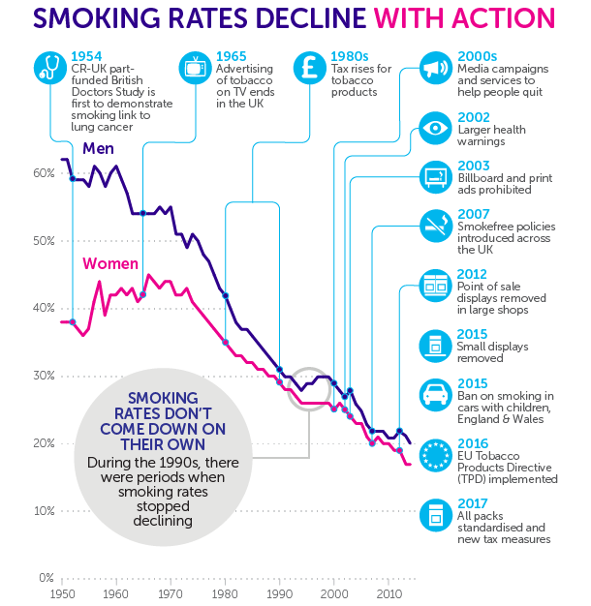

Source: This is the end of tobacco advertising - Cancer Research UK - Cancer News

Slide 6
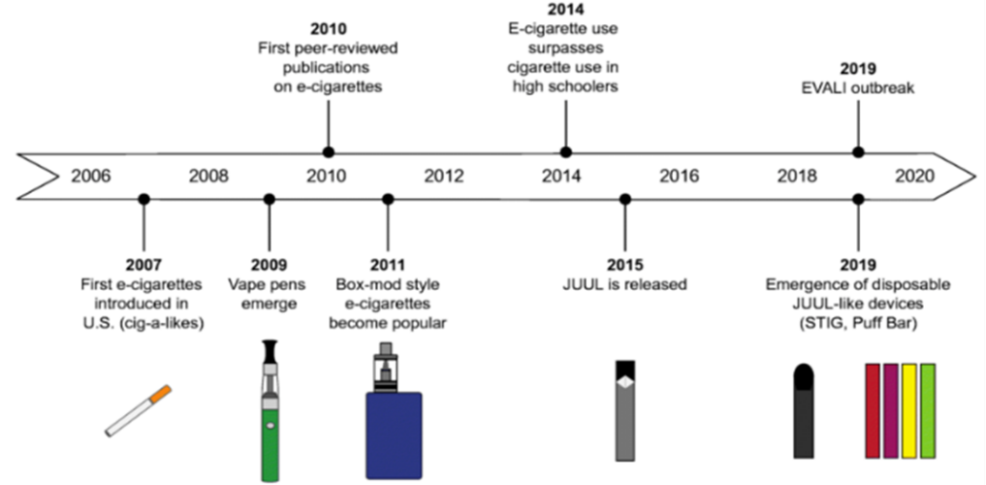
Cigarettes to vaping
    Vapes started to appear in the UK market in early 2010s.
    Generally ‘cig a likes’ that look like cigarettes, were marketed to current smokers but they weren't very popular as they weren’t very effective in delivering nicotine compared with cigarettes.
    Over 2010s, more vaping products began to emerge alongside industry developments:
      Became much more effective at delivering nicotine (now similar to cigarettes)
      Products looked less and less like cigarettes and are marketed differently
      Bright branding and packaging, high visibility in areas where children and young people are
      Disposables vapes emerged in later 2010s and rapidly become the device of choice, especially amongst CYP
Current E-Cigarette Research in the Context of Asthma - Scientific Figure on ResearchGate. Available from: https://www.researchgate.net/figure/Timeline-representing-the-evolution-of-e-cigarette-devices-and-pertinent-events-related_fig1_343531738 [accessed 8 Apr, 2024]
(Source: ASH: Use of e-cigarettes among young people in Great Britain June 2023)
Action on Smoking and Health (ASH) carry out an annual survey of vape use amongst young people (under 18) across Great Britain. ​
​
The proportion of young people using non-rechargeable disposable electronic cigarettes has increased significantly since 2021.

Slide 7

Vaping today
    Vapes are being designed to be more attractive to the consumer using bright colours and sleek designs.
    There are concerns about how vaping devices are marketed and promoted, especially how they may appeal to children and young people.
    Most children and young people do not vape. However, there has been a rise in children and young people in Wales reporting experimenting and regularly using vapes.
    There is concern that young people using vapes are more likely to become addicted to nicotine, have more difficulty quitting and are at higher risk of addiction to other substances in the future.
Check out the Data and Statistics resource for further information on vaping use today.

Slide 8
What next?
    We know that vaping including nicotine can cause addiction and dependency and have an adverse effect on your health and wellbeing.
    We do not yet know the long-term health effects of vaping.
    We know that there are planned changes to the law in Wales relating to vaping.
    We do not yet know how this will impact current rates of vaping amongst children and young people.
    We know that the Tobacco industry continue to design 'next generation' products.
    We do not know what these products will look like and how they may be marketed.
What do you think the future holds?

