Slide 1


See, Think, Wonder
Vaping

Slide 2
Discuss the following images and answer the following three questions:
What do you see?
What do you think?
What do you wonder?

Slide 3
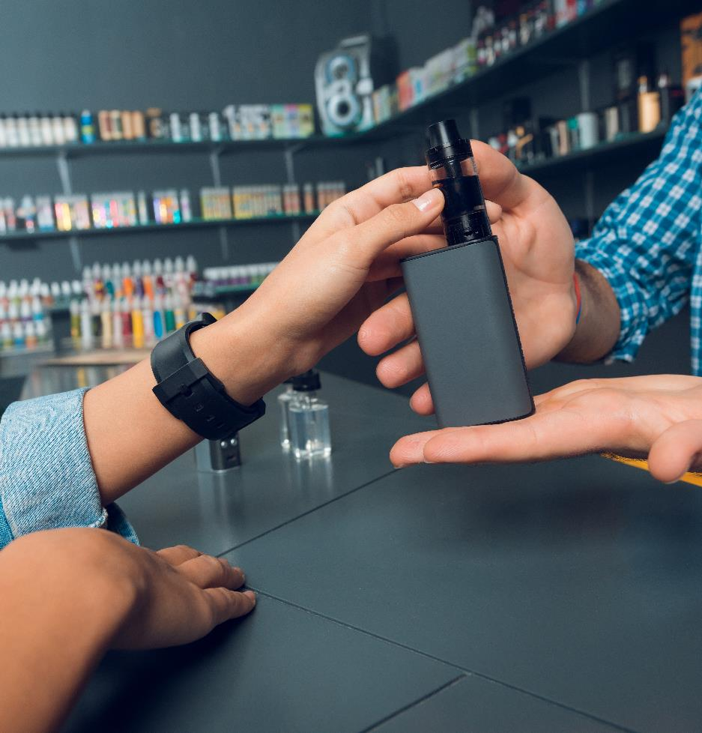

DRAFT
Vaping devices should not be used by children and young people. It is illegal for adults to buy (or try to buy) vaping devices or e-cigarettes for anyone under 18. This is known as ‘proxy purchase’.
Fines can be issued to retailers and individuals breaking the law.

Slide 4

Switching completely from smoking to vaping significantly reduces health harm for smokers who are unable or unwilling to quit. Unlike cigarettes, there is no combustion (burning) involved in vaping devices, so there is no smoke and no other harmful products of combustion, such as tar and carbon monoxide. This does not mean they are entirely safe, but they are understood to be less harmful than smoking as they do not contain the tar, carbon monoxide and other products that cause many smoking-related illnesses.
This mother may be using a vaping device
to stop smoking.

Slide 5
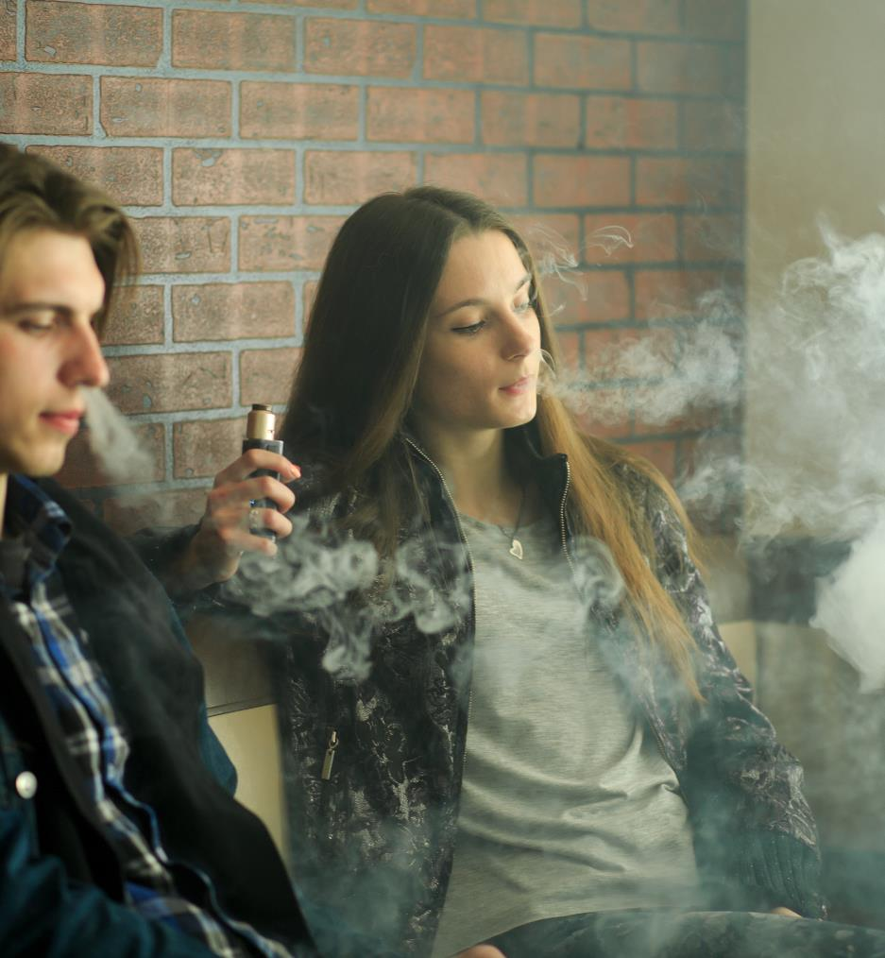
Germs can live almost everywhere. When vapes are used by more than one person germs can spread between them. Multiple viruses such as Flu, the common cold and the herpes virus (which causes cold sores) is present in saliva and so can be passed between people by sharing vapes. It is sensible hygiene advice not to share vapes or to use vapes discarded by others.
It is sensible hygiene advice not to share vapes.

Slide 6
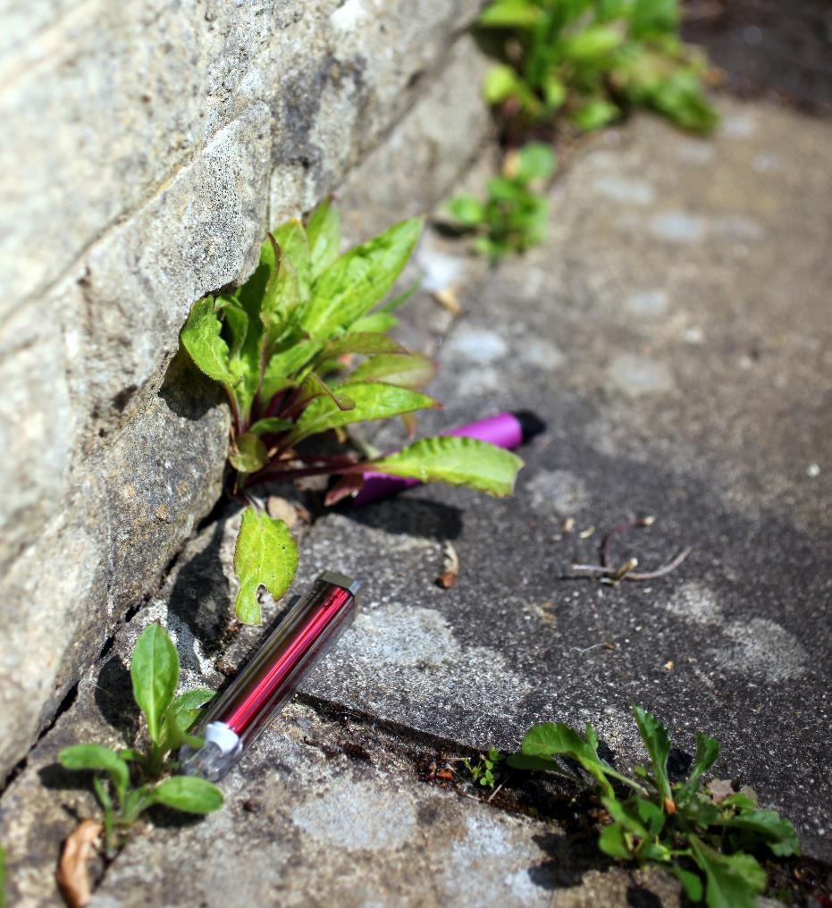
Vaping devices contain metals and plastics which can take many years to decompose. The use of disposable vaping devices and products has increased substantially amongst young people, with 69% of current vapers using disposable vaping devices in 2023 compared with 7.7% in 2015. Rather than decomposing, plastic turns into “microplastics” which continue to pollute the environment, our food and drinking water.
Disposable vapes pose a risk to our environment.

Slide 7
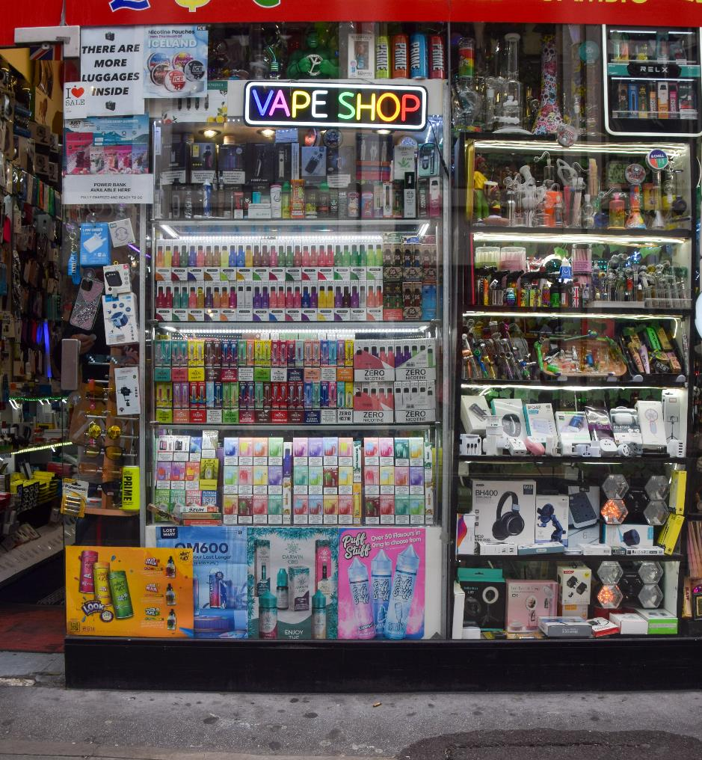
There are concerns about the marketing and promotion of vaping devices and how these may appeal to children and young people. For example, vaping devices may be offered in flavours and colours with packaging and designs (to look like a highlighter pen for example) that can be particularly attractive to young people. New market innovations such as disposable vapes are often cheaper and therefore more affordable to young people and are widely sold.
However, the fact remains, vaping devices should not be used by children and young people.

