Slide 1


Risk Taking Behaviours
Vaping

Slide 2

What do we mean by 'risk'?
'Actions that increase the likelihood of harm or danger to someone or something'
Consider the following questions and images.

Slide 3
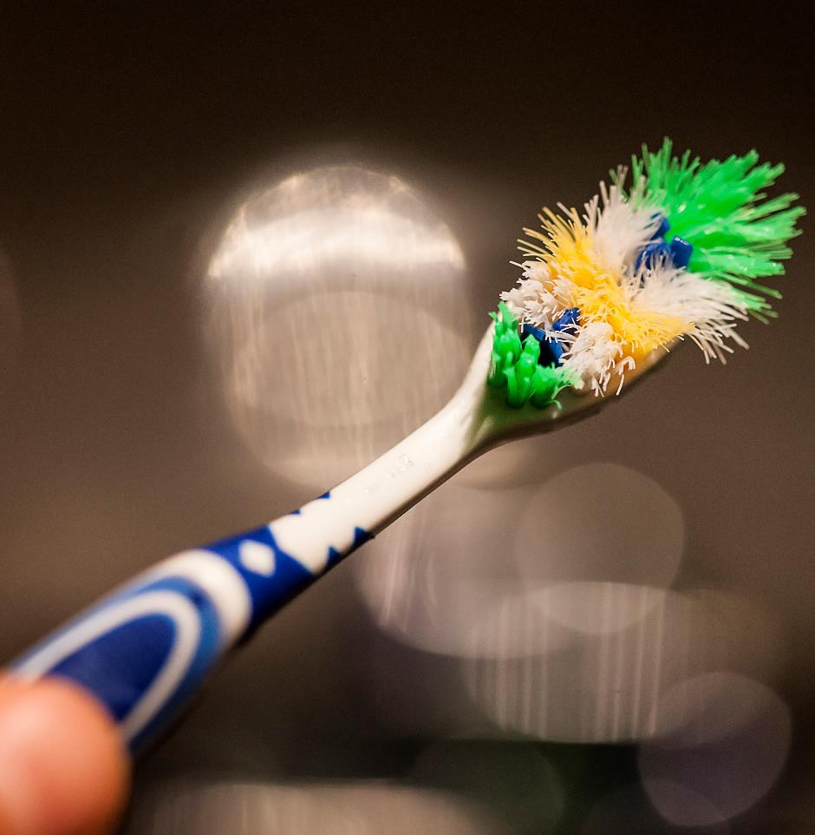
Would you brush your teeth with someone else’s toothbrush?
Germs can live almost everywhere.
When vapes are used by more than one person germs can spread between them.
Viruses and bacteria that can be spread through saliva include the common cold, flu and Herpes simplex (cause of cold sores).
It is sensible hygiene advice not to share vapes.

Slide 4
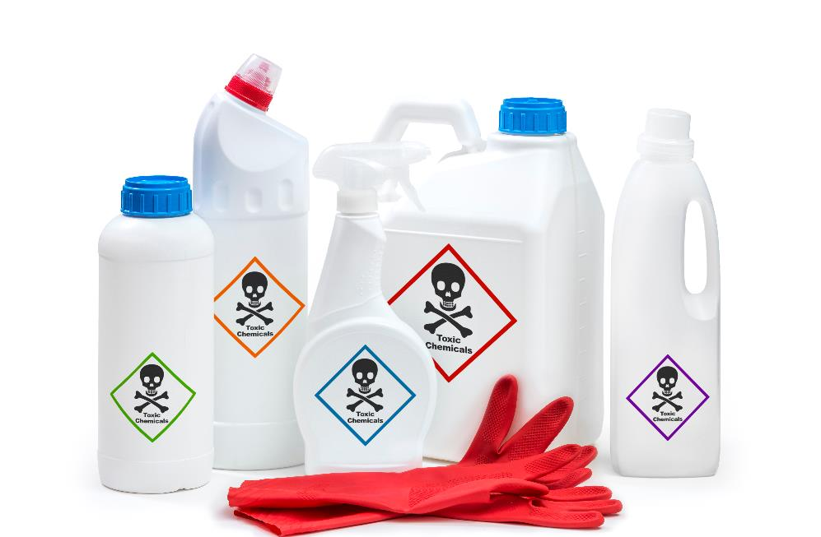
Would you drink these liquids?
Vaping devices use liquid.
It may not always be clear to the user whether the liquid contains nicotine or other substances.
Illegal vapes could pose additional health risks to those using them because they are not regulated and may not meet UK standards.
Some illegal vapes have been found to contain ingredients that are banned in the UK such as caffeine, certain colourings, vitamins and taurine as well as a higher concentration of nicotine.

Slide 5

Would you swim in these conditions?
Evidence regarding the long-term health effects resulting from the use of vaping devices is very limited.
A young person may not be able to detect if a vape contains nicotine or cannabis and other banned substances.
There is also emerging evidence that suggests young people who vape are at an increased risk of addiction to other illegal and health harming substances in the future.

Slide 6
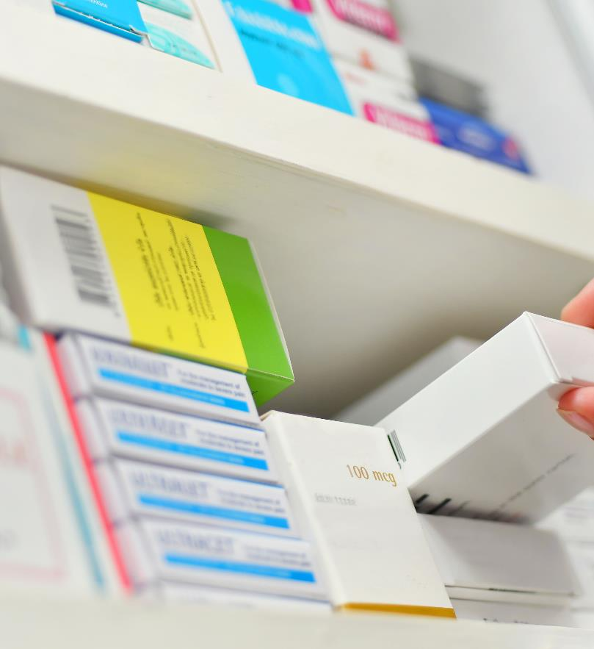
Would you take antibiotics if you weren’t unwell?…
Vaping is a smoking cessation tool that is used to help cigarette smokers to quit smoking.
Vaping is not for non-smokers.
Vaping devices should not be used by children and young people.
Individuals should never use or take medication that they do not need.

