Slide 1
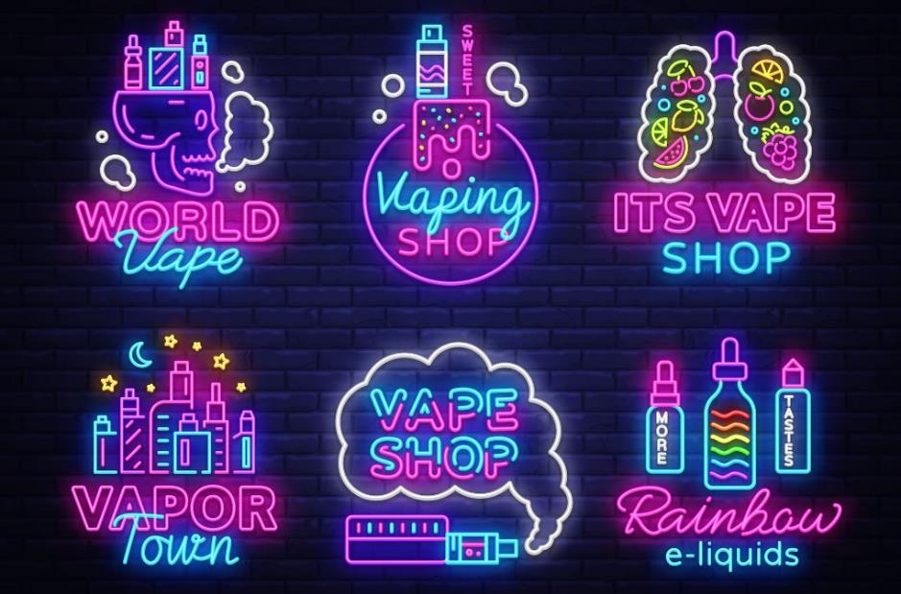
How are we influenced?
Vapes, Nicotine and Tobacco

Slide 2

The definition of influence:
'The capacity to have an effect on the character, development, or behaviour of someone or something, or the effect itself'
Just about anything can influence your decision making, behavior and values but the more we are exposed to something, the more normal it can seem. For example, you may be influenced to wear certain types of clothes, listen to certain music or even to drink certain drinks.
Consider how you are influenced by your friends, family, social media, music, reels and adverts.
What influences you?

Slide 3
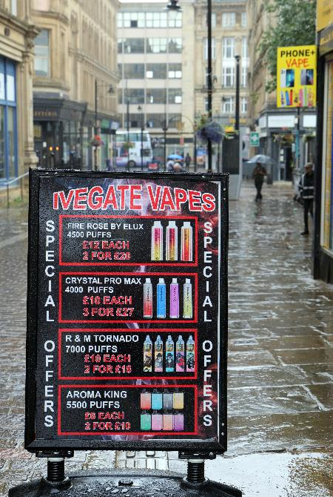
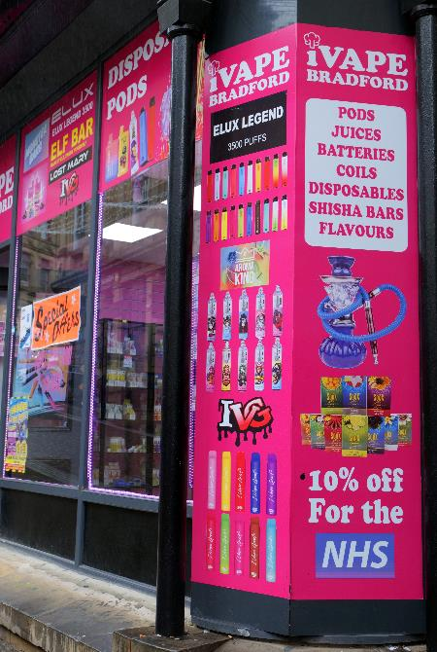
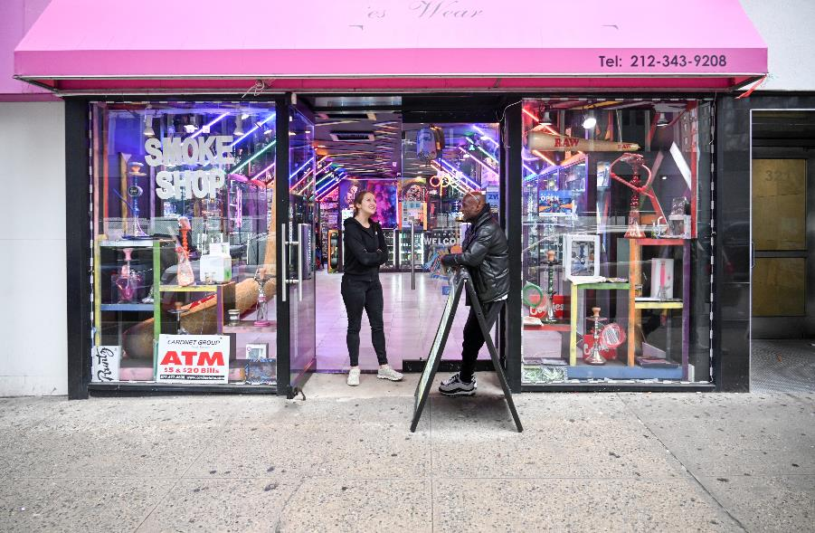
Discuss the following images

Slide 4

How are vape shops and displays designed?
Why do you think are bright lights, large text, colours and logos used?
Why do you think special offers or discounts are advertised?
Does vape product packing come with harm statements in the same way that tobacco products do? How does this effect the packing and the way the product looks?

Slide 5

Why do you think vaping devices and products are sold in different flavours that may appeal to children and young people?
Why do you think vaping devices and products sold in bright colours are likely to appeal to children and young people?
What other products do you see in shops with similar colours and flavours?

Slide 6
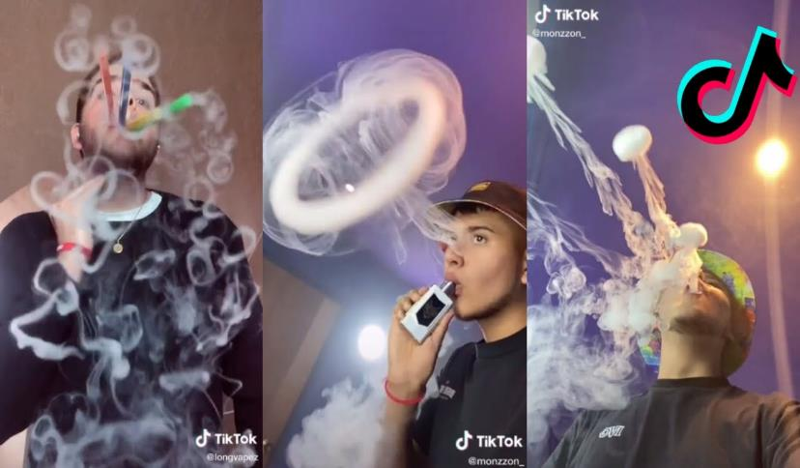
What product placement techniques do the vaping industry use to promote their products, for example, social media and influencers?
What does their approach tell you about their target audiences?
Are there similarities with the tobacco industry now or in the past?
1

Slide 7
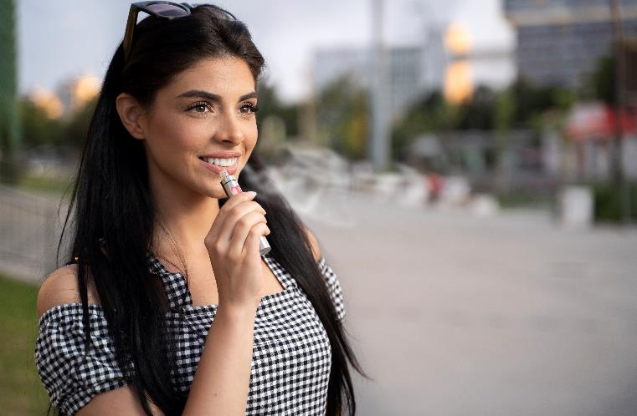
Why would advertisers use images of people looking happy and smiling when they vape?
What thoughts, feelings and emotions are advertisers and marketers trying to evoke in response to their products? Are these realistic?
What are advertisers not telling you?

Slide 8
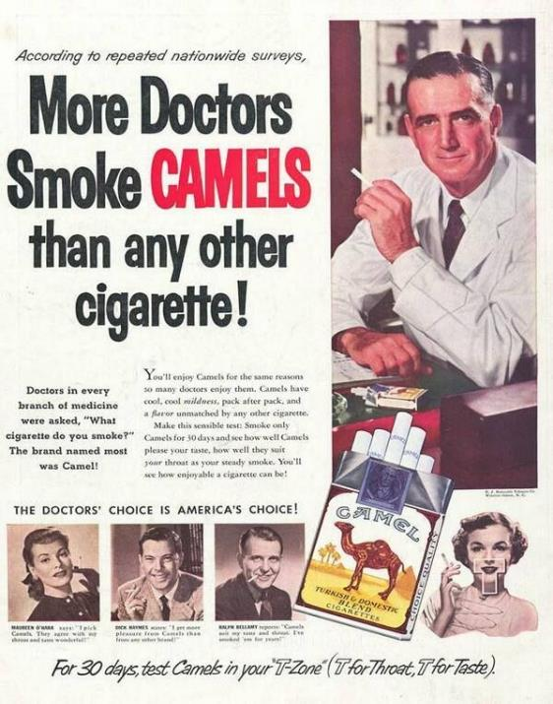
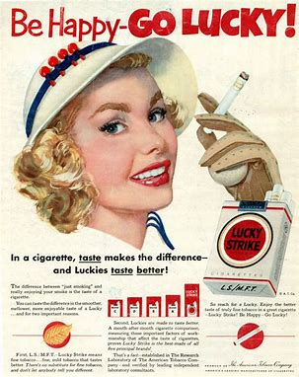
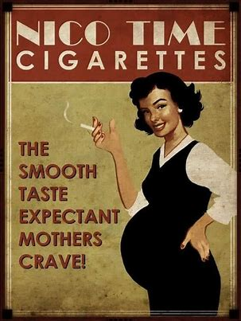
Discuss the following images
2
3
4

Slide 9
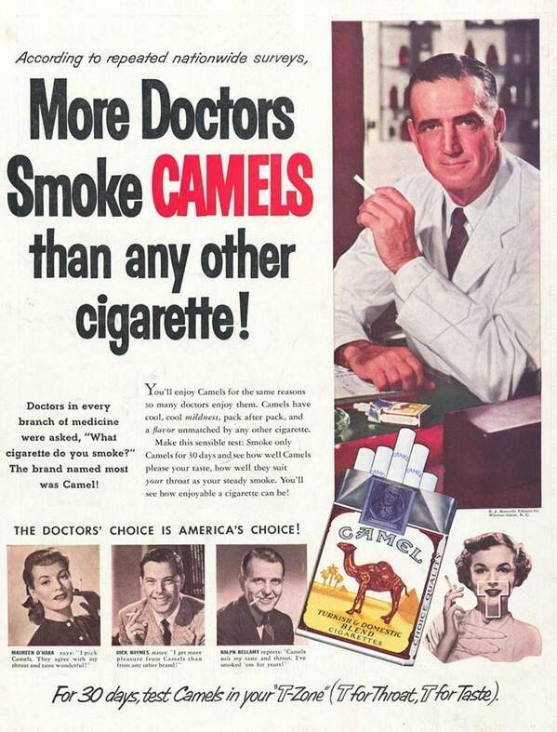
What do these adverts tell you about attitudes toward smoking, tobacco and nicotine at the time?
Is it likely you would see an advertisement like this today, in 2024?
What do we know now that we didn't know then?

Slide 10
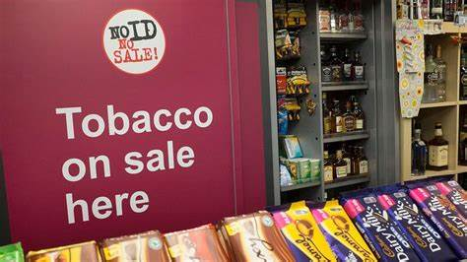
What are the differences in advertising regulation of tobacco and vaping devices?
Can you see the different types of tobacco and cigarette products on sale in shops?
What impact does this have on young people’s exposure to vaping and messages about vaping?
5

Slide 11
Things to consider:
Be aware of who and what influences you
Think critically about the source of information and their motivations
Ask questions
Build your own understanding by exploring the facts
Make decisions based on your own beliefs and not those of others

Slide 12
Image reference library
Source
1: Amazing Vape Trick.. Tiktok Compilation.. Learn Some Tricks.. - YouTube
2: https://idevie.com/resources/25-controversial-vintage-ads-that-wouldnt-be-allowed-today
3: Example of tobacco advertising in the 1950s [5] | Download Scientific Diagram(researchgate.net)
4: "Be Happy, Go Lucky!" – The Appeal of Vintage Lucky Strike Tobacco Ads Fromthe Early 1950s ~ Vintage Everyday
5: Bristol study finds shops 'undermining' tobacco display ban - BBC News

