Slide 1
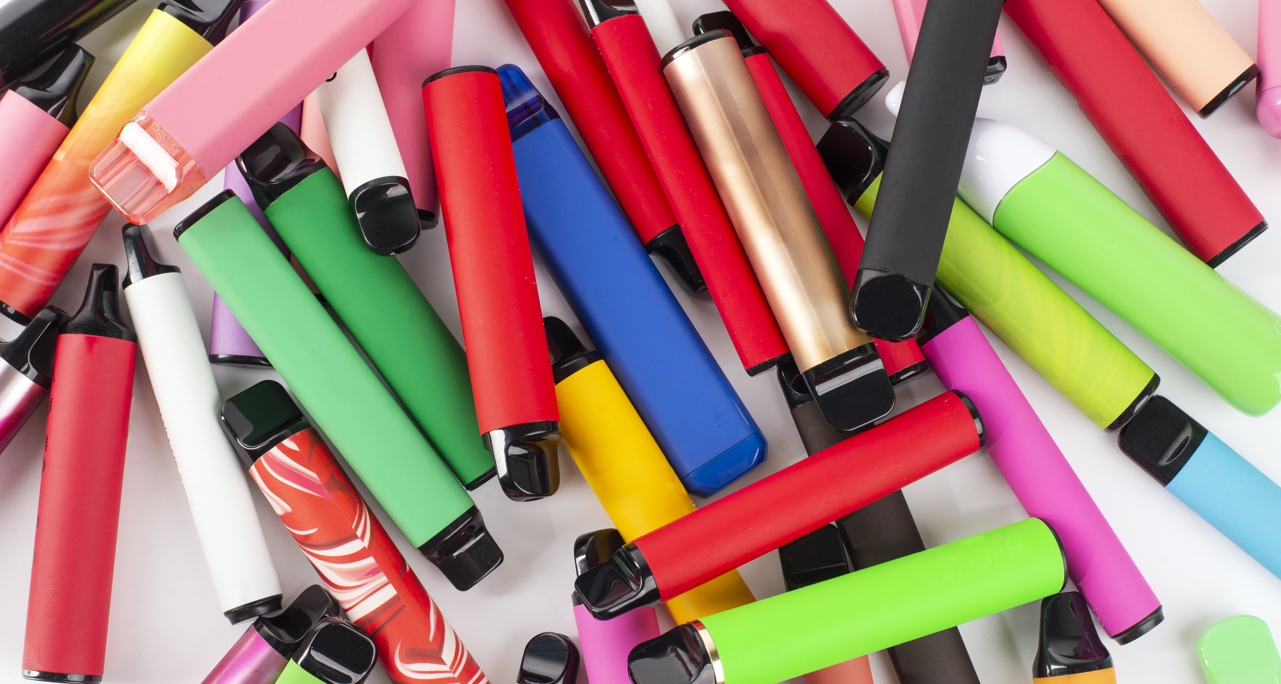
Data and Statistics
Vaping

Slide 2
Key sources of data
School Health Research Network student Health and Well-being Surveys in Wales are undertaken every two years and provide a regular snapshot of children and young people in Wales' health behaviours.
An interactive data dashboard is available which shows patterns of experimental and regular vape, cigarette and other substance use relating to area, age, gender and family affluence at local authority, health board and All Wales level.
A national report is also available.
Schools can currently access their SHRN data via a bespoke school report sent directly to participating schools. A school-level interactive dashboard is currently in development; the prototype for this work is available.
Action on Smoking on Health (ASH) is a charity that conducts research and provides data on smoking and vaping. Use of e-cigarettesamongyoungpeopleinGreatBritain - ASH

Slide 3
How many children and
young people use vapes?
The vast majority of children and young people in Wales do not vape. The 2022/23 SHRN survey report found:
95% of young people reported they did not currently use vapes*
80% of young people reported they had never tried a vape
97% of young people reported they do not smoke tobacco*
However, studies including the School Health Research Network (SHRN) Student Health and Well-being Survey in Wales have shown that the use of vaping devices among children and young people in the UK has been on the rise in recent years.
Data from the SHRN 2023 Health and Well-being Survey, available in summer 2024, will help us to understand more about patterns and trends in smoking and vaping amongst young people in Wales.
*answered I do not use or use less than once a week.

Slide 4
How many children and
young people use vapes?
• 1 in 5 secondary aged learners (20%) from Year 7 to 11 had ever tried vapes.
• 5% of secondary aged learners reported use of vapes regularly (defined as at least weekly).
• Year 11 learners were more likely to use a vaping device at least weekly (14%) compared with Year 7 learners (1%).
• Secondary aged learners from less affluent families were the most likely to have tried vapes and to use them regularly.
• A higher proportion of year 7 to 11 girls (7%) reported vaping at least weekly compared with boys (4%). Amongst young people who identified as neither a boy nor a girl, 8% reported vaping at least weekly.

Slide 5

Learners regularly using vapes
• 5% of secondary aged learners reported use of vapes regularly (defined as at least weekly)
The vast majority of children and young people in Wales do not vape
1 in 20
Secondary aged learners
reported using vapes regularly
Based findings from the 2021 School Health Research Network Health
and Well-being Survey. 2023 data will be available in summer 2024.

Slide 6
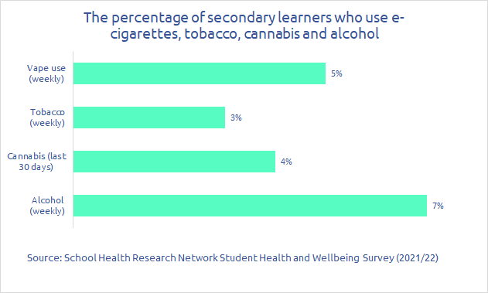
Vape use compared to
other substances
Use of vapes, tobacco, alcohol and cannabis amongst learners in secondary years 7-11 in Wales in 2021 (Source: SHRN)​.
​
A higher proportion of secondary ages learners drink alcohol weekly compared to vape weekly.
Based findings from the 2021 School Health Research Network Health
and Well-being Survey. 2023 data will be available in summer 2024.

Slide 7
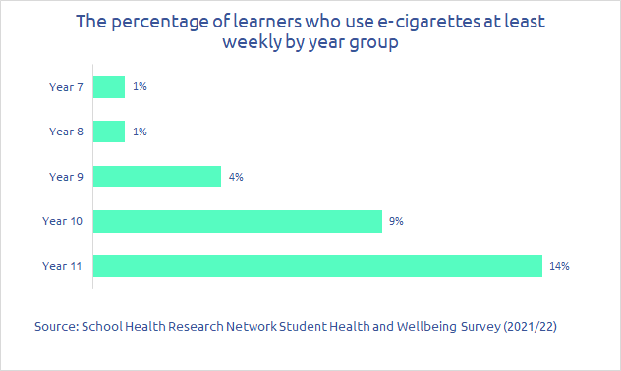
Learners regularly using vapes
by year group
Year 11 learners were more likely to use a vaping device at least weekly (14%) compared with Year 7 learners (1%).
Based findings from the 2021 School Health Research Network Health
and Well-being Survey. 2023 data will be available in summer 2024.

Slide 8

Learners regularly using vapes
20% of secondary aged learners from Year 7 to 11 had ever tried vapes
The vast majority of children and young people in Wales do not vape
4 in 20
Secondary aged learners
reported ever trying vapes
Based findings from the 2021 School Health Research Network Health
and Well-being Survey. 2023 data will be available in summer 2024.

Slide 9
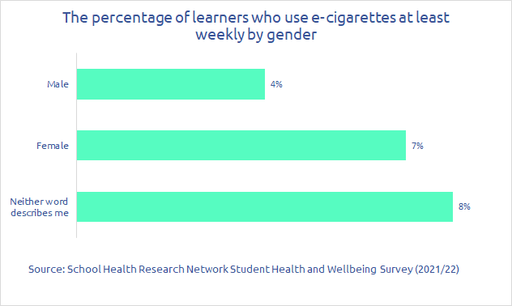
Vape use by gender
A higher proportion of Year 7 to 11 girls (7%) reported vaping at least weekly compared with boys (4%).
Amongst young people who identified as neither a boy nor a girl, 8% reported vaping at least weekly.
Based findings from the 2021 School Health Research Network Health
and Well-being Survey. 2023 data will be available in summer 2024.

Slide 10
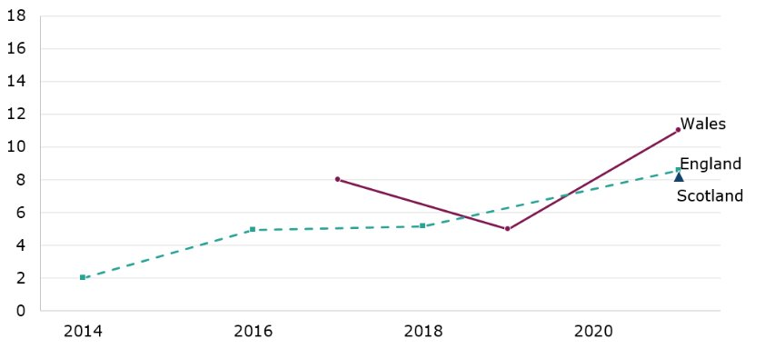
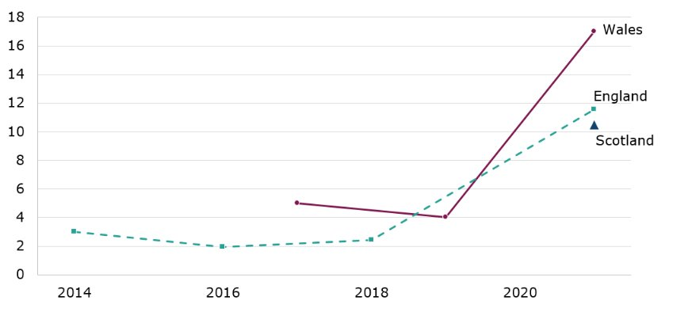
Vape use by gender in Wales
and other UK nations
Boys in year 11 reporting to use e-cigarettes regularly
Girls in year 11 reporting to use e-cigarettes regularly
Wales: School Health Research Network (SHRN), DECIPHer​
England: Survey of smoking, drinking and drug use among young people in England (SDD), NHS Digital​
Scotland 2021: Health and Wellbeing Census Scotland, Scottish Government​
In 2021, Wales had the highest proportion of girls and boys in year 11 using e-cigarettes regularly.

Slide 11
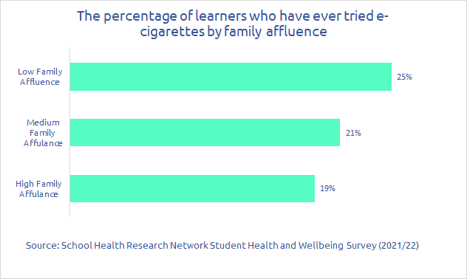
Vape use by family affluence
Secondary aged learners from less affluent* families were the most likely to have ever tried vapes.
* SHRN use the ‘Family Affluence Scale’ to estimate young people’s social-economic status. This is a well-established measure used internationally.
Based findings from the 2021 School Health Research Network Health
and Well-being Survey. 2023 data will be available in summer 2024.

Slide 12
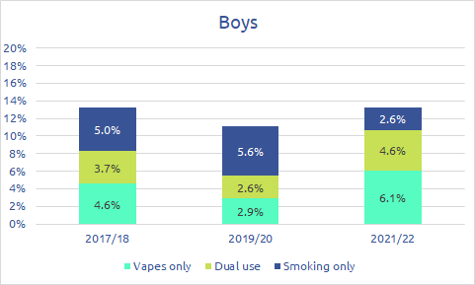
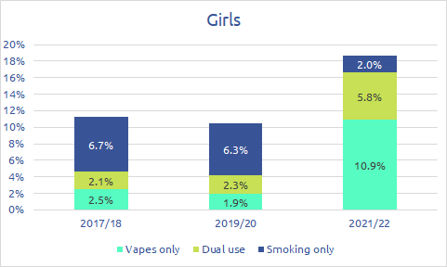
Smoking, dual use and vaping
The proportion of boys and girls in year 11 only smoking is decreasing. ​
However, the proportion who are dual users and vaping only is increasing.
Figure 4: Percentages in year 11 of secondary education in Wales by gender who i) smoke regularly ('smoking only'), ii) use vapes regularly (‘vapes only’), iii) use both regularly ('dual use'). (Source: SHRN, additional analysis by Public Health Wales Observatory)

Slide 13
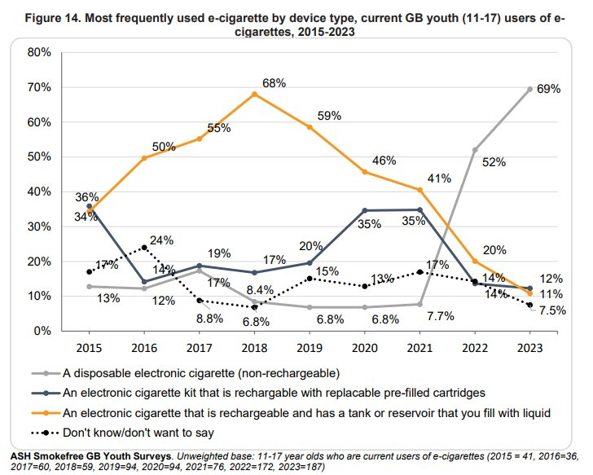
Most frequently used vape
by device type
Action on Smoking and Health (ASH) carry out an annual survey of vape use amongst young people (under 18) across Great Britain.
The proportion of young people using non-rechargeable disposable electronic cigarettes has increased significantly since 2021.
(Source: ASH: Use of e-cigarettes among young people in Great Britain June 2023)

Slide 14
Emerging data
There are various queries about vaping that are not easily answerable as the data/information is not currently available or reliable. These include, for example:​
​
What is the equivalent nicotine content of vapes versus cigarettes?​
What is the number of school exclusions where vaping is cited as a factor?​
How many disposable vapes are purchased per day/month/year/to date?​
Where do young people obtain vapes (e.g. shops, parents, other)?​
​
As the evidence builds and we are able to provide reliable data sources to respond to such queries, we will be able to update future iterations of this knowledge bank.

