Slide 1
Introduction to proposed changes to the routine childhood immunisation programme ​
Recorded slide set (1)
20th March 2025
Vaccine Preventable Disease Programme
Public Health Wales

Slide 2
Acknowledgements
UK Health Security Agency​
Vaccine Preventable Disease Programme​
Vaccine Programme Wales​

Slide 3
Aim of this resource​
The aim of this recorded slide set is to provide healthcare professionals with an introduction and overview of the proposed changes to the routine childhood immunisation schedule in 2025/2026.​
​
This is the first in a series of recorded slide sets in relation to the changes. ​
​
Further slide sets in this series will be published as more information about the changes becomes available. These will be made available here: Immunisation training resources and events - Public Health Wales​
​
As these are recorded slides they can be viewed in many clinical settings, including lunch and learn sessions and independent CPD. ​
​
The proposed changes are dependent on policy approval. ​
​
The information within these slides is up to date as of the 20th March 2025

Slide 4
The Joint Committee on Vaccination and Immunisation (JCVI)​
These proposed changes are based on advice by the JCVI.
The role of the JCVI​
Independent expert committee advising the UK government on vaccines.​
Reviews scientific evidence, safety data, cost-effectiveness and public health impact.​
Ensures vaccine programmes provide the greatest benefit to public health.​
Joint Committee on Vaccination and Immunisation - GOV.UK

Slide 5
JCVI Decision making process​
Review disease burden - How serious and widespread is the disease?​
Assess Vaccine Safety & Effectiveness - Evidence from clinical trials and real-world data.​
Consider cost-effectiveness - Is the vaccine a good use of NHS resources?​
Model Public Health Impact - How will the vaccine reduce infections and hospitalisations?​
Consult stakeholders - Input from experts, healthcare professionals and public health bodies.​
Make recommendations ​
Government decision​
Welsh Government​
Health is devolved. Wales aligns with UK guidance for consistency across the UK, unless specific adaptations are needed.

Slide 6
Overview of proposed changes to routine childhood schedule
Juliet Norwood, Specialist Nurse, Vaccine Preventable Disease Programme, Public Health Wales.

Slide 7
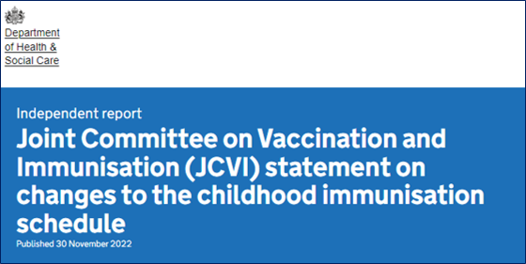
Hib/MenC (Menitorix®) to be discontinued
In November 2022 the JCVI put out a statement following notification that manufacturing of Hib/MenC (Menitorix®) is to be discontinued.​
This is a commercial decision made by the manufacturer, GlaxoSmithKlein (GSK). ​
As this is the only Hib/MenC vaccine available, changes to the routine infant schedule are necessary.​
The UKHSA estimates that the central stock of Hib/MenC (Menitorix ®) will be depleted by mid 2025.
Joint Committee on Vaccination and Immunisation (JCVI) statement on changes to the childhood immunisation schedule - GOV.UK
Policy is awaited.

Slide 8
JCVI recommendations:
The JCVI recommended the following changes once the current supply of Hib/MenC (Menitorix®) vaccine has been used:​
due to the success of the adolescent MenACWY programme in controlling meningococcal C disease across the population, the JCVI has advised that MenC is no longer required in the childhood schedule.​
the JCVI advised that there is still a continued need for a dose of Hib vaccine during the second year of life. They advise that a, additional dose of Hib-containing multivalent vaccine (such as the 6-in-1 DTaP/IPV/Hib/HepB, which is also given earlier in infancy) should be given at 18 months to replace the Hib. This would be at a new appointment.​
the second dose of MMR vaccine should be brought forward from 3 years 4 months to 18 months of age, to improve coverage (in the new appointment).​
In the meantime, the JCVI will keep emerging evidence under review, including ongoing epidemiology and disease incidence.​
Policy is awaited.

Slide 9
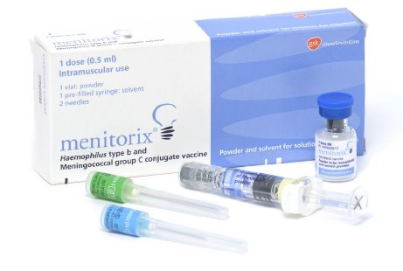
Hib/MenC (Menitorix®): current schedule
The Hib/MenC (Menitorix®) vaccine provides protection against Haemophilus influenzae type b (Hib) and invasive capsular group C (MenC) disease.
​It is currently given at 12 months of age.​
Hib: ​
The Hib/MenC (Menitorix®) given at 12 months is the 4th routine Hib containing vaccine given to children. ​
The previous 3 doses of Hib antigen are given as part of the 6-in-1 hexavalent vaccine (DTaP/IPV/Hib/HepB) given at 8, 12 and 16 weeks of age.​
MenC: ​
The Hib/MenC (Menitorix®) given at 12 months is the only MenC vaccine given routinely to infants.​
MenC is given as part of the MenACWY vaccine given routinely to teenagers.

Slide 10
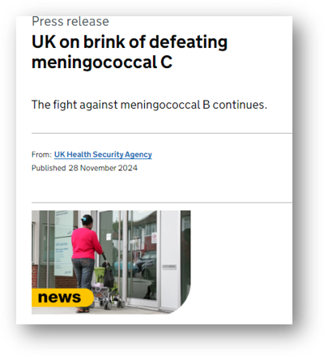
Discontinuation of Hib/MenC (Menitorix®): MenC
The introduction of the MenC vaccination programme in 1999 led to a significant reduction in the number of cases of invasive meningococcal C disease.​
The adolescent MenACWY programme commenced in 2015 and has been successful in further reducing the incidence of meningococcal C disease (as well as cases of meningococcal W disease).​
Alongside this programme, a further significant decline in the spread and detection of invasive meningococcal disease (IMD) was seen because of the implementation of social distancing and lockdown measures as part of the emergency response to the COVID-19 pandemic.
UK on brink of defeating meningococcal C - GOV.UK

Slide 11

Discontinuation of Hib/MenC (Menitorix®):MenC
Modelling work reviewed by the JCVI in June 2022 found that indirect protection against MenC in infants is sustained because of the teenage MenACWY programme. ​
Over time the teenage vaccine programme is expected to reduce carriage prevalence of groups C, W and Y to near elimination levels (group A carriage has already been almost undetectable for many years in the UK).​
It is therefore predicted that by the time Hib/MenC (Menitorix®) vaccine is no longer available there would be very few invasive meningococcal disease (IMD) cases caused by meningococcus groups A, C, W and Y each year, and therefore very few cases which could be prevented by a MenC-containing vaccine in infancy.​
The JCVI state that it is therefore very unlikely that an infant or toddler MenACWY immunisation campaign would be cost effective.

Slide 12
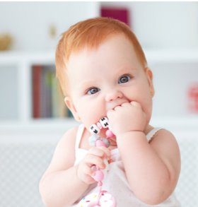
Discontinuation of Hib/MenC Menitorix®):MenC
The JCVI has advised that:​
“Due to the success of the adolescent MenACWY programme in controlling meningococcal C disease across the population a dose of meningococcal C containing vaccine is no longer recommended at 12 months”.​
Joint Committee on Vaccination and Immunisation (JCVI) statement on changes to the childhood immunisation schedule - GOV.UK​
From mid 2025 (subject to policy) MenACWY will be the only routine MenC dose in the routine immunisation schedule for Wales. ​
The JCVI did note concerns about the MenACWY vaccine uptake in the teenage programme, where this is relied upon to provide indirect protection. Modelling did show that where the uptake substantially dropped, indirect protection was still maintained. ​
However, it will be important that effort continues to be made for vaccine catchup for any cohort that missed vaccination. It is important to promote high uptake of the MenACWY vaccine. ​
It is essential that high uptake of MenACWY and good surveillance of meningococcal infection and invasive meningococcal disease is maintained to monitor the impact of the vaccination programme and expected overall decline in disease.​

Slide 13

Discontinuation of Hib/MenC (Menitorix®): Hib
As Hib/MenC (Menitorix®) is being discontinued, the dose of Hib vaccine at 12 months will no longer be available. Therefore, the JCVI advise:​
there remains a need for a dose of Hib vaccine during the second year of life​
it is recommended that this dose of Hib vaccine be replaced with an additional dose of Hib containing vaccine, such as the hexavalent DTaP/IPV/Hib/HepB (6-in-1)​
it is recommended that this additional dose of DTaP/IPV/Hib/HepB (6-in-1) should be given at 18 months​
this would be at a new 18-month appointment​
having the new 18-month appointment provides an opportunity for the second dose of MMR (MMR2) to be brought forward from 3 years 4 months to 18-months.​
Note: an additional DTaP/IPV/Hib/HepB (6-in-1) vaccine at 18 months will have implications for the selective Hepatitis B programme.
Await policy on this.​

Slide 14

Timing of the replacement Hib dose
The JCVI considered many factors in relation to the timing of the Hib-containing vaccine:​
the overarching aim of the Hib programme is to attain herd immunity in the population.​
due to the success of the current Hib immunisation programme there is minimal Hib disease currently circulating in the UK. ​
modelling shows that Hib transmission is primarily driven by children aged 2- 4 year olds, therefore vaccination at any time before then should prevent transmission.​
giving the Hib-containing vaccine at 18 month allows space and flexibility to consider the best schedule for future programmes.​
a dose of a multivalent Hib-containing vaccine at 18 months mitigates blunting from maternal programmes*.​
having an immunisation visit prior to school entry provides an additional opportunity for any children who may have missed previous vaccine doses to catch up with their routine immunisations.
Recommended additional dose of Hib containing vaccine DTaP/IPV/Hib/HepB (6-in-1) at 18 months

Slide 15
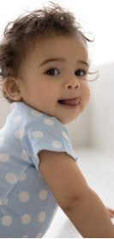
Bringing forward second MMR
The JCVI have proposed bringing forward the second MMR from 3 years 4 months to the new 18-month appointment.​
The main reason for bringing the MMR forward is to improve coverage and reduce the likelihood of measles outbreaks.​
In areas of London where the second dose of MMR was brought forward in response to local measles outbreaks in the 2000’s, coverage of the second dose of MMR vaccine increased by an average of 3.3% Impact of an accelerated measles-mumps-rubella (MMR) vaccine schedule on vaccine coverage: An ecological study among London children, 2012–2018 - ScienceDirect.​
The JCVI considers that the likely added benefit of increasing coverage for the second MMR further justifies the additional routine immunisation appointment at 18 months.

Slide 16
Summary of proposed changes to routine childhood schedule
AGE​ | CURRENT​ | PROPOSED​
12-13 months​ | Hib/MenC​ PCV​ MMR 1​ MenB​ | X​ PCV​ MMR 1​ MenB​ ​
18 months. New appointment​ | ​ | Additional 6-in-1​ MMR 2​ ​
2-3 years (and every school year annually from September)​ | Flu​ | Flu​ ​
3 years 4 months​ | 4-in-1​ MMR 2​ | 4-in-1​ X​ ​
For routine immunisation schedules for Wales see: Routine immunisation schedules for Wales - Public Health Wales​

Slide 17
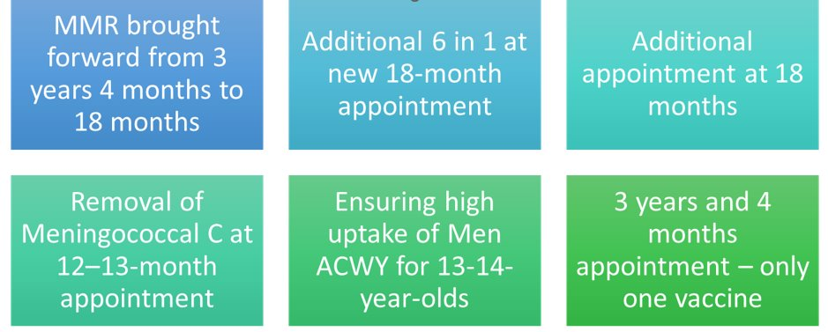
Some points to consider
Policy is awaited.

Slide 18
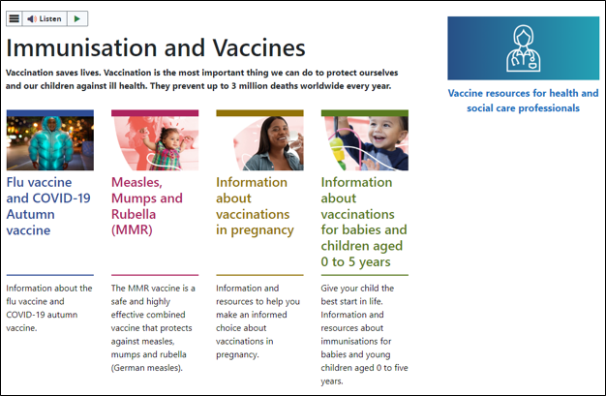
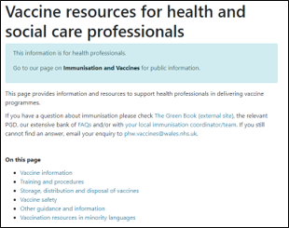
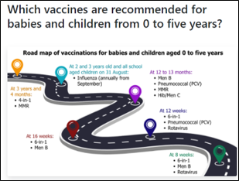
Signposting: to be updated to reflect the changes
Vaccine resources for health and social care professionals - Public Health Wales
Immunisation and Vaccines - Public Health Wales
Information about vaccinations for babies and children aged 0 to 5 years - Public Health Wales

Slide 19
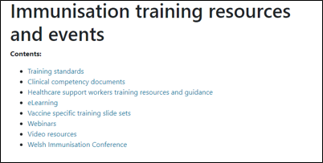
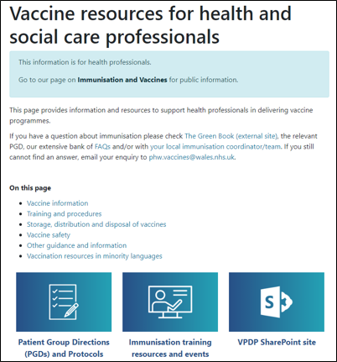
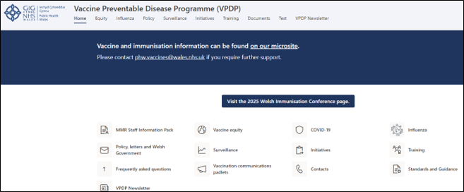
Training resources
Immunisation training resources and events - Public Health Wales
Vaccine resources for health and social care professionals - Public Health Wales

Slide 20
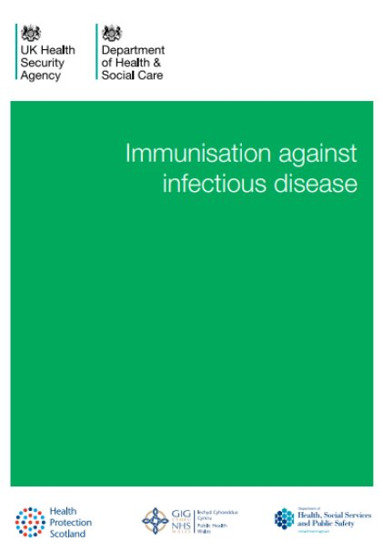
Planned resources
There will be a full range of resources and guidance for healthcare professionals, parents and carers. ​
All relevant Green Book chapters, PGDs and existing resources will be updated.
Immunisation against infectious disease - GOV.UK
Patient Group Directions (PGD) - Welsh Medicines Advice Service

Slide 21
Epidemiology and Surveillance
Charlotte McDermott – Senior Epidemiologist – Health Protection - CDSC

Slide 22
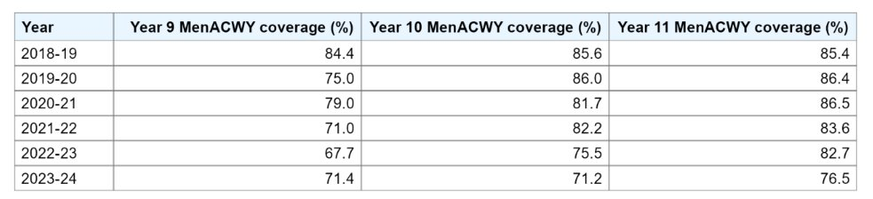
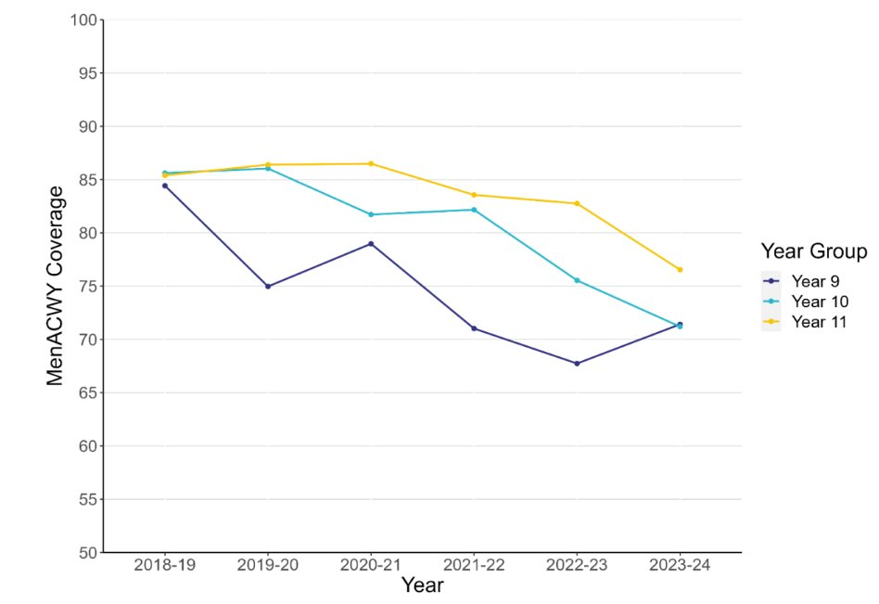
Importance of maintaining high uptake in teenage MenACWY vaccine programme
MenACWY coverage in years 9, 10 and 11 in Wales from 2018-2024.
MenACWY vaccine coverage in 2023-24 increased in year 9 pupils, but continued to decrease in 10 and 11 school year cohorts, following a downward trend seen since 2020-21.​
Indicating an ongoing need for improving catch-up activities in these age groups.

Slide 23
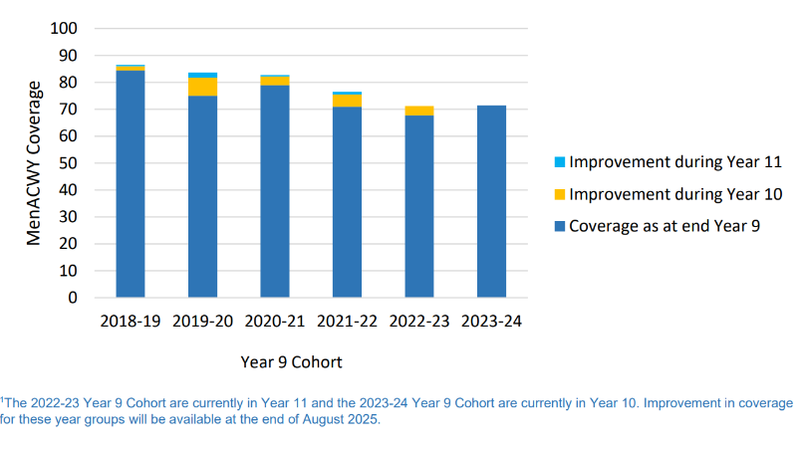
Importance of catch-up vaccinations
MenACWY coverage in a year cohort from academic year 2018-19 to 2023-24.*

Slide 24
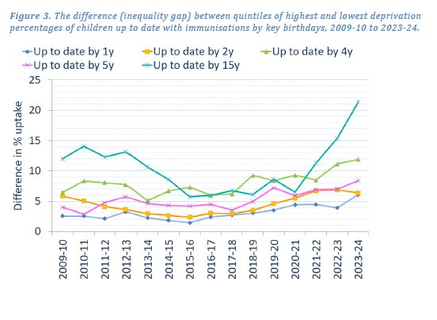
Inequalities in uptake of routine childhood immunisations in Wales 2023-24
Compared to 2022-23, the percentage point gap in uptake of routine immunisations in the most deprived and least deprived areas in Wales have:
Increased in one-year-olds from 3.9 to 6.1
Decreased in two-year-olds from 6.8 to 6.3
Increased in four-year-olds from 11.2 to 11.9
Increased in five-year-olds from 7.0 to 8.4
Increased in 15-year-olds from 15.4 to 21.3
Widening inequalities. Largest since 2009-10 for all ages apart from 2-year-olds.​
Plan to monitor this quarterly going forward​.

Slide 25
Determinants of Equity in Vaccination Coverage
Studies have shown that there are numerous determinants that can impact on vaccination coverage.​
For example, factors such as: living in a more deprived area, children resident in large or single parent household, being eligible for free school meals, and having a recorded language other than English or Welsh have been found to be associated with lower coverage. [1]​
Demographic factor such as ethnicity, country of birth and gender have also been shown to be associated with vaccination coverage. [2][3]​
Evidence of determinants of uptake can guide targeted strategies to improve it and reduce inequality gaps.
  [1] Determinants of Equity in Coverage of Measles-Containing Vaccines in Wales, UK, during the Elimination Era - PMC (nih.gov)
  [2] Equity of the Meningitis B vaccination programme in England, 2016-2018 - PubMed (nih.gov)
  [3] Childhood vaccination coverage in Australia: an equity perspective - PMC (nih.gov)

Slide 26
Surveillance Webpages
Surveillance of Vaccines, Vaccine Preventable Diseases and Respiratory Infections​
COVER - National childhood immunisation uptake data - Public Health Wales​
Teenage Immunisation Report 2023/24: nhswales365.sharepoint.com/sites/PHW_VPDPComms/Shared Documents/Forms/AllItems.aspx?id=%2Fsites%2FPHW_VPDPComms%2FShared Documents%2FCOVER%2FTeenage Immunisation Coverage_202324_FINAL%2Epdf&parent=%2Fsites%2FPHW_VPDPComms%2FShared Documents%2FCOVER

Slide 27
Public Engagement and Vaccine Equity
Jasmin Chowdhury – Service Development and User Engagement Senior Practitioner, Vaccine Preventable Disease Programme

Slide 28

Attitudinal Survey with Parents of 0-5 years old
The aim is to gather insights on:​
Attitudes & perceptions on childhood immunisation​
Explore & understand motivations, barriers & facilitators ​
Identify trusted sources of information, preferred formats & explore interest in co-production
Survey of Parental Attitudes towards Immunisation of Pre-School Children (2021)
Childhood vaccines: parental attitudes survey 2023 findings

Slide 29
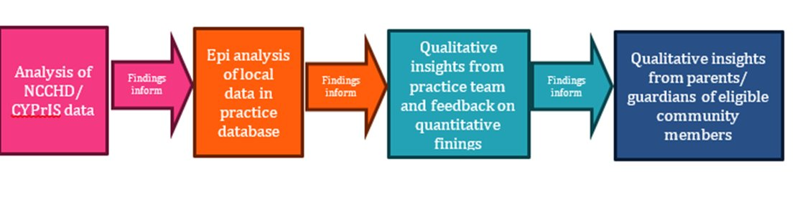
Rapid Service Evaluation Pilot with Deep End Practice
This collaborative piece of work between PHW VPDP, Practice within Deep End Cymru project, is intended to pilot an approach which could be used for future work to explore issues associated with under vaccination in highlighted deprived areas.​
The approach builds on the frameworks recommended in WHO guidance on tailoring immunisation programmes (TIP) (WHO Regional Office for Europe, 2019) and practical guidance on identifying, addressing and tracking inequities in immunisation (WHO Regional Office for Europe, 2023)
Deep End Wales Project

Slide 30

Community Vaccine Champions ​from Ethnic Minority Communities
Working with colleagues from LPHT at Cardiff & Vale to develop a pool of community vaccine champions for pregnancy & pre-school vaccination from ethnic minority communities ​
Roles of vaccine champions:​
Raise awareness of vaccines in local communities​
Gather feedback and insights around vaccination from local communities​
Work with us to co-produce vaccine-related resources​

Slide 31

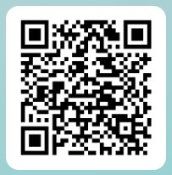
We value your feedback! Please take a few moments to complete the evaluation – this will ensure future sessions are meeting service needs.
Potential changes to the routine childhood immunisation programme - Feedback Form

