Slide 1
Respiratory syncytial virus (RSV)
vaccination programme for older adults
These slides are version controlled and subject to revision
Vaccine Preventable Disease Programme
Public Health Wales
Version 6
Last update: August 2025
Notes:
Material contained in this document may be reproduced without prior permission provided it is done so accurately and is not used in a misleading context.
Acknowledgement to Public Health Wales NHS Trust to be stated.
© 2025 Public Health Wales NHS Trust.
Change History:
Version 2
Slide 5: Updated links
Slide 6: Content updated to reflect catch-up
Slide 7: Added ®to the vaccine names and content updated based on JCVI advice (RSV immunisation programme: JCVI advice, 16 July 2025 - GOV.UK)
Slide 8: Added Green Book reference and updated WHC
Slide 11: Amended bullet point 4
Slide 13: Symptoms updated in line with Green Book RSV Chapter
Slide 14: The word ‘suitable’ has been removed from the first bullet point: There is no specific treatment suitable for RSV and treatment is therefore aimed at supporting the patient and relieving symptoms
Slide 15: Added: with a catch-up programme for those already past 28 weeks gestation, but that have not yet given birth. This information added to notes section:*Pregnant women will remain eligible until discharge from maternity services and should be actively offered vaccination at each opportunity. Introduction of RSV Vaccination Programme 2024 (WHC/2024/032). Updated to reflected extended catch-up.
Slide 18: Added following bullet point - individuals should be invited within 12 weeks of their 75th birthday, moved generic content to notes field.
Slide 19: Amended bullet point 3. Information added to notes section
Slide 20: Updated to reflect extended catch-up including eligibility table
Slide 21: Content added to notes field
Slide 24: Content updated to reflect recent MHRA Drug Safety Alert on Guillain-Barre syndrome (GBS) and updated Green Book chapter content
Slide 25: Content updated to reflect recent MHRA Drug Safety Alert on Guillain-Barre syndrome (GBS) and updated Green Book chapter content
Slide 30: Added following text ‘As we get older, we all experience age related reduction in immune response to vaccination, this is a natural part of ageing and is called immunosenescence’.
Slide 32: New slide added with co-administration table
Slide 33: More detailed information added to this slide and image of vaccine pack
Slide 34: Added first 5 bullet points as additional information
Slide 41: Linked SmPC to EMC webpage
Slide 58: Removed link to recorded slide set
Slide 59: New slide
Version 3
Slide 5: redrafted the lay out, to ensure a consistent approach across the training slides
Slides 24 and 25: updated with the latest incidence data on Guillain-Barré syndrome (GBS) in surveillance trials of older adults. Respiratory syncytial virus: the green book, chapter 27a - GOV.UK [ updated 5 Feb 2025]
Version 4
Slide 24: Text changed in last bullet point: This compares to a background rate of GBS which is 20 per million per year in those aged 70-79 years (Sejvar et al., 2011). Respiratory syncytial virus: the green book, chapter 27a - GOV.UK [ updated 25 Feb 2025]
Version 5
Slides 43-44: New slides outlining the updated advice on vaccine preparation and use of the vial adapter: Abrysvo powder and solvent for solution for injection - Summary of Product Characteristics (SmPC) - (emc) [updated 27 February]
Version 6
Amendments made to the slide deck v5.0 inline with updated policy (CEM/CMO/2025/04 Respiratory Syncytial Virus (RSV) 2025: Amendment to WHC/2024/032) and updated Green Book RSV Chapter (Dated: 14/07/2025)
CEM/CMO/2025/04: Public Health Alerts
Green Book RSV Chapter: https://assets.publishing.service.gov.uk/media/686fbfcf2557debd867cbf9d/Green_Book_Chapter27a_RSV_14July2025.pdf

Slide 2
Please note:
This slide set focuses on the RSV vaccination programme of older adults. There is a separate slide set for the RSV vaccination of pregnant women for infant protection. Available to access on the PHW Immunisation training resources and events page

Slide 3
Acknowledgements
These slides were originally produced by UK Heath Security Agency (UKHSA), with permission from colleagues in UKHSA the content of these slides have been adapted for use in NHS Wales by the Vaccine Preventable Disease Programme in Public Health Wales

Slide 4
Learning objectives
By the end of this session, you should be able to:
explain what RSV is and be aware of the UK epidemiology
understand the rationale for the RSV older adult vaccination programme
describe how Abrysvo® RSV vaccine works
identify the groups that are eligible to receive an RSV vaccine
describe the process of consent and how this applies when giving vaccines
understand the legal mechanisms by which immunisers can supply and administer Abrysvo® RSV vaccine
describe how to correctly store, prepare and administer Abrysvo® RSV vaccine
communicate key facts in response to questions from individuals and/or their carer(s) and direct them to additional sources of information

Slide 5
Pre-requisites to administering RSV vaccine
Before administering RSV vaccine, it is recommended that:
Those new to immunisation should receive comprehensive foundation immunisation training. Both knowledge and clinical competence should be assessed before new immunisers start to give and/or advise about the RSV vaccine National Minimum Standards and Core Curriculum for Vaccination Training - an advisory document for Wales is being published alongside these standards and will be available here: Immunisation training resources and events - Public Health Wales
Training in the management of anaphylaxis and Basic Life Support is undertaken, as specified by policy for your local area and are familiar with Resuscitation Council UK (RCUK) guidance on Management of Anaphylaxis in the Vaccination Setting
Any additional statutory and mandatory training as required by your employer is completed
An appropriate legal framework to supply and administer RSV vaccine is in place e.g. patient specific prescription (PSD), Patient Specific Direction (PSD), Patient Group Direction (PGD). Visit here for Wales PGD template
Those involved in immunisation and vaccination understand the process of consent and how this applies when giving vaccines. Information on consent can be viewed here: Consent: the green book, chapter 2 - GOV.UK
Immunisers and those giving immunisation advice access and familiarise themselves with the following key documents: Green Book RSV Chapter 27a , Information for healthcare practitioners: RSV vaccination programme for older adults information for healthcare practitioners , the vaccine product information in the Summary of Product Characteristics (Electronic Medicines Compendium website) and the WHC/2024/032 Introduction of RSV vaccination programme 2024, WHC/2025/016 Update on RSV vaccination programme 2025, CEM/CMO/2025/04 Respiratory Syncytial Virus (RSV) 2025: Amendment to WHC/2024/032.
RSV vaccination programme for older adults: training slide set for healthcare practitioners
Notes:
New immunisers should also have a period of supervised practice and support with a registered healthcare practitioner who is experienced, up to date and competent in immunisation.
Practitioners should always ensure they are accessing the most up to date information and guidance.
Respiratory Syncytial Virus (RSV) training statement available at: https://phw.nhs.wales/topics/immunisation-and-vaccines/vaccines-professionals/immunisation-training-resources-and-events/

Slide 6
Background (1)
Respiratory syncytial virus (RSV) causes hundreds of thousands of infections across the UK each autumn/winter in the young and the old
RSV is an important cause of lower respiratory tract infections in older adults, resulting in illness (including pneumonia), admissions to hospital and deaths
Vaccines have now been developed which have been rigorously tested for safety and efficacy; Abrysvo® RSV vaccine (Pfizer Limited) was introduced into the UK schedule on 1st September 2024
The RSV vaccine protects for at least two years. Studies are ongoing to see how long it lasts. There are no data currently to support second doses in older adults
Those with a role in delivering the RSV vaccine programme need to be knowledgeable, confident and competent in order to promote the vaccination programme and deliver the vaccine safely
Notes:
See JCVI statement: Respiratory syncytial virus (RSV) immunisation programme for infants and older adults: JCVI full statement, 11 September 2023 - GOV.UK (www.gov.uk) and:
Hardelid P, Pebody R and Andrews N. Mortality caused by influenza and respiratory syncytial virus by age group In England and Wales 1999 to 2010. Influenza and Other Respiratory Viruses 2012: 1(7), 35-45.
Li Y and others. Adjusting for case under-ascertainment in estimating RSV hospitalisation burden of older adults in high income countries: a systematic review and modelling study. Infectious Diseases and Therapy 2023: 12, 1137-1149.
Fleming DM and others. Modelling estimates of the burden of respiratory syncytial virus infection in adults and the elderly in the United Kingdom. BMC Infectious Diseases 2015: 15, 443.
Introduction of RSV vaccination programme 2024 (WHC/2024/032) [HTML] | GOV.WALES
RSV immunisation programme: JCVI advice, 16 July 2025 - GOV.UK

Slide 7
Background (2)
Since 2022, a number of RSV products have become licensed in the UK for immunisation of infants (nirsevimab®), pregnant women (Abrysvo® vaccine) and older adults (Abrsyvo®, Arexvy® and mRESVIA ® vaccines). Abrysvo® vaccine is the vaccine used in both routine RSV programmes (Older Adult and Maternal vaccination programmes).
Since 2023, the JCVI has been actively reviewing evidence and considering a range of issues including disease epidemiology, vaccine efficacy, vaccine safety and cost-effectiveness. In July 2025 following continued reviews of the RSV vaccination programme, the JCVI recommended that the one-off catch-up campaign be extended to include adults aged 80 years and over and all residents in a care home for older adults. These recommendations will be considered by policymakers.**Policy awaited**
RSV vaccine should be offered to eligible individuals throughout the year as this is a year-round programme
Notes:
Introduction of a new RSV passive immunisation from autumn 2025 [HTML] | GOV.WALES
CEM/CMO/2025/04 Respiratory Syncytial Virus (RSV) 2025: Amendment to WHC/2024/032 available here: Public Health Alerts

Slide 8
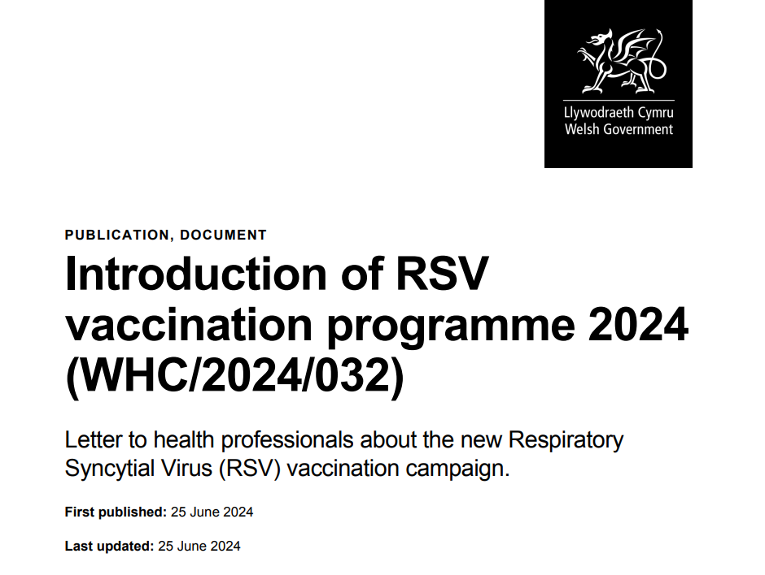
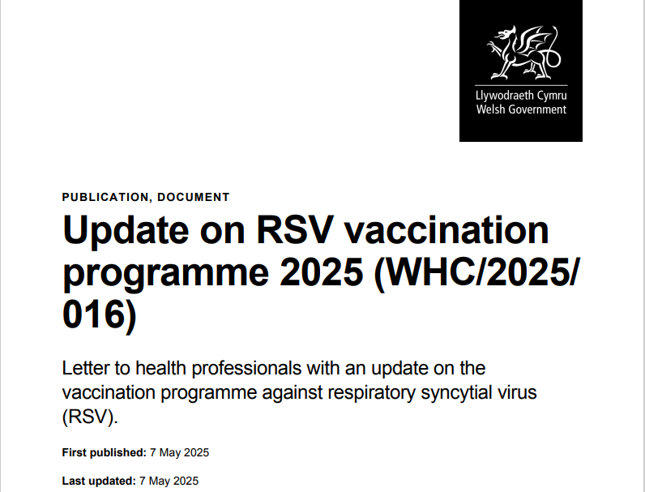
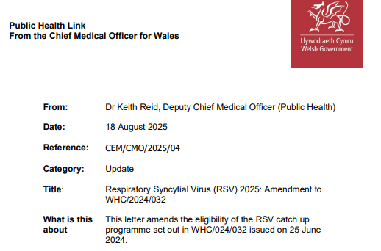
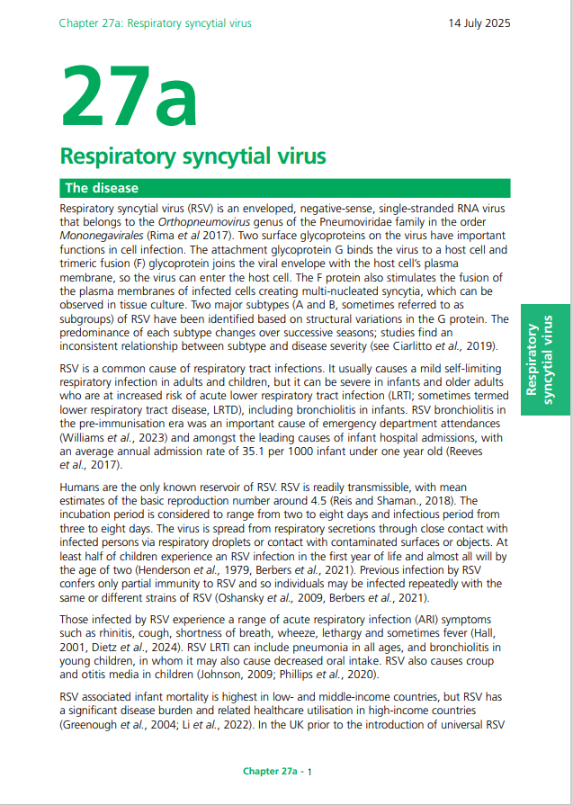
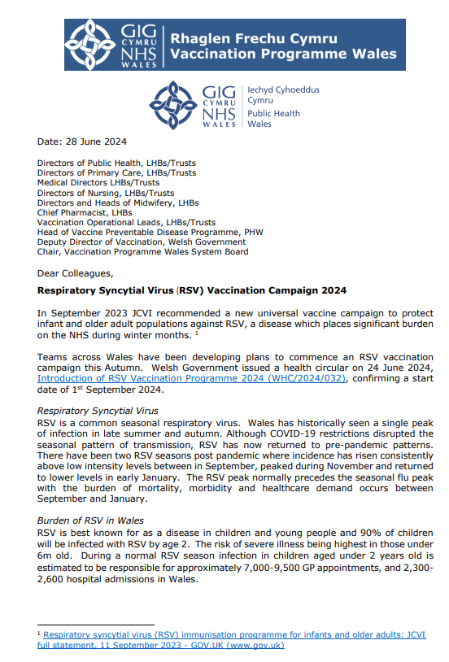
Key publications
Welsh Government issued a health circular on 24 June 2024, Introduction of RSV Vaccination Programme 2024 (WHC/2024/032), confirming a start date of 1st September 2024
Vaccine Programme Wales also issued a letter on the 28 June 2024, Respiratory Syncytial Virus (RSV) Vaccination Campaign 2024, summarising the maternal and adult RSV vaccination programmes, highlighting the vaccine to be used and the resources available from Public Health Wales to support the implementation of the campaign
The Green Book RSV chapter is currently being updated and will be available to view here: Respiratory syncytial virus: the green book, chapter 27a - GOV.UK (www.gov.uk) (14/07/2024)
UKHSA RSV vaccination of older adults: information for healthcare practitioners. This guidance is for healthcare practitioners implementing the vaccination programme to protect older adults from RSV.
Welsh Government issued a health circular on 6 May 2025, Update on RSV vaccination programme 2025 (WHC/2025/016) [HTML] | GOV.WALES, providing an update on the programme, and highlighting concerns of low vaccination uptake with request for immediate action.
Welsh Government issued a letter from the Deputy Chief Medical Officer on 18 August 2025, CEM/CMO/2025/04 Respiratory Syncytial Virus (RSV) 2025: Amendment to WHC/2024/032 which amends the eligibility of the RSV catch up programme set out in WHC/2024/032 issued on 25 June 2024.
Notes:
Update on RSV vaccination programme 2025 (WHC/2025/016) [HTML] | GOV.WALES Welsh Government, May 2025
CEM/CMO/2025/04 Respiratory Syncytial Virus (RSV) 2025: Amendment to WHC/2024/032 available here: Public Health Alerts

Slide 9
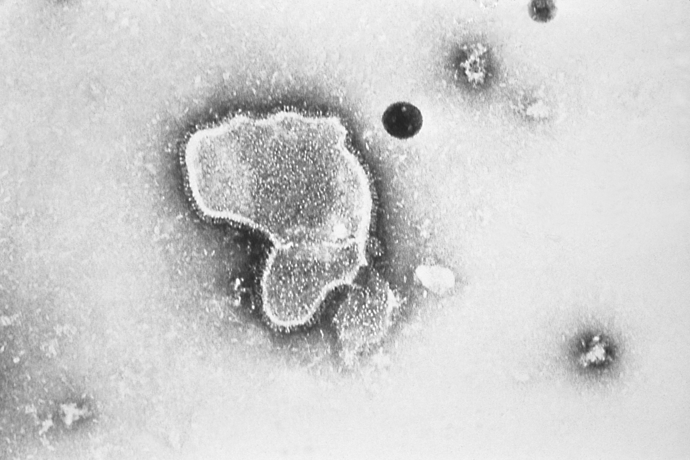
What is RSV?
Respiratory syncytial virus (RSV) is an enveloped, single-stranded RNA virus that belongs to the Orthopneumovirus genus of the Pneumoviridae family
RSV is a common cause of respiratory tract infections
It usually causes a mild self-limiting respiratory infection in adults and children but can be severe in infants and older adults who are at increased risk of acute lower respiratory tract infection
RSV is best known for causing bronchiolitis in infants. RSV disease may be under-recognised in older adults
Previous infection by RSV may only confer partial immunity to RSV and so individuals may be infected repeatedly with the same or different strains of RSV
Older adults may become vulnerable to RSV due to age-related decline of parts of their immune system (T-cell immunosenescence)
RSV virion highly magnified by transmission electron microscopic​
Image courtesy of the CDC

Slide 10
Transmission of RSV
RSV is highly communicable, but humans are the only known reservoir
The incubation period (time between infection and appearance of symptoms) varies from 2 to 8 days and the infectious period from 3 to 8 days
The virus is spread from respiratory secretions following close contact with an infected person via respiratory droplets or contact with contaminated surfaces or objects
The virus can survive on surfaces or objects for about 4 to 7 hours
10
Notes:
https://www.gov.uk/government/publications/respiratory-syncytial-virus-rsv-symptoms-transmission-prevention-treatment/respiratory-syncytial-virus-rsv-symptoms-transmission-prevention-treatment

Slide 11
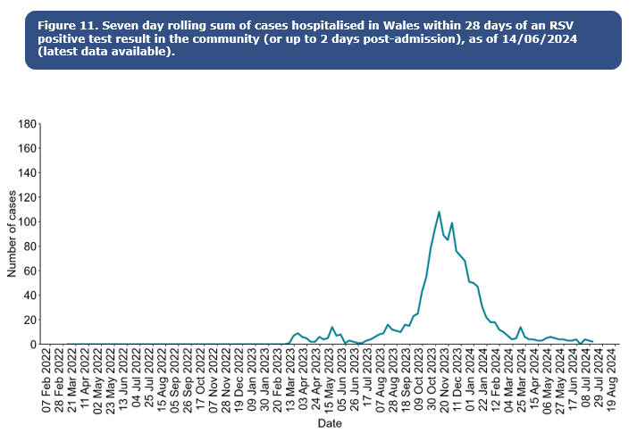
RSV epidemiology
Activity is highest in autumn and winter, with RSV season in the UK usually starting from October and declining by March
The peak of the RSV season varies from year to year
At least half of children experience an RSV infection in the first year of life and almost all will by the age of two. It frequently reinfects older children and adults
Confirmed case burden is highest in children aged up to 5y. In Wales, there are more than 1,000 babies (<1y) in hospital with RSV annually
It is a leading cause of infant mortality globally, and results in 20 to 30 deaths per year in the UK
For further information on RSV in Wales please go to Public Health Wales Weekly Influenza & Acute Respiratory Infection Surveillance Report 10 (wales.nhs.uk)
Notes:
In recent years, the RSV season has been interrupted by control measures against the COVID-19 pandemic which has resulted in unseasonal RSV activity; this included significant rebound activity in summer 2021 and summer 2022 and a very prolonged period of virus activity in 2022.
RSV is a leading cause of infant mortality globally, resulting in 20 to 30 deaths per year in the UK. RSV-related mortality in low-income countries is considerably higher, and in some analyses is the second commonest cause of death (after malaria) in infancy.
https://www2.nphs.wales.nhs.uk/CommunitySurveillanceDocs.nsf/($All)/FAC3B97E96996B2C80258CE500606BCC/$File/Weekly%20Acute%20Respiratory%20Infection%20Summary.pdf

Slide 12
RSV epidemiology in adults
Whilst the burden of RSV is well understood in infants and children, the burden of RSV in older adults is comparatively poorly understood and considered to be underestimated by existing routine surveillance
Only a minority of adult infections are diagnosed as RSV is not widely recognised as a cause of respiratory infections in adults
RSV can lead to serious health complications for adults aged over 75
The WHC/2025/016 highlights that annually in Wales it is estimated that RSV infection in adults over 75 years of age is responsible for:
  7,000-9,000 GP appointments,
  700-1,000 hospital admissions and
  400-600 hundred deaths each year
Notes:
Hardelid, P., Pebody, R. and Andrews, N. (2013), Mortality caused by influenza and respiratory syncytial virus by age group in England and Wales 1999–2010. Influenza and Other Respiratory Viruses, 7: 35-45. https://doi.org/10.1111/j.1750-2659.2012.00345.x (first published 09 March 2012)
Fleming DM and others. Modelling estimates of the burden of respiratory syncytial virus infection in adults and the elderly in the United Kingdom. BMC Infectious Diseases 2015: 15, 443.
Welsh reference: https://www.gov.wales/update-rsv-vaccination-programme-2025-whc2025016-html

Slide 13
RSV symptoms
For most people RSV infection causes a mild respiratory illness
RSV can cause a range of symptoms such as rhinitis (runny nose, sneezing or nasal congestion), cough, shortness of breath, wheeze, lethargy and sometimes fever
Symptoms can progress to acute lower respiratory tract infection
Short or long-term complications may include respiratory complications, cardiovascular abnormalities, and bacterial infections such as pneumonia
RSV may manifest as exacerbations of underlying COPD or cardiovascular disease
In immunocompromised patients, RSV can cause severe infections with mortality rates as high as 80%. Immunosenescence of T-cell responses may be a factor in vulnerability to severe RSV infection in older adults
Green Book Chapter 27a RSV
Notes:
A decreased appetite, croup and otitis media may also be symptoms in children.
RSV LRTI can include bronchiolitis in children.
Immunosenescence: age related reduction in immune response to vaccination.

Slide 14
Treatment and prevention
There is no specific treatment for RSV and treatment is therefore aimed at supporting the patient and relieving symptoms
Transmission can be reduced through standard infection control practices such as respiratory hygiene, hand washing with soap and warm water, and cleaning of surfaces
Ideally, people with colds should avoid close contact with vulnerable older adults, particularly those with weakened immune systems, and co-morbidities (particularly respiratory and cardiac disease)

Slide 15
RSV vaccination of older adults programme

Slide 16
Aim
The aim of the programme is to reduce the incidence and severity of RSV disease, and hospitalisation because of RSV disease, in eligible older adults.

Slide 17
RSV Immunisation programme eligibility (1)
In 2023 the Joint Committee of Vaccination and Immunisation (JCVI) recommended two RSV programmes, these programmes commenced on 1 September 2024:
  older adults programme
    adults turning 75 years old on or after 1 September 2024 until their 80th birthday
    adults already aged 75 to 79 years on 1 September 2024 until their 80th birthday (or until 31 August 2025 if they have their 80th birthday within the first year of the programme)
  *infant protection programme
    offered to all pregnant women from 28 weeks' gestation in every pregnancy for infant protection.
    A catch-up programme for women past 28 weeks' gestation up to discharge from midwifery services, starting from 1 September 2024
    (separate training slide set here and resources available here)
Notes:
*Pregnant women will remain eligible until discharge from maternity services and should be actively offered vaccination at each opportunity. Introduction of RSV Vaccination Programme 2024 (WHC/2024/032),

Slide 18
RSV Immunisation programme eligibility (2)
In 2025 the JCVI recommended extending the RSV programme for older adults to include:
  Adults aged 80 years and over and
  Residents in care homes for older adults
Welsh Government are currently investigating the options of the JCVI recommended wider expansion with partners across the four nations and public health authorities which is proposed to begin in 2026. In the interim there will be an extension to the current catch-up cohort.
From September 2025 inline with the CEM/CMO/2025/04 the following individuals will be eligible for the routine RSV vaccination programme:
  Individuals aged 75 years. These individuals should be vaccinated on or after (but not before) their 75th birthday.
  Individuals aged between 75 and 79 years of age are eligible for catch-up vaccination from 01 September 2024. These individuals will be eligible indefinitely.
  Individuals turning 80 years of age from 2 September 2024 (with a DOB AFTER 02 September 1944)
Notes:
CEM/CMO/2025/04 Respiratory Syncytial Virus (RSV) 2025: Amendment to WHC/2024/032 available here: Public Health Alerts

Slide 19
Eligibility table
Age | When can they have the RSV vaccine?
74 years | On or after their 75th birthday
75 to 79 years | Any time during this age range
80 years (born after September 1944) | Any time

Slide 20
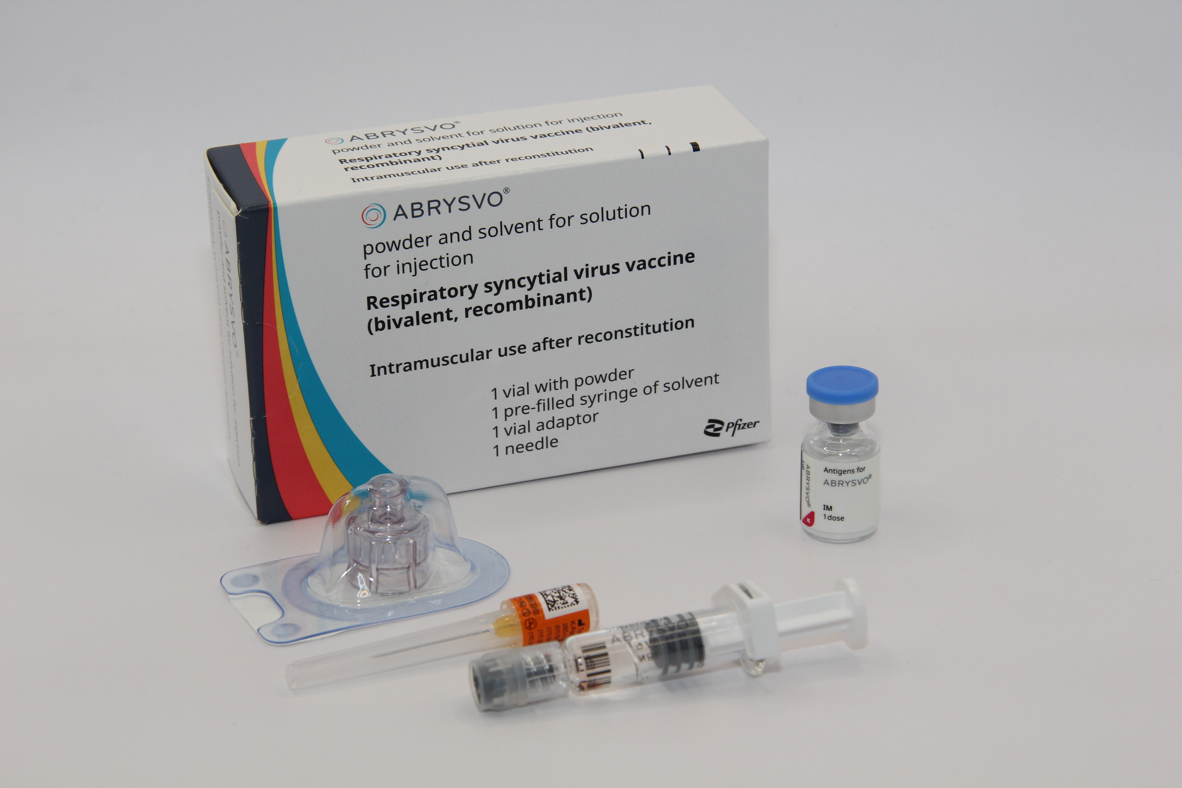
Abrysvo® vaccine: pharmaceutical information
Abrysvo® is the recommended vaccine for RSV vaccination of older adults and is the only vaccine currently available for use within the national programme in the UK
It is a non-live, bivalent recombinant vaccine
As it does not contain any live organisms, it cannot cause the disease against which it protects and can be given to immunosuppressed individuals
Abrysvo® requires reconstitution prior to administration
After reconstitution, one 0.5ml dose of Abrysvo® contains:
  RSV subgroup A stabilised prefusion F antigen 60 micrograms
  RSV subgroup B stabilised prefusion F antigen 60 micrograms
  Abrysvo® is licensed for active immunisation of individuals 60 years of age and older* for the prevention of lower respiratory tract disease caused by RSV
  (Note: individuals aged 60 to 74 are not included in the national programme)
Image source: UKHSA
Notes:
*Abrysvo® is also licensed to protect infants from RSV LRTI through vaccination of pregnant women. The maternal indication is licensed by the Medical and Healthcare products Regulatory Agency (MHRA) as between 28 and 36 weeks gestation (see Green Book, Chapter 27a Respiratory syncytial virus: the green book, chapter 27a - GOV.UK for off-label use).

Slide 21
How Abrysvo® vaccine works
The RSV vaccine Abrysvo® is a non-live bivalent recombinant vaccine
Recombinant means a small piece of DNA from the protein of the virus is taken and inserted into a manufactured cell. As these cells grow the protein is made too. This protein is then purified and put into the vaccine which, when introduced into the body via IM injection, activates the immune system
It is referred to as bivalent because Abrysvo® contains versions of two proteins found on the surface of the virus called ‘RSV subgroup A stabilised prefusion F’ and ‘RSV subgroup B stabilised prefusion F’
The vaccine antigen (prefusion F proteins) stimulates the immune system to produce antibodies. When the individual encounters RSV virus, the antibodies neutralise the prefusion F proteins thus preventing the virus particle from fusing with and entering the host’s cells and causing an RSV infection
The vaccine is sometimes called pre-F because it is based on the prefusion form of the fusion (F) protein which the virus uses to invade human cells
Notes:
How RSV causes infection:
any virus particle consists of a protein shell (capsid) inside which is the nucleic acid (DNA or RNA) – the genome or the genetic code for that virus; RSV is an RNA virus
when a virus particle enters the host’s cells it is able to reproduce and release more virus particles which in turn infect other cells – establishing an infection
RSV virus particles use a special type of protein on the surface of the virus called a fusion (F) glycoprotein to pass through the cell membrane
the F proteins does this by fusing the virus cell membrane and the host’s cell membrane together; this allows the virus to move through the host’s cell membrane and enter the cells
the F protein changes shape as it fuses the RSV virus and human cell membranes together: while on the virus surface before infection, the protein is in a “prefusion” form, but as it interacts with the cell membrane it rearranges into an inactive, “postfusion” form
the prefusion form is antigenic – it stimulates an immune response; the immune system is able to recognise and respond to the presence RSV virus particles with prefusion F proteins on their surface by producing antibodies to combat the infection; the postfusion form is not antigenic
there are two subgroups of the prefusion form: A and B
Recombinant vaccine technology
different cells (for example bacteria, yeast, other established laboratory cell culture lines) are used to manufacture the vaccine
a small piece of genetic material (DNA) is taken from the microorganism (virus or bacterium) against which we want to protect and inserted into the manufacturing cells: this results in a “recombinant” version of those cells
the role of these recombinant cells is to help transport the DNA instructions for making the antigen into a host cell
once the recombinant cell enters the host cell line it instructs the host cells to rapidly produce the antigen
this antigen is grown in bulk, collected, purified, and then packaged as recombinant vaccine (the cell line used to manufacture the cells is not in the vaccine)
when the vaccine is injected, the antigen in it triggers the immune system to create antibodies that specifically target that antigen
recombinant vaccines are non-live so they cannot cause disease in the vaccine recipient

Slide 22
Abrysvo® vaccine: effectiveness
Abrysvo® was licensed in the UK by the MHRA in November 2023 on the basis of safety and efficacy following a clinical trial of over 17,000 immunocompetent adults aged 60 years and above, 52% of whom had at least one stable chronic underlying condition
At the end of the first RSV season, analysis demonstrated statistically significant vaccine efficacy (VE) for Abrysvo® for reduction of RSV-associated lower respiratory tract illness with 2 or more symptoms of 65.1% and 3 or more symptoms of 88.9%
In the second season, the efficacy against 2 or more symptoms was 55.7% and against 3 or more symptoms was 77.8%.
To date, over 12 million doses have been given to older adults around the world including over 1.5 million in the UK.
Healthcare professionals are asked to report all suspected adverse reactions via the Yellow Card Scheme at: www.mhra.gov.uk/yellowcard
There is currently no data to support second doses in older adults
Notes:
Source: Abrysvo powder and solvent for solution for injection - Summary of Product Characteristics (SmPC) - (emc) (medicines.org.uk)
The Green Book, Chapter 27A (https://www.gov.uk/government/publications/respiratory-syncytial-virus-the-green-book-chapter-27a) contains the following information regarding vaccine effectiveness in older adults:
For older adults, the pivotal phase 3, multi-country, randomised, double-blind, placebo-controlled trial recruited from the age of 60 years to assess Abrysvo’s efficacy against RSV lower respiratory tract infection (LRTI) with 2+ or 3+ symptoms (Walsh et al., 2023). Participants were randomised to receive vaccine (n=18,488) or placebo (n=18,479), stratified by ages 60-69 years (63%), 70-79 years (32%) and ≥80 years (5%). Stable chronic underlying conditions were present in 52% of participants; immunocompromised individuals were excluded. At the end of the first RSV season VE against RSV LRTI with ≥2 symptoms was 65.1% (95%CI: 35.9 to 82.0%) and with ≥3 symptoms 88.9%, (95%CI: 53.6 to 98.7%) (Pfizer 2024). VE estimates by RSV subtype have overlapping confidence intervals (Walsh et al., 2023). In the second season, VE was 77.8% against lower respiratory tract infection (LRTI )with 3+ symptoms (95%CI: 51.4 to 91.1%) and 55.7% (95%CI: 34.7 to 70.4%) against 2+ symptoms (Pfizer 2024).
Bullet 4 reference source: Respiratory syncytial virus (RSV) programme: information for healthcare professionals - GOV.UK

Slide 23
Abrysvo® Vaccine safety (1)
Guillain-Barre syndrome
  A small number of cases of Guillain-Barré syndrome (GBS) were detected in phase 3 clinical trials and in post-marketing surveillance of older adults
  Preliminary studies over the first seasons of vaccination in the USA, England and Scotland suggested that RSV vaccines were associated with an increased risk of GBS in the six weeks following administration
  The risk is estimated at around 10 to 25 cases of GBS for every million doses of the vaccine administered to older people. This compares to a background rate of GBS which is 20 per million per year in those aged 70-79 years
  The MHRA issued a Drug Safety Update (DSU) on 7 July 2025: Abrysvo▼® (Pfizer RSV vaccine) and Arexvy▼® (GSK RSV vaccine): be alert to a small risk of Guillain-Barré syndrome following vaccination in older adults. This informed healthcare staff to advise recipients of a small increase of GBS in older adults.
  The risk of experiencing Guillain-Barré syndrome following Abrysvo® in older adults remains rare.
Green Book Chapter 27a: RSV
RSV vaccination programme for older adults: training slide set for healthcare practitioners
Notes:
Green Book Chapter 27a RSV
Abrysvo▼ (Pfizer RSV vaccine) and Arexvy▼ (GSK RSV vaccine): be alert to a small risk of Guillain-Barré syndrome following vaccination in older adults - GOV.UK
Bullet #1: Schwarz et al., 2023, Walsh et al., 2023
Bullet #3: Sejvar et al., 2011

Slide 24
Abrysvo® Vaccine safety (2)
Guillain-Barre syndrome continued
  Overall, the benefit of vaccination in preventing hospitalisation and death from RSV LRTI in the eligible group remains highly favorable relative to the risks of any serious adverse reactions
  Healthcare professionals should advise all recipients of Abrysvo® and Arexvy® that they should be alert to signs and symptoms of Guillain-Barré syndrome and, if they occur, to seek immediate medical attention as it requires urgent treatment in hospital.
  Healthcare professionals should be alert to the signs and symptoms of GBS, to ensure correct diagnosis in order to initiate adequate supportive care and treatment and to rule out other causes.
  Individuals with a history of GBS can be vaccinated as recommended for their age. There is evidence to suggest that having had a prior diagnosis of GBS does not predispose an individual to further episodes of GBS when immunised with other vaccines. Although there is no current indication for revaccination, those who are diagnosed with GBS within six weeks of a dose of RSV vaccine, should be advised to seek medical advice before accepting a future offer of revaccination, on a precautionary basis.
RSV vaccination programme for older adults: training slide set for healthcare practitioners
24
Notes:
Reference: Respiratory syncytial virus: the green book, chapter 27a - GOV.UK
Reference: Respiratory syncytial virus (RSV) programme: information for healthcare professionals - GOV.UK (Older Adult HTML)
Bullet#4: Baxter et al 2012.

Slide 25
Abrysvo® contraindications and precautions
Abrysvo® is contraindicated following:
confirmed anaphylactic reaction to a previous dose or to any of the components of the vaccine
Precautions:
immunisation of individuals who are acutely unwell with fever should be postponed until they have recovered fully to avoid confusing the diagnosis of any acute illness by wrongly attributing any sign or symptoms to the adverse effects of the vaccine
minor illness, such as a common cold, without fever or systemic upset are not valid reasons to postpone immunisation
Refer to the Green Book RSV Chapter 27a and Abrysvo® Patient Group Direction (PGD) for full details

Slide 26
Abrysvo® vaccine excipients
Polysorbate 80
Rarely, people may be allergic to polysorbate 80. However, polysorbate 80 is widely used in medicines and foods, and is present in many medicines including monoclonal antibody preparations.
Some vaccines (such as the main injected influenza vaccines for individuals aged 65 years and above) contain polysorbate 80. It is also in foods such as ice cream, and other frozen desserts. It is likely that people will know if they are allergic to it and individuals who have tolerated injections that contain polysorbate 80 are likely to tolerate the Abrysvo® vaccine.
Additional information
There is no animal content in the vaccine
Abrysvo® has been certified Halal by The Islamic Food and Nutrition Council of America (IFANCA)
Abrysvo® contains the following excipients:
Powder vial
trometamol
trometamol hydrochloride
sucrose
mannitol
polysorbate 80
sodium chloride
hydrochloric acid
(for pH adjustment)
Solvent
water for injections
Notes:
Abrysvo powder and solvent for solution for injection - Summary of Product Characteristics (SmPC) - (emc) | 15309
RSV vaccination of older adults: information for healthcare practitioners - GOV.UK

Slide 27
Administering Abrysvo® at the same time as other vaccines
Advice for co-administration is different for different vaccines. (Please see the following slides for specific scenarios)
Where more than one vaccine can be administered at the same time, the vaccines should be given at a separate site, preferably in a different limb
If more than one vaccine is given in the same limb, they should be given at least 2.5cm apart
The sites at which each vaccine is given should be noted in the individual’s health records
When co-administered, any reactions experienced are expected to be the same as those experienced when receiving the vaccines separately

Slide 28
Administering Abrysvo® at the same time as seasonal influenza vaccine
There is some data which shows that in older adults administering Abrysvo® at the same time as seasonal influenza vaccine may reduce the immune response to the RSV vaccine
There is also data that suggests that the response to the influenza A(H3N2) component of seasonal influenza vaccine (the influenza subtype which most severely affects older adults) may be diminished when RSV and seasonal influenza vaccine are co-administered to older adults
The clinical significance of any reduced response is unknown, but influenza immune response is known to correlate with protection against infection, and there is emerging data that RSV immune response also correlates with clinical protection
It is therefore recommended that these vaccines are not routinely scheduled to be given at the same appointment or on the same day
No specific interval is required between administering the vaccines
However, if it is thought that the individual is unlikely to return for a second appointment or immediate protection is necessary, Abrysvo® can be administered at the same time as the influenza vaccine

Slide 29
Administering Abrysvo® at the same time as other vaccines
Co-administration with pneumococcal, Shingrix® (shingles), COVID-19 and other inactivated or non-live vaccines
  in line with general advice about co-administration of inactivated and non-live vaccines, Abrysvo® can be safely given concomitantly with pneumococcal, Shingrix (shingles) and COVID-19 vaccines
  Abrysvo® can be given at any interval before or after these vaccines or other inactivated or non-live vaccines
Co-administration with a live vaccine
  although live vaccines are not commonly indicated in older adults, Abrysvo® is an inactivated or non-live vaccine so can be given at the same time as any live vaccines
As we get older, we all experience age related reduction in immune response to vaccination, this is a natural part of ageing and is called immunosenescence

Slide 30
Co-administration:
Vaccines commonly administered to older adults | Can they be administered together?
Abrysvo® and Zostavax® or Shingrix® | ✔
Abrysvo® and Pneumovax 23® | ✔
Abrysvo® and COVID-19 vaccine | ✔
Abrysvo® and influenza vaccine | ✔*
*Abrysvo® should not be routinely scheduled on the same day as the influenza vaccine in older adults. Giving Abrysvo® with the seasonal influenza vaccine may reduce the immune response to both the RSV and influenza (H3N2) components, which may increase the risk of severe respiratory disease in older adults. However, if it is thought that the individual is unlikely to return for their influenza vaccine, they can be given at the same time.

Slide 31
Ordering Considerations
Abrysvo® vaccine
Considerations when ordering Abrysvo®
Vaccines for the national RSV vaccination programmes in Wales should be ordered via ImmForm
Abrysvo® stocks should be monitored by the named staff members to avoid over-ordering or stockpiling.
Current expiry and quantity of Abrysvo® should be checked before ordering.
Only order stock sufficient for two weeks' worth of clinics.
One pack contains one vial of vaccine, diluent for reconstitution and patient information leaflet (PIL). Each pack will also contain one 25 G x 25 mm (1") needle.
Ensure the correct Abrysvo® is ordered for the required cohort (eg. maternal vaccine for infant protection or for older adult protection).
Abrysvo® vaccine packaging is physically larger than most other vaccines supplied via ImmForm. Each single dose pack measures 73mm x 35mm x 116mm (H x W x D). Please ensure you have enough fridge capacity before placing large orders.
Image source: UKHSA
Notes:
Vaccines required for individuals who are not in the eligible cohort, for example where a clinician has decided that it is clinically appropriate to vaccinate the individual, but they are not within the eligible age cohorts for the national vaccination programme, would require the GP practice to purchase the vaccine directly from the manufacturer and then reclaim the cost of the vaccine

Slide 32
Storage Considerations: Abrysvo® vaccine
Store vaccines in a validated fridge specifically designed for pharmaceutical products. Do not use a domestic fridge
Maintain the temperature between +2 and + 8⁰C. Keep the vaccine fridge secure. It should only be accessible to authorised practice staff. Therefore, keep it locked or in a locked room
Good practice is to have a data logger in the fridge to monitor internal temperatures
Reduce the possibility of accidentally interrupting the electricity supply. For example, install a switchless socket or clearly label the plug with a cautionary notice: ’Do not unplug/switch off’.
Use a large enough fridge to allow enough space around the vaccine packages for air to circulate
Do not freeze. Discard if the carton has been frozen
Vaccines should be ordered, stored and monitored as described in the Green Book Chapter 3 (Storage, distribution and disposal of vaccines).
The advisory document for the ordering, storage and handling of vaccines is currently under review and may contain outdated information. An updated version is in development and will be published in due course. To view click here
RSV vaccination programme for older adults: training slide set for healthcare practitioners
Notes:
Further information on vaccine storage and stability is available in the Summary of Product Characteristics (SPC), the Patient Group Direction and from the manufacturer

Slide 33
Before administering a vaccine
Before administering a vaccine, the individual should be assessed to ensure that:
there are no contraindications to the vaccine being given
they have not experienced any serious reactions to a previous dose or component of the vaccine
they or their carer is fully informed about the vaccine to be given and understand the vaccination procedure
they or their carer are aware of possible adverse reactions to the vaccine and how to treat them
they have consented to having the vaccine
Immunisers should ensure that:
they have the appropriate knowledge and legal authority to administer the vaccine (refer to slide 5)
the vaccine has been properly stored and prepared for use and that they know where and how to administer it

Slide 34
Consent
Before vaccinating, ‘informed’ consent must be obtained
Informed consent is a legal requirement, and the individual’s views must be respected
Sufficient evidence-based information must be provided to enable the person to make a balanced and informed decision about their care and treatment
As well as a general explanation of the procedure, there is also a duty to explain the risks inherent in the procedure and the risks inherent in refusing the procedure
Consent can be given verbally, in writing or it can be implied, but however it is given, the person must understand what they are consenting to
If there are any issues or uncertainties with seeking or gaining consent, ask for advice from an experienced colleague rather than abandon the offer of immunisation
Consent is a process and can be withdrawn
Notes:
Before giving RSV vaccine , immunisers must ensure that they have obtained informed consent from the individual or that a best interest decision has been made if the individual does not have mental capacity at the time of vaccination.
In order to be able to consent to vaccination, the vaccinee should receive an explanation of the treatment and its benefits and risks, either verbally from a clinician, or in the form of a leaflet and letter.
When assessing capacity to consent, the immuniser should be guided by the principles of the Mental Capacity Act (2005). This Act applies to those aged 16 years and over and is designed to protect and empower people who may lack the mental capacity to make their own decisions about their care and treatment.
Consent is a process, not a one-off discussion and must consider 3 factors:
the person giving consent must be appropriately informed: they must have the necessary information in order to make the decision
consent must be voluntary by the individual without undue pressure or coercion
the person consenting must have the capacity to make the decision

Slide 35
Informed consent
How much information should you give?
this will be personal to the individual at the time and will depend on their previous knowledge and discussions with others
give people as much information as they need and/or want to make an informed decision
some people will just ‘trust’ what you say while others want lots of information; either is fine
how much each individual needs is up to them, no one is obliged to seek full information
Information to be given includes:
which vaccine is being offered and the disease against which it protects
benefits/risks of immunisation versus risks of the disease​
any possible vaccine reactions and what to do if these occur
Consent is a process, not a one-off discussion and must consider 3 factors:
the person giving consent must be appropriately informed: they must have the necessary information in order to make the decision
consent must be voluntary by the individual without undue pressure or coercion
the person consenting must have the capacity to make the decision
Consent: the green book, chapter 2 - GOV.UK (www.gov.uk)
Mental capacity Act 2005 https://www.legislation.gov.uk/ukpga/2005/9/contents

Slide 36
Legal requirements for the supply and administration of vaccines
The regulation of medicines is defined under the Human Medicines Regulations 2012
All vaccines are classified as Prescription Only Medicines (POMs)
Vaccines are subject to legal restrictions and to give them, there needs to be an appropriate legal framework in place before they can be supplied and/or administered to eligible people
Additionally, any person who supplies and administers a vaccine must have a legal authority to do so

Slide 37
Legal requirements for the supply and administration of vaccines
As vaccines are Prescription Only Medicines (POMs), there must be a legal framework to supply and/or administer the vaccine in place. This can be in the form of a:
  written patient specific prescription
  Patient Specific Direction (PSD): a written instruction, signed by a doctor, dentist, or non-medical prescriber for medicines to be supplied and/or administered to a named patient after the prescriber has assessed the patient on an individual basis
  Patient Group Direction (PGD): allows some registered specified health care professionals to supply and/or administer a POM directly to a patient with an identified clinical condition rather than needing an individual prescription or an instruction from a prescriber. PGDs are often used for the administration of vaccines
Notes:
A PSD must include the dose, route and frequency or appliance to be supplied or administered to a named patient.
A PGD is a legal framework. It sets out the core requisites of those people who can have the medicine under the direction and those who should not. The health care professional working within the PGD is responsible for assessing that the patient fits the criteria set out in the PGD.

Slide 38
Patient Group Directions (PGDs)
PGDs set out the core requisites of those people who can have the medicine under the direction and those who should not:
The document will also include details of any additional training that should have been undertaken, actions to be taken if the individual is excluded or declines the medicine, a description of the medicine(s), route of administration, doses, frequency, reporting of adverse reactions, recording, storage and disposal
The Healthcare Practitioner working under a PGD is responsible for assessing that the individual fits the criteria set out in the PGD. The healthcare professional operating under the PGD may not delegate the role to others
Those using a PGD must ensure that it is authorised by the organisation in which they are operating and signed in section 2 by an appropriate authorising person, relating to the class of person by whom the product is to be supplied, in accordance with the Human Medicines Regulations 2012 (HMR2012)
There is a Wales PGD Template for the Older adult RSV programme. It will be available to download for local authorisation and use from PGD webpage
Healthcare practitioners who will be using the PGD must be named and authorised before they use it to provide care

Slide 39
Pack contents
Each pack of Abrysvo® RSV vaccine contains:
powder for 1 dose in a vial
solvent (water for injection) in a pre-filled glass syringe with a stopper (synthetic chlorobutyl rubber), luer lock adaptor and tip cap (synthetic isoprene/bromobutyl blend rubber)
vial adaptor
25G 25mm needle (suitable alternatives can be used if required)
Image source: UKHSA
Abrysvo powder and solvent for solution for injection - Summary of Product Characteristics (SmPC) - (emc)

Slide 40
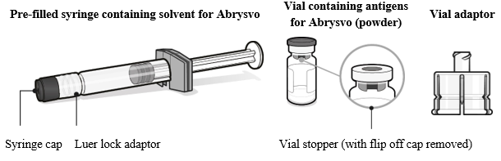
Preparing the Abrysvo® vaccine
Abrysvo® must be reconstituted prior to the administration by adding the entire contents of the pre-filled syringe of solvent to the vial containing the powder using the vial adaptor
the vaccine must be reconstituted only with the solvent provided
Clear instructions on how to prepare the vaccine for administration can be found in the SmPC and the manufacturer's video. Immunisers are strongly encouraged to watch the video in its entirety before preparing the vaccine for the first time.
Image from Abrysvo® vaccine
SmPC

Slide 41
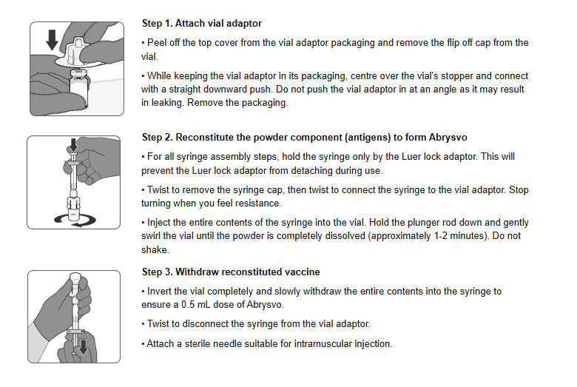
Preparation of Abrysvo® vaccine using a pre-filled syringe of solvent and adding this to the vial containing the powder using the vial adaptor
Image from Abrysvo® vaccine SmPC

Slide 42
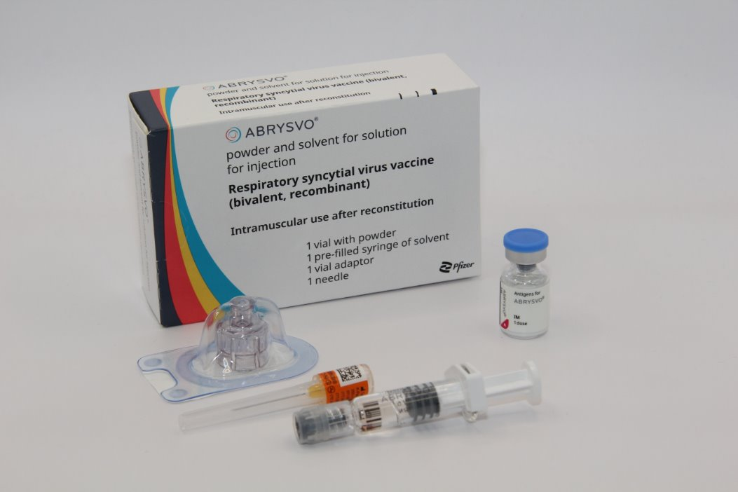
Preparation for administration
The prepared vaccine is a clear and colourless solution. Visually inspect the vaccine for large particulate matter and discolouration prior to administration
Do not use if large particulate matter or discolouration is found
Disposal
Any unused medicinal product or waste material should be disposed of in accordance with local requirements
*For further information please visit: Respiratory syncytial virus (RSV) programme: information for healthcare professionals - GOV.UK
Image source: UKHSA
Abrysvo powder and solvent for solution for injection - Summary of Product Characteristics (SmPC) - (emc)
Notes:
* The UKHSA guidance for healthcare practitioners has a section on what do in the event of reconstitution errors

Slide 43
Vaccination intramuscular administration
Giving vaccine into the muscle:
leads to a better immune response to the vaccine (as the muscle contains the appropriate cells necessary to initiate the immune response)
is less likely to cause local reactions than if the vaccine is given under the skin (subcutaneously)
The needle needs to be long enough to ensure vaccine is injected into the muscle. For this reason, a 25mm needle is being provided for administration of the RSV vaccine. In larger adults, a longer length (for example, 38mm) may be required, and an individual assessment should be made. Abrysvo® packs contain a 25mm 25G needle
Abrysvo® should be injected into the deltoid muscle in the upper arm. If there is insufficient muscle mass in the deltoid or a particular reason the deltoid muscle is unsuitable, the vaccine should be given into the vastus lateralis muscle in the anterolateral aspect of the thigh

Slide 44
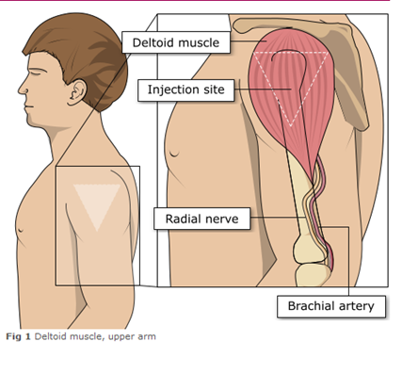
Administering vaccine into the deltoid muscle
It is essential that the correct site and injection technique is used to administer vaccines.
Injecting too high into the upper arm might result in a shoulder injury or a frozen shoulder. This leads to pain, weakness and a limited range of motion that can last for months.
Injecting too low or too far to the side of the arm risks injecting into the axillary nerve or the radial nerve.
To avoid shoulder injury, always assess the limb before administering the vaccine to identify the correct site for injection.
Image adapted from the Australian Immunisation Handbook

Slide 45
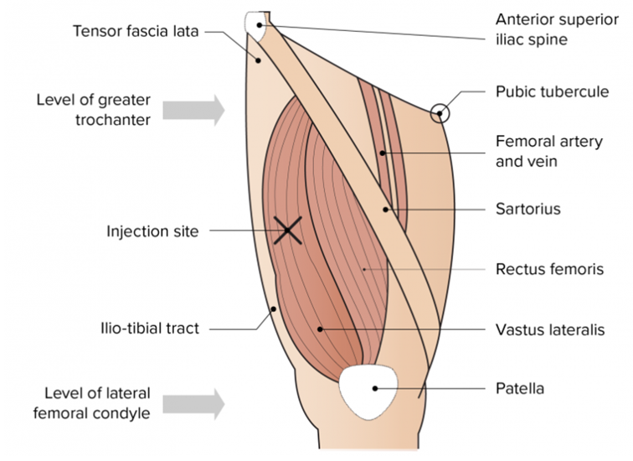
The vastus lateralis muscle (anterolateral aspect of the thigh)
Although the deltoid muscle is more commonly used in older children and adults as it is quicker and easier to access, the vastus lateralis muscle in the thigh can be used in these age groups if necessary.
Image from the Australian Immunisation Handbook

Slide 46
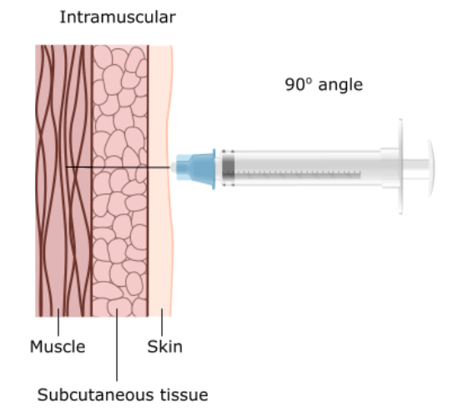
Vaccine administration
Skin does not need to be specially cleaned prior to vaccination. If it is visibly dirty, then water is sufficient to clean it.
Intramuscular process:
identify the correct site for IM injection
stretch the skin at the site
insert the needle at a 90 degrees angle far enough to ensure vaccine is delivered into muscle
depress the plunger
gently remove the needle
apply light pressure using gauze or cotton wool if bleeding occurs
Notes:
https://assets.publishing.service.gov.uk/government/uploads/system/uploads/attachment_data/file/147915/Green-Book-Chapter-4.pdf

Slide 47
Individuals with bleeding disorders or taking anticoagulation therapy
Individuals with bleeding disorders may be vaccinated intramuscularly if, in the opinion of a doctor familiar with the individual’s bleeding risk, vaccines or similar small volume intramuscular injections can be administered with reasonable safety by this route
If the individual receives medication/ treatment to reduce bleeding, for example treatment for haemophilia, intramuscular vaccination can be scheduled shortly after such medication or treatment is administered
Individuals on stable anticoagulation therapy, including individuals on warfarin who are up-to-date with their scheduled INR testing and whose latest INR is below the upper level of the therapeutic range, can receive intramuscular vaccination
A fine needle (23 or 25 gauge) should be used for the vaccination, followed by firm pressure applied to the site without rubbing for at least 2 minutes
The individual or their carer should be informed about the risk of haematoma from the injection

Slide 48
Post vaccination
Following RSV vaccine administration, individuals should be observed for any immediate reactions whilst you are giving them any verbal post vaccination information
Vaccinees should be given a copy of the patient information leaflet for the vaccine that they have received and any other relevant written information
They should be given information about possible vaccine reactions, how to treat these, and when and from whom to seek further advice if required
Generally, symptoms post vaccination resolve within 1 to 2 days without treatment, but antipyretics and/or analgesics can be taken if necessary to relieve any symptoms
If individuals are concerned about any symptoms following vaccination, they should seek advice from their GP or NHS 111
Facilities for management of anaphylaxis should be available at all vaccination sites and staff should have undertaken BLS and anaphylaxis training

Slide 49
Disposal of consumables
Needles should not be re-sheathed following vaccination under any circumstances because of the risk of sustaining a needlestick injury
The needle and syringe should be disposed of immediately after use in a puncture resistant yellow sharps bin
The yellow sharps bin should be sealed when it is two-thirds full and replaced with a new one
Any blood-stained gauze should be placed in a bin for healthcare waste

Slide 50
Possible adverse reactions
The Abrysvo® SmPC reports the following possible adverse reactions in individuals aged 60 years and over:
  Very common (1:10 of people vaccinated
  Vaccination site pain
  Common (≥1/100 to <1/10)
  Vaccination site redness and swelling
  Rare (≥1/10,000 to <1/1,000)
  Guillain-Barre syndrome
  Very rare (≥1/10,000)
  Hypersenstivity
Driving and using machines
  Abrysvo® has no or negligible influence on the ability to drive and use machines.
Notes:
A full list of side effects can be found in the Abrysvo® summary of product characteristics:​
Abrysvo powder and solvent for solution for injection - Summary of Product Characteristics (SmPC) - (emc) | 15309

Slide 51
Adverse reactions following vaccination
Some people can feel unwell following an injection and some people may experience an adverse reaction.
Vaccinees should be informed of the potential expected reactions to Abrysvo®
Adverse reactions reported by Abrysvo® clinical trial participants were the expected side-effects commonly reported after any vaccination, reflecting the initiation of the inflammatory and immune responses that lead to vaccine-induced protection against disease
For individuals aged 60 years and above, only vaccination site pain was very commonly reported (reported by 11% of those who received the vaccine in clinical trials)
Commonly reported reactions (affecting more than 1 in 100 but not as many as 1 in 10 of those receiving the vaccine) were vaccination site redness and swelling
Although headache and myalgia were commonly reported adverse reactions from the clinical trial of younger adults (aged 49 years or below), these were not reported by the 60 years and above age group
For a full list of adverse reactions refer to SmPC

Slide 52
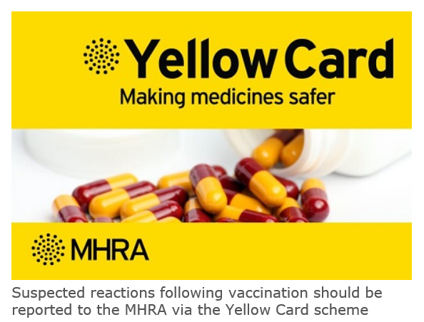
Reporting adverse reactions
Abrysvo® is a newly licensed vaccine and is subject to additional monitoring under the black triangle labelling scheme. This means that all suspected adverse reactions following administration should be reported to the MHRA using their Yellow CARD reporting scheme at Yellow Card | Making medicines and medical devices safer (mhra.gov.uk).
vaccines are carefully monitored to ensure they are safe, not causing untoward side effects and are suitable for the immunisation programme
MHRA promotes the collection and investigation of adverse reactions through the Yellow Card scheme which is a voluntary reporting system for suspected adverse reactions
anyone (vaccine recipients and HCWs) can make a Yellow Card report, even if they are uncertain as to whether a vaccine caused the condition

Slide 53
Documentation and record keeping
It is essential that the information in Box 1 is recorded for all doses of vaccine given to ensure complete and accurate patient vaccination records* and to enable extraction of the correct data for surveillance and vaccine coverage purposes.
Box 1. Following vaccination, the following information should be recorded:
vaccine name
product name
batch number
expiry date
dose administered
date immunisation given
route/site used
name and signature of vaccinator
The engaged provider must use the Welsh Immunisation System (WIS) for documenting RSV vaccination.
Including:
consent for vaccination
noting any contraindications
recording immediate adverse events
recording the refrigerator temperature(s) where vaccines are stored, twice daily (start and end of the day) on all working days, as per national guidance
Clinical services may wish to update their own clinical records by entering vaccination on local systems/paper notes.
Notes:
*Also refer to the relevant PGD Section 5 Description of treatment: Records requirements to ensure these requirements in relation to record keeping are met.

Slide 54
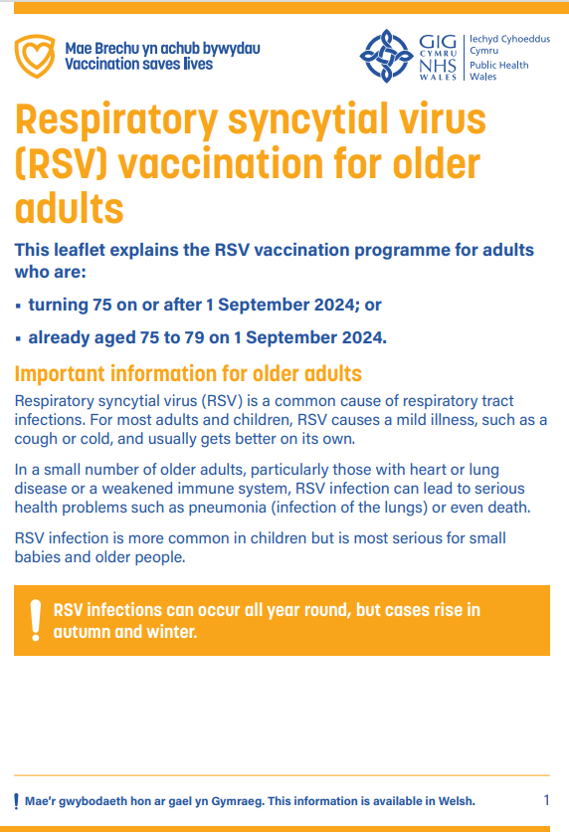
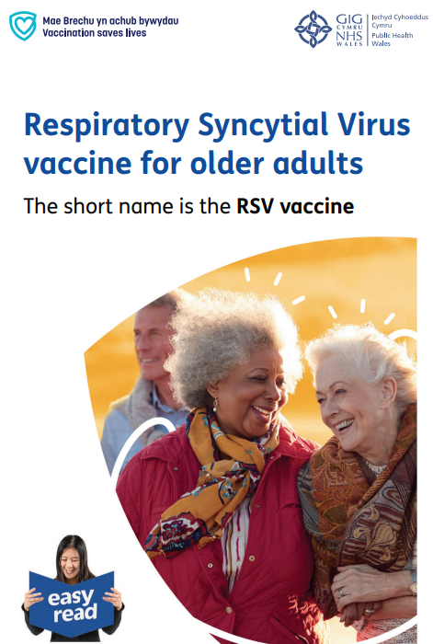
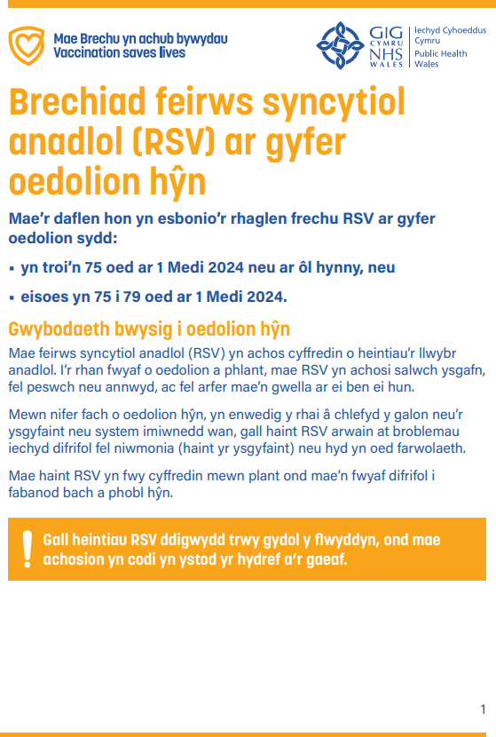



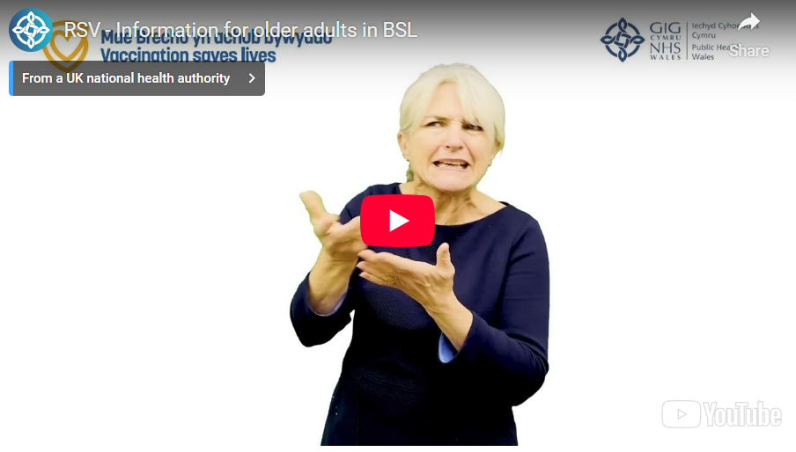
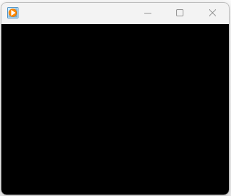
Public Resources (1)
Resources are available to order for free on Health Information Resources website
(Note: please contact phw.vaccines@wales.nhs.uk if you wish to place a large order
Accessible resources are also available online here
Currently being updated
Currently being updated
Currently being updated
Large print booklet CYM/ENG
Easy read booklet CYM/ENG
Patient information leaflet
Bilingual digital version available on PHW vaccines website:
English website page (English presents first on the leaflet)
Welsh website page (Welsh presents first on the leaflet)
Currently being updated
Currently being updated
BSL
Audio file CYM/ENG

Slide 55
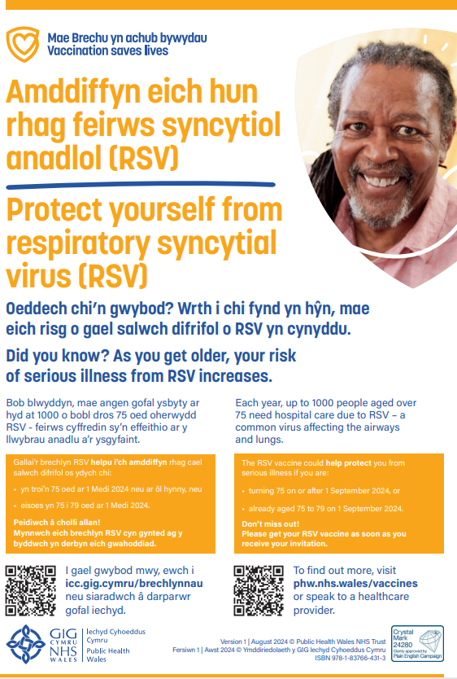
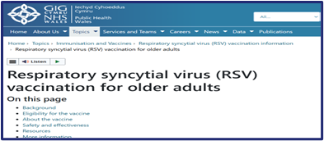

Public Resources (2)
Resources are available to order for free on Health Information Resources website
(Note: please contact phw.vaccines@wales.nhs.uk if you wish to place a large order
Currently being updated
Currently being updated
PHW bilingual public website
Poster

Slide 56
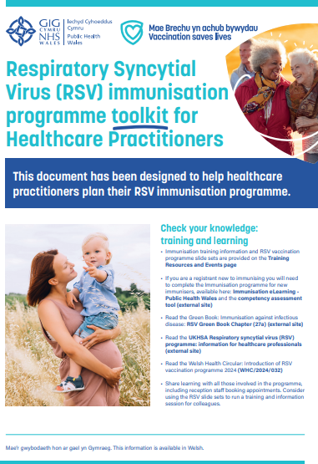
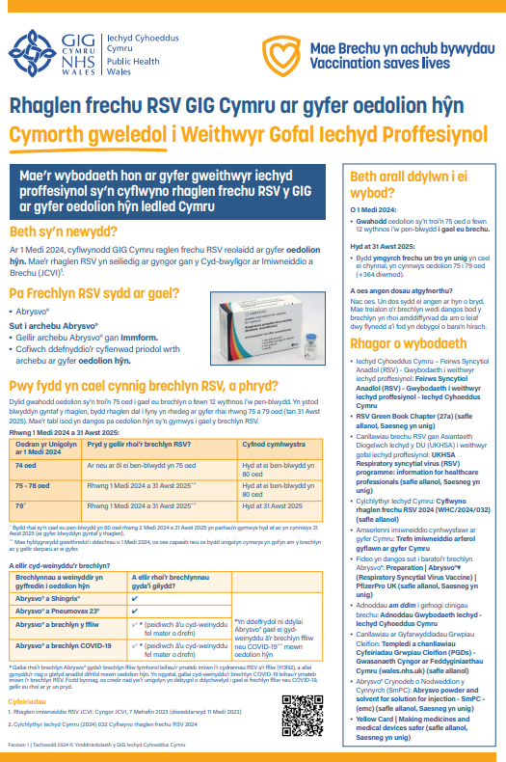
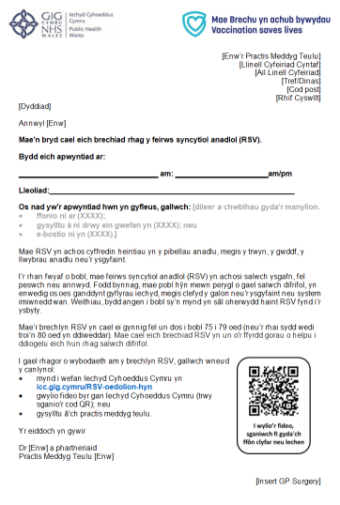
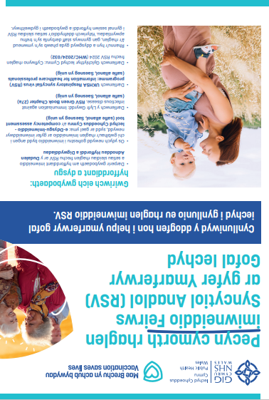
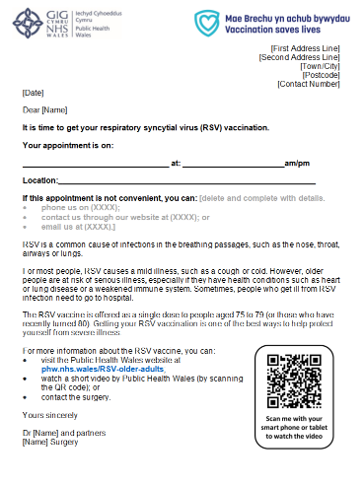
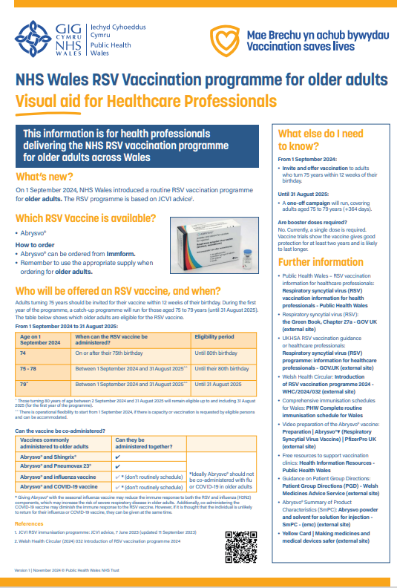
Healthcare professional resources (1)
Resources are available to order for free on Health Information Resources website
Or download from the RSV HCP webpage
Currently being updated
Currently being updated
RSV Toolkit CYM/ENG
RSV Template invite
letter CYM/ENG
RSV Visual Aid CYM/ENG

Slide 57
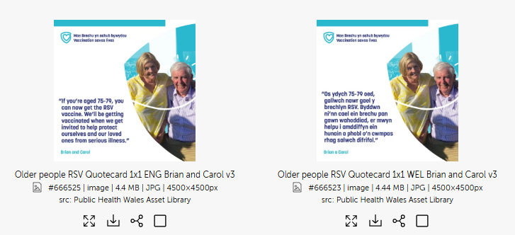
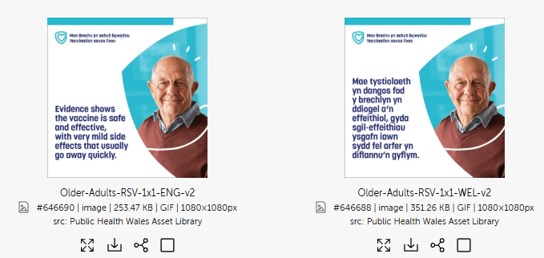
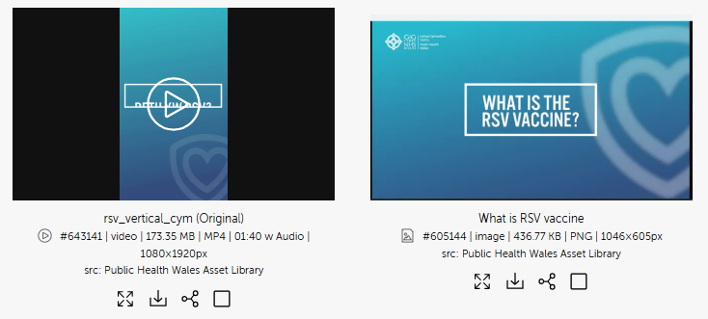
Healthcare professional resources (2)
PHW Asset library
  A range of bilingual assets to support the RSV Campaign for older adults are available here
You will need to log in without a password when you first use

Slide 58
Further information
The Green Book: Immunisation against infectious disease: RSV Green Book Chapter (27a)
Welsh Government DCMO Letter Respiratory Syncytial Virus (RSV) 2025: Amendment to WHC/2024/032 (CEM/CMO/2025/04) [18 August 2025]
Welsh Health Circular: Update on RSV vaccination programme 2025 (WHC/2025/016) [07 May 2025]
Welsh Health Circular: Introduction of RSV vaccination programme 2024 (WHC/2024/032) [25 June 2024]
UKHSA RSV Programme: Information for healthcare practitioners document for older adults
Marketing authorisation holder’s Summary of product characteristics
Medicines and Healthcare products Regulatory Agency (MHRA): reporting adverse reactions
National Patient Group Direction (PGD): RSV vaccine
Pfizer Abrysvo® vaccine preparation instructional video
Public Health Wales public webpage: Respiratory syncytial virus (RSV) vaccination information - Public Health Wales (nhs.wales)
For information: A separate training slide set and information for healthcare practitioners document is also available for the RSV vaccination of pregnant women for infant protection

Slide 59
Further resources - update
These resources are not designed for local training, but as briefing resources to support with awareness raising of the RSV vaccination programme
RSV recorded slides:
An Introduction to Respiratory Syncytial Virus (RSV) – Published May 2024
The slides and recording will be available here: Training (sharepoint.com)
RSV Q&A webinar:
VPDP hosted a live Q&A RSV webinar on the 8th of August 2024. The slides and recording will be available to view here: Immunisation training resources and events - Public Health Wales (nhs.wales)

Slide 60
Resources: Information for healthcare practitioner guidance
The UKHSA information for healthcare practitioners' guidance Respiratory syncytial virus (RSV) programme: information for healthcare professionals - GOV.UK (www.gov.uk) is recommended reading for anyone involved in RSV immunisation
This is a practical document for healthcare practitioners administering or providing advice about RSV vaccination of older adults. It includes the vaccination programme recommendations, contraindications, precautions and examples of scenarios that staff may experience when immunising

Slide 61
Optimising Vaccine Uptake: Using motivational interviewing for better conversations eLearning
The approach and style of a vaccine conversation can make a real difference in understanding individual hesitancy, addressing barriers, and influencing vaccine uptake
There is an eLearning module available called Optimising Vaccine Uptake: Using motivational interviewing for better conversations which aims to support staff with having positive conversations about immunisations
The module aims to provide health professionals the skills and knowledge required to implement motivational interviewing techniques when having vaccine-related conversations
Further information about the module and how to access it is available here: Immunisation eLearning - Public Health Wales (nhs.wales)
RSV vaccination programme for older adults: training slide set for healthcare practitioners

Slide 62
Learning objectives
You should now be able to:
explain what RSV is and be aware of the UK epidemiology
understand the rationale for the RSV older adult vaccination programme
describe how Abrysvo® RSV vaccine works
identify the groups that are eligible to receive the RSV vaccines
describe the process of consent and how this applies when giving vaccines
understand the legal mechanisms by which immunisers can supply and administer Abrysvo® RSV vaccine
describe how to correctly store, prepare and administer Abrysvo® RSV vaccine
communicate key facts in response to questions from individuals and/or their carer(s) and direct them to additional sources of information

