Slide 1
Current issues – immunisation & vaccination
Clinical update
Vaccine Preventable Disease Programme
Public Health Wales
17 June 2024
Notes:
Material contained in this document may be reproduced without prior permission provided it is done so accurately and is not used in a misleading context.
Acknowledgement to Public Health Wales NHS Trust to be stated.
© 2024 Public Health Wales NHS Trust.

Slide 2
Aims and objectives
To highlight key messages relating to immunisation and vaccination
To provide information on current epidemiology and surveillance of vaccine preventable disease
To provide information about new vaccination programmes
To highlight changes to vaccine products or vaccine supply
To promote the Public Health Wales microsite and resources
To highlight the work being conducted by the engagement team to ensure vaccine equity across Wales
To promote the importance of healthcare professionals as trusted voices

Slide 3
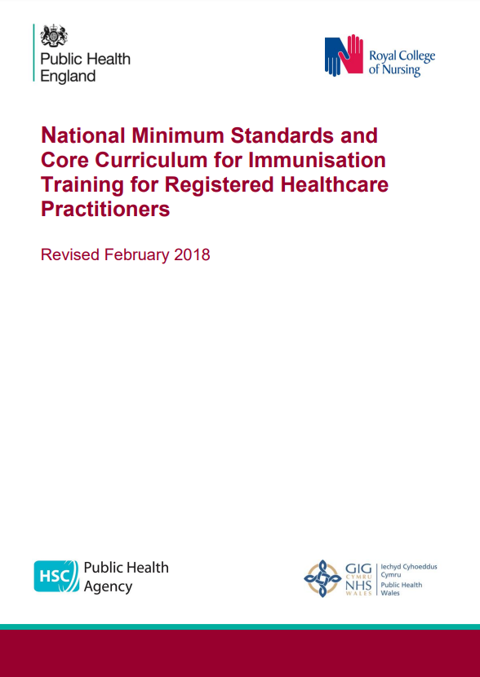
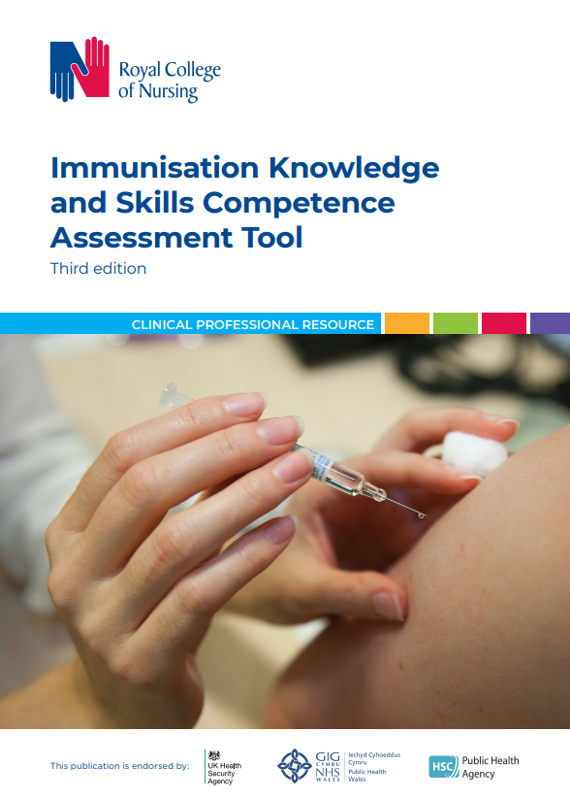
Training context
With the ongoing development of new and improved vaccines and the epidemiology of infectious diseases constantly changing, the need to modify or introduce new vaccine programmes occurs frequently.
It is vital that healthcare professionals involved in immunisation receive solid foundation training in immunisation.
Annual updates should be provided. More frequent updates may be required if substantial changes to programmes or policies are made, or new vaccines are introduced.
www.gov.uk/government/publications/national-minimum-standards-and-core-curriculum-for-immunisation-training-for-registered-healthcare-practitioners
https://www.rcn.org.uk/Professional-Development/publications/immunisation-knowledge-and-skills-competence-assessment-tool-uk-pub-010-074

Slide 4
Legal framework for vaccinations
The Welsh Medicines Advice Service website Home - Welsh Medicines Advice Service (wales.nhs.uk) provides information about Patient Group Directions (PGDs) and their use in clinical practice. Guidance, advisory documents, templates and resources can be accessed via the website.
PGD templates are available to support immunisation programmes, with some templates authored by WMAS in collaboration with the Vaccine Clinical Advisory Group (VCAG). Others are authored by UKHSA. All are accessible via the website.
There are also links to the relevant national protocols.
Any queries regarding the clinical content of the PGDs should be addressed to welshmedicines.information@wales.nhs.uk

Slide 5
PGDs
The following PGDs are in progress the Welsh Medicines Advice Service: Patient Group Directions (PGD) - Welsh Medicines Advice Service (wales.nhs.uk)
Inactivated Flu
LAIV
RSV for prenatal and older adults
Gonorrhoea

Slide 6
Vaccination System Pipeline
Clare Williams - Director of Planning and SRO
Vaccine Programme Wales

Slide 7
Vaccination System Pipeline
(in addition to routine delivery and VPW Transformation Programme)
Gonorrhoea Routine Programme
Schools Flu
Programme
Adult Flu
Programme
Spring Booster COVID-19
MenACWY Product Change
Autumn Booster COVID-19
MPox Routine Programme
Pneumococcal Product Change
Varicella
Programme
Apr ‘24 | May ‘24 | Jun ’24 | Jul ‘24 | Aug ‘24 | Sep ‘24 | Oct ‘24 | Nov ‘24 | Dec ‘24 | Jan ‘25 | Feb ‘25 | Mar ‘25 | Apr-Sep ‘25 | Oct-Mar ’25/26 | 26/27
Adult RSV Programme
Changes to Childhood Schedule
Infant/ Maternal RSV Programme
Pertussis
Product Change
Notes
Timeline is based VPW planning assumptions of approximate first vaccine administered
JCVI are reviewing
Welsh Government policy review
Vaccination Programme Wales planning pipeline
VERSION APPROVED: VPW System Board 07 May 2024

Slide 8
Pregnancy Vaccinations: Key messages and vaccine changes
Kate Lloyd
Specialist Nurse Immunisation
VPDP

Slide 9
Information on maternal pertussis vaccine change from July 2024
UKHSA published information on the maternal pertussis vaccine change on the 28th May 2024: Prenatal pertussis vaccine change from July 2024 letter - GOV.UK (www.gov.uk) Vaccine Programme Wales also published a letter for NHS Wales which provides information about the vaccine change from July 2024 when ADACEL® (Tdap) a non IPV-containing vaccine, will replace Boostrix-IPV® (dTaP/IPV) for the pertussis vaccination in pregnancy programme: 202405 Pertussis change letter.docx (sharepoint.com)

Slide 10
Background to the Change
A safe and highly effective maternal pertussis vaccination programme was first introduced in October 2012 to protect young infants at highest risk of severe disease. Studies in England found maternal pertussis vaccination offers around 90% vaccine effectiveness against confirmed disease and 97% protection against death from pertussis in infants under 3 months of age
Studies which looked at antibody levels of infants of mothers who had received pertussis-containing vaccines in pregnancy, showed lower antibody responses to polio compared to infants born to unvaccinated mothers, although all remained above the protective threshold
In October 2022, following a review of the latest evidence, the JCVI advised preference for a non-IPV containing pertussis vaccine (Tdap) in the maternal programme, to address a potential immunity gap caused by the blunting of the infant’s polio response to primary vaccines
Tdap vaccine has been used in maternal pertussis vaccine programmes in many countries, including other European countries, USA and Australia, where millions of doses have been administered without any safety concerns
Notes:
To address this potential immunity gap, a non-IPV-containing (Tdap) vaccine has now been procured.

Slide 11
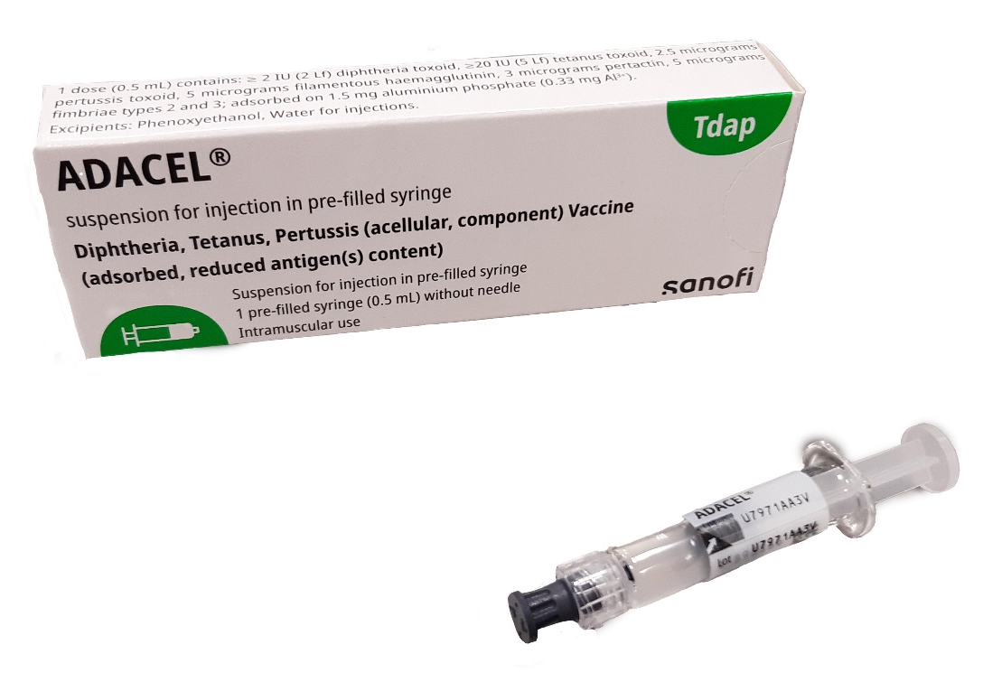
Summary of key changes to the programme:
From 01 July 2024, the vaccine used in the programme will change to ADACEL®. Vaccine ordering will open in June (exact date will be confirmed via an ImmForm news item)
The ADACEL® vaccine, manufactured by Sanofi, contains tetanus, diphtheria, and pertussis (acellular) antigens and was licensed for UK use in 2016. The SmPC is available here: ADACEL (Tdap) Summary of Product Characteristics- products.mhra.gov.uk
The JCVI recognises the importance of vaccinating pregnant women to protect their babies from pertussis and therefore advise that the Boostrix-IPV® (dTaP/IPV) vaccine can still be given if ADACEL® (Tdap) is not available or is clinically contraindicated (for example, those who have a latex allergy)
Image source: Sanofi Pasteur

Slide 12
Vaccine supply
ADACEL® (Tdap) will be available to order online via the ImmForm website from Monday 3rd June 2024. Please remember to add ADACEL® to your routine ImmForm order where possible and update any internal ordering processes rather than creating additional orders
ADACEL® will be available in single dose packs, in a pre-filled syringe. This vaccine will come without a needle, sites are to ensure needles are ordered for this product. Information on recommended needles is available here: Immunisation procedures: the green book, chapter 4 - GOV.UK (www.gov.uk)
It is recommended that practices hold no more than 2 weeks’ worth of stock. After the introduction of ADACEL® on 1st July, local stocks of Boostrix-IPV can be used in the preschool programme.
Providers who do not provide pre-school boosters should plan to use up local stocks of Boostrix® ahead of the 1st of July, and any remaining stocks of Boostrix® may continue to be offered to pregnant women if this will prevent vaccine wastage

Slide 13
Patient Group Directions (PGDs)
An updated Pertussis vaccination PGD template will be produced for Health Boards to authorise their commissioned services. Health Boards must have plans in place to update their PGDs prior to the commencement of the programme change.
It is imperative to ensure that individuals are offered a suitable and available vaccine containing a pertussis-containing antigen, rather than risk not being immunised against pertussis. PGD’s will permit the use of ADACEL®, Boostrix-IPV® or Repevax®; while noting the JCVI’s preference for Tdap (ADACEL®) over the other vaccines for pregnant women.
Though ADACEL® is preferred for the maternal programme, if ADACEL® is not available or otherwise unsuitable, such as in individuals with a severe allergy to latex, offer either Boostrix-IPV® or Repevax®.
Commissioners will need to ensure that all providers have processes in place to deliver the new vaccine ADACEL® using the appropriate legal framework which needs to be in place prior to 1st July 2024.
Patient Group Directions (PGD) - Welsh Medicines Advice Service (wales.nhs.uk)

Slide 14
Vaccine Uptake
This is a good opportunity to highlight the continued importance of ensuring all pregnant women are offered vaccination against pertussis in every pregnancy. Women should normally receive their whooping cough vaccine around the time of their mid-pregnancy scan, (usually 20 weeks) but can receive it from 16 weeks to protect their babies in the early weeks of their life
As at 10th May 2024, there are high levels of notified cases of whooping cough in Wales which reinforces the importance of protecting infants through the maternal pertussis vaccination programme and timely immunisation of babies with their first dose of the combined 6 in 1 vaccine
To help provide optimal protection, the vaccine should be given before 32 weeks; but women who miss out can still have the vaccine later. Sadly, 8 babies died in England from pertussis in the first quarter of 2024. Since the programme began, the vast majority (23 of 29) of deaths have been in infants of unvaccinated mothers under the age of 3 months. Prenatal pertussis vaccine change from July 2024 letter - GOV.UK (www.gov.uk)
Notes:
Practices are reminded that in line with their contractual requirements, pertussis vaccination should be offered and provided to eligible patients either opportunistically or on request

Slide 15
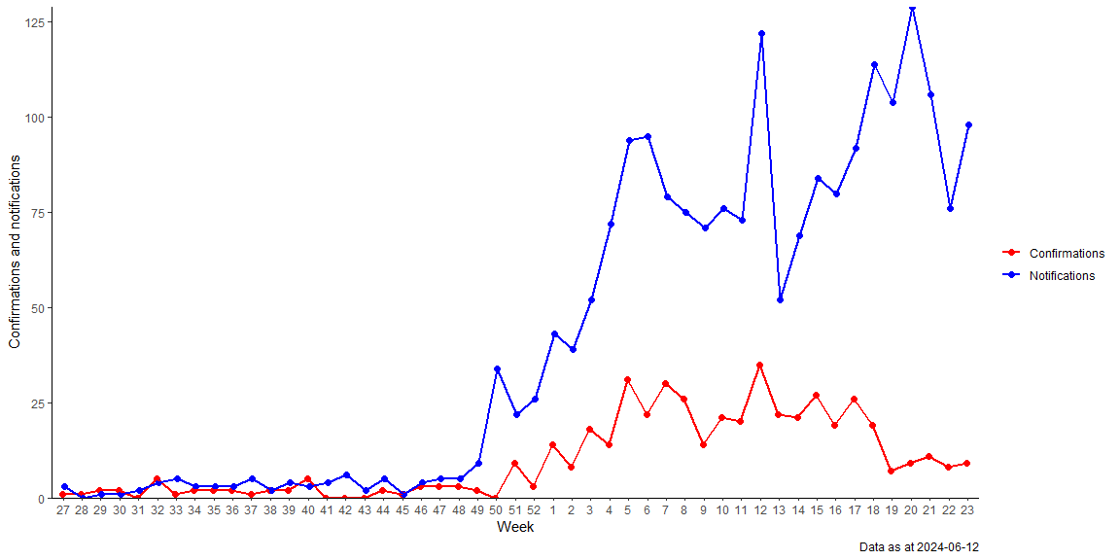
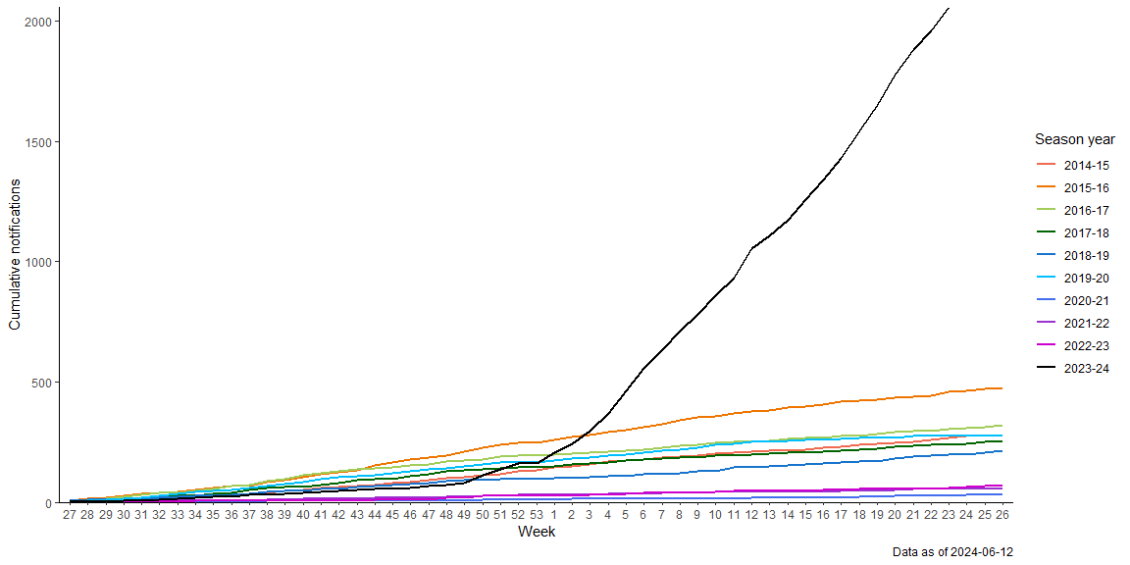
Increased incidence of pertussis (whooping cough)
Weekly notifications and confirmations of Pertussis/Whooping Cough in Wales in the 2023-24 season year.
Cumulative notifications chart of Whooping Cough across the past 10 seasons.
Source: PHW VPDP Pertussis Weekly Report (12/06/2024)

Slide 16
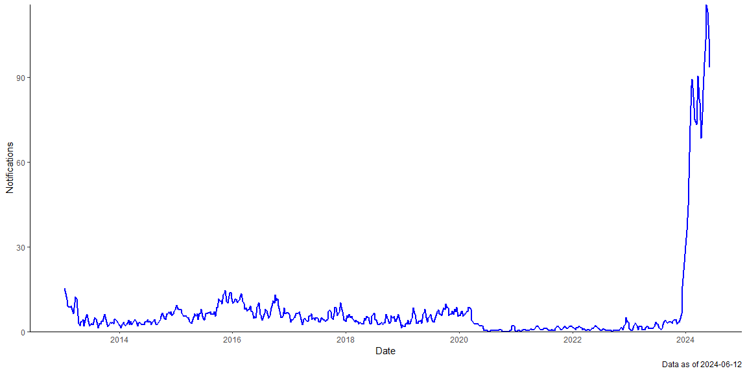
Increased incidence of pertussis (whooping cough)
3-weekly average notifications of Whooping Cough in Wales, from Week 3 2013 to Week 23 2024.
Source: PHW VPDP Pertussis Weekly Report (12/06/2024)

Slide 17
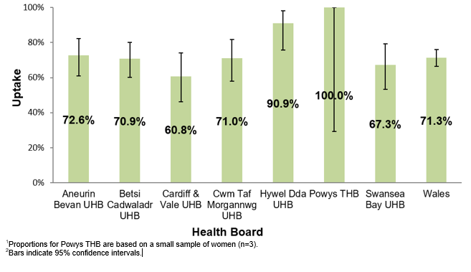
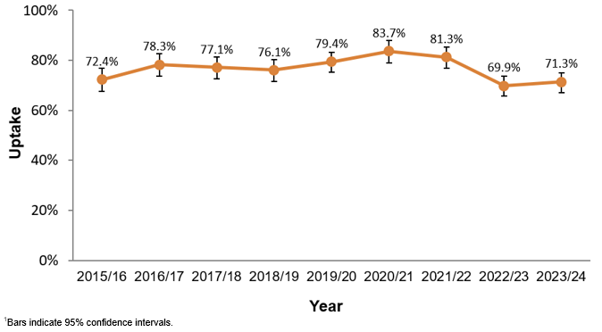
Point of Delivery (POD) survey 2024
Pertussis
Uptake of pertussis vaccination in pregnant women by health board, 2023/24 (n=259)^{1,2}
Uptake of pertussis vaccination in pregnant women participating in the 2015/16 to 2023/24 surveys¹

Slide 18
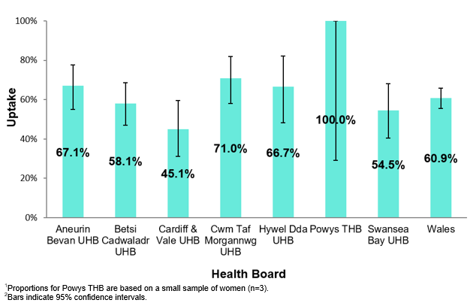
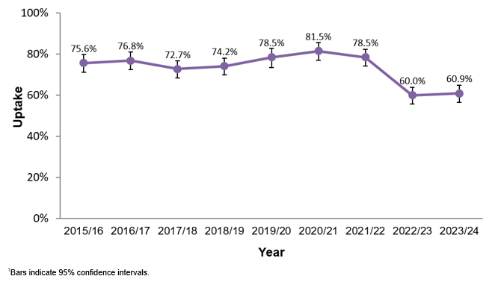
Point of Delivery (POD) survey 2024
Influenza
Uptake of influenza vaccination in pregnant women; by health board, 2023/24 (n=221)^{1,2}
Uptake of influenza vaccination in pregnant women participating in the 2015/16 to 2023/24 surveys¹

Slide 19
Record keeping
It is imperative that vaccine provision is recorded in the patient maternal handheld notes as well as the GP system, this enables a more accurate Point of Delivery Survey to monitor and evaluate the programme
Pregnant women should be advised to take their hand-held record to vaccination appointments so that recording of the vaccination can be completed, preferably by the Healthcare Professional delivering the vaccine

Slide 20
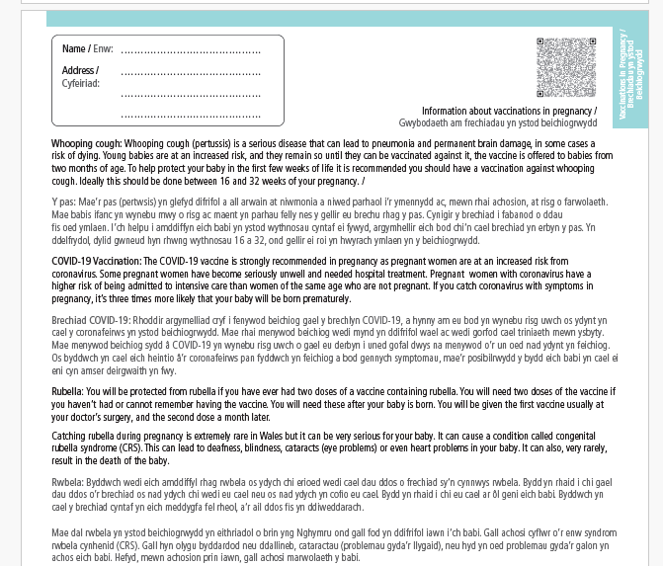
All Wales Maternity Record: Vaccinations in pregnancy found on pages 37 & 38

Slide 21
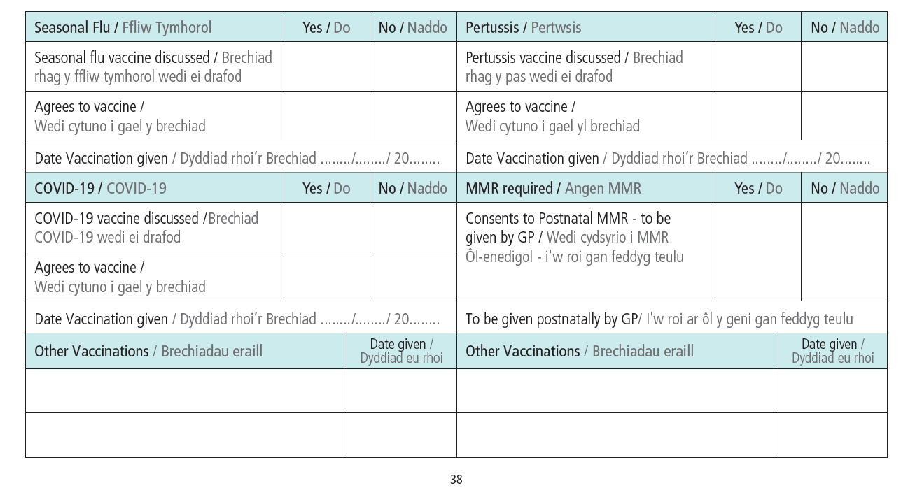
Recording vaccinations in the record

Slide 22

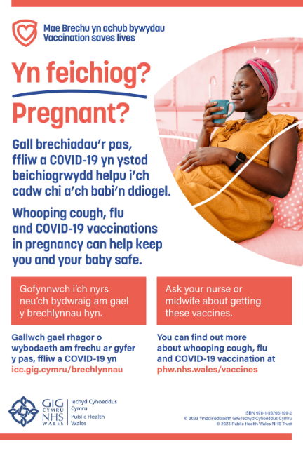
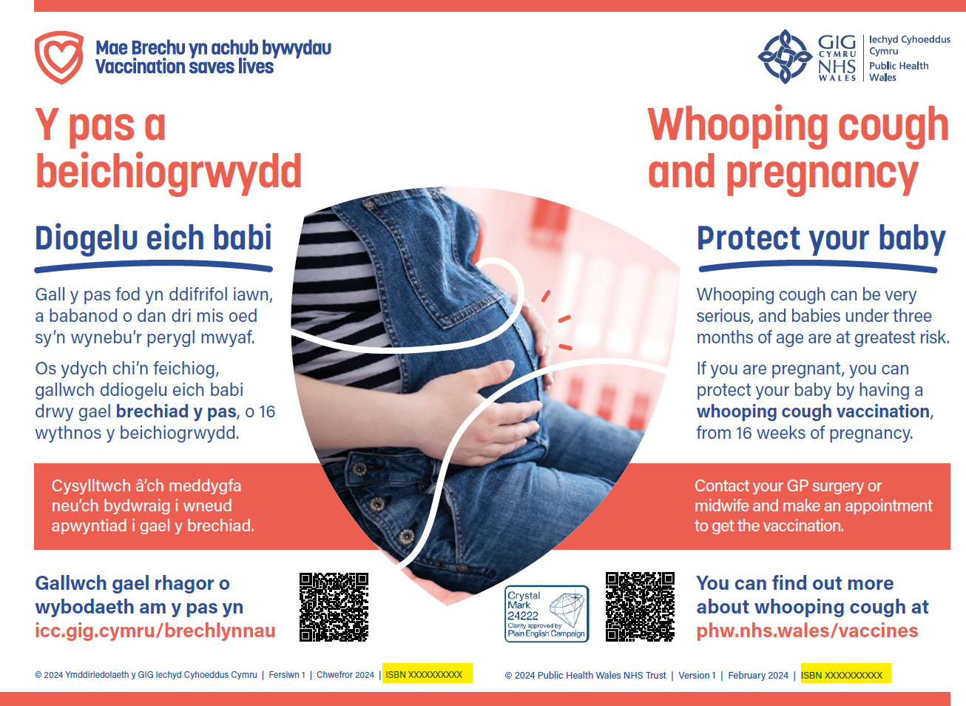
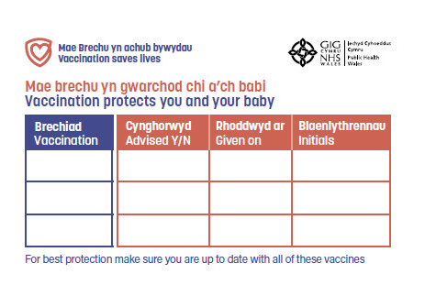
Resources - vaccination in pregnancy
Leaflets
Posters
Maternity record stickers
Order resources at: Health Information Resources - Public Health Wales (nhs.wales)
Accessible resources:
Easy read
Large print
Audio
Sign language video
All available at:
Information about vaccinations in pregnancy - Public Health Wales (nhs.wales)

Slide 23
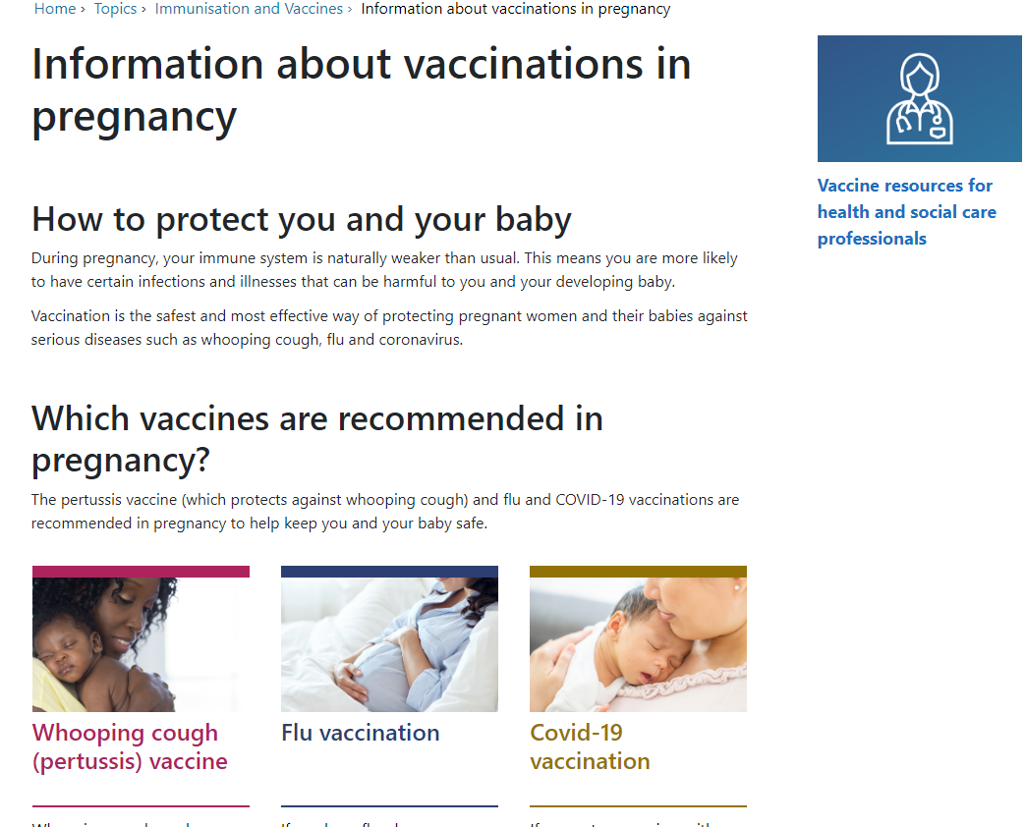
Resources/signposting
Public Health Wales Resources
Pregnancy landing page: Immunisation and Vaccines - Public Health Wales (nhs.wales)
Vaccine information in accessible resources: Information about vaccinations in pregnancy - Public Health Wales (nhs.wales)
Leaflet ordering: Health Information Resources - Public Health Wales (nhs.wales)
Training resources: Immunisation training resources and events - Public Health Wales (nhs.wales)

Slide 24
Respiratory Syncytial Virus (RSV)

Slide 25
RSV vaccination programme (1)
Vaccine Programme Wales published a letter on the 7th June 2024 outlining the RSV Vaccination Campaign Planning Scenarios and Delivery Plans – Post Vaccine Award Update
The infant protection programme will be implemented with Abrysvo® supplied by Pfizer https://www.medicines.org.uk/emc/product/15309, and delivered through a maternal vaccination programme.
The older adult programme including catch up will be implemented with Abrysvo® supplied by Pfizer (https://www.medicines.org.uk/emc/product/15309.
As a result for planning purposes, the confirmed scenarios for the delivery of the RSV vaccination campaign are:
Protection of Infants Scenario 1. From 1st September, a universal year-round offer to pregnant women (during each pregnancy) who reach 28 weeks' gestation, provided where possible alongside an existing antenatal appointment, and a catch up offer to pregnant women up to term.
One dose of vaccine will be required. The vaccine supplied will be suitable for storge at 2˚C to 8˚C and will require reconstitution.
The current high risk infant monoclonal antibody (mAb) programme will continue for 2024/25
Notes:
Policy, letters and Welsh Government (sharepoint.com)

Slide 26
RSV vaccination programme (2)
Protection of Older Adults Scenario 2.
From 1st September:,
a universal year-round offer to those turning 75yr (eligibility is retained until 79yrs and 364 days), and
a catch-up offer, completed by August 2025 to those 75yr-79yr on 1st September 2024
The current planning scenario for those turning 80 years of age between 02 September 2024 and 31 August 2025, is that they will remain eligible up to and including 31 August 2025. Only for the first year of the programme.
One dose of vaccine will be required. The vaccine supplied will be suitable for storge at 2˚C to 8˚C and will require reconstitution https://www.medicines.org.uk/emc/product/15309
The letter further outlines that announcement of the campaign by the Cabinet Secretary has been postponed following the announcement of the UK elections due to take place on the 4th July 2024, however this is not delaying the system enabling work
Welsh Government plan to issue a Welsh Health Circular during the week of 24 June 2024
Updated Green book RSV chapter anticipated week commencing 1st July 2024

Slide 27
RSV vaccination programme training
The Vaccine Preventable Disease Programme (VPDP) have produced an awareness raising resource about Respiratory Syncytial Virus (RSV). This resource is a recorded slide set – An introduction to RSV and is available to view here: Training (sharepoint.com)
This resource provides information on RSV the disease, the current use of monoclonal antibody therapy (passive immunisation), the burden of RSV in Wales, current engagement and insight work, communication and engagement plans and current RSV vaccination programme planning
Additional training resources planned:
  Additional recorded slide set to outline the RSV vaccination programme for Wales [July TBC]
  RSV programme specific slide sets [July TBC]
  RSV Q&A webinar [8th August 2024]
  The RSV programme specific slides and the Q&A webinar slides will be uploaded to the Immunisation training resources and events - Public Health Wales (nhs.wales). The recorded slide sets and the Q&A webinar recording will be uploaded to the Training SharePoint page.

Slide 28
Changes to childhood vaccination programme
Juliet Norwood
Specialist Nurse Immunisation
VPDP

Slide 29
Menitorix© (Hib/MenC) to be discontinued
The JCVI published a statement outlining changes to the childhood schedule – November 2022. This statement highlights that Menitorix© (Hib/MenC) is to be discontinued. A commercial decision made by the marketing authorisation holder, GSK. The JCVI recommended the following changes once the current supply of Menitorix© Hib/MenC vaccine has been used:
an additional dose of Hib-containing multivalent vaccine (such as the DTaP/IPV/Hib/HepB which is also given earlier in infancy) should be given at 18 months
the second dose of MMR vaccine should be brought forwards from 3 years 4 months to 18 months of age
due to the success of the adolescent MenACWY programme in controlling meningococcal C disease across the population a dose of meningococcal C containing vaccine should no longer be given at 12 months
In the meantime, the JCVI will keep emerging evidence under review, including ongoing epidemiology and disease incidence.
Notes:
https://www.gov.uk/government/publications/changes-to-the-childhood-immunisation-schedule-jcvi-statement/joint-committee-on-vaccination-and-immunisation-jcvi-statement-on-changes-to-the-childhood-immunisation-schedule

Slide 30
Timing of the Hib dose
The overarching aim of the Hib programme is to attain herd immunity in the population
Modelling studies have shown that Hib transmission is primarily driven by children aged 2 to 4 years. Therefore vaccination at any time before then should prevent transmission. Without a booster dose carriage is likely to increase, with one study showing a carriage prevalence of 4% in school-age children who had not had a booster
As Menitorix© (Hib/MenC) is being discontinued, once it is no longer available the dose of Hib vaccine at 12 months will no longer be available
It have been recommended that this is replaced with an additional dose of Hib containing vaccine (DTaP/IPV/Hib/HepB) at 18 months
Giving the Hib-containing vaccine dose at 18 months allows space and flexibility to consider the best schedule for future programmes.
https://www.gov.uk/government/publications/changes-to-the-childhood-immunisation-schedule-jcvi-statement/joint-committee-on-vaccination-and-immunisation-jcvi-statement-on-changes-to-the-childhood-immunisation-schedule
Notes:
1. Jackson ML and others (2012). Modelling insights into Haemophilus influenzae type b disease, transmission and vaccine programs. Emerging Infectious Disease 18 (1), 13 to 20.
2. Oh SY and others (2008). School-aged children: a reservoir for continued circulation of Haemophilus influenzae type b in the United Kingdom. Journal of Infectious Disease 197 (9), 1275 to 1281.

Slide 31
MMR and DTaP/IPV/Hib/HepB at 18 months
The recommendation for giving both the Hib-containing vaccine and the second dose of MMR vaccine at 18 months requires the creation of a new immunisation visit
The main purpose of advancing the second dose of MMR vaccine from3 yrs and 4 months to 18 months is to improve coverage of the second dose and therefore further reduce the likelihood of measles outbreaks
In areas of London where the second dose of MMR was brought forwards in response to local measles outbreaks, an increase in uptake was noted¹
As the uptake of all routine vaccines remains of paramount importance, the JCVI considered that the probable benefit of increasing coverage in MMR justifies the additional routine immunisation visit
Notes:
1. Lacy J and others (2022). Impact of an accelerated measles-mumps-rubella (MMR) vaccine schedule on vaccine coverage: an ecological study among London children, 2012–2018. Vaccine: volume 40 (issue 3), pages 444 to 449.

Slide 32

Group C meningococcal vaccine (1)
Modelling work reviewed by the JCVI in June 2022 found that indirect protection against MenC in infants is sustained because of the teenage MenACWY programme
Over time the teenage vaccine programme is expected to reduce carriage prevalence of groups C, W and Y to near elimination levels (group A carriage has already been almost undetectable for many years in the UK)
The predicted decline in transmission has been accelerated by the effects of the pandemic and the resulting reduction in social contact

Slide 33
Group C meningococcal vaccine (2)
It is therefore predicted that by the time Menitorix Hib/MenC vaccine is no longer available there would be very few invasive meningococcal disease (IMD) cases caused by meningococcus groups A, C, W and Y each year, and therefore very few cases which could be prevented by a MenC-containing vaccine in infancy
It is therefore essential that high uptake of MenACWY and good surveillance of meningococcal infection and IMD is maintained to monitor the impact of the vaccination programme and expected overall decline in disease
https://www.gov.uk/government/publications/changes-to-the-childhood-immunisation-schedule-jcvi-statement/joint-committee-on-vaccination-and-immunisation-jcvi-statement-on-changes-to-the-childhood-immunisation-schedule

Slide 34
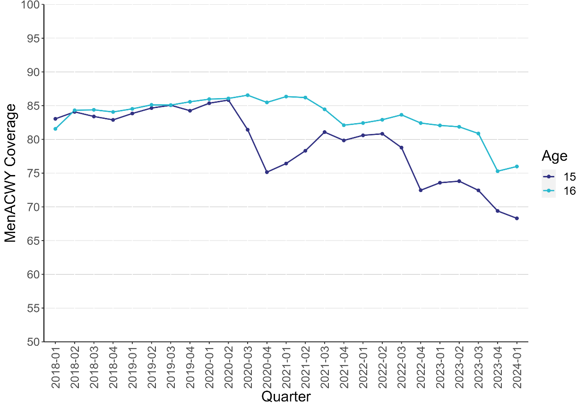
MenACWY coverage in adolescents aged 15 and 16 years of age in Wales, from quarter 1 (2018) to quarter 1 (2024)
Source: PHW Vaccine Preventable Disease Programme Surveillance team

Slide 35
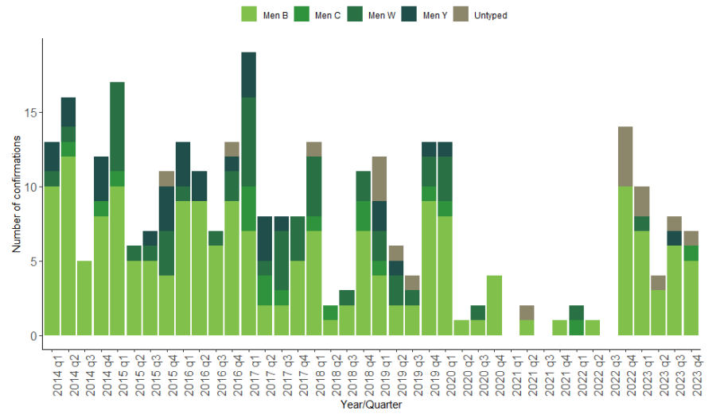
Invasive meningococcal disease cases confirmed by quarter and capsular group: Wales, 2014-2023
Source: PHW VPD case report Q4 2023

Slide 36
JCVI statement on a childhood varicella (chickenpox) vaccination programme
In November 2023, the Joint Committee on Vaccination and Immunisation (JCVI) advised that a universal varicella (chickenpox) vaccination programme should be introduced as part of the routine childhood schedule. Stating that this should be a 2-dose programme offering vaccination at 12 and 18 months of age using the combined MMRV (measles, mumps, rubella and varicella) vaccine
Complications of Varicella infection
  Some children will go on to develop complications from varicella including bacterial infection of skin lesions (including group A streptococcus) and in rare cases, encephalitis, pneumonitis and stroke. These complications can result in hospitalisation and very rarely may result in death
  Varicella is often more serious in very young infants (under 4 weeks) and adults, in particular in pregnancy when it may cause complications in both the mother and the foetus, and in adults who are immunosuppressed
Notes:
https://www.gov.uk/government/publications/childhood-varicella-vaccination-programme-jcvi-advice-14-november-2023/jcvi-statement-on-a-childhood-varicella-chickenpox-vaccination-programme
During the COVID-19 pandemic, restrictions on social mixing led to fewer cases of varicella in younger age groups compared with before the pandemic, therefore leaving a larger pool of children susceptible to varicella.

Slide 37
Varicella burden
  A study was carried out by the University of Bristol to better capture the impact on quality of life for children hospitalised with varicella. The study highlighted that the true extent of hospitalisations caused by varicella is underestimated through routine data sources due to errors in coding
  hospitalisations are frequently due to secondary complications of varicella infection including cellulitis, invasive group A streptococcal infection or childhood stroke, and therefore are not always recorded as a hospital admission related to varicella
  The study suggested that there may be other secondary complications from varicella infection which are not currently well understood or captured
Marlow R, Roderick M, Oliver J and others. Epidemiology of hospitalisations due to chickenpox and quality of life lost in community and hospital settings: protocol for a prospective cohort study across 2 countries. BMJ Open (2023), volume 13, e068611.

Slide 38
Other considerations
Herpes zoster (commonly known as shingles) is caused by reactivation of the varicella zoster virus in a previously infected person. The virus remains dormant in the body following an initial varicella infection
One of the reasons that the JCVI have not previously recommended a universal varicella programme was due to concern over a predicted increase in cases of herpes zoster in middle-aged adults, who were not old enough to receive shingles vaccination and therefore would be relying on exposure to circulating varicella to maintain immunity (exogenous boosting).
The idea behind exogenous boosting is that those who have previously had varicella have their immunity boosted by exposure to circulating varicella zoster virus, thereby inhibiting reactivation of the varicella virus and the development of herpes zoster
It was theorised that a varicella vaccine programme would prevent exogenous boosting by preventing cases of varicella, and that this would therefore lead to a significant increase in cases of herpes zoster in middle-aged adults as immunity would not be boosted
At the time of this analysis, it was thought that this effect on exogenous boosting could last for as much as 20 years. From reviewing the cost-effective modelling with new data, the JCVI considered that the duration was likely to be far less, around 3 years

Slide 39
MMRV – Adverse reaction profile
Using the combined MMRV vaccine as a first dose has been associated with a slightly increased rate of febrile seizures when compared with using separate MMR and varicella vaccines at the same visit
This increased rate has not been observed when using the combined MMRV vaccine as a second dose
Although there is an increased risk of febrile seizures occurring when using the MMRV as the first dose, the absolute risk is very low. The JCVI considered that this very small increased risk was not of clinical concern and that there was a considerable benefit from giving fewer injections across all eligible children
Notes:
Febrile seizures are usually benign and self limiting, and are unlikely to cause long-term effects or harm. Febrile seizures usually affect children aged between 6 months and 6 years old. Febrile seizures can occur as a result of infection including varicella but are also an established side effect of both the MMR and varicella vaccines. The CDC estimates that one additional febrile seizure is seen for every 2,300 doses given compared with using separate vaccines.

Slide 40
Catch-up varicella vaccine programme
The JCVI discussed the potential for a catch-up vaccination programme. Most countries following the implementation of a routine programme have offered some form of catch up
Analysis of the cost-effectiveness of potential catch-up vaccination scenarios are underway. Initial findings suggest that a universal catch-up vaccination programme using a single dose of vaccine is likely to be cost-effective for children aged up to and including 5 years
Further work is needed to understand whether a targeted catch-up programme could be cost-effective for children aged 6 to 11 years

Slide 41
Implications for schedule…
AGE | CURRENT | PROPOSED??
8 weeks | 6-in-1, Men B, Rotavirus | 6-in-1, Men B, Rotavirus
12 weeks | 6-in-1, PCV, Rotavirus | 6-in-1, Men B, Rotavirus
16 weeks | 6-in-1, Men B | 6-in-1, Men B, Rotavirus
12-13 months | Hib/MenC, PCV, MMR 1, Men B | PCV, MMRV, Men B No Hib/Men C
18 months** Additional visit |  | Additional 6-in-1, MMRV
2-3 years | Flu | Flu
3 years 4 months | 4-in-1, MMR 2 | 4-in-1, No MMR 2
12-14 years | HPV | HPV
13+14 years | 3-in-1, Men ACWY | 3-in-1, Men ACWY

Slide 42
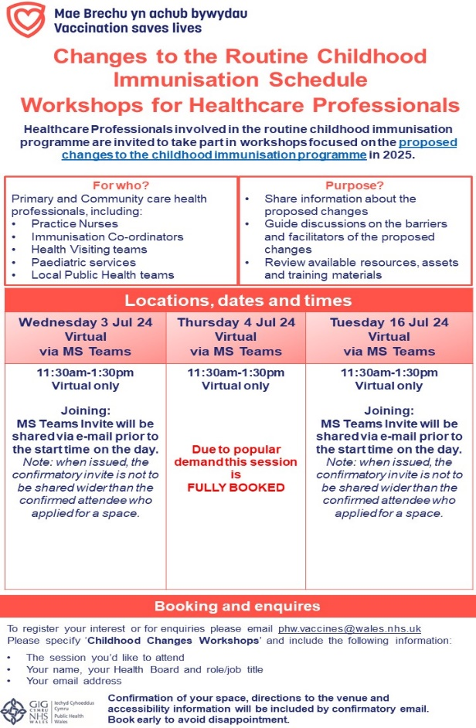
Childhood Schedule Changes Workshops:
Healthcare professionals who are involved with or lead on delivering the childhood immunisation programme are invited to take part in interactive workshops focused on the proposed changes to the childhood immunisation schedule.
The workshops will focus on:
sharing information about the proposed changes and current epidemiology;
supporting opportunities to take part in discussions focused on the barriers and facilitators of implementing the changes;
supporting discussions on resources, with an opportunity to review and share perspectives on resources, assets, and training to support the proposed changes.
Further information about the workshops and how to register is available here: Immunisation training resources and events - Public Health Wales (nhs.wales)

Slide 43
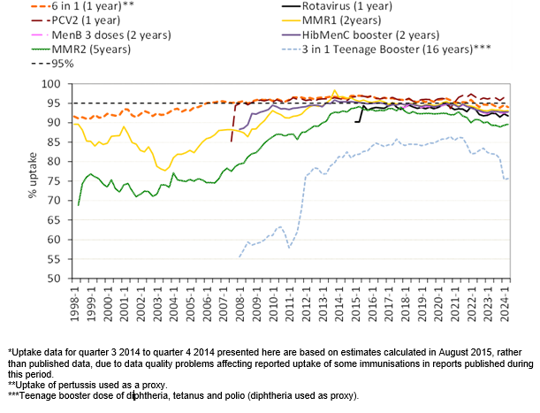
Measles
Latest MMR uptake data
Measles case epidemiology
One current outbreak ongoing in Gwent
17 cases to date
No new cases identified since 20 May 2024 (as at 10 June 2024)
Further information: Parents reminded of MMR importance as Gwent measles cases rise to 17 - Public Health Wales (nhs.wales)
Source: PHW VPDP Annual COVER report 2023-2024

Slide 44
Targeted policy to protect against measles
Vaccination of healthcare staff to protect against measles (WHC/2023/043)
Vaccination of children to protect against measles (WHC/2024/008)
Targeted action: health boards to ensure that:
  by 31 July 2024, every school in Wales with 50 pupils or more on roll has 90% of its pupils recorded as having received two doses of MMR for pupils of reception age and above
  where this has not been achieved, the health board will be required to document the reasons why it hasn’t been possible and set out further steps which will be taken to achieve it

Slide 45
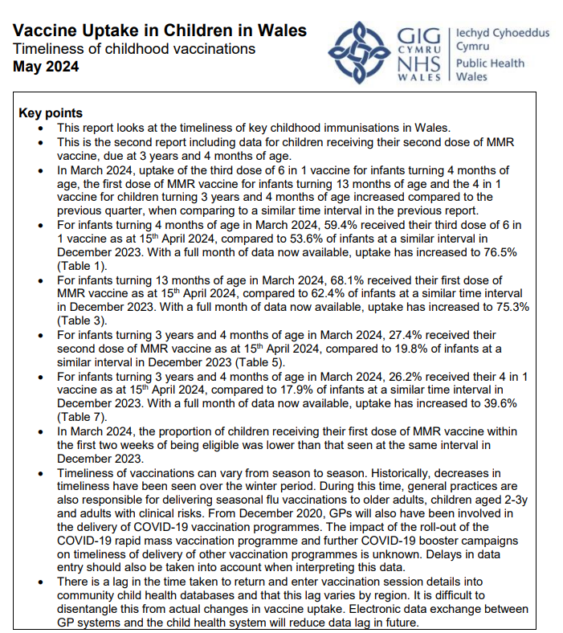
Enhanced cover reporting – Timeliness of childhood vaccinations
Interactive dashboards are also available here:
Residence: https://phw-tableau.cymru.nhs.uk/views/EnhancedCOVER_Test/DataByResidence?iframeSizedToWindow=true&:embed=y&:showAppBanner=false&:display_count=no&:showVizHome=no
GP Cluster: https://phw-tableau.cymru.nhs.uk/views/EnhancedCOVER_Test/DataByGP?iframeSizedToWindow=true&:embed=y&:showAppBanner=false&:display_count=no&:showVizHome=no
Surveillance of Vaccines, Vaccine Preventable Diseases and Respiratory Infections (sharepoint.com)

Slide 46
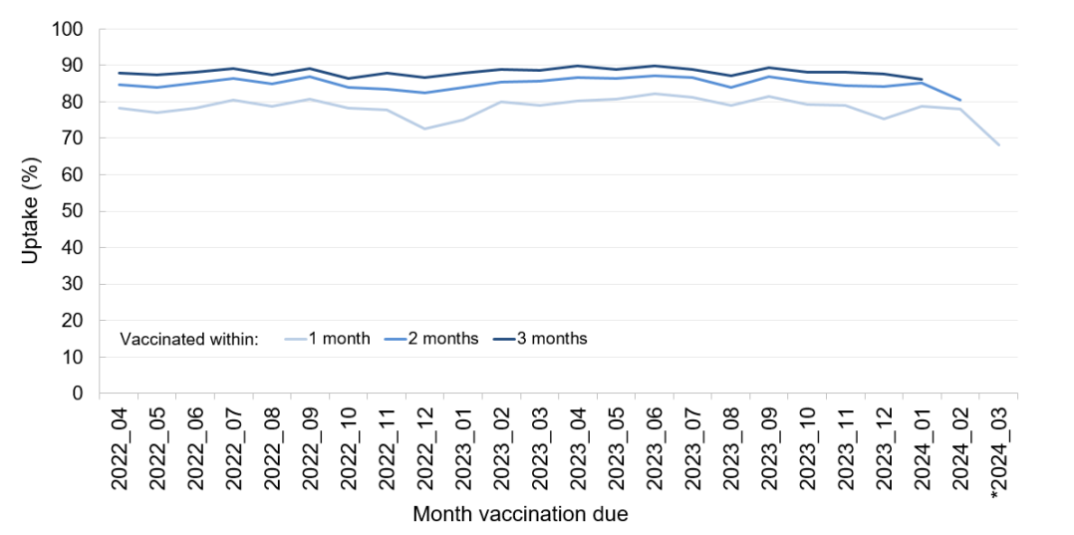
Proportion of children receiving their first dose of MMR vaccine within one, two and three months after it was due. Children due their MMR1 vaccine 01/04/2022 to 31/03/2024 and alive and resident in Wales at 31/03/20024

Slide 47
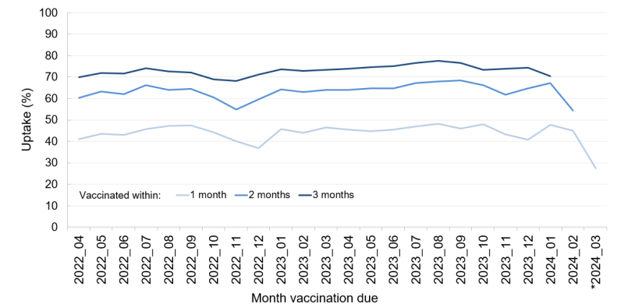
Proportion of children receiving their second dose of MMR vaccine within one, two and three months after it was due. Children due their MMR2 vaccine 01/04/2022 to 31/03/2024 and alive and resident in Wales as at 31/03/2024

Slide 48

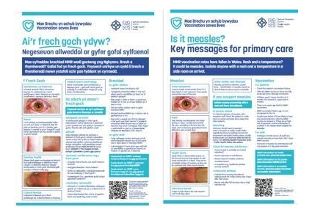



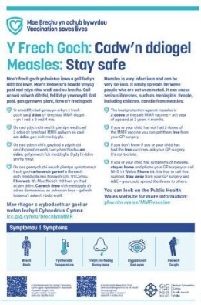

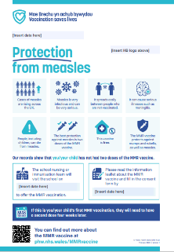

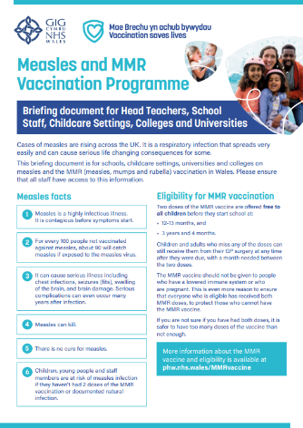
MMR resources
Leaflets Available to order here
Accessible versions of the leaflet including: Easy read, Large Print, Audio, BSL video, are available here: and for downloading here
Is it measles? Poster
This bilingual resource is available to order here
MMR toolkit for primary care
Available to view and download under ‘Clinical resources and information’ here.
Protection from measles letter
This resource has been developed to support MMR vaccination sessions for the school aged population. Available here
Measles Stay Safe poster
This is available to download and print (in colour or black and white) here
MMR briefing document for educational and childcare settings It can be accessed under ‘School vaccination programme’ here.
Measles, Mumps and Rubella (MMR) - Public Health Wales (nhs.wales)

Slide 49
School aged vaccination programmes
Rose Jones
Specialist Nurse Immunisation
VPDP

Slide 50
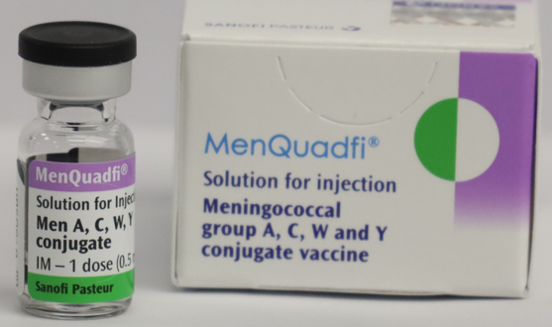
Men ACWY vaccine - Change of vaccine in Men ACWY programme 2024
Vaccine Programme Wales (NHS Executive) published a letter on the 10th June 2024 to inform NHS Wales that MenQuadfi® will replace Nimenrix® in the MenACWY programme during autumn 2024
This is a straight vaccine brand switch, following a competitive tender. The vaccines are clinically equivalent
Multi-component group A, C, W135 and Y conjugate vaccine marketed by Sanofi Pasteur
The meningococcal group polysaccharides are conjugated to a tetanus toxoid carrier
Immunisation with MenQuadfi® does not substitute routine tetanus containing immunisations and coadministration of MenQuadfi® with a tetanus toxoid containing vaccine does not impact the response to tetanus toxoid or impact safety
Presents as a clear, colourless solution for injection in a glass vial with a chlorobutyl stopper (non-latex)
Image source: Sanofi Pasteur
Notes:
Vaccine Programme Wales, MenACWY vaccine change (MenQuadfi) 2024. Available here: https://nhswales365.sharepoint.com/sites/PHW_VPDPComms/SitePages/Policy,-letters-and-Welsh-Government.aspx

Slide 51
MenACWY PGD
The routine MenACWY PGD template was updated on 23 June 2023
The at risk MenACWY PGD template was updated on 2 February 2023
Both are available via the Welsh Medicines Advice Service page (Patient Group Directions (PGD) – Welsh Medicines Advice Service (wales.nhs.uk)
The revised templates include Menveo®, Nimenrix® and MenQuadfi® as suitable products for the MenACWY vaccination programme to allow for a phased introduction of MenQuadfi®
It is likely that Nimenrix® and MenQuadfi® may be in use at the same time for a short period when the vaccine is introduced in autumn 2024.

Slide 52
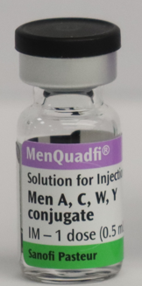
MenQuadfi® preparation and administration (1)
MenQuadfi® should be administered by intramuscular injection only, preferably in the arm (deltoid muscle) or anterolateral thigh depending on the recipient's age and muscle mass.
MenQuadfi® is a black triangle drug ▼ and is supplied in 0.5-mL single-dose vials as a ready-to-use solution that does not require reconstitution
Each box contains 5 single dose vials

Slide 53
MenQuadfi® preparation and administration (2)
The vaccine should be inspected visually for any particulate matter and/or variation of physical aspect (or discolouration) prior to administration. In the event of either being observed, do not use the vaccine and report to the MHRA via the Yellow Card scheme
Remove the flip off seal and using a suitable syringe and needle, withdraw 0.5 mL of solution, ensuring no air bubbles are present before injection.
Any unused medicinal product or waste material should be disposed of in accordance with local requirement

Slide 54
MenQuadfi®: adverse reactions
Very common (≥1/10);
Headache
Myalgia
Malaise
Common (≥1/100 to <1/10);
Fever
At the injection site: swelling, erythema
▼This medicinal product is subject to additional monitoring. This will allow quick identification of new safety information. Healthcare professionals are asked to report any suspected adverse reactions.
▼MenQuadfi solution for injection - Summary of Product Characteristics (SmPC) - (emc) (medicines.org.uk)

Slide 55

Update: Green Book chapter 2: consent
Green Book Chapter 2 updated on 13 October 2023
Consent: the green book, chapter 2 - GOV.UK (www.gov.uk)
Updates on information relating to:
    Consent
    Written consent
    Use of unlicensed and off-label vaccines*.
Of informed consent the GB chapter says:
‘The exchange of information between the healthcare provider and the individual is key to ensuring informed consent’.
Notes:
*not covered in the content of these slides

Slide 56
Information for informed consent: vaccinations in the school setting
Consent for vaccinations in the school setting differs depending on the age and competence of the individual child or young person
Recent engagement commissioned by VPDP, PHW engagement team shows that children and young people of secondary school age often want to be involved in the decision-making process
The GB chapter on consent states:
‘In secondary school age children, information leaflets should be available for the young person’s own use and to share with their parents prior to the date that the immunisation is scheduled.’
Consent: the green book, chapter 2 - GOV.UK (www.gov.uk)

Slide 57
Written consent
In the routine school-based immunisation programmes traditionally an information leaflet and consent form are usually sent to the parent to complete and return
‘The completion of a consent form is not a substitute for the provision of meaningful information sufficient to meet the individual’s needs.’
The GB chapter recognises that there is no legal requirement for consent to be in writing but it is good practice to record the discussion and decision
Electronic consent is being used increasingly across Wales and the rest of the UK but the GB chapter recognises:
‘Consideration should be given for appropriate routes to reach parents/families who may not easily access information digitally. Providers should make sure parents have sight of the NHS information leaflets.’
It is recognised that consent forms should not act as a barrier to vaccination and should be as simple to complete as possible
Notes:
Consent: the green book, chapter 2 - GOV.UK (www.gov.uk)

Slide 58

Vaccination information leaflets
The immunisation standards for school aged children in Wales (PHW 2017) state that ‘parents and young people should have an opportunity to read an information leaflet prior to giving consent’
The Vaccination in School Settings (VISS) guidance (PHW 2018) supports compliance with the Immunisation standards for school aged children and recommends the use of leaflets
NICE (2022) recommends that ‘providers should ensure that young people and their parents or carers have reliable information about vaccines that covers risks and benefits to help them make informed decisions’
Notes:
Immunisation standards for school aged children in Wales (2017) Appendix 3 in ‘A School Nursing Framework for Wales’ p.32 here: a-school-nursing-framework-for-wales-may-2017.pdf (gov.wales)
Vaccination in School Settings (VISS) (2018) Available here: vaccination in school settings v2 March 2018_Rosemary Jones.docx (sharepoint.com)
NICE (2022) NG218 Visual summary – Vaccinations for school-aged children and young people: invitations, reminders and escalation of contact (nice.org.uk)

Slide 59
Influenza vaccination programmes
Lead Nurse
Hawys Youlden
VPDP

Slide 60
Changes to the start of the 2024 to 2025 flu vaccination programme
WHC/2023/047 provides guidance on the phased approach for the commencement of the 2024/25 flu vaccination programme:
September
General practices and health boards should concentrate their efforts on maximising uptake in the children’s programme (school-age children and 2-and 3-year-olds)
Recommends pregnant women should continue to be vaccinated in September, if delaying until October would mean they risk missing out on vaccination
October
Adult vaccination should begin at the start of October and be delivered at pace with an expectation that all eligible patients should be offered a vaccination by early December
Notes:
JCVI noted that delaying the start of the adult programme until October made sense based on the evidence of waning and the timing of the flu season on the understanding that there would be a timely completion of the majority of the vaccinations by the end of November before the potential uptick of the flu season commonly started.

Slide 61
LAIV move to a trivalent vaccine (1)
WHO (September 2023) Recommended composition of influenza virus vaccines for use in the 2024 southern hemisphere influenza season states:
  no confirmed detections of circulating B/Yamagata/16/88 lineage viruses after March 2020
  data indicate that B/Yamagata lineage viruses are no longer circulating in the population and unlikely to cause future epidemics
  current vaccines containing B/Yamagata viruses pose theoretical risk of reintroduction to the population
Notes:
WHO (2023) reports that there have been no confirmed detections of circulating B/Yamagata/16/88 lineage viruses after March 2020. Data indicate that B/Yamagata lineage viruses are no longer circulating in the population and therefore are unlikely to cause future epidemics. WHO go on to state that while influenza vaccines are safe and effective, the manufacture and use of inactivated and live attenuated vaccines containing B/Yamagata lineage viruses pose a theoretical risk of reintroduction of B/Yamagata lineage virus into the population. This risk can be mitigated by the removal of B/Yamagata lineage viruses from the vaccines. Therefore, it is the opinion of the WHO influenza vaccine composition advisory committee that the inclusion of a B/Yamagata antigen as a component of influenza vaccines is no longer warranted, and every effort should be made to exclude it as soon as possible. (202309_recommendation.pdf (who.int))

Slide 62
LAIV move to a trivalent vaccine (2)
JCVI (October 2023) advised:
  that the LAIV vaccine should move to a trivalent formulation as soon as possible and
  quadrivalent or trivalent formulations of the inactivated vaccines could be used
We understand LAIV will be a trivalent vaccine for the 2024/25 season, but we are still awaiting a formal confirmation
Notes:
In June 2023 the JVCI advised that a move to trivalent was appropriate if Yamagata continued not to circulate. In the statement of JCVI advice on influenza vaccines for the 2024/25 influenza season the Committee had advised that trivalent formulations of the advised influenza vaccines were equally suitable. (Minute 2023 06.pdf | Powered by Box)
In October 2023 JCVI noted that the WHO vaccination composition meeting (VCM) took place at end of September to provide advice for the southern hemisphere and concluded that B/Yamagata lineages were no longer circulating and were unlikely to cause future epidemics. The opinion of the VCM was that the inclusion
of a B/Yamagata antigen as a component of influenza vaccines was no longer warranted and that every effort should be made to exclude this as soon as possible, across all vaccine types. (Minute 74th JCVI COVID19_Influenza_ main_10_10_2023.pdf | Powered by Box

Slide 63
QIVr flu vaccine will not be available for 2024/25
The Influenza vaccines and eligible cohorts for the 2024 to 2025 season (WHC/2023/047) [HTML] | GOV.WALES was re-issued on the 12 June 2024 - This revised Welsh Health Circular is being issued following a notification from the manufacturer of QIVr - quadrivalent recombinant influenza vaccine - that this product will not be available as expected in the UK for the 2024 to 2025
Considering the vaccines recommended by the JCVI for the 2024 to 2025 flu season, the vaccines eligible for reimbursement in Wales for the different age cohorts will be as follows:
  Those aged 65 years and over
  aQIV - aQIV may be offered ‘off-label’ to those who become 65 years of age before 31 March 2025
  QIV- HD - QIV-HD was not previously available in the UK but its manufacturers have confirmed that it will now be made available for 2024 to 2025
  QIVc where aQIV/QIV-HD is not available*
Notes:
* Whether a vaccine is ‘available’ should be a balance of clinical and operational judgement. The potential delay in sourcing the preferred vaccine (due to a temporary or localised shortage or a national batch failure) should be weighed against the protection afforded by the alternative vaccine. Whether the flu virus is circulating or is imminent at the time would be a factor in making this judgement.

Slide 64
Vaccines eligible for reimbursement in Wales for the different age cohorts
Those aged 18 to less than 65 years (including pregnant women)
QIVc
QIV HD (those aged 60 years and over only)
Children aged 2 to less than 18 years who are contraindicated/ decline LAIV
QIVc
Children aged 6 months to 2 years in risk groups
QIVc*
*QIVc was previously recommended for eligible 6 months – 2 year olds as ‘off label’. It is no longer off label and is now licensed for use from 6 months old. Cell-based Quadrivalent Influenza Vaccine (Surface Antigen, Inactivated) Seqirus suspension for injection in pre-filled syringe - Summary of Product Characteristics (SmPC) - (emc) (medicines.org.uk)

Slide 65
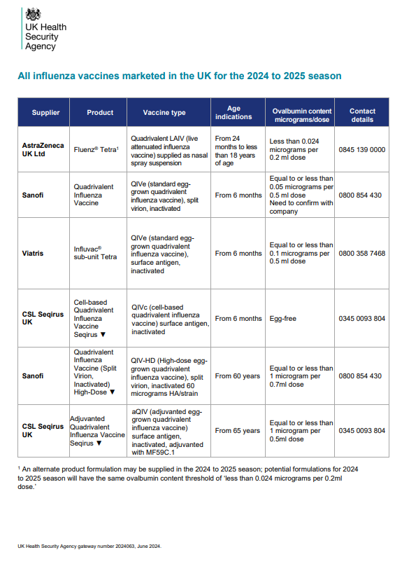
All influenza vaccines marketed in the UK for the 2024 to 2025 season (publishing.service.gov.uk) has been updated confirming ovalbumin content of QIV-HD*
Notes:
*If over 65 and egg allergic, QIVc would be recommended.

Slide 66
Adult vaccination programmes
Ceriann Howard
Specialist Nurse Immunisation
VPDP

Slide 67
Shingles
Immunocompromised cohort:
Shingrix® for those aged 50 years and over (there is no upper age limit)
  2 doses (Second dose given 8 weeks to 6 months after first dose)
Immunocompetent cohort:
Phase 1 (1 September 2023 to 31 August 2028)
Shingrix® for those turning 65 and 70 years on or after 1 September 2023
  2 doses (Second dose given 6 to 12 months after the first dose)
Zostavax® for individuals aged between 70 to 79 that were eligible for the vaccination programme before 1 September 2023 unless contraindicated. Once all stocks of Zostavax® are exhausted, these individuals can be offered Shingrix® if they have not previously been given a shingles vaccine
Zostavax expiry for last batch in UK is 31/10/2024
Notes:
Rollout to all immunocompromised individuals aged 50 years and over should be completed by September 2024
For immunocompetent individuals the vaccine may be offered from 8 weeks after the first dose. For operational reasons a longer dose interval is being used between 6-12 months in England and Wales

Slide 68
Shingles opportunistic vaccination
The ability to provide opportunistic shingles vaccination has been instrumental in the shingles programme. The *WHC/2023/024 encourages this practice to continue:
General practices can accommodate opportunistic vaccination (if operationally possible) in instances where an individual has already attained or passed the age of:
  65 but not yet 80 for phase one and
  60 but not yet 80 in phase two
This opportunistic offer is available to enhance the robust call/recall that should be in place from 1 September 2023.
Notes:
* The WHC/2023/024 allows for opportunistic vaccination of this group as it has been instrumental in the shingles programme to date and maintaining this practice going forwards is encouraged. In instances where an individual has already attained or passed the age of 65 but not yet 80 for phase one, or 60 but
not yet 80 in stage two, then general practices can accommodate opportunistic vaccination if operationally possible. The SFE will be clear on the parameters for this reimbursement route for opportunistic vaccination. This opportunistic offer is available to enhance the robust call/recall that should be in place from 1 September 2023.
The SFE will be clear on the parameters for this reimbursement route for opportunistic vaccination.

Slide 69

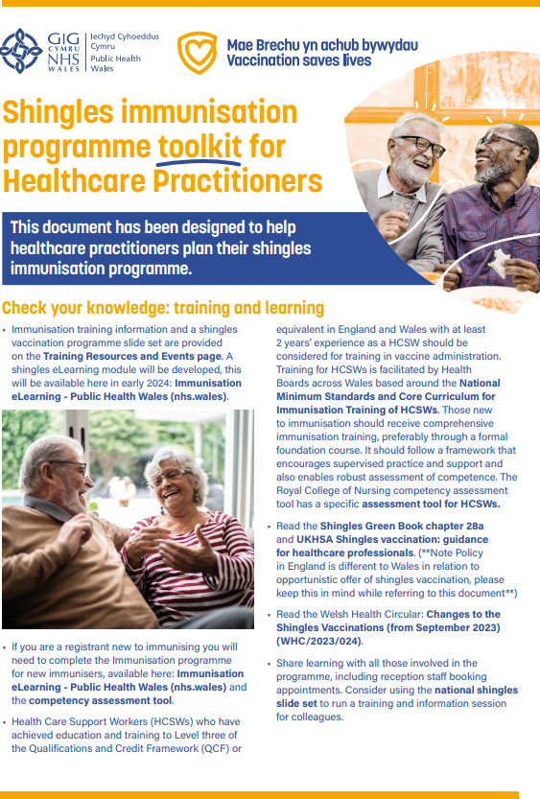
Shingles
Shingles Toolkit:
This new resource has been designed to help healthcare practitioners plan their shingles immunisation programme.
This is available at: Shingles - Information for health professionals - Public Health Wales (nhs.wales)
Shingles eLearning:​
This module provides key information on the Shingles infection, shingles vaccination (Shingrix) and the national shingles vaccination programme in Wales. ​
Suitable for: All NHS staff who have responsibility for administering shingles vaccination or providing advice.​
Access to the module is via ESR or Learning@Wales (for further guidance click here)​
Notes:
It is important to note that the elearning module does not cover information on the Zostavax® vaccine, therefore Zostavax specific training will be required. A shingles training slide set outlining information about the Zostavax® vaccine is available here: Immunisation training resources and events - Public Health Wales (nhs.wales)

Slide 70
Mpox vaccination programme

Slide 71
Mpox vaccination
Mpox: Use of licensed stock (Jynneos®) and return to Intramuscular administration, addendum to training for healthcare practitioners. (v4.1) The addendum to UKHSA training slides can be viewed here: Monkeypox - Information for health professionals - Public Health Wales (nhs.wales)
UKHSA Vaccination against monkeypox using the MVA-BN vaccine: training for healthcare practitioners slide set has not been updated since 20th October 2022
Important to note that since the UKHSA training slides were published, Vaccination Clinical Advisory Group (VCAG) have approved the return to the use of an intramuscular injection as opposed to the previous advice of an intradermal injection due to current vaccine supply. Administration of licensed stock in Wales can be given using a PGD. A Wales National PGD template has been provided for Health Boards or NHS organisations to review, authorise and sign off locally according to their policies and governance procedures.

Slide 72
Legal Framework for Administration
At present in Wales there is a mixture of licensed (Jynneos® branded) and unlicensed (Jynneos® and Imvanex® branded) vaccine
Unlicensed stock was quarantined in line with the VPW Unlicenced Jynneos® vaccine collection SOP, and use of licensed stock commenced on 01 May 2024
Administration of licensed stock in Wales can be given using a PGD
A Wales National PGD template has been provided for Health Boards or NHS organisations to review, authorise and sign off locally according to their policies and governance procedures
The Wales National PGD allows only the use of US licensed Batch FDP00072 of Jynneos▼® vaccine.
The Wales National PGD template is available here Welsh medicines information centre

Slide 73
Intramuscular administration of Jynneos® Vaccine
The MVA-BN (Jynneos▼®) package insert advises the vaccine should be administered by the deep sub-cutaneous (SC) route. However, UKHSA and more recently VCAG advise that intramuscular (IM) route is an acceptable alternative but is off-label
Where a vaccine is recommended off-label, as part of the consent process, consider informing the individual or their parent/carer that the vaccine is being offered in accordance with national guidance but that this is outside the product licence
For further information about off-label use please see: https://www.sps.nhs.uk/articles/off-label-medicine-use-under-a-patient-group-direction/

Slide 74
Gonorrhoea vaccination programme

Slide 75
Gonorrhoea vaccination programme (1)
JCVI advised on the use of meningococcal B vaccination for the prevention of gonorrhoea - Published 10 November 2023
Gonorrhoea epidemiology:
Gonorrhoea is a bacterial sexually transmitted infection (STI) caused by the Neisseria gonorrhoeae bacterium. It is the second most commonly diagnosed STI in England, with around 80,000 diagnoses a year
Gonorrhoea causes significant morbidity and remains a public health concern globally. Increased resistance to most antibiotics used to treat gonococcal infection has been reported worldwide, with extensively resistant strains exhibiting resistance to multiple antibiotic classes
The World Health Organization considers Neisseria gonorrhoeae to be a high priority pathogen due to this widespread antimicrobial resistance
Neisseria meningitidis and Neisseria gonorrhoeae are closely genetically related

Slide 76
Gonorrhoea vaccination programme (2)
Vaccine effectiveness:
Real world studies have estimated that the 4CMenB vaccine has between 32.7% to 42% effectiveness against gonorrhoea
Therefore, although vaccination would be expected to reduce the chance of becoming infected with gonorrhoea, it would not completely eliminate the possibility
Vaccinated individuals could expect to have some reduction in their own risk of contracting gonorrhoea, however the main benefit of a vaccination programme is expected to be at a community level with a significant reduction in the number of cases overall
Even with a modest vaccine effectiveness, vaccination is of benefit as previous infection with gonorrhoea is thought to offer little protection against future infection and reinfection is therefore common
As protection against gonorrhoea isn’t currently a licensed indication for 4CMenB vaccine, the advice is based on off-label use of vaccine
JCVI advice on the use of meningococcal B vaccination for the prevention of gonorrhoea - GOV.UK (www.gov.uk)

Slide 77
Vaccine equity- Public Engagement Team
Claire Woodcock
Service Development and User Engagement Senior Practitioner
VPDP

Slide 78

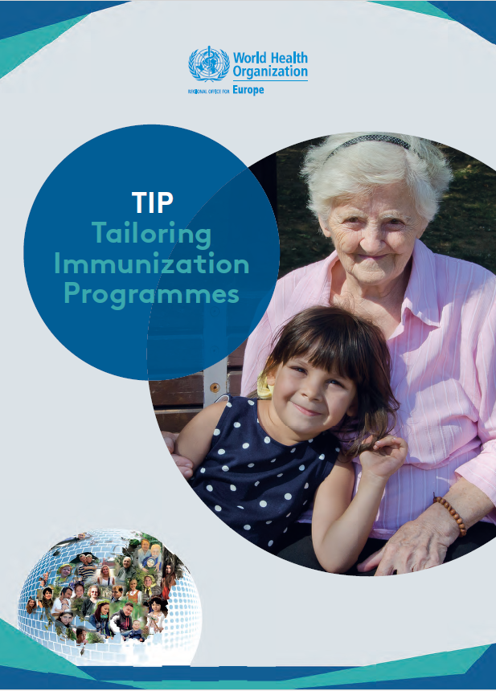
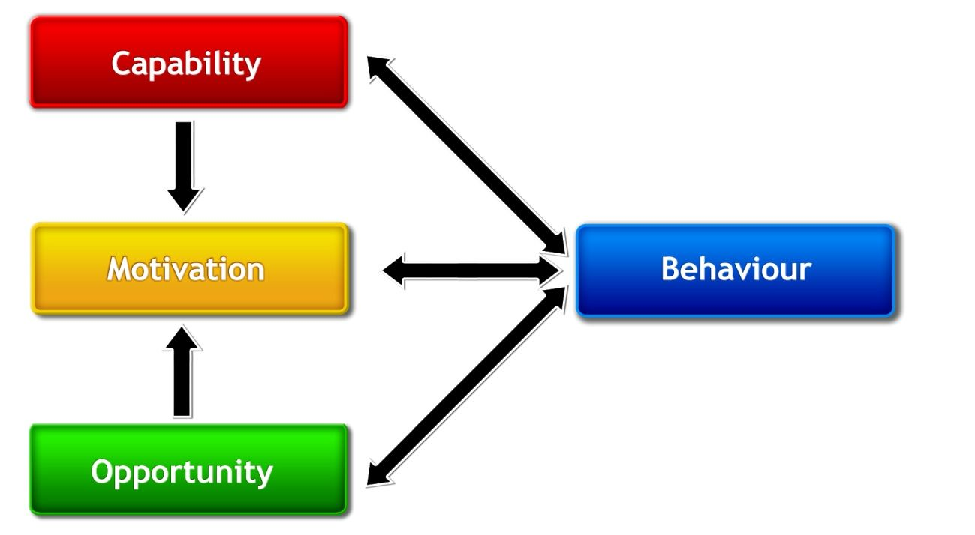
Public Engagement Team
The national immunisation framework:
Focus on equity
Behavioural insights
Co-production of patient information
COM-B Model
Priorities
1. Vaccination Equity
2. Digitally Enabled Vaccination
3. Eligibility
4. Public Vaccination Literacy
5. Deployment
6. Governance

Slide 79

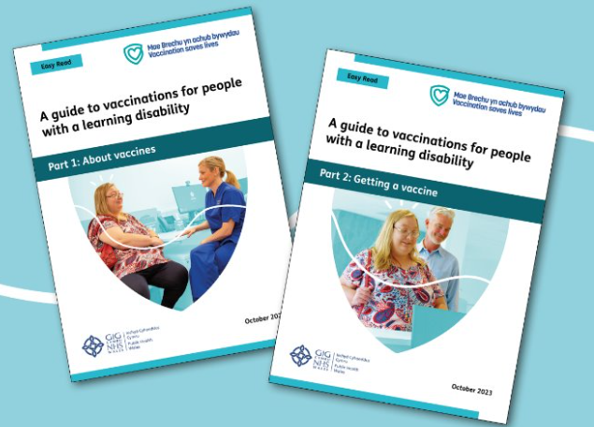
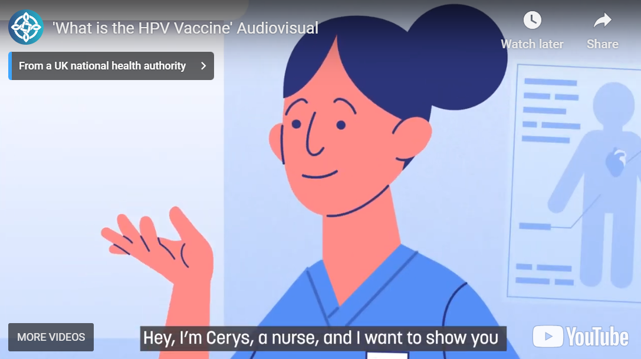
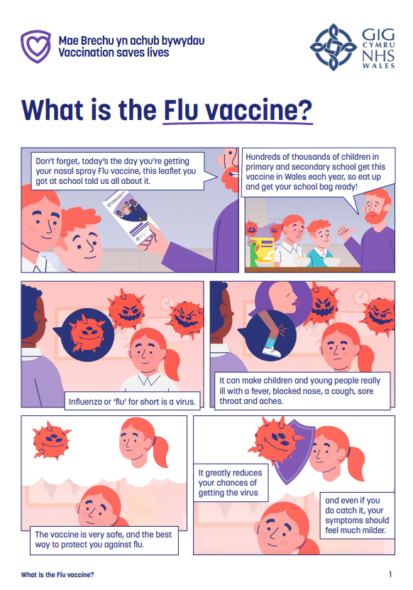
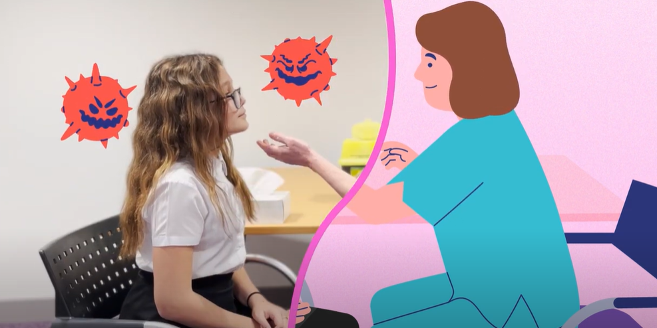
Co-Production
Co-produced resources:
Rachel’s story: getting a vaccine
A guide to vaccinations for people with a learning disability
What is the HPV vaccine?
What is the flu vaccine?
Co-produced resources in development:
MenACWY animation
3 in 1 booster animation
MMR and gelatine poster
Vaccine equity network:
Co-production practice – challenges and opportunities
Share and reflect on approaches
Workshop with Co-production network Wales

Slide 80
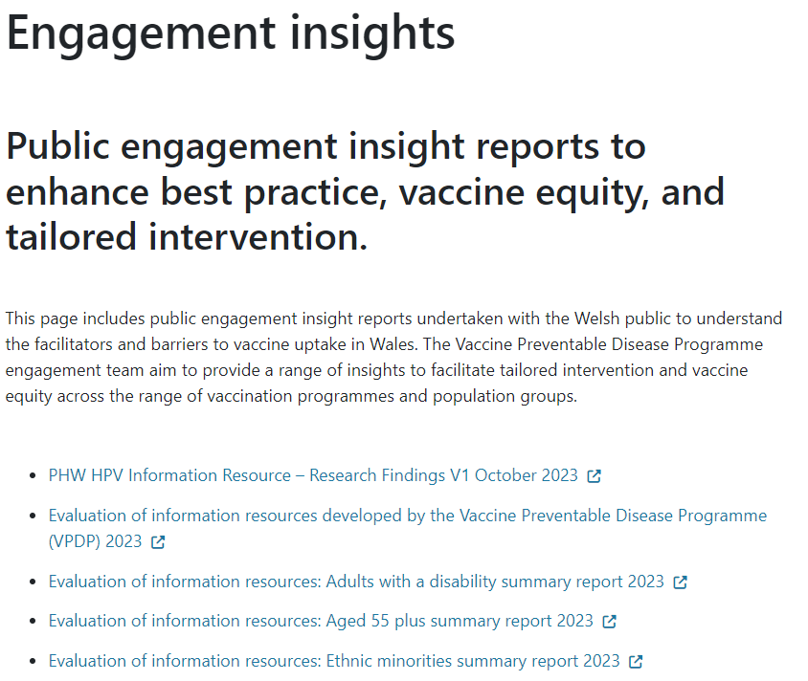
Engagement and Behavioural Science
Behavioural insight reports:
Engagement insights - Public Health Wales (nhs.wales)
Planned engagement 2024/25:
Young people age13-14 years – insights on MenACWY and 3 in 1 teenage booster vaccines
Adults aged 55+ insights on vaccination facilitators and barriers, including RSV and shingles
Parents from ethnic minorities and MMR vaccine
Insights from parents and staff at Deep End Cymru practice – focusing on pre-school immunisations
Behavioural Science Unit Collaboration:
COM-B and TIP implementation advice
Behaviourally informed communications initiative (BICI) – pilot
Motivational Interviewing for vaccinations - training

Slide 81
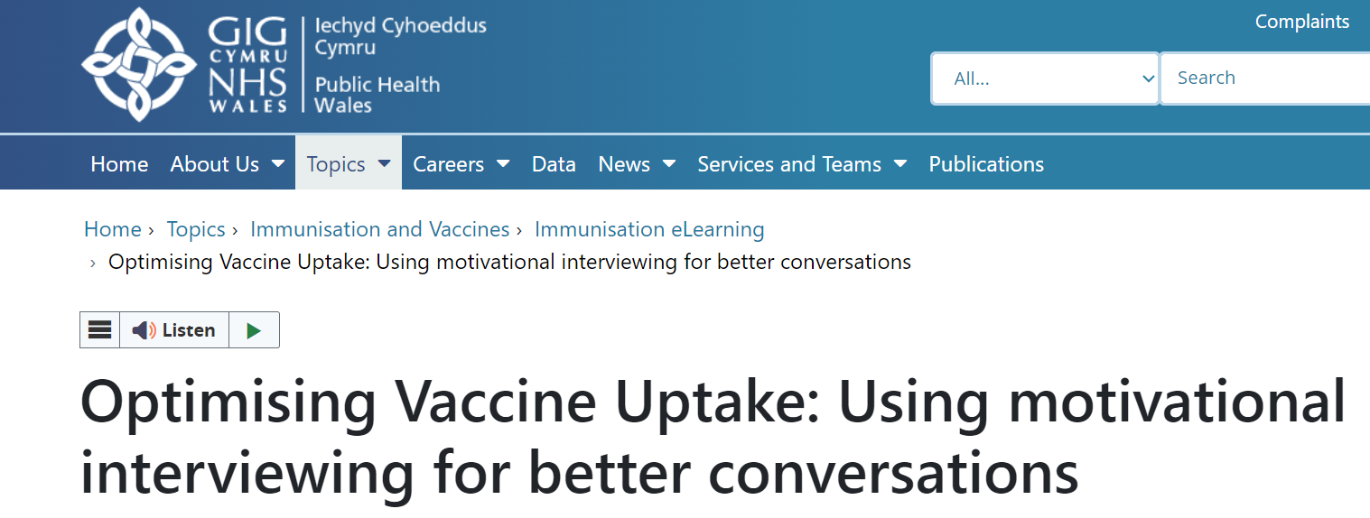
eLearning module: Optimising Vaccine Uptake: Using motivational interviewing for better conversations
The approach and style of a vaccine conversation can make a real difference in understanding individual hesitancy, addressing barriers, and influencing vaccine uptake
There is an eLearning module available called Optimising Vaccine Uptake: Using motivational interviewing for better conversations which aims to support staff with having positive conversations about immunisations
The module aims to provide health professionals the skills and knowledge required to implement motivational interviewing techniques when having vaccine-related conversations
Further information about the module and how to access it is available here: Immunisation eLearning - Public Health Wales (nhs.wales)

Slide 82
Communications team update
Sarah Hartman
Communications Manager VPDP/Health Protection
Communications team
PHW

Slide 83
Communication team update
General election pre-election period will affect any JCVI and government announcements around vaccinations
Measles remains a priority area for us to focus on and is an additional campaign for 24/25
Winter Respiratory Vaccination campaign will extend the coat creative for another year
An RSV campaign is being developed
A National Communication Strategy for Vaccination is being developed to support the work of the National Immunisation framework

Slide 84
Any questions ?

