Slide 1

Pneumococcal disease
Vaccine Preventable Disease Programme
Public Health Wales
Notes:
Material contained in this document may be reproduced without prior permission provided it is done so accurately and is not used in a misleading context.
Acknowledgement to Public Health Wales NHS Trust to be stated.
© 2021 Public Health Wales NHS Trust.

Slide 2
Learning objectives
Describe pneumococcal disease and highlight which age groups are mostly affected by this infectious disease
Outline the epidemiology of pneumococcal disease
Describe the pneumococcal vaccines licensed in the UK including contraindications, and indications for use
Outline the groups that are recommended to receive pneumococcal vaccination

Slide 3
Pneumococcal disease
Pneumococcal disease is the term used to describe infections caused by the bacterium Streptococcus pneumoniae (also called pneumococcus)
Streptococcus pneumoniae is an encapsulated Gram-positive coccus
Over 90 capsular types
Some serotypes are carried in nasopharynx asymptomatically
Spread by respiratory droplets
Can spread locally into the sinuses and ear causing sinusitis & otitis media
Can spread into the lungs causing pneumonia
Can cause systemic infections including bacteraemia, meningitis and septicaemia

Slide 4
Epidemiology of pneumococcal disease
Mainly affects very young and elderly, those with absent or non-functioning spleen and individuals with other causes of impaired immunity
Recurrent infections may occur in association with skull fractures, skull defects, cerebrospinal fluid (CSF) leaks and cochlear implants
Commonest cause of community-acquired pneumonia
Pneumococcal disease is one of the most frequently reported causes of bacteraemia and meningitis in children and adults
Invasive Pneumococcal Disease (IPD) is a major cause of morbidity and mortality
Consistent seasonal peaks of pneumococcal disease are seen during December and February¹

Slide 5
Pneumococcal immunisation programme objectives
The primary objective of this programme is to protect all of those for whom pneumococcal infection is likely to be more common and/or serious.
This is:
Infants as part of the routine childhood immunisation programme
Children and adults in clinical risk groups
Those aged 65 years or over

Slide 6
Pneumococcal vaccines
There are two pneumococcal vaccines currently used in the routine immunisation schedule within the UK
Pneumococcal CONJUGATE vaccine (PCV13)
Contains 13 capsular types used for:
Routine infant immunisation schedule
• Unimmunised >2 years of age to under 10
years in clinical risk groups
• Severely immunocompromised children and
adults
(Unimmunised or partially immunised
children over the age of one year only
require one dose of PCV13 - up to 2 years
of age)
Pneumococcal POLYSACCHARIDE Vaccine (PPV23)
Contains 23 capsular types used for:
Individuals in clinical risk groups >2 years of age
All adults 65 years of age and over
Booster given 5 yearly to patients with no spleen, splenic dysfunction or chronic renal disease
Note: Not immunogenic in young children (<2yrs)
Information on vaccine supply and vaccine products is published in Vaccine update
SPC: Pneumococcal conjugate vaccine (PCV13)
SPC: Pneumococcal polysaccharide vaccine (PPV23)
Notes:
In April 2010, PCV13 replaced PCV7, also at a 2+1 schedule. Pneumococcal conjugate vaccine (PCV13) is very effective in preventing otitis media, pneumonia and invasive disease. There is good evidence that pneumococcal polysaccharide vaccine (PPV23) is moderately effective (50-70%) at preventing invasive pneumococcal disease and there is some evidence that it offers protection against non-bacteraemia pneumococcal pneumonia. Both have an excellent safety record. https://www.gov.uk/government/publications/pneumococcal-the-green-book-chapter-25
SPC: Pneumococcal conjugate vaccine (PCV13) - https://www.medicines.org.uk/emc/product/453/smpc
SPC: Pneumococcal polysaccharide vaccine (PPV23) - https://www.medicines.org.uk/emc/product/9692/smpc

Slide 7
Pneumococcal Conjugate Vaccine (PCV13) routine immunisation schedule in the UK
PCV immunisation programme has been part of the routine schedule since 2006 with PCV13 introduced in 2010, it has successfully achieved high levels of population (herd) immunity
Circulation of the 13 pneumococcal serotypes contained in the vaccine and the risk of disease from these serotypes is very low in the UK¹
As a result of the success changes to the UK routine PCV immunisation programme schedule were implemented on the 1st January 2000
  Infants born on or after 1 January 2020 should be offered a single dose of PCV13 at 12 weeks alongside the other routine immunisations, followed by a PCV13 booster at 12 to 13 months of age. This is the 1+1 PCV13 schedule
Changes to the infant pneumococcal conjugate vaccine schedule. Information for healthcare practitioners. PHE December 2019
Notes:
Changes to the infant pneumococcal conjugate vaccine schedule. Information for healthcare practitioners. PHE December 2019: https://assets.publishing.service.gov.uk/government/uploads/system/uploads/attachment_data/file/849646/PCV_schedule_change_HCP_information.pdf

Slide 8
Who should have Pneumococcal Polysaccharide Vaccine (PPV23)?
Individuals aged 2 years or over in one or more of these clinical groups:
Asplenia/splenic dysfunction - This also includes conditions that may lead to splenic dysfunction such as homozygous sickle cell disease and coeliac syndrome.
Chronic respiratory disease
Chronic heart disease
Chronic kidney disease
Chronic liver disease
Diabetes
Immunosuppression
Individuals with cochlear implants or cerebrospinal fluid leaks
Everyone aged 65 years or over
Individuals at occupational risk - consider for those at risk of frequent or continuous occupational exposure to metal fume (e.g. welders)^{2,3,4}
Notes:
Individuals at occupational risk
There is an association between exposure to metal fume and pneumonia and infectious pneumonia, particularly lobar pneumonia (Industrial Injuries Advisory Council, 2010; Toren et al., 2011) and between welding and invasive pneumococcal disease (Wong et al., 2010). PPV23 (single 0.5ml dose in those who have not received PPV23 previously) should be considered for those at risk of frequent or continuous occupational exposure to metal fume (e.g. welders) taking into account the exposure control measures in place. Vaccination may reduce the risk of invasive pneumococcal disease but should not replace the need for measures to prevent or reduce exposure.

Slide 9
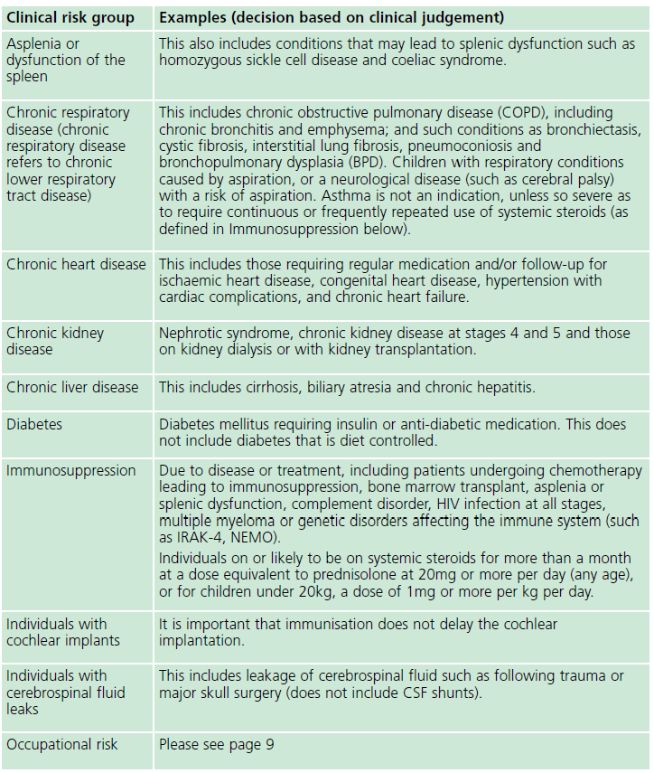
Table 25.2 Clinical risk groups who should receive the pneumococcal immunisation
Notes:
Children and adults in at-risk groups as outlined in table 25.2 may require additional protection against pneumococcal disease. The vaccine(s) and schedule used will depend on the age at presentation, their routine vaccination status and the nature of the underlying condition. For age group specific advice see green book pneumococcal chapter: https://www.gov.uk/government/publications/pneumococcal-the-green-book-chapter-25 IRAK-4, NEMO, are both rare primary immunodeficiency disorders.
Source: The green book, chapter 25, Pneumococcal: https://www.gov.uk/government/publications/pneumococcal-the-green-book-chapter-25

Slide 10
Risk Groups
Children and adults in clinical risk groups as outlined in Green book Pneumococcal chapter 25 - table 25.2 (on previous slide) these individuals may require additional protection against pneumococcal disease. The vaccine(s) and schedule used will depend on the age at presentation, their routine vaccination status and the nature of the underlying condition
Infants diagnosed with at risk conditions from birth to two years of age
All at risk infants under one year (see Table 25.2 on previous slide), including those severely immunocompromised, should be given PCV13 according to the national immunisation schedule
Single dose of PPV23 should then be given when they reach 2 years of age, at least two months after the last dose of PCV
In severely immunocompromised children a further dose of PCV13 should be given two months after the routine dose due on their first birthday
Notes:
All at risk infants under one year (see Table 25.2 on previous slide), including those severely immunocompromised this includes: bone marrow transplant patients, patients with acute and chronic leukaemia, multiple myeloma or genetic disorders affecting the immune system (e.g. IRAK-4, NEMO, complement deficiency).
Children in this age group who are severely immunocompromised and those with asplenia, splenic dysfunction or complement disorders are recommended to have an additional PCV13 dose. A further dose of PCV13 should be given at least two months after the routine dose due on their first birthday. A single dose of PPV23 should be then given when they reach the age of two years, at least two months after the last dose of PCV13. The intervals between doses of PCV13 may be reduced to one month if necessary to ensure that the immunisation schedule is completed.

Slide 11
Green Book advice on children diagnosed with at-risk conditions from two years to under ten years of age
Children in clinical risk groups who received PCV13 routinely according to the national schedule should be given PPV23 at least two months after the last dose of PCV13
Children in this age group who are unvaccinated or partially vaccinated should receive one dose of PCV13, followed by a single dose of PPV23 at least two months later
Severely immunocompromised children in this age group should be given an extra dose of PCV13 even if they are fully immunised, as they may have reduced immune responses to the vaccine, a single dose of PPV23 should then be given at least two months after the last dose of PCV13
What if PPV23 has already been given? Wait 6 months after the PPV23 dose to give PCV13 to ensure maximum effectiveness from vaccine
Notes:
If PPV23 has already been administered, then wait at least six months after the PPV23 dose to give PCV13 in order to reduce the theoretical risk of pneumococcal serotype-specific hypo-responsiveness.

Slide 12
Green Book advice on children aged over 10 years and adults diagnosed with at-risk conditions
Individuals in this group should receive a single dose of PPV23, regardless of prior PCV13 vaccination, no additional PPV23 is recommended once they reach 65 years of age
Severely immunocompromised children aged over 10 years and adults should be offered a single dose of PCV13 followed by PPV23 at least two months later, irrespective of previous pneumococcal vaccinations
What if PPV23 has already been given? Wait 6 months after the PPV23 dose to give PCV13 to ensure maximum effectiveness from vaccine
Notes:
If PPV23 has already been administered, then wait at least six months after the PPV23 dose to give PCV13 in order to reduce the theoretical risk of pneumococcal serotype-specific hypo-responsiveness.

Slide 13
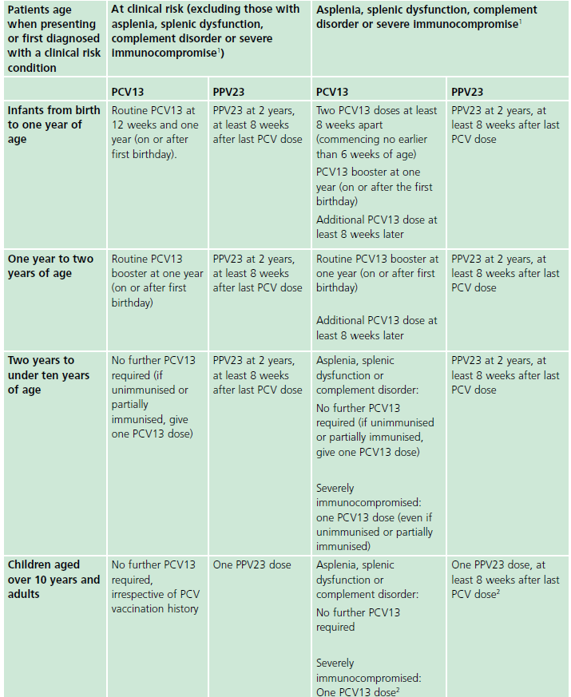
Summary of vaccine doses for Individuals in a clinical risk group
Table 25.3 in the Pneumococcal Green book chapter summarises which pneumococcal vaccines are needed based on:
Age
Clinical risk group
Source: The Green book, chapter 25, Pneumococcal
Notes:
Source: The Green book, chapter 25, Pneumococcal:
https://www.gov.uk/government/publications/pneumococcal-the-green-book-chapter-25

Slide 14
Green Book advice on timing of vaccination for individuals with splenic dysfunction or those requiring splenectomy or commencing immunosuppressive treatment
Children and adults requiring splenectomy or commencing immunosuppressive treatment should be vaccinated according to the age-specific advice outlined (slides 8-10) for risk groups
Ideally, pneumococcal vaccine should be given four to six weeks before elective splenectomy or initiation of treatment such as chemotherapy or radiotherapy
If it is not practicable to vaccinate two weeks before splenectomy, immunisation should be delayed until at least two weeks after the operation
If it is not practicable to vaccinate two weeks before starting chemotherapy/radiotherapy, immunisation should be delayed until at least 3 months after completion of therapy
Notes:
If it is not possible to vaccinate beforehand, splenectomy, chemotherapy or radiotherapy should never be delayed.

Slide 15
Uptake data
Data to monitor PCV13 and PPV23 immunisation in Wales are provided to Public Health Wales (PHW) by General Practices through Audit+
PCV13 data is included in the Coverage of Vaccination Evaluated Rapidly (COVER) reports, published quarterly and annually
  PCV13 uptake of final dose by 2 years was 94.8% in the 2020/21 Annual COVER report
The first annual uptake for PPV23 was published by PHW in September 2020
  PPV23 uptake in Wales by 31st March 2020 was 32.8% for 2-64 year olds in at risk groups and 60.2% in those 65 years and over
  The next annual PPV uptake report is due to be published shortly, this report when published will be available to view here: http://nww.immunisation.wales.nhs.uk/pneumococcal-immunisation
COVER Annual Report 2020
Pneumococcal polysaccharide vaccination (PPV) uptake in Wales in 2019/20
Notes:
COVER Annual Report 2020/21: http://nww.immunisation.wales.nhs.uk/annual-cover-reports
Pneumococcal polysaccharide vaccination (PPV) uptake in Wales in 2019/20: http://nww.immunisation.wales.nhs.uk/pneumococcal-immunisation

Slide 16
PPV23 Vaccine supply
Supply of PPV23 has been problematic since 2017 due to global demand
In late 2017 the Chief Medical Officer (CMO) gave recommendations as to how available supply should be prioritised when limited
This guidance recommends that newly diagnosed high and moderate priority risk groups should be vaccinated first followed by others in high and moderate priority risk groups who are unvaccinated
This PPV23 supply prioritisation guidance still applies in 2021
CMO - PPV23 supply and prioritisation letters 2017-2021
Notes:
CMO – PPV23 supply and prioritisation letters: http://nww.immunisation.wales.nhs.uk/policy-letters-j-to-z#Pneumococcal_Disease

Slide 17
Prioritisation of PPV23 supplies
When supply of PPV23 is limited, vaccination should be offered in this order of priority
High priority
Asplenia or dysfunction of the spleen
Immunosuppression
Moderate priority
Chronic respiratory disease
Chronic kidney disease
Low priority
Individuals aged 65 and over with no other risk factors
Individuals with cochlear implants
Individuals with cerebrospinal fluid leaks
Chronic liver disease
Diabetes (not diet controlled)
Booster dose for individuals recommended
Notes:
‘National stocks of PCV13 (Prevenar13), or separately procured PCV10 (Synflorix), should not be used in place of PPV23 because herd protection from the childhood PCV13 programme has reduced pneumococcal disease due to these serotypes across all ages, including the elderly. PPV23 helps provide additional protection against serotypes that are not covered by PCV13 or PCV10.’ CMO November 2020

Slide 18
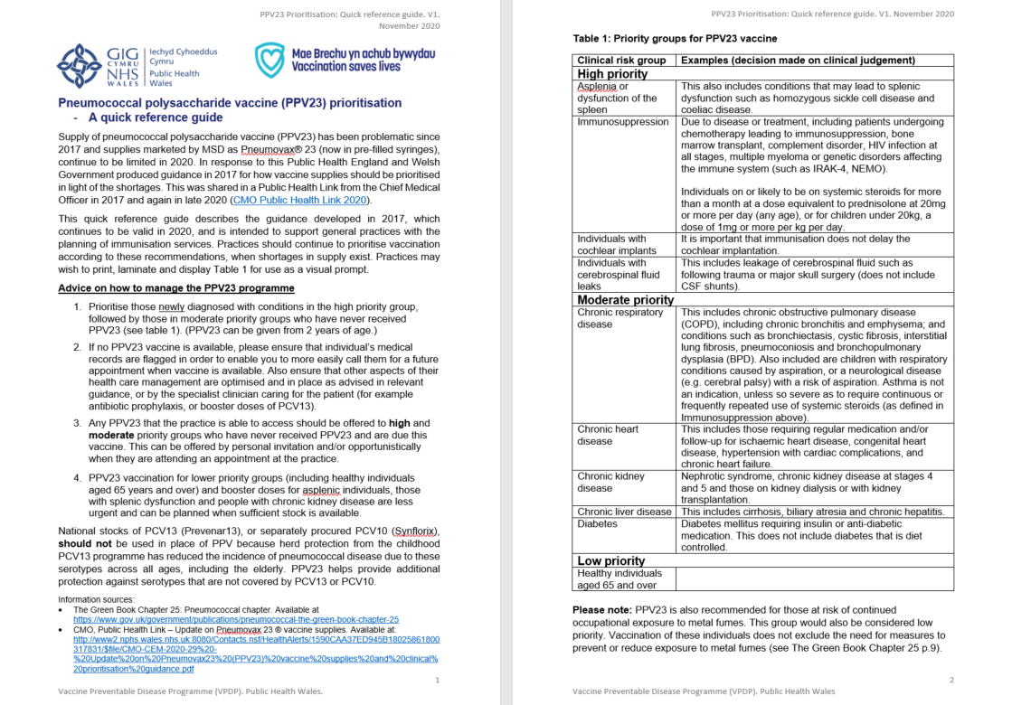
PPV23 prioritisation – A quick reference guide
This resource has been developed to support general practices with the planning of PPV23 immunisation services
Practices may wish to print, laminate and display Table 1 for use as a visual prompt
PPV prioritisation – A quick reference guide, Public Health Wales 2021
Notes:
PPV prioritisation – A quick reference guide, Public Health Wales 2021: http://nww.immunisation.wales.nhs.uk/pneumococcal-disease

Slide 19
Changes to ordering of PPV23
Since 1st June 2021 PPV23 has be available to order via the ImmForm website for the NHS immunisation programme
PPV23 no longer needs to be procured locally via a wholesaler and is now supplied centrally for England, Wales and the rest of the UK
Supply may be limited so services should continue to prioritise available vaccine in the same order that has been advised since 2017
Full details of the change to ordering and the continued prioritisation of available PPV23 is in the Public Health Link from the Chief Medical Officer (CMO) 6th May 2021
Update on Pneumovax 23 vaccine supplies, CMO, Welsh Government May 2021
How to register for an ImmForm account, Public Health England 2020
Notes:
Update on Pneumovax 23 vaccine supplies, CMO, Welsh Government May 2021: http://nww.immunisation.wales.nhs.uk/policy-letters-j-to-z#Pneumococcal_Disease
How to register for an ImmForm account, Public Health England 2020: https://assets.publishing.service.gov.uk/government/uploads/system/uploads/attachment_data/file/932130/ImmForm_how_to_register_helpsheet.pdf

Slide 20
Contraindications
Minor illnesses without fever or systemic upset are not valid reasons to postpone pneumococcal immunisation in children and adults
However, fever with systemic upset is a reason to postpone pneumococcal immunisation
There are very few individuals who cannot receive pneumococcal vaccines. When there is doubt, appropriate advice should be sought from a consultant paediatrician, immunisation coordinator or the individual’s specialist rather than withholding the vaccine
The vaccines should not be given to those who have had:
  a confirmed anaphylactic reaction to a previous dose of the vaccine
  a confirmed anaphylactic reaction to any component of the vaccine

Slide 21
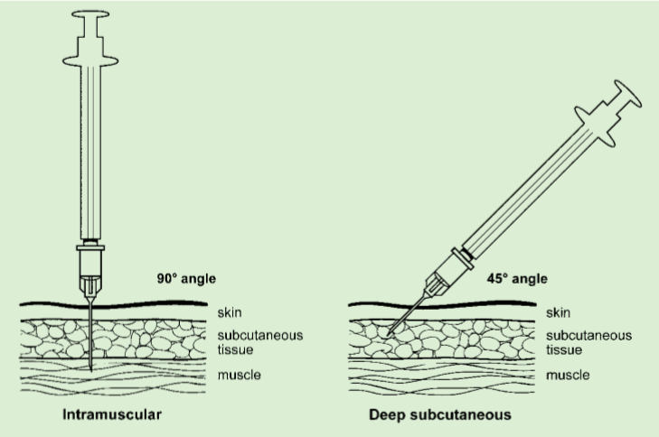
Vaccine administration
Both pneumococcal vaccines are administered via the Intramuscular (IM) route, IM injections should be given with the needle at a 90º angle to the skin and the skin should be stretched, not bunched
For individuals with a bleeding disorder, vaccines normally given by an IM route may alternatively be given by deep subcutaneous (SC) injection to reduce the risk of bleeding
Deep SC injections should be given with the needle at a 45º angle to the skin and the skin should be bunched, not stretched
It is not necessary to aspirate the syringe after the needle is introduced into the muscle^{5,6}
Source: Chapter 4 Immunisation procedures

Slide 22
Co-administration of pneumococcal vaccines
Pneumococcal conjugate vaccine (PCV13) can be given at the same time as other vaccines such as DTaP/IPV/ Hib/HepB, 4CMenB, MMR, MenC, Hib/MenC .
Pneumococcal polysaccharide vaccine (PPV23) can be given at the same time as influenza and shingles vaccine, the vaccines should be given at separate sites, preferably in different limbs.
Pneumococcal vaccine may be given at the same time as COVID-19 vaccines
If more than one vaccine is given in the same limb, they should be given at least 2.5cm apart. (The site at which each vaccine was given should be noted in the individual’s records)
Pneumococcal polysaccharide vaccine (PPV23) can be given at any time of the year.

Slide 23
Pneumococcal Polysaccharide Vaccine (PPV23)
Length of protection
The length of protection is not known, this may vary between capsular types
Antibody levels usually begin to decline after about 5 years, but may decline more rapidly in asplenic patients and children with nephrotic syndrome
Reinforcing immunisation
Antibody levels decline rapidly in individuals with no spleen, splenic dysfunction or chronic renal disease -
Revaccination with PPV23 is recommended every five years in these groups
Revaccination not recommended in any other groups

Slide 24
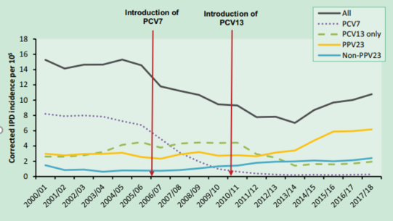
Impact of the pneumococcal vaccination programme
Significant impact of the childhood PCV7 & PCV13 immunisation programme on the reduced incidence of invasive Pneumococcal disease (IPD) and Community Acquired Pneumonia (CAP) in adults until 2013/14
Since 2013/14 an increase in overall incidence of invasive pneumococcal disease has been observed, largely due to increases in non-PCV13 vaccine serotypes and mainly in older age groups
Eight of the 10 most prevalent serotypes currently causing IPD are included in PPV23⁷
Figure 25.1 Corrected IPD incidence in England between 2000/01 and 2017/2018 by serotype group
Source: The Green book, chapter 25, Pneumococcal
Notes:
The Green book, chapter 25, Pneumococcal:
https://www.gov.uk/government/publications/pneumococcal-the-green-book-chapter-25

Slide 25
Adverse reactions
Pneumococcal conjugate vaccine (PCV13)
The most commonly reported adverse reactions in children 6 weeks to 5 years of age are vaccination-site reactions, fever, irritability, decreased appetite, and increased and/or decreased sleep. Reports of all adverse reactions can be found in the summary of product characteristics available at: https://www.medicines.org.uk/emc/product/453/smpc
Pneumococcal polysaccharide vaccine (PPV23)
Mild soreness and induration at the site of injection lasting one to three days and, less commonly, a low grade fever may occur. More severe systemic reactions are infrequent. Reports of all adverse reactions can be found in the summary of product characteristics for available at: https://www.medicines.org.uk/emc/product/9692/smpc
Anyone can report a suspected adverse reaction to the Medical and Healthcare products Regulatory Agency (MHRA) using the Yellow Card reporting scheme at: http://yellowcard.mhra.gov.uk/

Slide 26
Vaccine efficacy of Pneumococcal
Polysaccharide Vaccine (PPV23)
Limited number of trails on the efficacy of PPV23 in those aged 65 years and over (not in clinical risk group)
After considering the evidence JCVI considered it likely that PPV23 provides some short lived protection against vaccine – type Invasive Pneumococcal Disease⁸
However unlikely to be any protection against vaccine – type Community Acquired Pneumonia
Evidence regarding efficacy in clinical risk groups is conflicting, where efficacy seen duration of protection is short lived
A study by Andrews et al, 2012 showed 63% vaccine effectiveness (VE) in immunocompetent clinical risk groups, and 43% VE in those who were immunocompromised in the first two years following vaccination
Interim JCVI statement on adult pneumococcal vaccination in the UK –
November 2015
Notes:
A 2013 Cochrane review ⁹ looked at 25 studies of PPV23 vaccine effectiveness in over 125,000 people. It found strong evidence that the PPV23 was effective against invasive pneumococcal disease (meningitis and septicaemia) in adults. It also said that ‘Evidence from the included studies indicates vaccination might not afford as much protection in adults with chronic illness as it does for healthy adults. The available evidence does not demonstrate that pneumococcal polysaccharide vaccines prevent pneumonia (of all causes) or mortality in adults.’
Studies have shown that protection offered by the PPV23 wanes after about 3 years, and that PPV23 is less effective in over 75s than in 65-75 year olds (see Andrews et al, 2012⁹ and Suzuki et al, 2017¹⁰ ). The vaccine is also not very effective in people with some types of immunosuppression, and in people with some other long-term health conditions. The vaccine is recommended in the UK because it prevents invasive pneumococcal disease (including meningitis) and meets the criteria for cost-effectiveness. Adults are also protected against pneumococcal disease through herd immunity. Vaccination of babies with the infant pneumococcal vaccine, the PCV13, has reduced the amount of disease in the whole population, because infants and children are no longer carrying so many pneumococcal bacteria and spreading them around.
Interim JCVI statement on adult pneumococcal vaccination in the UK – November 2015: https://assets.publishing.service.gov.uk/government/uploads/system/uploads/attachment_data/file/477966/JCVI_pnemococcal.pdf

Slide 27
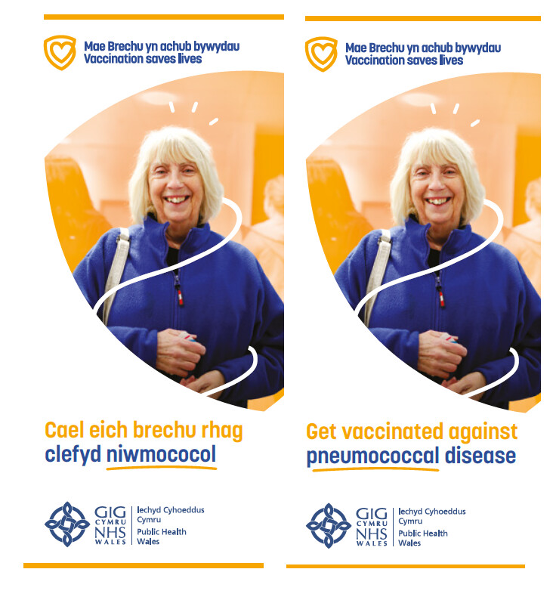
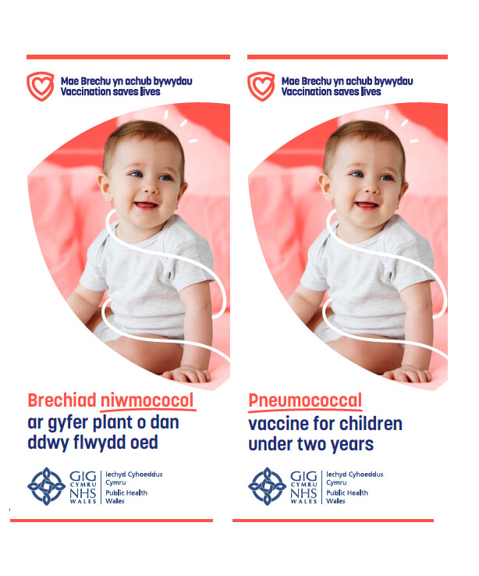
Resources
A Pneumococcal leaflet for adults and individuals in risk groups is available to order from the Health Information Resources Service (HIR) which can be accessed here: https://phw.nhs.wales/services-and-teams/health-information-resources/
A Pneumococcal eLearning module is available in Wales via ESR and on the Learning@Wales platform. More information is available here: https://phw.nhs.wales/immslearning
Pneumococcal ‘Frequently Asked Questions’ are available here: http://nww.immunisation.wales.nhs.uk/faqs-pneumococcal (NHS intranet only)
Template PGDs are available here: http://nww.immunisation.wales.nhs.uk/current-pgd-templates (NHS intranet only)
Pneumococcal vaccination programme intranet page is available here: http://nww.immunisation.wales.nhs.uk/pneumococcal-disease (NHS intranet only)
Pneumococcal: the green book, chapter 25 is available here: https://www.gov.uk/government/publications/pneumococcal-the-green-book-chapter-25

Slide 28
Improving vaccine uptake
Remove/reduce barriers to access as much as possible, making sure clinics and appointments are accessible, and being flexible can help
Primary care staff should identify patients for whom vaccine is recommended and use all opportunities to ensure that they are appropriately immunised, for example, when immunising eligible adults against influenza or shingles
It is good practice to proactively invite individuals for their vaccine (using an appropriate format)
It is important to remember that PPV can be given all year round, so consider opportunities for vaccination at other routine consultations, especially on discharge after hospital admission
Remuneration:
Funding for the PPV23 programme is contained within health boards’ core budgets. Following the transition to the central vaccine supply from 1 June 2021, health boards will receive invoices (via NHS Supply Chain) for PPV orders placed on ImmForm in line with the arrangements in place for other national programmes where vaccine are supplied centrally.

Slide 29
References
Immunisation against infectious disease. Cited in Green book chapter 25-Pneumococcal [UKHSA]
Industrial Injuries Advisory Council (2010) Lobar pneumonia in welders. Information Note. Nov 2010 https:// www.gov.uk/government/publications/lobar-pneumonia-in-welders-iiac- information-note. Cited in Green book chapter 25 – Pneumococcal
Toren et al. (2011) Increased mortality from infectious pneumonia after occupational exposure to inorganic dust, metal fumes and chemicals. Thorax 66: 992-6. Cited in Green book chapter 25 – Pneumococcal
Wong et al. (2010) Welders are at increased risk for invasive pneumococcal disease. Int. J. Infect. Dis e796-9. Cited in Green book chapter 25 – Pneumococcal
World Health Organization (2004) Immunization in practice: a guide for health workers. WHO. Cited in Green book chapter 4 – Immunisation procedures
Plotkin SA and Orenstein WA (eds) (2008) Vaccines, 5th edition. Philadelphia: WB Saunders Company Cited in Green book chapter 4 – Immunisation procedures
Ladhani SN, Collins S, Djennad A et al. Rapid increase in non-vaccine serotypes causing invasive pneumococcal disease in England and Wales, 2000-17: a prospective national observational cohort study. Lancet Infect Dis. 2018 Apr;18(4):441-451.
Andrews et al, 2012 https://www.ncbi.nlm.nih.gov/pubmed/23000122
Cochrane library Vaccines for preventing pneumococcal infection in adults https://www.cochranelibrary.com/cdsr/doi/10.1002/14651858.CD000422.pub3/abstract
Suzuki et al, 2017 https://www.ncbi.nlm.nih.gov/pubmed/28126327

Slide 30
Acknowledgements
PHW–VPDP intranet site
http://nww.immunisation.wales.nhs.uk/home
Public Health England
https://www.gov.uk/government/topics/public-health
VPDP team members
Other references included in slides
Notes:
Material contained in this document may be reproduced without prior permission provided it is done so accurately and is not used in a misleading context.
Acknowledgement to Public Health Wales NHS Trust to be stated.
© 2021 Public Health Wales NHS Trust.

