Slide 1
The national flu immunisation programme 2024-25
Vaccine Preventable Disease Programme
Public Health Wales
August 2024 version 1
Notes:
Material contained in this document may be reproduced without prior permission provided it is done so accurately and is not used in a misleading context.
Acknowledgement to Public Health Wales NHS Trust to be stated.
© 2024 Public Health Wales NHS Trust.

Slide 2
Acknowledgements
UK Health Security Agency (UKHSA)
Vaccine Preventable Disease programme

Slide 3
Pre-requisites to administering Flu vaccine
Before administering flu vaccine, it is recommended you have:
Undertaken training in the management of anaphylaxis and Basic Life Support as specified by policy for your local area and are familiar with Resuscitation Council UK (RCUK) guidance on Management of Anaphylaxis in the Vaccination Setting
Undertaken any additional statutory and mandatory training as required by your employer
Received flu vaccine training through appropriate training/ or eLearning. If you are a new immuniser a competency assessment is recommended – A flu specific competency assessment tool, is available in the flu training recommendations published by UKHSA, available to view here: Immunisation training resources and events - Public Health Wales (nhs.wales)
An appropriate legal framework to supply and administer flu vaccine in place e.g. patient specific prescription, Patient Specific Direction (PSD), Patient Group Direction (PGD), National protocol. Further information will be available here: Patient Group Directions (PGD) - Welsh Medicines Advice Service (wales.nhs.uk)
Described the process of consent and how this applies when giving vaccines
Accessed and familiarised yourself with the following key documents: https://www.gov.uk/government/publications/influenza-the-green-book-chapter-19 , the UK Health Security Agency https://www.gov.uk/government/publications/flu-vaccination-programme-information-for-healthcare-practitioners
3
Notes:
Practitioners should always ensure they are accessing the most up to date information and guidance

Slide 4
Key messages
Flu immunisation is one of the most effective interventions we can provide to reduce harm from flu and pressures on health and social care services during the winter
It is important to increase flu vaccine uptake in clinical risk groups because of increased risk of death and serious illness if people in these groups catch flu
Flu during pregnancy may be associated with perinatal mortality, prematurity, smaller neonatal size, lower birth weight and increased risk of complications for mother
Vaccination of health and social care workers protects them and reduces risk of spreading flu to their patients, service users, colleagues and family members
By preventing flu infection through vaccination, secondary bacterial infections such as pneumonia are prevented. This reduces the need for antibiotics and helps prevent antibiotic resistance
For a number of years, only around half of patients aged 6 months to under 65 years in clinical risk groups have been vaccinated
The childhood flu programme should reduce the impact of seasonal flu on children and reduce transmission of flu within the community
By reducing transmission of flu, it should also avert many cases of severe flu and flu-related deaths in older adults and people in clinical risk groups

Slide 5
Aims of resource
The purpose of this training resource is to:
Develop the knowledge base of healthcare practitioners regarding the 2024 to 2025 seasonal flu vaccination programme
Support healthcare practitioners involved in discussing flu vaccination with those eligible by providing evidence based information
Promote high uptake of flu vaccination in all eligible groups by increasing the knowledge of those involved in delivering the vaccination programme
Provide information on the administration of flu vaccines

Slide 6
Learning outcomes
On completion of this resource, healthcare practitioners will be able to:
Describe the cause of flu
Understand how flu is transmitted and the possible effects of flu
Explain which vaccines should be used and the precautions and contraindications to the administration of these
Explain the sequence of steps in flu vaccine administration
Explain the possible side effects from flu vaccines
Understand the importance of their role in promoting and providing evidence based information about flu vaccination to patients
Identify sources of additional information

Slide 7
Influenza overview
Flu is an acute viral infection of the respiratory tract (nose, mouth, throat, bronchial tubes and lungs)
It is a highly infectious illness which spreads rapidly in communities
Even people with mild or no symptoms can infect others
Most cases in the UK occur during an 8 to 10 week period during the winter

Slide 8
Influenza viruses
A viruses
Cause outbreaks most years and are the usual cause of epidemics and pandemics
Live and multiply in many different animals and may spread between them
Birds, particularly wildfowl, are the main animal reservoir
B viruses
Tend to cause less severe disease and smaller outbreaks
Predominantly found in humans
Burden of disease mostly in children

Slide 9

Flu A virus
Genetic material (RNA) in the centre
Two surface antigens:
Haemagglutinin (H) (blue)
Neuraminidase (N) (red)
There are 18 different types of H and 11 different types of N
The role of haemagglutinin is to bind to the cells of the infected person
The role of neuraminidase is to release the virus from the cell surface
The different types of H and N are identified by numbers, hence H1N1 or H3N2 for example

Slide 10
Genetic changes in the flu virus – what this means
Changes in the surface antigens (H and N) result in the flu virus constantly changing
Antigenic drift: minor changes (natural mutations) in the genes of flu viruses that occur gradually over time
Antigenic shift: when 2 or more different strains combine. This abrupt major change results in a new subtype. Immunity from previous flu infections/vaccinations may not protect against the new subtype, potentially leading to a widespread epidemic or pandemic
Because of the changing nature of flu viruses, the World Health Organisation (WHO) monitors their epidemiology throughout the world. Each year WHO makes recommendations about the strains of influenza A and B which are predicted to be circulating in the forthcoming winter.
These strains are then included in the flu vaccine developed each year
Notes:
The World Health Organization (WHO) convenes a group that reviews the global influenza situation (once each year for the northern hemisphere and once for the southern hemisphere) and recommends which flu strains should go in the seasonal vaccine to be produced by manufacturers for the following season 6 to 8 months later. This recommendation is based on information about the circulating viruses and epidemiological data from around the world at that time.
In previous years, most influenza vaccines were trivalent, containing 2 subtypes of influenza A and one B virus but quadrivalent vaccines with an additional B virus have been developed in recent years. The first authorised quadrivalent flu vaccine was made available for use in the UK in 2013. The use of quadrivalent flu vaccines containing a B strain from each of the 2 B strain lineages should improve the matching of the vaccine to the circulating B strain(s).

Slide 11
Possible complications of flu
Common:
  Bronchitis
  Otitis media (children), sinusitis
  Secondary bacterial pneumonia
Less common:
  Meningitis, encephalitis, meningoencephalitis
  Primary influenza pneumonia
Risk of most serious illness is higher in:
      Children under 6 months
      Older people
      Those with underlying health conditions such as respiratory disease, cardiac disease, long-term neurological conditions or immunosuppression
      Pregnant women (flu during pregnancy may be associated with perinatal mortality, prematurity, smaller neonatal size and lower birth weight)
Notes:
The risk of serious illness from flu is higher among children under 6 months of age, older people and those with underlying health conditions such as respiratory disease, cardiac disease or immunosuppression, as well as pregnant women. These groups are at greater risk of complications from flu such as bronchitis or pneumonia.

Slide 12
Features of flu
  Easily transmitted by large droplets, small-particle aerosols and by hand to mouth/eye contamination from a contaminated surface or respiratory secretions of infected person
  People with mild or no symptoms can still infect others
  Influenza is highly infectious with a usual incubation period of 1 to 3 days, though may be longer especially in people with immune deficiency.
  In healthy individuals, flu is usually unpleasant but self-limiting with recovery within 5-7 days.
  Common symptoms include:
  Sudden onset of fever, chills, headache, muscle and joint pain and extreme fatigue
  Dry cough, sore throat and stuffy nose
  In young children gastrointestinal symptoms such as vomiting and diarrhoea may be seen
Serological studies in healthcare professionals have shown that approximately 30 to 50% of flu infections can be asymptomatic but the proportion of flu infections that are asymptomatic may vary depending on the characteristics of the influenza strain.
  Influenza: the green book, chapter 19 - GOV.UK (www.gov.uk)

Slide 13
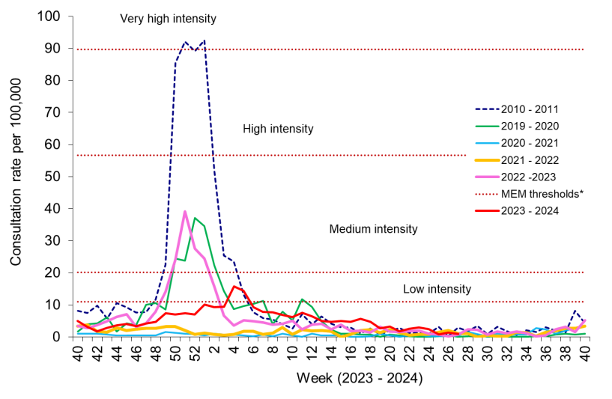
Flu epidemiology
The following graph highlights the clinical consultation rate for influenza like illness (ILI) per 100,000 practice population in Welsh sentinel practices (as of 07/072024).
Compared to the previous season 2022-2023 which reached a medium intensity threshold, the 2023-2024 season peaked in the low intensity threshold for consultation rates for ILI. This highlights how each flu season is different depending on the flu strains that are circulating. The predominant flu strain circulating in 2023-2024 was flu A.
There have been 4641 confirmed influenza cases since 2023 Week 40:
512 influenza A(H3N2)
1032 influenza A(H1N1)pdm09
2502 influenza A untyped
595 influenza B
Data source: Public health Wales
Weekly Influenza and Acute Respiratory Infection Report - Public Health Wales (nhs.wales)
Notes:
* The Moving Epidemic Method (MEM) threshold calculated for Wales ILI consultation rates is 11.1 per 100,000. MEM thresholds used in this chart are based on influenza from 2010-11 to 2018-19 seasons. Caution should be used when comparing consultation rates from March 2020 onwards to previous periods due to the changes in health-seeking behaviours brought about by the COVID-19 pandemic. **Clinical consultations for ILI seasons are monitored from W40 to W40, the most recent data is presented in red.
Vega T, Lozano J E, Meerhoff T et al. Influenza surveillance in Europe: establishing epidemic thresholds by the Moving Epidemic Method. Influenza and Other Respiratory Viruses. 2013;7(4):346-558 Available from: http://onlinelibrary.wiley.com/doi/10.1111/j.1750-2659.2012.00422.x/full

Slide 14
Changes to the start of the 2024-25 vaccination programme (1)
JCVI has recently advised that the evidence on vaccination effectiveness supports the case for moving the start of the adult flu vaccination programme to early October. The committee has recommended there should be no change to the start of the children’s programme as evidence shows early vaccination of children provides the best protection against transmission
It has been recommended pregnant women should continue to be vaccinated in September, if delaying until October would mean they risk missing out on vaccination Welsh Health Circular (WHC/2023/047)
Joint Committee on Vaccination and Immunisation:
Advice on influenza vaccines for 2024-25 available here
Notes:
Welsh Health Circular (WHC/2024/028): (opens in a new tab)The national influenza immunisation programme 2024 to 2025
Welsh Health Circular (WHC/2023/047)(opens in a new tab): Influenza vaccines and eligible cohorts for the 2024-25 season
For more information on flu and flu vaccines: https://phw.nhs.wales/topics

Slide 15
Changes to the start of the 2024-25 vaccination programme (2)
In the light of the committee’s advice, there will be a phased approach to the start of the flu vaccination programme in 2024 as follows:
  During September, general practices and health boards should concentrate their efforts on maximising uptake in the children’s programme, both amongst school-age children and 2-and 3-year-olds
  The main adult vaccination programme should begin at the start of October and be delivered at pace with an expectation that all eligible individuals should be offered a vaccination by early December
Where a Primary Care contractor does not have confidence that it will be possible to vaccinate their entire eligible adult cohort between October and early December, they should inform their health board. In this event, the health board can agree for vaccination to begin in September, rather than risk failing to complete the programme in a timely way
Further information available to view here: Welsh Health Circular (WHC/2023/047)

Slide 16
Childhood flu vaccination programme
The seasonal flu vaccination programme to children aims to lower the public health impact of flu by:
  Providing direct protection by preventing cases of flu infection in children
  Providing indirect protection by lowering flu transmission from children to other children, adults and to those in the clinical risk groups of any age
  Reducing flu transmission in the community averts many cases of severe flu and flu-related deaths in older adults and people with clinical risk factors
Annual administration of flu vaccine to children is expected to substantially reduce flu-related illness, GP consultations, hospital admissions and deaths
Children aged 6 months to 2 years in a clinical risk group are eligible due to their underlying medical condition or treatment
With concerns about co-circulation of the SARs-CoV-2 virus during the 2024 to 2025 flu season, it is particularly important to reduce transmission of flu in the community

Slide 17
Flu vaccine eligibility: 2024 to 2025 flu season
The eligible groups for 2024-25 are as follows:
• Children aged two and three years on 31 August 2024
• Children in primary school from reception class to year 6 (inclusive)
• Children in secondary school from year 7 to year 11 (inclusive)
• People aged six months to 64 years in clinical risk groups
• People aged 65 years and older (age on 31 March 2025)
• All adult residents in Welsh prisons
• Pregnant women
• Carers
• People with a learning disability
• Staff in nursing homes and care homes with regular client contact
• Staff providing domiciliary care
• Staff providing frontline NHS/Primary care services
• Healthcare workers (including healthcare students) with direct patient contact
In addition, individuals experiencing homelessness will also be an eligible group in 2024-25.
Further information is available here:(WHC/2023/047)
https://www.gov.wales/national-influenza-immunisation-programme-2023-24-whc2023023
Notes:
Influenza vaccines and eligible cohorts for the 2024 to 2025 season (WHC/2023/047)
Letter to health professionals about the 2024 to 2025 national influenza vaccination programme.
First published: 21 December 2023 Last updated:11 June 2024 https://www.gov.wales/influenza-vaccines-and-eligible-cohorts-2024-2025-season-whc2023047

Slide 18
Clinical risk groups
Chronic respiratory disease such as asthma requiring regular inhaled steroids, or chronic obstructive pulmonary disease (COPD)
Chronic heart disease
Chronic kidney disease at stage 3, 4 or 5
Chronic liver disease
Chronic neurological disease such as Parkinson’s disease, motor neurone disease
*Learning disability
*Severe mental illness
Diabetes
*Epilepsy
Immunosuppression due to disease such as HIV/AIDS or treatment such as cancer treatment (and household contacts of at risk individuals)
Asplenia or dysfunction of the spleen
Morbidly obese (class III obesity). This is defined as those with a Body Mass Index (BMI) of 40 or above, aged 16 or over
Further information and additional definitions of these groups can be viewed in table 19.4 of the Green Book influenza chapter
Notes:
*Learning disability, severe mental illness and epilepsy are eligible groups in Wales

Slide 19
Additional groups that are eligible for a flu vaccine
Household contacts of those that are immunosuppressed (from 6 months)
People living in Care Homes and other Long-stay Care Facilities
Carers - Paid and unpaid as well as third sector carers
Community first responders
Voluntary Organisations providing 1st aid
Social Care staff with client contact
Further detail on the eligible groups is contained in Annex 1 of the Welsh Health Circular: (WHC 2024/028)

Slide 20
Flu uptake for the 2023/24 season:
Eligible Cohort | 2023-2024
Aged 65 years and over | 72.5%
At clinical risk 6m to 64 years | 39.1%
Children aged 2&3 years | 42.8%
Children aged 4-10 years | 61.9%
Children aged 11-15 years | 49.7%
Total NHS staff | 40.8%
NHS staff with direct patient contact | 40.5%
Source: Public Health Wales
Notes:
A dashboard is available which presents provisional uptake data for children and young people in risk groups aged 2 to 17 years under ‘Childhood vaccine uptake’ here: Influenza Vaccine Online Reporting (IVOR) (sharepoint.com)

Slide 21
Vaccine uptake
Provisional flu uptake data indicates a fall in uptake in 2023/24 compared to 2022/23 in adults ages 65 years and over, individuals in a clinical risk group and NHS employees with direct patient contact.
National recommendations on maximising vaccine uptake and ambitions for uptake in different groups is outlined in the Winter Respiratory Vaccination Strategy: Autumn-Winter 2024/25 this will be available to view here: https://www.gov.wales/health-circulars

Slide 22
Clinical risk groups
Increasing flu vaccine uptake in clinical risk groups is important because of increased risk of death and serious illness if people in these groups catch flu
For a number of years only around half of patients aged 6 months to under 65 in clinical risk groups have been vaccinated
Vaccine uptake for all clinical risk groups needs to improve
Strategies to improve vaccine uptake should be tailored to each risk group to ensure optimum uptake of vaccine in each of them
Further information on flu vaccination for those with learning disabilities can be found on the GOV.UK website
  www.gov.uk/government/publications/flu-vaccinations-for-people-with-learning-disabilities/flu-vaccinations-supporting-people-with-learning-disabilities

Slide 23
Pregnant women (1)
All pregnant women are recommended to receive the inactivated flu vaccine irrespective of their stage of pregnancy
Pregnant women are at increased risk from complications if they contract flu
Having flu during pregnancy may be associated with premature birth and smaller birth size and weight
Flu vaccination during pregnancy provides passive immunity against flu to infants in the first few months of life
Studies on safety of flu vaccine in pregnancy show that inactivated flu vaccine can be safely and effectively administered during any trimester of pregnancy
No study to date has demonstrated an increased risk of either maternal complications or adverse fetal outcomes associated with inactivated flu vaccine
Pregnant women should be offered flu vaccine for each pregnancy. This needs to be the flu vaccination recommended for the flu season in which they are expected to deliver
Notes:
All pregnant women are recommended to receive the inactivated flu vaccine irrespective of their stage of pregnancy.
There is good evidence that pregnant women are at increased risk from complications if they contract flu. In addition, there is evidence that having flu during pregnancy may be associated with premature birth and smaller birth size and weight and that flu vaccination may reduce the likelihood of prematurity and smaller infant size at birth associated with an influenza infection during pregnancy. Furthermore, a number of studies show that flu vaccination during pregnancy provides passive immunity against flu to infants in the first few months of life. A review of studies on the safety of flu vaccine in pregnancy concluded that inactivated flu vaccine can be safely and effectively administered during any trimester of pregnancy and that no study to date has demonstrated an increased risk of either maternal complications or adverse fetal outcomes associated with inactivated influenza vaccine.
The ideal time for flu vaccination is before flu starts circulating. However, even after flu is in circulation, vaccine should continue to be offered to those at risk and newly pregnant women. If a woman becomes pregnant after the usual vaccinating period of October to January, it is still worth considering offering the vaccine if flu is still circulating in the community. Women should be offered the vaccine every time they are pregnant as the flu virus constantly mutates and therefore the strains included in the vaccine are reviewed annually.

Slide 24
Pregnant women (2)
All pregnant women are recommended to receive flu vaccine irrespective of their stage of pregnancy. This was first recommended in the 2010-11 flu season. The vaccine provides protection for the woman and the baby during pregnancy and protects the baby against flu for up to six months following birth (Dabrera, 2014)¹
There were 29 deaths of pregnant women and women up to six weeks postpartum in association with influenza in the UK between 2009 and 2012, representing one in eleven maternal deaths (MBRRACE-UK, 2014)². Influenza presents significant risks to pregnant women and their babies
If a woman catches influenza during pregnancy, she is at increased risk of experiencing severe disease, admission to intensive care and perinatal mortality (Jamieson, 2009; Pierce, 2011)^{3,4}. There were three maternal deaths from influenza in the UK between 2013 and 2018 (MBRRACE UK, 2017 & MBRRACE UK, 2020)^{5,6} and two further influenza deaths between 2019 and 2021 (MBRRACE UK, 2023)⁷. Both women were unvaccinated
Notes:
1. Dabrera G, Zhao H, Andrews N, Begum F, Green H, Ellis J, Donati M, Zambon M and Pebody R (2014) Effectiveness of seasonal influenza vaccination during pregnancy in preventing influenza infection in infants, England, 2013/14. Eurosurveillance, Volume 19, Issue 45. http://www.eurosurveillance.org/ViewArticle.aspx?ArticleId=20959
2. MBRRACE-UK (2014) Saving Lives, Improving Mothers’ Care - Lessons learned to inform future maternity care from the UK and Ireland Confidential Enquiries into Maternal Deaths and Morbidity 2009–12. Oxford: National Perinatal Epidemiology Unit, University of Oxford 2014. https://www.npeu.ox.ac.uk/assets/downloads/mbrraceuk/reports/Saving%20Lives%20Improving%20Mothers%20Care%20report%202014%20Full. Pdf
3. Jamieson D, Honein M A, Rasmussen S A, Williams J L, Swerdlow D L, Biggerstaff M S, Lindstrom S, Louie J K, Christ C M, Bohm S R, Fonseca V P, Ritger K A, Kuhles D J, Eggers P, Bruce H, Davidson H A, Lutterloh E, Harris M L, Burke C, Cocoros N, Finelli L, MacFarlane K, Shu B. (2009) H1N1 2009 influenza virus infection during pregnancy in the USA. The Lancet, Volume 374, Issue 9688: 451-8. http://www.sciencedirect.com/science/article/pii/S0140673609613040
4. Pierce M, Kurinczuk J, Spark P, Brocklehurst P and Knight M. (2011) Perinatal outcomes after maternal 2009/H1N1 infection: national cohort study. BMJ 342:d3214, http://www.bmj.com/content/342/bmj.d3214
5. MBRRACE-UK (2017) Saving Lives, Improving Mothers’ Care. Lessons learned to inform maternity care from the UK and Ireland Confidential Enquiries into Maternal Deaths and Morbidity 2013-15. Oxford: National Perinatal Epidemiology Unit, University of Oxford 2017. https://www.npeu.ox.ac.uk/assets/downloads/mbrrace-uk/reports/MBRRACEUK%20Maternal%20Report%202017%20-%20Web.pdf
6. MBRRACE-UK (2020) Saving Lives, Improving Mothers’ Care. Lessons learned to inform maternity care from the UK and Ireland Confidential Enquiries into Maternal Deaths and Morbidity 2016-18. Oxford: National Perinatal Epidemiology Unit, University of Oxford 2020. https://www.npeu.ox.ac.uk/assets/downloads/mbrrace-uk/reports/maternal-report2020/MBRRACE-UK_Maternal_Report_Dec_2020_v10_ONLINE_VERSION_1404.pdf
7. MBRRACE-UK (2023) Lessons learned to inform maternity care from the UK and Ireland Confidential Enquiries into Maternal Deaths from infection, neurological, haematological, respiratory, endocrine, gastrointestinal and general surgical causes 2019-21. Oxford: National Perinatal Epidemiology Unit, University of Oxford 2023. https://www.npeu.ox.ac.uk/assets/downloads/mbrrace-uk/reports/maternal-report2023/MBRRACE-UK_Themed_Maternal_Mortality_Report_2023.pdf

Slide 25
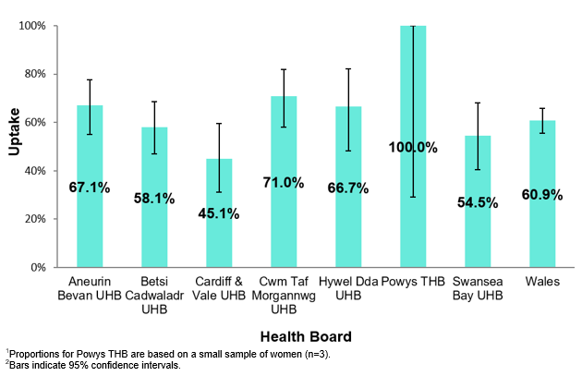
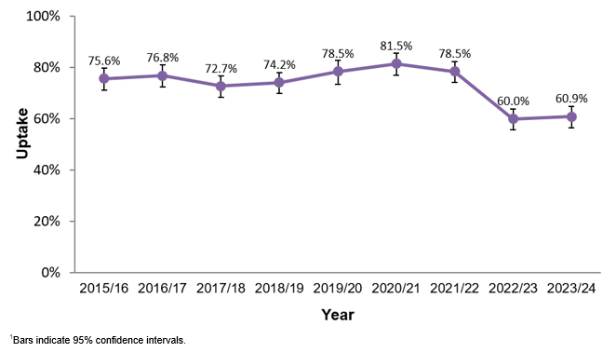
Point of Delivery (POD) survey 2024
Influenza
Uptake of influenza vaccination in pregnant women; by health board, 2023/24 (n=221)^{1,2}
Uptake of influenza vaccination in pregnant women participating in the 2015/16 to 2023/24 surveys¹
\\phwfilestore\phs\HP\VPD\Pertussis Point of Delivery\2024

Slide 26
Residential care/nursing home residents and staff
People living in care homes or other long-stay care facilities
Vaccination is recommended for people living in care homes or other long-stay care facilities where rapid spread is likely to follow introduction of infection and cause high morbidity and mortality. This includes adult residential care homes, nursing care homes and children’s hospices
This does not include young offender institutions, university halls of residence or boarding schools (except those in eligible school years, or eligible due to another factor). Opportunities for co-administration with the COVID-19 vaccine should be explored where individuals are eligible for both the COVID-19 and flu vaccines
Social care staff
Individuals employed in adult residential care homes, nursing care homes and children’s hospices, or providing domiciliary care, who are in regular direct contact with residents/service users, are eligible to receive a flu vaccine. This may be via the community pharmacy, NHS seasonal influenza vaccination service or through an alternative model if agreed locally
Uptake of flu vaccination should be actively encouraged and supported/facilitated by their employer. Social care staff, apart from those referred to above, should be encouraged, supported and offered/facilitated vaccination by their employer

Slide 27
Health and social care workers
Healthcare workers who are in direct contact with patients/clients should have their flu vaccine via their employer. This should be actively encouraged and provided or facilitated as part of their occupational health care.
Vaccination of health and social care workers protects them and reduces risk of spreading flu to their patients, service users, colleagues and family members
Evidence that vaccination significantly lowers rates of flu-like illness, hospitalisation and mortality in the elderly in long-term healthcare settings
Vaccination reduces transmission of flu to vulnerable patients, some of whom may have impaired immunity and may not respond well to immunisation
Frontline health and social care workers have a duty of care to protect their patients and service users from infection
Vaccination of frontline workers also helps reduce sickness absences and contributes to keeping the NHS and care services running through winter pressures
NHS and social care bodies have a responsibility to ensure, as far as is reasonably practicable, that health and social care workers are free of, and are protected from exposure to infections that can be caught at work (Health and Social Care Act 2008, Code of Practice on the prevention and control of infections)

Slide 28
Vaccine uptake for health and social care workers
Uptake of flu vaccine in NHS employees with direct patient contact fell from 46.7% in 2022-23 to 40.5% in 2023-24
All frontline health care and social care workers should be offered vaccination by their employer
Employer’s have a responsibility to help protect their staff and patients or clients and ensure the overall safe running of services
Further information is available to view here: Resources for health and social care professionals - Public Health Wales (nhs.wales)

Slide 29
Childhood flu vaccination uptake in Wales for the years 2020-21 to 2023- 24*
Eligible cohort | 2019/20 | 2020/21 | 2021/22 | 2022/23 | 2023/24
Children 2 and 3 years | 50.7% | 56.3% | 47.6% | 44.8% | 42.8%
Primary school aged children | 68.7% | 72.4% | 68.2% | 63.8% | 61.9%
Secondary school aged children | --- | --- | 59.8% | 54.4% | 49.7%
*2023-24 data is provisional
Provisional flu uptake data indicates a fall in uptake in 2023/24 compared to 2022/23 in children aged 2 and 3 years, primary and secondary school aged children.
National recommendations on maximising vaccine uptake and ambitions for uptake in different groups is outlined in the Winter Respiratory Vaccination Strategy: Autumn-Winter 2024/25 this will be available to view here: https://www.gov.wales/health-circulars
Notes:
More detailed uptake data will be available for the 2023-24 flu season in Wales in the Seasonal influenza 2023-24 Annual report. The Annual report will be available to view here: Annual influenza surveillance and influenza vaccination uptake reports - Public Health Wales (nhs.wales(opens in a new tab)) when it is published.

Slide 30
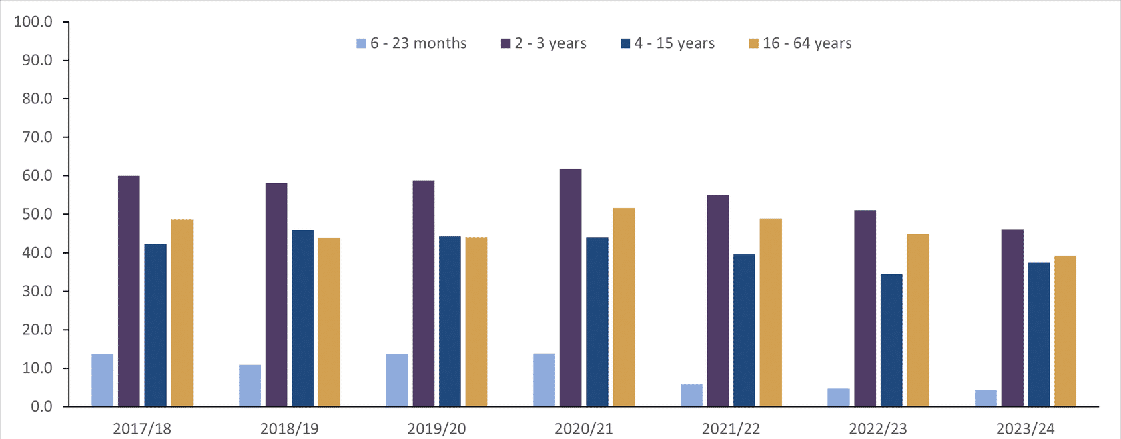
Childhood flu vaccination uptake in Wales for Children from 6 months in a clinical risk group
This graph outlines flu uptake data in Children from 6 months, highlighted in different ages groups, who are in a clinical risk group, from 2017/18 to 2023/24
Data source: General Practice data collected through Audit+ Data Quality System
Age group | 2017/18 | 2018/19 | 2019/20 | 2020/21 | 2021/22 | 2022/23 | 2023/24
6-23 months | 13.6 | 10.9 | 13.6 | 13.9 | 5.9 | 4.7 | 4.3
2 - 3 years | 60.0 | 58.2 | 58.8 | 61.9 | 55.0 | 51.1 | 46.2
4 - 15 years | 42.4 | 45.9 | 44.3 | 44.1 | 39.7 | 34.5 | 37.5
16 - 64 years | 48.8 | 44.0 | 44.1 | 51.6 | 48.9 | 45.0 | 39.3
Data indicates a decline in flu uptake since 2020/21, across all age groups of children in a clinical risk group.

Slide 31
Influenza vaccines and their components
Two main types of flu vaccine available:
  Inactivated – given by injection
  Live attenuated – given by nasal application
  None of the flu vaccines can cause clinical influenza in those that can be vaccinated safely (there is a theoretical risk from LAIV to those who are severely immunocompromised)
The inactivated flu vaccines are quadrivalent vaccines – they contain 2 subtypes of Influenza A and both B lineages
LAIV is a trivalent vaccine this season and contains 2 subtypes of Influenza A and one B lineage (see next slide more information)
The live attenuated vaccine is licensed for children aged 2 up to 18 years
The inactivated flu vaccines are recommended for people aged 18+ years, children in clinical risk groups aged 6months to 2 years and for children aged 2 years to 18 years who cannot receive live attenuated vaccine
Further information on NHS Wales recommended flu vaccines 2024/25 influenza season. This resource can be viewed in full here: phw.nhs.wales/topics/immunisation-and-vaccines/fluvaccine/resourcesforprofessionals/flu-vaccines-recommended-in-wales-23-24/
Notes:
Inactivated flu vaccines given by intramuscular injection have been used in the UK for many years. The live intranasal influenza vaccine (LAIV) was introduced into the UK schedule in 2013. However, a live intranasal flu vaccine called FluMist (same vaccine as Fluenz, different trade name) was introduced in the US schedule in 2003 therefore there is nearly 20 years' experience of widespread use of the vaccine in the US.
In previous years, most inactivated flu vaccines were trivalent, containing 2 subtypes of influenza A and one B virus. However, quadrivalent vaccines, containing 2 subtypes of influenza A and both B virus types have been developed and up until 2024/25 have been recommended for all eligible groups including pregnant women.
LAIV has returned to a trivalent from 2024/25.
An inactivated quadrivalent vaccine was made available for the first time in 2013 and is the preferred vaccine for children who are contraindicated to receive the LAIV.
NB The Fluenz vaccine used in the 2013/14 flu season was a trivalent live vaccine. Fluenz Tetra was first used in the 2014/15 flu season and continued as a quadrivalent up until 2024/25, where it then became a trivalent again due to no confirmed detections of the B/Yamagata lineage since 2020 .
We now have 11 years’ experience using Fluenz LAIV vaccine in the UK.

Slide 32
Trivalent LAIV
Following the WHO northern hemisphere flu vaccination recommendations LAIV offered to children aged 2 years and over is now a trivalent vaccine for the 2024/25 flu programme. This is because there has been no confirmed detection of naturally occurring B/Yamagata-lineage influenza viruses since March 2020
The public health risk from B/Yamagata is now considerably
lower than at the time of the introduction of quadrivalent vaccines and B/Yamagata may be extinct
Therefore, trivalent influenza vaccines, without a B/Yamagata strain, are currently considered clinically suitable. As manufacturers start to produce trivalent products, their use will be preferred over the equivalent quadrivalent formulation
The inactivated flu vaccines given by injection will remain a quadrivalent formulation for the 2024/25 season
Fluenz Trivalent nasal spray suspension Influenza vaccine (live attenuated, nasal) - Summary of Product Characteristics (SmPC) - (emc) (medicines.org.uk)

Slide 33
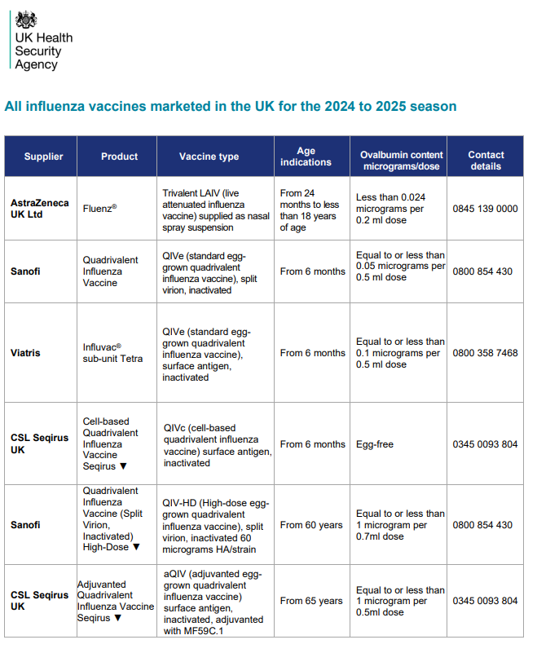
Influenza vaccines available for 2024 to 2025
Several different flu vaccines are available for the 2024 to 2025 flu season
Poster detailing these available from GOV.UK website:
www.gov.uk/government/publications/influenza-vaccines-marketed-in-the-uk
Notes:
There are a number of different flu vaccines available each year and it is important to be aware of the age indications and the ovalbumin content of each of them.

Slide 34
Flu vaccine presentation and dosage
Inactivated influenza vaccines are for intramuscular (IM) administration and are supplied as suspensions in pre-filled syringes containing a 0.5ml dose
LAIV is supplied as a nasal spray suspension in a single use, pre-filled, nasal applicator with a divider clip. No reconstitution or dilution is required. Each vaccine contains 0.2ml (administered as 0.1 ml per nostril)
Some flu vaccines are restricted for use in particular age groups
The SmPC for individual products should always be referred to when ordering vaccines for particular patients. Further information is available here: Home - electronic medicines compendium (emc)
Notes:
Inactivated flu vaccine for intramuscular (IM) administration is supplied as a suspension in a pre-filled syringe. They should be shaken well before they are administered.
The LAIV is supplied as a single use prefilled nasal applicator that is ready to use. No reconstitution or dilution is required.
All but one of the flu vaccines available in the UK are inactivated, do not contain live viruses and cannot cause clinical influenza in those that can be safely vaccinated. In previous years, most of the available flu vaccines were prepared from viruses grown in embryonated hens eggs. For 2023/24, flu vaccines are available that are cell based, egg based or recombinant.

Slide 35
Vaccine composition 2024/25
For the 2024 to 2025 flu season (northern hemisphere winter), the WHO have recommended that quadrivalent vaccines contain the following:
Egg-based vaccines
an A/Victoria/4897/2022 (H1N1)pdm09-like virus;
an A/Thailand/8/2022 (H3N2)-like virus; and
a B/Austria/1359417/2021 (B/Victoria lineage)-like virus.
Cell culture- or recombinant-based vaccines
an A/Wisconsin/67/2022 (H1N1)pdm09-like virus;
an A/Massachusetts/18/2022 (H3N2)-like virus; and
a B/Austria/1359417/2021 (B/Victoria lineage)-like virus.
For quadrivalent egg or cell culture-based or recombinant vaccines for use in the 2024-2025 northern hemisphere influenza season: While the B/Yamagata lineage vaccine component should be excluded as it is no longer warranted, where quadrivalent vaccines are still in use, the B/Yamagata lineage component remains unchanged:
a B/Phuket/3073/2013 (B/Yamagata lineage)-like virus.
Recommended composition of influenza virus vaccines for use in the 2024-2025 northern hemisphere influenza season (who.int)

Slide 36
2024 to 2025 flu vaccine recommendations for those aged 65 years and over
For vaccination of those aged 65 years and over JCVI advises the use of the following vaccines:
• Adjuvanted quadrivalent inactivated influenza vaccine (aQIV)*
• High-dose quadrivalent inactivated influenza vaccine (QIV-HD)
Quadrivalent recombinant Influenza vaccine (QIVr)**
If aQIV or QIV-HD or QIVr are not available, the quadrivalent influenza cell-culture vaccine (QIVc) is considered an acceptable alternative and is suitable for use in this age group.
*aQIV may be offered ‘off-label’ to those who become 65 years of age before 31 March 2025
Note: **QIVr is not available for 2024/25
JCVI Statement on Influenza Vaccines 2024-25.pdf

Slide 37
At-risk adults aged under 65 years and pregnant women
For vaccination of adults aged 18 to less than 65 years of age in an at-risk group JCVI advises the use of the influenza vaccines below:
  Quadrivalent influenza cell-culture vaccine (QIVc)
  Quadrivalent recombinant Influenza vaccine (QIVr)**
  There is a potential advantage to using influenza vaccines which do not use eggs in the manufacturing process (cell-culture or recombinant) compared with egg-cultured influenza vaccines, due to the possible impact of “egg-adaptation” on the effectiveness of influenza vaccines, particularly against A(H3N2) strains.
  The evidence on additional benefit is available for only very few seasons but the issue of egg adaptation remains a real concern particularly for the AH3N2 virus which is the more virulent influenza subtype in terms of morbidity and mortality
  QIVe is no longer on the approved vaccine list for reimbursement in 2024-25.
  Note: **QIVr is not available for 2024/25
JCVI Statement on Influenza Vaccines 2024-25.pdf
Notes:
Egg adaptation - in recent flu seasons, changes to the virus during the manufacturing process have arisen with A(H3N2) strain when flu vaccine strains are propagated in eggs which means that the vaccines do not work as well against confirmed disease.

Slide 38
Children aged two to less than 18 years of age in an at-risk group
The live attenuated Influenza vaccine (LAIV) is the vaccine of choice for the childhood influenza programme. Therefore, children aged two years to less than 18 years in clinical risk groups should be offered LAIV unless it is medically contraindicated or otherwise unsuitable.
In those for whom LAIV is not suitable, JCVI advises the use of QIVc
JCVI therefore advises the influenza vaccines below in the following order of preference:
1. live attenuated Influenza vaccine (LAIV)
2. Quadrivalent influenza cell-culture vaccine (QIVc)
QIVc is licenced for use in those aged 2 years and over and is egg free
JCVI Statement on Influenza Vaccines 2024-25.pdf
Notes:
JCVI recommend QIVe in the absence of QIVc for this group, however QIVe is no longer on the approved vaccine list for reimbursement in 2024-25.
Live attenuated influenza vaccine (LAIV) nasal spray is not licensed in the UK for use in adults. This is because there is some evidence of poorer efficacy in adults when compared with the inactivated injectable vaccines. Individuals aged 18 years or older, who are recommended to have annual flu vaccine, should be encouraged where possible to have an injectable influenza vaccine suitable for their age. However for adults who have a severe ‘needle phobia’ prescribing clinicians may choose to use LAIV ‘off-label’. This may include those with a learning disability who become seriously distressed with needles.
Legislation does allow for such situations and states that “prescribers can use unlicensed and off-label medicines where there is no suitable alternative”. The responsibility for this rests with the health professional who is prescribing. In this situation, a patient specific direction (PSD) will be required. In these exceptional circumstances, where it has not been possible to administer an injectable flu vaccine, Welsh Government has agreed that the national LAIV stock may be used for this purpose. The National Influenza Immunisation Programme 2023 to 24 (WHC/2023/023) | GOV.WALES

Slide 39
Children aged less than two years old
For vaccination of at-risk children aged less than 2 years of age in an at-risk group JCVI advises the use of the following vaccine:
  Quadrivalent influenza cell-culture vaccine (QIVc)*
*QIVc was previously recommended for eligible 6 months – 2 year olds as ‘off label’. It is no longer off label and is now licensed for use from 6 months old. Cell-based Quadrivalent Influenza Vaccine (Surface Antigen, Inactivated) Seqirus suspension for injection in pre-filled syringe - Summary of Product Characteristics (SmPC) - (emc) (medicines.org.uk)
JCVI Statement on Influenza Vaccines 2024-25.pdf

Slide 40
QIVr flu vaccine will not be available for 2024/25
The Influenza vaccines and eligible cohorts for the 2024 to 2025 season (WHC/2023/047) [HTML] | GOV.WALES was re-issued on the 12 June 2024 - This revised Welsh Health Circular is being issued following a notification from the manufacturer of QIVr - quadrivalent recombinant influenza vaccine - that this product will not be available as expected in the UK for the 2024 to 2025
Considering the vaccines recommended by the JCVI for the 2024 to 2025 flu season, the vaccines eligible for reimbursement in Wales for the different age cohorts will be as follows:
  Those aged 65 years and over
  aQIV - aQIV may be offered ‘off-label’ to those who become 65 years of age before 31 March 2025
  QIV - HD - QIV-HD was not previously available in the UK but its manufacturers have confirmed that it will now be made available for 2024 to 2025, QIV-HD is licenced for use from 60 years of age
If aQIV or QIV-HD are not available, QIVc is considered an acceptable alternative and is suitable for use in this age group
JCVI Statement on Influenza Vaccines 2024-25.pdf
Notes:
Whether a vaccine is ‘available’ should be a balance of clinical and operational judgement. The potential delay in sourcing the preferred vaccine (due to a temporary or localised shortage or a national batch failure) should be weighed against the protection afforded by the alternative vaccine. Whether the flu virus is circulating or is imminent at the time would be a factor in making this judgement.

Slide 41
Vaccines eligible for reimbursement in Wales for the different age cohorts
Those aged 18 to less than 65 years (including pregnant women)
QIVc
QIV HD (those aged 60 years and over only)
Children aged 2 to less than 18 years who are contraindicated/ decline LAIV
QIVc
Children aged 6 months to 2 years in risk groups
QIVc*
*QIVc was previously recommended for eligible 6 months – 2 year olds as ‘off label’. It is no longer ‘off label’ and is now licensed for use from 6 months old. Cell-based Quadrivalent Influenza Vaccine (Surface Antigen, Inactivated) Seqirus suspension for injection in pre-filled syringe - Summary of Product Characteristics (SmPC) - (emc) (medicines.org.uk)

Slide 42
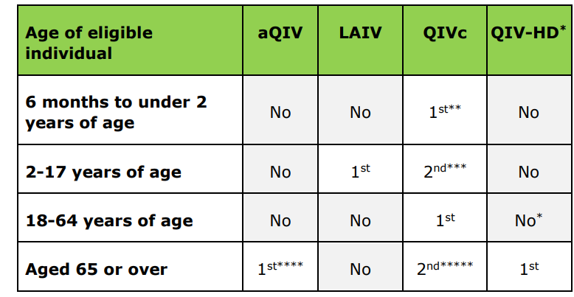

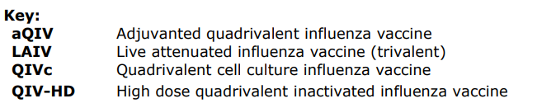
2024/25 influenza season NHS Wales recommended flu vaccines
This resource is also available here: Resources for health and social care professionals - Public Health Wales (nhs.wales) under ‘Vaccines Recommended’

Slide 43
Adjuvanted influenza vaccine (aQIV)
Adjuvanted trivalent influenza vaccine (aTIV) was used in the UK in and other countries for a number of years with an excellent safety record
An adjuvanted quadrivalent vaccine (aQIV) replaced aTIV for the 2021 to 2022 flu season onwards
aQIV contains 2 subtypes of Influenza A (H3N2 and H1N1pdm09) and both B virus lineages
Adjuvanted vaccines have higher immunogenicity and effectiveness than non-adjuvanted, standard dose vaccines in older people
The adjuvant known as MF59 has been added to the vaccine to enhance the immune response to counter the effect of immunosenescence (age related reduction in immune response)
MF59 adjuvant is an oil-in-water emulsion of squalene oil which is a naturally occurring substance found in humans, animals and plants. In humans, it is made in the liver and circulates in the bloodstream
aQIV is made using an egg-based manufacturing process
aQIV may be offered ‘off-label’ to those who become 65 years of age before 31 March 2024
Adjuvanted Quadrivalent Influenza Vaccine (Surface Antigen, Inactivated) Seqirus suspension for injection in pre-filled syringe Influenza vaccine, Adjuvanted with MF59C.1 - Summary of Product Characteristics (SmPC) - (emc) (medicines.org.uk)

Slide 44
Quadrivalent influenza cell culture vaccine (QIVc)
QIVc was licenced in the US in 2016 and in the UK in December 2018
QIVc is a quadrivalent vaccine containing 2 subtypes of Influenza A (H3N2 and H1N1pdm00) and both B virus lineages
QIVc has a similar safety profile to other flu vaccines (similar rate and type of adverse reactions reported). Hundreds of millions of doses of cell-based vaccine have been administered worldwide with no serious safety concerns
the cell-based vaccine manufacturing process uses an animal cell line (Madin-Darby Canine Kidney, or MDCK) to grow the influenza virus rather than the traditional egg based manufacturing methods
this manufacturing process eliminates the risk of egg-adaptation and may result in the vaccine containing virus that is a closer match to wild-type circulating flu viruses
QIVc was previously recommended for eligible 6 months – 2-year-olds as ‘off label’. It is no longer ‘off label’ and is now licensed for use from 6 months old
Cell-based Quadrivalent Influenza Vaccine (Surface Antigen, Inactivated) Seqirus suspension for injection in pre-filled syringe - Summary of Product Characteristics (SmPC) - (emc) (medicines.org.uk)

Slide 45
High dose quadrivalent influenza vaccine (QIV-HD)
Quadrivalent influenza vaccine high dose (QIV-HD) was first licenced in the US in 2009 and was licensed in the UK in January 2019
QIV-HD is a quadrivalent inactivated flu vaccine containing 2 subtypes of Influenza A and both B lineages
QIV-HD contains 4 times the amount of antigen contained in standard-dose inactivated influenza vaccines. The additional antigen content is intended to enhance the immune response to counter the effect of immunosenescence in those aged 65 and over
QIV-HD has been proven to be safe and effective
QIV-HD is made using an egg-based manufacturing process
QIV-HD was not previously available in the UK, but its manufacturers have confirmed that it will now be made available for 2024-2025
Quadrivalent Influenza Vaccine Split Virion Inactivated High-Dose suspension for injection in pre-filled syringe –
Summary of Product Characteristics (SmPC) - (emc) (medicines.org.uk)

Slide 46
Egg grown quadrivalent influenza vaccine (QIVe)
The most common way to make flu vaccines is the egg-based manufacturing process
Flu viruses are injected into fertilised hen’s eggs and incubated for several days to allow the viruses to replicate.
The fluid containing virus is harvested from the eggs and then, for inactivated flu vaccines, the vaccine viruses are inactivated (killed) and the virus antigen is purified
The egg-grown quadrivalent influenza vaccines (QIVe) protect against 4 strains of flu: 2 A types and both B lineages
QIVe is no longer on the approved vaccine list for reimbursement in Wales for 2024-25
Quadrivalent Influenza Vaccine (split virion, inactivated), suspension for injection in pre-filled syringe - Summary of Product Characteristics (SmPC) - (emc) (medicines.org.uk)

Slide 47
Live attenuated influenza vaccine (LAIV)
A live attenuated (weakened) influenza vaccine (LAIV) given intranasally is the recommended vaccine for the childhood flu programme
LAIV has been shown to be more effective in children compared with inactivated influenza vaccines
It may offer some protection against strains not contained in the vaccine as well as to those that are and has the potential to offer better protection against virus strains that have undergone antigenic drift
Since this vaccine is comprised of weakened whole live virus, it replicates natural infection which induces better immune memory (thereby offering better long-term protection to children than from the inactivated vaccines)
In addition to being attenuated, the live viruses in LAIV have been adapted to cold so that they cannot replicate efficiently at body temperature
LAIV has a good safety profile in children aged 2 years and older
Fluenz Trivalent nasal spray suspension Influenza vaccine (live attenuated, nasal) –
Summary of Product Characteristics (SmPC) - (emc) (medicines.org.uk)

Slide 48
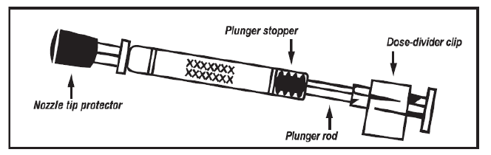
The LAIV used in the UK is Fluenz
  Licensed from 24 months to less than 18 years of age
  Nasal spray (suspension) in a prefilled nasal applicator
  The suspension is colourless to pale yellow, clear to opalescent. Small white particles may be present
  Supplied in a pack containing 10 doses (single use prefilled nasal applicators)
  Ready to use (no reconstitution or dilution required)
  Each applicator contains 0.2ml (administered as 0.1ml per nostril)

Slide 49
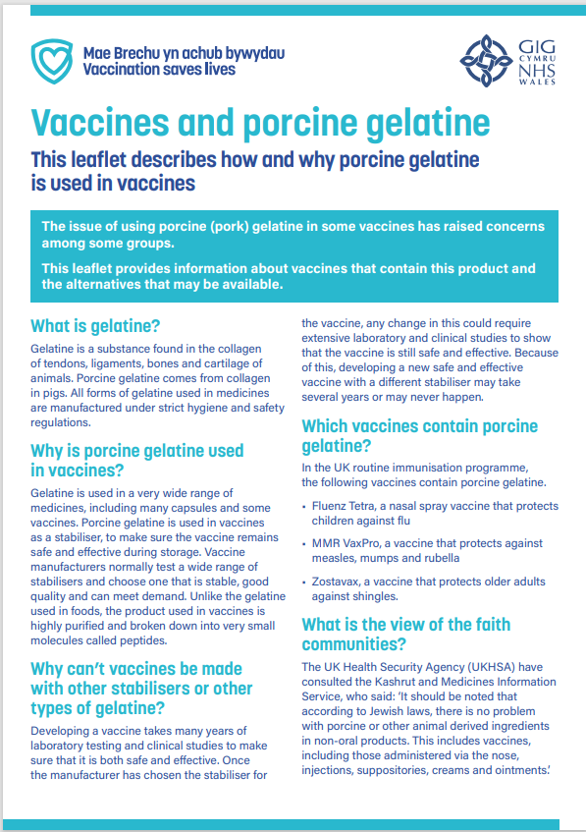
Porcine gelatine
The LAIV contains a highly purified form of gelatine derived from pigs
Gelatine is used in LAIV as a stabiliser - it protects the live viruses from the effects of temperature
Gelatine is commonly used in a range of pharmaceutical products, including many capsules and some vaccines
There is no other live attenuated flu vaccine available that does not contain porcine gelatine. The manufacturer of LAIV (Fluenz) tested 40 potential stabilisers – gelatine was chosen because without it, stability was significantly reduced
LAIV is the recommended vaccine for use in all eligible children aged 2-17 years of age unless contraindicated or declined due to gelatine content. LAIV is supplied centrally. Where an injectable vaccine is offered as an alternative to LAIV in the circumstances described above, it will be eligible for reimbursement.(WHC/2023/047)
Leaflets and accessible vaccination information - Public Health Wales (nhs.wales)

Slide 50
Number of doses
Children aged 6 months to less than 9 years who are in clinical risk groups or who are a household contact of an immunosuppressed individual who have not received flu vaccine previously should be offered a second dose of LAIV, given at least 4 weeks apart (if no contraindications – otherwise offer inactivated vaccine)
JCVI has advised that children aged 2 years to under 9 years of age who are not in a clinical risk group, only require a single dose of LAIV irrespective of whether they have received influenza vaccine previously as only modest additional protection is provided by a second dose of LAIV This advice differs from that in the SmPC for LAIV
Also, healthy children under 9 years whose parents request they receive injectable influenza vaccine instead of LAIV should be offered a single dose, even if they have not previously received influenza vaccine. The same applies to healthy children who cannot receive LAIV due to contraindications

Slide 51
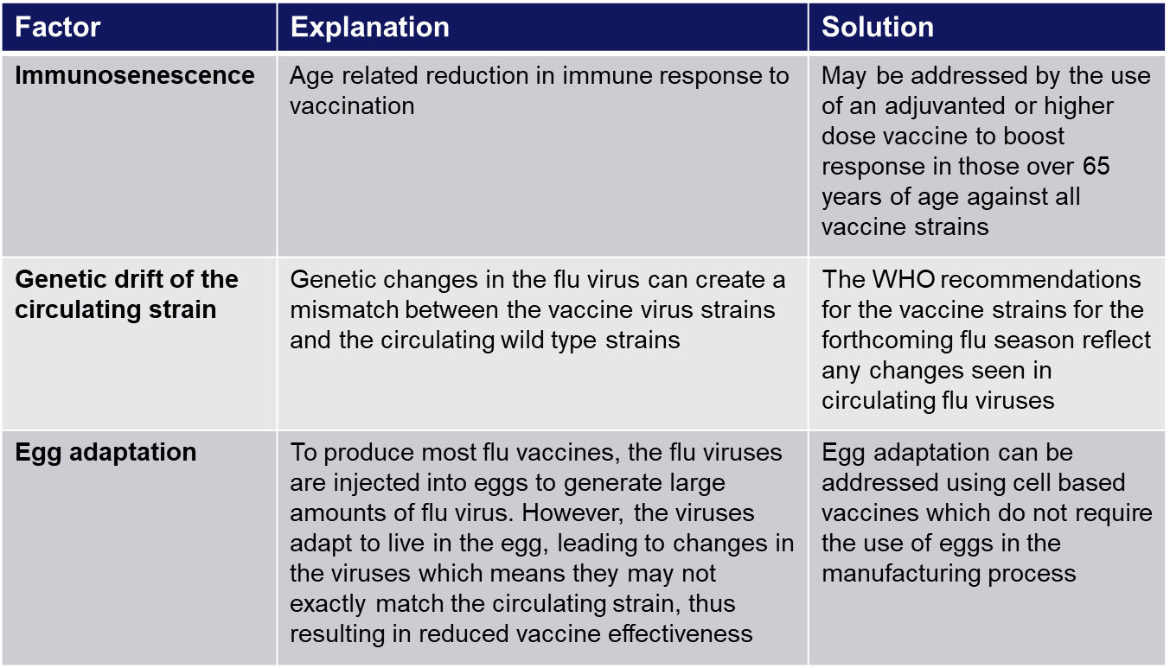
Improving vaccine effectiveness
There are a number of potential factors leading to reduced vaccine effectiveness

Slide 52
Influenza vaccine effectiveness
The effectiveness and cost-effectiveness of influenza vaccine depends upon the
composition of the vaccine, the circulating strains, the type of vaccine and the age of the
individual being vaccinated
LAIV is thought to provide broader protection than inactivated vaccines, and therefore has potential to offer better protection against strains that have undergone antigenic drift compared to the original virus strains in the vaccine). LAIV has been shown to provide a higher level of protection for children than trivalent inactivated influenza vaccine a meta-analysis suggested an efficacy Green book Chapter 19
There is lower effectiveness in older people although immunisation can provide important protection against flu GP consultation and severe disease/flu confirmed hospital admission
In the last decade, there has generally been a good match between the strains of flu in the vaccine and those circulating but there has often been poorer effectiveness against influenza A (H3N2), particularly in the elderly, where burden of infection from that strain is highest
Potential explanations for the low effectiveness against influenza A(H3N2) include
        Immunosenescence (age related reduction in immune response)
        Genetic drift of the circulating viral strain (compared to the vaccine strain, as happened in 2014 to 2015 flu season)
        Egg adaptation - in recent seasons, changes to the virus during the manufacturing process have arisen with A(H3N2) strain when flu vaccine strains are propagated in eggs which means that the vaccines do not work as well against confirmed disease

Slide 53
Contraindications to flu vaccination
There are very few individuals who cannot receive any flu vaccine
Where LAIV cannot be given to a child, it is likely that inactivated vaccine could be given instead
Where there is doubt, expert advice should be sought promptly so that the period the individual is left unvaccinated is minimised
Contraindications for all flu vaccines:
Confirmed anaphylactic reaction to a previous dose of flu vaccine
Confirmed anaphylactic reaction to a component of flu vaccine (for example to gelatine in LAIV) or residue from the manufacturing process (gentamicin), except egg proteins (see slide on egg allergy)
Additional contraindications for LAIV :
        Clinically severely immunocompromised due to a condition or immunosuppressive therapy such as:
        Acute and chronic leukaemias
        Lymphoma
        HIV infection not suppressed by highly active antiretroviral therapy (HAART)
        Cellular immune deficiencies
        High dose corticosteroids
        Receiving salicylate therapy e.g. aspirin
        Known to be pregnant
Also contraindications for children with acute and severe asthma - see specific slide
This list is not exhaustive please refer to https://www.gov.uk/government/publications/influenza-the-green-book-chapter-19
Notes:
Confirmed anaphylaxis is rare. Other allergic conditions such as rashes may occur more commonly and are not contraindications to further immunisation. A careful history of the event will often distinguish between true anaphylaxis and other events that are either not due to the vaccine or are not life threatening. In the latter circumstance, it may be possible to continue the immunisation course. Specialist advice must be sought on the vaccines and the circumstances in which they could be given. The risk to the individual of not being immunised must be taken into account.
The live attenuated influenza vaccine (Fluenz) should not be given to children or adolescents who are clinically severely immunodeficient due to conditions or immunosuppressive therapy such as: acute and chronic leukaemias; lymphoma; HIV infection not suppressed by antiretroviral therapy (HAART); cellular immune deficiencies; and high dose corticosteroids. It is not contraindicated for use in children or adolescents living with HIV infection who are receiving antiretroviral therapy and attaining viral suppression; or who are receiving topical/inhaled corticosteroids or low-dose systemic corticosteroids or those receiving corticosteroids as replacement therapy, e.g. for adrenal insufficiency.
Chapter 6 of the Green Book on contraindications and special precautions gives further advice on the use of live vaccines in individuals who are severely immunosuppressed. It states that the definition of “systemic high doses steroids” (and until at least 3 months after treatment has stopped) would include children who receive prednisolone, orally or rectally, at a daily dose (or its equivalent) of 2mg/ kg/day for at least one week, or 1mg/kg/day for one month. Occasionally, individuals on lower doses of steroids may be immunosuppressed and at increased risk from infections. In those cases, live vaccines should be considered with caution, in discussion with a relevant specialist physician”.
The live attenuated vaccine is contraindicated in children and adolescents receiving salicylate therapy (other than for topical treatment of localised conditions) because of the association of Reye's syndrome with salicylates and wild-type flu infection as described in the SPC for Fluenz. Reye's syndrome has been reported following the use of salicylates during wild-type influenza infection.
Because of the theoretical risk of Reye’s syndrome following administration of the LAIV to children on aspirin therapy or other salicylate-containing medicine, they should not be given LAIV and should instead be offered an inactivated flu vaccine.
Safety data for the live attenuated flu vaccine when given in pregnancy is limited. Whilst there is no evidence of risk with live attenuated flu vaccine, inactivated flu vaccines are preferred for those who are pregnant. There is no need, however, to specifically test eligible girls for pregnancy or to advise avoidance of pregnancy in those who have been recently vaccinated.
Confirmed anaphylaxis is rare. Other allergic conditions such as rashes may occur more commonly and are not contraindications to further immunisation. A careful history of the event will often distinguish between true anaphylaxis and other events that are either not due to the vaccine or are not life threatening. In the latter circumstance, it may be possible to continue the immunisation course. Specialist advice must be sought on the vaccines and the circumstances in which they could be given. The risk to the individual of not being immunised must be taken into account.
The SmPCs for individual products should always be referred to when deciding which vaccine to give. There are very few individuals who cannot receive any flu vaccine. When there is doubt, appropriate advice should be sought promptly from the local screening and immunisation or health protection team or the patient’s consultant so that the period the individual is left unvaccinated is minimised.

Slide 54
Salicylate therapy and LAIV
Children and adolescents who are receiving salicylate therapy (e.g. aspirin) (other than for topical treatment of localised conditions such as in skin creams for verrucae) should not be given LAIV
This is because of the association of Reye’s syndrome with salicylates and wild-type influenza infection
Reye's syndrome has been reported following the use of salicylates during wild-type influenza infection
Because of the theoretical risk of Reye’s syndrome following administration of the LAIV to children on aspirin therapy or other salicylate-containing medicine, they should not be given LAIV and should instead be offered an inactivated flu vaccine
Reye's syndrome is a very rare disorder that can cause serious liver and brain damage. If not treated promptly, it may lead to permanent brain injury or death
Notes:
Reye’s syndrome

Slide 55
Pregnancy and breast feeding
In young people under 18 years of age who present for a flu vaccination, the first vaccine of choice is LAIV. There is limited data on the use of live attenuated flu vaccine in pregnancy. However, in a study of inadvertent LAIV administration to pregnant women, there was no evidence of significant maternal adverse outcomes (read the article here). The live viruses in LAIV have been attenuated (weakened) and adapted to cold so that they can only replicate at the lower temperatures found in the nasal passage.
These live viruses cannot replicate efficiently elsewhere in the body and therefore there is no theoretical basis for concern about infection of the unborn foetus or the mother’s lungs. Inactivated influenza vaccines are, however, preferred for those who are pregnant. There is no need to specifically ask about or test for pregnancy or ask about breastfeeding when offering LAIV to eligible girls or to advise avoidance of pregnancy or breastfeeding in those who have been recently vaccinated.

Slide 56
Precautions to flu vaccination
Acutely unwell/severe febrile illness:
  defer until recovered
Heavy nasal congestion:
  defer live intranasal vaccine until resolved or, if the child is in a risk group, consider inactivated flu vaccine to provide protection without delay
Use with antiviral agents against flu:
  LAIV should not be administered at the same time or within 48 hours of cessation of treatment with flu antiviral agents
  administration of flu antiviral agents within 2 weeks of administration of LAIV may adversely affect the effectiveness of the vaccine
Notes:
Minor illnesses without fever or systemic upset are not valid reasons to postpone vaccination. If the individual is acutely unwell, immunisation may be postponed until they have recovered. This is to avoid confusing the differential diagnosis of acute illness by wrongly attributing any signs or symptoms to the adverse effects of the vaccine.
There are no data on the effectiveness of LAIV when given to children with heavily blocked or runny nose (rhinitis) attributable to infection or allergy. As heavy nasal congestion might impede delivery of the vaccine to the nasopharyngeal mucosa, deferral of administration until resolution of the nasal congestion should be considered or an appropriate alternative intramuscularly administered influenza vaccine should be considered.
There is a potential for influenza antiviral agents to lower the effectiveness of the live attenuated influenza vaccine. Therefore, influenza antiviral agents and LAIV should not be administered concomitantly. LAIV should be delayed until 48 hours following the cessation of treatment with influenza antiviral agents. Administration of influenza antiviral agents within 2 weeks of administration of LAIV may adversely affect the effectiveness of the vaccine.
Minor illnesses without fever of systemic upset are not valid reasons to postpone vaccination. If the individual is acutely unwell the vaccination may be deferred until they have recovered. This is to avoid confusing the differential diagnosis of any acute illness by wrongly attributing any signs or symptoms to the adverse effects of the vaccine.

Slide 57
Acute and severe asthma
Children with asthma on inhaled corticosteroids may safely be given LAIV irrespective of the dose prescribed, or those who are receiving topical corticosteroids, inhaled corticosteroids or low-dose systemic corticosteroids, or those receiving corticosteroids as replacement therapy, for example for adrenal insufficiency
However, LAIV is not recommended for children and adolescents currently experiencing an acute exacerbation of symptoms including
  - Those who have had increased wheezing and/or
  - Needed additional bronchodilator treatment in the previous 72 hours
Such children should be offered a suitable inactivated influenza vaccine to avoid a delay in protection
Children who require regular oral steroids for maintenance of asthma control, or have previously required admission to intensive care for asthma exacerbation should only be given LAIV on the advice of their specialist
As these children may be at higher risk from influenza infection, those who cannot receive LAIV should receive a suitable inactivated influenza vaccine
Children with significant asthma* and aged under 9 years who have not been previously vaccinated against influenza will require a second dose (of either LAIV or inactivated vaccine as appropriate) at least 4 weeks later.
(*Note: please see the Green Book chapter 19, Table 19.4 for asthma eligibility criteria Influenza: the green book, chapter 19 - GOV.UK (www.gov.uk))
Notes:
In 2019, JCVI advised that, on the basis of recent data, children with asthma on inhaled corticosteroids may safely be given LAIV, irrespective of the dose prescribed. LAIV is not recommended for children and adolescents currently experiencing an acute exacerbation of symptoms including those who have had increased wheezing and/or needed additional bronchodilator treatment in the previous 72 hours. Such children should be offered a suitable inactivated influenza vaccine to avoid a delay in protection.
There are limited safety data in children who require regular oral steroids for maintenance of asthma control, or have previously required intensive care for asthma exacerbation – such children should only be given LAIV on the advice of their specialist. As these children may be at higher risk from influenza infection, those who cannot receive LAIV should receive a suitable inactivated influenza vaccine. Children with significant asthma and aged under 9 years who have not been previously vaccinated against influenza will require a second dose (of either LAIV or inactivated vaccine as appropriate).

Slide 58
Patients taking anticoagulants or with a bleeding disorder
Individuals on stable anticoagulation therapy (including individuals on warfarin who are up-to-date with their scheduled INR testing and whose latest INR was below the upper threshold of their therapeutic range) can receive intramuscular vaccination
If in any doubt, consult with the clinician responsible for prescribing or monitoring the individual’s anticoagulant therapy
Individuals with bleeding disorders may be vaccinated intramuscularly if, in the opinion of a doctor familiar with the individual's bleeding risk, vaccines or similar small volume intramuscular injections can be administered with reasonable safety by this route
If the individual receives medication/treatment to reduce bleeding, for example treatment for haemophilia, intramuscular vaccination can be scheduled shortly after such medication/treatment is administered
A fine needle (equal to 23 gauge or finer calibre) should be used for the vaccination, followed by firm pressure applied to the site (without rubbing) for at least 2 minutes
Influenza vaccines licensed for intramuscular or subcutaneous administration may alternatively be administered by the subcutaneous route
QIVc, and aQIV are not licensed for subcutaneous administration so should only be administered intramuscularly, however QIV-HD is licensed for subcutaneous administration

Slide 59
Egg allergy in adults
For many years, most flu vaccines have been prepared from flu viruses grown in embryonated hens’ eggs and the final vaccine product contains varying amounts of egg protein as ovalbumin
The ovalbumin content for the 2024 to 2025 flu vaccines is available here: www.gov.uk/government/publications/influenza-vaccines-marketed-in-the-uk
For the 2024 to 2025 season, those aged 18 years and over are recommended to receive QIVc
Adults with egg allergy can be immunised in any setting using:
  The cell-based quadrivalent inactivated egg-free vaccines QIVc
  *QIVe should only be offered if it is not possible to give QIVc. If *QIVe is given, it must have an ovalbumin content less than 0.12 micrograms/ml (equivalent to <0.06 micrograms for 0.5ml dose)
Adults with severe anaphylaxis to egg which has previously required intensive care should be offered an egg-free vaccine or referred to a specialist for assessment with regard to receiving immunisation in hospital if this is not possible
*QIVe is no longer on the approved vaccine list for reimbursement in 2024-25

Slide 60
Egg allergy in children
Children who have required admission to intensive care for a previous severe anaphylaxis to egg should be given LAIV in the hospital setting
Children with an egg allergy (including those with previous anaphylaxis to egg) can be safely vaccinated with LAIV in any setting (including primary care and schools)
Children with both egg allergy and a clinical risk factor that contraindicate LAIV (for example immunosuppression) should be offered an* inactivated flu vaccine with a very low ovalbumin content (less than 0.12micrograms/ml)
Children over age 2 years with egg allergy can also be given the quadrivalent cell-based inactivated egg-free vaccine QIVc
Egg-allergic children with asthma can receive LAIV if their asthma is well-controlled (see previous slide on severe asthma)
*Children aged 6 months to under 9 years in a clinical risk group who have not been previously vaccinated against influenza will require a second dose (of either LAIV (over 2 years) or inactivated vaccine as appropriate)- with an interval of 4 weeks

Slide 61
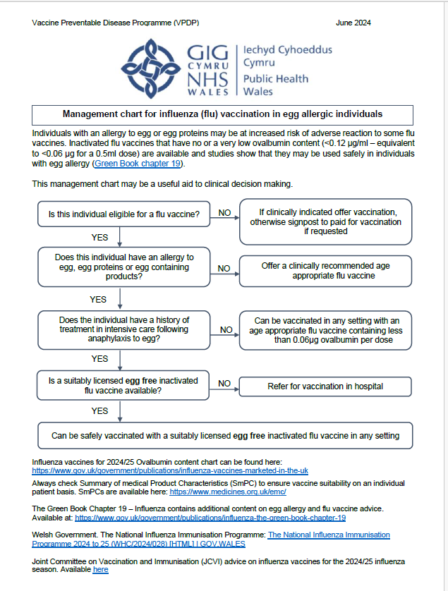
Management chart for influenza (flu) vaccination in egg allergic individuals for 2024/25
This resource is available to view here: Resources for health and social care professionals - Public Health Wales (nhs.wales) under further clinical resources and information

Slide 62
Children with cochlear implants
Children with cochlear implants can be given LAIV safely although ideally it should not be given:
  In the week prior to implant surgery, or
  for 2 weeks afterwards, or
  if there is evidence of on-going cerebrospinal fluid leak.
  Influenza: the green book, chapter 19 - GOV.UK (www.gov.uk)

Slide 63
Inadvertent administration of LAIV
If an immunocompromised individual receives LAIV, the degree of immunosuppression should be assessed
If the individual is severely immunocompromised, antiviral prophylaxis should be considered
Otherwise, they should be advised to seek medical advice if they develop flu-like symptoms in the 4 days following administration of the vaccine
If antivirals are used for prophylaxis or treatment, the individual should also be offered inactivated flu vaccine in order to maximise their protection (this can be given straight away)
There is limited data on the use of live attenuated flu vaccine in pregnancy. However, in a study
of inadvertent LAIV administration to pregnant women, there was no evidence of significant
maternal adverse outcomes. The live viruses in LAIV have been attenuated (weakened)
and adapted to cold so that they can only replicate at the lower temperatures found in the nasal
passage. These live viruses cannot replicate efficiently elsewhere in the body and therefore
there is no theoretical basis for concern about infection of the unborn foetus or the mother’s
lungs. Inactivated influenza vaccines are, however, preferred for those who are pregnant
The national influenza immunisation programme 2024-2025: Information for healthcare practitioners (publishing.service.gov.uk) will be available to view here: Flu vaccination programme 2023 to 2024: healthcare practitioners - GOV.UK (www.gov.uk)

Slide 64
LAIV and ‘viral shedding’
    LAIV does not create an external mist of vaccine virus in the air when children are being vaccinated and others in the room should not be at risk of ‘catching’ the vaccine virus
    Administration of the intranasal vaccine delivers just 0.1ml of fluid straight into each nostril and almost all the fluid is immediately absorbed into the child’s nose
    Although vaccinated children are known to shed virus a few days after vaccination, the vaccine virus that is shed is less able to spread from person to person than natural flu infection
    The amount of virus shed is normally below the levels needed to pass on infection to others and the virus does not survive for long outside of the body. This is in contrast to natural flu infection, which spreads easily during the flu season

Slide 65
Risk of transmission of live vaccine virus
There is a theoretical potential for transmission of live attenuated flu virus to very severely immunocompromised contacts for 1 to 2 weeks following vaccination
Following extensive use of LAIV in the US, there have been no reported instances of illness or infections from the vaccine virus among immunocompromised patients inadvertently exposed to vaccinated children
However, if close contact with very severely immunocompromised patients (such as bone marrow transplant patients requiring isolation) is likely or unavoidable (for example other household members) consider an appropriate inactivated flu vaccine instead
Notes:
There is a theoretical potential for transmission of live attenuated influenza virus in the LAIV to immunocompromised contacts for 1 to 2 weeks following vaccination. In the US, where there has been extensive use of the live attenuated influenza vaccine, there have been no reported instances of illness or infections from the vaccine virus among immunocompromised patients inadvertently exposed. Where close contact with very severely immunocompromised patients (such as bone marrow transplant patients requiring isolation) is likely or unavoidable (for example, household members), however, appropriate alternative inactivated influenza vaccines should be considered.

Slide 66
Exposure of healthcare professionals to live attenuated influenza vaccine viruses
Theoretically there may be some low-level exposure to the vaccine viruses for those administering LAIV and/or from recently vaccinated patients
In the US, where there has been extensive use of LAIV, there have not been any reported instances of illness or infections from the vaccine virus among healthcare professionals inadvertently exposed
Risk of acquiring vaccine viruses from the environment is unknown but probably low
The vaccine viruses are cold-adapted and attenuated and therefore unlikely to cause symptomatic flu
As a precaution, very severely immunosuppressed individuals should not administer LAIV
Other healthcare workers who have less severe immunosuppression or are pregnant, should follow normal clinical practice to avoid inhaling the vaccine and ensure that they themselves are appropriately vaccinated

Slide 67
Storage of flu vaccine
  Efficacy, safety and quality may be adversely affected if vaccines are not stored at the temperatures specified in the licence
All flu vaccines, inactivated and LAIV, must be stored in accordance with manufacturer’s instructions:
  Store between +2⁰C and +8⁰C
  Do not freeze
  Store in original packaging
  Protect from light
Check expiry dates regularly:
  The LAIV has an expiry date 18 weeks after manufacture – this is much shorter than inactivated flu vaccines
  It is important that the expiry date on the nasal spray applicator is checked before use
  The advisory document for the ordering, storage and handling of vaccines has been updated.
  The updated edition will be available to view here: https://www.wmic.wales.nhs.uk/vaccine-ordering-storing-handling
Notes:
Vaccines should be stored in the original packaging at +2°C to +8°C and protected from light. All vaccines are sensitive to some extent to heat and cold. Heat speeds up the decline in potency of most vaccines, thus reducing their shelf life. Efficacy, safety and quality may be adversely affected if vaccines are not stored at the temperatures specified in the licence. Freezing may cause increased reactogenicity and loss of potency for some vaccines and can also cause hairline cracks in the container, leading to contamination of the contents.
LAIV has a shelf life of 18 weeks that starts at the point of release from the manufacturer. This is a shorter shelf life than other influenza vaccines and some of this time will have passed when the vaccine reaches the place where it is to be administered. It is important that the expiry date on the nasal spray applicator is checked before use. If the expiry date has passed, arrangements should be made to have the vaccine disposed safely.
The vaccine should be stored in the original packaging. This makes it easy to identify in the vaccine fridge and to check batch numbers and expiry dates. The original packaging also provides some protection against fluctuation of temperature and protection from light.
Vaccines are expensive and it is important to minimise wastage through inappropriate storage.

Slide 68
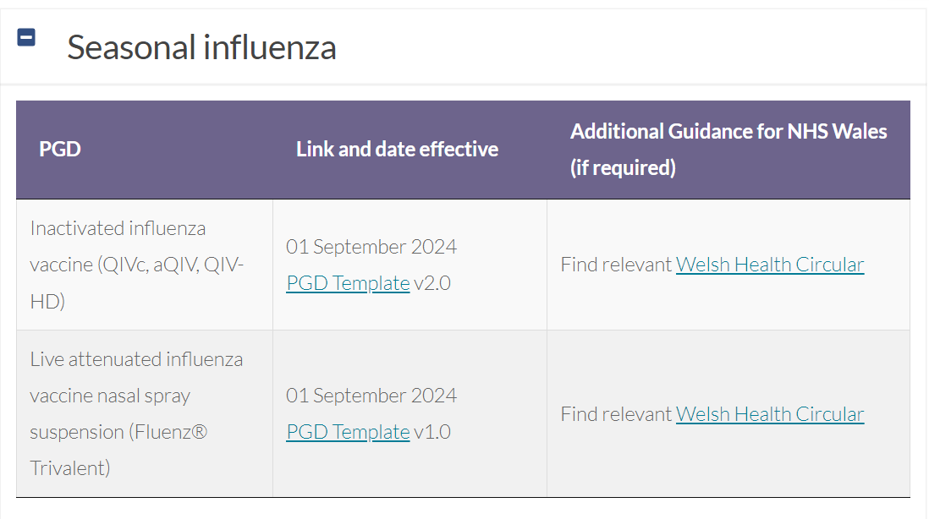
Legal framework for vaccination
The NHS Wales PGD’s for injectable influenza vaccines and LAIV are available on Welsh Medicines Advice Service .
National Protocols will once again be available for the 2024/25 flu season and will be available to view on the Welsh Medicines Advice Service web-page
Notes:
PGD templates: Patient Group Directions (PGD) - Welsh Medicines Advice Service (wales.nhs.uk)

Slide 69
Vaccine administration (inactivated vaccines)
Inactivated flu vaccines should be given intramuscularly into the upper arm (deltoid muscle) of those aged 12 months or older and into the anterolateral aspect of the thigh in infants aged 6 months to one year of age
Due to the presence of adjuvant and therefore increased potential for more local reactions if administered by subcutaneous injection, aQIV should only be administered intramuscularly using a 25mm length needle
The cell-based quadrivalent vaccines QIVc is also not licensed for subcutaneous administration so should only be administered intramuscularly
Inactivated and live flu vaccines can currently be given at the same time as, or at any interval before or after, other currently used live and inactivated vaccines If any new vaccines are introduced during the flu vaccination season, please ensure any specific guidance given about concomitant administration for these is followed.
For advice on co-administration of vaccines refer to appropriate chapters in the green book (see next slide for further information on co-administration of flu vaccine with RSV vaccine)
If given at the same time, different vaccines should be given at separate sites, preferably in a different limb. If given in the same limb, they should be given at least 2.5cm apart
Notes:
.

Slide 70
Co-administration of influenza vaccine with Abrysvo® RSV vaccine
There is some data which shows that in older adults administering Abrysvo® at the same time as seasonal influenza vaccine may reduce the immune response to the RSV vaccine
There is also data that suggests that the response to the influenza A(H3N2) component of seasonal influenza vaccine (the influenza subtype which most severely affects older adults) may be diminished when RSV and seasonal influenza vaccine are co-administered to older adults
The clinical significance of any reduced response is unknown, but influenza immune response is known to correlate with protection against infection, and there is emerging data that RSV immune response also correlates with clinical protection
It is therefore recommended that these vaccines are not routinely scheduled to be given at the same appointment or on the same day for older adults.
No specific interval is required between administering the vaccines
However, if it is thought that the individual is unlikely to return for a second appointment or immediate protection is necessary, Abrysvo® can be administered at the same time as the influenza vaccine
**Note: this information does not apply to pregnant women, where Abrysvo RSV vaccine can be administered at the same time as seasonal influenza vaccine**
Further information is available here: Respiratory syncytial virus: the green book, chapter 27a - GOV.UK (www.gov.uk)

Slide 71
Before administering a vaccine
Before administering a vaccine, the individual should be assessed to ensure that:
there are no contraindications to the vaccine being given
they have not experienced any serious reactions to a previous dose or component of the vaccine
they or their carer is fully informed about the vaccine to be given and understand the vaccination procedure
they or their carer are aware of possible adverse reactions to the vaccine and how to treat them
they have consented to having the vaccine
Immunisers should ensure that:
they have the appropriate knowledge and legal authority to administer the vaccine
the vaccine has been properly stored and prepared for use and that they know where and how to administer it

Slide 72
Consent
Before vaccinating, ‘informed’ consent must be obtained
Informed consent is a legal requirement, and the individual’s views must be respected
Sufficient evidence-based information must be provided to enable the person to make a balanced and informed decision about their care and treatment
As well as a general explanation of the procedure, there is also a duty to explain the risks inherent in the procedure and the risks inherent in refusing the procedure
Consent can be given verbally, in writing or it can be implied, but however it is given, the person must understand what they are consenting to
If there are any issues or uncertainties with seeking or gaining consent, ask for advice from an experienced colleague rather than abandon the offer of immunisation
Consent is a process and can be withdrawn
Notes:
Before giving flu vaccine , immunisers must ensure that they have obtained informed consent from the individual or that a best interest decision has been made if the individual does not have mental capacity at the time of vaccination.
In order to be able to consent to vaccination, the vaccinee should receive an explanation of the treatment and its benefits and risks, either verbally from a clinician, or in the form of a leaflet and letter.
When assessing capacity to consent, the immuniser should be guided by the principles of the Mental Capacity Act (2005). This Act applies to those aged 16 years and over and is designed to protect and empower people who may lack the mental capacity to make their own decisions about their care and treatment.
Consent is a process, not a one-off discussion and must consider 3 factors:
the person giving consent must be appropriately informed: they must have the necessary information in order to make the decision
consent must be voluntary by the individual without undue pressure or coercion
the person consenting must have the capacity to make the decision

Slide 73
Informed consent
How much information should you give?
this will be personal to the individual at the time and will depend on their previous knowledge and discussions with others
give people as much information as they need and/or want to make an informed decision
some people will just ‘trust’ what you say while others want lots of information; either is fine
how much each individual needs is up to them, no one is obliged to seek full information
Information to be given includes:
which vaccine is being offered and the disease against which it protects
benefits/risks of immunisation versus risks of the disease​
any possible vaccine reactions and what to do if these occur
Consent is a process, not a one-off discussion and must consider 3 factors:
the person giving consent must be appropriately informed: they must have the necessary information in order to make the decision
consent must be voluntary by the individual without undue pressure or coercion
the person consenting must have the capacity to make the decision
Consent: the green book, chapter 2 - GOV.UK (www.gov.uk)
Mental capacity Act 2005: https://www.legislation.gov.uk/ukpga/2005/9/contents

Slide 74
Vaccination intramuscular administration
Giving vaccine into the muscle:
leads to a better immune response to the vaccine (as the muscle contains the appropriate cells necessary to initiate the immune response)
is less likely to cause local reactions than if the vaccine is given under the skin (subcutaneously)
The needle needs to be long enough to ensure vaccine is injected into the muscle. For this reason, a 25mm needle is recommended. In larger adults, a longer length (for example, 38mm) may be required, and an individual assessment should be made
Flu vaccine in adults should be injected into the deltoid muscle in the upper arm

Slide 75
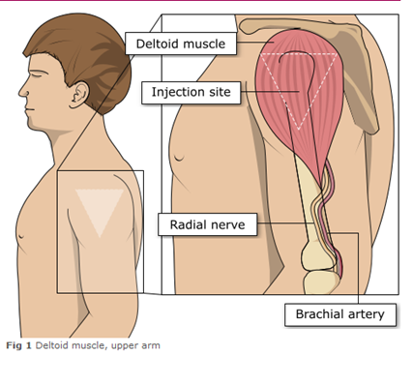
Administering vaccine into the deltoid muscle
It is essential that the correct site and injection technique is used to administer vaccines.
Injecting too high into the upper arm might result in a shoulder injury or a frozen shoulder. This leads to pain, weakness and a limited range of motion that can last for months.
Injecting too low or too far to the side of the arm risks injecting into the axillary nerve or the radial nerve.
To avoid shoulder injury, always assess the limb before administering the vaccine to identify the correct site for injection.
Image adapted from the Australian Immunisation Handbook

Slide 76
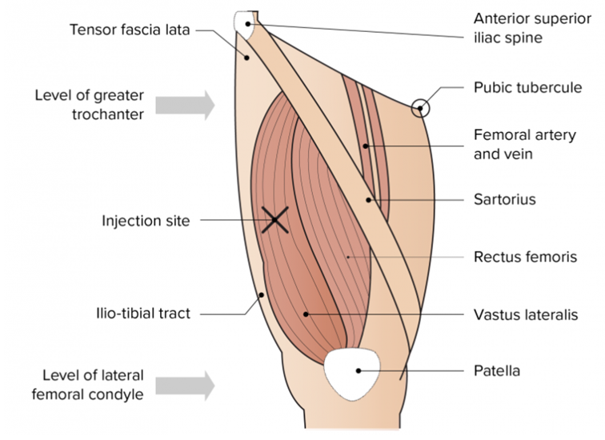
The vastus lateralis muscle
(anterolateral aspect of the thigh)
The preferred site for intramuscular vaccine administration in infants under 1 year is generally the anterolateral aspect of the thigh
The preferred site for intramuscular vaccine administration in individuals aged 1 year and over is generally the deltoid area of the upper arm.
Image from the Australian Immunisation Handbook

Slide 77
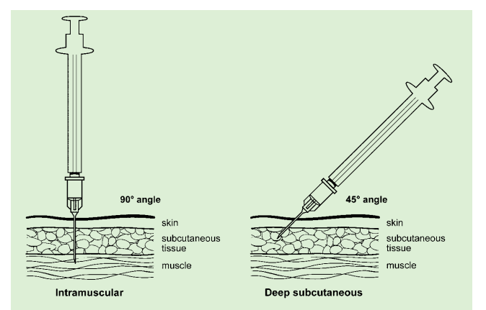
Vaccine administration
Skin does not need to be specially cleaned prior to vaccination. If it is visibly dirty, then water is sufficient to clean it.
Intramuscular process:
identify the correct site for IM injection
stretch the skin at the site
insert the needle at a 90 degrees angle far enough to ensure vaccine is delivered into muscle
depress the plunger
gently remove the needle
apply light pressure using gauze or cotton wool if bleeding occurs
Green-Book-Chapter-4.pdf (publishing.service.gov.uk)
Deep subcutaneous process:
Deep SC injections should be given with the needle at a 45º angle to the skin and the skin should be bunched, not stretched
Notes:
https://assets.publishing.service.gov.uk/government/uploads/system/uploads/attachment_data/file/147915/Green-Book-Chapter-4.pdf

Slide 78
Consequences of incorrect injection technique
It is essential that the correct site and injection technique are used to administer vaccines
Injecting too high into the upper arm might result in the vaccine being deposited in the shoulder capsule rather than the deltoid muscle
If this happens, inflammation can occur, leading to a shoulder injury or a frozen shoulder
  This leads to pain, weakness and a limited range of motion that can last for months
Injecting too far to the side of the arm or too low on the arm risks injecting into the axillary nerve or the radial nerve
  This can cause a burning or shooting pain during the procedure and can lead to nerve damage (neuropathy/paralysis)
To avoid shoulder injury, always assess the limb before administering the vaccine to identify the correct site for injection

Slide 79
Administration of Live Attenuated Influenza vaccine (LAIV)
  LAIV is different from other flu vaccines – it is a live attenuated nasal vaccine and must not be injected
  Do not attempt to attach a needle
  LAIV can be administered at the same time as, or at any interval from other currently used vaccines including live vaccines
  The applicator has a divider clip to enable one application in each nostril
  The vaccinee should breathe normally - they do not need to actively inhale or sniff
  The vaccine is rapidly absorbed so there is no need to repeat either half of dose if patient sneezes, blows their nose or their nose drips following administration
Notes:
An incomplete dose of LAIV does not need to be repeated as long as at least 0.1ml of the vaccine has been given intranasally as each half dose (0.1ml) contains enough viral particles to
induce an immune response.
If the vaccine is accidentally squirted into the child’s eye, it may cause some slight irritation to the eye and eyewash or normal saline should be used to wash out the eye. The child or
parent/carer should be advised to seek medical advice if any irritation occurs and persists beyond what might reasonably be expected.

Slide 80
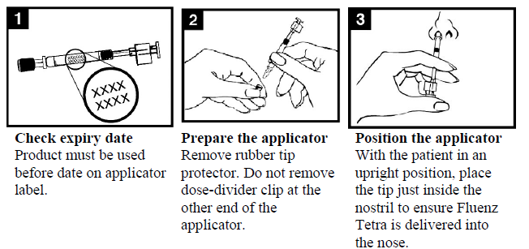
Administration of LAIV (1)

Slide 81
Administration of LAIV (2)

Slide 82
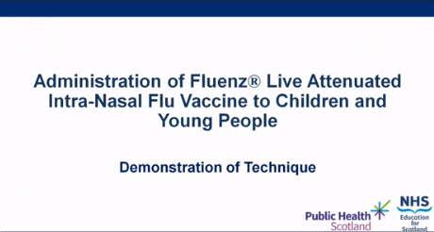
LAIV administration video
A video for healthcare practitioners on how to administer LAIV has been produced by NHS Education for Scotland and Public Health Scotland
It is available to view on the NES website at: https://learn.nes.nhs.scot/63183/immunisation/seasonal-flu/administration-of-fluenz-tetra-video (recommended watching from 2 minutes to 4m 30s for vaccinators in Wales)
This video was updated by Public Health Scotland and NHS Education for Scotland for 2021/22 flu season, the PPE advice is now out of date. See here for up to date NHS Wales guidance: Guidance - Public Health Wales (nhs.wales)

Slide 83
Commonly reported adverse reactions
Following inactivated influenza vaccine:
Pain, swelling or redness at the injection site, low grade fever, malaise, shivering, sweating, fatigue, headache, myalgia and arthralgia
A small painless nodule may also form at the injection site
These symptoms usually disappear within 1 to 2 days without treatment
Due to the MF59 adjuvant, a higher incidence of mild post-immunisation reactions has been reported with aQIV, compared to non-adjuvanted influenza vaccines
Following live attenuated influenza vaccine (LAIV):
Nasal congestion/rhinorrhoea, reduced appetite, weakness, fever and headache
Rarely, after live or inactivated vaccine, immediate reactions such as urticaria, angio-oedema, bronchospasm and anaphylaxis can occur

Slide 84
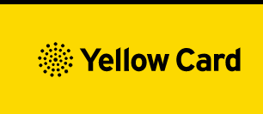
Reporting adverse events
All serious suspected reactions following vaccination should be reported to the Medicines and Healthcare products Regulatory Agency (MHRA) using the Yellow Card scheme
Suspected adverse events occurring in children or involving products that carry the black triangle symbol (▼) should be reported, even where these are mild or expected.
Anyone (patients and HCWs) can make a Yellow Card report, even if they are uncertain as to whether a vaccine caused the condition/side effect
Vaccinees should be advised that they can report any adverse reactions using the MHRA’s online Yellow Card scheme (www.mhra.gov.uk/yellowcard), by downloading the Yellow Card app or by calling the Yellow Card scheme on 0800 731 6789 9am to 5pm Monday to Friday

Slide 85
Improving vaccine uptake
National Institute of Clinical Excellence (NICE) published guidance in August 2018 they made 7 key recommendations:(opens in a new tab)
Providers of flu vaccination(opens in a new tab) should work together with other agencies to develop programmes to increase vaccination uptake.
Educate health and social care staff, particularly those in contact with eligible groups(opens in a new tab), about flu vaccination.
Use every opportunity throughout the flu vaccination season to identify people in eligible groups(opens in a new tab) and offer them the flu vaccination.
Use strategies to increase uptake among eligible groups in primary and secondary care.
Keep patient records up to date and accurate to help identify people who have not been vaccinated and are eligible for flu vaccination that season.
Offer flu vaccination to carers(opens in a new tab), base decisions to offer vaccination on whether the carer looks after someone whose wellbeing may be at risk if the carer was ill or hospitalised with flu.
Employers of health and social care staff are responsible for providing occupational flu vaccinations.

Slide 86
Optimising Vaccine Uptake: Using motivational interviewing for better conversations
The approach and style of a vaccine conversation can make a real difference in understanding individual hesitancy, addressing barriers, and influencing vaccine uptake. There is an eLearning module available called Optimising Vaccine Uptake: Using motivational interviewing for better conversations which aims to support staff with having positive conversations about immunisations.
The module aims to provide health professionals the skills and knowledge required to implement motivational interviewing techniques when having vaccine-related conversations
Further information about the module and how to access it is available here: Immunisation eLearning - Public Health Wales (nhs.wales)

Slide 87
Maximising flu vaccine uptake in healthcare and social care staff
If you work on the healthcare staff facing element of the flu programme click here(opens in a new tab) to access a number of resources that may be useful to you, including:
Guidance and policy
Evidence
Links to vaccine uptake
Resources
Links to further information
Resources for peer vaccinators/flu champions
Staff flu campaign: an evaluation and planning toolkit (NHS Wales intranet only)(opens in a new tab)
More information on planning a healthcare staff flu campaign including delivering and evaluation can be found here(opens in a new tab) (NHS Wales intranet only)

Slide 88
Social care staff
If you work on the social care staff facing element of the flu programme, you will find a number of resources that may be useful to you on the flu vaccination, Public Health Wales internet site(opens in a new tab). Information Including:
Guidance
Links to vaccine uptake
Resources
Links to further information

Slide 89
Key messages to health and social care workers
    Getting vaccinated against flu can help protect you, your patients and family
    Everyone is susceptible to flu, even if you are in good health and eat well
    You can be infected with the virus and have no symptoms but can still pass flu virus to others including patients or residents
    Good infection control measures reduce spread of flu and other acute respiratory infections in healthcare settings but are not sufficient alone to prevent them
    Throughout the last 10 years there has generally been a good to moderate match between the strains of flu virus in the vaccine and those that subsequently circulated
    Impact of flu on frail and vulnerable patients can be fatal and outbreaks can cause severe disruption in communities, care homes and hospitals
    Flu vaccine has a good safety record and will help protect you. It cannot give you flu. Having the vaccination can encourage your colleagues to do likewise
    Staff act as positive role models for those with long-term health conditions and pregnant women to take up the offer too
    Duty of care as professionals to patients or residents to do everything in your power to protect them against infection, including being immunised against flu

Slide 90
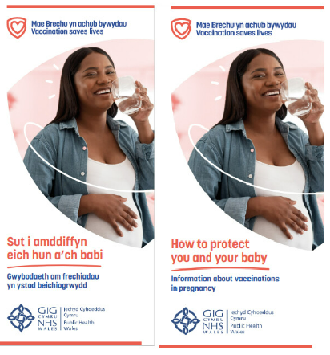
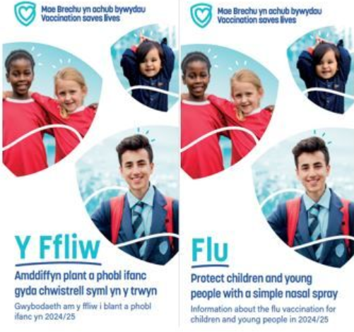
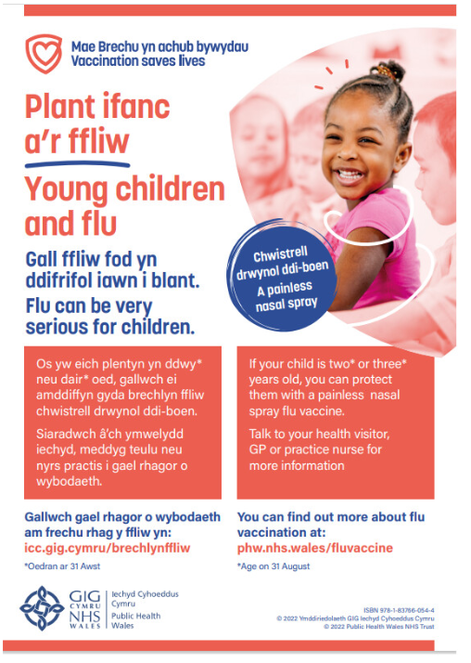



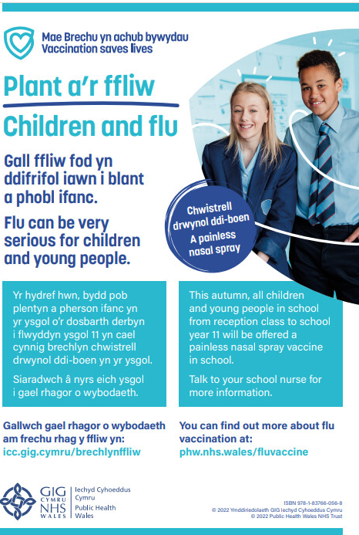
Resources
Currently being updated
All immunisation resources can be downloaded and ordered from: Health Information Resources - Public Health Wales (nhs.wales)
Leaflets and other resources in accessible formats can be accessed here: Flu vaccine accessible information - Public Health Wales (nhs.wales)
Resources for health and social care professionals are available here: Resources for health and social care professionals - Public Health Wales (nhs.wales)

Slide 91
Flu eLearning modules – available shortly
Flu Vaccine information for health and social care staff in Wales 2024-25
The FluOne eLearning module has a new name and new look! The module is now called Flu Vaccine information for health and social care staff in Wales 2024-25. If you work in NHS Wales, are a non-NHS health worker, work in a care home, social care or in the voluntary sector this module will give you all the information you need on flu, and why it’s so beneficial to you and those you care for to get your flu vaccine
For more information about the module and how to access it please visit: Immunisation eLearning - Public Health Wales (nhs.wales)
Flu Clinical update for Wales 2024-25
The FluTwo elearning module also has a new name. This module is now called Flu Clinical update for Wales 2024-25. This eLearning is suitable for all healthcare professionals including health care support workers who immunise against flu or provide flu immunisation advice. It is the clinical update for Wales and has been updated for the 2024-25 flu season
For more information about the eLearning and how to access it please visit: Immunisation eLearning - Public Health Wales (nhs.wales)

Slide 92
Learning outcomes
On completion of this resource, healthcare practitioners should now be able to:
Describe the cause of flu
Understand how flu is transmitted and the possible effects of flu
Explain which vaccines should be used and the precautions and contraindications to the administration of these
Explain the sequence of steps in flu vaccine administration
Explain the possible side effects from flu vaccines
Understand the importance of their role in promoting and providing evidence based information about flu vaccination to patients
Identify sources of additional information

