Slide 1
Vaccination against Influenza 2025-2026
Vaccine Preventable Disease Programme
Public Health Wales
Version 1
28 July 2025
Notes:
Material contained in this document may be reproduced without prior permission provided it is done so accurately and is not used in a misleading context.
Acknowledgement to Public Health Wales NHS Trust to be stated.
© 2025 Public Health Wales NHS Trust.

Slide 2
Vaccination against Influenza
The information contained within this slide set is up to date as of 28/07/2025
*Please note the term Inactivated Influenza Vaccine (IIV) is used interchangeably with Trivalent Influenza Vaccine (TIV) within these training slides
It is important that all immunisers delivering the Influenza vaccination programme and/ or those who are providing immunisation advice familiarise themselves with the most up to date clinical evidence and guidance, this can be found in the following key documents:
The Green Book: Influenza: the green book, chapter 19 - GOV.UK
Flu Vaccination programme 2025/26:Information for healthcare practitioners. Will be available to view here: Annual flu programme - GOV.UK
The national influenza immunisation programme 2025 to 2026 (WHC/2025/020)
Guidance - Eligible groups in the 2025 to 2026 flu immunisation programme
Joint Committee on Vaccination and Immunisation: JCVI statement on influenza vaccines for 2025 to 2026 - GOV.UK
VPDP webpage is available here: Flu Vaccination - Public Health Walesh professionals about the 2025 to 2026 national influenza immunisation programme.
The content of this training slide set is subject to review. This resource will be version controlled. This is version 1
Notes:
*Note: For the purpose of this resource Human Papillomavirus will be referred to as HPV and both men who have sex with men (MSM) and gay, bisexual and other men who have sex with men (GBMSM) will be used interchangeably as required in line with reference to related policy.

Slide 3
Acknowledgements
Vaccine Preventable Disease Programme (VPDP), Public Health Wales: Immunisation and Vaccines - Public Health Wales
Vaccine Programme Wales (VPW)
UK Health Security Agency: www.gov.uk/government/topics/public-health

Slide 4
Contents
Section | Slide number
Aims & learning outcomes | 5
Influenza overview | 10
Epidemiology & surveillance / vaccine eligibility | 17
Influenza vaccines | 31
Vaccine administration – including assessment and consent | 65
Improving flu vaccine uptake | 84
Summary & resources | 89

Slide 5
Aims & learning outcomes

Slide 6
Aims of resource
The purpose of this training resource is to:
Develop the knowledge base of healthcare practitioners regarding the 2025 to 2026 seasonal flu vaccination programme
Support healthcare practitioners involved in discussing flu vaccination with those eligible by providing evidence based information
Promote high uptake of flu vaccination in all eligible groups by increasing the knowledge of those involved in delivering the vaccination programme
Provide information on the administration of flu vaccines

Slide 7
Learning outcomes
On completion of this resource, healthcare practitioners will be able to:
Describe the cause of flu
Understand how flu is transmitted and the possible effects of flu
Explain which vaccines should be used and the precautions and contraindications to the administration of these
Explain the sequence of steps in flu vaccine administration
Explain the possible side effects from flu vaccines
Understand the importance of their role in promoting and providing evidence based information about flu vaccination to patients
Identify sources of additional information

Slide 8
Pre-requisites to administering Influenza vaccine
Before administering an Influenza vaccine, it is recommended that:
*Those new to immunisation should receive comprehensive foundation immunisation training. Both knowledge and clinical competence should be assessed before new immunisers start to give and/or advise about the Influenza vaccine National Minimum Standards and Core Curriculum for Vaccination Training - an advisory document for Wales is being published alongside these standards and will be available here: Immunisation training resources and events - Public Health Wales
Immunisers have received Influenza vaccine training through attending a taught session and/or eLearning Immunisation eLearning - Public Health Wales (nhs.wales)​. Specific flu training recommendations for Wales will be available to view here: Immunisation training resources and events - Public Health Wales
Immunisers have received practical training in Influenza vaccine preparation and administration (if required)
​Training in the management of anaphylaxis and Basic Life Support is undertaken, as specified by policy for your local area and are familiar with Resuscitation Council UK (RCUK) guidance on Management of Anaphylaxis in the Vaccination Setting
Any additional statutory and mandatory training as required by your employer is completed
An appropriate legal framework to supply and administer Influenza vaccine is in place e.g. Written prescription, Patient Specific Direction (PSD), Patient Group Direction (PGD) or National Protocols. Visit here for Wales PGD template and National protocols
Those involved in immunisation and vaccination understand the process of consent and how this applies when giving vaccines. Information on consent can be viewed here: Consent: the green book, chapter 2 - GOV.UK
Immunisers and those giving immunisation advice access and familiarise themselves with the following key documents: Specific Green Book Chapter Vaccination against Influenza:Influenza: the green book, chapter 19 - GOV.UK, Flu Vaccination programme 2025/26:information for healthcare practitioners:Annual flu programme - GOV.UK The vaccine product information in the Summary of Product Characteristics: Electronic Medicines Compendium website)
Notes:
*This should be either through a face to face taught course or a blended approach of both e-learning and a face to face taught course. New immunisers should also have a period of supervised practice and support with a registered healthcare practitioner who is experienced, up to date and competent in immunisation.
Practitioners should always ensure they are accessing the most up to date information and guidance.

Slide 9
Key messages
Flu immunisation is one of the most effective interventions we can provide to reduce harm from flu and pressures on health and social care services during the winter
It is important to increase flu vaccine uptake in clinical risk groups because of increased risk of death and serious illness if people in these groups catch flu
For a number of years, only around half of patients aged 6 months to under 65 years in clinical risk groups have been vaccinated
Flu during pregnancy may be associated with perinatal mortality, prematurity, smaller neonatal size, lower birth weight and increased risk of complications for mother
Vaccination of health and social care workers protects them and reduces risk of spreading flu to their patients, service users, colleagues and family members
By preventing flu infection through vaccination, secondary bacterial infections such as pneumonia are prevented. This reduces the need for antibiotics and helps prevent antibiotic resistance
The childhood flu programme should reduce the impact of seasonal flu on children and reduce transmission of flu within the community
By reducing transmission of flu, it should also avert many cases of severe flu and flu-related deaths in older adults and people in clinical risk groups

Slide 10
Influenza overview

Slide 11
Influenza overview
Flu is an acute viral infection of the respiratory tract (nose, mouth, throat, bronchial tubes and lungs)
It is a highly infectious illness which spreads rapidly in communities
Even people with mild or no symptoms can infect others
Most cases in the UK occur during an 8 to 10 week period during the winter

Slide 12
Influenza viruses
A viruses
Cause outbreaks most years and are the usual cause of epidemics and pandemics
Live and multiply in many different animals and may spread between them
Birds, particularly wildfowl, are the main animal reservoir
B viruses
Tend to cause less severe disease and smaller outbreaks
Predominantly found in humans
Burden of disease mostly in children

Slide 13

Flu A virus
Genetic material (RNA) in the centre
Two surface antigens:
Haemagglutinin (H) (blue)
Neuraminidase (N) (red)
There are 18 different types of H and 11 different types of N
The role of haemagglutinin is to bind to the cells of the infected person
The role of neuraminidase is to release the virus from the cell surface
The different types of H and N are identified by numbers, hence H1N1 or H3N2 for example

Slide 14
Genetic changes in the flu virus – what this means
Changes in the surface antigens (H and N) result in the flu virus constantly changing
Antigenic drift: minor changes (natural mutations) in the genes of flu viruses that occur gradually over time
Antigenic shift: when 2 or more different strains combine. This abrupt major change results in a new subtype. Immunity from previous flu infections/vaccinations may not protect against the new subtype, potentially leading to a widespread epidemic or pandemic
Because of the changing nature of flu viruses, the World Health Organisation (WHO) monitors their epidemiology throughout the world. Each year WHO makes recommendations about the strains of influenza A and B which are predicted to be circulating in the forthcoming winter.
These strains are then included in the flu vaccine developed each year
Notes:
The World Health Organization (WHO) convenes a group that reviews the global influenza situation (once each year for the northern hemisphere and once for the southern hemisphere) and recommends which flu strains should go in the seasonal vaccine to be produced by manufacturers for the following season 6 to 8 months later. This recommendation is based on information about the circulating viruses and epidemiological data from around the world at that time.
In previous years, most influenza vaccines were trivalent, containing 2 subtypes of influenza A and one B virus but quadrivalent vaccines with an additional B virus have been developed in recent years. The first authorised quadrivalent flu vaccine was made available for use in the UK in 2013. The use of quadrivalent flu vaccines containing a B strain from each of the 2 B strain lineages should improve the matching of the vaccine to the circulating B strain(s).

Slide 15
Possible complications of flu
Common:
  Bronchitis
  Otitis media (children), sinusitis
  Secondary bacterial pneumonia
Less common:
  Meningitis, encephalitis, meningoencephalitis
  Primary influenza pneumonia
Risk of most serious illness is higher in:
      Children under 6 months
      Older people
      Those with underlying health conditions such as respiratory disease, cardiac disease, long-term neurological conditions or immunosuppression
      Pregnant women (flu during pregnancy may be associated with perinatal mortality, prematurity, smaller neonatal size and lower birth weight)
Notes:
The risk of serious illness from flu is higher among children under 6 months of age, older people and those with underlying health conditions such as respiratory disease, cardiac disease or immunosuppression, as well as pregnant women. These groups are at greater risk of complications from flu such as bronchitis or pneumonia.

Slide 16
Features of flu
  Easily transmitted by large droplets, small-particle aerosols and by hand to mouth/eye contamination from a contaminated surface or respiratory secretions of infected person
  People with mild or no symptoms can still infect others
  Influenza is highly infectious with a usual incubation period of 1 to 3 days, though may be longer especially in people with immune deficiency.
  In healthy individuals, flu is usually unpleasant but self-limiting with recovery within 5-7 days.
  Common symptoms include:
  Sudden onset of fever, chills, headache, muscle and joint pain and extreme fatigue
  Dry cough, sore throat and stuffy nose
  In young children gastrointestinal symptoms such as vomiting and diarrhoea may be seen
Serological studies in healthcare professionals have shown that approximately 30% to 50% of flu infections can be asymptomatic but the proportion of flu infections that are asymptomatic may vary depending on the characteristics of the influenza strain.
  Influenza: the green book, chapter 19 - GOV.UK (www.gov.uk)

Slide 17
Epidemiology & surveillance
Vaccine eligibility

Slide 18
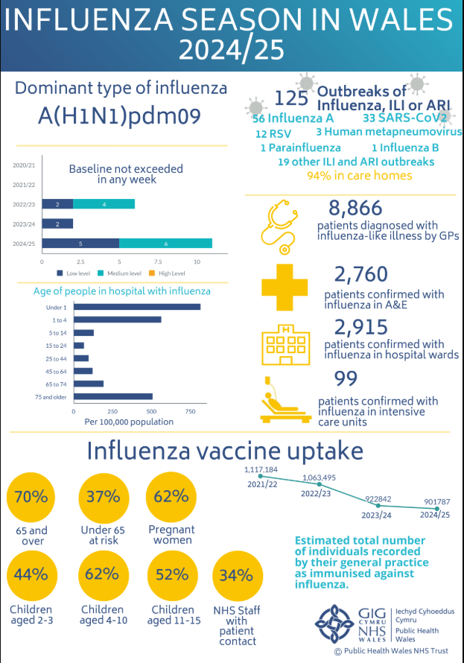
Summary of influenza season in Wales 2024/25
The full report and infographic will be available to view here: Annual influenza surveillance and influenza vaccination uptake reports - Public Health Wales
Weekly Influenza and Acute Respiratory Infection Report - Public Health Wales (nhs.wales)
18

Slide 19
Vaccine uptake ambitions for 2025/26 (1)
September start: school-aged children / young people
Starting as soon as Live Attenuated Influenza Vaccine (LAIV) becomes available in September, 2- and 3-year-olds and school-aged children / young people should be vaccinated as soon as possible
Welsh Governments ambition is to achieve 75% uptake amongst these groups during the 2025 to 2026 season. There should be a concerted drive towards increasing the numbers of flu vaccines delivered particularly during the main vaccination window for these cohorts from September to October half-term
For children where the LAIV vaccine is not appropriate, for example, due to the porcine gelatine content, health boards are expected to ensure a suitable alternative pathway for vaccination is in place, ideally offering concurrent vaccination*. This must be communicated to all providers and parents
Pregnant women can also be offered flu vaccine from the beginning of September or when flu vaccine becomes available Influenza: the green book, chapter 19 - GOV.UK [Page8]
WHC/2025/020
Notes:
*The intention is that LAIV and TIVc will both be offered in the same session. Some HBs are already planning to take this approach, others will be offering the gelatine free inactivated TIVc in alternative settings/community clinics or via primary care.

Slide 20
Vaccine uptake ambitions for 2025/26 (2)​
October start: older adults and at-risk groups
In accordance with the Joint Committee on Vaccination and Immunisation (JCVI) advice, based on the best clinical evidence for vaccine efficacy and waning, the adult flu programme will again commence on 1 October
The Welsh Government uptake target for adults aged 65 years and older remains at 75%. In 2023 to 2024 and again in 2024 to 2025, the uptake for the over 65 years cohort fell. At the end of last season, it stood at 70% across Wales.
For people aged under 65 in a clinical risk group eligible for flu vaccination the uptake ambition also remains at 75%. For this cohort, overall uptake across Wales has fallen each season over the last three years, standing at 37% at the end of the 2024 to 2025 season
WHC/2025/020

Slide 21
Flu vaccine eligibility: 2025 to 2026 flu season
The eligible groups for 2025-26 are as follows:
children aged two and three years on 31 August 2025
• school aged children from reception to year 11 (inclusive)
• people aged 6 months to 64 years in a clinical risk group
• people aged 65 years and older reaching 65 by 31 March 2026 (that is born before 1 April 1961)
• all adult residents in Welsh prisons
• pregnant women
• carers of a person whose health or welfare may be at risk if the carer falls ill
• frontline health and social care workers
• people experiencing homelessness
• household contacts of the immunocompromised
• *poultry workers
Further information is available here: The national influenza immunisation programme 2025 to 2026 (WHC/2025/020) | GOV.WALES
Guidance: Eligible groups in the 2025 to 2026 flu immunisation programme | GOV.WALES - Further detail on the groups to
receive a flu vaccine, with a focus on the children's programme as well as health and social care workers.
Further information is available here:(The national influenza immunisation programme 2025 to 2026 (WHC/2025/020) | GOV.WALES)
Notes:
Vaccinations for poultry workers will only be delivered in community pharmacies. Poultry workers who meet the eligibility criteria should present to their nearest community pharmacy with a confirmation letter they can obtain from their employer.

Slide 22
Clinical risk groups
People aged six months to 64 years in clinical risk groups including:
chronic respiratory disease such as asthma requiring regular inhaled steroids, or chronic obstructive pulmonary disease (COPD)
chronic heart disease
chronic kidney disease at stage 3, 4 or 5
chronic liver disease
chronic neurological disease such as Parkinson’s disease, motor neurone disease
diabetes
*learning disability
*severe mental illness
*epilepsy
immunosuppression due to disease such as HIV/AIDS or treatment such as cancer treatment (and household contacts of at risk individuals)
asplenia or dysfunction of the spleen
morbidly obese (class III obesity); this is defined as those with a Body Mass Index (BMI) of 40 or above, aged 16 or over
Further information and additional definitions of these groups can be viewed in table 19.4 of the Green Book influenza chapter
Eligible groups in the 2025 to 2026 flu immunisation programme | GOV.WALES
Notes:
*Learning disability, severe mental illness and epilepsy are eligible groups in Wales

Slide 23
Additional groups that are eligible for a flu vaccine
Household contacts (from 6 months of age) of those that are immunosuppressed
People living in Care Homes and other Long-stay Care Facilities
Carers - Paid and unpaid as well as third sector carers
Community first responders
Voluntary Organisations providing 1st aid
Social Care staff with client contact
Further detail on the eligible groups: Eligible groups in the 2025 to 2026 flu immunisation programme [HTML] | GOV.WALES

Slide 24

Health and social care workers
Flu vaccination rates have also fallen amongst health and social care workers
Health boards should make every effort to encourage health and social care staff to come forward for a flu vaccine by ensuring easy access and effectively communicating the benefits of vaccination. There is a short module designed for health and social care staff *Flu vaccine information for health and social care staff in Wales 2025-26 - Public Health Wales
Where there is sufficient vaccine supply, vaccination of health and social care staff who are under the age of 65, can commence before October or as soon as vaccine is available and should continue following the start of the older adults and at-risk groups programme
The earlier start of health and social care staff vaccinations does not apply to the older adults and at-risk groups, which should commence in October as set out in earlier slide
Further information available here: Influenza (flu) - Information for health and social care workers eligible for the vaccine - Public Health Wales
Notes:
*There is a short module designed for health and social care staff. The module explains why the annual flu vaccine is so important for all health and social care workers. It gives an overview of flu and its complications. It gives details of who is eligible to receive the vaccine and how to obtain it. It is suitable for all NHS Wales workers, non-NHS health care workers, people who work in care homes, social care and the third/voluntary sector. More information on how to access module is available here: Flu vaccine information for health and social care staff in Wales 2025-26 - Public Health Wales
NHS Wales staff can access the module via ESR. Search flu vaccine in the course catalogue on the “My Learning Home Page” or Click here for a direct link to the module (you will be prompted to log in before you can enroll). For more guidance on how to access the course via ESR click here

Slide 25
Health and social care workers
Healthcare workers who are in direct contact with patients/clients should have their flu vaccine via their employer. This should be actively encouraged and provided or facilitated as part of their occupational health care.
Vaccination of health and social care workers protects them and reduces risk of spreading flu to their patients, service users, colleagues and family members
Evidence that vaccination significantly lowers rates of flu-like illness, hospitalisation and mortality in the elderly in long-term healthcare settings
Vaccination reduces transmission of flu to vulnerable patients, some of whom may have impaired immunity and may not respond well to immunisation
Frontline health and social care workers have a duty of care to protect their patients and service users from infection
Vaccination of frontline workers also helps reduce sickness absences and contributes to keeping the NHS and care services running through winter pressures
NHS and social care bodies have a responsibility to ensure, as far as is reasonably practicable, that health and social care workers are free of, and are protected from exposure to infections that can be caught at work (Health and Social Care Act 2008, Code of Practice on the prevention and control of infections)
Notes:
There is a short module designed for health and social care staff. The module explains why the annual flu vaccine is so important for all health and social care workers. It gives an overview of flu and its complications. It gives details of who is eligible to receive the vaccine and how to obtain it. It is suitable for all NHS Wales workers, non-NHS health care workers, people who work in care homes, social care and the third/voluntary sector. More information on how to access module is available here: Flu vaccine information for health and social care staff in Wales 2025-26 - Public Health Wales
NHS Wales staff can access the module via ESR. Search flu vaccine in the course catalogue on the “My Learning Home Page” or Click here for a direct link to the module (you will be prompted to log in before you can enroll). For more guidance on how to access the course via ESR click here

Slide 26
Clinical risk groups
Increasing flu vaccine uptake in clinical risk groups is important because of increased risk of death and serious illness if people in these groups catch flu
For a number of years only around half of patients aged 6 months to under 65 in clinical risk groups have been vaccinated
Vaccine uptake for all clinical risk groups needs to improve
Strategies to improve vaccine uptake should be tailored to each risk group to ensure optimum uptake of vaccine in each of them
Further information on flu vaccination for those with learning disabilities Vaccination information in accessible formats - Public Health Wales

Slide 27
Residential care/nursing home residents and staff
People living in care homes or other long-stay care facilities
Vaccination is recommended for people living in care homes or other long-stay care facilities where rapid spread is likely to follow introduction of infection and cause high morbidity and mortality. This includes adult residential care homes, nursing care homes and children’s hospices
This does not include young offender institutions, university halls of residence or boarding schools (except those in eligible school years, or eligible due to another factor). Opportunities for co-administration with the COVID-19 vaccine should be explored where individuals are eligible for both the COVID-19 and flu vaccines
Social care staff
Individuals employed in adult residential care homes, nursing care homes and children’s hospices, or providing domiciliary care, who are in regular direct contact with residents/service users, are eligible to receive a flu vaccine. This may be via the community pharmacy, NHS seasonal influenza vaccination service or through an alternative model if agreed locally
Uptake of flu vaccination should be actively encouraged and supported/facilitated by their employer. Social care staff, apart from those referred to above, should be encouraged, supported and offered/facilitated vaccination by their employer

Slide 28
Pregnant women
All pregnant women are recommended to receive the inactivated flu vaccine irrespective of their stage of pregnancy
Pregnant women are at increased risk from complications if they contract flu
Having flu during pregnancy may be associated with premature birth and smaller birth size and weight
Flu vaccination during pregnancy provides passive immunity against flu to infants in the first few months of life
Studies on safety of flu vaccine in pregnancy show that inactivated flu vaccine can be safely and effectively administered during any trimester of pregnancy
No study to date has demonstrated an increased risk of either maternal complications or adverse fetal outcomes associated with inactivated flu vaccine
Pregnant women should be offered flu vaccine for each pregnancy. This needs to be the flu vaccination recommended for the flu season in which they are expected to deliver
Notes:
All pregnant women are recommended to receive the inactivated flu vaccine irrespective of their stage of pregnancy.
There is good evidence that pregnant women are at increased risk from complications if they contract flu. In addition, there is evidence that having flu during pregnancy may be associated with premature birth and smaller birth size and weight and that flu vaccination may reduce the likelihood of prematurity and smaller infant size at birth associated with an influenza infection during pregnancy. Furthermore, a number of studies show that flu vaccination during pregnancy provides passive immunity against flu to infants in the first few months of life. A review of studies on the safety of flu vaccine in pregnancy concluded that inactivated flu vaccine can be safely and effectively administered during any trimester of pregnancy and that no study to date has demonstrated an increased risk of either maternal complications or adverse fetal outcomes associated with inactivated influenza vaccine.
The ideal time for flu vaccination is before flu starts circulating. However, even after flu is in circulation, vaccine should continue to be offered to those at risk and newly pregnant women. If a woman becomes pregnant after the usual vaccinating period of October to January, it is still worth considering offering the vaccine if flu is still circulating in the community. Women should be offered the vaccine every time they are pregnant as the flu virus constantly mutates and therefore the strains included in the vaccine are reviewed annually.

Slide 29
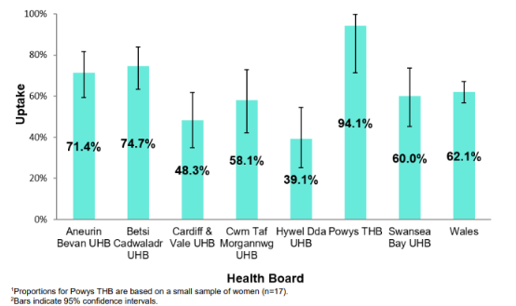
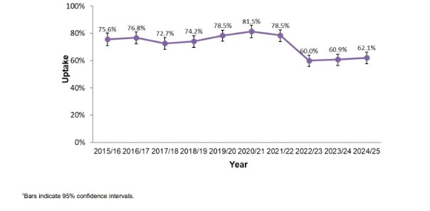
Point of Delivery (POD) survey 2024/25
Influenza
Uptake of influenza vaccination in pregnant women; by health board, 2024/25 (n=359)^{1,2}
Uptake of influenza vaccination in pregnant women participating in the 2015/16 to 2024/25 surveys¹
Immunisation uptake in pregnancy

Slide 30
Childhood flu vaccination programme
The seasonal flu vaccination programme for children aims to lower the public health impact of flu by:
  Providing direct protection by preventing cases of flu infection in children
  Providing indirect protection by lowering flu transmission from children to other children, adults and to those in the clinical risk groups of any age
  Reducing flu transmission in the community averts many cases of severe flu and flu-related deaths in older adults and people with clinical risk factors
Annual administration of flu vaccine to children is expected to substantially reduce flu-related illness, GP consultations, hospital admissions and deaths
All children from age 2 and 3 and school age children from reception to year 11 are eligible*.
Children aged 6 months to 2 years, and 17-18 year olds in a clinical risk group are eligible due to their underlying medical condition or treatment*
With concerns about co-circulation of the SARs-CoV-2 virus during the 2025 to 2026 flu season, it is particularly important to reduce transmission of flu in the community
Notes:
*full details on eligibility is available from Eligible groups in the 2025 to 2026 flu immunisation programme | GOV.WALES

Slide 31
Influenza vaccines

Slide 32
Influenza vaccines and their components
Two main types of flu vaccine available:
  Inactivated – given by injection
  Live attenuated (LAIV) – given by nasal application
  None of the flu vaccines can cause clinical influenza in those that can be vaccinated safely (there is a theoretical risk from LAIV to those who are severely immunocompromised)
The inactivated flu vaccines are Trivalent vaccines – they contain 2 subtypes of Influenza A and one B lineage
LAIV is a trivalent vaccine and contains 2 subtypes of Influenza A and one B lineage (see next slide more information)
The LAIV is licensed for children aged 2 up to 18 years
The inactivated flu vaccines are recommended for people aged 18+ years, children in clinical risk groups aged 6 months to 2 years and for children aged 2 years to 18 years who cannot receive LAIV
Further information on NHS Wales recommended flu vaccines 2025/26 influenza season is available here: Resources for health and social care professionals - Public Health Wales (nhs.wales) - under ‘ Recommended Vaccines ’

Slide 33
Trivalent Flu vaccines
Following the Recommendations announced for influenza vaccine composition for the 2025–2026 northern hemisphere influenza season LAIV offered to children aged 2 years and over is a trivalent vaccine for the 2025/26 flu programme. This is because there has been no confirmed detection of naturally occurring B/Yamagata-lineage influenza viruses since March 2020
The public health risk from B/Yamagata is now considerably
lower than at the time of the introduction of quadrivalent vaccines and B/Yamagata may be extinct
Therefore, trivalent influenza vaccines, without a B/Yamagata strain, are currently considered clinically suitable. As manufacturers start to produce trivalent products, their use will be preferred over the equivalent quadrivalent formulation
The inactivated flu vaccines given by injection will be a trivalent formulation for the 2025/26 season
Fluenz Trivalent nasal spray suspension Influenza vaccine (live, nasal) - Summary of Product Characteristics (SmPC) - (emc) | 15790
Notes:
Inactivated flu vaccines given by intramuscular injection have been used in the UK for many years. The live intranasal influenza vaccine (LAIV) was introduced into the UK schedule in 2013. However, a live intranasal flu vaccine called FluMist (same vaccine as Fluenz, different trade name) was introduced in the US schedule in 2003 therefore there is nearly 20 years' experience of widespread use of the vaccine in the US.
In previous years, most inactivated flu vaccines were trivalent, containing 2 subtypes of influenza A and one B virus. However, quadrivalent vaccines, containing 2 subtypes of influenza A and both B virus types became available and were used up until 2024/25.
Fluenz LAIV vaccine has been in use in the UK for over a decade. The Fluenz LAIV vaccine originally used in the 2013/14 flu season was a trivalent live vaccine. Fluenz Tetra was first used in the 2014/15 flu season and continued as a quadrivalent up until 2024/25, where it then became a trivalent again.
Flu vaccines (LAIV and Inactivated) have returned to trivalent from 2025/26 due to no confirmed detections of the B/Yamagata lineage since 2020.

Slide 34
Vaccine composition 2025/26
The WHO recommends that trivalent vaccines for use in the 2025–2026 northern hemisphere influenza season contain the following:
Egg-based vaccines
an A/Victoria/4897/2022 (H1N1)pdm09-like virus
an A/Croatia/10136RV/2023 (H3N2)-like virus
a B/Austria/1359417/2021 (B/Victoria lineage)-like virus.
Cell culture-, recombinant protein- or nucleic acid-based vaccines
an A/Wisconsin/67/2022 (H1N1)pdm09-like virus
an A/District of Columbia/27/2023 (H3N2)-like virus
a B/Austria/1359417/2021 (B/Victoria lineage)-like virus
Recommendations announced for influenza vaccine composition for the 2025–2026 northern hemisphere influenza season

Slide 35
National Influenza Immunisation Programme in Wales 2025 to 2026 (1)
In Wales there are a number of important changes from the way the programme operated in 2024 to 2025:
The flu and COVID-19 Immunisation Programmes will no longer be treated as a single Winter Respiratory Vaccination Programme. Although opportunities for co-administration of these vaccines should continue to be maximised, they will be run as two separate programmes
The Inactivated Influenza Vaccine (IIV) necessary to deliver the 2025 to 2026 vaccination programme has been procured centrally by NHS Wales Shared Services Partnership on behalf of Welsh Government and will be supplied directly to those providing vaccinations. This is a significant departure from previous programmes, where primary care providers have procured their own supply of IIV for use with eligible patients
The national influenza immunisation programme 2025 to 2026 (WHC/2025/020) | GOV.WALES

Slide 36
National Influenza Immunisation Programme 2025 to 2026 (2)
Primary Care Providers (GMS contractors and community pharmacies) will be commissioned by health boards to provide flu vaccination services under a Primary Care (Contracted Services): Immunisation Specification (for eligible groups aged 16 and over).
This specification replaces the previous separate arrangements made for engaging GMS contractors and community pharmacies. In respect of community pharmacies, the specification relates to the provision of inactivated influenza vaccine, not live attenuated influenza vaccine, to eligible persons aged 17 and over
All providers operating under the national programme will be required to use the newly improved Welsh Immunisation System (WIS) to record digitally, flu vaccinations given to adults
The national influenza immunisation programme 2025 to 2026 (WHC/2025/020) | GOV.WALES

Slide 37
Flu vaccine supply
The vaccines for use in Wales in the 2025 to 2026 season for the different age cohorts are as follows:
• Those aged 65 years and over – aTIV (adjuvanted Trivalent Influenza Vaccine)
• Those aged 18 to 64 years (including pregnant women) – TIVc (Trivalent cell culture Influenza Vaccine)
• Children aged 2 to 17 years – LAIV (Live Attenuated Influenza Vaccine)
• Children aged 2 to 17 Years who are contraindicated for or decline LAIV – TIVc
• Children aged 6 months – 2 years in risk groups - TIVc
Note: aTIV is licensed for use in those aged 50 to 64 years. Where TIVc is not immediately available pending delivery of additional TIVc vaccine, or where TIVc is not available to order, aTIV can offered as an alternative to 50 to 64 year olds.
The national influenza immunisation programme 2025 to 2026 (WHC/2025/020) | GOV.WALES
Notes:
Summary of Product Characteristics - SmPCs:
Adjuvanted Trivalent Influenza Vaccine (Surface Antigen, Inactivated) Seqirus suspension for injection in pre-filled syringe - Summary of Product Characteristics (SmPC) - (emc) | 10444
Cell-based Trivalent Influenza Vaccine (Surface Antigen, Inactivated) Seqirus suspension for injection in pre-filled syringe - Summary of Product Characteristics (SmPC) - (emc) | 15818
Fluenz Trivalent nasal spray suspension Influenza vaccine (live, nasal) - Summary of Product Characteristics (SmPC) - (emc) | 15790

Slide 38
Children aged two to less than 18 years of age in an at-risk group
Children in a risk group aged 2 to less than 18 years of age should be offered the live attenuated influenza vaccine (LAIV) unless it is medically contraindicated or otherwise unsuitable. In those for whom LAIV is not suitable, JCVI advises the use of IIVc. JCVI therefore advises the influenza vaccines below in the following order of preference:
Live attenuated influenza vaccine (LAIV)
Inactivated influenza cell-culture vaccine (IIVc) (where LAIV is medically contraindicated or otherwise unsuitable)
The inactivated influenza cell-culture vaccine (IIVc) is egg-free. Egg-allergic individuals can be safely vaccinated in any setting with this vaccine, including those who have required admission to intensive care for a previous severe anaphylaxis to egg
JCVI statement on influenza vaccines for 2025 to 2026 - GOV.UK

Slide 39
Children aged less than two years old
For vaccination of at-risk children aged less than 2 years of age in an at-risk group JCVI advises the use of the following vaccine:
For vaccination of children less than 2 years of age in an at-risk group, JCVI advises the use of the inactivated influenza cell-culture vaccine (IIVc)
Licenced for use from 6 months old: Cell-based Trivalent Influenza Vaccine (Surface Antigen, Inactivated) Seqirus suspension for injection in pre-filled syringe - Summary of Product Characteristics (SmPC) - (emc) | 15818
JCVI statement on influenza vaccines for 2025 to 2026 - GOV.UK

Slide 40
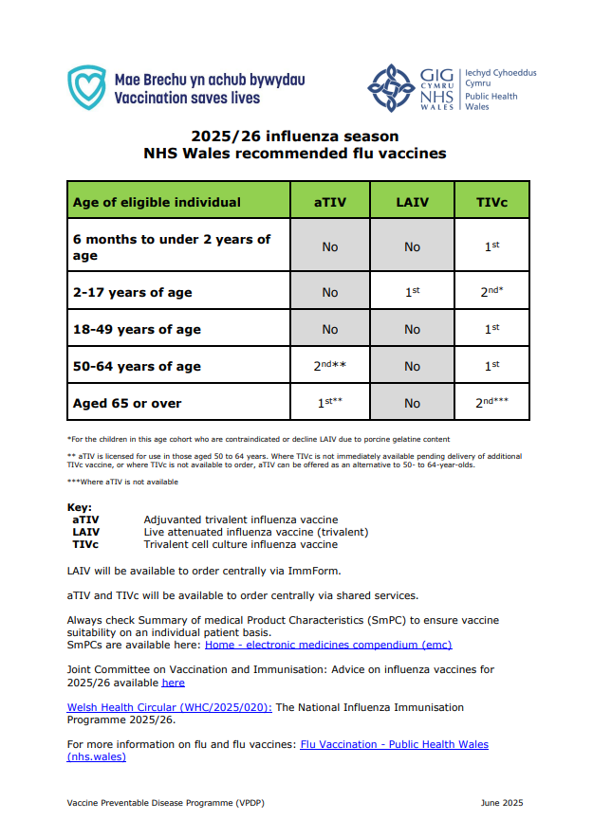
2025/26 influenza season NHS Wales recommended flu vaccines
This resource is also available here: Resources for health and social care professionals - Public Health Wales (nhs.wales) under ‘ Recommended Vaccines ’

Slide 41
Adjuvanted trivalent influenza vaccine (aTIV)
aTIV is the preferred vaccine in Wales for all those aged 65 years and over
aTIV is licenced for use in those aged 50 - 64 years, where TIVc is not immediately available, pending delivery of additional TIVc vaccine, or where TIVc is not available to order, aTIV can be offered as an alternative vaccine to 50 - 64 year olds
aTIV contains 2 subtypes of Influenza A (H3N2 and H1N1pdm09) and one B virus lineage
Adjuvanted vaccines have higher immunogenicity and effectiveness than non-adjuvanted, standard dose vaccines in older people
The adjuvant known as MF59 has been added to the vaccine to enhance the immune response to counter the effect of immunosenescence (age related reduction in immune response)
MF59 adjuvant is an oil-in-water emulsion of squalene oil which is a naturally occurring substance found in humans, animals and plants. In humans, it is made in the liver and circulates in the bloodstream
aTIV is made using an egg-based manufacturing process
Adjuvanted Trivalent Influenza Vaccine (Surface Antigen, Inactivated) Seqirus suspension for injection in pre-filled syringe - Summary of Product Characteristics (SmPC) - (emc) | 10444

Slide 42
Trivalent influenza cell culture vaccine (TIVc)
TIVc is a trivalent vaccine containing 2 subtypes of Influenza A (H3N2 and H1N1pdm00) and one B virus lineage
TIVc has a similar safety profile to other flu vaccines (similar rate and type of adverse reactions reported). Hundreds of millions of doses of cell-based vaccine have been administered worldwide with no serious safety concerns
The cell-based vaccine manufacturing process uses an animal cell line (Madin-Darby Canine Kidney, or MDCK) to grow the influenza virus rather than the traditional egg-based manufacturing methods
This manufacturing process eliminates the risk of egg-adaptation and may result in the vaccine containing virus that is a closer match to wild-type circulating flu viruses
Licenced from 6 months of age
Cell-based Trivalent Influenza Vaccine (Surface Antigen, Inactivated) Seqirus suspension for injection in pre-filled syringe - Summary of Product Characteristics (SmPC) - (emc) | 15818

Slide 43
Live attenuated influenza vaccine (LAIV)
A live attenuated (weakened) influenza vaccine (LAIV) given intranasally is the recommended vaccine for the childhood flu programme
The effectiveness of LAIV has been proven over many years, offering direct protection to children against flu A and flu B, and contributing to indirect protection in older adults.
JCVI highlighted that LAIV provides significant protection to children, including against hospitalisations from flu
Since this vaccine is comprised of weakened whole live virus, it replicates natural infection which induces better immune memory. In addition to being attenuated, the live viruses in LAIV have been adapted to cold so that they cannot replicate efficiently at body temperature
LAIV has a good safety profile in children aged 2 years and older
Advice from JCVI remains clear that LAIV is an effective vaccine and should be prioritised for children aged 2 to 17years, unless it is medically contraindicated or unsuitable on other grounds.
Fluenz Trivalent nasal spray suspension Influenza vaccine (live attenuated, nasal) –
Summary of Product Characteristics (SmPC) - (emc) (medicines.org.uk)
Notes:
JCVI June 2025 meeting minutes: https://app.box.com/s/iddfb4ppwkmtjusir2tc/file/1926550619649

Slide 44
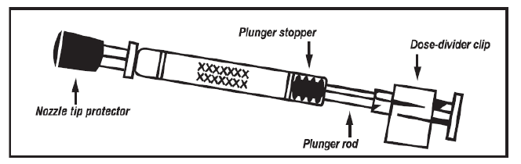
The LAIV used in the UK is Fluenz
  Licensed from 24 months to less than 18 years of age
  Nasal spray (suspension) in a prefilled nasal applicator
  The suspension is colourless to pale yellow, clear to opalescent. Small white particles may be present
  Supplied in a pack containing 10 doses (single use prefilled nasal applicators)
  Ready to use (no reconstitution or dilution required)
  Each applicator contains 0.2ml (administered as 0.1ml per nostril)

Slide 45
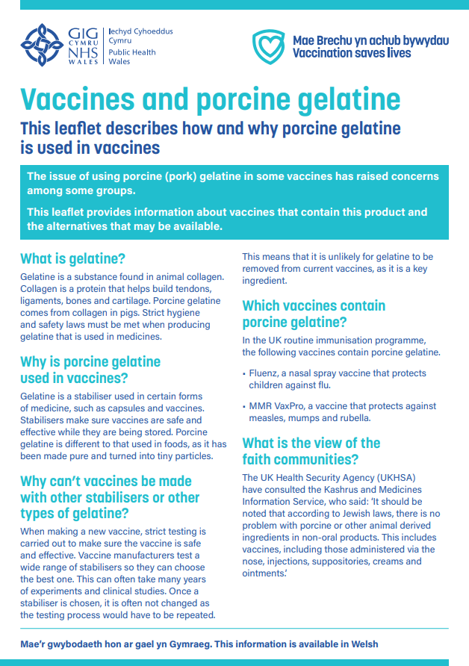
Porcine gelatine
The LAIV contains a highly purified form of gelatine derived from pigs
Gelatine is used in LAIV as a stabiliser - it protects the live viruses from the effects of temperature
Gelatine is commonly used in a range of pharmaceutical products, including many capsules and some vaccines
There is no other live attenuated flu vaccine available that does not contain porcine gelatine. The manufacturer of LAIV tested 40 potential stabilisers – gelatine was chosen because without it, stability was significantly reduced
LAIV is the recommended vaccine for use in all eligible children aged 2-17 years of age unless contraindicated or declined due to gelatine content. LAIV is supplied centrally. Where an injectable vaccine is offered as an alternative to LAIV in the circumstances described above, it will be eligible for reimbursement.(WHC/2025/020)
Leaflets and accessible vaccination information - Public Health Wales (nhs.wales)

Slide 46
Number of doses
Children aged 6 months to less than 9 years who are in clinical risk groups or who are a household contact of an immunosuppressed individual who have not received flu vaccine previously should be offered a second dose of LAIV (if no contraindications – otherwise offer inactivated vaccine). These doses should be given at least 4 weeks apart
JCVI has advised that children aged 2 years to under 9 years of age who are not in a clinical risk group, only require a single dose of LAIV irrespective of whether they have received influenza vaccine previously as only modest additional protection is provided by a second dose of LAIV This advice differs from that in the SmPC for LAIV
Also, children under 9 years who are not in a clinical risk group whose parents request they receive injectable influenza vaccine instead of LAIV should be offered a single dose, even if they have not previously received influenza vaccine. The same applies to children not in a clinical risk group who cannot receive LAIV due to contraindications

Slide 47
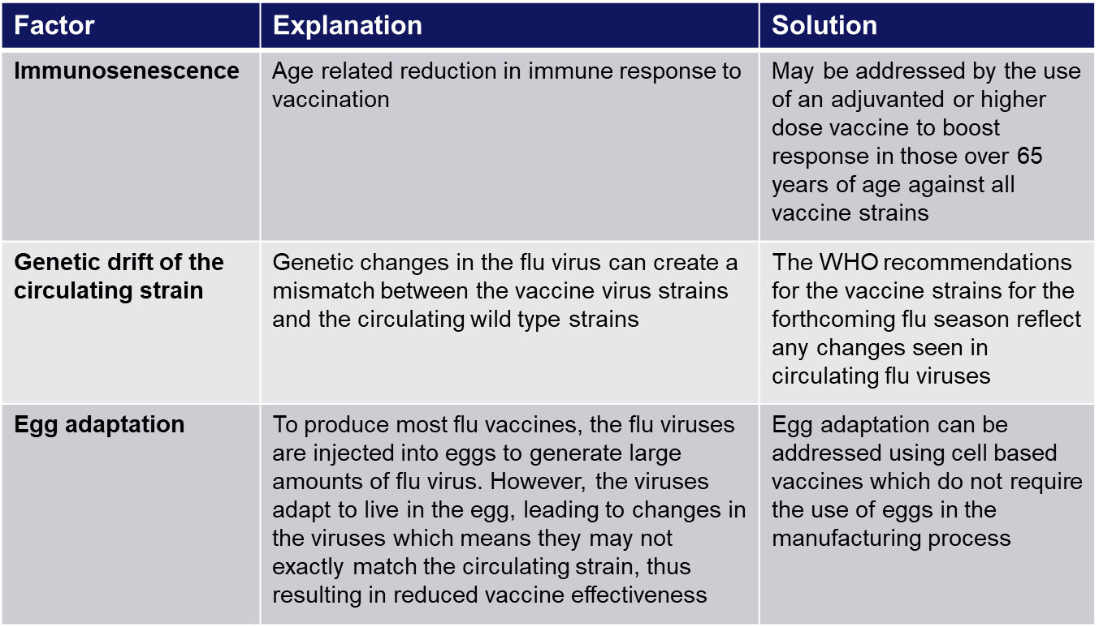
Improving vaccine effectiveness
There are a number of potential factors leading to reduced vaccine effectiveness

Slide 48
Influenza vaccine effectiveness
The effectiveness and cost-effectiveness of influenza vaccine depends upon the
composition of the vaccine, the circulating strains, the type of vaccine and the age of the
individual being vaccinated
There is lower effectiveness in older people although immunisation can provide important protection against flu GP consultation and severe disease/flu confirmed hospital admission
In the last decade, there has generally been a good match between the strains of flu in the vaccine and those circulating but there has often been poorer effectiveness against influenza A (H3N2), particularly in the elderly, where burden of infection from that strain is highest
Potential explanations for the low effectiveness against influenza A(H3N2) include
        Immunosenescence (age related reduction in immune response)
        Genetic drift of the circulating viral strain (compared to the vaccine strain, as happened in 2014 to 2015 flu season)
        Egg adaptation - in recent seasons, changes to the virus during the manufacturing process have arisen with A(H3N2) strain when flu vaccine strains are propagated in eggs which means that the vaccines do not work as well against confirmed disease

Slide 49
Contraindications to flu vaccination
There are very few individuals who cannot receive any flu vaccine
Where there is doubt, expert advice should be sought promptly so that the period the individual is left unvaccinated is minimised
Contraindications for all flu vaccines:
Confirmed anaphylactic reaction to a previous dose of flu vaccine
Confirmed anaphylactic reaction to a component of flu vaccine (for example to gelatine in LAIV) or residue from the manufacturing process (gentamicin), except egg proteins (see slide on egg allergy)
Notes:
Confirmed anaphylaxis is rare. Other allergic conditions such as rashes may occur more commonly and are not contraindications to further immunisation. A careful history of the event will often distinguish between true anaphylaxis and other events that are either not due to the vaccine or are not life threatening. In the latter circumstance, it may be possible to continue the immunisation course. Specialist advice must be sought on the vaccines and the circumstances in which they could be given. The risk to the individual of not being immunised must be taken into account.
The SmPCs for individual products should always be referred to when deciding which vaccine to give. Electronic Medicines Compendium.There are very few individuals who cannot receive any flu vaccine. When there is doubt, appropriate advice should be sought promptly from an appropriate healthcare practitioner so that the period the individual is left unvaccinated is minimised.

Slide 50
Contraindications to LAIV flu vaccination
Where LAIV cannot be given to a child, it is likely that inactivated vaccine could be given instead
Specific contraindications for LAIV :
        Clinically severely immunocompromised due to a condition or immunosuppressive therapy such as:
        Acute and chronic leukaemias
        Lymphoma
        HIV infection not suppressed by highly active antiretroviral therapy (HAART)
        Cellular immune deficiencies
        High dose corticosteroids
        Receiving salicylate therapy e.g. aspirin
        Known to be pregnant
Also contraindications for children with acute and severe asthma - see specific slide
This list is not exhaustive please refer to https://www.gov.uk/government/publications/influenza-the-green-book-chapter-19
Notes:
The live attenuated influenza vaccine (LAIV) should not be given to children or adolescents who are clinically severely immunodeficient due to conditions or immunosuppressive therapy such as: acute and chronic leukaemias; lymphoma; HIV infection not suppressed by antiretroviral therapy (HAART); cellular immune deficiencies; and high dose corticosteroids. It is not contraindicated for use in children or adolescents living with HIV infection who are receiving antiretroviral therapy and attaining viral suppression; or who are receiving topical/inhaled corticosteroids or low-dose systemic corticosteroids or those receiving corticosteroids as replacement therapy, e.g. for adrenal insufficiency.
Chapter 6 of the Green Book on contraindications and special precautions: Contraindications and special considerations: the green book, chapter 6 - GOV.UK gives further advice on the use of live vaccines in individuals who are severely immunosuppressed. It states that the definition of “systemic high doses steroids” (and until at least 3 months after treatment has stopped) would include children who receive prednisolone, orally or rectally, at a daily dose (or its equivalent) of 2mg/ kg/day for at least one week, or 1mg/kg/day for one month. Occasionally, individuals on lower doses of steroids may be immunosuppressed and at increased risk from infections. In those cases, live vaccines should be considered with caution, in discussion with a relevant specialist physician”.

Slide 51
Salicylate therapy and LAIV
Children and adolescents who are receiving salicylate therapy (e.g. aspirin) (other than for topical treatment of localised conditions such as in skin creams for verrucae) should not be given LAIV
This is because of the association of Reye’s syndrome with salicylates and wild-type influenza infection
Reye's syndrome has been reported following the use of salicylates during wild-type influenza infection
Because of the theoretical risk of Reye’s syndrome following administration of the LAIV to children on aspirin therapy or other salicylate-containing medicine, they should not be given LAIV and should instead be offered an inactivated flu vaccine
Reye's syndrome is a very rare disorder that can cause serious liver and brain damage. If not treated promptly, it may lead to permanent brain injury or death
Notes:
Reye’s syndrome
The live attenuated vaccine is contraindicated in children and adolescents receiving salicylate therapy (other than for topical treatment of localised conditions) because of the association of Reye's syndrome with salicylates and wild-type flu infection as described in the SPC for Fluenz. Reye's syndrome has been reported following the use of salicylates during wild-type influenza infection.
Because of the theoretical risk of Reye’s syndrome following administration of the LAIV to children on aspirin therapy or other salicylate-containing medicine, they should not be given LAIV and should instead be offered an inactivated flu vaccine.

Slide 52
Pregnancy and breast feeding
In young people under 18 years of age who present for a flu vaccination, the first vaccine of choice is LAIV. There is limited data on the use of live attenuated flu vaccine in pregnancy. However, in a study of inadvertent LAIV administration to pregnant women, there was no evidence of significant maternal adverse outcomes (read the article here).
The live viruses in LAIV have been attenuated (weakened) and adapted to cold so that they can only replicate at the lower temperatures found in the nasal passage.
These live viruses cannot replicate efficiently elsewhere in the body and therefore there is no theoretical basis for concern about infection of the unborn foetus or the mother’s lungs. Inactivated influenza vaccines are, however, preferred for those who are pregnant. There is no need to specifically ask about or test for pregnancy or ask about breastfeeding when offering LAIV to eligible girls or to advise avoidance of pregnancy or breastfeeding in those who have been recently vaccinated.
Notes:
Safety data for the live attenuated flu vaccine when given in pregnancy is limited. Whilst there is no evidence of risk with live attenuated flu vaccine, inactivated flu vaccines are preferred for those who are pregnant. There is no need, however, to specifically test eligible girls for pregnancy or to advise avoidance of pregnancy in those who have been recently vaccinated.

Slide 53
Precautions to flu vaccination
Acutely unwell/severe febrile illness:
  defer until recovered
Heavy nasal congestion:
  defer LAIV until resolved or, if the child is in a risk group, consider inactivated flu vaccine to provide protection without delay
Use with antiviral agents against flu:
  LAIV should not be administered at the same time or within 48 hours of cessation of treatment with flu antiviral agents
  administration of flu antiviral agents within 2 weeks of administration of LAIV may adversely affect the effectiveness of the vaccine
Notes:
Minor illnesses without fever or systemic upset are not valid reasons to postpone vaccination. If the individual is acutely unwell, immunisation may be postponed until they have recovered. This is to avoid confusing the differential diagnosis of acute illness by wrongly attributing any signs or symptoms to the adverse effects of the vaccine.
There are no data on the effectiveness of LAIV when given to children with heavily blocked or runny nose (rhinitis) attributable to infection or allergy. As heavy nasal congestion might impede delivery of the vaccine to the nasopharyngeal mucosa, deferral of administration until resolution of the nasal congestion should be considered or an appropriate alternative intramuscularly administered influenza vaccine should be considered.
There is a potential for influenza antiviral agents to lower the effectiveness of the live attenuated influenza vaccine. Therefore, influenza antiviral agents and LAIV should not be administered concomitantly. LAIV should be delayed until 48 hours following the cessation of treatment with influenza antiviral agents. Administration of influenza antiviral agents within 2 weeks of administration of LAIV may adversely affect the effectiveness of the vaccine.
Minor illnesses without fever of systemic upset are not valid reasons to postpone vaccination. If the individual is acutely unwell the vaccination may be deferred until they have recovered. This is to avoid confusing the differential diagnosis of any acute illness by wrongly attributing any signs or symptoms to the adverse effects of the vaccine.

Slide 54
Acute and severe asthma
Children with asthma on inhaled corticosteroids may safely be given LAIV irrespective of the dose prescribed, or those who are receiving topical corticosteroids, inhaled corticosteroids or low-dose systemic corticosteroids, or those receiving corticosteroids as replacement therapy, for example for adrenal insufficiency
However, LAIV is not recommended for children and adolescents currently experiencing an acute exacerbation of symptoms including
  - Those who have had increased wheezing and/or
  - Needed additional bronchodilator treatment in the previous 72 hours
Such children should be offered a suitable inactivated influenza vaccine to avoid a delay in protection
Children who require regular oral steroids for maintenance of asthma control, or have previously required admission to intensive care for asthma exacerbation should only be given LAIV on the advice of their specialist
As these children may be at higher risk from influenza infection, those who cannot receive LAIV should receive a suitable inactivated influenza vaccine
Children with significant asthma* and aged under 9 years who have not been previously vaccinated against influenza will require a second dose (of either LAIV or inactivated vaccine as appropriate) at least 4 weeks later.
(*Note: please see the Green Book chapter 19, Table 19.4 for asthma eligibility criteria Influenza: the green book, chapter 19 - GOV.UK (www.gov.uk))
Notes:
In 2019, JCVI advised that, on the basis of recent data, children with asthma on inhaled corticosteroids may safely be given LAIV, irrespective of the dose prescribed. LAIV is not recommended for children and adolescents currently experiencing an acute exacerbation of symptoms including those who have had increased wheezing and/or needed additional bronchodilator treatment in the previous 72 hours. Such children should be offered a suitable inactivated influenza vaccine to avoid a delay in protection.
There are limited safety data in children who require regular oral steroids for maintenance of asthma control, or have previously required intensive care for asthma exacerbation – such children should only be given LAIV on the advice of their specialist. As these children may be at higher risk from influenza infection, those who cannot receive LAIV should receive a suitable inactivated influenza vaccine. Children with significant asthma and aged under 9 years who have not been previously vaccinated against influenza will require a second dose (of either LAIV or inactivated vaccine as appropriate).

Slide 55
Patients taking anticoagulants or with a bleeding disorder
Individuals on stable anticoagulation therapy (including individuals on warfarin who are up-to-date with their scheduled INR testing and whose latest INR was below the upper threshold of their therapeutic range) can receive intramuscular vaccination
If in any doubt, consult with the clinician responsible for prescribing or monitoring the individual’s anticoagulant therapy
Individuals with bleeding disorders may be vaccinated intramuscularly if, in the opinion of a doctor familiar with the individual's bleeding risk, vaccines or similar small volume intramuscular injections can be administered with reasonable safety by this route
If the individual receives medication/treatment to reduce bleeding, for example treatment for haemophilia, intramuscular vaccination can be scheduled shortly after such medication/treatment is administered
A fine needle (equal to 23 gauge or finer calibre) should be used for the vaccination, followed by firm pressure applied to the site (without rubbing) for at least 2 minutes
Influenza vaccines licensed for intramuscular or subcutaneous administration may alternatively be administered by the subcutaneous route
TIVc and aTIV are not licenced for *subcutaneous administration so should only be administered intramuscularly
Notes:
* Subcutaneous administration would be 'off license' so would need to be administered via a Patient Specific Direction (PSD)

Slide 56
Egg allergy
For many years, flu vaccines have been prepared from flu viruses grown in embryonated hens’ eggs and the final vaccine product contains varying amounts of egg protein as ovalbumin
The ovalbumin content for the 2025 to 2026 flu vaccines is available here: www.gov.uk/government/publications/influenza-vaccines-marketed-in-the-uk
In line with the JCVI recommendations, individuals with egg allergy (including those with anaphylaxis to egg, unless they have required admission to intensive care) can be immunised in any setting using a vaccine with an ovalbumin content less than 0.12 micrograms/mL (equivalent to 0.06 micrograms for 0.5 mL dose):
  Children who have required admission to intensive care for a previous severe anaphylaxis to egg should only be given LAIV on advice from their specialist. These children are best given LAIV, if appropriate, in a hospital setting. In children in this group aged 2 years and over, LAIV remains the preferred vaccine as the intranasal route is less likely to cause systemic reactions
  Alternatively, to avoid delay in protection, egg-allergic individuals can be given the egg-free trivalent cell-based inactivated vaccine (TIVc), in any setting, in line with *JCVI recommendations and the **PHW management chart for influenza (flu) vaccination in egg allergic individuals. The cell-based trivalent inactivated vaccine TIVc is egg free. Adults with a severe anaphylaxis to egg which has previously required intensive care can be immunised in any setting using TIVc, as this is an egg free vaccine
If an egg free vaccine is not available individuals with severe anaphylaxis to egg which has previously required admission to intensive care, should be referred to a specialist for assessment with regard to receiving immunisation in hospital
Notes:
*JCVI statement on influenza vaccines for 2025 to 2026 - GOV.UK
** PHW management chart for influenza (flu) vaccination in egg allergic individuals can be viewed here: Resources for health and social care professionals - Public Health Wales (nhs.wales) under
further clinical resources and information

Slide 57
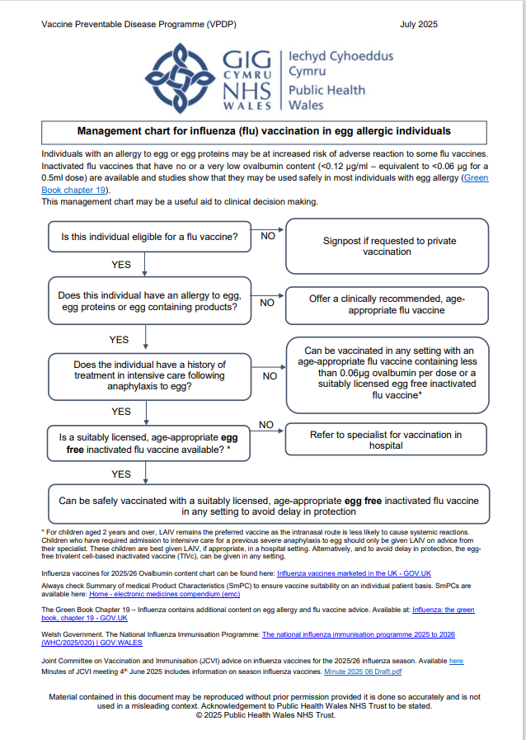
Management chart for influenza (flu) vaccination in egg allergic individuals for 2024/25
This resource is available to view here: Resources for health and social care professionals - Public Health Wales (nhs.wales) under further clinical resources and information
Notes:
Update once available

Slide 58
Children with cochlear implants
Children with cochlear implants can be given LAIV safely although ideally it should not be given:
  In the week prior to implant surgery, or
  for 2 weeks afterwards, or
  if there is evidence of on-going cerebrospinal fluid leak.
  Influenza: the green book, chapter 19 - GOV.UK (www.gov.uk)

Slide 59
Unrepaired craniofacial malformations
Unrepaired craniofacial malformations including cleft palate may occasionally be encountered by vaccinators immunising children of an age eligible for LAIV
Where there may be a potential portal of entry to the brain/central nervous system, or where there are particular concerns around absorption, these children are excluded under the PGD and may require TIVc injection instead
The child’s specialist team should be consulted if advice is required regarding the malformation and its potential impact on the suitability of LAIV

Slide 60
Inadvertent administration of LAIV
If an immunocompromised individual receives LAIV, the degree of immunosuppression should be assessed
If the individual is severely immunocompromised, antiviral prophylaxis should be considered
Otherwise, they should be advised to seek medical advice if they develop flu-like symptoms in the 4 days following administration of the vaccine
If antivirals are used for prophylaxis or treatment, the individual should also be offered inactivated flu vaccine in order to maximise their protection (this can be given straight away)
There is limited data on the use of live attenuated flu vaccine in pregnancy. However, in a study
of inadvertent LAIV administration to pregnant women, there was no evidence of significant
maternal adverse outcomes. The live viruses in LAIV have been attenuated (weakened)
and adapted to cold so that they can only replicate at the lower temperatures found in the nasal
passage. These live viruses cannot replicate efficiently elsewhere in the body and therefore
there is no theoretical basis for concern about infection of the unborn foetus or the mother’s
lungs. Inactivated influenza vaccines are, however, preferred for those who are pregnant
Flu Vaccination programme 2025/26:Information for healthcare practitioners. Will be available to view here: Annual flu programme - GOV.UK

Slide 61
LAIV and ‘viral shedding’
    LAIV does not create an external mist of vaccine virus in the air when children are being vaccinated and others in the room should not be at risk of ‘catching’ the vaccine virus
    Administration of the intranasal vaccine delivers just 0.1ml of fluid straight into each nostril and almost all the fluid is immediately absorbed into the child’s nose
    Although vaccinated children are known to shed virus a few days after vaccination, the vaccine virus that is shed is less able to spread from person to person than natural flu infection
    The amount of virus shed is normally below the levels needed to pass on infection to others and the virus does not survive for long outside of the body. This is in contrast to natural flu infection, which spreads easily during the flu season
Notes:
Based on information from: Flu vaccination programme 2024 to 2025: information for healthcare practitioners - GOV.UK

Slide 62
Risk of transmission of live vaccine virus
There is a theoretical potential for transmission of live attenuated flu virus to very severely immunocompromised contacts for 1 to 2 weeks following vaccination
Following extensive use of LAIV in the US, there have been no reported instances of illness or infections from the vaccine virus among immunocompromised patients inadvertently exposed to vaccinated children
However, if close contact with very severely immunocompromised patients (such as bone marrow transplant patients requiring isolation) is likely or unavoidable (for example other household members) consider an appropriate inactivated flu vaccine instead

Slide 63
Exposure of healthcare professionals to live attenuated influenza vaccine viruses
Theoretically there may be some low-level exposure to the vaccine viruses for those administering LAIV and/or from recently vaccinated patients
In the US, where there has been extensive use of LAIV, there have not been any reported instances of illness or infections from the vaccine virus among healthcare professionals inadvertently exposed
Risk of acquiring vaccine viruses from the environment is unknown but probably low
The vaccine viruses are cold-adapted and attenuated and therefore unlikely to cause symptomatic flu
As a precaution, very severely immunosuppressed individuals should not administer LAIV
Other healthcare workers who have less severe immunosuppression or are pregnant, should follow normal clinical practice to enable them to safely administer the vaccine

Slide 64
Storage of flu vaccine
  Efficacy, safety and quality may be adversely affected if vaccines are not stored at the temperatures specified in the licence
All flu vaccines, inactivated and LAIV, must be stored in accordance with manufacturer’s instructions:
  Store between +2⁰C and +8⁰C
  Do not freeze
  Store in original packaging
  Protect from light
Check expiry dates regularly:
  The LAIV has an expiry date 18 weeks after manufacture – this is much shorter than inactivated flu vaccines
  It is important that the expiry date on the nasal spray applicator is checked before use
  The advisory document for the ordering, storage and handling of vaccines is currently being updated.
  The updated edition will be available to view here: https://www.wmic.wales.nhs.uk/vaccine-ordering-storing-handling
Notes:
Vaccines should be stored in the original packaging at +2°C to +8°C and protected from light. All vaccines are sensitive to some extent to heat and cold. Heat speeds up the decline in potency of most vaccines, thus reducing their shelf life. Efficacy, safety and quality may be adversely affected if vaccines are not stored at the temperatures specified in the licence. Freezing may cause increased reactogenicity and loss of potency for some vaccines and can also cause hairline cracks in the container, leading to contamination of the contents.
LAIV has a shelf life of 18 weeks that starts at the point of release from the manufacturer. This is a shorter shelf life than other influenza vaccines and some of this time will have passed when the vaccine reaches the place where it is to be administered. It is important that the expiry date on the nasal spray applicator is checked before use. If the expiry date has passed, arrangements should be made to have the vaccine disposed safely.
The vaccine should be stored in the original packaging. This makes it easy to identify in the vaccine fridge and to check batch numbers and expiry dates. The original packaging also provides some protection against fluctuation of temperature and protection from light.
Vaccines are expensive and it is important to minimise wastage through inappropriate storage.

Slide 65
Vaccine administration – including assessment and consent

Slide 66
Prescription only medication (POM)
The Influenza vaccine should only be administered using a:
Prescription written manually or electronically by a registered medical practitioner or other authorised prescriber, Patient specific direction (PSD), Patient group direction (PGD) or National Protocol.
UK Health Security Agency (UKHSA) provide updated PGD templates (Patient Group Directions) which are available here: Welsh Medicines Advice Service (WMAS). These are template PGD’s that can be amended locally by health boards
In Wales an Advisory Document to supplement the UKHSA Influenza PGD templates is available here: Patient Group Directions (PGD) - Welsh Medicines Advice Service (wales.nhs.uk)
NB: Local authorisation is required before PGD templates can be used.
The NHS Wales PGD’s for injectable influenza vaccines and LAIV are available on Welsh Medicines Advice Service .
National Protocols will once again be available for the 2025/26 flu season and will be available to view on the Welsh Medicines Advice Service web-page

Slide 67
Vaccine administration (inactivated vaccines)
Inactivated flu vaccines should be given intramuscularly into the upper arm (deltoid muscle) of those aged 12 months or older and into the anterolateral aspect of the thigh in infants aged 6 months to one year of age
Due to the presence of adjuvant and therefore increased potential for more local reactions if administered by subcutaneous injection, aTIV should only be administered intramuscularly using a 25mm length needle
The cell-based quadrivalent vaccines TIVc is also not licensed for subcutaneous administration so should only be administered intramuscularly
Inactivated and live flu vaccines can currently be given at the same time as, or at any interval before or after, other currently used live and inactivated vaccines If any new vaccines are introduced during the flu vaccination season, please ensure any specific guidance given about concomitant administration for these is followed.
For advice on co-administration of vaccines refer to appropriate chapters in the green book (see next slide for further information on co-administration of flu vaccine with RSV vaccine)
If given at the same time, different vaccines should be given at separate sites, preferably in a different limb. If given in the same limb, they should be given at least 2.5cm apart
Notes:
Adjuvanted Trivalent Influenza Vaccine (Surface Antigen, Inactivated) Seqirus suspension for injection in pre-filled syringe - Summary of Product Characteristics (SmPC) - (emc) | 10444
Cell-based Trivalent Influenza Vaccine (Surface Antigen, Inactivated) Seqirus suspension for injection in pre-filled syringe - Summary of Product Characteristics (SmPC) - (emc) | 15818

Slide 68
Co-administration of influenza vaccine with Abrysvo® RSV vaccine
There is some data which shows that in older adults administering Abrysvo® at the same time as seasonal influenza vaccine may reduce the immune response to the RSV vaccine
There is also data that suggests that the response to the influenza A(H3N2) component of seasonal influenza vaccine (the influenza subtype which most severely affects older adults) may be diminished when RSV and seasonal influenza vaccine are co-administered to older adults
The clinical significance of any reduced response is unknown, but influenza immune response is known to correlate with protection against infection, and there is emerging data that RSV immune response also correlates with clinical protection
It is therefore recommended that these vaccines are not routinely scheduled to be given at the same appointment or on the same day for older adults.
No specific interval is required between administering the vaccines
However, if it is thought that the individual is unlikely to return for a second appointment or immediate protection is necessary, Abrysvo® can be administered at the same time as the influenza vaccine
**Note: this information does not apply to pregnant women, where Abrysvo RSV vaccine can be administered at the same time as seasonal influenza vaccine**
Further information is available here: Respiratory syncytial virus: the green book, chapter 27a - GOV.UK (www.gov.uk)

Slide 69
Before administering a vaccine
Before administering a vaccine, the individual should be assessed to ensure that:
there are no contraindications to the vaccine being given
they have not experienced any serious reactions to a previous dose or component of the vaccine
they or their carer is fully informed about the vaccine to be given and understand the vaccination procedure
they or their carer are aware of possible adverse reactions to the vaccine and how to treat them
Appropriate consent is obtained
Immunisers should ensure that:
they have the appropriate knowledge and legal authority to administer the vaccine
the vaccine has been properly stored and prepared for use and that they know where and how to administer it

Slide 70
Consent
Before vaccinating, ‘informed’ consent must be obtained
Informed consent is a legal requirement, and the individual’s views must be respected
Sufficient evidence-based information must be provided to enable the person to make a balanced and informed decision about their care and treatment
As well as a general explanation of the procedure, there is also a duty to explain the risks inherent in the procedure and the risks inherent in refusing the procedure
Consent can be given verbally, in writing or it can be implied, but however it is given, the person must understand what they are consenting to
If there are any issues or uncertainties with seeking or gaining consent, ask for advice from an experienced colleague rather than abandon the offer of immunisation
Consent is a process and can be withdrawn
Notes:
Before giving flu vaccine , immunisers must ensure that they have obtained informed consent from the individual or that a best interest decision has been made if the individual does not have mental capacity at the time of vaccination.
In order to be able to consent to vaccination, the vaccinee should receive an explanation of the treatment and its benefits and risks, either verbally from a clinician, or in the form of a leaflet and letter.
When assessing capacity to consent, the immuniser should be guided by the principles of the Mental Capacity Act (2005). This Act applies to those aged 16 years and over and is designed to protect and empower people who may lack the mental capacity to make their own decisions about their care and treatment.
Consent is a process, not a one-off discussion and must consider 3 factors:
the person giving consent must be appropriately informed: they must have the necessary information in order to make the decision
consent must be voluntary by the individual without undue pressure or coercion
the person consenting must have the capacity to make the decision

Slide 71
Informed consent
How much information should you give?
this will be personal to the individual at the time and will depend on their previous knowledge and discussions with others
give people as much information as they need and/or want to make an informed decision
some people will just ‘trust’ what you say while others want lots of information; either is fine
how much each individual needs is up to them, no one is obliged to seek full information
Information to be given includes:
which vaccine is being offered and the disease against which it protects
benefits/risks of immunisation versus risks of the disease​
any possible vaccine reactions and what to do if these occur
Consent is a process, not a one-off discussion and must consider 3 factors:
the person giving consent must be appropriately informed: they must have the necessary information in order to make the decision
consent must be voluntary by the individual without undue pressure or coercion
the person consenting must have the capacity to make the decision
Consent: the green book, chapter 2 - GOV.UK (www.gov.uk)
Mental capacity Act 2005: https://www.legislation.gov.uk/ukpga/2005/9/contents

Slide 72
Gaining consent for those under 16 years
In the routine school based flu vaccination programme in Wales, both paper and electronic consent forms are in use, with “parental” consent the most common method for obtaining consent. This involves parent/guardian providing their consent for the child or young person to receive the flu vaccine.
Young people aged 16 and over can consent for themselves, a parent/guardian cannot override that consent.
In some cases, young people under the age of 16 may be able to give consent themselves. This can happen if they are assessed as having sufficient maturity and mental capacity to understand fully what is involved in the proposed procedure, these young people are described as “Gillick competent”. It is still preferred that parents/guardians are involved in the consent process.
If a Gillick-competent young person consents to vaccination, a parent/guardian cannot override that consent. Where a Gillick competent young person has provided consent, vaccination can proceed despite the disagreement of one or both parents.
A young person may be considered Gillick competent to make one decision but not another, depending on how complex each decision is. If the health professional giving the immunisation felt the young person was not Gillick competent to consent to flu vaccination then the consent of someone with parental responsibility is required.
Further information on self consent and Gillick competence in children and young people is available from Consent: the green book, chapter 2 - GOV.UK

Slide 73
Vaccination intramuscular administration
Giving vaccine into the muscle:
leads to a better immune response to the vaccine (as the muscle contains the appropriate cells necessary to initiate the immune response)
is less likely to cause local reactions than if the vaccine is given under the skin (subcutaneously)
The needle needs to be long enough to ensure vaccine is injected into the muscle. For this reason, a 25mm needle is recommended.

Slide 74
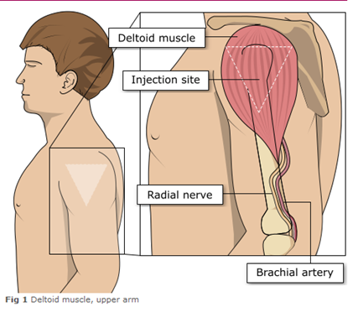
Administering vaccine into the deltoid muscle
Flu vaccine in adults should be injected into the deltoid muscle in the upper arm
It is essential that the correct site and injection technique is used to administer vaccines
Injecting too high into the upper arm might result in a shoulder injury or a frozen shoulder. This leads to pain, weakness and a limited range of motion that can last for months
Injecting too low or too far to the side of the arm risks injecting into the axillary nerve or the radial nerve
To avoid shoulder injury, always assess the limb before administering the vaccine to identify the correct site for injection
Image adapted from the Australian Immunisation Handbook

Slide 75
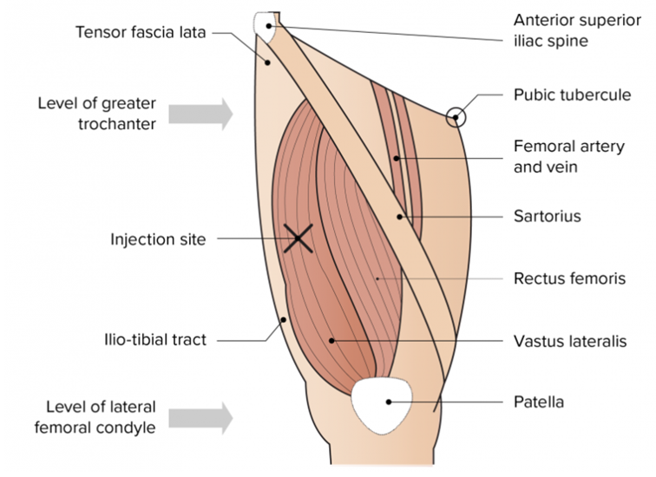
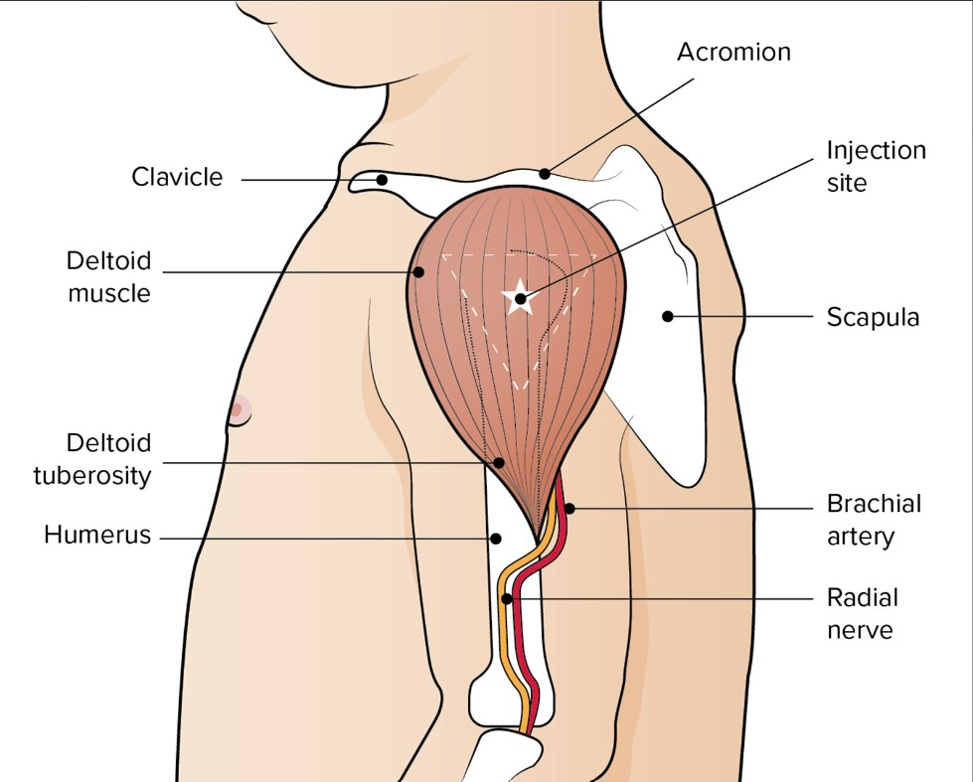
The vastus lateralis muscle
(anterolateral aspect of the thigh)
The preferred site for intramuscular vaccine administration in individuals aged 1 year and over is generally the deltoid area of the upper arm.
The preferred site for intramuscular vaccine administration in infants under 1 year is generally the anterolateral aspect of the thigh​
Image from the Australian Immunisation Handbook

Slide 76
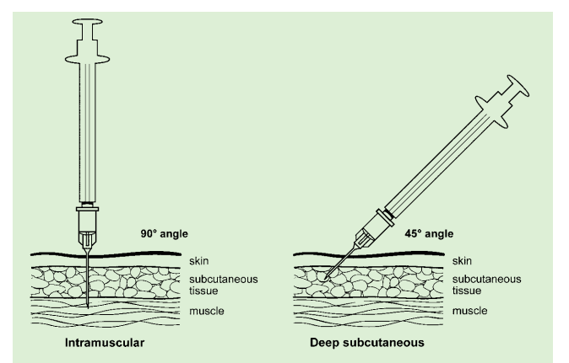
Vaccine administration
Skin does not need to be specially cleaned prior to vaccination. If it is visibly dirty, then water is sufficient to clean it.
Intramuscular process:
identify the correct site for IM injection
stretch the skin at the site
insert the needle at a 90 degrees angle far enough to ensure vaccine is delivered into muscle
depress the plunger
gently remove the needle
apply light pressure using gauze or cotton wool if bleeding occurs
Green-Book-Chapter-4.pdf (publishing.service.gov.uk)
Deep subcutaneous process:
Deep SC injections should be given with the needle at a 45º angle to the skin and the skin should be bunched, not stretched - TIVc and aTIV are not licenced for *subcutaneous administration so should only be administered intramuscularly
Notes:
https://assets.publishing.service.gov.uk/government/uploads/system/uploads/attachment_data/file/147915/Green-Book-Chapter-4.pdf
* Subcutaneous administration would be 'off licence' so would need to be administered via a patient Specific Direction (PSD)

Slide 77
Consequences of incorrect injection technique
It is essential that the correct site and injection technique are used to administer vaccines
Injecting too high into the upper arm might result in the vaccine being deposited in the shoulder capsule rather than the deltoid muscle
If this happens, inflammation can occur, leading to a shoulder injury or a frozen shoulder
  This leads to pain, weakness and a limited range of motion that can last for months
Injecting too far to the side of the arm or too low on the arm risks injecting into the axillary nerve or the radial nerve
  This can cause a burning or shooting pain during the procedure and can lead to nerve damage (neuropathy/paralysis)
To avoid vaccination related injury, always assess the limb before administering the vaccine to identify the correct site for injection

Slide 78
Administration of Live Attenuated Influenza vaccine (LAIV)
  LAIV is different from other flu vaccines – it is a live attenuated nasal vaccine and must not be injected
  Do not attempt to attach a needle
  LAIV can be administered at the same time as, or at any interval from other currently used vaccines including live vaccines
  The applicator has a divider clip to enable one application in each nostril
  The vaccinee should breathe normally - they do not need to actively inhale or sniff
  The vaccine is rapidly absorbed so there is no need to repeat either half of dose if patient sneezes, blows their nose or their nose drips following administration
Notes:
An incomplete dose of LAIV does not need to be repeated as long as at least 0.1ml of the vaccine has been given intranasally as each half dose (0.1ml) contains enough viral particles to
induce an immune response.
If the vaccine is accidentally squirted into the child’s eye, it may cause some slight irritation to the eye and eyewash or normal saline should be used to wash out the eye. The child or
parent/carer should be advised to seek medical advice if any irritation occurs and persists beyond what might reasonably be expected.

Slide 79
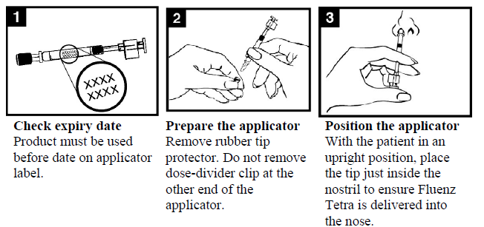
Administration of LAIV (1)

Slide 80
Administration of LAIV (2)

Slide 81
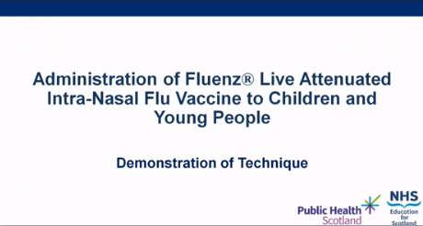
LAIV administration video
A video for healthcare practitioners on how to administer LAIV has been produced by NHS Education for Scotland (NES) and Public Health Scotland
It is available to view on the NES website here: (recommended watching from 2 minutes to 4m 30s for vaccinators in Wales)
This video was updated by Public Health Scotland and NHS Education for Scotland for 2021/22 flu season, the PPE advice is now out of date. See here for up to date NHS Wales guidance: Guidance - Public Health Wales (nhs.wales)

Slide 82
Commonly reported adverse reactions
Following inactivated influenza vaccine:
Pain, swelling or redness at the injection site, low grade fever, malaise, shivering, sweating, fatigue, headache, myalgia and arthralgia
A small painless nodule may also form at the injection site
These symptoms usually disappear within 1 to 2 days without treatment
Due to the MF59 adjuvant, a higher incidence of mild post-immunisation reactions has been reported with the adjuvanted vaccine (aTIV), compared to non-adjuvanted influenza vaccines
Following live attenuated influenza vaccine (LAIV):
Nasal congestion/rhinorrhoea, reduced appetite, weakness, fever and headache
Rarely, after live or inactivated vaccine, immediate reactions such as urticaria, angio-oedema, bronchospasm and anaphylaxis can occur

Slide 83

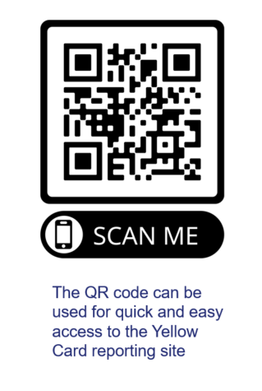
Reporting suspected adverse reactions
Vaccines should be advised that they can report any adverse reactions or suspected side effects to the MHRA through the online yellow card scheme website or the Yellow Card app
Any suspected side effects following vaccine administration should be reported to the MHRA Yellow Card Scheme.
Anyone can report even if uncertain about whether vaccine caused condition:
  www.mhra.gov.uk/yellowcard or call 0800 731 6789 (9am to 5pm Monday to Friday)
  Green Book Chapter 9 for detailed guidance on reporting vaccine reactions
  Suspected adverse events occurring in children or involving products that carry the black triangle symbol (▼) should be reported, even where these are mild or expected.
Notes:
Healthcare professionals and patients are encouraged to report suspected adverse reactions to the Medicines and Healthcare Products Regulatory Agency (MHRA) using the yellow card reporting scheme
Green Book chapter 9: https://www.gov.uk/government/publications/surveillance-and-monitoring-for-vaccine-safety-the-green-book-chapter-9

Slide 84
Improving flu vaccine uptake

Slide 85
Improving vaccine uptake
National Institute of Clinical Excellence (NICE) published guidance in August 2018 they made 7 key recommendations:(opens in a new tab)
Providers of flu vaccination(opens in a new tab) should work together with other agencies to develop programmes to increase vaccination uptake.
Educate health and social care staff, particularly those in contact with eligible groups(opens in a new tab), about flu vaccination.
Use every opportunity throughout the flu vaccination season to identify people in eligible groups(opens in a new tab) and offer them the flu vaccination.
Use strategies to increase uptake among eligible groups in primary and secondary care.
Keep patient records up to date and accurate to help identify people who have not been vaccinated and are eligible for flu vaccination that season.
Offer flu vaccination to carers(opens in a new tab), base decisions to offer vaccination on whether the carer looks after someone whose wellbeing may be at risk if the carer was ill or hospitalised with flu.
Employers of health and social care staff are responsible for providing occupational flu vaccinations.

Slide 86
Optimising Vaccine Uptake: Using motivational interviewing for better conversations
The approach and style of a vaccine conversation can make a real difference in understanding individual hesitancy, addressing barriers, and influencing vaccine uptake. There is an eLearning module available called Optimising Vaccine Uptake: Using motivational interviewing for better conversations which aims to support staff with having positive conversations about immunisations.
The module aims to provide health professionals the skills and knowledge required to implement motivational interviewing techniques when having vaccine-related conversations
Further information about the module and how to access it is available here: Immunisation eLearning - Public Health Wales (nhs.wales)
* This module is currently being updated

Slide 87
Maximising flu vaccine uptake in healthcare and social care staff
If you work on the healthcare staff facing element of the flu programme click here (opens in a new tab) to access a number of resources that may be useful to you, including:
Guidance and policy
Evidence
Links to vaccine uptake
Resources
Links to further information
Resources for peer vaccinators/flu champions
Staff flu campaign: an evaluation and planning toolkit (NHS Wales intranet only) (opens in a new tab)
More information on planning a healthcare staff flu campaign including delivering and evaluation can be found here (opens in a new tab) (NHS Wales intranet only)

Slide 88
Social care staff
If you work on the social care staff facing element of the flu programme, you will find a number of resources that may be useful to you on the flu vaccination, Public Health Wales internet site(opens in a new tab). Information Including:
Guidance
Links to vaccine uptake
Resources
Links to further information

Slide 89
Summary & resources

Slide 90
Key messages to health and social care workers
    Getting vaccinated against flu can help protect you, your patients and family
    Everyone is susceptible to flu, even if you are in good health and eat well
    You can be infected with the virus and have no symptoms but can still pass flu virus to others including patients or residents
    Good infection control measures reduce spread of flu and other acute respiratory infections in healthcare settings but are not sufficient alone to prevent them
    Throughout the last 10 years there has generally been a good to moderate match between the strains of flu virus in the vaccine and those that subsequently circulated
    Impact of flu on frail and vulnerable patients can be fatal and outbreaks can cause severe disruption in communities, care homes and hospitals
    Flu vaccine has a good safety record and will help protect you. It cannot give you flu. Having the vaccination can encourage your colleagues to do likewise
    Staff act as positive role models for those with long-term health conditions and pregnant women to take up the offer too
    Duty of care as professionals to patients or residents to do everything in your power to protect them against infection, including being immunised against flu

Slide 91
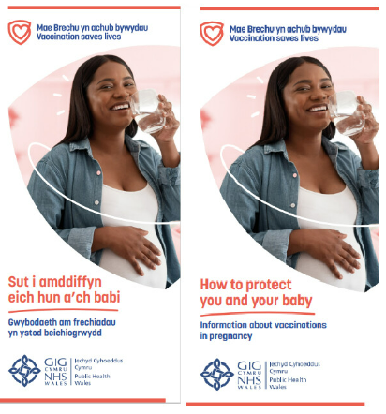


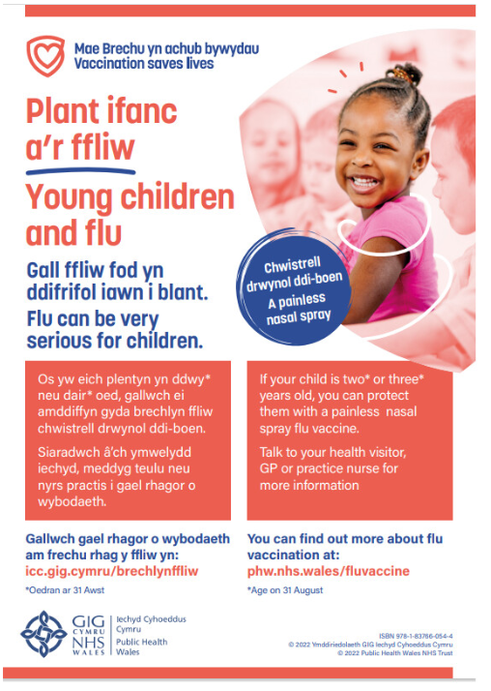


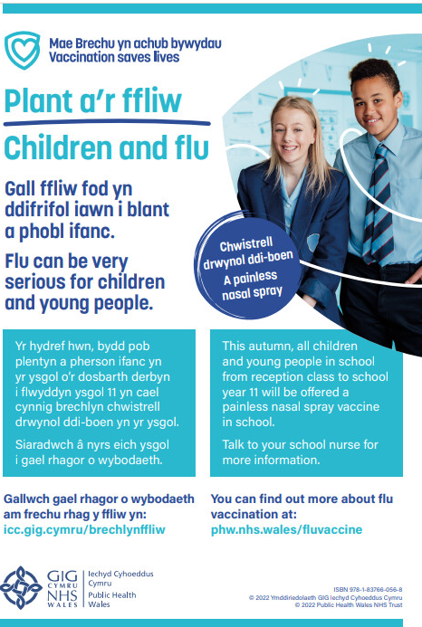
Resources
All immunisation resources can be downloaded and ordered from: Health Information Resources - Public Health Wales (nhs.wales)
Leaflets and other resources in accessible formats can be accessed here: Flu vaccine accessible information - Public Health Wales (nhs.wales)
Resources for health and social care professionals are available here: Resources for health and social care professionals - Public Health Wales (nhs.wales)
Example
Example

Slide 92
Flu eLearning modules
Flu Vaccine information for health and social care staff in Wales 2025-26
The module explains why the annual flu vaccine is so important for all health and social care workers. It gives an overview of flu and its complications. It gives details of who is eligible to receive the vaccine and how to obtain it. It is suitable for all NHS Wales workers, non-NHS health care workers, people who work in care homes, social care and the third/voluntary sector. More information on how to access module is available here: Flu vaccine information for health and social care staff in Wales 2025-26 - Public Health Wales
This module is not a clinical update. The flu clinical update for Wales is currently being update for the 2025-26 season and will be available soon.
Flu Clinical update for Wales 2025-26 – Coming soon
This elearning module is suitable for all healthcare professionals including health care support workers who immunise against flu or provide flu immunisation advice. It is the clinical update for Wales and has been updated for the 2025-26 flu season
For more information about the eLearning and how to access it please visit: Immunisation eLearning - Public Health Wales (nhs.wales)

