Slide 1
The national flu immunisation programme 2023-24
Vaccine Preventable Disease Programme
Public Health Wales
August 2023 version 1
Notes:
Material contained in this document may be reproduced without prior permission provided it is done so accurately and is not used in a misleading context.
Acknowledgement to Public Health Wales NHS Trust to be stated.
© 2023 Public Health Wales NHS Trust.

Slide 2
Acknowledgements
UK Health Security Agency (UKHSA)
Vaccine Preventable Disease programme

Slide 3
Pre-requisites to administering Flu vaccine
Before administering flu vaccine, it is recommended you have:
Undertaken training in the management of anaphylaxis and Basic Life Support as specified by policy for your local area and are familiar with Resuscitation Council UK (RCUK) guidance on Management of Anaphylaxis in the Vaccination Setting
Undertaken any additional statutory and mandatory training as required by your employer
Received flu vaccine training through appropriate training/ or eLearning. If you are a new immuniser a competency assessment is recommended – A flu specific competency assessment tool, is available in the flu training recommendations published by UKHSA, available to view here: Immunisation training resources and events - Public Health Wales (nhs.wales)
An appropriate legal framework to supply and administer flu vaccine in place e.g. patient specific prescription, Patient Specific Direction (PSD), Patient Group Direction (PGD). Further information will be available here: Patient Group Directions (PGD) - Welsh Medicines Advice Service (wales.nhs.uk)
Described the process of consent and how this applies when giving vaccines
Accessed and familiarised yourself with the following key documents: https://www.gov.uk/government/publications/influenza-the-green-book-chapter-19 , the UK Health Security Agency https://www.gov.uk/government/publications/flu-vaccination-programme-information-for-healthcare-practitioners
3
Notes:
Practitioners should always ensure they are accessing the most up to date information and guidance

Slide 4
Key messages
Flu immunisation is one of the most effective interventions we can provide to reduce harm from flu and pressures on health and social care services during the winter
It is important to increase flu vaccine uptake in clinical risk groups because of increased risk of death and serious illness if people in these groups catch flu
Flu during pregnancy may be associated with perinatal mortality, prematurity, smaller neonatal size, lower birth weight and increased risk of complications for mother
Vaccination of health and social care workers protects them and reduces risk of spreading flu to their patients, service users, colleagues and family members
By preventing flu infection through vaccination, secondary bacterial infections such as pneumonia are prevented. This reduces the need for antibiotics and helps prevent antibiotic resistance
For a number of years, only around half of patients aged 6 months to under 65 years in clinical risk groups have been vaccinated
The childhood flu programme should reduce the impact of seasonal flu on children and reduce transmission of flu within the community
By reducing transmission of flu, it should also avert many cases of severe flu and flu-related deaths in older adults and people in clinical risk groups

Slide 5
Aims of resource
The purpose of this training resource is to:
Develop the knowledge base of healthcare practitioners regarding the 2023 to 2024 seasonal flu vaccination programme
Support healthcare practitioners involved in discussing flu vaccination with those eligible by providing evidence based information
Promote high uptake of flu vaccination in all eligible groups by increasing the knowledge of those involved in delivering the vaccination programme
Provide information on the administration of flu vaccines

Slide 6
Learning outcomes
On completion of this resource, healthcare practitioners will be able to:
Describe the cause of flu
Understand how flu is transmitted and the possible effects of flu
Explain which vaccines should be used and the precautions and contraindications to the administration of these
Explain the sequence of steps in flu vaccine administration
Explain the possible side effects from flu vaccines
Understand the importance of their role in promoting and providing evidence based information about flu vaccination to patients
Identify sources of additional information

Slide 7
Influenza overview
Flu is an acute viral infection of the respiratory tract (nose, mouth, throat, bronchial tubes and lungs)
It is a highly infectious illness which spreads rapidly in communities
Even people with mild or no symptoms can infect others
Most cases in the UK occur during an 8 to 10 week period during the winter

Slide 8
Influenza viruses
A viruses
Cause outbreaks most years and are the usual cause of epidemics and pandemics
Live and multiply in many different animals and may spread between them
Birds, particularly wildfowl, are the main animal reservoir
B viruses
Tend to cause less severe disease and smaller outbreaks
Predominantly found in humans
Burden of disease mostly in children

Slide 9

Flu A virus
Genetic material (RNA) in the centre
Two surface antigens:
Haemagglutinin (H) (blue)
Neuraminidase (N) (red)
There are 18 different types of H and 11 different types of N
The role of haemagglutinin is to bind to the cells of the infected person
The role of neuraminidase is to release the virus from the cell surface
The different types of H and N are identified by numbers, hence H1N1 or H3N2 for example

Slide 10
Genetic changes in the flu virus – what this means
Changes in the surface antigens (H and N) result in the flu virus constantly changing
Antigenic drift: minor changes (natural mutations) in the genes of flu viruses that occur gradually over time
Antigenic shift: when 2 or more different strains combine. This abrupt major change results in a new subtype. Immunity from previous flu infections/vaccinations may not protect against the new subtype, potentially leading to a widespread epidemic or pandemic
Because of the changing nature of flu viruses, the World Health Organisation (WHO) monitors their epidemiology throughout the world. Each year WHO makes recommendations about the strains of influenza A and B which are predicted to be circulating in the forthcoming winter.
These strains are then included in the flu vaccine developed each year
Notes:
The World Health Organization (WHO) convenes a group that reviews the global influenza situation (once each year for the northern hemisphere and once for the southern hemisphere) and recommends which flu strains should go in the seasonal vaccine to be produced by manufacturers for the following season 6 to 8 months later. This recommendation is based on information about the circulating viruses and epidemiological data from around the world at that time.
In previous years, most influenza vaccines were trivalent, containing 2 subtypes of influenza A and one B virus but quadrivalent vaccines with an additional B virus have been developed in recent years. The first authorised quadrivalent flu vaccine was made available for use in the UK in 2013. The use of quadrivalent flu vaccines containing a B strain from each of the 2 B strain lineages should improve the matching of the vaccine to the circulating B strain(s).

Slide 11
Possible complications of flu
Common:
  Bronchitis
  Otitis media (children), sinusitis
  Secondary bacterial pneumonia
Less common:
  Meningitis, encephalitis, meningoencephalitis
  Primary influenza pneumonia
Risk of most serious illness is higher in:
      Children under 6 months
      Older people
      Those with underlying health conditions such as respiratory disease, cardiac disease, long-term neurological conditions or immunosuppression
      Pregnant women (flu during pregnancy may be associated with perinatal mortality, prematurity, smaller neonatal size and lower birth weight)
Notes:
The risk of serious illness from flu is higher among children under 6 months of age, older people and those with underlying health conditions such as respiratory disease, cardiac disease or immunosuppression, as well as pregnant women. These groups are at greater risk of complications from flu such as bronchitis or pneumonia.

Slide 12
Features of flu
  Easily transmitted by large droplets, small-particle aerosols and by hand to mouth/eye contamination from a contaminated surface or respiratory secretions of infected person
  People with mild or no symptoms can still infect others
  Incubation period 1 to 5 days (average 2 to 3 days) though may be longer especially in people with immune deficiency.
  In healthy individuals, flu is usually unpleasant but self-limiting with recovery within 5-7 days.
  Common symptoms include:
  Sudden onset of fever, chills, headache, muscle and joint pain and extreme fatigue
  Dry cough, sore throat and stuffy nose
  In young children gastrointestinal symptoms such as vomiting and diarrhoea may be seen
Serological studies in healthcare professionals have shown that approximately 30 to 50% of flu infections can be asymptomatic but the proportion of flu infections that are asymptomatic may vary depending on the characteristics of the influenza strain.
Notes:
Serological studies in healthcare professionals have shown that approximately 30 to 50% of flu infections can be asymptomatic but the proportion of flu infections that are asymptomatic may vary depending on the characteristics of the influenza strain.

Slide 13
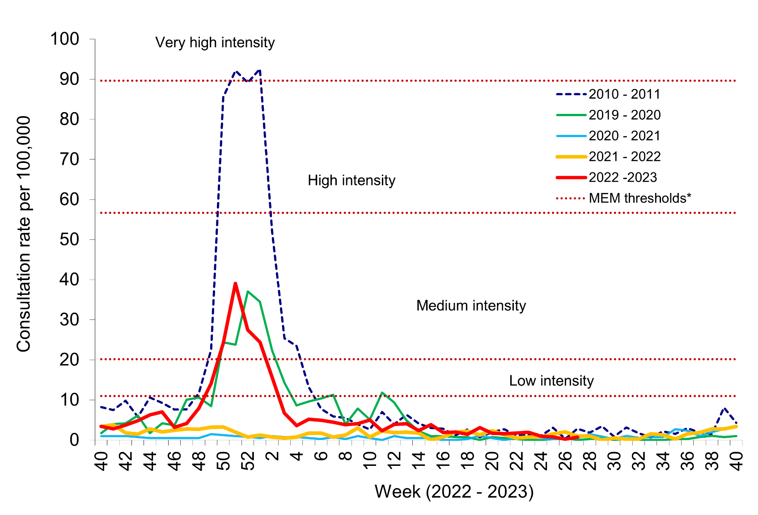
Flu epidemiology
Clinical consultation rate for ILI per 100,000 practice population in Welsh sentinel practices (as of 09/07/2023)
Flu activity usually occurs between September to March (weeks 37 and 15)
Confirmed influenza cases since 2022 Week 40: 7835 (3056 influenza A(H3N2), 1624 influenza A(H1N1)pdm09, 2670 influenza A(not subtyped) and 485 influenza B
The number of flu cases in the 2022 to 2023 flu season was significantly higher than levels observed during the 2021 to 2022
There were 103 cases of influenza detected in ICU settings throughout the whole season. Of the 103 influenza cases detected, 21 were A (H1N1), 40 A (H3) and 39 A (not subtyped). There were 3 cases of influenza B. Influenza in ICU settings peaked in week 51 2022, with 24 samples testing positive for influenza A.
Data source: Public health Wales
Notes:
*The threshold at which the sentinel GP influenza like illness (ILI) consultation rate suggests that the influenza season has started is calculated using the Moving Epidemic Method (MEM). This method also produces thresholds to indicate medium, high and very high intensities of activity. In Wales, all influenza seasons from 2010/11 onwards are used to provide a historical comparison for MEM analysis. Due to unusual activity during the COVID-19 pandemic, 2020/21 and 2021/22 season data was not included in the calculation for 2022/23 MEM thresholds.
Vega T, Lozano J E, Meerhoff T et al. Influenza surveillance in Europe: establishing epidemic thresholds by the Moving Epidemic Method. Influenza and Other Respiratory Viruses. 2013;7(4):346-558 Available from: http://onlinelibrary.wiley.com/doi/10.1111/j.1750-2659.2012.00422.x/full

Slide 14
When to vaccinate
Those eligible should be given flu vaccination as soon as vaccine is available so that people are protected when flu begins to circulate in the community
Ideally most vaccination should be completed before the end of December before flu circulation usually peaks
Flu can circulate considerably later than this however so clinical judgement should be applied to assess needs of individual patients and whether it is appropriate to continue to offer vaccination from January to March
This decision should take into account level of flu-like illness in community and fact that the immune response following flu vaccination takes about 2 weeks to develop fully
As antibody levels likely to reduce in subsequent seasons and there may be changes to circulating strains from one season to next, annual revaccination is important
Notes:
Although influenza activity is not usually significant in the UK before the middle of November, the influenza season can start early and therefore the ideal time for immunisation is between September and early November. After immunisation, protective immune responses may be achieved within 14 days. Protection afforded by the vaccine is thought to last for at least one influenza season. However, as the level of protection provided in subsequent seasons is likely to reduce and there may be changes to the circulating strains from one season to the next, annual revaccination is important.

Slide 15
Childhood flu vaccination programme
The seasonal flu vaccination programme to children aims to lower the public health impact of flu by:
  Providing direct protection by preventing cases of flu infection in children
  Providing indirect protection by lowering flu transmission from children to other children, adults and to those in the clinical risk groups of any age
  Reducing flu transmission in the community averts many cases of severe flu and flu-related deaths in older adults and people with clinical risk factors
Annual administration of flu vaccine to children is expected to substantially reduce flu-related illness, GP consultations, hospital admissions and deaths
Children aged 6 months to 2 years in a clinical risk group are eligible due to their underlying medical condition or treatment
With concerns about co-circulation of the SARs-CoV-2 virus during the 2023 to 2024 flu season, it is particularly important to reduce transmission of flu in the community

Slide 16
Flu vaccine eligibility: 2023 to 2024 flu season
The eligible groups for 2023-24 are as follows:
• Children aged two and three years on 31 August 2023
• Children in primary school from reception class to year 6 (inclusive)
• Children in secondary school from year 7 to year 11 (inclusive)
• People aged six months to 64 years in clinical risk groups
• People aged 65 years and older (age on 31 March 2024)
• All adult residents in Welsh prisons
• Pregnant women
• Carers
• People with a learning disability
• Staff in nursing homes and care homes with regular client contact
• Staff providing domiciliary care
• Staff providing frontline NHS/Primary care services
• Healthcare workers (including healthcare students) with direct patient contact
In addition, individuals experiencing homelessness will also be an eligible group in 2023-24.
Further information is available here: (WHC 2023/023)
https://www.gov.wales/national-influenza-immunisation-programme-2023-24-whc2023023
Notes:
Otherwise healthy 50-64 year olds The Welsh Health Circular (Reimbursable vaccines and eligible cohorts for the 2023- 24 NHS Seasonal Influenza Vaccination Programme WHC/2022/031), issued on 8 December 2022, noted that further assessment was needed to determine whether to include otherwise healthy 50-64 year-olds in the programme for 2023-24. The Welsh Government has decided this group will not form part of the eligible cohort for 2023- 24, with the programme reverting to the age eligibility which was applied before the COVID-19 pandemic.

Slide 17
Clinical risk groups
Chronic respiratory disease such as asthma requiring regular inhaled steroids, or chronic obstructive pulmonary disease (COPD)
Chronic heart disease
Chronic kidney disease at stage 3, 4 or 5
Chronic liver disease
Chronic neurological disease such as Parkinson’s disease, motor neurone disease
*Learning disability
*Severe mental illness
Diabetes
Epilepsy
Immunosuppression due to disease such as HIV/AIDS or treatment such as cancer treatment (and household contacts of at risk individuals)
Asplenia or dysfunction of the spleen
Morbidly obese (class III obesity). This is defined as those with a Body Mass Index (BMI) of 40 or above, aged 16 or over
Further information and additional definitions of these groups can be viewed in table 19.4 of the Green Book influenza chapter::https://assets.publishing.service.gov.uk/government/uploads/system/uploads/attachment_data/file/1107978/Influenza-green-book-chapter19-16September22.pdf
Notes:
*Learning disability and severe mental illness are eligible groups in Wales

Slide 18
Additional groups that are eligible for a flu vaccine
Household contacts of those that are immunosuppressed (from 6 months)
People living in Care Homes and other Long-stay Care Facilities
Carers - Paid and unpaid as well as third sector carers
Community first responders
Voluntary Organisations providing 1st aid
Social Care staff with client contact
Further detail on the eligible groups is contained in Annex 2 of the Welsh Health Circular: (WHC 2023/023)

Slide 19
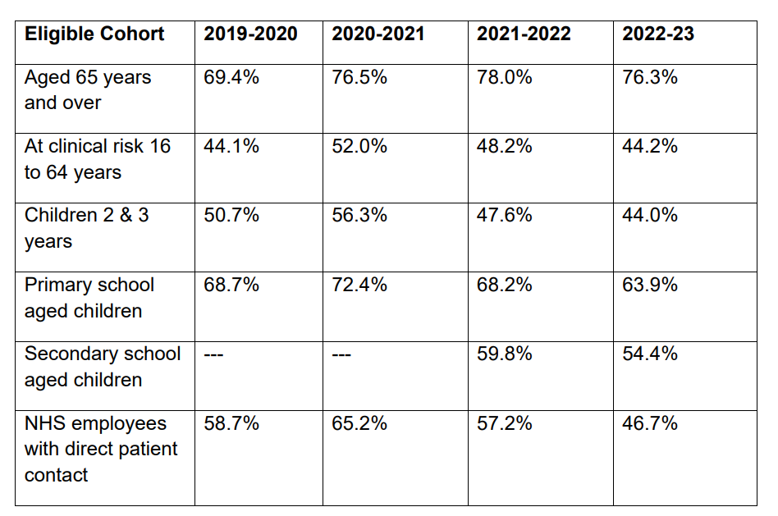
Table showing Influenza vaccination uptake in
Wales for the years 2020-21 to 2022- 23*
*2022-23 data is provisional. Data for previous years uptake from Public Health Wales vaccination flu vaccination coverage data.
Notes:
Uptake data is currently unavailable for infants from 6 months to 2 years in a clinical risk group. A dashboard is available which presents provisional uptake data for children and young people in risk groups aged 2 to 17 years under ‘Childhood vaccine uptake’ here: Influenza Vaccine Online Reporting (IVOR) (sharepoint.com)
More detailed uptake data will be available for the 2022-23 flu season in Wales in the Seasonal influenza 2022-23 Annual report. The Annual report will be available to view here: Annual influenza surveillance and influenza vaccination uptake reports - Public Health Wales (nhs.wales(opens in a new tab)) when it is published.

Slide 20
Vaccine uptake
Provisional flu uptake data indicates a fall in uptake in 2022/23 compared to 2021/22 in adults ages 65 years and over, individuals in a clinical risk group from 16 years to 65 years and NHS employees with direct patient contact.
National recommendations on maximising vaccine uptake and ambitions for uptake in different groups is outlined in the Winter Respiratory Vaccination Strategy: Autumn-Winter 2023/24 this will be available to view here: https://www.gov.wales/health-circulars
Information on the flu season in Wales during 2022-23 will be available in the Seasonal influenza 2022-23 Annual report.
The Annual report will be available to view here: Annual influenza surveillance and influenza vaccination uptake reports - Public Health Wales (nhs.wales(opens in a new tab)) when it is published.

Slide 21
Clinical risk groups
Increasing flu vaccine uptake in clinical risk groups is important because of increased risk of death and serious illness if people in these groups catch flu
For a number of years only around half of patients aged 6 months to under 65 in clinical risk groups have been vaccinated
Vaccine uptake for all clinical risk groups needs to improve
Strategies to improve vaccine uptake should be tailored to each risk group to ensure optimum uptake of vaccine in each of them
Further information on flu vaccination for those with learning disabilities can be found on the GOV.UK website
  www.gov.uk/government/publications/flu-vaccinations-for-people-with-learning-disabilities/flu-vaccinations-supporting-people-with-learning-disabilities

Slide 22
Pregnant women (1)
All pregnant women are recommended to receive the inactivated flu vaccine irrespective of their stage of pregnancy
Pregnant women are at increased risk from complications if they contract flu
Having flu during pregnancy may be associated with premature birth and smaller birth size and weight
Flu vaccination during pregnancy provides passive immunity against flu to infants in the first few months of life
Studies on safety of flu vaccine in pregnancy show that inactivated flu vaccine can be safely and effectively administered during any trimester of pregnancy
No study to date has demonstrated an increased risk of either maternal complications or adverse fetal outcomes associated with inactivated flu vaccine
Pregnant women should be offered flu vaccine for each pregnancy. This needs to be the flu vaccination recommended for the flu season in which they are expected to deliver
Notes:
All pregnant women are recommended to receive the inactivated flu vaccine irrespective of their stage of pregnancy.
There is good evidence that pregnant women are at increased risk from complications if they contract flu. In addition, there is evidence that having flu during pregnancy may be associated with premature birth and smaller birth size and weight and that flu vaccination may reduce the likelihood of prematurity and smaller infant size at birth associated with an influenza infection during pregnancy. Furthermore, a number of studies show that flu vaccination during pregnancy provides passive immunity against flu to infants in the first few months of life. A review of studies on the safety of flu vaccine in pregnancy concluded that inactivated flu vaccine can be safely and effectively administered during any trimester of pregnancy and that no study to date has demonstrated an increased risk of either maternal complications or adverse fetal outcomes associated with inactivated influenza vaccine.
The ideal time for flu vaccination is before flu starts circulating. However, even after flu is in circulation, vaccine should continue to be offered to those at risk and newly pregnant women. If a woman becomes pregnant after the usual vaccinating period of October to January, it is still worth considering offering the vaccine if flu is still circulating in the community. Women should be offered the vaccine every time they are pregnant as the flu virus constantly mutates and therefore the strains included in the vaccine are reviewed annually.

Slide 23
Pregnant women (2)
Pregnant women are at higher risk of complications of influenza than individuals who are not pregnant, and therefore since 2010 are recommended to receive seasonal influenza vaccine (Welsh Government, 2014)
There were 29 deaths of pregnant women and women up to six weeks postpartum in association with influenza in the UK between 2009 and 2012, representing one in eleven maternal deaths (MBRRACE-UK, 2014). Influenza presents significant risks to pregnant women and their babies
If a woman catches influenza during pregnancy, she is at increased risk of experiencing severe disease, admission to intensive care and perinatal mortality (Jamieson, 2009; Pierce, 2011). There was one maternal death from influenza in the UK between 2013 and 2015 (MBRRACE UK, 2017) and two maternal deaths between 2016 and 2018 (MBRRACE UK, 2018)

Slide 24
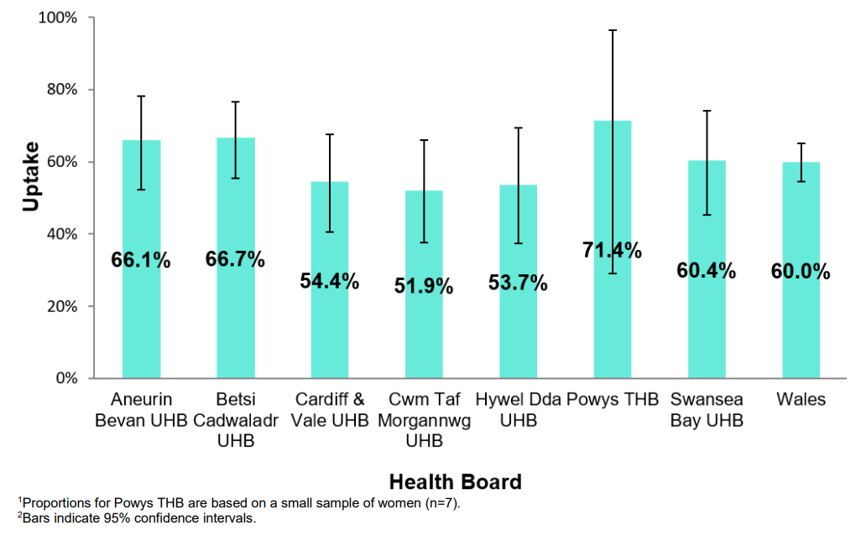
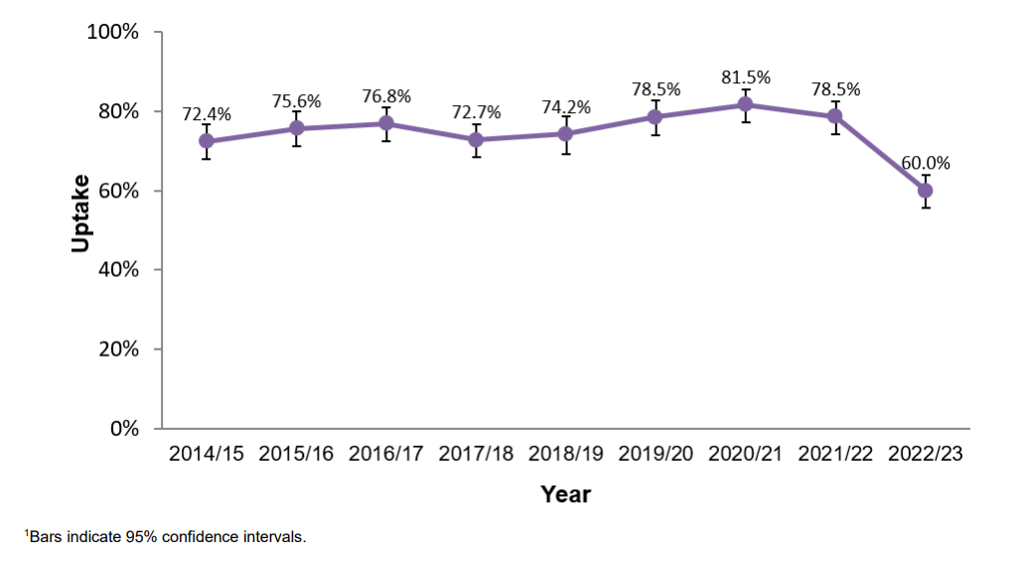
Coverage of influenza vaccination in pregnant women in Wales 2022/23
Point of delivery survey
A survey was conducted on all women who delivered in health board maternity units in Wales during a five-day period in January 2023. Data was mainly collected from notes, and some were self-reported. Of the women surveyed, 93.3% could re-call being offered influenza vaccination. Coverage of influenza vaccination also decreased, from 78.5% to 60.0%.
Uptake of influenza vaccination in pregnant women;
by health board, 2022/23 (n=345)1,2
Uptake of influenza vaccination in pregnant women
Participating in the 2014/15 to 2022/23 surveys¹
Notes:
In addition to this survey Public Health Wales also uses Audit+ data to monitor the uptake of influenza immunisation in women recorded in General Practices as being pregnant. There are challenges in defining influenza vaccine uptake in pregnant women using these data, particularly in ascertainment of accurate denominators. This highlights the importance of also conducting an annual survey of women at delivery.

Slide 25
Residential care/nursing home residents and staff
People living in care homes or other long-stay care facilities
Vaccination is recommended for people living in care homes or other long-stay care facilities where rapid spread is likely to follow introduction of infection and cause high morbidity and mortality. This includes adult residential care homes, nursing care homes and children’s hospices.
This does not include young offender institutions, university halls of residence or boarding schools (except those in eligible school years, or eligible due to another factor). Opportunities for co-administration with the COVID-19 vaccine should be explored where individuals are eligible for both the COVID-19 and flu vaccines.
Social care staff
Individuals employed in adult residential care homes, nursing care homes and children’s hospices, or providing domiciliary care, who are in regular direct contact with residents/service users, are eligible to receive a flu vaccine. This may be via the community pharmacy, NHS seasonal influenza vaccination service or through an alternative model if agreed locally.
Uptake of flu vaccination should be actively encouraged and supported/facilitated by their employer. Social care staff, apart from those referred to above, should be encouraged, supported and offered/facilitated vaccination by their employer.

Slide 26
Health and social care workers
Healthcare workers who are in direct contact with patients/clients should have their flu vaccine via their employer. This should be actively encouraged and provided or facilitated as part of their occupational health care.
Vaccination of health and social care workers protects them and reduces risk of spreading flu to their patients, service users, colleagues and family members
Evidence that vaccination significantly lowers rates of flu-like illness, hospitalisation and mortality in the elderly in long-term healthcare settings
Vaccination reduces transmission of flu to vulnerable patients, some of whom may have impaired immunity and may not respond well to immunisation
Frontline health and social care workers have a duty of care to protect their patients and service users from infection
Vaccination of frontline workers also helps reduce sickness absences and contributes to keeping the NHS and care services running through winter pressures
NHS and social care bodies have a responsibility to ensure, as far as is reasonably practicable, that health and social care workers are free of, and are protected from exposure to infections that can be caught at work (Health and Social Care Act 2008, Code of Practice on the prevention and control of infections)

Slide 27
Vaccine uptake for health and social care workers
Uptake of flu vaccine in NHS employees with direct patient contact fell from 57.2% in 2021-22 to 46.7% in 2022-23
All frontline health care and social care workers should be offered vaccination by their employer
Employer’s have a responsibility to help protect their staff and patients or clients and ensure the overall safe running of services
Further information is available to view here: Resources for health and social care professionals - Public Health Wales (nhs.wales)

Slide 28
Childhood flu vaccination uptake in Wales for the years 2020-21 to 2022- 23*
Eligible cohort | 2019/20 | 2020/21 | 2021/22 | 2022/23
Children 2 and 3 years | 50.7% | 56.3% | 47.6% | 44.o%
Primary school aged children | 68.7% | 72.4% | 68.2% | 63.9%
Secondary school aged children | --- | --- | 59.8% | 54.4%
*2022-23 data is provisional
Provisional flu uptake data indicates a fall in uptake in 2022/23 compared to 2021/22 in children aged 2 and 3 years, primary and secondary school aged children.
National recommendations on maximising vaccine uptake and ambitions for uptake in different groups is outlined in the Winter Respiratory Vaccination Strategy: Autumn-Winter 2023/24 this will be available to view here: https://www.gov.wales/health-circulars
Notes:
Uptake data is currently unavailable for infants from 6 months to 2 years in a clinical risk group. A dashboard is available which presents provisional uptake data for children and young people in risk groups aged 2 to 17 years under ‘Childhood vaccine uptake’ here: Influenza Vaccine Online Reporting (IVOR) (sharepoint.com)
More detailed uptake data will be available for the 2022-23 flu season in Wales in the Seasonal influenza 2022-23 Annual report. The Annual report will be available to view here: Annual influenza surveillance and influenza vaccination uptake reports - Public Health Wales (nhs.wales(opens in a new tab)) when it is published.

Slide 29
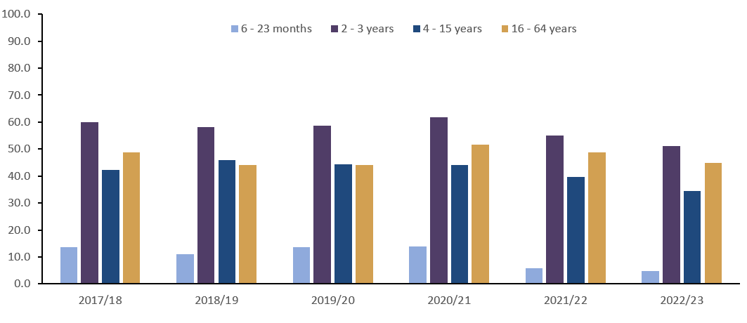
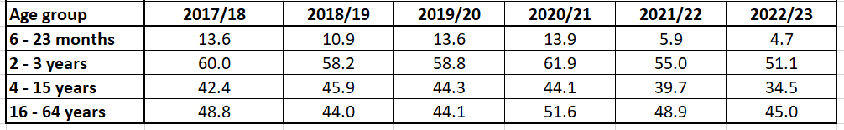
Childhood flu vaccination uptake in Wales for Children from 6 months in a clinical risk group
This graph outlines flu uptake data in Children from 6 months, highlighted in different ages groups, who are in a clinical risk group, from 2017/18 to 2022/23
Data source: General Practice data collected through Audit+ Data Quality System
This data indicates a decline in flu uptake since 2020/21, across all age groups of children in a clinical risk group.
Notes:
Uptake data is not currently readily available for infants from 6 months to 2 years in a clinical risk group, data presented in this slide has been provided on request for these training slides. A dashboard is available which presents provisional uptake data for children and young people in risk groups aged 2 to 17 years under ‘Childhood vaccine uptake’ here: Influenza Vaccine Online Reporting (IVOR) (sharepoint.com)
More detailed uptake data will be available for the 2022-23 flu season in Wales in the Seasonal influenza 2022-23 Annual report. The Annual report will be available to view here: Annual influenza surveillance and influenza vaccination uptake reports - Public Health Wales (nhs.wales(opens in a new tab)) when it is published.

Slide 30
Influenza vaccines and their components
Two main types of flu vaccine available:
  Inactivated – given by injection
  Live attenuated – given by nasal application
  None of the flu vaccines can cause clinical influenza in those that can be vaccinated safely (there is a risk from LAIV to those who are severely immunocompromised).
Both the live and inactivated flu vaccines are quadrivalent vaccines – they contain 2 subtypes of Influenza A and both B lineages
The live attenuated vaccine is licensed for children aged 2 up to 18 years
The inactivated vaccines are recommended for people aged 18+, children in clinical risk groups aged 6months to 2 years and for children aged 2years to 18 years who cannot receive live attenuated vaccine
Further information on NHS Wales recommended flu vaccines 2023/24 influenza season. This resource can be viewed in full here: phw.nhs.wales/topics/immunisation-and-vaccines/fluvaccine/resourcesforprofessionals/flu-vaccines-recommended-in-wales-23-24/
Notes:
Inactivated flu vaccines given by intramuscular injection have been used in the UK for many years. The live intranasal influenza vaccine (LAIV) was introduced into the UK schedule in 2013. However, a live intranasal flu vaccine called FluMist (same vaccine as Fluenz, different trade name) was introduced in the US schedule in 2003 so although the live vaccine is newer, there is nearly 20 years experience of widespread use of the vaccine in the US.
In previous years, most inactivated flu vaccines were trivalent, containing 2 subtypes of influenza A and one B virus. However, quadrivalent vaccines, containing 2 subtypes of influenza A and both B virus types have been developed and are now recommended for all eligible groups including pregnant women . The live intranasal vaccine is a quadrivalent vaccine (hence the ‘Tetra’ part of the name Fluenz Tetra). An inactivated quadrivalent vaccine was made available for the first time in 2013 and is the preferred vaccine for children who are contraindicated to receive the LAIV.
NB The Fluenz vaccine used in the 2013/14 flu season was a trivalent live vaccine. Fluenz Tetra was first used in the 2014/15 flu season and has been used since.
We now have 10 years experience using Fluenz LAIV vaccine in the UK.

Slide 31
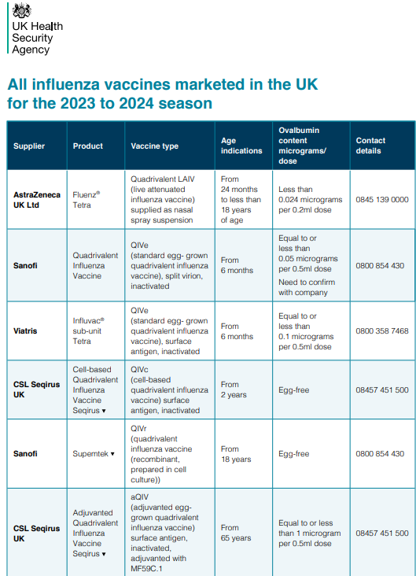
Influenza vaccines available for 2023 to 2024
Several different flu vaccines are available for the 2023 to 2024 flu season
Poster detailing these available from GOV.UK website:
www.gov.uk/government/publications/influenza-vaccines-marketed-in-the-uk
**QIVe NOT RECOMMENDED FOR USE IN WALES AND NOT REIMBURSABLE (WHC/2023/23 AND WHC/2022/31**
Notes:
There are a number of different flu vaccines available each year and it is important to be aware of the age indications and the ovalbumin content of each of them.

Slide 32
Flu vaccine presentation and dosage
Inactivated influenza vaccines are for intramuscular (IM) administration and are supplied as suspensions in pre-filled syringes containing a 0.5ml dose
The live intranasal flu vaccine is supplied as a nasal spray suspension in a single use, pre-filled, nasal applicator with a divider clip. No reconstitution or dilution is required. Each vaccine contains 0.2ml (administered as 0.1 ml per nostril)
Some flu vaccines are restricted for use in particular age groups
The SmPC for individual products should always be referred to when ordering vaccines for particular patients. Further information is available here: Home - electronic medicines compendium (emc)
Notes:
Inactivated flu vaccine for intramuscular (IM) administration is supplied as a suspension in a pre-filled syringe. They should be shaken well before they are administered.
The LAIV is supplied as a single use prefilled nasal applicator that is ready to use. No reconstitution or dilution is required.
All but one of the flu vaccines available in the UK are inactivated, do not contain live viruses and cannot cause clinical influenza in those that can be safely vaccinated. In previous years, most of the available flu vaccines were prepared from viruses grown in embryonated hens eggs. For 2023/24, flu vaccines are available that are cell based, egg based or recombinant.

Slide 33
Vaccine composition 2023/24
For the 2023 to 2024 flu season (northern hemisphere winter), the WHO have recommended that quadrivalent vaccines contain the following:
Egg-based vaccines
An A/Victoria/4897/2022 (H1N1)pdm09-like virus;
An A/Darwin/9/2021 (H3N2)-like virus; and
A B/Austria/1359417/2021 (B/Victoria lineage)-like virus.
A B/Phuket/3073/2013 (B/Yamagata lineage)-like virus.
Cell culture- or recombinant-based vaccines
An A/Wisconsin/67/2022 (H1N1)pdm09-like virus;
An A/Darwin/6/2021 (H3N2)-like virus; and
A B/Austria/1359417/2021 (B/Victoria lineage)-like virus
A B/Phuket/3073/2013 (B/Yamagata lineage)-like virus.
https://www.who.int/publications/m/item/recommended-composition-of-influenza-virus-vaccines-for-use-in-the-2023-2024-northern-hemisphere-influenza-season

Slide 34
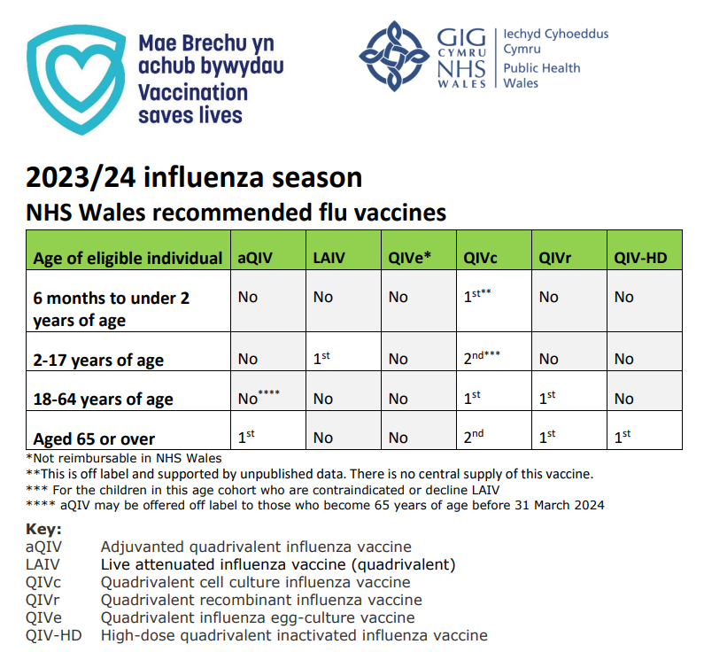
NHS Wales recommended flu vaccines 2023/24 influenza season
This resource can be viewed in full here:
phw.nhs.wales/topics/immunisation-and-vaccines/fluvaccine/resourcesforprofessionals/flu-vaccines-recommended-in-wales-23-24/
Reimbursable vaccines and eligible cohorts for the 2023/24 NHS Seasonal Influenza (flu) Vaccination Programme: reimbursable-vaccines-and-eligible-cohorts-for-the-202324-nhs-seasonal-influenza-flu-vaccination-programme.pdf (gov.wales)
QIVe NOT RECOMMENDED FOR USE IN WALES AND NOT REIMBURSABLE WHC/2023/23 AND WHC/2022/31

Slide 35
Adjuvanted influenza vaccine (aQIV)
Adjuvanted trivalent influenza vaccine (aTIV) was used in the UK in and other countries for a number of years with an excellent safety record
An adjuvanted quadrivalent vaccine (aQIV) replaced aTIV for the 2021 to 2022 flu season onwards
aQIV contains 2 subtypes of Influenza A (H3N2 and H1N1pdm09) and both B virus lineages
Adjuvanted vaccines have higher immunogenicity and effectiveness than non-adjuvanted, standard dose vaccines in older people
The adjuvant known as MF59 has been added to the vaccine to enhance the immune response to counter the effect of immunosenescence (age related reduction in immune response)
MF59 adjuvant is an oil-in-water emulsion of squalene oil which is a naturally occurring substance found in humans, animals and plants. In humans, it is made in the liver and circulates in the bloodstream
aQIV is made using an egg-based manufacturing process
aQIV may be offered ‘off-label’ to those who become 65 years of age before 31 March 2024.

Slide 36
Quadrivalent influenza cell culture vaccine (QIVc)
QIVc was licenced in the US in 2016 and in the UK in December 2018
QIVc is a quadrivalent vaccine containing 2 subtypes of Influenza A (H3N2 and H1N1pdm00) and both B virus lineages
QIVc has a similar safety profile to other flu vaccines (similar rate and type of adverse reactions reported). Hundreds of millions of doses of cell-based vaccine have been administered worldwide with no serious safety concerns
the cell-based vaccine manufacturing process uses an animal cell line (Madin-Darby Canine Kidney, or MDCK) to grow the influenza virus rather than the traditional egg based manufacturing methods
this manufacturing process eliminates the risk of egg-adaptation and may result in the vaccine containing virus that is a closer match to wild-type circulating flu viruses
QIVc is licenced for use in those aged 2 years and over and is egg free

Slide 37
Quadrivalent influenza cell culture vaccine (QIVc) - continued
Children under 2 years of age in a clinical risk group are recommended quadrivalent influenza cell-culture vaccine (QIVc). This is an off-label recommendation that is supported by unpublished data, which shows non inferiority immunogenicity and a very similar safety profile compared with QIVe, which was recommended in previous years but not included as a reimbursable vaccine for 2023-24. There is no central supply for this vaccine supply and local arrangements should be put in place for vaccine supply. https://www.gov.wales/sites/default/files/publications/2023-06/the-national-influenza-immunisation-programme-2023-24.pdf
Where current practice supports the use of a medicine outside the terms of its licence, it may not be necessary to draw attention to the licence when seeking consent. However, it is good practice to give as much information as patients or carers require or which they may see as relevant.
https://www.gov.uk/drug-safety-update/off-label-or-unlicensed-use-of-medicines-prescribers-responsibilities
Notes:
https://www.gov.uk/government/publications/off-label-vaccine-leaflets/off-label-vaccines-an-introductory-guide-for-healthcare-professionals-text-version

Slide 38
Quadrivalent recombinant influenza vaccine (QIVr)
QIVr is a quadrivalent flu vaccine made using recombinant DNA technology using a baculovirus expression system in a continuous insect cell line that is derived from Sf9 cells of the fall armyworm, Spodoptera frugiperda.
It does not require the use of, or growth of flu virus during the manufacturing process which means that the antigen in the vaccine cannot adapt or mutate and should therefore be an exact match to the flu A and B strains contained in the vaccine
It also contains 3 times the amount of flu virus haemagglutinin antigen contained in standard inactivated flu vaccines in order to enhance the immune response made to it
The type and rates of local and systemic reactions following vaccination with QIVr are similar to those seen following vaccination with other flu vaccines (injection site tenderness, headache, fatigue, muscle ache and joint pain)
Since eggs are not required to grow the flu virus, cell-based flu vaccines (QIVc and QIVr) contain no egg and they also do not contain any live virus, antibiotics or gelatine
First used in the UK 2021 to 2022 flu season, QIVr is licensed from 18 years of age

Slide 39
Recombinant vaccine technology
To make recombinant vaccine, the manufacturers take the DNA (genetic instructions) for making the surface protein, haemagglutinin, found on flu viruses
The haemagglutinin DNA is then combined with a baculovirus (a virus that infects invertebrates); this results in a “recombinant” baculovirus
The role of the baculovirus is to help transport the DNA instructions for making the haemagglutinin antigen into a host cell
Once the recombinant virus enters the host cell line (an insect cell line in which the baculovirus grows well), it instructs the cells to rapidly produce the haemagglutinin antigen
This antigen is grown in bulk, collected, purified, and then packaged as recombinant flu vaccine
When the vaccine is injected, the haemagglutinin antigen in it triggers the immune system to create antibodies that specifically target the flu virus

Slide 40
High dose quadrivalent influenza vaccine (QIV-HD)
Quadrivalent influenza vaccine high dose (QIV-HD) was first licenced in the US in 2009 and was licensed in the UK in January 2019
QIV-HD is a quadrivalent inactivated flu vaccine containing 2 subtypes of Influenza A and both B lineages
QIV-HD contains 4 times the amount of antigen contained in standard-dose inactivated influenza vaccines. The additional antigen content is intended to enhance the immune response to counter the effect of immunosenescence in those aged 65 and over
QIV-HD has been proven to be safe and effective
QIV-HD is made using an egg-based manufacturing process
QIV-HD is reimbursable in NHS Wales but it is currently not available in the UK.

Slide 41
Egg grown quadrivalent influenza vaccine (QIVe)
Removal of QIVe from the approved vaccines for reimbursement: Although the JCVI has not advised the removal of this particular vaccine, their advice suggests only using it in the low risk 50-64 year old cohort when other preferred vaccines are unavailable. As the decision on the inclusion of this cohort has been postponed until next spring, QIVe is no longer on the approved vaccine list for reimbursement in Wales for 2023-24.
The most common way to make flu vaccines is the egg-based manufacturing process
Flu viruses are injected into fertilised hen’s eggs and incubated for several days to allow the viruses to replicate.
The fluid containing virus is harvested from the eggs and then, for inactivated flu vaccines, the vaccine viruses are inactivated (killed) and the virus antigen is purified
The egg-grown quadrivalent influenza vaccines (QIVe) protect against 4 strains of flu: 2 A types and both B lineages

Slide 42
Live attenuated influenza vaccine (LAIV)
A live attenuated (weakened) influenza vaccine (LAIV) given intranasally is the recommended vaccine for the childhood flu programme
LAIV has been shown to be more effective in children compared with inactivated influenza vaccines
It may offer some protection against strains not contained in the vaccine as well as to those that are and has the potential to offer better protection against virus strains that have undergone antigenic drift
Since this vaccine is comprised of weakened whole live virus, it replicates natural infection which induces better immune memory (thereby offering better long-term protection to children than from the inactivated vaccines)
In addition to being attenuated, the live viruses in LAIV have been adapted to cold so that they cannot replicate efficiently at body temperature
LAIV has a good safety profile in children aged 2 years and older
Notes:
Fluenz Tetra is a live attenuated vaccine (a weakened form of flu virus which cannot cause disease but which protects against flu). It is a cold adapted virus which means it cannot replicate at body temperature.
This is a nasal vaccine and must not be injected.
It is supplied in a box containing 10 prefilled nasal applicators.
Live attenuated influenza vaccine (Fluenz Tetra) has been shown to provide greater protection for children than inactivated influenza vaccine. This vaccine is the preferred vaccine for children aged 2 to less than 18 years.
It became available in the UK for the 2012/13 flu season. It has been used in USA (same vaccine but under the name FluMist) for many years and millions of doses have been given.

Slide 43
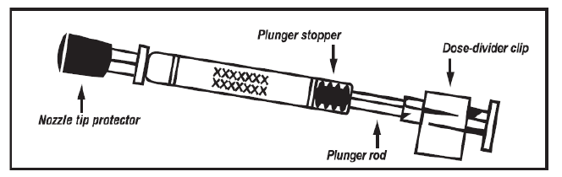

The LAIV used in the UK is Fluenz Tetra
  Licensed from 24 months to less than 18 years of age
  Nasal spray (suspension) in a prefilled nasal applicator
  The suspension is colourless to pale yellow, clear to opalescent. Small white particles may be present
  Supplied in a pack containing 10 doses (single use prefilled nasal applicators)
  Ready to use (no reconstitution or dilution required)
  Each applicator contains 0.2ml (administered as 0.1ml per nostril)

Slide 44
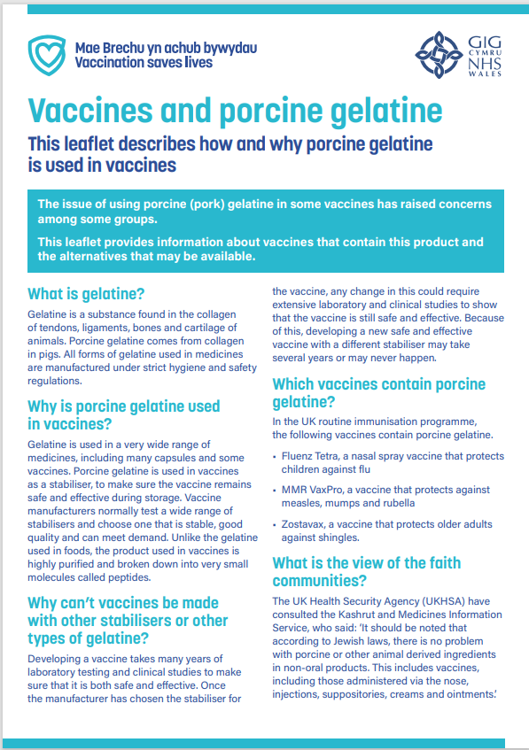
Porcine gelatine
The LAIV contains a highly purified form of gelatine derived from pigs
Gelatine is used in LAIV as a stabiliser - it protects the live viruses from the effects of temperature
Gelatine is commonly used in a range of pharmaceutical products, including many capsules and some vaccines
There is no other live attenuated flu vaccine available that does not contain porcine gelatine. The manufacturer of LAIV (Fluenz Tetra) tested 40 potential stabilisers – gelatine was chosen because without it, stability was significantly reduced
LAIV is the recommended vaccine for use in all eligible children aged 2-17 years of age unless contraindicated or declined due to gelatine content. LAIV is supplied centrally. Where an injectable vaccine is offered as an alternative to LAIV in the circumstances described above, it will be eligible for reimbursement. WHC/2022/31/ WHC/2023/23
Leaflets and accessible vaccination information - Public Health Wales (nhs.wales)

Slide 45
2023 to 2024 flu vaccine recommendations for those aged 65 years and over
For vaccination of those aged 65 years and over JCVI advises the use of the following vaccines:
• Adjuvanted quadrivalent inactivated influenza vaccine (aQIV)*
• High-dose quadrivalent inactivated influenza vaccine (QIV-HD)
• Quadrivalent Recombinant Influenza Vaccine (QIVr)
If aQIV, QIV-HD or QIVr are not available, the quadrivalent influenza cell-culture vaccine (QIVc) is considered an acceptable alternative and is suitable for use in this age group.
*aQIV may be offered ‘off-label’ to those who become 65 years of age before 31 March 2024
JCVI Statement on Influenza Vaccines 2023-24_final version.pdf (nitag-resource.org)

Slide 46
At-risk adults aged under 65 years and pregnant women
For vaccination of adults aged 18 to less than 65 years of age in an at-risk group JCVI advises the use of the influenza vaccines below:
  Quadrivalent influenza cell-culture vaccine (QIVc)
  Quadrivalent Recombinant Influenza Vaccine (QIVr
  There is a potential advantage to using influenza vaccines which do not use eggs in the manufacturing process (cell-culture or recombinant) compared with egg-cultured influenza vaccines, due to the possible impact of “egg-adaptation” on the effectiveness of influenza vaccines, particularly against A(H3N2) strains.
  The evidence on additional benefit is available for only very few seasons but the issue of egg adaptation remains a real concern particularly for the AH3N2 virus which is the more virulent influenza subtype in terms of morbidity and mortality
  QIVe is no longer on the approved vaccine list for reimbursement in 2023-24.
JCVI Statement on Influenza Vaccines 2023-24_final version.pdf (nitag-resource.org)
Notes:
Egg adaptation - in recent flu seasons, changes to the virus during the manufacturing process have arisen with A(H3N2) strain when flu vaccine strains are propagated in eggs which means that the vaccines do not work as well against confirmed disease.

Slide 47
Children aged two to less than 18 years of age in an at-risk group
The live attenuated Influenza vaccine (LAIV) is the vaccine of choice for the childhood influenza programme. Therefore, children aged two years to less than 18 years in clinical risk groups should be offered LAIV unless it is medically contraindicated or otherwise unsuitable.
In those for whom LAIV is not suitable, JCVI advises the use of QIVc.
JCVI therefore advises the influenza vaccines below in the following order of preference:
1. live attenuated Influenza vaccine (LAIV)
2. Quadrivalent influenza cell-culture vaccine (QIVc)
QIVc is licenced for use in those aged 2 years and over and is egg free
JCVI Statement on Influenza Vaccines 2023-24_final version.pdf (nitag-resource.org)
Notes:
JCVI recommend QIVe in the absence of QIVc for this group, however QIVe is no longer on the approved vaccine list for reimbursement in 2023-24.
Live attenuated influenza vaccine (LAIV) nasal spray is not licensed in the UK for use in adults. This is because there is some evidence of poorer efficacy in adults when compared with the inactivated injectable vaccines. Individuals aged 18 years or older, who are recommended to have annual flu vaccine, should be encouraged where possible to have an injectable influenza vaccine suitable for their age. However for adults who have a severe ‘needle phobia’ prescribing clinicians may choose to use LAIV ‘off-label’. This may include those with a learning disability who become seriously distressed with needles.
Legislation does allow for such situations and states that “prescribers can use unlicensed and off-label medicines where there is no suitable alternative”. The responsibility for this rests with the health professional who is prescribing. In this situation, a patient specific direction (PSD) will be required. In these exceptional circumstances, where it has not been possible to administer an injectable flu vaccine, Welsh Government has agreed that the national LAIV stock may be used for this purpose. The National Influenza Immunisation Programme 2023 to 24 (WHC/2023/023) | GOV.WALES

Slide 48
Children aged less than two years old
For vaccination of at-risk children aged less than 2 years of age in an at-risk group JCVI advises the use of the following vaccine:
  Quadrivalent influenza cell-culture vaccine (QIVc)
This is an off-label recommendation that is supported by unpublished data
JCVI Statement on Influenza Vaccines 2023-24_final version.pdf (nitag-resource.org)
Where current practice supports the use of a medicine outside the terms of its licence, it may not be necessary to draw attention to the licence when seeking consent. However, it is good practice to give as much information as patients or carers require or which they may see as relevant https://www.gov.uk/drug-safety-update/off-label-or-unlicensed-use-of-medicines-prescribers-responsibilities
Notes:
This is an off-label recommendation which is supported by unpublished data which shows non inferiority immunogenicity and a very similar safety profile for QIVc. This is an off-label recommendation which is supported by unpublished data which shows non inferiority immunogenicity and a very similar safety profile for QIVc compared with QIVe in children less than two years old. JCVI recommend QIVe in the absence of QIVc for this group, however QIVe is no longer on the approved vaccine list for reimbursement in 2023-24.

Slide 49
Number of doses
Children aged 6 months to less than 9 years who are in clinical risk groups or who are a household contact of an immunosuppressed individual who have not received flu vaccine previously should be offered a second dose of LAIV, given at least 4 weeks apart (if no contraindications – otherwise offer inactivated vaccine)
JCVI has advised that children aged 2 years to under 9 years of age who are not in a clinical risk group, only require a single dose of LAIV irrespective of whether they have received influenza vaccine previously as only modest additional protection is provided by a second dose of LAIV. This advice differs from that in the SmPC for LAIV.
Also, healthy children under 9 years whose parents request they receive Injectable Influenza Vaccine instead of LAIV should be offered a single dose, even if they have not previously received influenza vaccine. The same applies to healthy children who cannot receive LAIV due to contraindications.

Slide 50
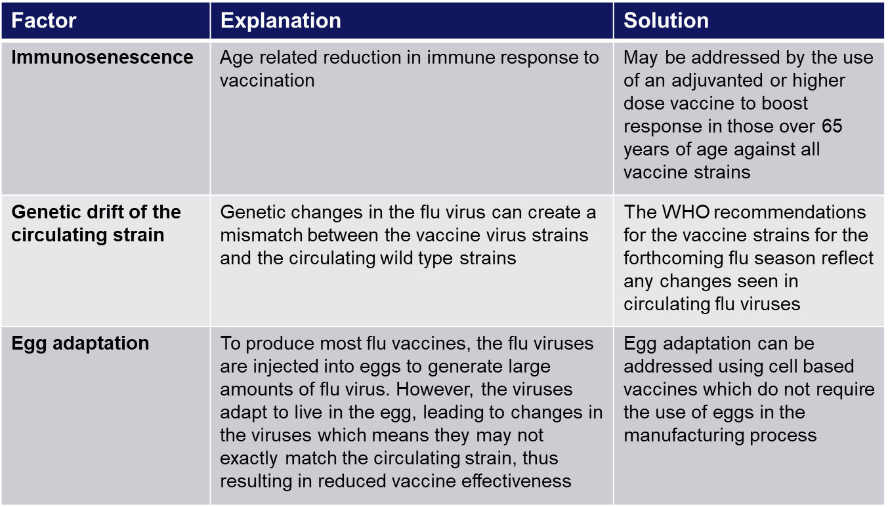
Improving vaccine effectiveness
There are a number of potential factors leading to reduced vaccine effectiveness

Slide 51
Influenza vaccine effectiveness
Vaccine effectiveness of injectable influenza vaccine (VE) varies from one season to the next. Overall effectiveness has been estimated at between 30% to 60% (adults aged 18 to 65 years) for flu infection in primary care
LAIV is thought to provide broader protection than inactivated vaccines, and therefore has potential to offer better protection against strains that have undergone antigenic drift compared to the original virus strains in the vaccine). LAIV has been shown to provide a higher level of protection for children than trivalent inactivated influenza vaccine a meta-analysis suggested an efficacy Green book Chapter 19
There is lower effectiveness in older people although immunisation can provide important protection against flu GP consultation and severe disease/flu confirmed hospital admission
In the last decade, there has generally been a good match between the strains of flu in the vaccine and those circulating but there has often been poorer effectiveness against influenza A (H3N2), particularly in the elderly, where burden of infection from that strain is highest
Potential explanations for the low effectiveness against influenza A(H3N2) include
        Immunosenescence (age related reduction in immune response)
        Genetic drift of the circulating viral strain (compared to the vaccine strain, as happened in 2014 to 2015 flu season)
        Egg adaptation - in recent seasons, changes to the virus during the manufacturing process have arisen with A(H3N2) strain when flu vaccine strains are propagated in eggs which means that the vaccines do not work as well against confirmed disease

Slide 52
Contraindications to flu vaccination
There are very few individuals who cannot receive any flu vaccine
Where LAIV cannot be given to a child, it is likely that inactivated vaccine could be given instead
Where there is doubt, expert advice should be sought promptly so that the period the individual is left unvaccinated is minimised
Contraindications for all flu vaccines:
Confirmed anaphylactic reaction to a previous dose of flu vaccine
Confirmed anaphylactic reaction to a component of flu vaccine (for example to gelatine in LAIV) or residue from the manufacturing process (gentamicin), except egg proteins (see slide on egg allergy)
Additional contraindications for LAIV :
        Clinically severely immunocompromised due to a condition or immunosuppressive therapy such as:
        Acute and chronic leukaemias
        Lymphoma
        HIV infection not suppressed by highly active antiretroviral therapy (HAART)
        Cellular immune deficiencies
        High dose corticosteroids
        Receiving salicylate therapy e.g. aspirin
        Known to be pregnant
Also contraindications for children with acute and severe asthma - see specific slide
This list is not exhaustive please refer to https://www.gov.uk/government/publications/influenza-the-green-book-chapter-19
Notes:
Confirmed anaphylaxis is rare. Other allergic conditions such as rashes may occur more commonly and are not contraindications to further immunisation. A careful history of the event will often distinguish between true anaphylaxis and other events that are either not due to the vaccine or are not life threatening. In the latter circumstance, it may be possible to continue the immunisation course. Specialist advice must be sought on the vaccines and the circumstances in which they could be given. The risk to the individual of not being immunised must be taken into account.
The live attenuated influenza vaccine (Fluenz Tetra) should not be given to children or adolescents who are clinically severely immunodeficient due to conditions or immunosuppressive therapy such as: acute and chronic leukaemias; lymphoma; HIV infection not suppressed by antiretroviral therapy (HAART); cellular immune deficiencies; and high dose corticosteroids. It is not contraindicated for use in children or adolescents living with HIV infection who are receiving antiretroviral therapy and attaining viral suppression; or who are receiving topical/inhaled corticosteroids or low-dose systemic corticosteroids or those receiving corticosteroids as replacement therapy, e.g. for adrenal insufficiency.
Chapter 6 of the Green Book on contraindications and special precautions gives further advice on the use of live vaccines in individuals who are severely immunosuppressed. It states that the definition of “systemic high doses steroids” (and until at least 3 months after treatment has stopped) would include children who receive prednisolone, orally or rectally, at a daily dose (or its equivalent) of 2mg/ kg/day for at least one week, or 1mg/kg/day for one month. Occasionally, individuals on lower doses of steroids may be immunosuppressed and at increased risk from infections. In those cases, live vaccines should be considered with caution, in discussion with a relevant specialist physician”.
The live attenuated vaccine is contraindicated in children and adolescents receiving salicylate therapy (other than for topical treatment of localised conditions) because of the association of Reye's syndrome with salicylates and wild-type flu infection as described in the SPC for Fluenz Tetra. Reye's syndrome has been reported following the use of salicylates during wild-type influenza infection.
Because of the theoretical risk of Reye’s syndrome following administration of the LAIV to children on aspirin therapy or other salicylate-containing medicine, they should not be given LAIV and should instead be offered an inactivated flu vaccine.
Safety data for the live attenuated flu vaccine when given in pregnancy is limited. Whilst there is no evidence of risk with live attenuated flu vaccine, inactivated flu vaccines are preferred for those who are pregnant. There is no need, however, to specifically test eligible girls for pregnancy or to advise avoidance of pregnancy in those who have been recently vaccinated.
Confirmed anaphylaxis is rare. Other allergic conditions such as rashes may occur more commonly and are not contraindications to further immunisation. A careful history of the event will often distinguish between true anaphylaxis and other events that are either not due to the vaccine or are not life threatening. In the latter circumstance, it may be possible to continue the immunisation course. Specialist advice must be sought on the vaccines and the circumstances in which they could be given. The risk to the individual of not being immunised must be taken into account.
The SmPCs for individual products should always be referred to when deciding which vaccine to give. There are very few individuals who cannot receive any flu vaccine. When there is doubt, appropriate advice should be sought promptly from the local screening and immunisation or health protection team or the patient’s consultant so that the period the individual is left unvaccinated is minimised.

Slide 53
Salicylate therapy and LAIV
Children and adolescents who are receiving salicylate therapy (e.g. aspirin) (other than for topical treatment of localised conditions such as in skin creams for verrucae) should not be given LAIV
This is because of the association of Reye’s syndrome with salicylates and wild-type influenza infection
Reye's syndrome has been reported following the use of salicylates during wild-type influenza infection
Because of the theoretical risk of Reye’s syndrome following administration of the LAIV to children on aspirin therapy or other salicylate-containing medicine, they should not be given LAIV and should instead be offered an inactivated flu vaccine
Reye's syndrome is a very rare disorder that can cause serious liver and brain damage. If not treated promptly, it may lead to permanent brain injury or death
Notes:
Reye’s syndrome

Slide 54
Pregnancy and breast feeding
In young people under 18 years of age who present for a flu vaccination, the first vaccine of choice is LAIV. There is limited data on the use of live attenuated flu vaccine in pregnancy. However, in a study of inadvertent LAIV administration to pregnant women, there was no evidence of significant maternal adverse outcomes (read the article here). The live viruses in LAIV have been attenuated (weakened) and adapted to cold so that they can only replicate at the lower temperatures found in the nasal passage.
These live viruses cannot replicate efficiently elsewhere in the body and therefore there is no theoretical basis for concern about infection of the unborn foetus or the mother’s lungs. Inactivated influenza vaccines are, however, preferred for those who are pregnant. There is no need to specifically ask about or test for pregnancy or ask about breastfeeding when offering LAIV to eligible girls or to advise avoidance of pregnancy or breastfeeding in those who have been recently vaccinated.

Slide 55
Precautions to flu vaccination
Acutely unwell/severe febrile illness:
  defer until recovered
Heavy nasal congestion:
  defer live intranasal vaccine until resolved or, if the child is in a risk group, consider inactivated flu vaccine to provide protection without delay
Use with antiviral agents against flu:
  LAIV should not be administered at the same time or within 48 hours of cessation of treatment with flu antiviral agents
  administration of flu antiviral agents within 2 weeks of administration of LAIV may adversely affect the effectiveness of the vaccine
Notes:
Minor illnesses without fever or systemic upset are not valid reasons to postpone vaccination. If the individual is acutely unwell, immunisation may be postponed until they have recovered. This is to avoid confusing the differential diagnosis of acute illness by wrongly attributing any signs or symptoms to the adverse effects of the vaccine.
There are no data on the effectiveness of LAIV when given to children with heavily blocked or runny nose (rhinitis) attributable to infection or allergy. As heavy nasal congestion might impede delivery of the vaccine to the nasopharyngeal mucosa, deferral of administration until resolution of the nasal congestion should be considered or an appropriate alternative intramuscularly administered influenza vaccine should be considered.
There is a potential for influenza antiviral agents to lower the effectiveness of the live attenuated influenza vaccine. Therefore, influenza antiviral agents and LAIV should not be administered concomitantly. LAIV should be delayed until 48 hours following the cessation of treatment with influenza antiviral agents. Administration of influenza antiviral agents within 2 weeks of administration of LAIV may adversely affect the effectiveness of the vaccine.
Minor illnesses without fever of systemic upset are not valid reasons to postpone vaccination. If the individual is acutely unwell the vaccination may be deferred until they have recovered. This is to avoid confusing the differential diagnosis of any acute illness by wrongly attributing any signs or symptoms to the adverse effects of the vaccine.

Slide 56
Acute and severe asthma
Children with asthma on inhaled corticosteroids may safely be given LAIV irrespective of the dose prescribed, or those who are receiving topical corticosteroids, inhaled corticosteroids or low-dose systemic corticosteroids, or those receiving corticosteroids as replacement therapy, for example for adrenal insufficiency
However, LAIV is not recommended for children and adolescents currently experiencing an acute exacerbation of symptoms including
  - Those who have had increased wheezing and/or
  - Needed additional bronchodilator treatment in the previous 72 hours
Such children should be offered a suitable inactivated influenza vaccine to avoid a delay in protection
Children who require regular oral steroids for maintenance of asthma control, or have previously required admission to intensive care for asthma exacerbation should only be given LAIV on the advice of their specialist
As these children may be at higher risk from influenza infection, those who cannot receive LAIV should receive a suitable inactivated influenza vaccine
Children with significant asthma* and aged under 9 years who have not been previously vaccinated against influenza will require a second dose (of either LAIV or inactivated vaccine as appropriate) at least 4 weeks later.
(*Note: please see the Green Book chapter 19, Table 19.4 for asthma eligibility criteria Influenza: the green book, chapter 19 - GOV.UK (www.gov.uk))
Notes:
In 2019, JCVI advised that, on the basis of recent data, children with asthma on inhaled corticosteroids may safely be given LAIV, irrespective of the dose prescribed. LAIV is not recommended for children and adolescents currently experiencing an acute exacerbation of symptoms including those who have had increased wheezing and/or needed additional bronchodilator treatment in the previous 72 hours. Such children should be offered a suitable inactivated influenza vaccine to avoid a delay in protection.
There are limited safety data in children who require regular oral steroids for maintenance of asthma control, or have previously required intensive care for asthma exacerbation – such children should only be given LAIV on the advice of their specialist. As these children may be at higher risk from influenza infection, those who cannot receive LAIV should receive a suitable inactivated influenza vaccine. Children with significant asthma and aged under 9 years who have not been previously vaccinated against influenza will require a second dose (of either LAIV or inactivated vaccine as appropriate).

Slide 57
Patients taking anticoagulants or with a bleeding disorder
Individuals on stable anticoagulation therapy (including individuals on warfarin who are up-to-date with their scheduled INR testing and whose latest INR was below the upper threshold of their therapeutic range) can receive intramuscular vaccination
If in any doubt, consult with the clinician responsible for prescribing or monitoring the individual’s anticoagulant therapy
Individuals with bleeding disorders may be vaccinated intramuscularly if, in the opinion of a doctor familiar with the individual's bleeding risk, vaccines or similar small volume intramuscular injections can be administered with reasonable safety by this route
If the individual receives medication/treatment to reduce bleeding, for example treatment for haemophilia, intramuscular vaccination can be scheduled shortly after such medication/treatment is administered
A fine needle (equal to 23 gauge or finer calibre) should be used for the vaccination, followed by firm pressure applied to the site (without rubbing) for at least 2 minutes
Influenza vaccines licensed for intramuscular or subcutaneous administration may alternatively be administered by the subcutaneous route
QIVc, QIVr and aQIV are not licensed for subcutaneous administration so should only be administered intramuscularly

Slide 58
Egg allergy in adults
For many years, most flu vaccines have been prepared from flu viruses grown in embryonated hens’ eggs and the final vaccine product contains varying amounts of egg protein as ovalbumin
The ovalbumin content for the 2023 to 2024 flu vaccines is available here: www.gov.uk/government/publications/influenza-vaccines-marketed-in-the-uk
for the 2023 to 2024 season, those aged 18 years and over are recommended to receive either QIVc or QIVr, both of which are egg free
Adults with egg allergy can be immunised in any setting using:
  The cell-based quadrivalent inactivated egg-free vaccines QIVc or QIVr
  *QIVe should only be offered if it is not possible to give QIVc or QIVr. If QIVe is given, it must have an ovalbumin content less than 0.12 micrograms/ml (equivalent to <0.06 micrograms for 0.5ml dose)
Adults with severe anaphylaxis to egg which has previously required intensive care should be offered an egg-free vaccine or referred to a specialist for assessment with regard to receiving immunisation in hospital if this is not possible
*QIVe is no longer on the approved vaccine list for reimbursement in 2023-24.

Slide 59
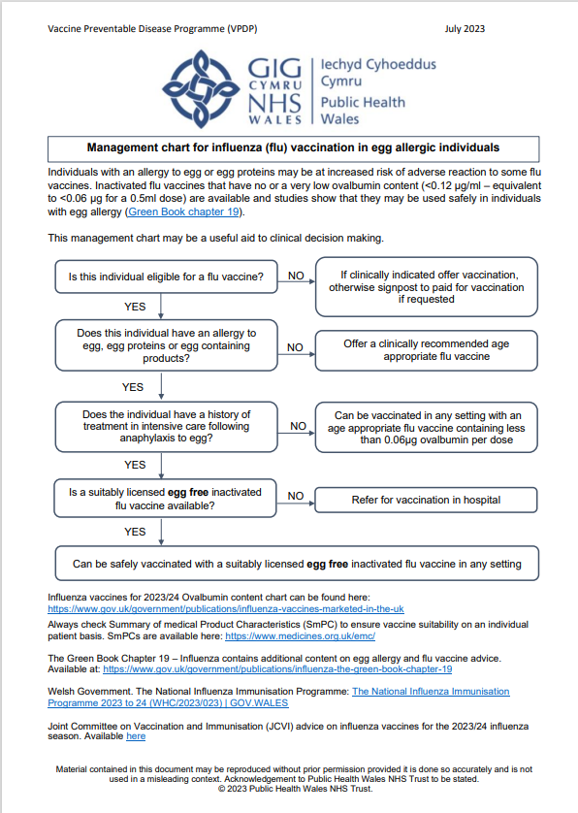
Management chart for influenza (flu) vaccination in egg allergic individuals for 2023/24
This resource is available to view here: Resources for health and social care professionals - Public Health Wales (nhs.wales) under further clinical resources and information

Slide 60
Egg allergy in children
Children who have required admission to intensive care for a previous severe anaphylaxis to egg should be given LAIV in the hospital setting
Children with an egg allergy (including those with previous anaphylaxis to egg) can be safely vaccinated with LAIV in any setting (including primary care and schools)
Children with both egg allergy and a clinical risk factor that contraindicate LAIV (for example immunosuppression) should be offered an* inactivated flu vaccine with a very low ovalbumin content (less than 0.12micrograms/ml)
Children over age 2 years with egg allergy can also be given the quadrivalent cell-based inactivated egg-free vaccine QIVc
Egg-allergic children with asthma can receive LAIV if their asthma is well-controlled (see previous slide on severe asthma)
*Children aged 6 months to under 9 years in a clinical risk group who have not been previously vaccinated against influenza will require a second dose (of either LAIV (over 2 years) or inactivated vaccine as appropriate)- with an interval of 4 weeks

Slide 61
Children with cochlear implants
Children with cochlear implants can be given LAIV safely although ideally it should not be given:
  In the week prior to implant surgery, or
  for 2 weeks afterwards, or
  if there is evidence of on-going cerebrospinal fluid leak.
  Influenza: the green book, chapter 19 - GOV.UK (www.gov.uk)

Slide 62
Inadvertent administration of LAIV
If an immunocompromised individual receives LAIV, the degree of immunosuppression should be assessed
If the individual is severely immunocompromised, antiviral prophylaxis should be considered
Otherwise they should be advised to seek medical advice if they develop flu-like symptoms in the 4 days following administration of the vaccine
If antivirals are used for prophylaxis or treatment, the individual should also be offered inactivated flu vaccine in order to maximise their protection (this can be given straight away)
There is limited data on the use of live attenuated flu vaccine in pregnancy. However, in a study
of inadvertent LAIV administration to pregnant women, there was no evidence of significant
maternal adverse outcomes. The live viruses in LAIV have been attenuated (weakened)
and adapted to cold so that they can only replicate at the lower temperatures found in the nasal
passage. These live viruses cannot replicate efficiently elsewhere in the body and therefore
there is no theoretical basis for concern about infection of the unborn foetus or the mother’s
lungs. Inactivated influenza vaccines are, however, preferred for those who are pregnant The national influenza immunisation programme 2022 to 2023: Information for healthcare practitioners (publishing.service.gov.uk)
Notes:
https://assets.publishing.service.gov.uk/government/uploads/system/uploads/attachment_data/file/1105068/Flu-information-for-HCPs-2022-to-2023-20Sept22.pdf

Slide 63
LAIV and ‘viral shedding’
    LAIV does not create an external mist of vaccine virus in the air when children are being vaccinated and others in the room should not be at risk of ‘catching’ the vaccine virus
    Administration of the intranasal vaccine delivers just 0.1ml of fluid straight into each nostril and almost all the fluid is immediately absorbed into the child’s nose
    Although vaccinated children are known to shed virus a few days after vaccination, the vaccine virus that is shed is less able to spread from person to person than natural flu infection
    The amount of virus shed is normally below the levels needed to pass on infection to others and the virus does not survive for long outside of the body. This is in contrast to natural flu infection, which spreads easily during the flu season

Slide 64
Risk of transmission of live vaccine virus
There is a theoretical potential for transmission of live attenuated flu virus to very severely immunocompromised contacts for 1 to 2 weeks following vaccination
Following extensive use of LAIV in the US, there have been no reported instances of illness or infections from the vaccine virus among immunocompromised patients inadvertently exposed to vaccinated children
However, if close contact with very severely immunocompromised patients (such as bone marrow transplant patients requiring isolation) is likely or unavoidable (for example other household members) consider an appropriate inactivated flu vaccine instead
Notes:
There is a theoretical potential for transmission of live attenuated influenza virus in the LAIV to immunocompromised contacts for 1 to 2 weeks following vaccination. In the US, where there has been extensive use of the live attenuated influenza vaccine, there have been no reported instances of illness or infections from the vaccine virus among immunocompromised patients inadvertently exposed. Where close contact with very severely immunocompromised patients (such as bone marrow transplant patients requiring isolation) is likely or unavoidable (for example, household members), however, appropriate alternative inactivated influenza vaccines should be considered.

Slide 65
Exposure of healthcare professionals to live attenuated influenza vaccine viruses
Theoretically there may be some low level exposure to the vaccine viruses for those administering LAIV and/or from recently vaccinated patients
In the US, where there has been extensive use of LAIV, there have not been any reported instances of illness or infections from the vaccine virus among healthcare professionals inadvertently exposed
Risk of acquiring vaccine viruses from the environment is unknown but probably low
The vaccine viruses are cold-adapted and attenuated and therefore unlikely to cause symptomatic flu
As a precaution, very severely immunosuppressed individuals should not administer LAIV
Other healthcare workers who have less severe immunosuppression or are pregnant, should follow normal clinical practice to avoid inhaling the vaccine and ensure that they themselves are appropriately vaccinated

Slide 66
Storage of flu vaccine
  Efficacy, safety and quality may be adversely affected if vaccines are not stored at the temperatures specified in the licence
All flu vaccines, inactivated and LAIV, must be stored in accordance with manufacturer’s instructions:
  Store between +2⁰C and +8⁰C
  Do not freeze
  Store in original packaging
  Protect from light
Check expiry dates regularly:
  The LAIV has an expiry date 18 weeks after manufacture – this is much shorter than inactivated flu vaccines
  It is important that the expiry date on the nasal spray applicator is checked before use
Vaccines (Handling and Storage) Cold Chain Management Procedure for Wales can be viewed here:
Clinical Governance and Infection Control Policies - Public Health Wales (nhs.wales).
Notes:
Vaccines should be stored in the original packaging at +2°C to +8°C and protected from light. All vaccines are sensitive to some extent to heat and cold. Heat speeds up the decline in potency of most vaccines, thus reducing their shelf life. Efficacy, safety and quality may be adversely affected if vaccines are not stored at the temperatures specified in the licence. Freezing may cause increased reactogenicity and loss of potency for some vaccines and can also cause hairline cracks in the container, leading to contamination of the contents.
LAIV has a shelf life of 18 weeks that starts at the point of release from the manufacturer. This is a shorter shelf life than other influenza vaccines and some of this time will have passed when the vaccine reaches the place where it is to be administered. It is important that the expiry date on the nasal spray applicator is checked before use. If the expiry date has passed, arrangements should be made to have the vaccine disposed safely.
The vaccine should be stored in the original packaging. This makes it easy to identify in the vaccine fridge and to check batch numbers and expiry dates. The original packaging also provides some protection against fluctuation of temperature and protection from light.
Vaccines are expensive and it is important to minimise wastage through inappropriate storage.

Slide 67
Legal framework for vaccination
It is currently intended for National Protocols to be available before the start of the season to support mixed workforce and flexible delivery models.
There will be a transition period during July and August 2023, whereby the Welsh Medicines Advice Service (WMAS) will start to lead on the development of PGDs. During this period Public Health Wales (PHW) and the Welsh Medicines Advice Service website will host PHW PGDs information and templates. It is anticipated that this transition period will be completed by w/e 18th August 2023.
UK Health Security Agency (UKHSA) provide updated PGDs (Patient Group Directions) which are available at the Welsh Medicines Advice Service (WMAS). These are template PGD’s that can be amended locally by health boards.
An advisory Document to supplement the UKHSA LAIV PGD template is available for Wales on Patient Group Directions (PGD) - Welsh Medicines Advice Service (wales.nhs.uk)
The NHS Wales PGD for injectable influenza vaccines will be available on Welsh Medicines Advice Service website w/c 21st August 2023
Further information is available here: (WHC 2023/023)
Notes:
PGD templates: Patient Group Directions (PGD) - Welsh Medicines Advice Service (wales.nhs.uk)

Slide 68
Vaccine administration (inactivated vaccines)
Inactivated flu vaccines should be given intramuscularly into the upper arm (deltoid muscle) of those aged 12 months or older and into the anterolateral aspect of the thigh in infants aged 6 months to one year of age
Due to the presence of adjuvant and therefore increased potential for more local reactions if administered by subcutaneous injection, aQIV should only be administered intramuscularly using a 25mm length needle
The cell-based quadrivalent vaccines (QIVc and QIVr) are also not licensed for subcutaneous administration so should only be administered intramuscularly
Inactivated and live flu vaccines can currently be given at the same time as, or at any interval before or after, other currently used live and inactivated vaccines
Shingrix® can be given at the same time as inactivated or live vaccines. This now includes the adjuvanted quadrivalent influenza vaccine (aQIV) Shingles (herpes zoster): the green book, chapter 28a - GOV.UK (www.gov.uk)
  Previously, a 7-day interval was recommended between Shingrix® and aQIV because the potential reactogenicity from two adjuvanted vaccines may reduce tolerability in those being vaccinated.
  Therefore, an appointment for flu vaccination can be an opportunity to also provide shingles vaccine, although shingles vaccine should be offered all year round, rather than purely as a seasonal programme.
Notes:
.

Slide 69
Consequences of incorrect injection technique
It is essential that the correct site and injection technique are used to administer vaccines
Injecting too high into the upper arm might result in the vaccine being deposited in the shoulder capsule rather than the deltoid muscle
If this happens, inflammation can occur, leading to a shoulder injury or a frozen shoulder
  This leads to pain, weakness and a limited range of motion that can last for months
Injecting too far to the side of the arm or too low on the arm risks injecting into the axillary nerve or the radial nerve
  This can cause a burning or shooting pain during the procedure and can lead to nerve damage (neuropathy/paralysis)
To avoid shoulder injury, always assess the limb before administering the vaccine to identify the correct site for injection

Slide 70
Administration of Live Attenuated Influenza vaccine (LAIV)
  LAIV is different from other flu vaccines – it is a live attenuated nasal vaccine and must not be injected
  Do not attempt to attach a needle
  LAIV can be administered at the same time as, or at any interval from other currently used vaccines including live vaccines
  The applicator has a divider clip to enable one application in each nostril
  The vaccinee should breathe normally - they do not need to actively inhale or sniff
  The vaccine is rapidly absorbed so there is no need to repeat either half of dose if patient sneezes, blows their nose or their nose drips following administration
Notes:
An incomplete dose of LAIV does not need to be repeated as long as at least 0.1ml of the vaccine has been given intranasally as each half dose (0.1ml) contains enough viral particles to
induce an immune response.
If the vaccine is accidentally squirted into the child’s eye, it may cause some slight irritation to the eye and eyewash or normal saline should be used to wash out the eye. The child or
parent/carer should be advised to seek medical advice if any irritation occurs and persists beyond what might reasonably be expected.
https://assets.publishing.service.gov.uk/government/uploads/system/uploads/attachment_data/file/1105068/Flu-information-for-HCPs-2022-to-2023-20Sept22.pdf

Slide 71
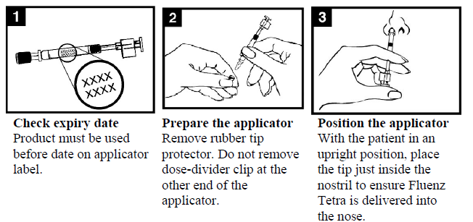
Administration of LAIV (1)

Slide 72
Administration of LAIV (2)

Slide 73
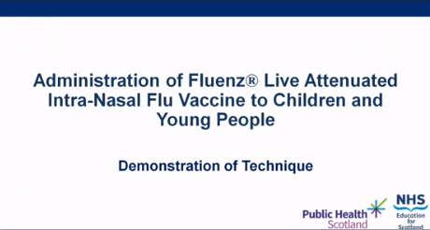
LAIV administration video
A video for healthcare practitioners on how to administer LAIV has been produced by NHS Education for Scotland and Public Health Scotland
It is available to view on the NES website at: https://learn.nes.nhs.scot/63183/immunisation/seasonal-flu/administration-of-fluenz-tetra-video (recommended watching from 2 minutes to 4m 30s for vaccinators in Wales)
This video was updated by Public Health Scotland and NHS Education for Scotland for 2021/22 flu season, the PPE advice is now out of date. See here for up to date NHS Wales guidance: Guidance - Public Health Wales (nhs.wales)

Slide 74
Commonly reported adverse reactions
Following inactivated flu vaccine:
Pain, swelling or redness at the injection site, low grade fever, malaise, shivering, sweating, fatigue, headache, myalgia and arthralgia
A small painless nodule may also form at the injection site
These symptoms usually disappear within 1 to 2 days without treatment
Due to the MF59 adjuvant, a higher incidence of mild post-immunisation reactions has been reported with aTIV, compared to non-adjuvanted influenza vaccines
Following live attenuated flu vaccine:
Nasal congestion/rhinorrhoea, reduced appetite, weakness, fever and headache
Rarely, after live or inactivated vaccine, immediate reactions such as urticaria, angio-oedema, bronchospasm and anaphylaxis can occur

Slide 75
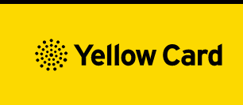
Reporting adverse events
All serious suspected reactions following flu vaccination should be reported to the Medicines and Healthcare products Regulatory Agency (MHRA) using the Yellow Card scheme
Suspected adverse events occurring in children or involving products that carry the black triangle symbol (▼) should be reported, even where these are mild or expected.
Anyone (patients and HCWs) can make a Yellow Card report, even if they are uncertain as to whether a vaccine caused the condition/side effect
Vaccinees should be advised that they can report any adverse reactions using the MHRA’s online Yellow Card scheme (www.mhra.gov.uk/yellowcard), by downloading the Yellow Card app or by calling the Yellow Card scheme on 0800 731 6789 9am to 5pm Monday to Friday

Slide 76
Improving vaccine uptake
National Institute of Clinical Excellence (NICE) published guidance in August 2018 they made 7 key recommendations:(opens in a new tab)
Providers of flu vaccination(opens in a new tab) should work together with other agencies to develop programmes to increase vaccination uptake.
Educate health and social care staff, particularly those in contact with eligible groups(opens in a new tab), about flu vaccination.
Use every opportunity throughout the flu vaccination season to identify people in eligible groups(opens in a new tab) and offer them the flu vaccination.
Use strategies to increase uptake among eligible groups in primary and secondary care.
Keep patient records up to date and accurate to help identify people who have not been vaccinated and are eligible for flu vaccination that season.
Offer flu vaccination to carers(opens in a new tab), base decisions to offer vaccination on whether the carer looks after someone whose wellbeing may be at risk if the carer was ill or hospitalised with flu.
Employers of health and social care staff are responsible for providing occupational flu vaccinations.

Slide 77
Optimising Vaccine Uptake: Using motivational interviewing for better conversations
The approach and style of a vaccine conversation can make a real difference in understanding individual hesitancy, addressing barriers, and influencing vaccine uptake. There is an eLearning module available called Optimising Vaccine Uptake: Using motivational interviewing for better conversations which aims to support staff with having positive conversations about immunisations.
The module aims to provide health professionals the skills and knowledge required to implement motivational interviewing techniques when having vaccine-related conversations
Further information about the module and how to access it is available here: Immunisation eLearning - Public Health Wales (nhs.wales)

Slide 78
Maximising flu vaccine uptake in healthcare and social care staff
If you work on the healthcare staff facing element of the flu programme click here(opens in a new tab) to access a number of resources that may be useful to you, including:
Guidance and policy
Evidence
Links to vaccine uptake
Resources
Links to further information
Resources for peer vaccinators/flu champions
Staff flu campaign: an evaluation and planning toolkit (NHS Wales intranet only)(opens in a new tab)
More information on planning a healthcare staff flu campaign including delivering and evaluation can be found here(opens in a new tab) (NHS Wales intranet only)

Slide 79
Social care staff
If you work on the social care staff facing element of the flu programme, you will find a number of resources that may be useful to you on the flu vaccination, Public Health Wales internet site(opens in a new tab). Information Including:
Guidance
Links to vaccine uptake
Resources
Links to further information

Slide 80
Key messages to health and social care workers
    Getting vaccinated against flu can help protect you, your patients and family
    Everyone is susceptible to flu, even if you are in good health and eat well
    You can be infected with the virus and have no symptoms but can still pass flu virus to others including patients or residents
    Good infection control measures reduce spread of flu and other acute respiratory infections in healthcare settings but are not sufficient alone to prevent them
    Throughout the last 10 years there has generally been a good to moderate match between the strains of flu virus in the vaccine and those that subsequently circulated
    Impact of flu on frail and vulnerable patients can be fatal and outbreaks can cause severe disruption in communities, care homes and hospitals
    Flu vaccine has a good safety record and will help protect you. It cannot give you flu. Having the vaccination can encourage your colleagues to do likewise
    Staff act as positive role models for those with long-term health conditions and pregnant women to take up the offer too
    Duty of care as professionals to patients or residents to do everything in your power to protect them against infection, including being immunised against flu

Slide 81
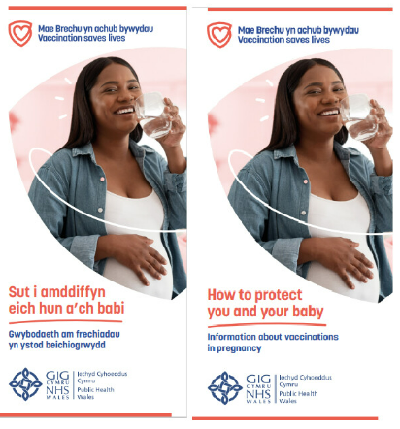
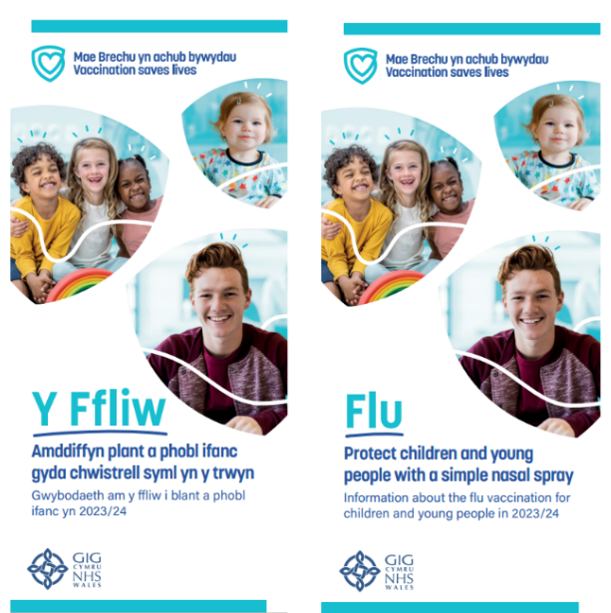

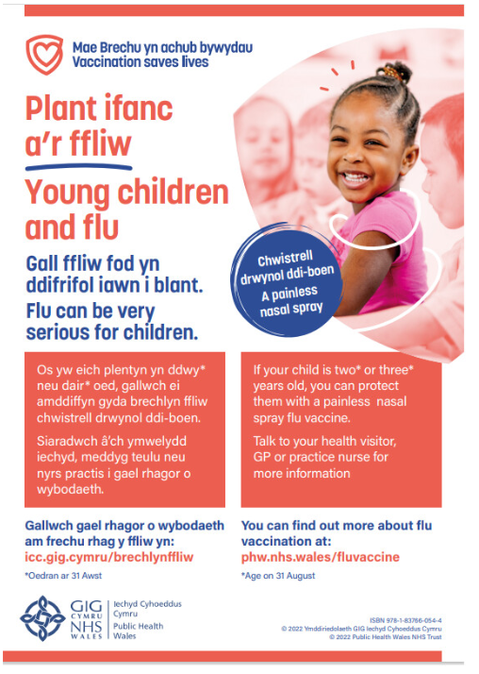
Resources
All immunisation resources can be downloaded and ordered from: Health Information Resources - Public Health Wales (nhs.wales)
Leaflets and other resources in accessible formats can be accessed here: Flu vaccine accessible information - Public Health Wales (nhs.wales)
Resources for health and social care professionals are available here: Resources for health and social care professionals - Public Health Wales (nhs.wales)

