Slide 1
School aged flu resources 2025/26
Vaccine Preventable Disease Programme
Public Health Wales
August 2025
Notes:
Material contained in this document may be reproduced without prior permission provided it is done so accurately and is not used in a misleading context.
Acknowledgement to Public Health Wales NHS Trust to be stated.
© 2024 Public Health Wales NHS Trust.

Slide 2


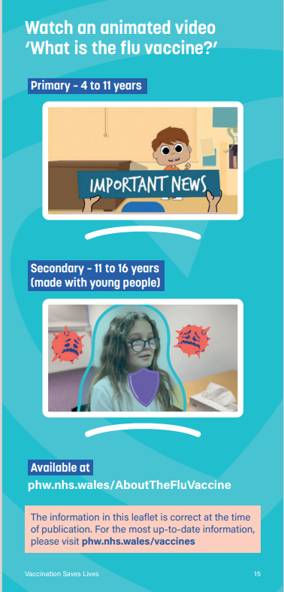
Leaflet
Bilingual digital version available on PHW vaccines website:
English website page (English presents first on the leaflet)
Welsh website page (Welsh presents first on the leaflet)
Some health boards have had direct delivery of quantities of the leaflet on request
A small number are available to order for free on Health Information Resources website (Note: please contact phw.vaccines@wales.nhs.uk if you wish to place a large order)
The following accessible versions will be available here soon (ENG/WEL):
Large Print
Easy Read
BSL
Audio
This year the leaflet signposts to the animations (see image left)

Slide 3
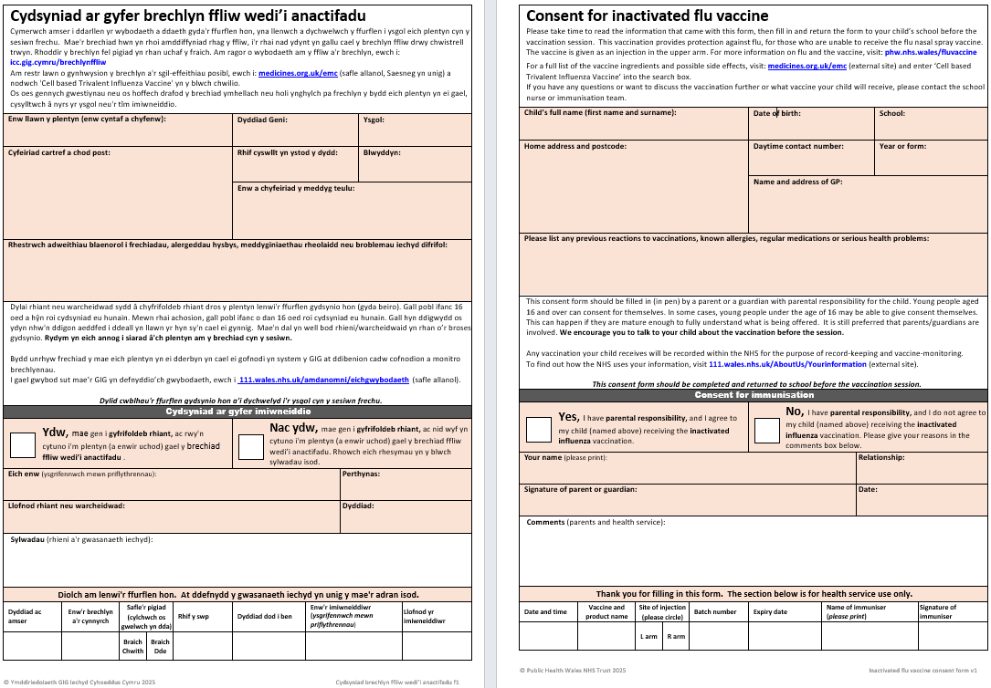
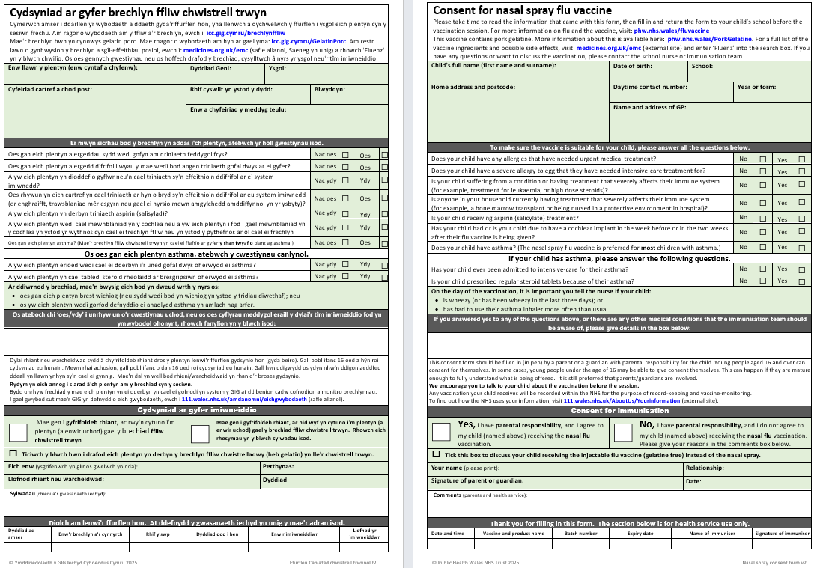
Consent forms
Newly developed for 2025/26 is the bilingual Inactivated Influenza Vaccine consent form, which is available for schools vaccinating with IIV
New for 2025/26 is one LAIV consent form template for both primary and secondary school aged children and young people
Both templates include information about Gillick Competence & self-consent
Bilingual versions of these templates are available here
Notes:
For LAIV, the consent form directs parents to look up ‘Fluenz’ for further information about side effects and ingredients.
For IIV, the consent form directs parents to look up ‘Cell based Trivalent Influenza Vaccine’ for further information about side effects and ingredients.

Slide 4
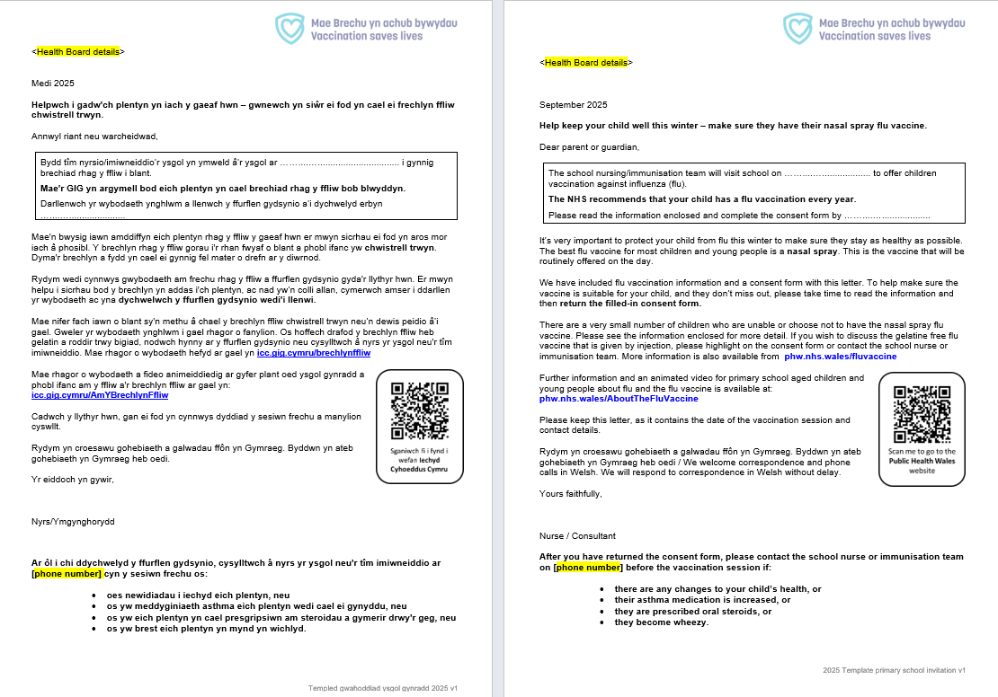
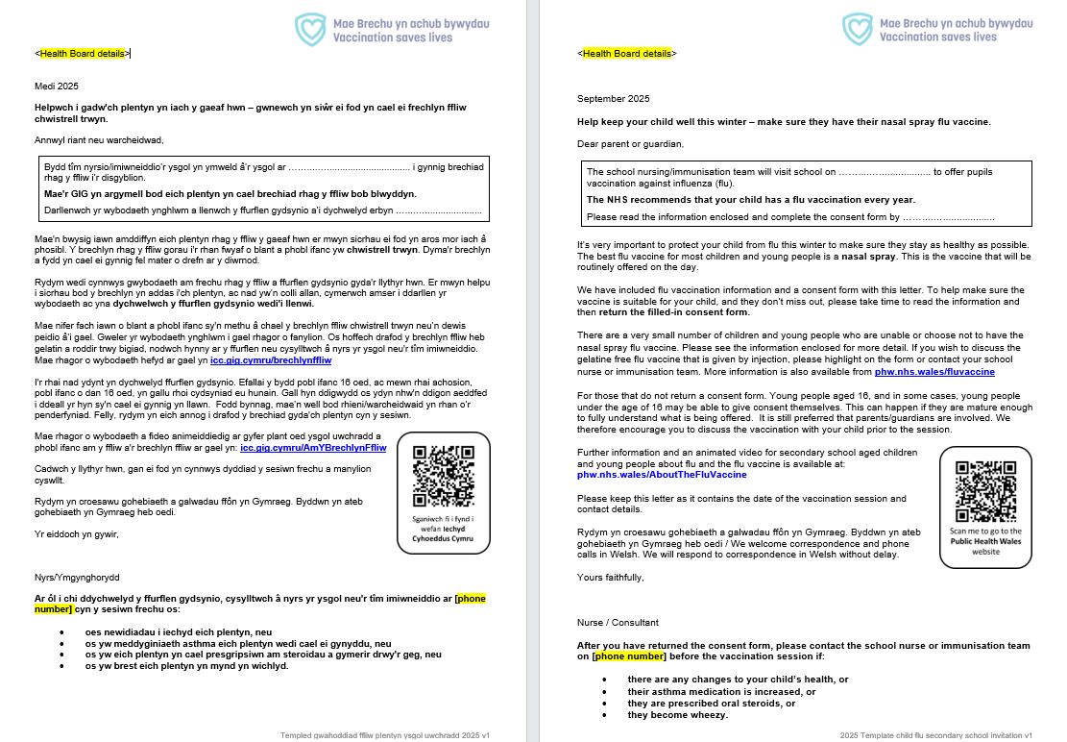
Template letters
As with previous years, there are different letters for primary/secondary schools
The secondary school template letter includes information about Gillick Competence & self-consent
Bilingual versions of these templates are available here

Slide 5
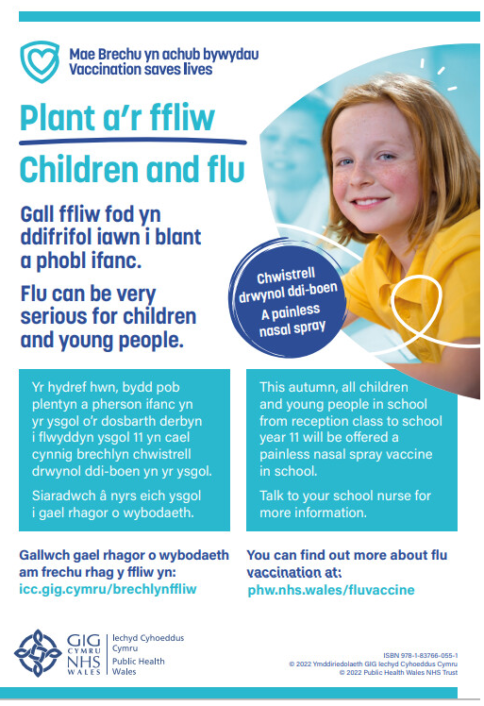
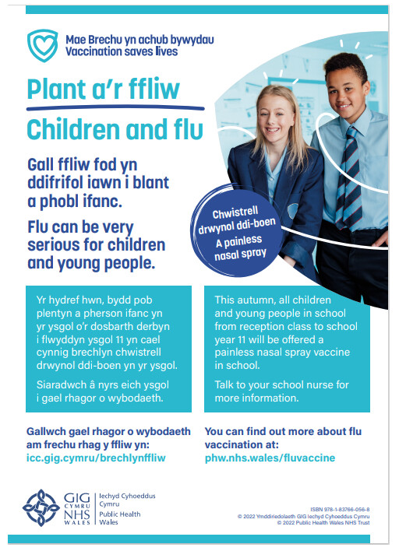
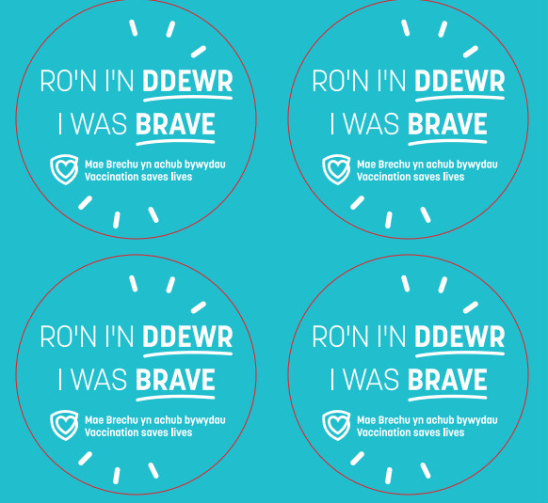
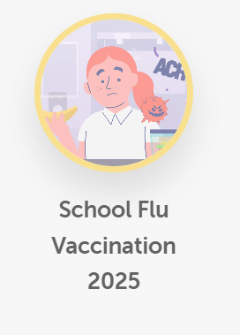

Posters/postcards/stickers
Some health boards have had direct delivery orders of these on request
Stock is still available to order for free on the Health Information Resources website here
Primary school aged poster
Secondary school aged poster
Browse all our current PHW assets on Brandkit and download resources here
Notes:
Available to order here: https://phw.nhs.wales/services-and-teams/health-information-resources/#!/Plant-a-phobl-ifanc-Children-&-young-people/c/161528096

Slide 6

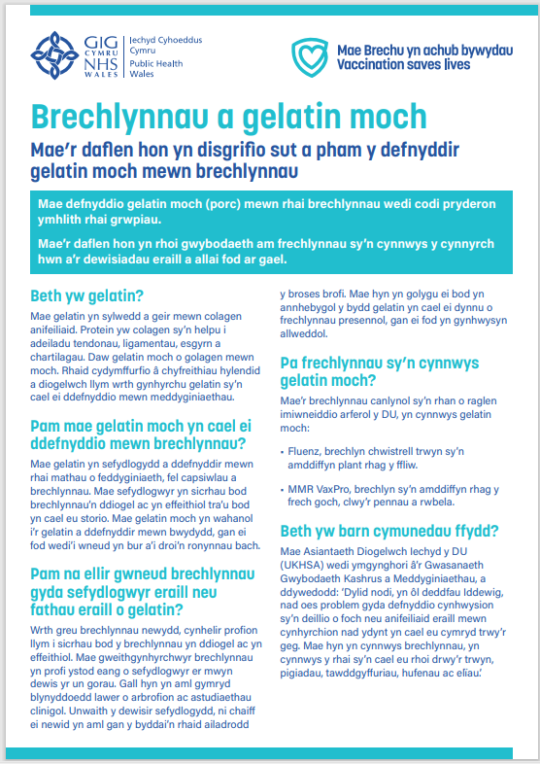
Gelatine content resources
A bilingual porcine gelatine information sheet is available here under ‘Leaflets for all ages’:
English (English presents first)
Welsh (Welsh presents first)

Slide 7
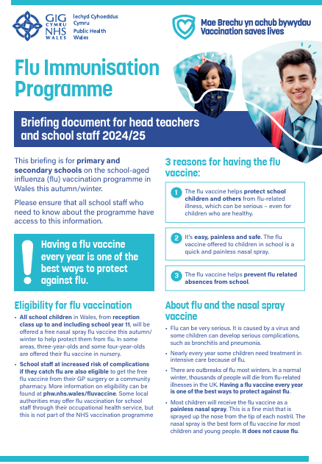
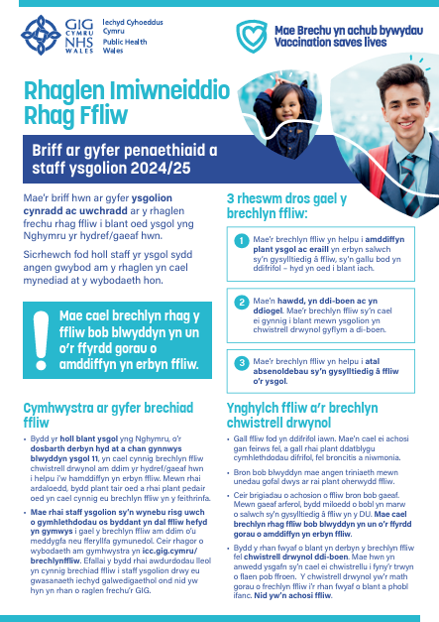
Briefing document for schools: flu
This bilingual resource is being updated for 2025/26 and will be made available from Information for schools: School Aged Children Young People page:
English page (English presents first)
Welsh page (Welsh presents first)
The briefing document is digital and bilingual – the link to it can be shared or it can be printed in health boards
Provides school staff with information about flu, the flu programme, why we vaccinate in schools, the vaccination process, how schools can help, and consent (including Gillick competence)
Feedback from school nurse evaluation of 2023/24 school aged flu resources was that many were not aware of this resource. Please promote it as a useful tool.
Being updated

Slide 8
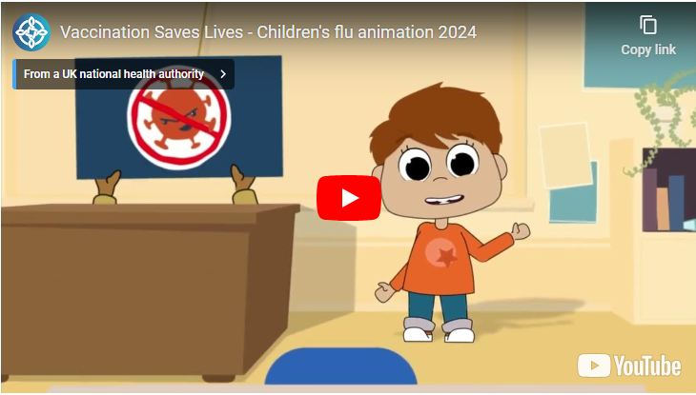
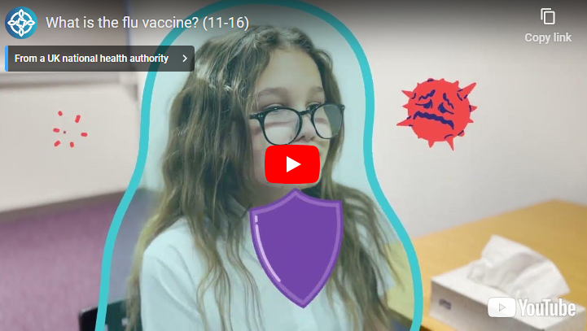
Animations
Primary school video
Vaccination Saves Lives - Children's flu animation 2024 (youtube.com)
Mae Brechu yn achub bywydau - Animeiddiad plant a ffliw 2024 (youtube.com)
Secondary school video
Co-produced and tested with young people
What is the flu vaccine? (11-16) (youtube.com)
Beth yw'r Brechlyn ffliw? (11-16) (youtube.com)

Slide 9

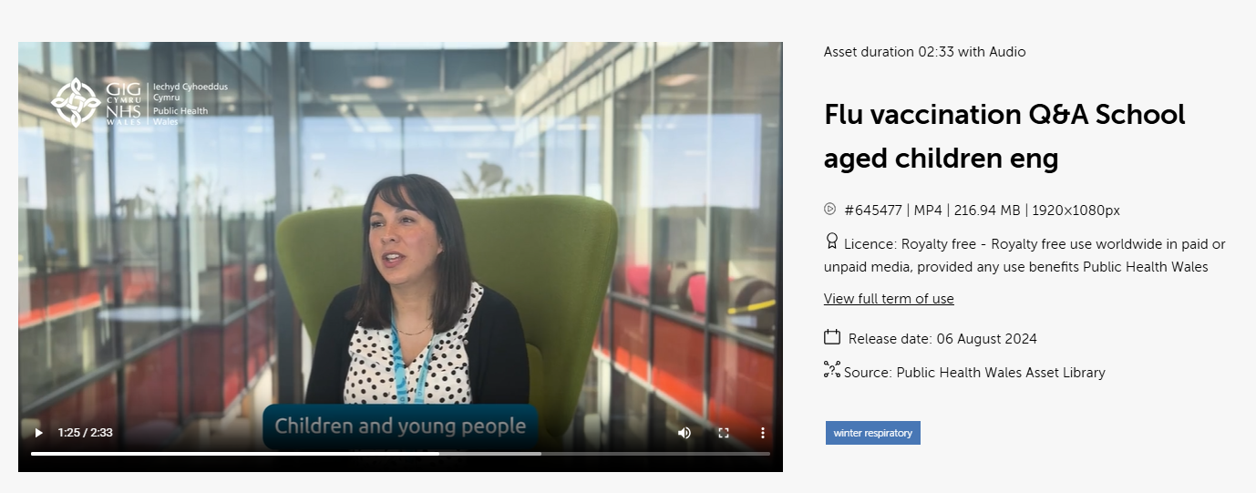
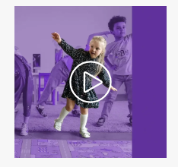
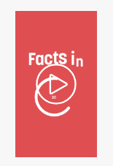
Communications campaign (1)
Although the Winter Respiratory Vaccination Programme communications campaign for 2025/26 is still in development, several communications and assets are already available for the school aged programme including stills/images, Gifs and, facts in 30 videos and explainer videos
These are available at the Brandkit Public Health Wales Asset Library here:
Public Health Wales Asset Library (brandkitapp.com) (look for this icon on the right)
The resources can be accessed on the platform by creating a free account

Slide 10
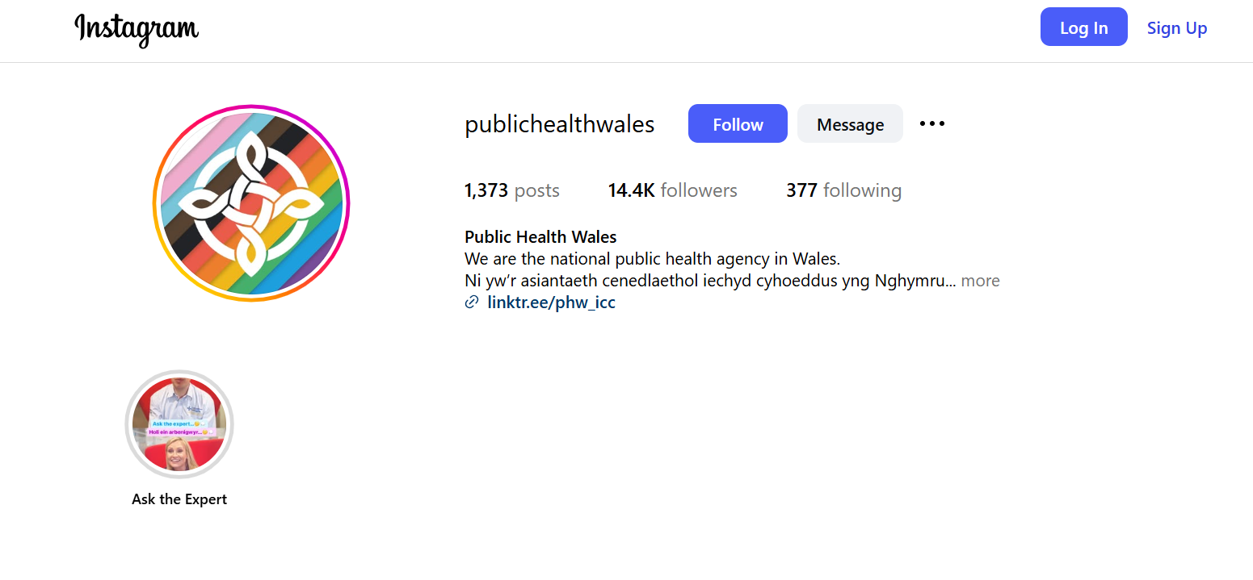
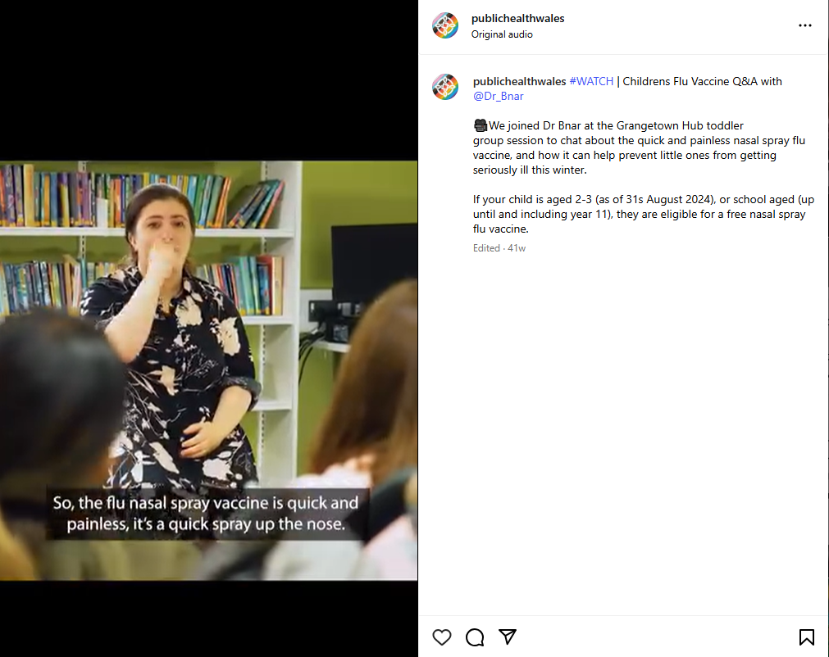
Communications campaign (2)
You can follow Public Health Wales on social media here:
Facebook: Eng | Cym
Instagram: @publichealthwales
LinkedIn: https://www.linkedin.com/company/public-health-wales
TikTok: @publichealthwales

Slide 11
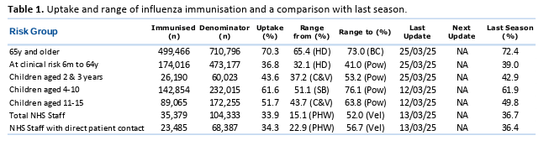
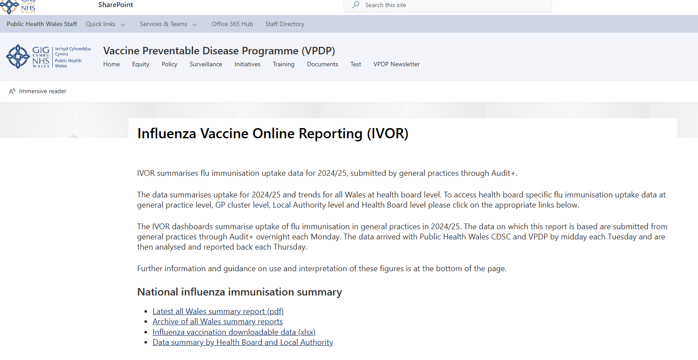
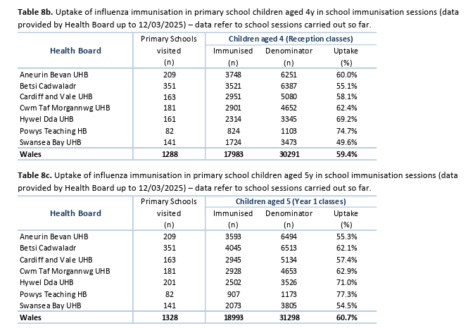
Public Health Wales – School Age Flu Vaccination Data
Public Health Wales publish weekly All Wales Summary reports of influenza vaccination uptake. These are circulated weekly during the influenza vaccination programme and include school aged vaccination uptake. Summaries are also uploaded on to VPDPs sharepoint page here:
Influenza Vaccine Online Reporting (NHS Intranet only)

Slide 12

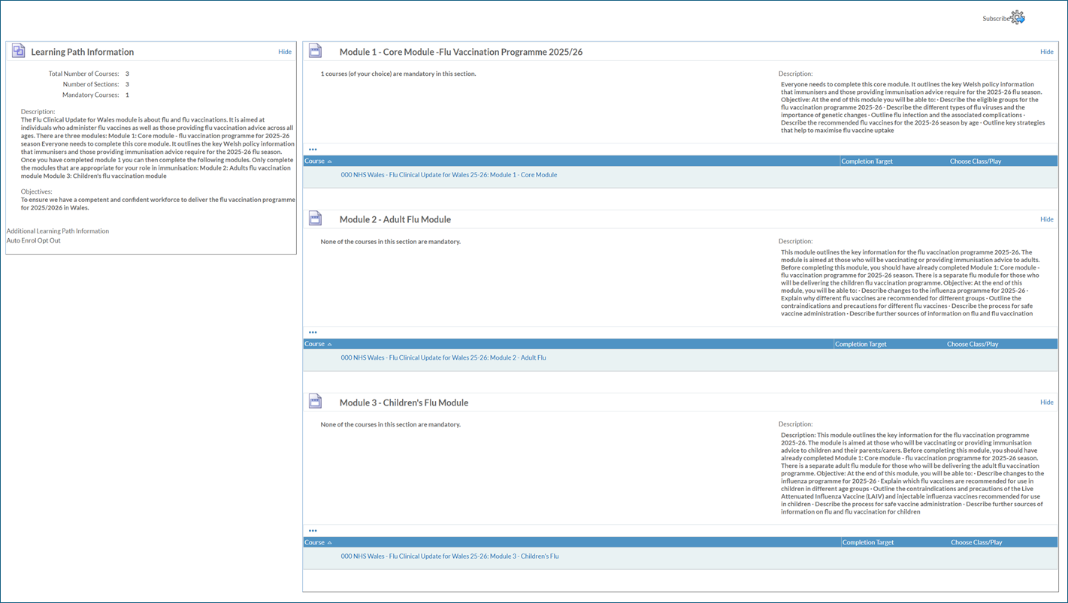
Flu training resources
Flu training slideset available here under ‘Training resources’
E-learning modules available via ESR or Learning@Wales:
Flu vaccine information for health and social care staff in Wales 2025-26
Flu clinical update for Wales 2025-26
More information available here

Slide 13
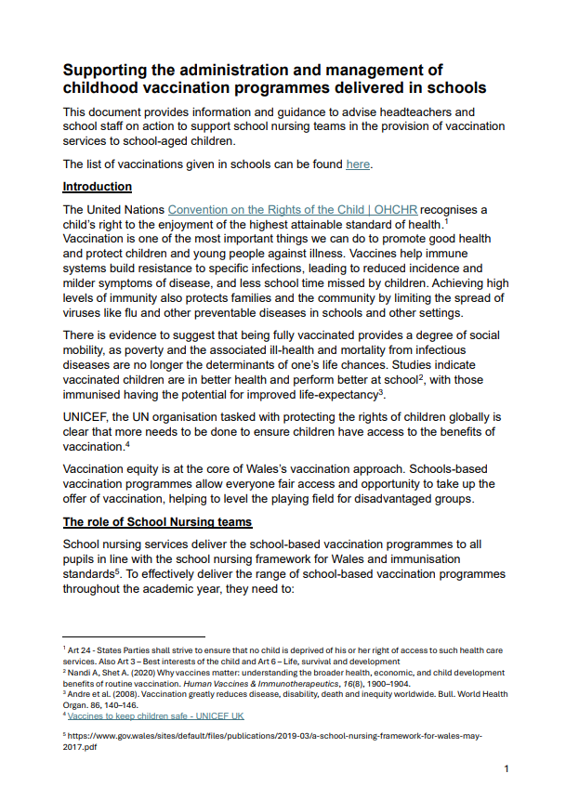
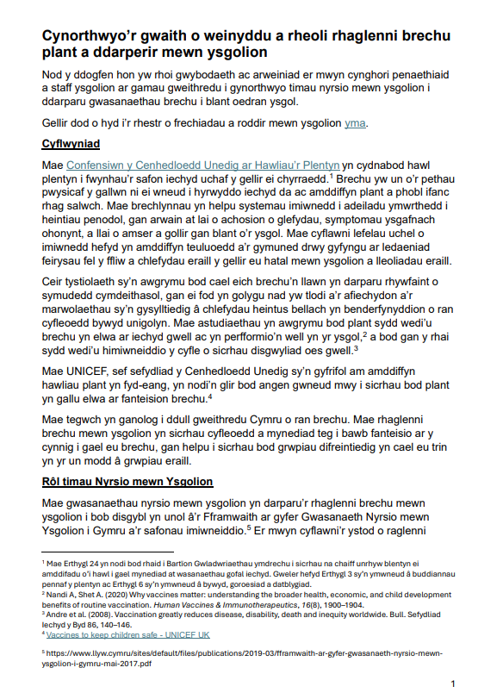
‘School Based Vaccinations - A Guide for Schools’ - Welsh Government 2025
School Based Vaccination Guidance released: Supporting the administration and management of childhood vaccination programmes delivered in schools.
This outlines information for headteachers and school staff to support school nursing services in the provision of school-aged immunisations.
It covers key information such as data sharing and consent to vaccination, including self consent / Gillick Competency.
This is available in Welsh and English, and can be found on this webpage, under the heading ‘Information for Schools’.
This can be shared with schools.

Slide 14
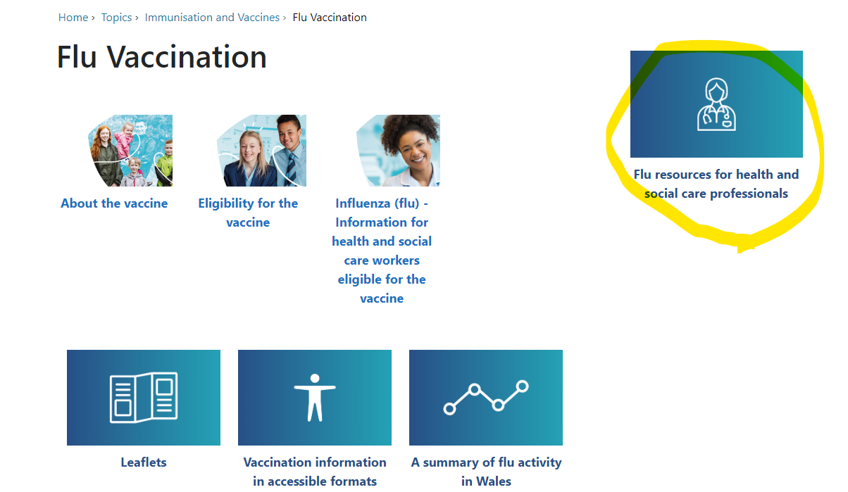
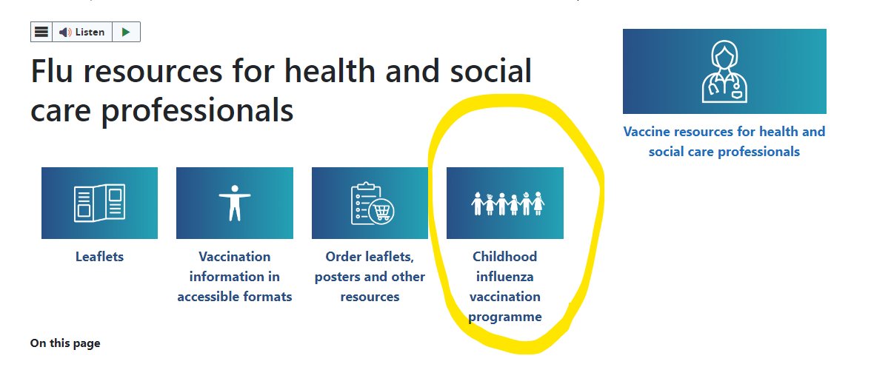
Public Health Wales website
Public Health Wales have flu specific pages for the public but also for health care professionals delivering the flu vaccination programme
The public page can be reached by visiting/typing into your web browser
phw.nhs.wales/fluvaccine
icc.gig.cymru/brechlynffliw
The health care professional page can also be accessed from the public page (see image circled right)
There is a specific page for the Childhood influenza vaccination programme available from the Flu resources for health and social care professionals page (see image circled right)
Additional resources on vaccination for health care professionals on vaccination and immunisation in Wales are available at:
phw.nhs.wales/vaccines-professionals and
Vaccine Preventable Disease Programme (VPDP) - Home (sharepoint.com)

