Slide 1
Pfizer Comirnaty® (10 microgram/ 30 microgram) Omicron XBB.1.5
COVID-19 vaccine – Spring campaign 2024
Vaccine Preventable Disease Programme
Public Health Wales
Version 1 8 March 2024
Notes:
Material contained in this document may be reproduced without prior permission provided it is done so accurately and is not used in a misleading context.
Acknowledgement to Public Health Wales NHS Trust to be stated.
© 2024 Public Health Wales NHS Trust.

Slide 2
Acknowledgements
Vaccine Preventable Disease Programme
Welsh Government
Vaccine Programme Wales
Welsh Medicines Advice Service
JCVI
Green Book

Slide 3
Pfizer Comirnaty® Omicron XBB.1.5 COVID-19 vaccines – spring 2024
The information contained in these slides is accurate at the time of publication 8 March 2024. These slides are version controlled; this is version 1
It is important that COVID-19 immunisers and/or those who are providing COVID-19 immunisation advice, should always ensure they are accessing the most up to date information and refer to the Green Book COVID-19 chapter 14a and other authoritative sources when administering vaccines.

Slide 4
Pre-requisites to administering COVID-19 vaccine
Before administering COVID-19 vaccine, you should have:
Undertaken training in the management of anaphylaxis and Basic Life Support as specified by policy for your local area.
Undertaken any additional statutory and mandatory training as required by your employer.
Received COVID-19 vaccine training through attending a taught session and/or eLearning.
COVID-19 core eLearning module and vaccine specific modules are available to access here: Immunisation eLearning - Public Health Wales (nhs.wales)
Received practical training in COVID-19 vaccine preparation and administration.
Completed the COVID-19 vaccinator competency assessment tool.
An appropriate legal framework to supply and administer COVID-19 vaccine in place e.g. patient specific prescription, Patient Specific Direction (PSD), Patient Group Direction (PGD) or National Protocol (NP).
Accessed and familiarised yourself with the following key documents: Green Book COVID-19 chapter 14a , the UK Health Security Agency COVID-19: vaccination programme guidance for healthcare practitioners, document and the vaccine product information in the Summary of Product Characteristics or ‘Information for healthcare professionals’ document (MHRA website).

Slide 5
JCVI statement on COVID-19 vaccination in spring 2024 and considerations on future COVID-19 vaccination, 4 December 2023 published 07 February 2024
In spring 2024, the Joint Committee on Vaccination and Immunisation (JCVI) advises that a COVID-19 vaccine should be offered to:
Residents in a care home for older adults
Adults aged 75 years and over
Individuals aged 6 months and over who are immunosuppressed (as defined in tables 3 and 4 of the COVID-19 chapter of the Green Book)
This should be offered around 6 months after the last vaccine dose, although operational flexibility around the timing of the spring dose in relation to the last vaccine dose is considered appropriate (with a minimum interval of 3 months between doses). More information on operational flexibility will be provided in the COVID-19 chapter of the Green Book
JCVI statement on COVID-19 vaccination in spring 2024 and considerations on future COVID-19 vaccination, 4 December 2023 - GOV.UK (www.gov.uk)
Notes:
Throughout the pandemic, older people have been among those most likely to experience severe disease if infected by SARS-CoV-2. Existing data on hospital admissions in the UK is consistent with the clinical risk continuing to be higher in those aged 75 years and above, with the highest risk being in those aged 85 years and over. Due to a combination of naturally acquired and vaccine-derived immunity in the population (hybrid immunity), COVID-19 is now a relatively mild disease for the vast majority of people. This ongoing increase in population immunity permits the development of a more targeted programme aimed at those at higher risk of developing serious COVID-19 disease.

Slide 6
JCVI statement on COVID-19 vaccination in spring 2024 and considerations on future COVID-19 vaccination, 4 December 2023 published 07 February 2024
This JCVI statement outlines the vaccine products for spring 2024 programme:
Advised for use in children aged 6 months to 4 years*:
Pfizer-BioNTech mRNA Comirnaty® 3 Omicron XBB.1.5 vaccine infant formulation Dose: 3 micrograms
Advised for use in children aged 5 to 11 years*
Pfizer-BioNTech mRNA Comirnaty ® 10 XBB.1.5 vaccine paediatric formulation. Dose: 10 micrograms
Advised for use in children and young adults aged 12 to 17 years*
Pfizer-BioNTech mRNA Comirnaty ® 30 XBB.1.5 Dose: 30 micrograms
Advised for use in all individuals aged 18 years and over
Pfizer-BioNTech mRNA Comirnaty ® 30 XBB.1.5 Dose: 30 micrograms
Moderna mRNA Spikevax® XBB.1.5 vaccine. Dose: 50 micrograms
*Pfizer BioNTech vaccine is the preferred vaccine for children due to a slightly lower reported rate of myocarditis.
JCVI statement on COVID-19 vaccination in spring 2024 and considerations on future COVID-19 vaccination, 4 December 2023 - GOV.UK (www.gov.uk)

Slide 7
Welsh Health Circular (2024) 009
COVID-19 spring booster vaccination programme 2024
8th February 2024
This WHC confirms the eligible cohorts for vaccination and COVID-19 vaccine products to be deployed in Wales for spring 2024 as per JCVI advice.
The COVID-19 spring vaccination programme will run between 1 April and 30 June 2024. There will be limited flexibility into July, for those who are unable to receive a booster within the main programme window, due to illness.
Programme ambitions:
  All those eligible for a spring booster to receive an invite for vaccination;
  Health boards should make every effort to maximise uptake across all cohorts ensuring that;
    i. uptake levels are maintained or improved for those over 75 years of age and those resident in a care home for older adults, and that every effort is made to achieve 75% uptake for these cohorts;
    ii. by taking account of the challenges faced in encouraging the immunosuppressed to come forward, all possible interventions which could improve uptake for this cohort are explored and any barriers to vaccination are removed;
    iii. the gap is reduced between uptake rates in the least and most deprived areas of the health board.
COVID-19 spring booster 2024 (WHC/2024/009) | GOV.WALES

Slide 8
Primary course and population immunity
By late 2022, it was estimated that most older children and adults in the UK had SARSCoV-2 antibodies, either from natural infection or vaccination or both. Those who have naturally acquired immunity are expected to generate as good an immune response to a single dose of vaccine than naive individuals given two doses
Therefore, from autumn 2023, JCVI is advising that all UK approved COVID-19 vaccines may be offered to those aged 5 years and over as a single vaccine dose
As eligibility for primary and booster vaccination have aligned since autumn 2023, a single dose may be offered to any eligible individual aged 5 years and above irrespective of prior vaccination status, providing there is at least three months from the previous dose
Eligible individuals who commenced or completed primary vaccination, (including those with severe immunosuppression who received additional doses since the previous seasonal campaign) should ideally observe a three month interval.
There is evidence of better immune response and/or protection where longer intervals are used between doses in the primary schedule
Using a three month interval for all second and subsequent doses, therefore, will help to maximise the duration of protection.
Green Book COVID-19 chapter 14a

Slide 9
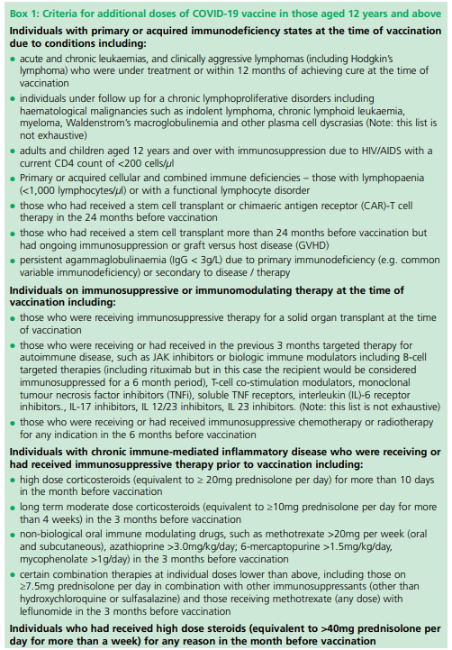
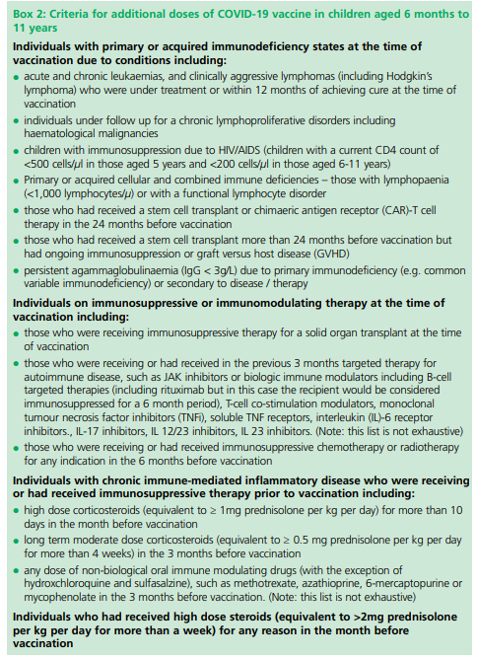
Individuals who are severely immunosuppressed
Individuals aged 6 months and above who have severe immunosuppression, are defined in Boxes 1 and 2.
Most individuals who receive brief immunosuppression (≥40mg prednisolone per day or equivalent for children) for an acute episode (for example, asthma / COPD / COVID-19) and individuals on replacement corticosteroids for adrenal insufficiency are not considered severely immunosuppressed sufficient to prevent response to vaccination.
Individuals who are severely immunosuppressed, as defined by Chapter 14a Green Book and/or have been referred for vaccination by a specialist who has designated them as group 01 or 02 as described in WIS (Welsh Immunisation System) are eligible for their COVID-19 vaccine via a PGD: Patient Group Directions (PGD) - Welsh Medicines Advice Service (wales.nhs.uk)
Notes:
Green Book COVID-19 chapter 14a

Slide 10
Severely immunosuppressed additional doses and intervals
JCVI initially advised that a third dose of vaccine should be offered to individuals who were considered to be severely immunosuppressed at the time of, or within two weeks after their first or second COVID-19 doses in the primary schedule.
These individuals then became eligible for catch-up or booster doses (in autumn 2021, spring 2022, autumn 2022, spring 2023 and autumn 2023) and are expected to be eligible for regular vaccination in all subsequent seasonal campaigns.
Individuals previously vaccinated
Individuals who become or have recently become severely immunosuppressed should be considered for an additional dose of the vaccine regardless of their past vaccination history. The additional dose can be offered at a minimum interval of 3 months (91 days) from previous dose
Individuals previously unvaccinated*
Individuals who become or have recently become severely immunosuppressed should be considered for a first dose of vaccination (off label) and the second dose given ideally at an interval of 8-12 weeks from the previous dose.
* including individuals who receive bone marrow transplants, CAR-T therapy as they may have lost immunological memory of previous vaccination
Notes:
In contrast to other eligible risk groups, those who are eligible for a vaccination due to severe immunosuppression but miss vaccination during the campaign period, may be considered for an additional dose at a later date based on individual clinical judgement, balancing their immediate level of risk against the advantages of waiting till the next seasonal campaign.

Slide 11
Severely immunosuppressed additional doses and intervals
For individuals about to receive planned immunosuppressive treatment, a minimum interval of 3 weeks between COVID-19 doses may be followed, to enable the vaccine to be given whilst the individual’s immune system is better able to respond. Due consideration must be given to the risk of delaying vaccination against that of delaying treatment.
Assessment of individuals is recommended on a case by case basis, in conjunction with their treating specialist.
More information on dosing intervals for additional doses and optimal timing of doses may be found in Chapter 14a.

Slide 12
Timing of additional doses
Vaccines administered during periods of minimum immunosuppression are more likely to generate better immune responses. Therefore, any planned additional doses should ideally be given with special attention paid to current or planned immunosuppressive therapies. For example:
For the small number of patients who are about to receive planned immunosuppressive therapy, vaccination may be brought forward to before commencing that therapy (ideally at least two weeks before), when their immune system is better able to make a response.
To maximise the benefit, the vaccine should not be given within three weeks of a previous dose
Where possible, additional booster doses should be delayed until two weeks after the period of immunosuppression, in addition to the time period for clearance of the therapeutic agent
Alternatively, consideration should be given to vaccination during a treatment ‘holiday’ or when the degree of immunosuppression is at a minimum
Any decision to defer immunosuppressive therapy or to delay possible benefit from vaccination until after therapy should only be taken with due consideration of the risks of exacerbating their underlying condition, as well as the risks from COVID-19.
Green Book COVID-19 chapter 14a

Slide 13
Individuals who receive bone marrow transplant and CAR-T therapy
These individuals may lose immunological memory from vaccination received prior to the treatment and the development of the underlying condition.
After treatment and recovery, these individuals should be considered for a full course of revaccination for all vaccines used in the routine programme (see chapter 7 Green Book) under specialist advice.
Individuals who have recovered from a bone marrow transplant should be considered for a first dose of COVID-19 vaccine, regardless of the time of year.
A subsequent dose should then be offered ideally at an interval of 8 to 12 weeks, to extend the duration of protection. This interval may be reduced to a minimum of three weeks on specialist clinical advice.
Those who remain immunosuppressed will then continue to be eligible for seasonal campaigns.

Slide 14
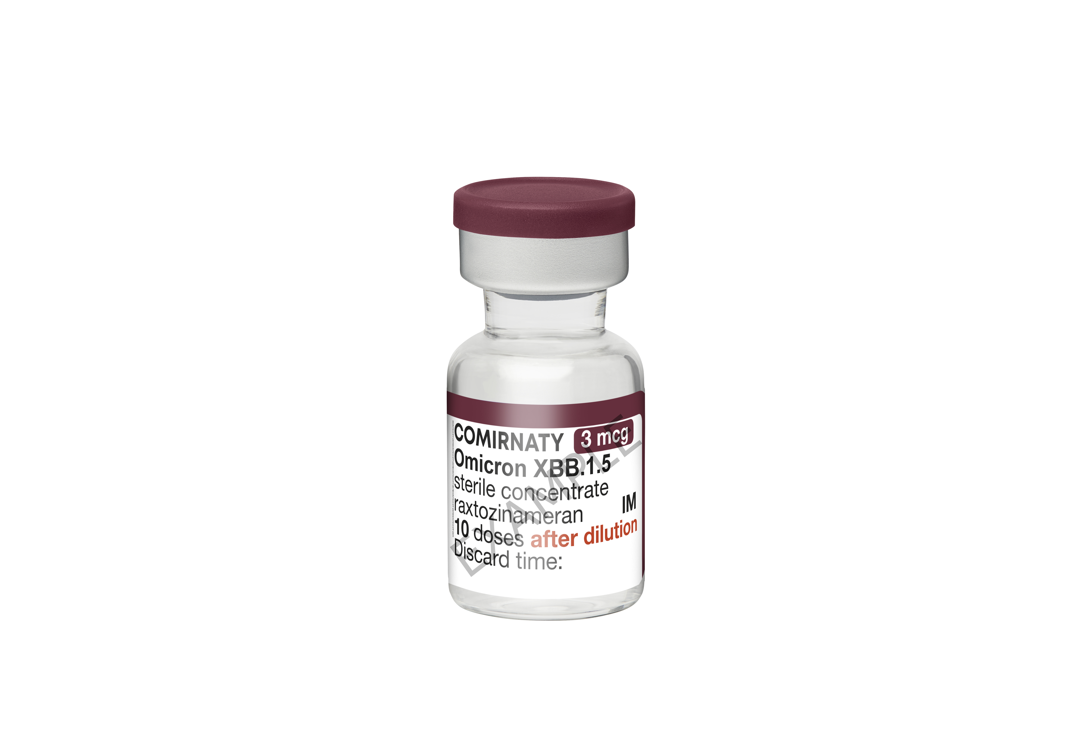
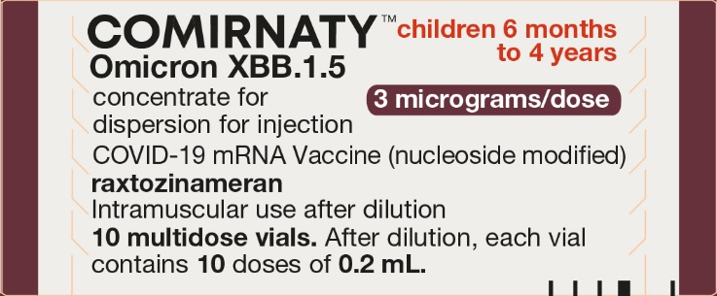
Regulatory approval of Pfizer/BioNTech vaccine for COVID-19 - GOV.UK (www.gov.uk)
Further information on Omicron XBB.1.5 (3 mcg) is available in this specific slide set:
COVID-19 Vaccination for infants and children aged 6 months to 4 years in a clinical risk group version 2
available to view here: Resources for health and social care professionals - Public Health Wales (nhs.wales)

Slide 15
Pfizer Comirnaty® Omicron XBB.1.5▼ 10 microgram per dose dispersion for injection COVID-19 mRNA Vaccine

Slide 16
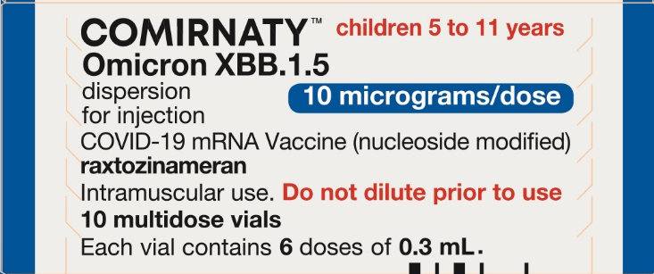
Pfizer Comirnaty® Omicron XBB.1.5▼ 10 microgram per dose dispersion for injection
COVID-19 mRNA Vaccine
SmPC Pfizer Comirnaty® Omicron XBB.1.5▼ 10 microgram per dose dispersion for injection COVID-19 mRNA Vaccine (nucleoside modified) raxtozinameran
Notes:
Regulatory approval of Pfizer/BioNTech vaccine for COVID-19 - GOV.UK (www.gov.uk)

Slide 17
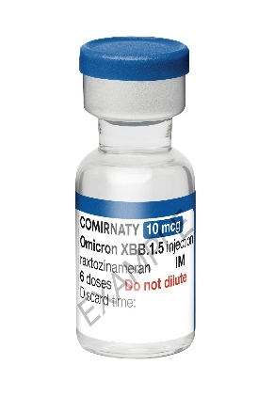
Current licence approval to administer Pfizer Comirnaty® Omicron XBB.1.5▼ 10 microgram per dose dispersion for injection COVID-19 mRNA Vaccine
This vaccine is indicated for the immunisation of children aged 5 to 11 years of age (i.e. 5 to less than 12 years of age), in accordance with the vaccine products to be used in the spring 2024 COVID-19 Vaccination programme COVID-19 spring booster 2024 (WHC/2024/009) | GOV.WALES including recommendations given in Chapter 14a of Immunisation Against Infectious Disease (the ‘Green Book’) and subsequent official correspondence/publications.
Regulatory approval of Pfizer/BioNTech vaccine for COVID-19 - GOV.UK (www.gov.uk)

Slide 18
Patient Group Directions (PGDs) and
National Protocols
Omicron XBB.1.5▼ 10 microgram per dose dispersion for injection COVID-19 mRNA Vaccine PGD and National Protocol will be available to view here: Patient Group Directions (PGD) - Welsh Medicines Advice Service (wales.nhs.uk)

Slide 19
Key features of Pfizer Comirnaty® Omicron XBB.1.5▼ 10 microgram per dose dispersion for injection COVID-19 mRNA Vaccine
Pfizer Comirnaty® Omicron XBB.1.5▼ 10 microgram per dose dispersion for injection COVID-19 mRNA Vaccine
Raxtozinameran is a single-stranded, 5’-capped messenger RNA (mRNA) produced using a cell-free in vitro transcription from the corresponding DNA templates, encoding the viral spike (S) protein of SARS-CoV-2 (Omicron XBB.1.5).
The vaccine contains the genetic code (mRNA) of the spike protein, which is found on the surface of the SARS-CoV-2 virus. Once inside the body, the spike protein is produced, causing the immune system to recognise it and initiate an immune response.
This means that if the body later encounters the spike protein of the coronavirus, the immune system will recognise it and destroy it before causing infection. As there is no whole or live virus involved, the vaccines cannot cause COVID-19 disease. The mRNA is naturally degraded after a few days.
Home | Vaccine Knowledge Project (ox.ac.uk) has additional information about different types of vaccines and how they are manufactured.

Slide 20
List of excipients: Pfizer Comirnaty® Omicron XBB.1.5▼ 10 microgram per dose dispersion for injection
COVID-19 mRNA Vaccine
This vaccine contains polyethylene glycol/macrogol (PEG)
2-[(polyethylene glycol)-2000]-N,
N-ditetradecylacetamide (ALC-0159)
(4-hydroxybutyl)azanediyl)bis(hexane-6,1-diyl)bis(2-hexyldecanoate) (ALC-0315)
1,2-Distearoyl-sn-glycero-3-phosphocholine (DSPC)
Cholesterol
Trometamol
Trometamol hydrochloride
Sucrose
Water for injections
Vaccine ingredients | Vaccine Knowledge (ox.ac.uk)

Slide 21
Polyethylene glycol (PEG)
The Pfizer Comirnaty® Omicron XBB.1.5▼ 10 microgram per dose dispersion for injection COVID-19 mRNA Vaccine contains polyethylene glycol (PEG).
PEGs (also known as macrogols) are a group of known allergens commonly found in medicines, many household products and cosmetics.
Medicines containing PEG include some tablets, laxatives, depot steroid injections, and some bowel preparations used for colonoscopy.
Known allergy to PEG is rare but has been implicated in a minority of allergic reactions reported.
Patients with undiagnosed PEG allergy often have a history of immediate onset-unexplained anaphylaxis or anaphylaxis to multiple classes of drugs or an unexplained anaphylaxis. Such individuals should not be vaccinated with Pfizer Comirnaty® Omicron XBB.1.5▼ 10 microgram per dose dispersion for injection COVID-19 mRNA Vaccine except on the expert advice of an allergy specialist.
Known allergy to PEG is rare but has been implicated in a minority of allergic reactions reported.
For further information see: Table 5: Management of patients with a history of allergy in Green Book COVID-19 chapter 14a

Slide 22
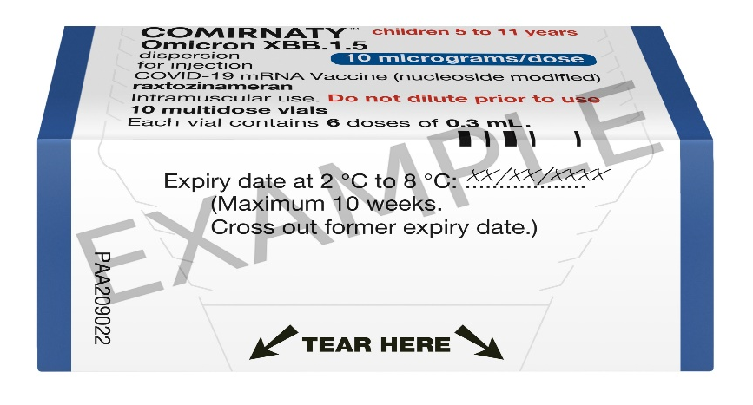
Storage and handling of Pfizer Comirnaty® Omicron XBB.1.5▼ 10 microgram per dose dispersion for injection COVID-19 mRNA Vaccine
Pfizer Comirnaty® Omicron XBB.1.5▼ 10 microgram per dose dispersion for injection COVID-19 mRNA Vaccine
will be coming into NHS Wales thawed from UKHSA, it will already have the expiry date and time labelled on the box.
The vaccine may then be delivered to where it is going to be administered thawed but refrigerated between +2ºC to +8ºC.
Thawed vaccine must be transferred immediately to a vaccine fridge on arrival and stored in a carefully monitored temperature range of +2ºC to +8ºC.
Once thawed, the unopened vaccine may be stored refrigerated at +2ºC to +8ºC, protected from light, for up to 10 weeks.
Stability data indicate the vial can be stored for up to 24 hours at temperatures of 8 °C to 30 °C, including up to 12 hours following first puncture.

Slide 23
Prior to giving the Pfizer Comirnaty® Omicron XBB.1.5▼ 10 microgram per dose dispersion for injection
COVID-19 mRNA Vaccine
Before giving the vaccine, you need to check whether the person to be vaccinated:
Is eligible to receive the Pfizer Comirnaty® Omicron XBB.1.5▼ 10 microgram per dose dispersion for injection COVID-19 mRNA Vaccine Has not received any COVID-19 vaccination in the previous 3 months.
Has any contraindications or precautions to Pfizer Comirnaty® Omicron XBB.1.5▼ 10 microgram per dose dispersion for injection COVID-19 mRNA Vaccine. The Green Book COVID-19 chapter 14a states, for those eligible for vaccination during seasonal campaigns, a single dose is offered at least 3 months after any previous dose. This interval applies to any vaccine, regardless of the product given for the previous doses. Timing should follow the JCVI advice for that campaign, which aims to provide protection to the most vulnerable at the optimal time
The only exceptions to the 3-month interval would be individuals who are immunosuppressed, these individuals would be recommended a second dose and in some circumstances may need to complete vaccinations within a treatment window. In this situation the minimum interval could be reduced to 3 weeks Green Book COVID-19 chapter 14a
Operational flexibility is permitted to offer the booster to eligible individuals expected to reach the target age during campaign windows.

Slide 24
Contraindications - Pfizer Comirnaty® Omicron XBB.1.5▼ 10 microgram per dose dispersion for injection COVID-19 mRNA Vaccine
Vaccination should be postponed in individuals suffering from acute severe febrile illness or acute infection. The presence of a minor infection and/or low-grade fever should not delay vaccination.
The vaccine is contraindicated in those who have had a previous systemic allergic reaction (including immediate-onset anaphylaxis) to:
  a previous dose of a Pfizer Comirnaty® vaccine
  any component (excipient) of the COVID-19 mRNA vaccines
  another mRNA vaccine
People with a history of allergy: A very small number of individuals have experienced anaphylaxis when receiving a COVID-19 vaccine. Anyone with a history of allergic reaction to an excipient in the COVID-19 vaccine should not receive that vaccine (except with expert advice), but those with any other allergies (such as a food allergy) – including those with prior anaphylaxis – can have the vaccine. Guidance about the management of individuals with a history of allergy should be followed (summarised in Table 5) COVID-19: the green book, chapter 14a - GOV.UK (www.gov.uk).
Notes:
Before administering a COVID-19 vaccine, it is important to check for any relevant medical history including allergies and any previous history of severe reaction to a vaccine.

Slide 25
Indication for use of Pfizer Comirnaty® Omicron XBB.1.5▼ 10 microgram per dose dispersion for injection COVID-19 mRNA Vaccine
Pfizer Comirnaty® Omicron XBB.1.5▼ 10 microgram per dose dispersion for injection COVID-19 mRNA Vaccine is indicated as a primary or booster dose for active immunisation to prevent COVID-19 caused by SARS-CoV-2 in children aged 5 to 11 years in a clinical risk group, as defined in tables 3 and 4 of the COVID-19 chapter of the Green Book.
There should be an interval of at least 3 months between administration of the Pfizer Comirnaty® Omicron XBB.1.5▼ 10 microgram per dose dispersion for injection COVID-19 mRNA Vaccine and previous dose of a COVID-19 vaccine.
Additional doses may be administered to children aged 5 years and older who are severely immunocompromised, in accordance with national recommendations.
Regulatory approval of Pfizer/BioNTech vaccine for COVID-19 - GOV.UK (www.gov.uk)

Slide 26
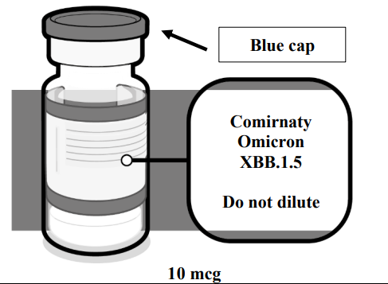
Vial verification - Pfizer Comirnaty® Omicron XBB.1.5▼ 10 microgram per dose dispersion for injection COVID-19 mRNA Vaccine
(CHILDREN 5 TO 11 YEARS), MULTIDOSE VIAL
Verify that the vial has a blue plastic cap and the product name is Comirnaty Omicron XBB.1.5 10 micrograms/dose dispersion for injection.
Comirnaty Omicron XBB.1.5 dispersion is supplied in a 2 mL clear vial (type I glass) with a stopper (synthetic bromobutyl rubber) and a blue flip-off plastic cap with aluminium seal.
One multidose vial (2.25 mL) contains 6 doses of 0.3 mL.
Multidose vial pack size: 10 vials.

Slide 27
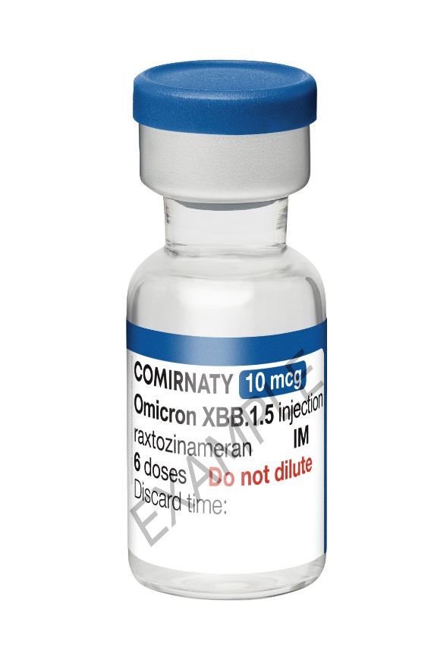
Presentation- Pfizer Comirnaty® Omicron XBB.1.5▼ 10 microgram per dose dispersion for injection
COVID-19 mRNA Vaccine
Multidose vials of Comirnaty Omicron XBB.1.5 contain 6 doses of 0.3 mL of vaccine.
In order to extract 6 doses from a single vial, low dead-volume syringes and/or needles should be used. The low dead-volume syringe and needle combination should have a dead volume of no more than 35 microlitres. If standard syringes and needles are used, there may not be sufficient volume to extract a sixth dose from a single vial.
Irrespective of the type of syringe and needle:
  Each dose must contain 0.3 mL of vaccine.
  If the amount of vaccine remaining in the vial cannot provide a full dose of 0.3 mL, discard the vial and any excess volume.
  Do not pool excess vaccine from multiple vials.
Regulatory approval of Pfizer/BioNTech vaccine for COVID-19 - GOV.UK (www.gov.uk)
Notes:
A single dose of 0.3 mL should be administered for those aged 5-11 years regardless of prior COVID-19 vaccination status, and at least three months from the previous COVID-19 vaccine dose.

Slide 28
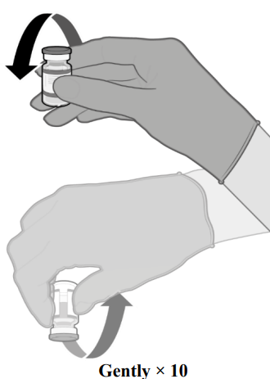
Vaccine dose preparation(1) - Pfizer Comirnaty® Omicron XBB.1.5▼ 10 microgram per dose dispersion for injection COVID-19 mRNA Vaccine
Pfizer Comirnaty® Omicron XBB.1.5▼ 10 microgram per dose dispersion for injection COVID-19 mRNA Vaccine does not require reconstitution.
Before drawing up a dose of vaccine from the multidose vial, clean hands with alcohol-based gel or soap and water.
Each multidose vial should be clearly labelled with the date and time of expiry (which will be 12 hours from when it was first punctured).
Do not use the vaccine if the time of first puncture was more than 12 hours previously. Stability data indicate the vial can be stored for up to 24 hours at temperatures of 8 °C to 30 °C, including up to 12 hours following first puncture.
Gently mix by inverting vials 10 times prior to use. Do not shake.
Prior to mixing, the thawed dispersion may contain white to off-white opaque amorphous particles.
After mixing, the vaccine should present as a clear to slightly opalescent dispersion with no particulates visible. Do not use the vaccine if particulates or discolouration are present.
Notes:
Comirnaty Omicron XBB.1.5 should be prepared by a healthcare professional using aseptic technique to ensure the sterility of the prepared dispersion. Opened vial Chemical and physical in-use stability has been demonstrated for 12 hours at 2 ºC to 30 ºC, which includes up to 6 hours transportation time. From a microbiological point of view, unless the method of opening precludes the risks of microbial contamination, the product should be used immediately. If not used immediately, in-use storage times and conditions are the responsibility of the user.

Slide 29
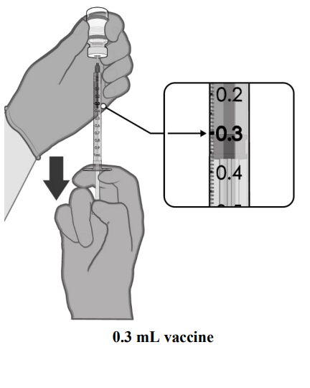
Vaccine dose preparation (2)
Using aseptic technique, cleanse the vial stopper with a single-use antiseptic swab.
Withdraw 0.3 mL of Pfizer Comirnaty® Omicron XBB.1.5▼ 10 microgram per dose dispersion for injection COVID-19 mRNA Vaccine. Low dead-volume syringes and/or needles should be used in order to extract 6 doses from a single vial.
The low dead-volume syringe and needle combination should have a dead volume of no more than 35 microlitres. If standard syringes and needles are used, there may not be sufficient volume to extract a sixth dose from a single vial.
Each dose must contain 0.3 mL of vaccine.
If the amount of vaccine remaining in the vial cannot provide a full dose of 0.3 mL, discard the vial and any excess volume.
Record the appropriate date/time on the vial.
Discard any unused vaccine 12 hours after first puncture.

Slide 30
Adverse reactions
Local reactions at the injection site are fairly common after Pfizer BioNTech COVID-19 vaccine, primarily pain at the injection site, usually without redness and swelling. Systemic events reported were generally mild and short lived (Walsh et al, 2020).
The most frequent adverse reactions in children 5 to 11 years of age that received 2 doses of Comirnaty® 10 mcg were injection site pain (> 80%), fatigue (> 50%), headache (> 30%), injection site redness and swelling (≥ 20%), myalgia, chills, and diarrhoea (> 10%).
Children 5 to 11 years of age (i.e., 5 to less than 12 years of age) – after booster dose
A study highlighted that a total of 401 children 5 to 11 years of age received a booster dose of Comirnaty ® 10 mcg at least 5 months (range of 5 to 9 months) after completing the primary series. The analysis of the Study 3 Phase 2/3 subset is based on data up to the cut-off date of 22 March 2022 (median follow-up time of 1.3 months).
The overall safety profile for the booster dose was similar to that seen after the primary course. The most frequent adverse reactions in children 5 to 11 years of age were injection site pain (> 70%), fatigue (> 40%), headache (> 30%), myalgia, chills, injection site redness and swelling (> 10%).
Regulatory approval of Pfizer/BioNTech vaccine for COVID-19 - GOV.UK (www.gov.uk)
The safety of Comirnaty Omicron XBB.1.5 is inferred from safety data of the prior Comirnaty vaccines

Slide 31
Pfizer Comirnaty® Omicron XBB.1.5▼ 30 microgram per dose dispersion for injection COVID-19 mRNA Vaccine

Slide 32
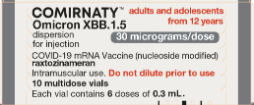
Pfizer Comirnaty® Omicron XBB.1.5▼ 30 microgram per dose dispersion for injection COVID-19 mRNA Vaccine
SmPC Pfizer Comirnaty® Omicron XBB.1.5▼ 30 microgram per dose dispersion for injection COVID-19 mRNA Vaccine (nucleoside modified) raxtozinameran
Notes:
Regulatory approval of Pfizer/BioNTech vaccine for COVID-19 - GOV.UK (www.gov.uk)

Slide 33
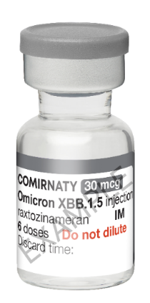
Current licence approval to administer Pfizer Comirnaty® Omicron XBB.1.5▼ 30 microgram per dose dispersion for injection COVID-19 mRNA Vaccine
This vaccine is indicated for the immunisation of adults and adolescents from 12 years of age in accordance with the vaccine products to be used in the spring 2024 COVID-19 Vaccination programme COVID-19 spring booster 2024 (WHC/2024/009) | GOV.WALES including recommendations given in Chapter 14a of Immunisation Against Infectious Disease (the ‘Green Book’) and subsequent official correspondence/publications.
Regulatory approval of Pfizer/BioNTech vaccine for COVID-19 - GOV.UK (www.gov.uk)

Slide 34
Patient Group Directions (PGDs) and
National Protocols
Omicron XBB.1.5▼ 30 microgram per dose dispersion for injection COVID-19 mRNA Vaccine PGD and National Protocol will be available to view here: Patient Group Directions (PGD) - Welsh Medicines Advice Service (wales.nhs.uk)

Slide 35
Key features of Pfizer Comirnaty® Omicron XBB.1.5▼ 30 microgram per dose dispersion for injection COVID-19 mRNA Vaccine
Pfizer Comirnaty® Omicron XBB.1.5▼ 30 microgram per dose dispersion for injection COVID-19 mRNA Vaccine
Raxtozinameran is a single-stranded, 5’-capped messenger RNA (mRNA) produced using a cell-free in vitro transcription from the corresponding DNA templates, encoding the viral spike (S) protein of SARS-CoV-2 (Omicron XBB.1.5).
The vaccine contains the genetic code (mRNA) of the spike protein, which is found on the surface of the SARS-CoV-2 virus. Once inside the body, the spike protein is produced, causing the immune system to recognise it and initiate an immune response.
This means that if the body later encounters the spike protein of the coronavirus, the immune system will recognise it and destroy it before causing infection. As there is no whole or live virus involved, the vaccines cannot cause COVID-19 disease. The mRNA is naturally degraded after a few days.
Home | Vaccine Knowledge Project (ox.ac.uk) has additional information about different types of vaccines and how they are manufactured.

Slide 36
List of excipients: Pfizer Comirnaty® Omicron XBB.1.5▼ 30 microgram per dose dispersion for injection
COVID-19 mRNA Vaccine
This vaccine contains polyethylene glycol/macrogol (PEG)
2-[(polyethylene glycol)-2000]-N,
N-ditetradecylacetamide (ALC-0159)
(4-hydroxybutyl)azanediyl)bis(hexane-6,1-diyl)bis(2-hexyldecanoate) (ALC-0315)
1,2-Distearoyl-sn-glycero-3-phosphocholine (DSPC)
Cholesterol
Trometamol
Trometamol hydrochloride
Sucrose
Water for injections
Vaccine ingredients | Vaccine Knowledge (ox.ac.uk)

Slide 37
Polyethylene glycol (PEG)
The Pfizer Comirnaty® Omicron XBB.1.5▼ 30 microgram per dose dispersion for injection COVID-19 mRNA Vaccine contains polyethylene glycol (PEG).
PEGs (also known as macrogols) are a group of known allergens commonly found in medicines, many household products and cosmetics.
Medicines containing PEG include some tablets, laxatives, depot steroid injections, and some bowel preparations used for colonoscopy.
Known allergy to PEG is rare but has been implicated in a minority of allergic reactions reported.
Patients with undiagnosed PEG allergy often have a history of immediate onset-unexplained anaphylaxis or anaphylaxis to multiple classes of drugs or an unexplained anaphylaxis. Such individuals should not be vaccinated with Pfizer Comirnaty® Omicron XBB.1.5▼ 30 microgram per dose dispersion for injection COVID-19 mRNA Vaccine except on the expert advice of an allergy specialist.
Known allergy to PEG is rare but has been implicated in a minority of allergic reactions reported.
For further information see: Table 5: Management of patients with a history of allergy in Green Book COVID-19 chapter 14a

Slide 38
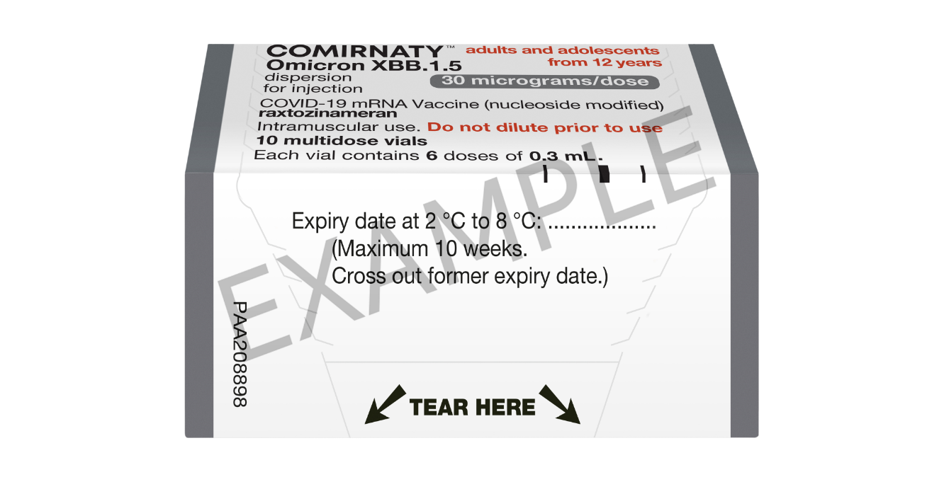
Storage and handling of Pfizer Comirnaty® Omicron XBB.1.5▼ 30 microgram per dose dispersion for injection COVID-19 mRNA Vaccine
Pfizer Comirnaty® Omicron XBB.1.5▼ 30 microgram per dose dispersion for injection COVID-19 mRNA Vaccine
will be coming into NHS Wales thawed from UKHSA, it will already have the expiry date and time labelled on the box.
The vaccine may then be delivered to where it is going to be administered thawed but refrigerated between +2ºC to +8ºC.
Thawed vaccine must be transferred immediately to a vaccine fridge on arrival and stored in a carefully monitored temperature range of +2ºC to +8ºC.
Once thawed, the unopened vaccine may be stored refrigerated at +2ºC to +8ºC, protected from light, for up to 10 weeks.
Stability data indicate the vial can be stored for up to 24 hours at temperatures of 8 °C to 30 °C, including up to 12 hours following first puncture.

Slide 39
Prior to giving the Pfizer Comirnaty® Omicron XBB.1.5▼ 30 microgram per dose dispersion for injection
COVID-19 mRNA Vaccine
Before giving the vaccine, you need to check whether the person to be vaccinated:
Is eligible to receive the Pfizer Comirnaty® Omicron XBB.1.5▼ 30 microgram per dose dispersion for injection COVID-19 mRNA Vaccine Has not received any COVID-19 vaccination in the previous 3 months.
Has any contraindications or precautions to Pfizer Comirnaty® Omicron XBB.1.5▼ 30 microgram per dose dispersion for injection COVID-19 mRNA Vaccine Green Book COVID-19 chapter 14a states, for those eligible for vaccination during seasonal campaigns, a single dose is offered at least 3 months after any previous dose. This interval applies to any vaccine, regardless of the product given for the previous doses. Timing should follow the JCVI advice for that campaign, which aims to provide protection to the most vulnerable at the optimal time
The only exceptions to the 3-month interval would be individuals who are immunosuppressed, these individuals would be recommended a second dose and in some circumstances may need to complete vaccinations within a treatment window. In this situation the minimum interval could be reduced to 3 weeks Green Book COVID-19 chapter 14a
Operational flexibility is permitted to offer the booster to eligible individuals expected to reach the target age during campaign windows.

Slide 40
Contraindications - Pfizer Comirnaty® Omicron XBB.1.5▼ 30 microgram per dose dispersion for injection COVID-19 mRNA Vaccine
Vaccination should be postponed in individuals suffering from acute severe febrile illness or acute infection. The presence of a minor infection and/or low-grade fever should not delay vaccination.
The vaccine is contraindicated in those who have had a previous systemic allergic reaction (including immediate-onset anaphylaxis) to:
  a previous dose of a Pfizer Comirnaty® vaccine
  any component (excipient) of the COVID-19 mRNA vaccines
  another mRNA vaccine
People with a history of allergy: A very small number of individuals have experienced anaphylaxis when receiving a COVID-19 vaccine. Anyone with a history of allergic reaction to an excipient in the COVID-19 vaccine should not receive that vaccine (except with expert advice), but those with any other allergies (such as a food allergy) – including those with prior anaphylaxis – can have the vaccine. Guidance about the management of individuals with a history of allergy should be followed (summarised in Table 5) COVID-19: the green book, chapter 14a - GOV.UK (www.gov.uk).
Notes:
Before administering a COVID-19 vaccine, it is important to check for any relevant medical history including allergies and any previous history of severe reaction to a vaccine.

Slide 41
Indication for use of Pfizer Comirnaty® Omicron XBB.1.5▼ 30 microgram per dose dispersion for injection COVID-19 mRNA Vaccine
Pfizer Comirnaty® Omicron XBB.1.5▼ 30 microgram per dose dispersion for injection COVID-19 mRNA Vaccine is indicated for the immunisation of individuals aged 12 years and over to prevent COVID-19 caused by SARS-CoV-2.
There should be an interval of at least 3 months between administration of the Pfizer Comirnaty® Omicron XBB.1.5▼ 30 microgram per dose dispersion for injection COVID-19 mRNA Vaccine and previous dose of a COVID-19 vaccine.
Pfizer Comirnaty® Omicron XBB.1.5▼ 30 microgram per dose dispersion for injection COVID-19 mRNA Vaccine can be offered when someone attends for primary vaccination
Regulatory approval of Pfizer/BioNTech vaccine for COVID-19 - GOV.UK (www.gov.uk)

Slide 42
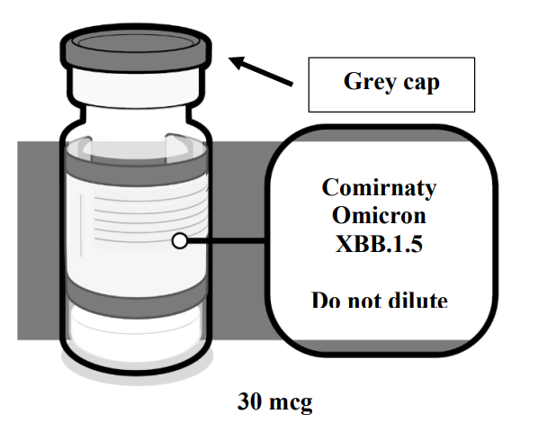
Vial verification: Pfizer Comirnaty® Omicron XBB.1.5▼ 30 microgram per dose dispersion for injection COVID-19 mRNA Vaccine (12 YEARS AND OLDER), MULTIDOSE VIAL
Verify that the vial has a grey plastic cap and the product name is Comirnaty Omicron XBB.1.5 30 micrograms/dose dispersion for injection.
This is a multidose vial
Do not dilute prior to use.
One multidose vial (2.25 mL) contains 6 doses of 0.3 mL,

Slide 43

Presentation- Pfizer Comirnaty® Omicron XBB.1.5▼ 30 microgram per dose dispersion for injection
COVID-19 mRNA Vaccine
Multidose vials of Comirnaty Omicron XBB.1.5 contain 6 doses of 0.3 mL of vaccine.
In order to extract 6 doses from a single vial, low dead-volume syringes and/or needles should be used. The low dead-volume syringe and needle combination should have a dead volume of no more than 35 microlitres. If standard syringes and needles are used, there may not be sufficient volume to extract a sixth dose from a single vial.
Irrespective of the type of syringe and needle:
  Each dose must contain 0.3 mL of vaccine.
  If the amount of vaccine remaining in the vial cannot provide a full dose of 0.3 mL, discard the vial and any excess volume.
  Do not pool excess vaccine from multiple vials.
Regulatory approval of Pfizer/BioNTech vaccine for COVID-19 - GOV.UK (www.gov.uk)

Slide 44
Vaccine dose preparation(1) - Pfizer Comirnaty® Omicron XBB.1.5▼ 30 microgram per dose dispersion for injection COVID-19 mRNA Vaccine
Pfizer Comirnaty® Omicron XBB.1.5▼ 30 microgram per dose dispersion for injection COVID-19 mRNA Vaccine does not require reconstitution.
Before drawing up a dose of vaccine from the multidose vial, clean hands with alcohol-based gel or soap and water.
Each multidose vial should be clearly labelled with the date and time of expiry (which will be 12 hours from when it was first punctured).
Do not use the vaccine if the time of first puncture was more than 12 hours previously. Stability data indicate the vial can be stored for up to 24 hours at temperatures of 8 °C to 30 °C, including up to 12 hours following first puncture.
Gently mix by inverting vials 10 times prior to use. Do not shake.
Prior to mixing, the thawed dispersion may contain white to off-white opaque amorphous particles.
After mixing, the vaccine should present as a white to off-white dispersion with no particulates visible. Do not use the vaccine if particulates or discolouration are present.
Notes:
Comirnaty Omicron XBB.1.5 should be prepared by a healthcare professional using aseptic technique to ensure the sterility of the prepared dispersion. Opened vial Chemical and physical in-use stability has been demonstrated for 12 hours at 2 ºC to 30 ºC, which includes up to 6 hours transportation time. From a microbiological point of view, unless the method of opening precludes the risks of microbial contamination, the product should be used immediately. If not used immediately, in-use storage times and conditions are the responsibility of the user.

Slide 45
Vaccine dose preparation (2)
Using aseptic technique, cleanse the vial stopper with a single-use antiseptic swab.
Withdraw 0.3 mL of Pfizer Comirnaty® Omicron XBB.1.5▼ 30 microgram per dose dispersion for injection COVID-19 mRNA Vaccine. Low dead-volume syringes and/or needles should be used in order to extract 6 doses from a single vial.
The low dead-volume syringe and needle combination should have a dead volume of no more than 35 microlitres. If standard syringes and needles are used, there may not be sufficient volume to extract a sixth dose from a single vial.
Each dose must contain 0.3 mL of vaccine.
If the amount of vaccine remaining in the vial cannot provide a full dose of 0.3 mL, discard the vial and any excess volume.
Record the appropriate date/time on the vial.
Discard any unused vaccine 12 hours after first puncture.

Slide 46
Adverse reactions
The overall safety profile of Comirnaty in adolescents 12 to 15 years of age was similar to that seen in participants 16 years of age and older. The most frequent adverse reactions in adolescents 12 to 15 years of age that received 2 doses were injection site pain (> 90%), fatigue and headache (> 70%), myalgia and chills (> 40%), arthralgia and pyrexia (> 20%).
The most frequent adverse reactions in participants 16 years of age and older that received 2 doses were injection site pain (> 80%), fatigue (> 60%), headache (> 50%), myalgia (> 40%), chills (> 30%), arthralgia (> 20%), pyrexia and injection site swelling (> 10%) and were usually mild or moderate in intensity and resolved within a few days after vaccination. A slightly lower frequency of reactogenicity events was associated with greater age.
The overall safety profile for the booster dose was similar to that seen after 2 doses. The most frequent adverse reactions in participants 18 to 55 years of age were injection site pain (> 80%), fatigue (> 60%), headache (> 40%), myalgia (> 30%), chills and arthralgia (> 20%).
Regulatory approval of Pfizer/BioNTech vaccine for COVID-19 - GOV.UK (www.gov.uk)
The safety of Comirnaty Omicron XBB.1.5 is inferred from safety data of the prior Comirnaty vaccines

Slide 47
Myocarditis and pericarditis
Cases of myocarditis and pericarditis have been reported rarely after COVID-19 vaccination.
If an individual develops myocarditis or pericarditis following the first COVID-19 vaccination they should be assessed by an appropriate clinician to determine whether it is likely to be vaccine related
https://www.gov.uk/government/publications/myocarditis-and-pericarditis-after-covid-19-vaccination/myocarditis-and-pericarditis-after-covid-19-vaccination-guidance-for-healthcare-professionals
As the mechanism of action and risk of recurrence of myocarditis and pericarditis are being investigated, the current advice is that an individual’s second or subsequent doses should be deferred pending further investigation and careful consideration of the risks and benefits
They have been observed more often after the second vaccination, and more often in younger males.
Available data suggest that the course of myocarditis and pericarditis following vaccination is not different from myocarditis or pericarditis in general
Healthcare professionals should be alert to the signs and symptoms of myocarditis and pericarditis. Vaccinees (including parents or caregivers) should be instructed to seek immediate medical attention if they develop symptoms indicative of myocarditis or pericarditis such as (acute and persisting) chest pain, shortness of breath, or palpitations following vaccination. Healthcare professionals should consult guidance and/or specialists to diagnose and treat this condition. Green Book COVID-19 chapter 14a
Notes:
Two large European pharmacoepidemiological studies have estimated the excess risk in younger males following the second dose of Spikevax (original). One study showed that in a period of 7 days after the second dose, there were about 1.316 (95% CI 1.299 – 1.333) extra cases of myocarditis in 12 to 29 year-old males per 10,000 compared to unexposed persons. In another study, in a period of 28 days after the second dose, there were 1.88 (95% CI 0.956 – 2.804) extra cases of myocarditis in 16 to 24 year-old males per 10,000 compared to unexposed persons. Microsoft Word - 5284974782444524564_spc-doc.doc (publishing.service.gov.uk)

Slide 48
Guillain-Barré syndrome (GBS)
Very rare reports have been received of GBS following COVID-19 vaccination, so healthcare professionals should be alert to the signs and symptoms of GBS to ensure correct diagnosis and to rule out other causes, in order to initiate adequate supportive care and treatment
Individuals who have a history of GBS should be vaccinated as recommended for their age and underlying risk status. Cases of GBS reported following vaccination may occur by chance (the background rate of GBS is 2 per 100,000 per year in the population) and no causal mechanism with COVID-19 vaccination has been proven
There is evidence to suggest that having had a prior diagnosis of GBS does not predispose an individual to further episodes of GBS when immunised with other vaccines (Baxter et al, 2012) and for the Pfizer BioNTech COVID-19 vaccine (Shapiro Ben David et al, 2021)
In those who are diagnosed with GBS after the first dose of vaccine, the balance of risk benefit is in favour of completing a full COVID-19 vaccination schedule. Green Book COVID-19 chapter 14a

Slide 49
Menstrual disorders and unexpected vaginal bleeding
The MHRA has continued to review reports of suspected side effects of menstrual disorders and unexpected vaginal bleeding following vaccination against COVID-19 in the UK. These reports are also being reviewed by the independent experts of the Commission on Human Medicines (CHM’s) COVID-19 Vaccines Benefit Risk Expert Working Group and the Medicines for Women’s Health Expert Advisory Group.
Evidence from the most recent review suggested a possible association between the Pfizer and Moderna COVID-19 vaccines and heavy menstrual bleeding. The events were mostly not serious and were temporary in nature. The product information for the Pfizer and Moderna COVID-19 vaccines is therefore being updated to add heavy menstrual bleeding as a possible side effect. The rigorous evaluation completed to date does not support a link between COVID-19 vaccines and other changes to menstrual periods.
Changes to the menstrual cycle have also been reported following infection with COVID-19 and in people affected by long-COVID. The MHRA will continue to closely review reports of suspected side effects of menstrual disorders and unexpected vaginal bleeding https://www.gov.uk/government/publications/coronavirus-covid-19-vaccine-adverse-reactions/coronavirus-vaccine-summary-of-yellow-card-reporting
The number of reports of menstrual disorders and vaginal bleeding is low in relation to both the number of people who have received COVID-19 vaccines to date and how common menstrual disorders are generally.
There is no evidence to suggest that COVID-19 vaccines affect fertility. Covid19 Vaccines FAQs.pdf (britishfertilitysociety.org.uk)

Slide 50
Pregnancy
Pregnancy
No data is available yet regarding the use of Pfizer Comirnaty® Omicron XBB.1.5▼ COVID-19 vaccine during pregnancy.
However, a large amount of observational data from pregnant women vaccinated with the initially approved Comirnaty vaccine during the second and third trimester have not shown any increase in adverse pregnancy outcomes. While data on pregnancy outcomes following vaccination during the first trimester are presently limited, no increased risk for miscarriage has been seen.
Animal studies do not indicate direct or indirect harmful effects with respect to pregnancy, embryo/foetal development, parturition or post-natal development. Since differences between products are confined to the spike protein sequence, and there are no clinically meaningful differences in reactogenicity.
Pfizer Comirnaty® Omicron XBB.1.5▼ COVID-19 vaccine can be used during pregnancy.
Regulatory approval of Pfizer/BioNTech vaccine for COVID-19
The safety of Comirnaty Omicron XBB.1.5 is inferred from safety data of the prior Comirnaty vaccines

Slide 51
Breastfeeding
Breastfeeding
No data is available yet regarding the use of Pfizer Comirnaty® Omicron XBB.1.5▼ COVID-19 vaccine during breast-feeding.
However, no effects on the breast-fed newborn/infant are anticipated since the systemic exposure of breast-feeding woman to the vaccine is negligible.
Observational data from women who were breast-feeding after vaccination with the initially approved Comirnaty vaccine have not shown a risk for adverse effects in breast-fed newborns/infants.
Protective antibodies have been detected in breast milk (Gray et al, 2021). The developmental and health benefits of breastfeeding are clear and should be discussed with the woman, along with her clinical need for immunisation against COVID-19. Green Book COVID-19 chapter 14a.
Pfizer Comirnaty® Omicron XBB.1.5▼ COVID-19 vaccine can be used during breast-feeding.
Regulatory approval of Pfizer/BioNTech vaccine for COVID-19
The safety of Comirnaty Omicron XBB.1.5 is inferred from safety data of the prior Comirnaty vaccines

Slide 52
Co-administration with other vaccines
Based on recent evidence, and, as COVID-19 vaccines are considered inactivated (including the non-replicating adenovirus vaccine), where individuals in an eligible cohort present having recently received one or more inactivated or another live vaccine, COVID-19 vaccination should still be given.
The same applies for other live and inactivated vaccines where COVID-19 vaccination has been received first or where a patient presents requiring two or more vaccines. It is generally better for vaccination to proceed to avoid any further delay in protection and to avoid the risk of the patient not returning for a later appointment.
This includes but is not limited to vaccines commonly administered around the same time or in the same settings, including pneumococcal polysaccharide vaccine and shingles vaccine Green Book COVID-19 chapter 14a.

Slide 53
Consumables for use with Pfizer Comirnaty® Omicron XBB.1.5▼ (10 mcg and 30 mcg doses) dispersion for injection COVID-19 mRNA Vaccines
Safety Needles:
GBUK/Caina Safety Syringe 1ml 25G x 25mm with needle cover will be supplied with Pfizer Comirnaty® Omicron XBB.1.5▼ (10mcg and 30mcg doses) dispersion for injection COVID-19 mRNA Vaccine
Play training video*: https://gbukgroup.com/safety-syringe-with-fixed-needle/
Reliance Medical Safety Syringe 1ml 25G x 38mm with needle cap is available to support vaccination of morbidly obese patients with) Pfizer Comirnaty® Omicron XBB.1.5▼ (10mcg and 30mcg doses) dispersion for injection COVID-19 mRNA Vaccine
Play training video*: https://reliancemedical.co.uk/combined-safety-needle-and-syringes/
*Please note: the IPC measures in these resources do not align with the national IPC requirements in Wales. See here for NHS Wales guidance: Guidance - Public Health Wales (nhs.wales).
Notes:
Safety needles will be dead volume (low dose) to allow for extraction of an extra dose of vaccine.

Slide 54
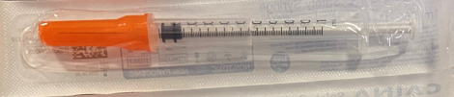
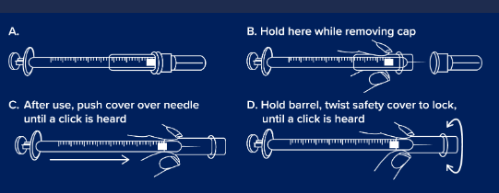
GBUK/Caina Safety Syringe 1ml 25G x 25mm with needle cover will be supplied with Pfizer Comirnaty® Omicron XBB.1.5▼ (10mcg and 30mcg doses) dispersion for injection COVID-19 mRNA Vaccine

Slide 55
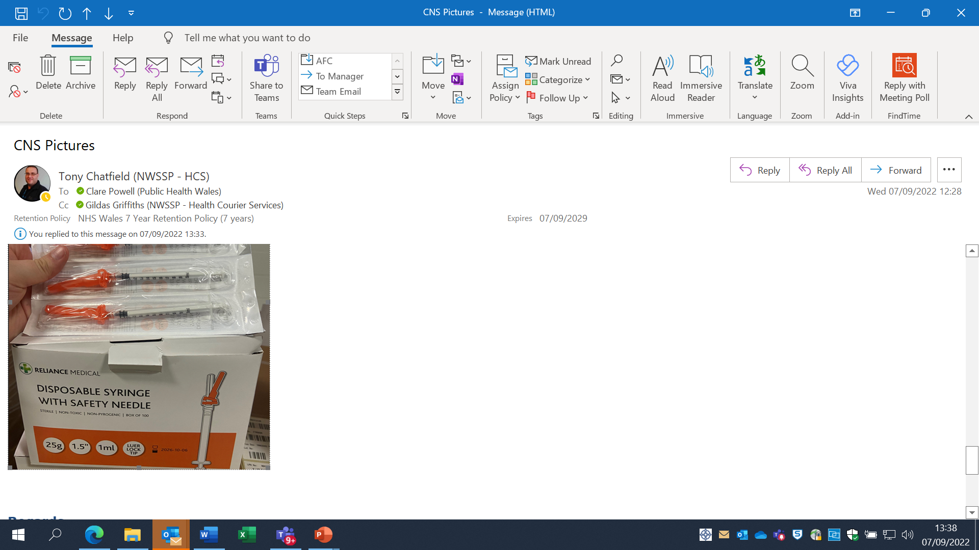
Reliance Medical Safety Syringe 1ml 25G x 38mm with needle cap is available to support vaccination of morbidly obese
Open the package and attach the safety needle firmly to the syringe.
If the needle is already attached to the syringe, make sure the connection is stable and secure.
Withdraw the protective cap.
Hold the syringe with one hand and remove the needle cap with the other hand.
Use the syringe for administration or withdrawal according to the prescribed schedule.
Due to the gauge and length, the needle is very flexible.
To minimise needle flex, a swift and purposeful administration action is required.
Activate the safety device immediately after injection.
Place your thumb or index finger on the safety sheath and push the sheath on the needle until there is auditory confirmation that it has been activated.
Visually check that the needle is covered.
Slow, firm activation of the safety sheath is required. The thumb must be high on the safety sheath for the needle to click in fully. Putting your thumb over the two holes in the sheath may help to achieve the correct positioning.
If necessary, the activation may also be carried out by pressing the safety sheath against a flat surface. The sheath must be pressed firmly near the top.

Slide 56
Vaccination site
The vaccine should be administered intramuscularly.
The preferred site is the deltoid muscle of the upper arm.
The vaccine should not be mixed in the same syringe with any other vaccines or medicinal products.
Giving vaccine into the muscle:
leads to a better immune response to the vaccine (as the muscle contains the appropriate cells necessary to initiate the immune response).
is less likely to cause local reactions than if the vaccine is given into the skin (subcutaneously).
The needle needs to be long enough to ensure vaccine is injected into the muscle. For this reason, a 25mm needle is being provided for administration of the COVID-19 vaccine. A 38mm length needle is available if required for adults who have more fat covering their muscles.
COVID-19 vaccine should be injected into the deltoid muscle in the upper arm. If there is insufficient muscle mass in the deltoid or a particular reason the deltoid muscle is unsuitable, the vaccine should be given into the vastus lateralis muscle in the anterolateral aspect of the thigh.

Slide 57
Vaccinating Individuals with bleeding disorders
Individuals with bleeding disorders may be vaccinated intramuscularly if, in the opinion of a doctor familiar with the individual’s bleeding risk, vaccines or similar small volume intramuscular injections can be administered with reasonable safety by this route.
If the individual receives medication/treatment to reduce bleeding, for example treatment for haemophilia, intramuscular vaccination can be scheduled shortly after such medication/ treatment is administered. Individuals on stable anticoagulation therapy, including individuals on warfarin who are up-to-date with their scheduled INR testing and whose latest INR is below the upper level of the therapeutic range, can receive intramuscular vaccination.
A fine needle (23 or 25 gauge) should be used for the vaccination, followed by firm pressure applied to the site without rubbing for at least 2 minutes (Advisory Committee on Immunization Practices 2019). The individual/parent/carer should be informed about the risk of haematoma from the injection Green Book COVID-19 chapter 14a
Notes:
Thrombocytopenia and coagulation disorders
As with other intramuscular injections, the vaccine should be given with caution in individuals receiving anticoagulant therapy or those with thrombocytopenia or any coagulation disorder (such as haemophilia) because bleeding or bruising may occur following an intramuscular administration in these individuals.

Slide 58
Individuals with history of COVID-19 infection
There is no convincing evidence of any safety concerns from vaccinating individuals with a past history of COVID-19 infection, or with detectable COVID-19 antibody.
Vaccination of individuals who may be infected or asymptomatic or incubating COVID-19 infection is unlikely to have a detrimental effect on the illness, although individuals with suspected COVID-19 infection should not attend vaccination sessions to avoid infecting others.
There is no need to defer immunisation in individuals after recovery from a recent episode with compatible symptoms, whether or not they are tested for COVID-19.
During care home outbreaks, vaccination of residents with confirmed COVID-19 may go ahead, provided the residents are clinically stable and infection control procedures can be maintained. These populations are likely to be highly vulnerable and this policy should help to maximise vaccination coverage without the need for multiple visits.
Having prolonged COVID-19 symptoms is not a contraindication to receiving COVID-19 vaccine but if the patient is seriously debilitated, still under active investigation, or has evidence of recent deterioration, deferral of vaccination may be considered to avoid incorrect attribution of any change in the person’s underlying condition to the vaccine. Green Book COVID-19 chapter 14a.

Slide 59
Post vaccination waiting times
From September 2023, the recommended observation periods in Wales are in accordance with the Green Book advice for all adults and children. COVID-19 vaccine products (WHC/2023/33) | GOV.WALES
For people with a history of allergy, as described in the Green Book, the 15 minute observation period remains. Further information is available here: Table 5 Green Book COVID-19 chapter 14a.
For those without a history of allergies (as described in the Green Book), observation times are as follows:
After COVID-19 vaccine administration, individuals should be observed for any immediate reactions whilst they are receiving any verbal post vaccination information and exiting the centre.
Facilities for management of anaphylaxis should be available at all vaccination sites.
The advice to suspend the 15 minute observation period applies to all COVID-19 vaccines.
Vaccinated individuals should be informed about how to access immediate healthcare advice in the event of displaying any symptoms.
In some settings, for example domiciliary vaccination, this may require a responsible adult to be present for at least 15 minutes after vaccination.
No specific management is required for patients with a family history of allergies.
As fainting can occur following vaccination, all those vaccinated with any of the COVID-19 vaccines should not drive for 15 minutes after vaccination.

Slide 60
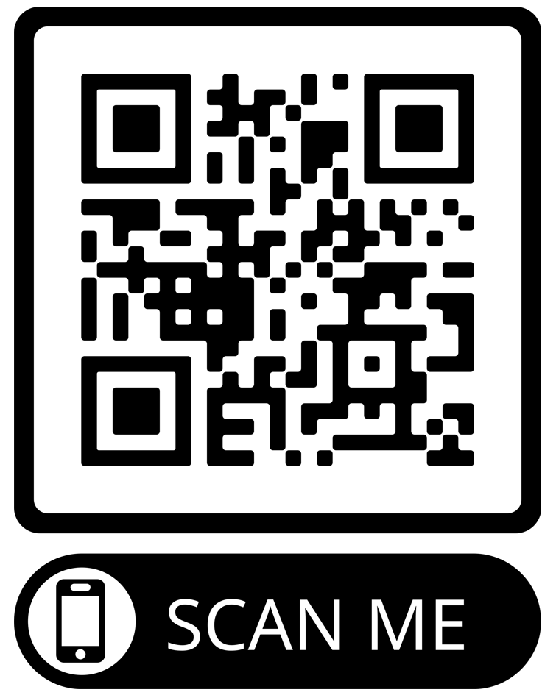
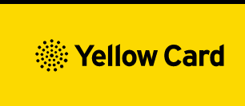
Reporting Adverse Events
Vaccinees should be advised that they can report any adverse reactions or suspected side effects to the MHRA through the online yellow card scheme website or the Yellow Card app.
Anyone (patients and HCWs) can make a Yellow Card report, even if they are uncertain as to whether a vaccine caused the condition.
ALL COVID-19 vaccine products are black triangle ▼ which means these medicinal product are subject to additional monitoring. This will allow quick identification of new safety information. Healthcare professionals are asked to report any suspected adverse reactions
This information was accurate at the time of writing. See product SmPC, available from the SmPC website, for indication of current black triangle status.
The QR code can be used for quick and easy access to the Yellow Card reporting site.
www.mhra.gov.uk/yellowcard

Slide 61
Key messages
COVID-19 is now a relatively mild disease for the vast majority of people. This ongoing increase in population immunity permits the development of a more targeted programme aimed at those at higher risk of developing serious COVID-19 disease.
For those eligible for vaccination during seasonal campaigns, a single dose is now offered at least three months after any previous dose. This interval applies to any vaccine, regardless of the product given for the previous doses and irrespective of age.
Previously vaccinated Individuals who become or have recently become severely immunosuppressed should be considered for an additional dose of the vaccine regardless of their past vaccination history. The additional dose can be offered at a minimum interval of 3 months (91 days) from previous dose
Previously unvaccinated Individuals who become or have recently become severely immunosuppressed, should be considered for a first dose of vaccination (off label) and the second dose given ideally at an interval of 8-12 weeks from the previous dose. Including individuals who receive bone marrow transplants, CAR-T therapy as they may have lost immunological memory of previous vaccination
For individuals about to receive planned immunosuppressive treatment, a minimum interval of 3 weeks between COVID-19 doses may be followed, to enable the vaccine to be given whilst the individual’s immune system is better able to respond

Slide 62
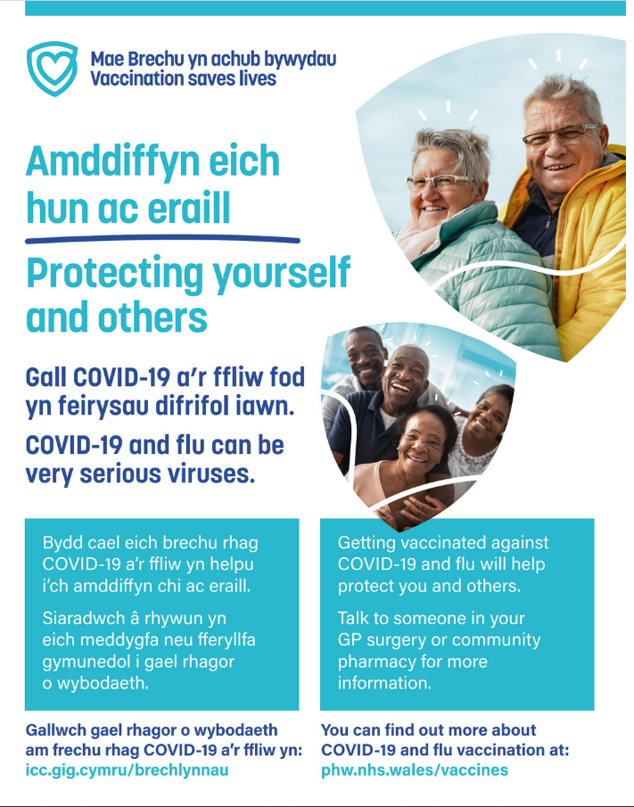



Public resources spring 2024
Immunisation and Vaccines - Public Health Wales (nhs.wales)
Order here: https://phw.nhs.wales/services-and-teams/health-information-resources/
Currently being updated

Slide 63
Patient leaflets
Immunisation and Vaccines - Public Health Wales (nhs.wales)
https://phw.nhs.wales/services-and-teams/health-information-resources/
Leaflets will be available as the following accessible resources:
Audio.
BSL.
Easy read.
Large print.
The DL can be ordered through HIR, accessible resources will be available here shortly: COVID-19 vaccine accessible information - Public Health Wales (nhs.wales) / Adnoddau Gwybodaeth Iechyd - Iechyd Cyhoeddus Cymru (gig.cymru).

Slide 64
Resources for COVID-19 campaigns
These bilingual microsite pages will be available for COVID-19 campaigns
COVID-19 vaccination information - Public Health Wales (nhs.wales).
About the vaccine - Public Health Wales (nhs.wales).
Eligibility for the vaccine - Public Health Wales (nhs.wales).
Patient information - Public Health Wales (nhs.wales).
Resources for health and social care professionals - Public Health Wales (nhs.wales).

Slide 65
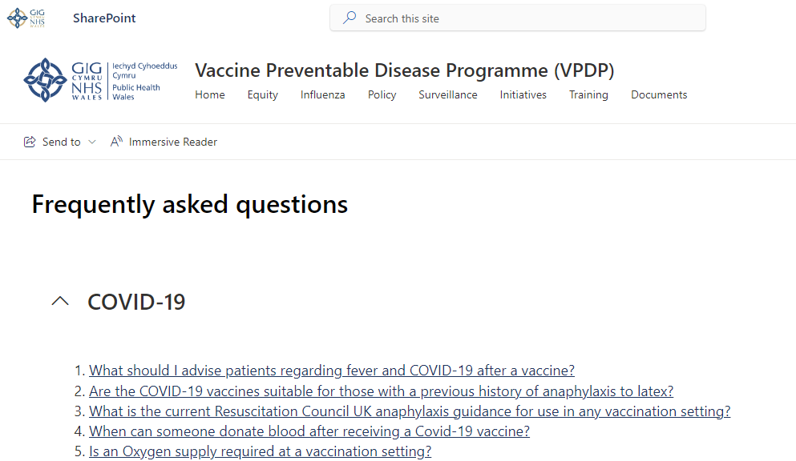
Resources for COVID-19 campaigns
FAQs on SharePoint : Frequently asked questions (sharepoint.com).

Slide 66

Clinical script
The clinical script will be available as download only and will be available at: Resources for health and social care professionals - Public Health Wales (nhs.wales) and Adnoddau i weithwyr proffesiynol iechyd a gofal cymdeithasol - Iechyd Cyhoeddus Cymru (gig.cymru)
Vaccine record card
Available to order on HIR

Slide 67
Using motivational interviewing for better conversations
Health professionals and vaccinators have an important role in vaccine conversations, and are reported by the public as trusted sources of vaccine information.
The approach and style of a vaccine conversation can make a real difference in understanding individual hesitancy, addressing barriers, and influencing vaccine uptake.
Motivational interviewing aims to support decision making by eliciting and strengthening a person's motivation to change their behaviour based on their own arguments for change.
It is used in a range of health settings and is an evidenced approach to improving vaccine uptake through conversation.

Slide 68
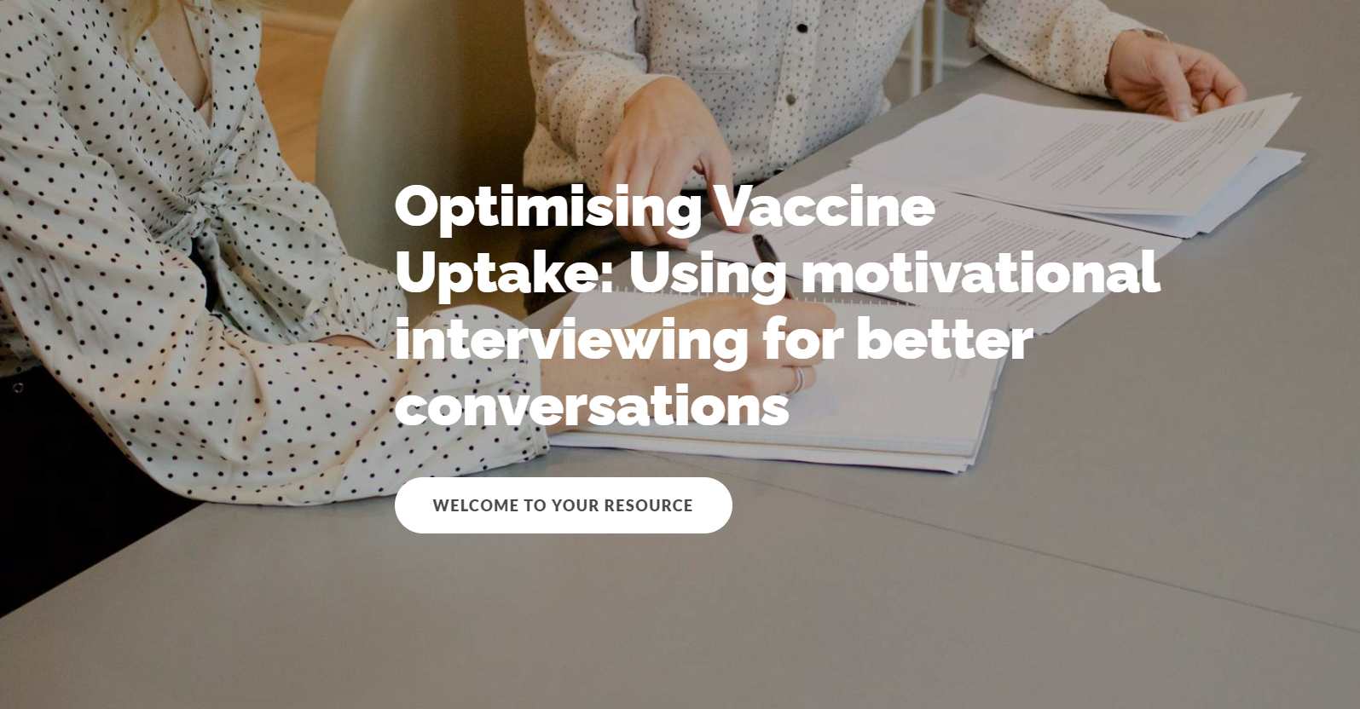
E-learning available on optimising vaccine uptake. Using motivational interviewing for better conversations.
Incorporating motivational interviewing into your vaccine conversations will enable you to identify the core barriers for an individual, and collaboratively address these in a personalised way.
Optimising Vaccine Uptake: Using motivational interviewing for better conversations - Overview | Rise 360 (articulate.com)

Slide 69
Further information (1)
UK vaccine policy can be found in the online publication commonly referred to as the
"Green Book" .
Green Book recommendations are based upon JCVI’s expert opinion and should
always be followed, even when they differ from those made by the vaccine
manufacturer. (Note: sometimes vaccine policy in Wales differs to England)
UKHSA COVID-19 Immunisation programme Information for healthcare practitioners
This document provides additional information, answers to frequently asked questions
and actions to take in the event of inadvertent errors.
It is important to read this document before you start vaccinating and also to refer to the
online version regularly as it will be updated as more information becomes available
and to address any issues or frequently arising questions as COVID-19 vaccines are
delivered more widely
Notes:
https://www.gov.uk/government/publications/covid-19-vaccination-programme-guidance-for-healthcare-practitioners

Slide 70
Further information (2)
PHW professional information resources:
COVID-19 resources for health and social care professionals - Public Health Wales (nhs.wales)
Vaccine resources for health and social care professionals - Public Health Wales (nhs.wales)
PHW training:
Immunisation training resources and events - Public Health Wales (nhs.wales)
Immunisation eLearning - Public Health Wales (nhs.wales)
UKHSA COVID-19 vaccination resources: COVID-19 vaccination programme - GOV.UK (www.gov.uk)
Oxford Knowledge Project: COVID-19 vaccines
MHRA: Guidance on coronavirus (COVID-19)

Slide 71
Additional information
JCVI statement on COVID-19 vaccination in spring 2024 and considerations on future COVID-19 vaccination, 4 December 2023 - GOV.UK (www.gov.uk)
COVID-19 spring booster 2024 (WHC/2024/009) | GOV.WALES
COVID-19 vaccine products (WHC/2023/33) | GOV.WALES
Resources for health and social care professionals - Public Health Wales (nhs.wales).
Patient Group Directions (PGD) - Welsh Medicines Advice Service (wales.nhs.uk).
Regulatory approval of Pfizer/BioNTech vaccine for COVID-19 - GOV.UK (www.gov.uk)
COVID-19: vaccination programme guidance for healthcare practitioners.
Green Book COVID-19 chapter 14a.
Coronavirus vaccine - summary of Yellow Card reporting - GOV.UK (www.gov.uk).

