Slide 1
COVID-19 Vaccination – Spring 2025 ​
Pfizer Comirnaty® JN.1​
(3 microgram/dose for those aged 6 months to 4 years & ​
10 microgram/dose for those aged 5 to 11 years) ​
VPDP update: Respiratory Planning and Delivery Meeting
Vaccine Preventable Disease Programme
Public Health Wales
Version 1
12 March 2025
Hawys Youlden, Lead Nurse Immunisation

Slide 2
Acknowledgements
Vaccine Preventable Disease Programme
Vaccine Programme Wales
Welsh Medicines Advice Service
Welsh Government
JCVI
Green Book

Slide 3
COVID-19 Vaccination for individuals aged 6 months to 11 years for Spring 2025
The information contained in these slides is accurate at the time of publication (12 March 2025) These slides are version controlled and subject to revision; this is version 1.
It is important that COVID-19 immunisers and/or those who are providing COVID-19 immunisation advice, should always ensure they are accessing the most up to date information and refer to the Green Book COVID-19 chapter 14a and other authoritative sources when administering vaccines.
This slide set has been published in advance of the Green Book update for Spring 2025, we do not anticipate any significant changes. Once published, this slide set will be reviewed for accuracy and re-published as Version 2 if required. This is an exception to the standard process, with an aim to support Health Boards with local training.
Only infants and children aged 6 months to 11 years who who are immunosuppressed (as defined in table 4 of COVID-19 chapter of the Green Book) are eligible for a COVID-19 vaccine in the Spring 2025 campaign

Slide 4
Pre-requisites to administering COVID-19 vaccine
Before administering COVID-19 vaccine, it is recommended that:
Those new to immunisation should receive comprehensive foundation immunisation training. Both knowledge and clinical competence should be assessed before new immunisers start to give and/or advise the shingles vaccine Immunisation training standards for healthcare practitioner UK Health Security Agency - UKHSA)
Received COVID-19 vaccine training through attending a taught session and/or eLearning. COVID-19 core eLearning module and vaccine specific modules are available to access here: Immunisation eLearning - Public Health Wales (nhs.wales)
Received practical training in COVID-19 vaccine preparation and administration
Training in the management of anaphylaxis and Basic Life Support is undertaken, as specified by policy for your local area and are familiar with Resuscitation Council UK (RCUK) guidance on Management of Anaphylaxis in the Vaccination Setting
Any additional statutory and mandatory training as required by your employer is completed
An appropriate legal framework to supply and administer COVID-19 vaccine is in place e.g. patient specific prescription (PSD), Patient Specific Direction (PSD), Patient Group Direction (PGD) National Protocol (NP). Visit here for Wales PGD template
Those involved in immunisation and vaccination understand the process of consent and how this applies when giving vaccines. Information on consent can be viewed here: Consent: the green book, chapter 2 - GOV.UK
Immunisers and those giving immunisation advice access and familiarise themselves with the following key documents:Green Book COVID-19 chapter 14a: COVID-19: vaccination programme guidance for healthcare practitioners, The vaccine product information in the Summary of Product Characteristics (Electronic Medicines Compendium website)
Notes:
*This should be either through a face to face taught course or a blended approach of both e-learning and a face to face taught course. New immunisers should also have a period of supervised practice and support with a registered healthcare practitioner who is experienced, up to date and competent in immunisation.
Practitioners should always ensure they are accessing the most up to date information and guidance.

Slide 5
JCVI statement on the COVID-19 vaccination in 2025 and Spring 2026 [published 13 November 2024] (1)
In Spring 2025, JCVI advises that a COVID-19 vaccine should be offered to:
residents in a care home for older adults
adults aged 75 years and over
individuals aged 6 months and over who are immunosuppressed (as defined in ‘immunosuppression’ sections of tables 3 & 4 of the COVID-19 chapter of the Green Book)
Timing of vaccination
The vaccine should usually be offered no earlier than around 6 months after the last vaccine dose, although operational flexibility around the timing of vaccination in relation to the last vaccine dose is considered appropriate (with a minimum interval of 3 months between doses). More information on operational flexibility will be provided in the COVID-19 chapter of the Green Book.
JCVI statement on COVID-19 vaccination in 2025 and spring 2026 - GOV.UK

Slide 6
JCVI statement on the COVID-19 vaccination in 2025 and Spring 2026 [published 13 November 2024] (2)
This JCVI statement outlines the vaccine products for 2025 – Spring 2026:
Adults:
JCVI does not have a preference for a specific COVID-19 vaccine product in the adult population. However, JCVI advises a preference for having vaccine products based on more than one vaccine platform in the programme, such as mRNA and protein-based vaccines.
Children and young people:
For children and young people who are immunosuppressed, JCVI continues to advise the use of the Pfizer-BioNTech COVID-19 mRNA (Comirnaty) vaccine, with the vaccine dose appropriate to the child’s age:
  12 to 17 years: 30 micrograms
  5 to 11 years: 10 micrograms
  6 months to 4 years: 3 micrograms
JCVI statement on COVID-19 vaccination in 2025 and spring 2026 - GOV.UK

Slide 7
COVID-19 Spring Vaccination Programme 2025,
Welsh Health Circular (WHC/2024/047) published 19 December 2024 (1)
Groups eligible for a COVID-19 vaccine in spring 2025:
As advised by the JCVI:
residents in a care home for older adults
adults aged 75 years and over
individuals aged 6 months and over who are immunosuppressed (as defined in ‘immunosuppression’ sections of tables 3 & 4 of the COVID-19 chapter of the Green Book)
Programme start and end date:
The COVID-19 spring vaccination programme will run between 1 April and 30 June 2025. There will be limited flexibility into July, for those who are unable to receive a booster within the main programme window, due to illness.
COVID-19 spring vaccination programme 2025 (WHC/2024/047) | GOV.WALES

Slide 8
COVID-19 Spring Vaccination Programme 2025,
Welsh Health Circular (WHC/2024/047) published 19 December 2024 (2)
Programme ambitions:
All those eligible for a spring booster to receive an invite for vaccination;
Health boards should make every effort to maximise uptake across all cohorts ensuring that;
    i. uptake levels are maintained or improved for those over 75 years of age and those resident in a care home for older adults, and that every effort is made to achieve 75% uptake for these cohorts;
    ii. all possible interventions which could improve uptake for the immunosuppressed cohort are explored and acted on, including removing any barriers to vaccination;
    iii. the gap is reduced between uptake rates in the least and most deprived areas of the health board.
COVID-19 spring vaccination programme 2025 (WHC/2024/047) | GOV.WALES

Slide 9
COVID-19 and severe disease
Over the past 4 years, population immunity to SARS-CoV-2 has been increasing due to 'hybrid immunity'. This is a combination of naturally acquired immunity following recovery from SARS-CoV-2 infection and vaccine derived immunity
COVID-19 is now a relatively mild disease for most people, though it can still be unpleasant, with rates of hospitalisation and death from COVID-19 having reduced significantly since SARS-CoV-2 first emerged
Age has always been strongly associated with the risk of hospitalisation and mortality from COVID-19, with the oldest in the population being the most vulnerable
The focus of the programme is shifting towards targeted vaccination of the oldest adults and individuals who are immunosuppressed. These are the 2 groups who continue to be at higher risk of serious disease, including mortality.

Slide 10
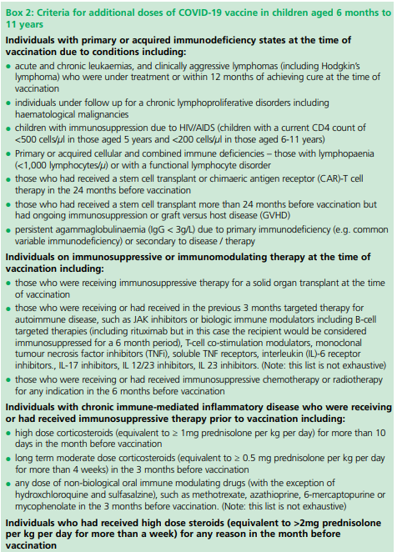
Individuals aged 6 months to 11 years with severe immunosuppression
Individuals aged 6 months to 11 years who have severe immunosuppression, are defined in Box 2 of Chapter 14a Green Book .
Most individuals who receive brief immunosuppression (≥40mg prednisolone per day or equivalent for children) for an acute episode (for example, asthma / COPD / COVID-19) and individuals on replacement corticosteroids for adrenal insufficiency are not considered severely immunosuppressed sufficient to prevent response to vaccination.
Severely immunosuppressed individuals are expected to be eligible for regular vaccination in all subsequent seasonal campaigns.
Green Book COVID-19 chapter 14a.

Slide 11
Dosing and schedule
The SmPC Pfizer Comirnaty JN.1 3 microgram per dose dispersion for injection COVID-19 mRNA Vaccine recommends a three-dose schedule, however, the JCVI advises that children aged 6 months to 4 years in a clinical risk group (as defined in the Green Book) should be offered two doses of JN.1 3 microgram per dose dispersion for injection COVID-19 mRNA Vaccine
Therefore, Pfizer Comirnaty® COVID-19 mRNA vaccine should be administered under a PGD in accordance with recommendations from the JCVI and Chapter 14a of the Green Book for the delivery of the COVID-19 vaccination programme. This use would be off-label.
JCVI advised that all second and any subsequent seasonal doses should be given at a minimum interval of three months.
To note:
Individuals aged six months and above with severe immunosuppression may be considered for additional doses ideally at an interval of 8 to 12 weeks from the previous dose. Where the specialist has advised an exception, then the interval may be reduced to a minimum of three weeks for any of the vaccine products.
Notes:
https://www.sps.nhs.uk/articles/off-label-medicine-use-under-a-patient-group-direction/

Slide 12
Recommended vaccine dose intervals for infants from 6 months to 4 years who are severely immunosuppressed:
Recent UKHSA seroprevalence studies suggest that most children under five in the UK have had COVID-19 infection. However, as the immunity profile of these children is less certain and may change for future birth cohorts, JCVI considers that these children should continue to receive two primary doses of vaccine.
Children who remain eligible should also receive doses of vaccine in a seasonal campaign, at a minimum interval of three months from their previous dose. Operationally, using the same minimum interval and timing for all products and age groups will simplify supply and booking, and will help to ensure longer lasting and optimally timed protection.
Infants from 6 months to 4 years who are severely immunosuppressed as defined by Chapter 14a Green Book and/or have been referred for vaccination by a specialist who has designated them as group 01 or 02 as described in WIS (Welsh Immunisation System) are eligible for their COVID-19 vaccine via a PGD: Patient Group Directions (PGD) - Welsh Medicines Advice Service (wales.nhs.uk)

Slide 13
Vaccine dose intervals for individuals who become or have recently become immunosuppressed
Individuals previously unvaccinated aged 6 months to 4 years :
should be considered for a first dose of vaccination regardless of the time of year and the second dose given ideally at an interval of 8 to12 weeks from the previous dose, this will be their primary course. An additional dose should be considered as outlined in subsequent slides
Individuals previously vaccinated aged 6 months to 4 years:
should be considered for an additional dose of the vaccine regardless of their past vaccination history and time of year. Timing of the additional dose outlined in subsequent slides.
Individuals previously unvaccinated aged 5 years and over :
should be considered for a first dose of vaccination regardless of the time of year with consideration of an additional dose as outlined in subsequent slides
Individuals previously vaccinated aged 5 years and over:
should be considered for an additional dose of the vaccine regardless of their past vaccination history and time of year. Timing of the additional dose outlined in subsequent slides.
Notes:
In contrast to other eligible risk groups, those who are eligible for a vaccination due to severe immunosuppression but miss vaccination during the campaign period, may be considered for an additional dose at a later date based on individual clinical judgement, balancing their immediate level of risk against the advantages of waiting till the next seasonal campaign.

Slide 14
Additional Doses
Individuals aged six months and above with severe immunosuppression may be considered for additional doses ideally at an interval of 8 to12 weeks from the previous dose.
Exception to this ideal interval may be advised based on specialist clinical judgement, for example for those about to receive or increase the intensity of an immunosuppressive treatment, where a better response would be made if immunised prior to that treatment commencing. Where the specialist has advised an exception, then the interval may be reduced to a minimum of three weeks for any of the vaccine products.
Assessment of individuals is recommended on a case by case basis, in conjunction with their treating specialist.
More information on dosing intervals for additional doses and optimal timing of doses may be found in Chapter 14a.

Slide 15
Timing of additional doses
Vaccines administered during periods of minimum immunosuppression are more likely to generate better immune responses. Therefore, any planned additional doses should ideally be given with special attention paid to current or planned immunosuppressive therapies. For example:
For the small number of patients who are about to receive planned immunosuppressive therapy, vaccination may be brought forward to before commencing that therapy (ideally at least two weeks before), when their immune system is better able to make a response.
To maximise the benefit, the vaccine should not be given within three weeks of a previous dose
Where possible, additional booster doses should be delayed until two weeks after the period of immunosuppression, in addition to the time period for clearance of the therapeutic agent
Alternatively, consideration should be given to vaccination during a treatment ‘holiday’ or when the degree of immunosuppression is at a minimum
Any decision to defer immunosuppressive therapy or to delay possible benefit from vaccination until after therapy should only be taken with due consideration of the risks of exacerbating their underlying condition, as well as the risks from COVID-19.
Green Book COVID-19 chapter 14a

Slide 16
Individuals who receive bone marrow transplant and CAR-T therapy
These individuals may lose immunological memory from vaccination received prior to the treatment and the development of the underlying condition.
After treatment and recovery, these individuals should be considered for a full course of revaccination for all vaccines used in the routine programme (see chapter 7 Green Book) under specialist advice.
Individuals who have recovered from a bone marrow transplant should be considered for a first dose of COVID-19 vaccine, regardless of the time of year.
A subsequent dose should then be offered ideally at an interval of 8 to 12 weeks, to extend the duration of protection. This interval may be reduced to a minimum of three weeks on specialist clinical advice.
Those who remain immunosuppressed will then continue to be eligible for seasonal campaigns.
Notes:
After treatment and recovery, these individuals should be considered for a full course of revaccination for all vaccines used in the routine programme (https://www.gov.uk/government/publications/immunisation-of-individuals-with-underlying-medical-conditions-the-green-book-chapter-7) under specialist advice.

Slide 17
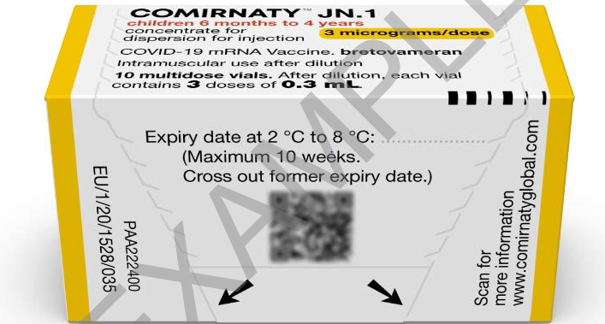
Pfizer Comirnaty® JN.1 3 microgram per dose dispersion for injection COVID-19 mRNA Vaccine
SmPC Pfizer Comirnaty® JN.1 3 microgram per dose dispersion for injection COVID-19 mRNA Vaccine (nucleoside modified) Bretovameran
14
Notes:
Comirnaty JN.1 3 micrograms/dose concentrate for dispersion for injection - 3-dose vial - Summary of Product Characteristics (SmPC) - (emc) (medicines.org.uk)

Slide 18
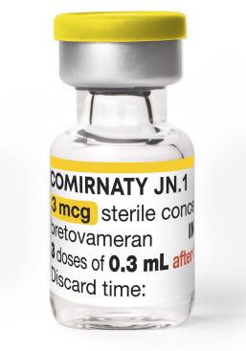
Presentation: Pfizer Comirnaty® JN.1
3 microgram per dose dispersion for injection
COVID-19 mRNA Vaccine
Pfizer Comirnaty® JN.1 3 microgram per dose dispersion for injection COVID-19 mRNA vaccine is a multi-dose vial and must be diluted before use.
After dilution, vials with a yellow cap of Comirnaty JN.1 contain 3 doses of 0.3 mL of vaccine. Standard syringes and needles can be used to extract 3 doses from a single vial.
Each dose must contain 0.3 mL of vaccine.
If the amount of vaccine remaining in the vial cannot provide a full dose of 0.3 mL, discard the vial and any excess volume.
Do not pool excess vaccine from multiple vials.

Slide 19
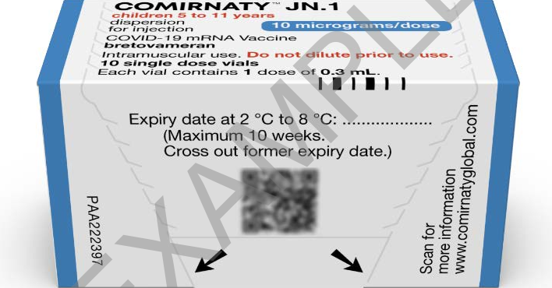
Pfizer Comirnaty® JN.1 10 microgram per dose dispersion for injection COVID-19 mRNA Vaccine
SmPC Pfizer Comirnaty® JN.1 10 microgram per dose dispersion for injection COVID-19 mRNA Vaccine (nucleoside modified) Bretovameran
16
Notes:
https://www.medicines.org.uk/emc/product/15836/smpc

Slide 20
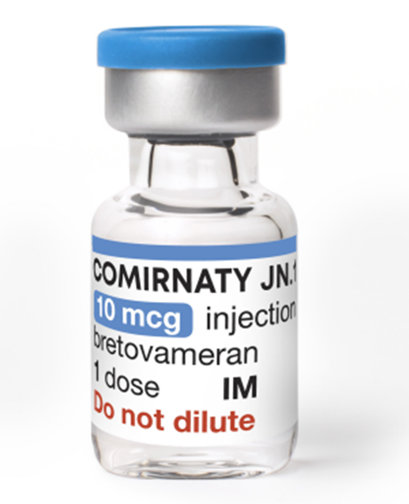
Presentation: Pfizer Comirnaty® JN.1
10 microgram per dose dispersion for injection
COVID-19 mRNA Vaccine
Pfizer Comirnaty® JN.1 10 microgram per dose dispersion for injection COVID-19 mRNA vaccine is a single dose vial. NO dilution is required.
Vials of Comirnaty JN.1 10microgram/dose have a blue cap and a single dose of 0.3 mL of vaccine. Each dose must contain 0.3 mL of vaccine.
Following withdrawal of 0.3 mL, discard the vial and any excess volume.
Do not pool excess vaccine from multiple vials.
SmPC Pfizer Comirnaty® JN.1 10 microgram per dose dispersion for injection COVID-19 mRNA Vaccine (nucleoside modified) Bretovameran

Slide 21
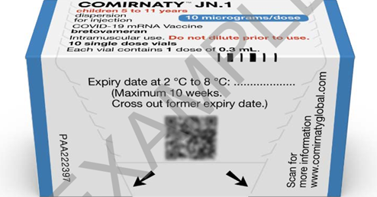
Storage: Pfizer Comirnaty® JN.1
COVID-19 mRNA Vaccines
Pfizer Comirnaty® JN.1 COVID-19 mRNA Vaccines will be coming into NHS Wales thawed from UKHSA, it will already have the expiry date and time labelled on the box.
The vaccine may then be delivered to where it is going to be administered thawed but refrigerated between +2ºC to +8ºC.
Thawed vaccine must be transferred immediately to a vaccine fridge on arrival and stored in a carefully monitored temperature range of +2ºC to +8ºC.
Once thawed, the unopened vaccine may be stored refrigerated at +2ºC to +8ºC, protected from light, for up to 10 weeks.
Prior to use, the unopened vial can be stored for up to 12 hours at temperatures between +8°C and +30°C. Thawed vials can be handled in room light conditions.

Slide 22
List of excipients: Pfizer Comirnaty® JN.1
COVID-19 mRNA Vaccines
This vaccine contains polyethylene glycol/macrogol (PEG)
2-[(polyethylene glycol - PEG)-2000]-N
N-ditetradecylacetamide (ALC-0159)
(4-hydroxybutyl)azanediyl)bis(hexane-6,1-diyl)bis(2-hexyldecanoate) (ALC-0315)
1,2-Distearoyl-sn-glycero-3-phosphocholine (DSPC)
Cholesterol
Trometamol
Trometamol hydrochloride
Sucrose
Water for injection
For further information about specific excipients in vaccines see:
Comirnaty JN.1 3 micrograms/dose concentrate for dispersion for injection - 3-dose vial - Summary of Product Characteristics (SmPC) - (emc) (medicines.org.uk)
Comirnaty JN.1 10 micrograms/dose dispersion for injection - single dose vial - Summary of Product
Vaccine ingredients | Vaccine Knowledge (ox.ac.uk)

Slide 23
Polyethylene glycol (PEG)
Pfizer Comirnaty® JN.1 3 microgram per dose dispersion for injection COVID-19 mRNA Vaccine contains polyethylene glycol (PEG)
PEGs (also known as macrogols) are a group of known allergens commonly found in medicines, many household products and cosmetics
Medicines containing PEG include some tablets, laxatives, depot steroid injections, and some bowel preparations used for colonoscopy
Individuals with undiagnosed PEG allergy often have a history of immediate onset-unexplained anaphylaxis or anaphylaxis to multiple classes of drugs. Such individuals should not be vaccinated with Pfizer Comirnaty® JN.1 3 microgram per dose dispersion for injection COVID-19 mRNA Vaccine (or any other COVID-19 vaccine containing polyethylene glycol (PEG)) except on the expert advice of a paediatric allergy specialist
Known allergy to PEG is rare but has been implicated in a minority of allergic reactions reported
For further information see: Table 5: Management of patients with a history of allergy in Green Book COVID-19 chapter 14a

Slide 24
Prior to giving Pfizer Comirnaty® JN.1
COVID-19 mRNA Vaccines
Before giving the vaccine, you need to check if the infant or child:
is eligible to receive the vaccine
has any contraindications or precautions to the Pfizer Comirnaty® mRNA Vaccines
has not received any COVID-19 vaccination in the previous 3 months. The Green Book COVID-19 chapter 14a states, for those eligible for vaccination during seasonal campaigns, a single dose is offered at least 3 months after any previous dose. This interval applies to any vaccine, regardless of the product given for the previous doses. Timing should follow the JCVI advice for that campaign, which aims to provide protection to the most vulnerable at the optimal time
the only exceptions to the 3-month interval would be individuals who are immunosuppressed, these individuals would be recommended a second dose, and in some circumstances, may need to complete vaccinations within a treatment window. In this situation the minimum interval could be reduced to 3 weeks Green Book COVID-19 chapter 14a

Slide 25
Contraindications: Pfizer Comirnaty® JN.1 COVID-19 mRNA Vaccines
Vaccination should be postponed in individuals suffering from acute severe febrile illness or acute infection. The presence of a minor infection and/or low-grade fever should not delay vaccination.
The vaccine is contraindicated in those who have had a previous systemic allergic reaction (including immediate-onset anaphylaxis) to:
  a previous dose of a COVID-19 mRNA vaccine
  any component (excipient) of the COVID-19 mRNA vaccine
People with a history of allergy: A very small number of individuals have experienced anaphylaxis when receiving a COVID-19 vaccine. Anyone with a history of allergic reaction to an excipient in the COVID-19 vaccine should not receive that vaccine (except with expert advice), but those with any other allergies (such as a food allergy) – including those with prior anaphylaxis – can have the vaccine. Guidance about the management of individuals with a history of allergy should be followed (summarised in Table 5) COVID-19: the green book, chapter 14a - GOV.UK (www.gov.uk).
Notes:
Before administering a COVID-19 vaccine, it is important to check for any relevant medical history including allergies and any previous history of severe reaction to a vaccine. Facilities for management of paediatric anaphylaxis should be available at all vaccination sites. (See Chapter 8 of the Green Book: https://www.gov.uk/government/publications/vaccine-safety-and-adverse-events-following-immunisation-the-green-book-chapter-8 ) and advice issued by the Resuscitation Council (https://www.resus.org.uk/).

Slide 26
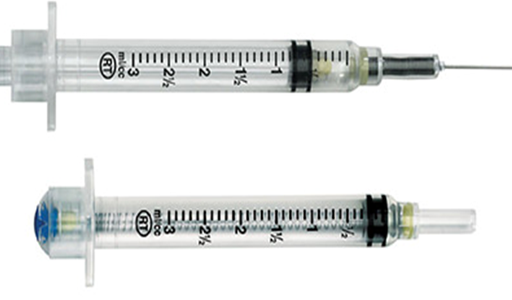
VanishPoint® combined needle and syringe product
Only required with Prizer Comirnaty ® JN.1 3 microgram per dose dispersion for injection COVID-19 mRNA Vaccine
Vanishpoint® syringes for the reconstitution of Pfizer Comirnaty® JN.1 3 microgram per dose dispersion for injection
COVID-19 mRNA Vaccine
Vanishpoint® syringes are self-retracting: If the bottom of the plunger of the syringe touches the neck of the syringe barrel the mechanism is triggered and the needle will auto retract into the barrel of the syringe.
Vanishpoint Online Training Content (gandn.com) The training videos show immunisers wearing gloves and sleeves being worn below the elbow. This is not in line with Infection Prevention and Control guidance and these practices are not recommended in NHS Wales.

Slide 27
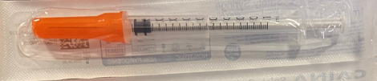
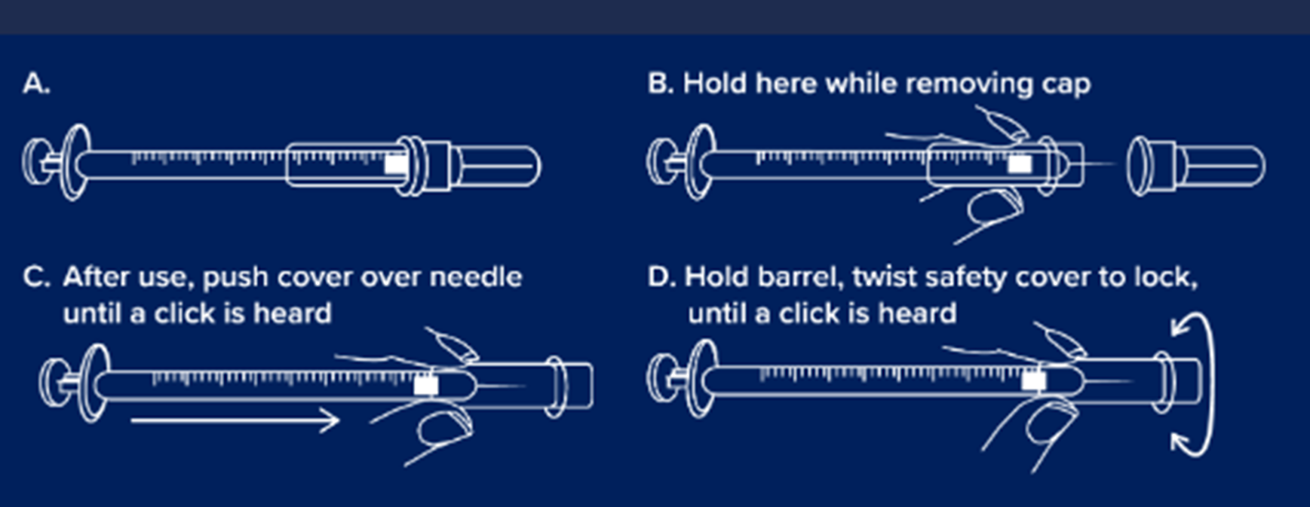
GBUK Safety Syringe 1ml 25G x 25mm with needle cover
GBUKSafety Syringe 1ml 25G x 25mm with needle cover will be supplied for the administration of Pfizer Comirnaty® JN.1 COVID-19 mRNA Vaccines https://gbukgroup.com/safety-syringe-with-fixed-needle/
Please note: the IPC measures in these resources do not align with the national IPC requirements in Wales. See here for NHS Wales guidance: Guidance - Public Health Wales (nhs.wales).

Slide 28
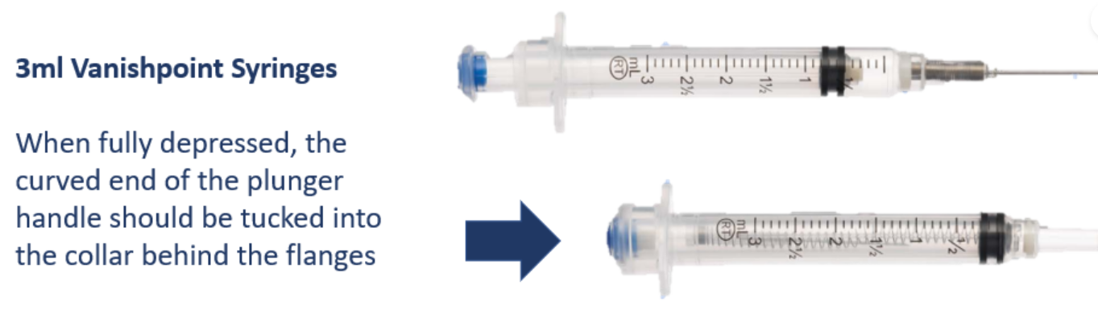
Dilution: Comirnaty® JN.1 3 microgram per dose dispersion for injection COVID-19 mRNA Vaccine (1)
Allow the thawed vial to come to room temperature and gently invert it 10 times prior to dilution. Do not shake.
Prior to dilution, the thawed dispersion may contain white to off-white opaque amorphous particles.
The thawed vaccine must be diluted in its original vial with 1.1 mL sodium chloride 9 mg/mL (0.9%) solution for injection, using a 21 gauge or narrower needle and aseptic techniques.
https://resources.gandn.com/vanishpoint-online-training
Notes:
Comirnaty JN.1 3 micrograms/dose concentrate for dispersion for injection - 3-dose vial - Summary of Product Characteristics (SmPC) - (emc) (medicines.org.uk)
https://www.medicines.org.uk/emc/product/15837/smpc

Slide 29
Dilution: Pfizer Comirnaty® JN.1 3 microgram per dose dispersion for injection COVID-19 mRNA Vaccine (2)
Equalise vial pressure before removing the needle from the vial stopper by withdrawing 1.1 mL air into the empty diluent syringe.
https://resources.gandn.com/vanishpoint-online-training
Notes:
Comirnaty JN.1 3 micrograms/dose concentrate for dispersion for injection - 3-dose vial - Summary of Product Characteristics (SmPC) - (emc) (medicines.org.uk)
https://www.medicines.org.uk/emc/product/15837/smpc

Slide 30
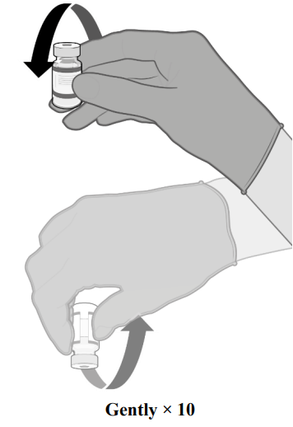
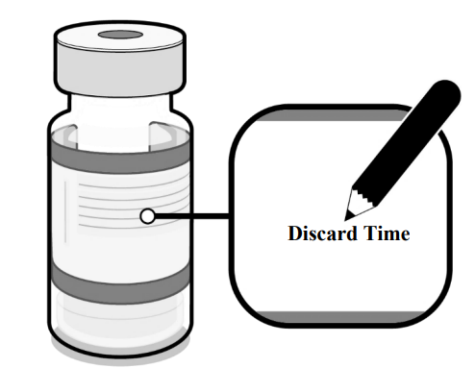
Dilution: Pfizer Comirnaty® JN.1 3 microgram per dose dispersion for injection COVID-19 mRNA Vaccine (3)
Gently invert the diluted dispersion 10 times. Do not shake
The diluted vaccine should present as a white to off-white dispersion with no particulates visible. Do not use the diluted vaccine if particulates or discolouration are present
The diluted vials should be marked with the appropriate discard date and time
After dilution store at +2ºC to +30ºC and use within 12 hours
Do not freeze or shake the diluted dispersion. If refrigerated, allow the diluted dispersion to come to room temperature prior to use.
Notes:
Comirnaty JN.1 3 micrograms/dose concentrate for dispersion for injection - 3-dose vial - Summary of Product Characteristics (SmPC) - (emc) (medicines.org.uk)
https://www.medicines.org.uk/emc/product/15837/smpc

Slide 31
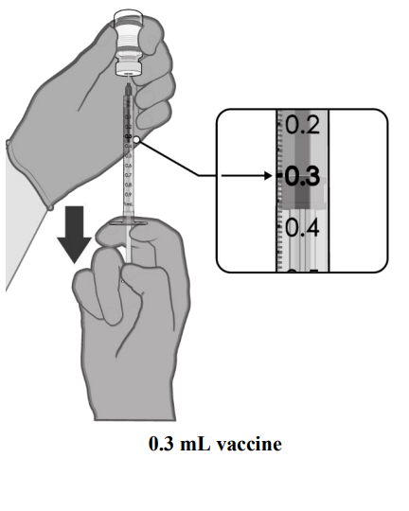
Dose preparation: Pfizer Comirnaty® JN.1 3 microgram per dose dispersion for injection COVID-19 mRNA Vaccine
Check product name, batch number and expiry date prior to administration.
After dilution, the vial contains 1.58 mL from which 3 doses of 0.3 mL can be extracted.
Using aseptic technique, cleanse the vial stopper with a single-use antiseptic swab.
Withdraw 0.3 mL of Comirnaty JN.1 for infants and children aged 6 months to 4 years. Standard syringes and/or needles can be used in order to extract 3 doses from a single vial.
Each dose must contain 0.3 mL of vaccine.
If the amount of vaccine remaining in the vial cannot provide a full dose of 0.3 mL, discard the vial and any excess volume.
Discard any unused vaccine within 12 hours after dilution.
Disposal
Any unused medicinal product or waste material should be disposed of in accordance with local requirements.
Notes:
Comirnaty JN.1 3 micrograms/dose concentrate for dispersion for injection - 3-dose vial - Summary of Product Characteristics (SmPC) - (emc) (medicines.org.uk)
https://www.medicines.org.uk/emc/product/15837/smpc

Slide 32
Patient Group Direction (PGD) and National Protocols
Pfizer Comirnaty® JN.1 3 microgram per dose dispersion for injection COVID-19 mRNA Vaccine can only be administered under a PGD. Available to view here: Patient Group Directions (PGD) - Welsh Medicines Advice Service (wales.nhs.uk)
Pfizer Comirnaty® JN.1 10 microgram per dose dispersion for injection COVID-19 mRNA Vaccine can be administered under a PGD and National Protocol.
PGD and National Protocol available here: Patient Group Directions (PGD) - Welsh Medicines Advice Service

Slide 33
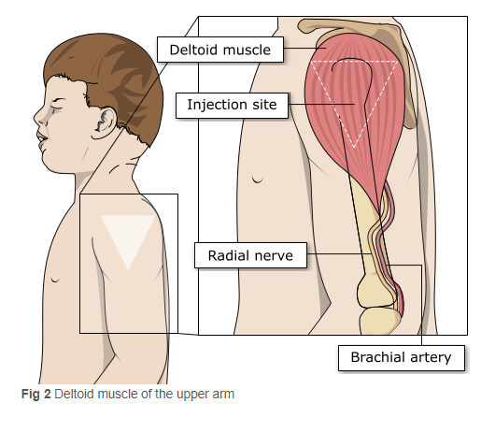
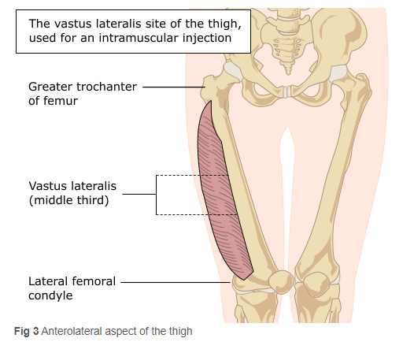
Site of administration:
In infants from 6 to less than 12 months of age, the recommended injection site is the anterolateral aspect of the thigh. In individuals 1 year of age and older, the recommended injection site is the deltoid muscle.
Image source: The Australian Immunisation Handbook (health.gov.au)

Slide 34
Vaccination site
The vaccine should be administered intramuscularly.
The preferred site is the deltoid muscle of the upper arm in individuals over 12 months of age and the anterolateral aspect of the thigh in those under 12 months of age.
The vaccine should not be mixed in the same syringe with any other vaccines or medicinal products.
Giving vaccine into the muscle:
leads to a better immune response to the vaccine (as the muscle contains the appropriate cells necessary to initiate the immune response).
is less likely to cause local reactions than if the vaccine is given into the skin (subcutaneously).
The needle needs to be long enough to ensure vaccine is injected into the muscle. For this reason, a 25mm needle is being provided for administration of the COVID-19 vaccine.

Slide 35
Vaccinating Individuals with bleeding disorders
Individuals with bleeding disorders may be vaccinated intramuscularly if, in the opinion of a doctor familiar with the individual’s bleeding risk, vaccines or similar small volume intramuscular injections can be administered with reasonable safety by this route.
If the individual receives medication/treatment to reduce bleeding, for example treatment for haemophilia, intramuscular vaccination can be scheduled shortly after such medication/ treatment is administered. Individuals on stable anticoagulation therapy, including individuals on warfarin who are up-to-date with their scheduled INR testing and whose latest INR is below the upper level of the therapeutic range, can receive intramuscular vaccination.
A fine needle (23 or 25 gauge) should be used for the vaccination, followed by firm pressure applied to the site without rubbing for at least 2 minutes (Advisory Committee on Immunization Practices 2019). The individual/parent/carer should be informed about the risk of haematoma from the injection Green Book COVID-19 chapter 14a
Notes:
Thrombocytopenia and coagulation disorders
As with other intramuscular injections, the vaccine should be given with caution in individuals receiving anticoagulant therapy or those with thrombocytopenia or any coagulation disorder (such as haemophilia) because bleeding or bruising may occur following an intramuscular administration in these individuals.

Slide 36
Disposal: Pfizer Comirnaty JN.1 COVID-19 mRNA Vaccines
Any unused product or waste material should be disposed of in accordance with local policy
Equipment used for immunisation, including used vials, ampoules, or discharged vaccines in a syringe or applicator, should be disposed of at the end of a session by sealing in an UN-approved puncture-resistant ‘sharps’ box, according to local authority regulations and guidance in the Welsh Health Technical Memorandum 07-01 Safe management of healthcare waste

Slide 37
Adverse reactions
Like all vaccines, Comirnaty JN.1 can cause side effects, although not everybody gets them
A detailed list of adverse reactions is available in the Summary of Product Characteristics.
The most frequently reported adverse effects (affecting between 1 in 10 people) include:
headache, irritability, drowsiness.
diarrhoea, nausea, vomiting.
muscle and or joint pain.
pain in the vaccinated arm.
enlarged lymph nodes.
feeling weak, lethargic, tiredness, chills and fever.
injections site pain, tenderness, redness, itching and swelling.
Irritability, injection site tenderness, sleepiness, rash and reduced appetite more common in individuals aged 6 to 23 months.
Notes:
Comirnaty JN.1 3 micrograms/dose concentrate for dispersion for injection - 3-dose vial - Summary of Product Characteristics (SmPC) - (emc) (medicines.org.uk)
Comirnaty JN.1 10 micrograms/dose dispersion for injection - single dose vial - Summary of Product Characteristics (SmPC) - (emc) (medicines.org.uk)

Slide 38
Myocarditis and pericarditis
Cases of myocarditis and pericarditis have been reported rarely after COVID-19 vaccination. Cases have been observed more often after the second vaccination, and more often in younger males
Although now licensed from 6 months of age, Moderna Spikevax COVID-19 vaccines are not recommended for use in individuals of less than 18 years of age because of the slightly higher risk of myocarditis/pericarditis compared to Pfizer vaccines COVID-19 vaccine information for healthcare practitioners
If an individual develops myocarditis or pericarditis following the first COVID-19 vaccination they should be assessed by an appropriate clinician to determine whether it is likely to be vaccine related
https://www.gov.uk/government/publications/myocarditis-and-pericarditis-after-covid-19-vaccination/myocarditis-and-pericarditis-after-covid-19-vaccination-guidance-for-healthcare-professionals
Healthcare professionals should be alert to the signs and symptoms of myocarditis and pericarditis. Vaccinees (including parents or caregivers) should be instructed to seek immediate medical attention if they develop symptoms indicative of myocarditis or pericarditis such as (acute and persisting) chest pain, shortness of breath, or palpitations following vaccination. Healthcare professionals should consult guidance and/or specialists to diagnose and treat this condition. Green Book COVID-19 chapter 14a
As the mechanism of action and risk of recurrence of myocarditis and pericarditis are being investigated, the current advice is that an individual’s second or subsequent doses should be deferred pending further investigation and careful consideration of the risks and benefits

Slide 39
Guillain-Barré syndrome (GBS)
Very rare reports have been received of GBS following COVID-19 vaccination, so healthcare professionals should be alert to the signs and symptoms of GBS to ensure correct diagnosis and to rule out other causes, in order to initiate adequate supportive care and treatment
Individuals who have a history of GBS should be vaccinated as recommended for their age and underlying risk status. Cases of GBS reported following vaccination may occur by chance (the background rate of GBS is 2 per 100,000 per year in the population) and no causal mechanism with COVID-19 vaccination has been proven
There is evidence to suggest that having had a prior diagnosis of GBS does not predispose an individual to further episodes of GBS when immunised with other vaccines (Baxter et al, 2012) and for the Pfizer BioNTech COVID-19 vaccine (Shapiro Ben David et al, 2021)
In those who are diagnosed with GBS after the first dose of vaccine, the balance of risk benefit is in favour of completing a full COVID-19 vaccination schedule. Green Book COVID-19 chapter 14a

Slide 40
Individuals with a history of immune thrombocytopenia
Individuals with a history of immune thrombocytopenia (ITP) may experience a fall in their platelet count. Guidance produced by the UK ITP Forum Working Party therefore recommends a platelet count check for individuals with a history of ITP, 2-5 days after receiving the COVID-19 vaccine. (British Society for Haematology-COVID-19).

Slide 41
Erythema multiforme
A number of cases of erythema multiforme (EM) have been reported after Moderna and Pfizer mRNA vaccinations.
These reports appear to be consistent with EM minor, with no fatalities.
MHRA have consulted dermatology experts who consider EM an uncommon, benign and self-limiting condition which could plausibly be triggered by COVID-19 vaccination; although overreporting due to misdiagnosis was possible.
A past history of EM is not a contraindication for vaccination.

Slide 42
Co-administration with other vaccines
COVID-19 vaccines are considered inactivated where individuals in an eligible cohort present having recently received one or more inactivated or another live vaccine, COVID-19 vaccination should still be given.
The same applies for other live and inactivated vaccines where COVID-19 vaccination has been received first or where a patient presents requiring two or more vaccines. It is generally better for vaccination to proceed to avoid any further delay in protection and to avoid the risk of the patient not returning for a later appointment. Green Book COVID-19 chapter 14a

Slide 43
Clinical Assessment
The clinical assessment and consent process for infants aged 6 months to 4 years must be carried out by a proficient registered healthcare practitioner only as indicated by the PGD
Considerations:
  An appropriate risk/benefit conversation with the child, their parent or carer has taken place
  Recognise that children and their family/carer may need more time to process information
  This should be factored in when considering pace of delivery
On the day of vaccination assess if the infant/child:
  Is feeling well
  Is eligible for vaccination
  Has no contraindications to the vaccine as per Green Book Chapter or other authoritative resources
  Is happy to receive the vaccination and address any questions or concerns from child or caregiver

Slide 44
Post vaccination waiting times
For people with a history of allergy, as described in the Green Book, the 15 minute observation period remains. Further information is available here: Table 5 Green Book COVID-19 chapter 14a.
For those without a history of allergies (as described in the Green Book), observation times are as follows:
  After COVID-19 vaccine administration, individuals should be observed for any immediate reactions whilst they are receiving any verbal post vaccination information and exiting the centre.
  Facilities for management of anaphylaxis should be available at all vaccination sites.
  The advice to suspend the 15 minute observation period applies to all COVID-19 vaccines.
  Vaccinated individuals should be informed about how to access immediate healthcare advice in the event of displaying any symptoms.
  In some settings, for example domiciliary vaccination, this may require a responsible adult to be present for at least 15 minutes after vaccination.
  No specific management is required for patients with a family history of allergies.
As fainting can occur following vaccination, all those vaccinated with any of the COVID-19 vaccines should not drive for 15 minutes after vaccination.

Slide 45
Tips to support clinical assessment and informed consent
Consider the best ways of communicating with the child and parent/carer
Take time to establish a rapport and build trust
Give time to process information and support to explore any questions
Use visuals if appropriate e.g. smiley face or sad face, thumbs up or thumbs down picture, or red/green tick/cross visual to establish understanding and a means of communication
Natural gestures or signs can also help build understanding
Further information on consent can be found at : Greenbook chapter 2 consent (publishing.service.gov.uk)

Slide 46
Informed consent
How much information should you give?
this will be personal to the individual at the time and will depend on their previous knowledge and discussions with others
give people as much information as they need and/or want to make an informed decision
some people will just ‘trust’ what you say while others want lots of information; either is fine
how much each individual needs is up to them, no one is obliged to seek full information
Information to be given includes:
which vaccine is being offered and the disease against which it protects
benefits/risks of immunisation versus risks of the disease​
any possible vaccine reactions and what to do if these occur
Consent is a process, not a one-off discussion and must consider 3 factors:
the person giving consent must be appropriately informed: they must have the necessary information in order to make the decision
consent must be voluntary by the individual without undue pressure or coercion
the person consenting must have the capacity to make the decision
Consent: the green book, chapter 2 - GOV.UK (www.gov.uk)
Mental capacity Act 2005 https://www.legislation.gov.uk/ukpga/2005/9/contents

Slide 47
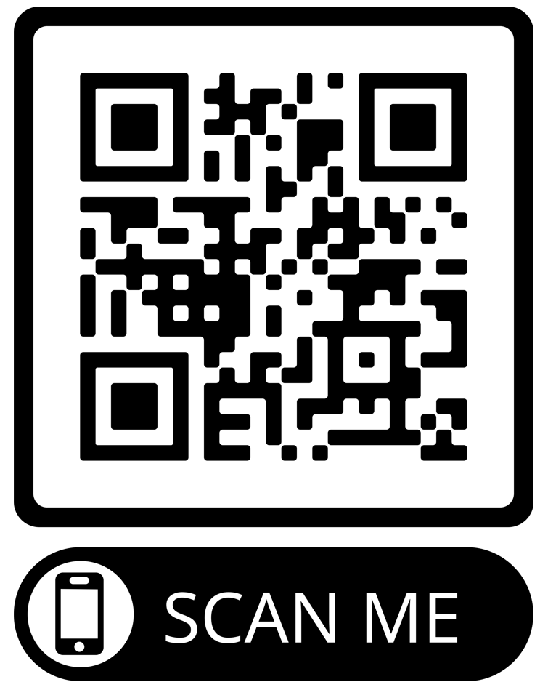
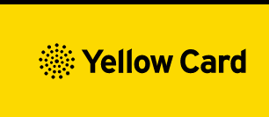
Reporting Adverse Events
Vaccinees should be advised that they can report any adverse reactions or suspected side effects to the MHRA through the online yellow card scheme website or the Yellow Card app
Anyone (patients and HCWs) can make a Yellow Card report, even if they are uncertain as to whether a vaccine caused the condition
▼ This medicinal product is subject to additional monitoring. This will allow quick identification of new safety information. Healthcare professionals are asked to report any suspected adverse reactions.
The QR code can be used for quick and easy access to the Yellow Card reporting site.
www.mhra.gov.uk/yellowcard

Slide 48
Key messages
COVID-19 is now a relatively mild disease for the vast majority of people. This ongoing increase in population immunity permits the development of a more targeted programme aimed at those at higher risk of developing serious COVID-19 disease.
Individuals aged six months to 4 years who become eligible for COVID-19 vaccination require 2 primary doses as per PGD (off-label).
Individuals aged six months and above with severe immunosuppression may be considered for additional doses ideally at an interval of 8 to 12 weeks from the previous dose.
Exception to this ideal interval may be advised based on specialist clinical judgement, for example for those about to receive or increase the intensity of an immunosuppressive treatment, where a better response would be made if immunised prior to that treatment commencing.
Where the specialist has advised an exception, then the interval may be reduced to a minimum of three weeks for any of the vaccine products.
Previously unvaccinated Individuals who become or have recently become severely immunosuppressed, should be considered for a first dose of vaccination and the second dose given ideally at an interval of 8-12 weeks from the previous dose. Including individuals who receive bone marrow transplants or CAR-T therapy as they may have lost immunological memory of previous vaccination
For individuals about to receive planned immunosuppressive treatment, a minimum interval of 3 weeks between COVID-19 doses may be followed, to enable the vaccine to be given whilst the individual’s immune system is better able to respond

Slide 49
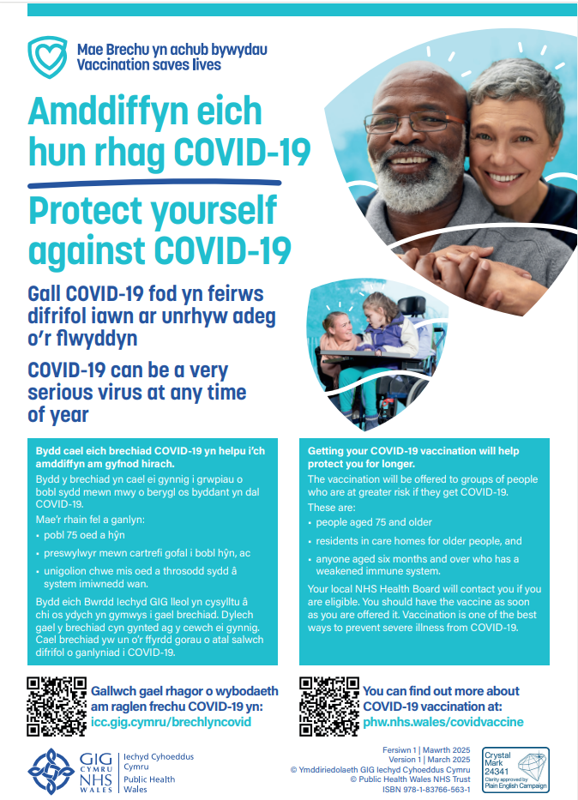


Public resources Spring 2025
Immunisation and Vaccines - Public Health Wales (nhs.wales)
Order for FREE here: https://phw.nhs.wales/services-and-teams/health-information-resources/
COVID-19 Poster
COVID-19 Spring Information Leaflet

Slide 50

Clinical script
A clinical script will be available as download only and will be available at: Resources for health and social care professionals - Public Health Wales (nhs.wales) and Adnoddau i weithwyr proffesiynol iechyd a gofal cymdeithasol - Iechyd Cyhoeddus Cymru (gig.cymru)
Vaccine record card
Available to order for FREE on HIR

Slide 51
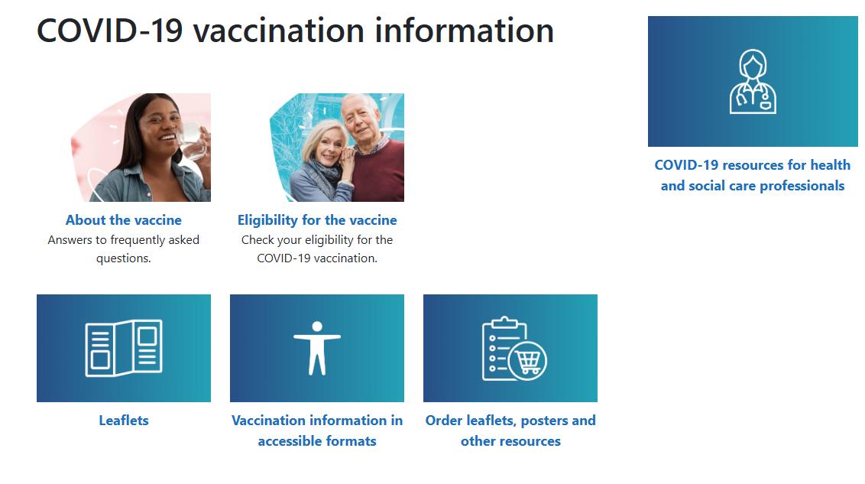
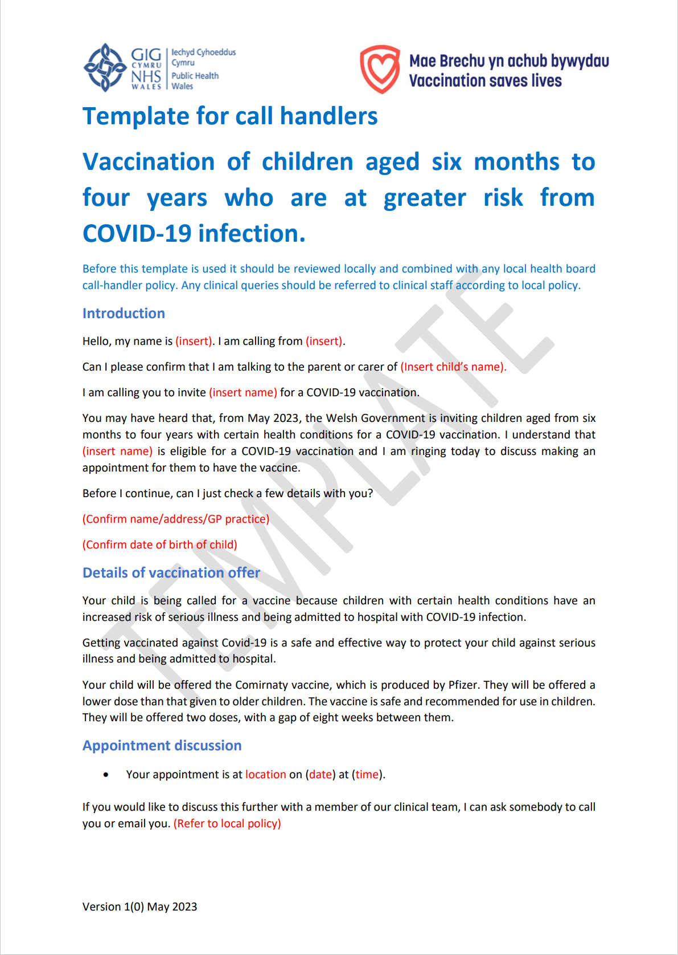
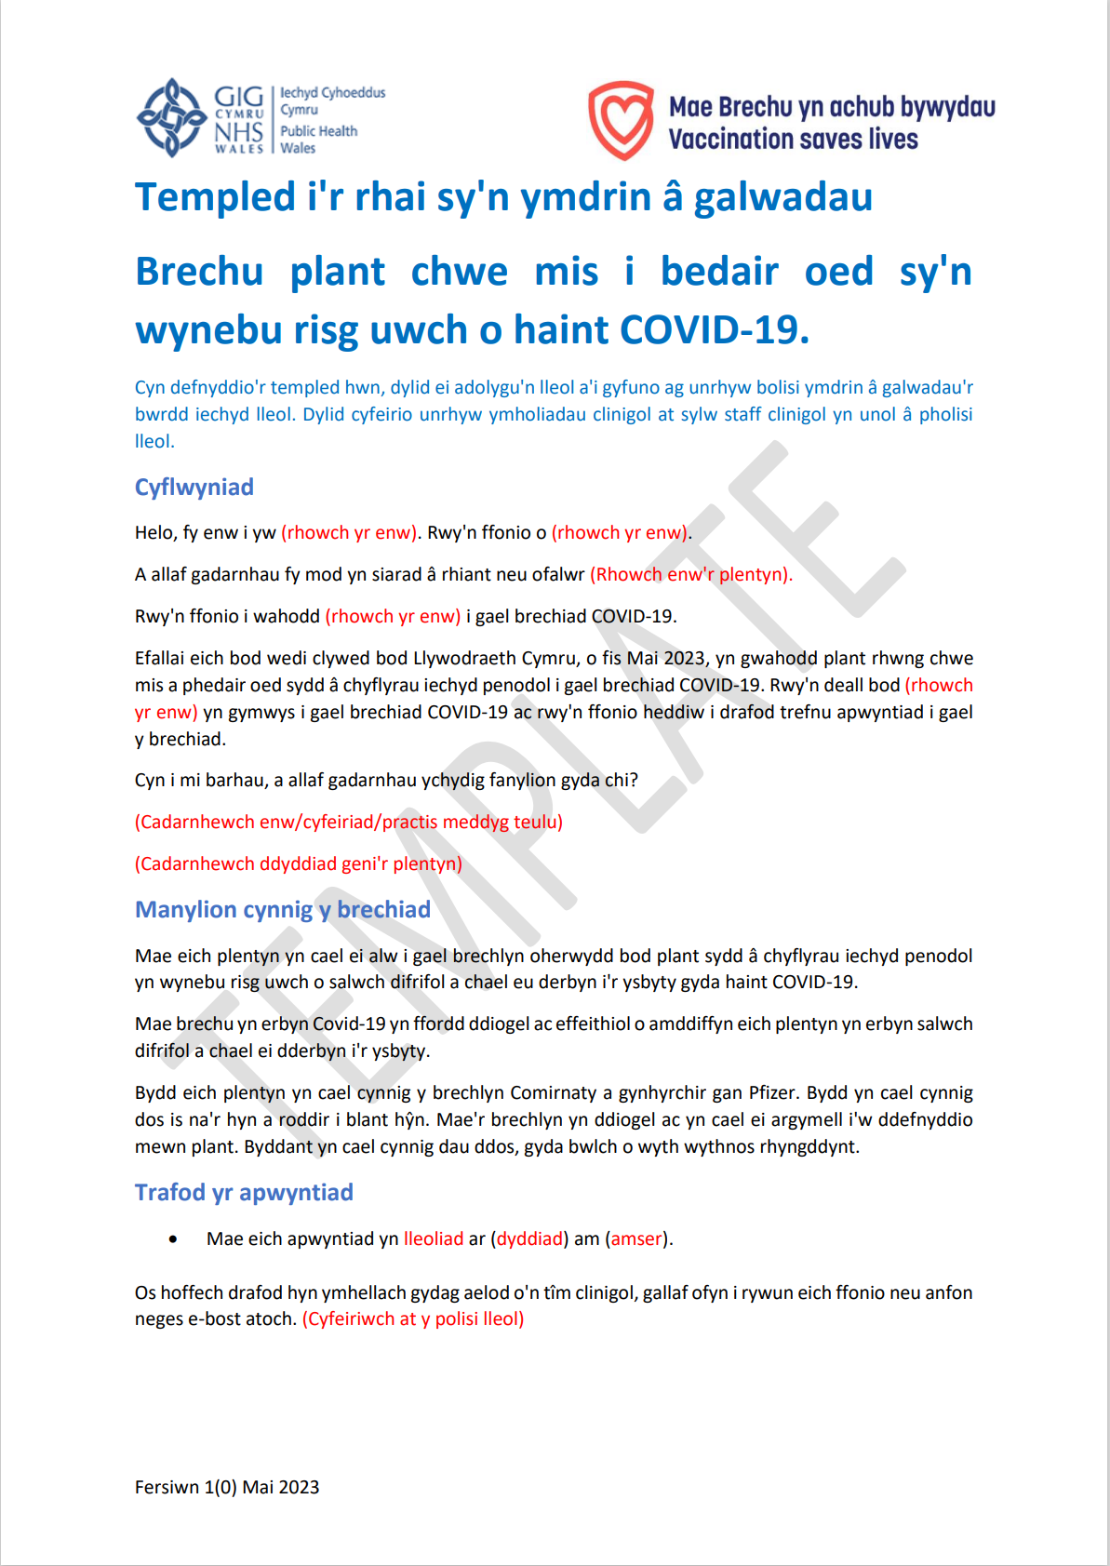
Further information to support the COVID-19 Vaccination Programme for those aged 6 months to 4 years
Information for health care professionals here
Template for Call Handlers (Bilingual): A template script can be found here.
COVID-19 Information for the public here
Notes:
Resources for health and social care professionals - Public Health Wales (nhs.wales)
About the vaccine - Public Health Wales (nhs.wales)

Slide 52
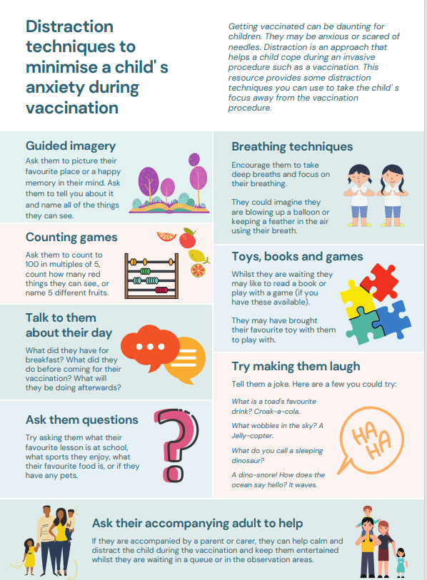
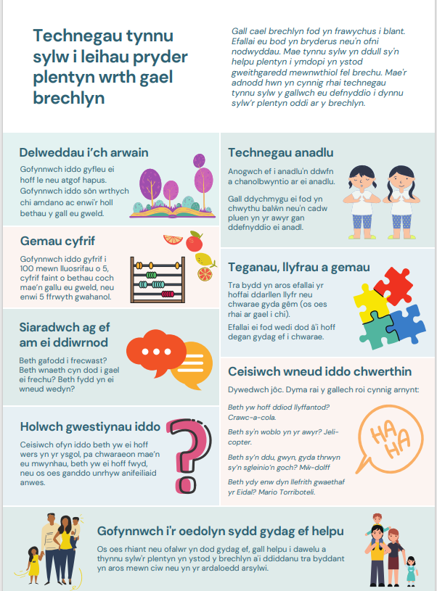
Distraction techniques to minimise a child's anxiety during vaccination
Getting vaccinated can be daunting for some people, particularly children and young people - they may be anxious, scared or needle phobic.
Children may like to bring a favourite toy with them to play with while they wait.
Distraction techniques to minimise a child's anxiety during vaccination [NHS EI Workforce & Training work stream of the national COVID-19 Vaccination programme V1, 4 January 2022]
Available from:
  Distraction techniques to minimise a child' s anxiety during vaccination (nhs.wales)
  WELSH VERSION - Distraction techniques to minimise a child' s anxiety during vaccination (nhs.wales)

Slide 53
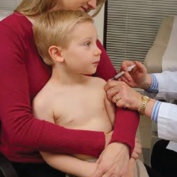
Positioning of infants and young children during vaccination
Parents can hold their child during vaccinations in recommended ways, which may reduce the child’s stress and help healthcare professionals more easily administer vaccines
Parents and caregivers play an important role when children receive vaccines.
A parent’s embrace during vaccination offers several benefits. A comforting hold:
  safely prevents children from moving their arms and legs during injections
  avoids frightening children by embracing them rather than overpowering them
  encourages parents to nurture and comfort their child
  allows the health care professional steady control of the limb and the injection site
Hold the child on your lap or have the child stand in front of you as you sit
Embrace your child during the process
Anchor both of the child’s legs between your thighs
How to Hold Your Child During Vaccination | Childhood Vaccines | CDC
Notes:
How to Hold Your Child During Vaccination | Childhood Vaccines | CDC
Centres for Disease Control and Prevention CDC

Slide 54
Using motivational interviewing for better conversations
Health professionals and vaccinators have an important role in vaccine conversations and are reported by the public as trusted sources of vaccine information.
The approach and style of a vaccine conversation can make a real difference in understanding individual hesitancy, addressing barriers, and influencing vaccine uptake.
Motivational interviewing aims to support decision making by eliciting and strengthening a person's motivation to change their behaviour based on their own arguments for change.
It is used in a range of health settings and is an evidenced approach to improving vaccine uptake through conversation.

Slide 55
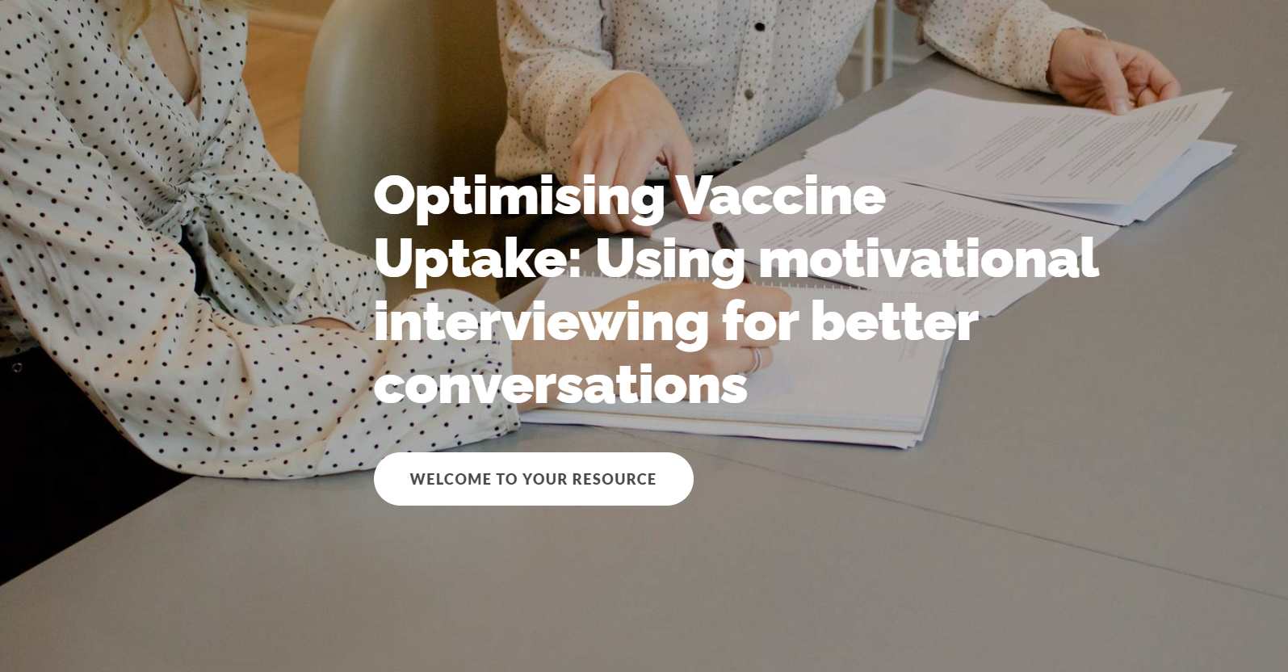
E-learning available on optimising vaccine uptake. Using motivational interviewing for better conversations.
Incorporating motivational interviewing into your vaccine conversations will enable you to identify the core barriers for an individual, and collaboratively address these in a personalised way.
Optimising Vaccine Uptake: Using motivational interviewing for better conversations - Overview | Rise 360 (articulate.com)

Slide 56
Further information (1)
The Green Book has the latest information on vaccines and vaccination procedures, for vaccine preventable infectious diseases in the UK. It also includes UK vaccine policy
"Green Book" .
Green Book recommendations are based upon JCVI’s expert opinion and should
always be followed, even when they differ from those made by the vaccine
manufacturer. (Note: sometimes vaccine policy in Wales differs to England)
UKHSA COVID-19 Immunisation programme Information for healthcare practitioners
This document provides additional information, answers to frequently asked questions
and actions to take in the event of inadvertent errors.
Notes:
https://www.gov.uk/government/publications/covid-19-vaccination-programme-guidance-for-healthcare-practitioners

Slide 57
Further information (2)
PHW professional information resources:
COVID-19 resources for health and social care professionals - Public Health Wales (nhs.wales)
Vaccine resources for health and social care professionals - Public Health Wales (nhs.wales)
PHW training:
Immunisation training resources and events - Public Health Wales (nhs.wales)
Immunisation eLearning - Public Health Wales (nhs.wales)
UKHSA COVID-19 vaccination resources: COVID-19 vaccination programme - GOV.UK (www.gov.uk)
Oxford Knowledge Project: COVID-19 vaccines
MHRA: Guidance on coronavirus (COVID-19)

