Slide 1
Pfizer Comirnaty® JN.1 3 microgram COVID-19 mRNA vaccine for Infants and Children aged 6 months to 4 years
Vaccine Preventable Disease Programme
Public Health Wales
Version 1 16 September 2024
Notes:
Material contained in this document may be reproduced without prior permission provided it is done so accurately and is not used in a misleading context.
Acknowledgement to Public Health Wales NHS Trust to be stated.
© 2024 Public Health Wales NHS Trust.

Slide 2
COVID-19 Vaccination Programme for Infants from 6 months to 4 years in clinical risk groups
The information contained in these slides is accurate at the time of publication (16 September 2024). These slides are version controlled and subject to revision; this is version 1.
It is important that COVID-19 immunisers and/or those who are providing COVID-19 immunisation advice, should always ensure they are accessing the most up to date information and refer to the Green Book COVID-19 chapter 14a and other authoritative sources when administering vaccines.
Only infants and children aged 6 months to 4 years who who are in a clinical risk group as per table 4 of COVID-19 chapter of the Green Book are eligible for a COVID-19 vaccine in the autumn 2024 campaign

Slide 3
Acknowledgements
Vaccine Preventable Disease Programme
Vaccine Programme Wales
Welsh Medicines Advice Service
Welsh Government
JCVI
Green Book

Slide 4
Pre-requisites to administering COVID-19 vaccine
Before administering COVID-19 vaccine, you should have:
Undertaken training in the management of anaphylaxis and Basic Life Support as specified by policy for your local area.
Undertaken any additional statutory and mandatory training as required by your employer.
Received COVID-19 vaccine training through attending a taught session and/or eLearning.
  COVID-19 core eLearning module and vaccine specific modules are available to access here: Immunisation eLearning - Public Health Wales (nhs.wales)
Received practical training in COVID-19 vaccine preparation and administration. (Pfizer Comirnaty JN.1 3micrograms/dose concentrate for dispersions for injection (3 dose vial) requires dilution before use: https://www.medicines.org.uk/emc/product/15837/smpc ).
All new COVID-19 immunisers should complete a competency assessment, for formal assessment and sign-off of their clinical competency. The competencies required will depend on the individual service area and the role of the immuniser. The RCN competency assessment tool is available here: Immunisation Knowledge and Skills Competence Assessment Tool.
An appropriate legal framework to supply and administer COVID-19 vaccine in place e.g. patient specific prescription, Patient Specific Direction (PSD), Patient Group Direction (PGD) or National Protocol (NP).
Accessed and familiarised yourself with the following key documents: Green Book COVID-19 chapter 14a , the UK Health Security Agency COVID-19: vaccination programme guidance for healthcare practitioners, document and the vaccine product information in the Summary of Product Characteristics.

Slide 5
JCVI statement on the COVID-19 vaccination programme for autumn 2024 [8 April 2024] published 02 August 2024 (1)
In autumn 2024, JCVI advises that a COVID-19 vaccine should be offered to:
adults aged 65 years and over
residents in a care home for older adults
persons aged 6 months to 64 years in a clinical risk group (as defined in tables 3 & 4 of the COVID-19 chapter of the Green Book)
JCVI does not advise an offer of COVID-19 vaccination within the autumn 2024 COVID-19 vaccination programme for the following groups:
  frontline Health and Social Care workers
  unpaid Carers
  household contacts of the immunosuppressed
The committee has advised that on the balance of evidence it does not believe there is a clinical benefit to offering the vaccine to these groups. However, owing to the late communication of this advice, Welsh Government has adopted a permissive approach in relation to these groups* Further details can be viewed here: Winter respiratory vaccination programme 2024 to 2025 (WHC/2024/033) (gov.wales)
JCVI statement on the COVID-19 vaccination programme for autumn 2024, 8 April 2024 - GOV.UK (www.gov.uk)
Notes:
*Whilst frontline health and social care workers, staff working in care homes for older adults and unpaid carers should be able to access a COVID-19 vaccine during the 2024/25 programme if they wish to, health board resources should not be channelled towards driving uptake of this vaccine amongst these groups

Slide 6
JCVI statement on the COVID-19 vaccination programme for autumn 2024 [8 April 2024] published 02 August 2024 (2)
This JCVI statement outlines the vaccine products for autumn 2024 programme:
Infants and young children:
Advised for use in children aged 6 months to 4 years*:
Pfizer-BioNTech mRNA Comirnaty® 3 vaccine infant formulation Dose: 3 micrograms
*Pfizer BioNTech vaccine is the preferred vaccine for children due to a slightly lower reported rate of myocarditis
Children and adolescents:
Advised for use in children aged 5 to 11 years*
Pfizer-BioNTech mRNA Comirnaty® 10 vaccine paediatric formulation. Dose: 10 micrograms
Advised for use in children and young adults aged 12 to 17 years*
Pfizer-BioNTech mRNA Comirnaty® 30 Dose: 30 micrograms
*Pfizer BioNTech vaccine is the preferred vaccine for children due to a slightly lower reported rate of myocarditis
Adults:
Advised for use in all individuals aged 18 years and over
Pfizer-BioNTech mRNA Comirnaty® 30 Dose: 30 micrograms
Moderna mRNA Spikevax® vaccine. Dose: 50 micrograms
JCVI statement on the COVID-19 vaccination programme for autumn 2024, 8 April 2024 - GOV.UK (www.gov.uk)

Slide 7
The Winter Respiratory Programme 2024/25,
Welsh Health Circular (2024) 033 published 2 August (1)
Groups eligible for a COVID-19 vaccine in autumn 2024
The following groups will be eligible for a single dose of Covid-19 vaccine:
people aged 6 months to 64 years in a clinical risk group, as defined in tables 3 and 4 of the COVID-19 chapter of the Green Book (which includes *pregnant women and the immunosuppressed)
residents in a care home for older adults
people aged 65 years and older (age on 31 March 2025)
all adult residents in Welsh prisons
unpaid carers
frontline health and social care workers
staff working in care homes for older adults
people experiencing homelessness
In addition, health boards are permitted to (and should reimburse primary care contractors who) vaccinate household contacts of the immunosuppressed who request vaccination. However, no proactive offer should be made to this group.
Winter respiratory vaccination programme 2024 to 2025 (WHC/2024/033) | GOV.WALES
Notes:
*This includes women who are pregnant regardless of their stage of pregnancy, while recognising that the risk of severe COVID-19 in both pregnant women and neonates is currently substantially lower than previously seen in these group

Slide 8
The Winter Respiratory Programme 2024/25,
Welsh Health Circular (2024) 033 published 2 August (2)
This WHC (2024) 033 confirms the eligible cohorts for vaccination and COVID-19 vaccine products to be deployed in Wales for autumn 2024 as per JCVI advice.
The COVID-19 autumn vaccination programme will run between 1 October 2024 aiming to be completed before Christmas 2024.
The Welsh Government uptake target for the following groups is 75%:
• residents in a care home for older adults
• all adults aged 65 years and older
    persons aged 6 months to 64 years in a clinical risk group (as defined in tables 3 & 4 of the COVID-19 chapter of the Green Book)
The vaccine should usually be offered no earlier than around 6 months after the last vaccine dose, although operational flexibility around the timing of vaccination in relation to the last vaccine dose is considered appropriate (with a minimum interval of 3 months between doses). More information on operational flexibility will be provided in the COVID-19 chapter of the Green Book

Slide 9
Recommended vaccine dose intervals for infants from 6 months to 4 years in a clinical risk group
Recent UKHSA seroprevalence studies suggest that most children under five in the UK have had COVID-19 infection. However, as the immunity profile of these children is less certain and may change for future birth cohorts, JCVI considers that these children should continue to receive two primary doses of vaccine.
Children who remain eligible should also receive doses of vaccine in a seasonal campaign, at a minimum interval of three months from their previous dose. Operationally, using the same minimum interval and timing for all products and age groups will simplify supply and booking, and will help to ensure longer lasting and optimally timed protection.
JCVI advises COVID-19 vaccination of children aged 6 months to 4 years who are in a clinical risk group: JCVI statement on the COVID-19 vaccination programme for autumn 2024, 8 April 2024 - GOV.UK (www.gov.uk)
Notes:
European Regulators have proposed basing advice on primary courses in this age group on a history of infection. Vaccines should be offered at least 3 months after the previous vaccine dose, although operational flexibility may be applied to maximise timely delivery of the autumn programme and in consideration of individual circumstances. For consistency across the programme, this interval also applies to second primary doses for eligible individuals.
Individuals immunosuppressed as defined by Chapter 14a Green Book and/or have been referred for vaccination by a specialist who has designated them as group 01 or 02 as described in WIS (Welsh Immunisation System) are eligible for their COVID-19 vaccine via a PGD: Patient Group Directions (PGD) - Welsh Medicines Advice Service (wales.nhs.uk)

Slide 10
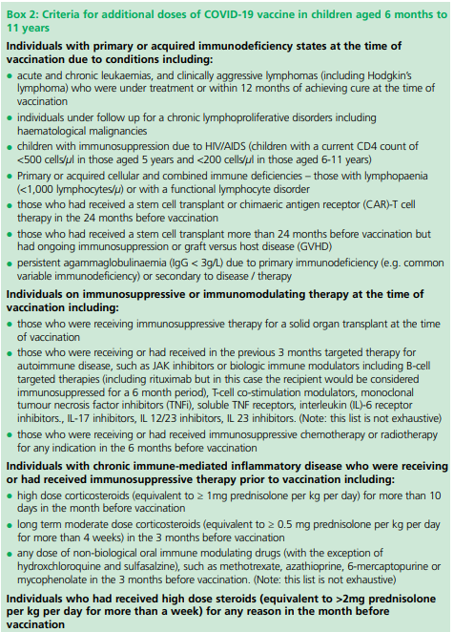
Individuals aged 6 months to 4 years with severe immunosuppression
Individuals aged 6 months and above who have severe immunosuppression, are defined in Boxes 1 and 2 of Chapter 14a Green Book .
Most individuals who receive brief immunosuppression (≥40mg prednisolone per day or equivalent for children) for an acute episode (for example, asthma / COPD / COVID-19) and individuals on replacement corticosteroids for adrenal insufficiency are not considered severely immunosuppressed sufficient to prevent response to vaccination.
Severely immunosuppressed children aged 6 months to 4 years only became eligible for primary vaccination during 2023. These individuals are expected to be eligible for regular vaccination in all subsequent seasonal campaigns.
Green Book COVID-19 chapter 14a.

Slide 11
Recommended vaccine dose intervals for infants from 6 months to 4 years who are immunosuppressed
Individuals aged six months and above with severe immunosuppression may be considered for additional doses ideally at an interval of 8 to12 weeks from the previous dose.
Infants and children aged 6 months to 4 years who are previously unvaccinated or have recently become severely immunosuppressed should be considered for a first dose of vaccination and the second dose given ideally at an interval of 8 to12 weeks from the previous dose. Including individuals who receive bone marrow transplants or CAR-T therapy as they may have lost immunological memory of previous vaccination.
Exception to this ideal interval may be advised based on specialist clinical judgement, for example for those about to receive or increase the intensity of an immunosuppressive treatment, where a better response would be made if immunised prior to that treatment commencing. Where the specialist has advised an exception, then the interval may be reduced to a minimum of three weeks for any of the vaccine products.
Assessment of individuals is recommended on a case by case basis, in conjunction with their treating specialist.
More information on dosing intervals for additional doses and optimal timing of doses may be found in Chapter 14a.
Notes:
In contrast to other eligible risk groups, those who are eligible for a vaccination due to severe immunosuppression but miss vaccination during the campaign period, may be considered for an additional dose at a later date based on individual clinical judgement, balancing their immediate level of risk against the advantages of waiting till the next seasonal campaign.

Slide 12
Timing of additional doses
Vaccines administered during periods of minimum immunosuppression are more likely to generate better immune responses. Therefore, any planned additional doses should ideally be given with special attention paid to current or planned immunosuppressive therapies. For example:
For the small number of patients who are about to receive planned immunosuppressive therapy, vaccination may be brought forward to before commencing that therapy (ideally at least two weeks before), when their immune system is better able to make a response.
To maximise the benefit, the vaccine should not be given within three weeks of a previous dose
Where possible, additional booster doses should be delayed until two weeks after the period of immunosuppression, in addition to the time period for clearance of the therapeutic agent
Alternatively, consideration should be given to vaccination during a treatment ‘holiday’ or when the degree of immunosuppression is at a minimum
Any decision to defer immunosuppressive therapy or to delay possible benefit from vaccination until after therapy should only be taken with due consideration of the risks of exacerbating their underlying condition, as well as the risks from COVID-19.
Green Book COVID-19 chapter 14a

Slide 13
Individuals who receive bone marrow transplant and CAR-T therapy
These individuals may lose immunological memory from vaccination received prior to the treatment and the development of the underlying condition.
After treatment and recovery, these individuals should be considered for a full course of revaccination for all vaccines used in the routine programme (see chapter 7 Green Book) under specialist advice.
Individuals who have recovered from a bone marrow transplant should be considered for a first dose of COVID-19 vaccine, regardless of the time of year.
A subsequent dose should then be offered ideally at an interval of 8 to 12 weeks, to extend the duration of protection. This interval may be reduced to a minimum of three weeks on specialist clinical advice.
Those who remain immunosuppressed will then continue to be eligible for seasonal campaigns.

Slide 14
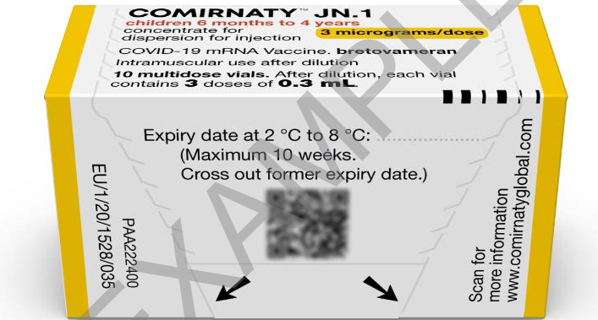
Pfizer Comirnaty® JN.1 3 microgram per dose dispersion for injection COVID-19 mRNA Vaccine
SmPC Pfizer Comirnaty® JN.1 3 microgram per dose dispersion for injection COVID-19 mRNA Vaccine (nucleoside modified) Bretovameran
14
Notes:
Comirnaty JN.1 3 micrograms/dose concentrate for dispersion for injection - 3-dose vial - Summary of Product Characteristics (SmPC) - (emc) (medicines.org.uk)

Slide 15
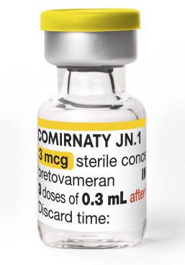
Presentation: Pfizer Comirnaty® JN.1
3 microgram per dose dispersion for injection
COVID-19 mRNA Vaccine
Pfizer Comirnaty® JN.1 3 microgram per dose dispersion for injection COVID-19 mRNA vaccine is a multi-dose vial and must be diluted before use.
After dilution, vials with a yellow cap of Comirnaty JN.1 contain 3 doses of 0.3 mL of vaccine. Standard syringes and needles can be used to extract 3 doses from a single vial.
Each dose must contain 0.3 mL of vaccine.
If the amount of vaccine remaining in the vial cannot provide a full dose of 0.3 mL, discard the vial and any excess volume.
Do not pool excess vaccine from multiple vials.

Slide 16
List of excipients: Pfizer Comirnaty® JN.1
3 microgram per dose dispersion for injection
COVID-19 mRNA Vaccine
Hypersensitivity to the active substance or to any of the excipients listed below:
2-[(polyethylene glycol - PEG)-2000]-N -This vaccine contains polyethylene glycol/macrogol (PEG)
N-ditetradecylacetamide (ALC-0159)
(4-hydroxybutyl)azanediyl)bis(hexane-6,1-diyl)bis(2-hexyldecanoate) (ALC-0315)
1,2-Distearoyl-sn-glycero-3-phosphocholine (DSPC)
Cholesterol
Trometamol
Trometamol hydrochloride
Sucrose
Water for injection
Comirnaty JN.1 3 micrograms/dose concentrate for dispersion for injection - 3-dose vial - Summary of Product Characteristics (SmPC) - (emc) (medicines.org.uk)
Vaccine ingredients | Vaccine Knowledge (ox.ac.uk)

Slide 17
Polyethylene glycol (PEG)
Pfizer Comirnaty® JN.1 3 microgram per dose dispersion for injection COVID-19 mRNA Vaccine contains polyethylene glycol (PEG)
PEGs (also known as macrogols) are a group of known allergens commonly found in medicines, many household products and cosmetics
Medicines containing PEG include some tablets, laxatives, depot steroid injections, and some bowel preparations used for colonoscopy
Individuals with undiagnosed PEG allergy often have a history of immediate onset-unexplained anaphylaxis or anaphylaxis to multiple classes of drugs. Such individuals should not be vaccinated with Pfizer Comirnaty® JN.1 3 microgram per dose dispersion for injection COVID-19 mRNA Vaccine (or any other COVID-19 vaccine containing polyethylene glycol (PEG)) except on the expert advice of a paediatric allergy specialist
Known allergy to PEG is rare but has been implicated in a minority of allergic reactions reported
For further information see: Table 5: Management of patients with a history of allergy in Green Book COVID-19 chapter 14a

Slide 18
Storage: Pfizer Comirnaty® JN.1
3 microgram per dose dispersion for injection
COVID-19 mRNA Vaccine
Unopened thawed vials are stable within a 10 week storage period between +2°C and +8°C.
Upon moving the vaccine to +2 °C to +8 °C storage, the updated expiry date must be written on the outer carton and the vaccine should be used or discarded by the updated expiry date. The original expiry date should be crossed out.
Thawed vials can be handled in room light conditions. Once thawed, the vaccine should not be re-frozen.
Stability data indicate the vial can be stored for up to 24 hours at temperatures of +8 °C to +30 °C, including up to 12 hours following first puncture.

Slide 19
Prior to giving Pfizer Comirnaty® JN.1
3 microgram per dose dispersion for injection
COVID-19 mRNA Vaccine
Before giving the vaccine, you need to check if the infant or child:
is eligible to receive the Pfizer Comirnaty® JN.1 3 microgram per dose dispersion for injection COVID-19 mRNA Vaccine
has any contraindications or precautions to the Pfizer Comirnaty® mRNA Vaccines
has not received any COVID-19 vaccination in the previous 3 months. The Green Book COVID-19 chapter 14a states, for those eligible for vaccination during seasonal campaigns, a single dose is offered at least 3 months after any previous dose. This interval applies to any vaccine, regardless of the product given for the previous doses. Timing should follow the JCVI advice for that campaign, which aims to provide protection to the most vulnerable at the optimal time
the only exceptions to the 3-month interval would be individuals who are immunosuppressed, these individuals would be recommended a second dose, and in some circumstances, may need to complete vaccinations within a treatment window. In this situation the minimum interval could be reduced to 3 weeks Green Book COVID-19 chapter 14a

Slide 20
Contraindications: Pfizer Comirnaty® JN.1 3 microgram per dose dispersion for injection COVID-19 mRNA Vaccine
Vaccination should be postponed in individuals suffering from acute severe febrile illness or acute infection. The presence of a minor infection and/or low-grade fever should not delay vaccination.
The vaccine is contraindicated in those who have had a previous systemic allergic reaction (including immediate-onset anaphylaxis) to:
  a previous dose of a COVID-19 mRNA vaccine
  any component (excipient) of the COVID-19 mRNA vaccine
People with a history of allergy: A very small number of individuals have experienced anaphylaxis when receiving a COVID-19 vaccine. Anyone with a history of allergic reaction to an excipient in the COVID-19 vaccine should not receive that vaccine (except with expert advice), but those with any other allergies (such as a food allergy) – including those with prior anaphylaxis – can have the vaccine. Guidance about the management of individuals with a history of allergy should be followed (summarised in Table 5) COVID-19: the green book, chapter 14a - GOV.UK (www.gov.uk).
Notes:
Before administering a COVID-19 vaccine, it is important to check for any relevant medical history including allergies and any previous history of severe reaction to a vaccine. Facilities for management of paediatric anaphylaxis should be available at all vaccination sites. (See Chapter 8 of the Green Book: https://www.gov.uk/government/publications/vaccine-safety-and-adverse-events-following-immunisation-the-green-book-chapter-8 ) and advice issued by the Resuscitation Council (https://www.resus.org.uk/).

Slide 21
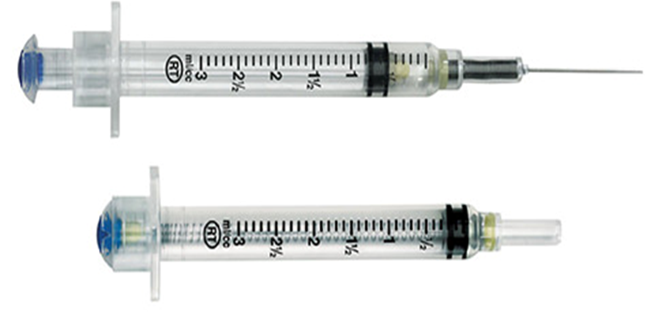
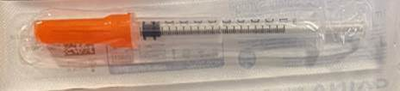
Pfizer Comirnaty® JN.1 3 microgram per dose dispersion for injection COVID-19 mRNA Vaccine:
Combined needles and safety syringes
The following Combined safety needles and syringes are being supplied with Pfizer Comirnaty® JN.1 3 microgram per dose dispersion for injection COVID-19 mRNA Vaccine
Reconstitution:
VanishPoint® combined fixed needle and safety syringe device, Vanishpoint® syringes are self retracting.
Administration:
GBUK Safety Syringe 1ml 25G x 25mm (fixed needle) with needle cover

Slide 22
VanishPoint® combined needle and syringe product
Vanishpoint® syringes for the reconstitution of Pfizer Comirnaty® JN.1 3 microgram per dose dispersion for injection
COVID-19 mRNA Vaccine
Vanishpoint® syringes are self-retracting: If the bottom of the plunger of the syringe touches the neck of the syringe barrel the mechanism is triggered and the needle will auto retract into the barrel of the syringe.
Vanishpoint Online Training Content (gandn.com) The training videos show immunisers wearing gloves and sleeves being worn below the elbow. This is not in line with Infection Prevention and Control guidance and these practices are not recommended in NHS Wales.

Slide 23
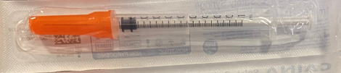
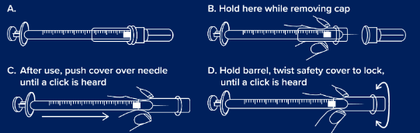
GBUK Safety Syringe 1ml 25G x 25mm with needle cover
GBUKSafety Syringe 1ml 25G x 25mm with needle cover will be supplied for the administration of Pfizer Comirnaty® JN.1 3 microgram per dose dispersion for injection COVID-19 mRNA Vaccine https://gbukgroup.com/safety-syringe-with-fixed-needle/
Please note: the IPC measures in these resources do not align with the national IPC requirements in Wales. See here for NHS Wales guidance: Guidance - Public Health Wales (nhs.wales).

Slide 24
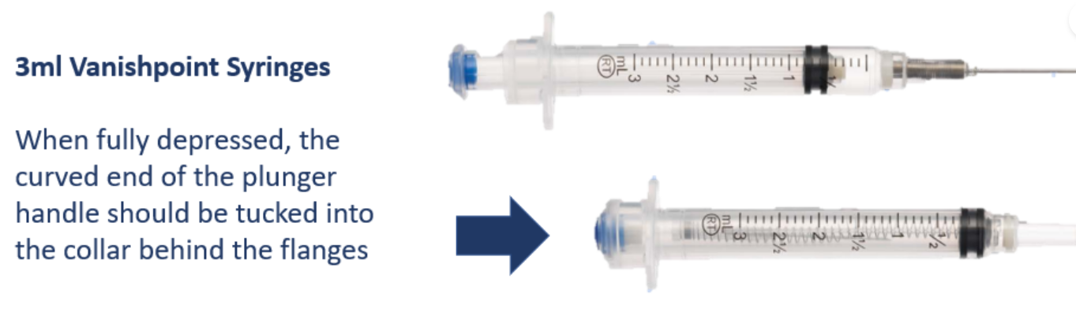
Dilution: Comirnaty® JN.1 3 microgram per dose dispersion for injection COVID-19 mRNA Vaccine (1)
Allow the thawed vial to come to room temperature and gently invert it 10 times prior to dilution. Do not shake.
Prior to dilution, the thawed dispersion may contain white to off-white opaque amorphous particles.
The thawed vaccine must be diluted in its original vial with 1.1 mL sodium chloride 9 mg/mL (0.9%) solution for injection, using a 21 gauge or narrower needle and aseptic techniques.
https://resources.gandn.com/vanishpoint-online-training
Notes:
Comirnaty JN.1 3 micrograms/dose concentrate for dispersion for injection - 3-dose vial - Summary of Product Characteristics (SmPC) - (emc) (medicines.org.uk)
https://www.medicines.org.uk/emc/product/15837/smpc

Slide 25
Dilution: Pfizer Comirnaty® JN.1 3 microgram per dose dispersion for injection COVID-19 mRNA Vaccine (2)
Equalise vial pressure before removing the needle from the vial stopper by withdrawing 1.1 mL air into the empty diluent syringe.
https://resources.gandn.com/vanishpoint-online-training
Notes:
Comirnaty JN.1 3 micrograms/dose concentrate for dispersion for injection - 3-dose vial - Summary of Product Characteristics (SmPC) - (emc) (medicines.org.uk)
https://www.medicines.org.uk/emc/product/15837/smpc

Slide 26
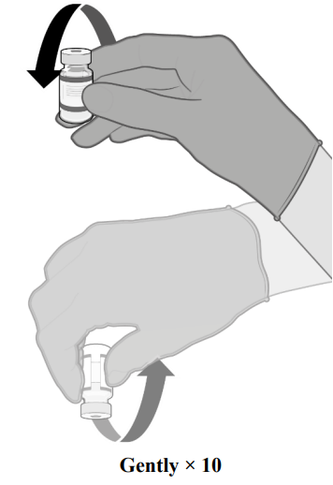
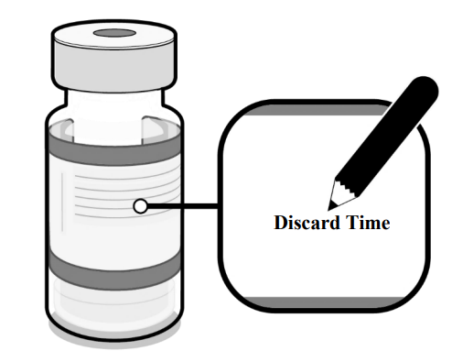
Dilution: Pfizer Comirnaty® JN.1 3 microgram per dose dispersion for injection COVID-19 mRNA Vaccine (3)
Gently invert the diluted dispersion 10 times. Do not shake
The diluted vaccine should present as a white to off-white dispersion with no particulates visible. Do not use the diluted vaccine if particulates or discolouration are present
The diluted vials should be marked with the appropriate discard date and time
After dilution store at 2ºC to 30ºC and use within 12 hours
Do not freeze or shake the diluted dispersion. If refrigerated, allow the diluted dispersion to come to room temperature prior to use.
Notes:
Comirnaty JN.1 3 micrograms/dose concentrate for dispersion for injection - 3-dose vial - Summary of Product Characteristics (SmPC) - (emc) (medicines.org.uk)
https://www.medicines.org.uk/emc/product/15837/smpc

Slide 27
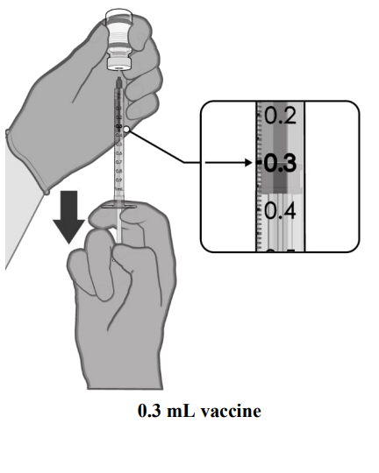
Dose preparation: Pfizer Comirnaty® JN.1 3 microgram per dose dispersion for injection COVID-19 mRNA Vaccine
Check product name, batch number and expiry date prior to administration.
After dilution, the vial contains 1.58 mL from which 3 doses of 0.3 mL can be extracted.
Using aseptic technique, cleanse the vial stopper with a single-use antiseptic swab.
Withdraw 0.3 mL of Comirnaty JN.1 for infants and children aged 6 months to 4 years. Standard syringes and/or needles can be used in order to extract 3 doses from a single vial.
Each dose must contain 0.3 mL of vaccine.
If the amount of vaccine remaining in the vial cannot provide a full dose of 0.3 mL, discard the vial and any excess volume.
Discard any unused vaccine within 12 hours after dilution.
Disposal
Any unused medicinal product or waste material should be disposed of in accordance with local requirements.
Notes:
Comirnaty JN.1 3 micrograms/dose concentrate for dispersion for injection - 3-dose vial - Summary of Product Characteristics (SmPC) - (emc) (medicines.org.uk)
https://www.medicines.org.uk/emc/product/15837/smpc

Slide 28
Dosing and schedule
The SmPC Pfizer Comirnaty JN.1 3 microgram per dose dispersion for injection COVID-19 mRNA Vaccine recommends a second dose is administered 3 weeks after the first dose followed by a third dose 8 weeks after the second dose however, the JCVI advises that children aged 6 months to 4 years in a clinical risk group (as defined in the Green Book) should be offered two doses of JN.1 3 microgram per dose dispersion for injection COVID-19 mRNA Vaccine
Therefore, Pfizer Comirnaty® COVID-19 mRNA vaccine should be administered under a PGD in accordance with recommendations from the JCVI and Chapter 14a of the Green Book for the delivery of the COVID-19 vaccination programme. This use would be off-label.
JCVI advised that all second and any subsequent seasonal doses should be given at a minimum interval of three months.
To note:
Individuals aged six months and above with severe immunosuppression may be considered for additional doses ideally at an interval of 8 to 12 weeks from the previous dose. Where the specialist has advised an exception, then the interval may be reduced to a minimum of three weeks for any of the vaccine products.

Slide 29
Patient Group Direction (PGD) only programme
Pfizer Comirnaty® JN.1 3 microgram per dose dispersion for injection COVID-19 mRNA Vaccine PGD will be available to view here: Patient Group Directions (PGD) - Welsh Medicines Advice Service (wales.nhs.uk)

Slide 30
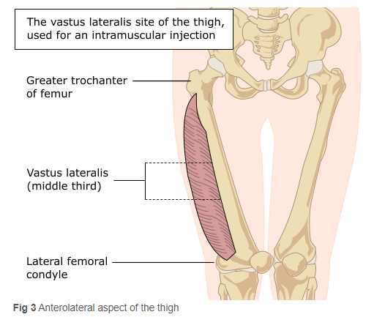
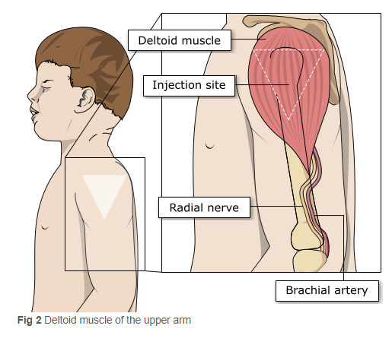
Administration: Pfizer Comirnaty JN.1 3 microgram per dose dispersion for injection COVID-19 mRNA Vaccine to infants from 6 months to 4 years
In infants from 6 to less than 12 months of age, the recommended injection site is the anterolateral aspect of the thigh. In individuals 1 year of age and older, the recommended injection site is the deltoid muscle.

Slide 31
Vaccination site
The vaccine should be administered intramuscularly.
The preferred site is the deltoid muscle of the upper arm in individuals over 12 months of age and the anterolateral aspect of the thigh in those under 12 months of age.
The vaccine should not be mixed in the same syringe with any other vaccines or medicinal products.
Giving vaccine into the muscle:
leads to a better immune response to the vaccine (as the muscle contains the appropriate cells necessary to initiate the immune response).
is less likely to cause local reactions than if the vaccine is given into the skin (subcutaneously).
The needle needs to be long enough to ensure vaccine is injected into the muscle. For this reason, a 25mm needle is being provided for administration of the COVID-19 vaccine.

Slide 32
Vaccinating Individuals with bleeding disorders
Individuals with bleeding disorders may be vaccinated intramuscularly if, in the opinion of a doctor familiar with the individual’s bleeding risk, vaccines or similar small volume intramuscular injections can be administered with reasonable safety by this route.
If the individual receives medication/treatment to reduce bleeding, for example treatment for haemophilia, intramuscular vaccination can be scheduled shortly after such medication/ treatment is administered. Individuals on stable anticoagulation therapy, including individuals on warfarin who are up-to-date with their scheduled INR testing and whose latest INR is below the upper level of the therapeutic range, can receive intramuscular vaccination.
A fine needle (23 or 25 gauge) should be used for the vaccination, followed by firm pressure applied to the site without rubbing for at least 2 minutes (Advisory Committee on Immunization Practices 2019). The individual/parent/carer should be informed about the risk of haematoma from the injection Green Book COVID-19 chapter 14a
Notes:
Thrombocytopenia and coagulation disorders
As with other intramuscular injections, the vaccine should be given with caution in individuals receiving anticoagulant therapy or those with thrombocytopenia or any coagulation disorder (such as haemophilia) because bleeding or bruising may occur following an intramuscular administration in these individuals.

Slide 33
Disposal: Pfizer Comirnaty JN.1 3 microgram per dose dispersion for injection COVID-19 mRNA Vaccine
Any unused product or waste material should be disposed of in accordance with local policy
Equipment used for immunisation, including used vials, ampoules, or discharged vaccines in a syringe or applicator, should be disposed of at the end of a session by sealing in a UN-approved puncture-resistant ‘sharps’ box, according to local authority regulations and guidance in the Welsh Health Technical Memorandum 07-01 Safe management of healthcare waste

Slide 34
Adverse reactions
A detailed list of adverse reactions is available in the Summary of Product Characteristics.
The most frequently reported adverse effects (affecting between 1 in 10 people and 1 in 1000 people) include:
headache, dizziness, irritability, drowsiness.
diarrhoea, nausea, vomiting, reduced appetite.
muscle and or joint pain.
pain in the vaccinated arm.
enlarged lymph nodes.
feeling unwell, feeling weak, lethargic, tiredness, chills and fever.
allergic reactions such as a rash and or itching.
injections site pain, tenderness, redness, itching and swelling.
excessive sweating, night sweats.
Irritability, injection site tenderness, sleepiness, rash and reduced appetite more common in individuals aged 6 to 23 months.
Notes:
Comirnaty JN.1 3 micrograms/dose concentrate for dispersion for injection - 3-dose vial - Summary of Product Characteristics (SmPC) - (emc) (medicines.org.uk)

Slide 35
Myocarditis and pericarditis
Cases of myocarditis and pericarditis have been reported rarely after COVID-19 vaccination. Moderna COVID-19 vaccine has a slightly higher rate of myocarditis reported. Cases have been observed more often after the second vaccination, and more often in younger males
If an individual develops myocarditis or pericarditis following the first COVID-19 vaccination they should be assessed by an appropriate clinician to determine whether it is likely to be vaccine related
https://www.gov.uk/government/publications/myocarditis-and-pericarditis-after-covid-19-vaccination/myocarditis-and-pericarditis-after-covid-19-vaccination-guidance-for-healthcare-professionals
Healthcare professionals should be alert to the signs and symptoms of myocarditis and pericarditis. Vaccinees (including parents or caregivers) should be instructed to seek immediate medical attention if they develop symptoms indicative of myocarditis or pericarditis such as (acute and persisting) chest pain, shortness of breath, or palpitations following vaccination. Healthcare professionals should consult guidance and/or specialists to diagnose and treat this condition. Green Book COVID-19 chapter 14a
As the mechanism of action and risk of recurrence of myocarditis and pericarditis are being investigated, the current advice is that an individual’s second or subsequent doses should be deferred pending further investigation and careful consideration of the risks and benefits

Slide 36
Individuals with a history of immune thrombocytopenia
Individuals with a history of immune thrombocytopenia (ITP) may experience a fall in their platelet count. Guidance produced by the UK ITP Forum Working Party therefore recommends a platelet count check for individuals with a history of ITP, 2-5 days after receiving the COVID-19 vaccine. (British Society for Haematology-COVID-19).

Slide 37
Erythema multiforme
A number of cases of erythema multiforme (EM) have been reported after Moderna and Pfizer mRNA vaccinations.
These reports appear to be consistent with EM minor, with no fatalities.
MHRA have consulted dermatology experts who consider EM an uncommon, benign and self-limiting condition which could plausibly be triggered by COVID-19 vaccination; although overreporting due to misdiagnosis was possible.
A past history of EM is not a contraindication for vaccination.

Slide 38
Co-administration with other vaccines
COVID-19 vaccines are considered inactivated where individuals in an eligible cohort present having recently received one or more inactivated or another live vaccine, COVID-19 vaccination should still be given.
The same applies for other live and inactivated vaccines where COVID-19 vaccination has been received first or where a patient presents requiring two or more vaccines. It is generally better for vaccination to proceed to avoid any further delay in protection and to avoid the risk of the patient not returning for a later appointment. Green Book COVID-19 chapter 14a

Slide 39
Clinical Assessment
The clinical assessment and consent process must be carried out by a proficient registered healthcare practitioner only
Considerations:
  An appropriate risk/benefit conversation with the child, their parent or carer has taken place
  Recognise that children and their family/carer may need more time to process information
  This should be factored in when considering pace of delivery
On the day of vaccination assess if the infant/child:
  Is feeling well
  Is eligible for vaccination
  Has no contraindications to the vaccine as per Green Book Chapter or other authoritative resources
  Is happy to receive the vaccination and address any questions or concerns from child or caregiver

Slide 40
Post vaccination waiting times
For people with a history of allergy, as described in the Green Book, the 15 minute observation period remains. Further information is available here: Table 5 Green Book COVID-19 chapter 14a.
For those without a history of allergies (as described in the Green Book), observation times are as follows:
  After COVID-19 vaccine administration, individuals should be observed for any immediate reactions whilst they are receiving any verbal post vaccination information and exiting the centre.
  Facilities for management of anaphylaxis should be available at all vaccination sites.
  The advice to suspend the 15 minute observation period applies to all COVID-19 vaccines.
  Vaccinated individuals should be informed about how to access immediate healthcare advice in the event of displaying any symptoms.
  In some settings, for example domiciliary vaccination, this may require a responsible adult to be present for at least 15 minutes after vaccination.
  No specific management is required for patients with a family history of allergies.
As fainting can occur following vaccination, all those vaccinated with any of the COVID-19 vaccines should not drive for 15 minutes after vaccination.

Slide 41
Tips to support clinical assessment and informed consent
Consider the best ways of communicating with the child and parent/carer
Take time to establish a rapport and build trust
Give time to process information and support to explore any questions
Use visuals if appropriate e.g. smiley face or sad face, thumbs up or thumbs down picture, or red/green tick/cross visual to establish understanding and a means of communication
Natural gestures or signs can also help build understanding
Further information on consent can be found at : Greenbook chapter 2 consent (publishing.service.gov.uk)

Slide 42
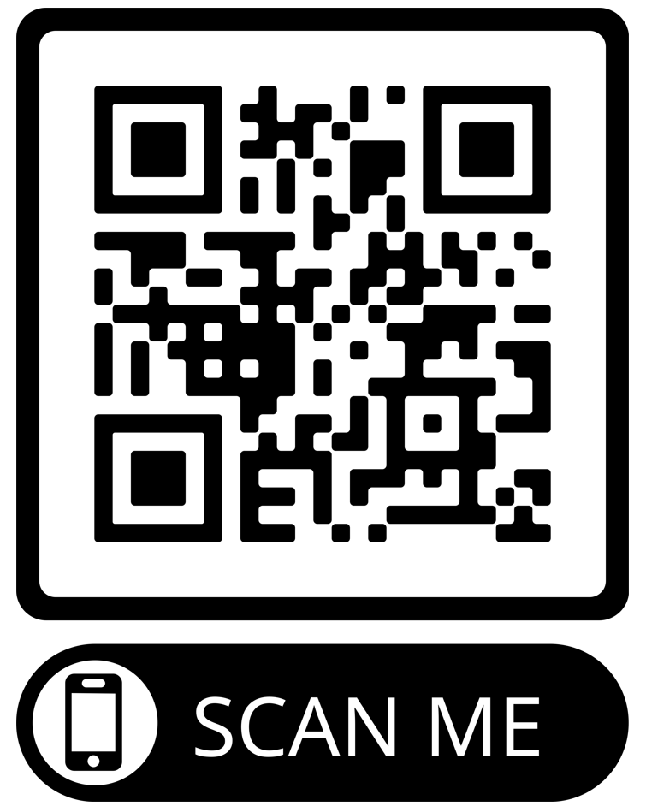
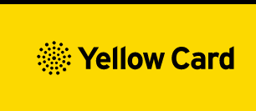
Reporting Adverse Events
Vaccinees should be advised that they can report any adverse reactions or suspected side effects to the MHRA through the online yellow card scheme website or the Yellow Card app
Anyone (patients and HCWs) can make a Yellow Card report, even if they are uncertain as to whether a vaccine caused the condition
▼ This medicinal product is subject to additional monitoring. This will allow quick identification of new safety information. Healthcare professionals are asked to report any suspected adverse reactions.
The QR code can be used for quick and easy access to the Yellow Card reporting site.
www.mhra.gov.uk/yellowcard

Slide 43
Key messages
COVID-19 is now a relatively mild disease for the vast majority of people. This ongoing increase in population immunity permits the development of a more targeted programme aimed at those at higher risk of developing serious COVID-19 disease.
Individuals aged six months to 4 years who become eligible for COVID-19 vaccination require 2 primary doses.
Individuals aged six months and above with severe immunosuppression may be considered for additional doses ideally at an interval of 8 to 12 weeks from the previous dose.
Exception to this ideal interval may be advised based on specialist clinical judgement, for example for those about to receive or increase the intensity of an immunosuppressive treatment, where a better response would be made if immunised prior to that treatment commencing.
Where the specialist has advised an exception, then the interval may be reduced to a minimum of three weeks for any of the vaccine products.
Previously unvaccinated Individuals who become or have recently become severely immunosuppressed, should be considered for a first dose of vaccination and the second dose given ideally at an interval of 8-12 weeks from the previous dose. Including individuals who receive bone marrow transplants or CAR-T therapy as they may have lost immunological memory of previous vaccination
For individuals about to receive planned immunosuppressive treatment, a minimum interval of 3 weeks between COVID-19 doses may be followed, to enable the vaccine to be given whilst the individual’s immune system is better able to respond

Slide 44
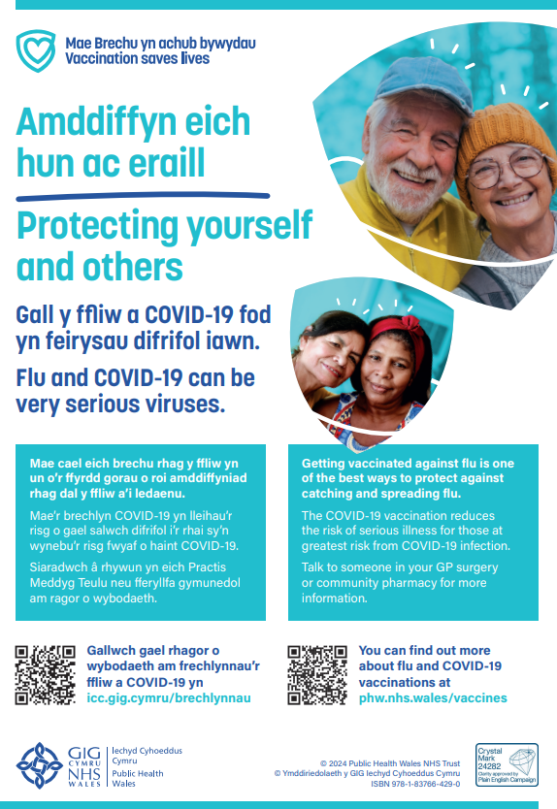


Public resources Autumn 2024
Immunisation and Vaccines - Public Health Wales (nhs.wales)
Order here: https://phw.nhs.wales/services-and-teams/health-information-resources/

Slide 45

Clinical script
A clinical script will be available as download only and will be available at: Resources for health and social care professionals - Public Health Wales (nhs.wales) and Adnoddau i weithwyr proffesiynol iechyd a gofal cymdeithasol - Iechyd Cyhoeddus Cymru (gig.cymru)
Vaccine record card
Available to order on HIR

Slide 46
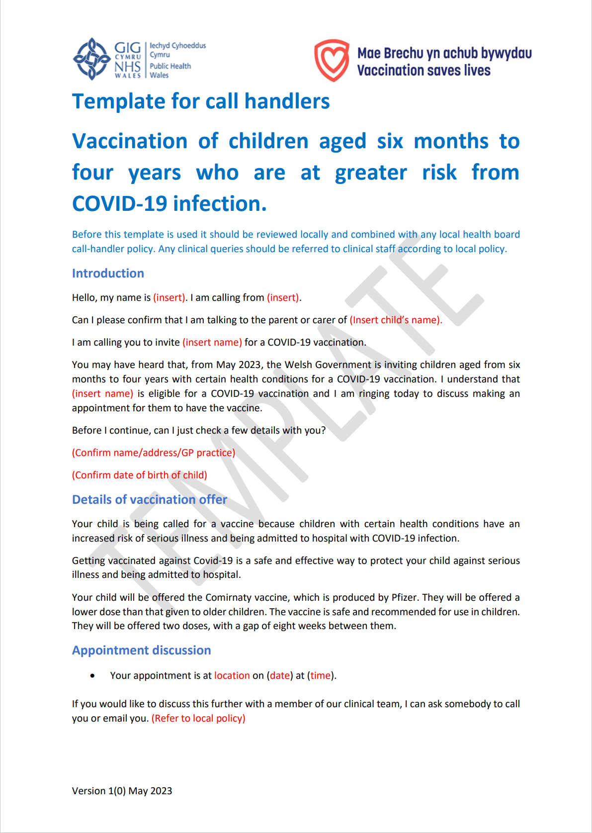
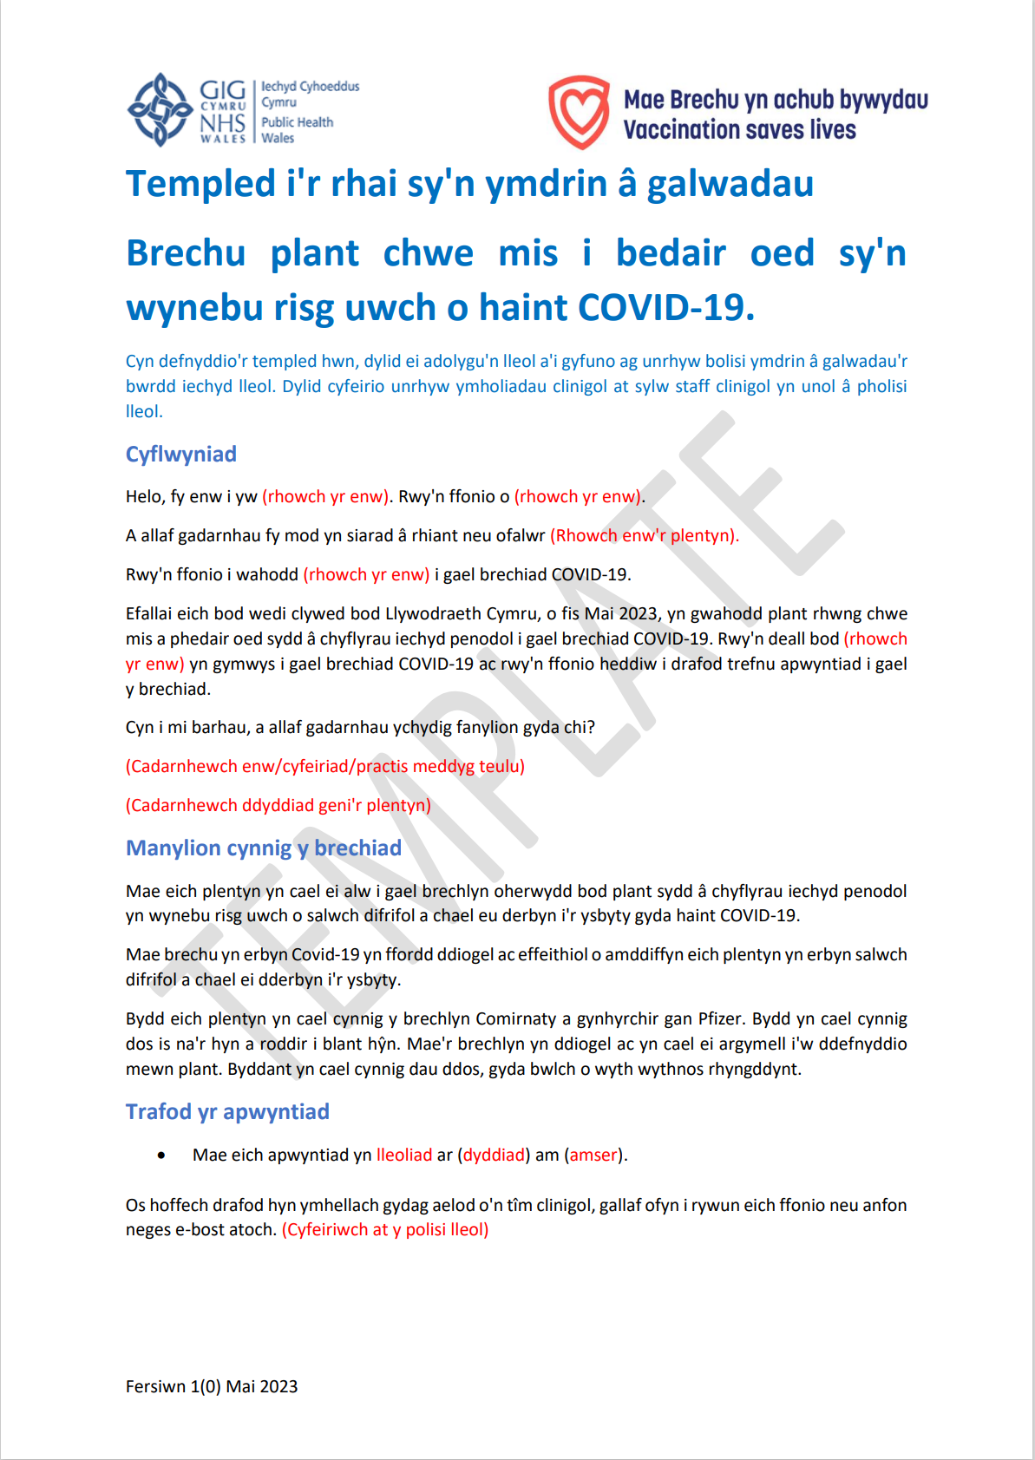
Publications to support the COVID-19 Vaccination Programme for Infants from 6 months to 4 years in clinical risk groups
Template for Call Handlers
Template for Call Handlers (Bilingual): A template script can be found here.
COVID-19 vaccination: A guide for children and young people who are at greater risk from COVID-19 infection
Available here to view and download
Available to order on Health Information Resources
Information about the vaccine can be found here
Notes:
Resources for health and social care professionals - Public Health Wales (nhs.wales)
About the vaccine - Public Health Wales (nhs.wales)

Slide 47
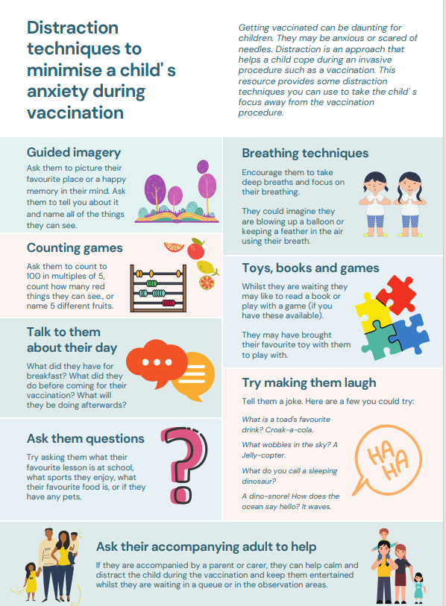
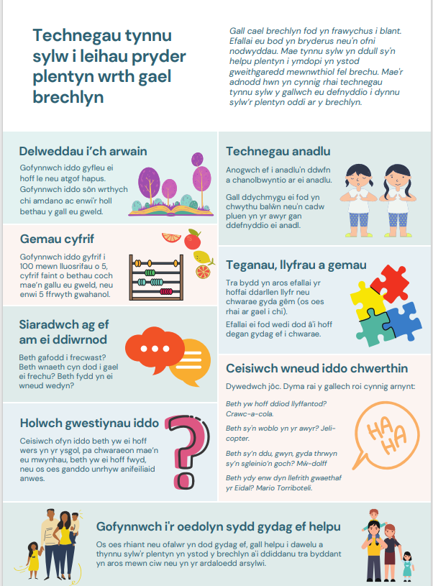
Distraction techniques to minimise a child's anxiety during vaccination
Getting vaccinated can be daunting for some people, particularly children and young people - they may be anxious, scared or needle phobic.
Children may like to bring a favourite toy with them to play with while they wait.
Distraction techniques to minimise a child's anxiety during vaccination [NHS EI Workforce & Training work stream of the national COVID-19 Vaccination programme V1, 4 January 2022]
Available from:
  Distraction techniques to minimise a child' s anxiety during vaccination (nhs.wales)
  WELSH VERSION - Distraction techniques to minimise a child' s anxiety during vaccination (nhs.wales)

Slide 48
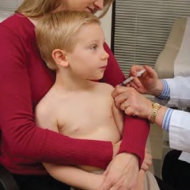
Positioning of infants and young children during vaccination
Parents can hold their child during vaccinations in recommended ways, which may reduce the child’s stress and help healthcare professionals more easily administer vaccines
Parents and caregivers play an important role when children receive vaccines.
A parent’s embrace during vaccination offers several benefits. A comforting hold:
  safely prevents children from moving their arms and legs during injections
  avoids frightening children by embracing them rather than overpowering them
  encourages parents to nurture and comfort their child
  allows the health care professional steady control of the limb and the injection site
Hold the child on your lap or have the child stand in front of you as you sit
Embrace your child during the process
Anchor both of the child’s legs between your thighs
How to Hold Your Child During Vaccination | Childhood Vaccines | CDC
Notes:
How to Hold Your Child During Vaccination | Childhood Vaccines | CDC
Centres for Disease Control and Prevention CDC

Slide 49
Using motivational interviewing for better conversations
Health professionals and vaccinators have an important role in vaccine conversations and are reported by the public as trusted sources of vaccine information.
The approach and style of a vaccine conversation can make a real difference in understanding individual hesitancy, addressing barriers, and influencing vaccine uptake.
Motivational interviewing aims to support decision making by eliciting and strengthening a person's motivation to change their behaviour based on their own arguments for change.
It is used in a range of health settings and is an evidenced approach to improving vaccine uptake through conversation.

Slide 50
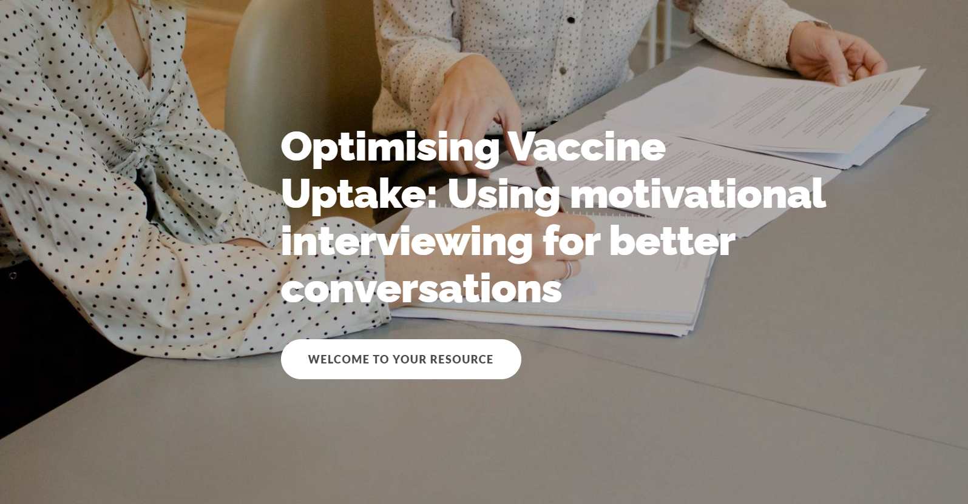
E-learning available on optimising vaccine uptake. Using motivational interviewing for better conversations.
Incorporating motivational interviewing into your vaccine conversations will enable you to identify the core barriers for an individual, and collaboratively address these in a personalised way.
Optimising Vaccine Uptake: Using motivational interviewing for better conversations - Overview | Rise 360 (articulate.com)

Slide 51
Further information (1)
The Green Book has the latest information on vaccines and vaccination procedures, for vaccine preventable infectious diseases in the UK. It also includes UK vaccine policy
"Green Book" .
Green Book recommendations are based upon JCVI’s expert opinion and should
always be followed, even when they differ from those made by the vaccine
manufacturer. (Note: sometimes vaccine policy in Wales differs to England)
UKHSA COVID-19 Immunisation programme Information for healthcare practitioners
This document provides additional information, answers to frequently asked questions
and actions to take in the event of inadvertent errors.
Notes:
https://www.gov.uk/government/publications/covid-19-vaccination-programme-guidance-for-healthcare-practitioners

Slide 52
Further information (2)
PHW professional information resources:
COVID-19 resources for health and social care professionals - Public Health Wales (nhs.wales)
Vaccine resources for health and social care professionals - Public Health Wales (nhs.wales)
PHW training:
Immunisation training resources and events - Public Health Wales (nhs.wales)
Immunisation eLearning - Public Health Wales (nhs.wales)
UKHSA COVID-19 vaccination resources: COVID-19 vaccination programme - GOV.UK (www.gov.uk)
Oxford Knowledge Project: COVID-19 vaccines
MHRA: Guidance on coronavirus (COVID-19)

Slide 53
Additional information
JCVI statement on the COVID-19 vaccination programme for autumn 2024, 8 April 2024 - GOV.UK (www.gov.uk)
Winter respiratory vaccination programme 2024 to 2025 (WHC/2024/033) (gov.wales)
Comirnaty JN.1 3 micrograms/dose concentrate for dispersion for injection - 3-dose vial - Summary of Product Characteristics (SmPC) - (emc) (medicines.org.uk)
Patient Group Directions (PGD) - Welsh Medicines Advice Service (wales.nhs.uk).
COVID-19: vaccination programme guidance for healthcare practitioners.
Green Book COVID-19 chapter 14a.
Coronavirus vaccine - summary of Yellow Card reporting - GOV.UK (www.gov.uk).

