Slide 1

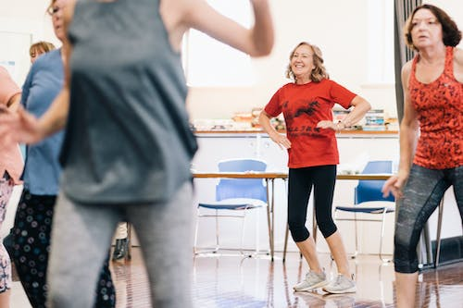

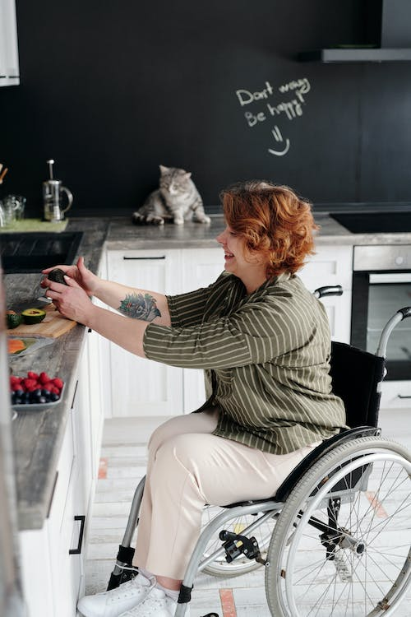


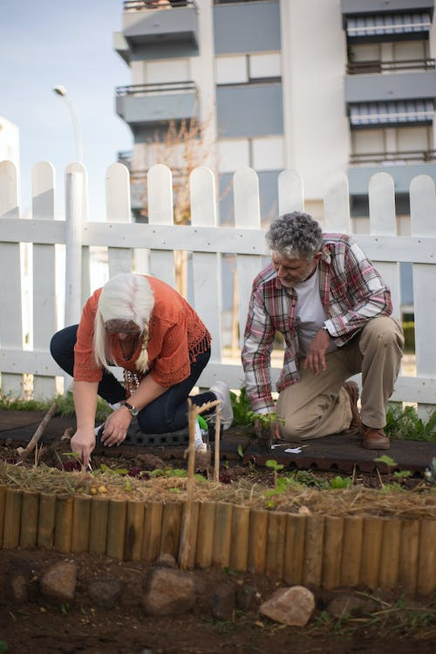


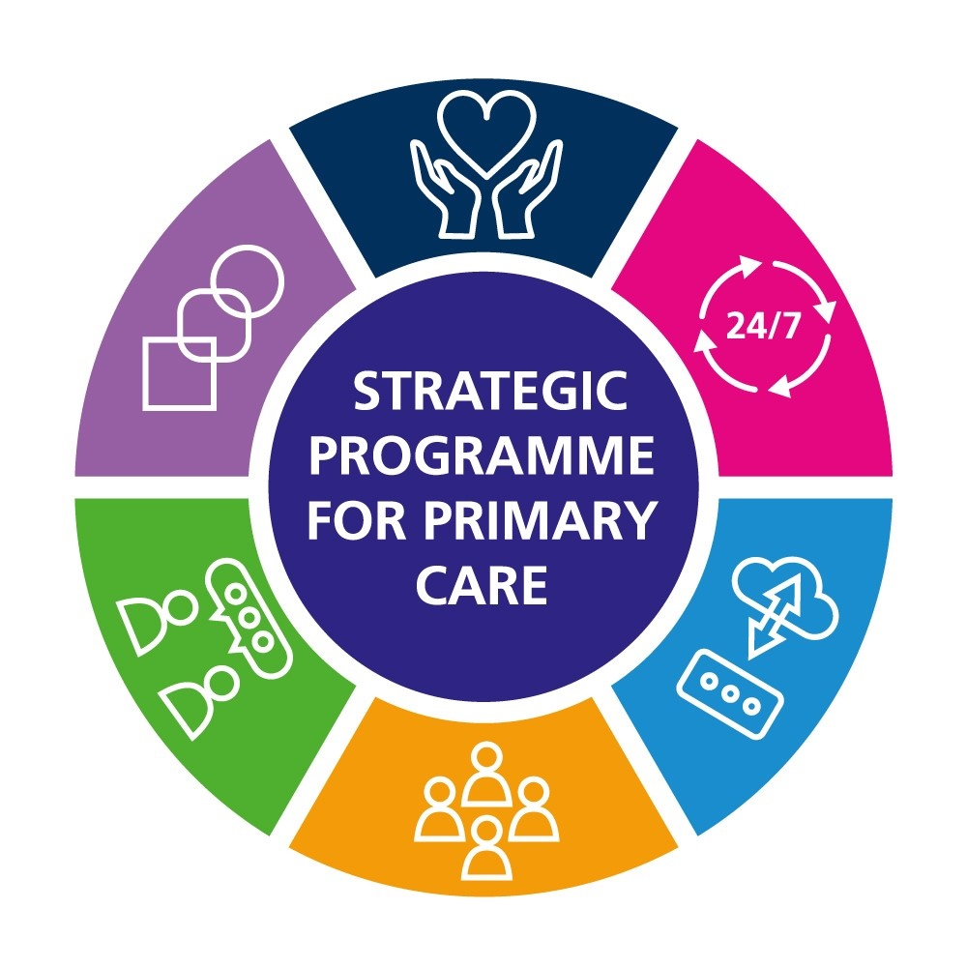

Supporting Healthy
Behaviours:
A Guide for Optometry

Slide 2
Supporting Healthy Behaviours: A Guide for Optometry
2
Contents
Supporting Healthy Behaviours | 3
Optometry Workforce Wellbeing | 4
Making Every Contact Count (MECC) | 5
Social Prescribing | 7
Smoking | 9
Alcohol | 11
Healthy Weight | 13
Physical Activity | 15
Preventing Type 2 Diabetes | 17
References | 18

Slide 3

Supporting Healthy Behaviours
A Healthier Wales highlighted the need for a shift towards greater prevention and early intervention, to improve people’s health and wellbeing, and support the sustainability of our health and care system.
Opportunities to initiate behaviour change conversations, and empower people to make healthier
choices, are plentiful through the high number of contacts between the public and primary care services.
Wellbeing of Wales (2023) reported around two thirds of avoidable deaths were attributed to preventable conditions
Areas for quality improvement in optometry:
Improve the identification of people who require support with adopting healthy behaviours
Optimise referrals for people who require support with healthy behaviours, where available and appropriate
Review skills/service gaps to support people to adopt healthy behaviours and take action to address gaps.

Slide 4

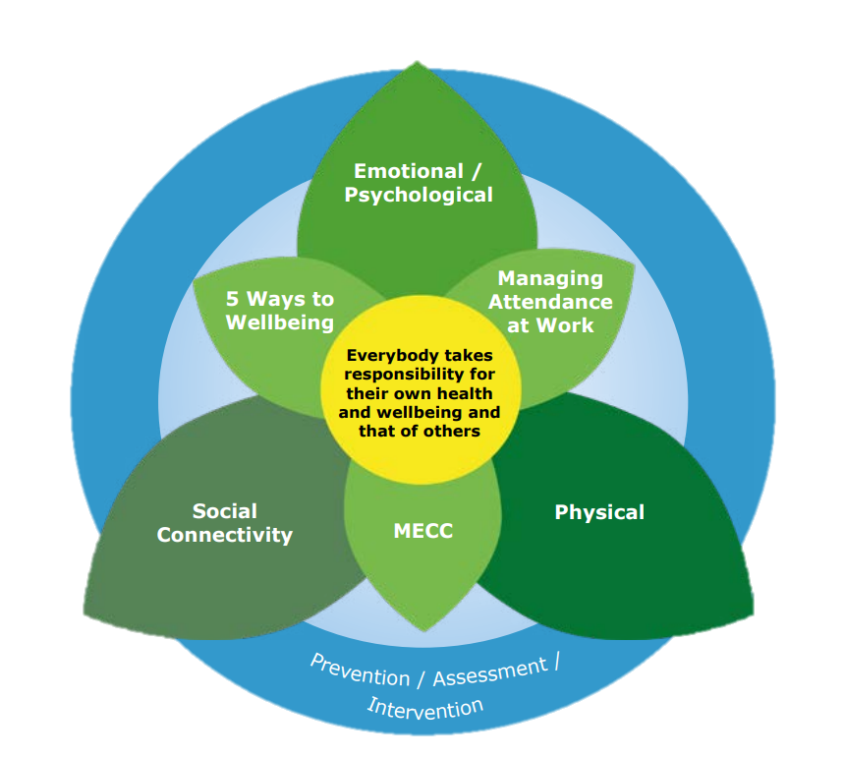
Optometry Workforce Wellbeing
The need to adopt and/or maintain healthy behaviours is relevant to us all and we can all consider how best to incorporate healthy behaviours into our lives.
The health and wellbeing of optometry staff is also a key factor that underpins performance at work, engagement within the workplace, recruitment and retention and sickness absence levels.
For yourself and colleagues, it is therefore beneficial to be aware of, and take up relevant resources, outlined in this document, to support your own health and wellbeing.
HEIW’s Our Wellbeing Matters links together a range of resources the workforce can use to support their wellbeing, and the Healthy Working Wales Digital Service aims to support and encourage employers to create healthy working environments and take action to improve the health and wellbeing of their staff.
Our Wellbeing Matters, HEIW

Slide 5


Making Every Contact Count
Making Every Contact Count (MECC) is an approach to behaviour change that utilises the millions of day-to-day interactions between people to support individuals in making positive changes to their health and wellbeing.
What is MECC?
MECC aims to empower all staff interacting with people, to recognise the opportunities they have to promote healthy lifestyles, support behaviour change and contribute to reducing the risk of developing a long term condition.
MECC is about:
Identifying opportunities to raise the issue of health behaviours
Communicating in a supportive, non directive manner to help motivate individuals to think about making a behaviour change
Signposting/referring individuals to further information and support
MECC is not about:
adding another job to already busy working days
becoming a specialist or expert in certain lifestyle areas
becoming a counsellor or providing ongoing support to particular individuals
telling somebody what to do and how to live their life.

Slide 6

Adopting this approach, as a part of what we all do, will allow us to move to a position where discussion of lifestyle behaviours and their impact on health and wellbeing is routine, non-judgemental and integral to everyone's professional and social responsibility.
MECC eLearning
It is not easy for everyone to raise questions about lifestyle behaviours. MECC requires a range of skills and knowledge in order for staff to gain confidence to support and direct people.
Training resources for staff are a key element of a MECC programme.
The Making Every Contact Count website provides access to training on the
skills and knowledge needed to have effective health behaviour change conversations.
Behaviour specific e-learning:
Modules to support conversations about healthy weight and alcohol use are planned for 2024.
Aligned to the optometry contract, optometrists can also access the generic MECC training via Y Ty Dysgu.

Slide 7
Social Prescribing
  What is social prescribing?
  Social prescribing describes a person-centred approach to connecting people to local community assets.
It can help empower individuals to recognise their own needs, strengths, and personal assets, and to connect with their communities for support with their health and wellbeing.
Social prescribing may provide a continuum of support, play a preventative role, or form part of a ‘step-down’ model of support.
  Social prescribing has grown organically within Wales, producing a range of different delivery models, across health and care, third sector, and statutory organisations.
  Often developed from the grass roots, services are delivered to meet local population needs.
  The Welsh Government ‘National Framework for Social Prescribing’ aims to support consistency in approach and help to provide reassurance on quality of delivery, without dictating how services are delivered in different communities.
  The Social Prescribing Pathway
Referral
Made by:
- Self
- Healthcare
- Community and
Voluntary sector
organisations
- Statutory
services
Social Prescribing
Includes:
- What matters
conversation
- Action
planning
- Signposting /
referral
Community Assets
For example:
- Welfare
support
- Exercise on
referral
- Social Cafes
- Nature based
interventions

Slide 8



  What does a Social Prescribing Practitioner do?
  A social prescribing practitioner may be known by a variety of terms, including ‘community connector’, ‘link worker’, ‘social prescriber’ or ‘local area coordinator’.
  They will:
  Have a what matters conversation with an individual to identify their non-medical needs
  Co-produce an action plan tailored to their preferences and needs
  Help to access local community assets such as groups, interventions or services
  Explore barriers and challenges to attending assets and activities, and encourage ongoing participation
  If a potential medical need is identified they may also refer to a GP, pharmacist or other health professional.
The benefits of social prescribing are wide-ranging, recognising its holistic role in improving physical, mental and social wellbeing
Signpost or refer to your local social prescribing service, people who need help to connect to community support to better manage their health and wellbeing.

Slide 9

Smoking
Smoking is still the largest cause of avoidable death in Wales, with 13% of the adult population reported to smoke¹.
6 in 10 smokers in Wales want to give up²
Up to a quarter of smokers are motivated to make a quit attempt in the next 3 months³.
Smokers are up to four times more likely to develop age-related macular degeneration (AMD), the leading cause of sight loss in England and Wales, than non-smokers.
Smokers are also more likely than non-smokers to develop cataracts and other eye conditions.
Areas for quality improvement activity in optometry
You and your colleagues can help people who smoke by:
Asking people about smoking and recording their current smoking status
Referring them to Help Me Quit if appropriate or encouraging self-referral via www.helpmequit.wales or 0800 085 2219
Signposting to the Help Me Quit website for advice on stopping smoking.

Slide 10


Help Me Quit is the single national smoking cessation brand for Wales
HMQ provides seamless evidence-based cessation support locally and nationally
Clients can receive free nicotine replacement products and tailored behavioural support
More than 40% smokers who receive support from HMQ are CO validated as having quit smoking at 4 weeks⁴.
Smoking is still the largest cause of avoidable death in Wales, 13% of the adult population smoke.¹
Help Me Quit is designed to make it as easy as possible for smokers to engage
People can get a call back at a point in the day that works for them via the HMQ website with just a name and phone number
Currently, optometry staff can provide an online referral that can be easily completed during a standard appointment. By 2024 referral will be integrated into all GP systems in Wales.
Location of local services can be viewed on a simple map.
Help Me Quit resources for optometry staff are available:
HMQ - Eye health
HMQ – Very brief advice
6 in 10 smokers in Wales want to give up.
Most smokers are prepared to make an attempt to quit and want support from primary care.

Slide 11
Alcohol
17% of adults (16+ years) in Wales are drinking above the recommended guidelines¹.
There is no completely safe limit for drinking alcohol and drinking even low amounts of alcohol increases the risk of diseases like cancer.
The risk of developing a range of health problems, including eye problems such as AMD, increases the more a person drinks on a regular basis⁵.
Areas for quality improvement activity in optometry
You and your colleagues can help people with their alcohol use by:
Being aware of alcohol-related harms
Asking about drinking behaviour when it might be relevant
Being aware of risks associated with different levels of drinking behaviour identified by AUDIT C
Providing advice and signposting to the DAN 24/7 helpline.
Alcohol Use Disorders Identification Test - Consumption scoring AUDIT C [abridged]
AUDIT-C Score | Risk
0-4 | Low risk drinking
5-7 | Increasing risk drinking
8-10 | Higher risk drinking
11-12 | Possibly dependant
AUDIT C consists of the consumption questions from the full AUDIT, an alcohol use screening test to assess a person’s risk to alcohol harm.

Slide 12


People wanting support can be signposted to the Wales Drug & Alcohol Helpline DAN 24/7.
DAN 24/7 is a free, confidential and bilingual telephone helpline providing a single point of contact for anyone in Wales wanting further information and/or help relating to drugs and/or
alcohol. Talking to somebody about a drug or alcohol problem can be the first step for a person in resolving their problems. People can self-refer for support.
The service is available 24 hours a day, 7 days a week.
Freephone: 0808 808 2234 or text DAN to: 81066

Slide 13
Healthy Weight
Getting to and maintaining a healthier weight can be challenging, and influenced by the conditions in which we are born, grow, live and work.
Areas for quality improvement activity in optometry
You and your colleagues can help people who are, at risk of or experiencing obesity, by:
Asking questions – seek permission to talk about and explore weight
Assessing health status and the persons weight management journey
Advising on the benefits of achieving and maintaining a healthier weight
Signposting the person to the Healthy Weight Healthy You website or your GP / local health board’s weight management service.
61% of adults in Wales were classified as experiencing overweight or obesity; including
35% overweight
26% obese¹.
Being overweight increases the risk of developing Age-related Macular Degeneration, cataracts, and diabetes and associated complications such as diabetic retinopathy.
Compassionate conversations and access to support, can help people to have a healthier weight.
It is important to understand a person’s weight journey from their perspective, free from judgement and bias.

Slide 14



The Healthy Weight Healthy
You website offers content and resources including:
Goal setting and self-monitoring
Understanding weight and your weight management journey
Interactive, downloadable resources such as meal planners
Signposting information for ways to get active and further weight loss options.
Information for health professionals webpage.
Individuals can be signposted to Healthy Weight Healthy You, a web-based NHS resource for adults in Wales with overweight and obesity.
It is a free, evidence-based, resource offering tailored information and self-directed support.

Slide 15

Physical Activity
Being physically inactive and spending too much time being sedentary can increase people’s chances of developing a wide range of chronic diseases and conditions, including conditions that can lead to sight loss.
Around 31% of adults in Wales are inactive, defined as undertaking less than 30 minutes of physical activity per week¹
Physical activity can both prevent and treat more long term conditions than any other single intervention⁶
Most notably: Cardiovascular disease, type 2 diabetes, obesity, depression, anxiety and certain types of cancer and musculoskeletal disorders.
Areas for quality improvement activity in optometry
You and your colleagues can help people to be more physically active by:
Asking people about being active
Advising on the benefits of physical activity
Signposting/referring to further information and support.

Slide 16


You can signpost people to:
NHS 111: Exercise webpage for information
Or to find facilities within your area, people can visit the local authorities’ website. Here people can find details of places such as leisure centres, green spaces, child and disability-friendly walks, beaches and more.
Click the link to Find your local authority | GOV.WALES
People needing additional support who are inactive and at risk of, or currently experiencing, a long term or chronic health condition, can be referred by a GP to the to the National Exercise Referral Scheme (NERS): Wales National Exercise Referral Scheme
Individuals can be referred by health professionals to a local NERS scheme and will receive:
an initial assessment,
a 4 week review and
a suitably graded exercise programme for 16 weeks
follow up at 52 weeks.

Slide 17

Preventing Type 2 Diabetes
More than 200,000 people in Wales are living with diabetes, and nine in 10 of them have type 2 diabetes⁷.
Diabetes is a leading cause of sight loss. If a person has diabetes they are more likely to develop cataracts, glaucoma and retinopathy⁸.
Evidence suggests that, by supporting people to make lifestyle changes, over half of type 2 diabetes cases could be prevented.
Areas for quality improvement activity in optometry
You and your colleagues can help prevent T2D by:
Recognising the risk factors for developing diabetes e.g. age, ethnicity, family history, experiencing obesity
Encouraging people to understand their risk of developing diabetes using Diabetes UK’s ‘Know Your Risk’ Tool
Advising on the risks of diabetes to eye health and broader health outcomes
Signposting individuals at risk, to their GP to discuss a blood test to measure their HbA1c levels
The number of people on a Primary Care Diabetic Disease Register has risen by 60,000 people since 2009, which is a 40% increase in just over ten years⁷.

Slide 18
References
1 StatsWales. Adult lifestyles by age and gender 2022-23.
2 Welsh Government. National Survey for Wales, 2016-17.
3 Smoking in Wales, Smoking Toolkit Study, 2023.
4 Stats Wales. Welsh resident treated smokers who were CO-validated as successfully quitting at 4 weeks, 2019-20.
5 Karimi, S., Arabi, A., and Shahraki, T. (2021). Alcohol and the Eye. Journal of Opthalmic and Vision Research, 16(2).
6 BMJ Learning. The Importance of Physical Activity Learning Module 1. Available from: http://learning.bmj.com/learning/info/getting-started.html [Accessed 8/6/2018].
7 PHW (2023). Diabetes prevalence – trends, risk factors, and 10-year projection. Available from: https://phw.nhs.wales/services-and-teams/observatory/data-and-analysis/diabetes-prevalence-trends-risk-factors-and-10-year-projection/ [Accessed 17/11/2023].
8 Diabetes UK. Diabetic Retinopathy – Diabetes and Eye Problems.

Slide 19
Published: February 2024

