Slide 1

Welsh Index of Multiple Deprivation 2014 revised: Health board maps
November 2015

Slide 2
Copyright
© 2015 Public Health Wales NHS Trust
Material contained in this document may be reproduced without prior permission provided it is done so accurately and is not used in a misleading context.
Acknowledgement to Public Health Wales NHS Trust to be stated.
Copyright in the typographical arrangement, design and layout belongs to Public Health Wales NHS Trust.

Slide 3
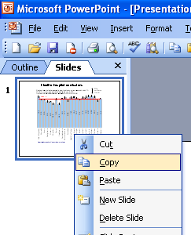
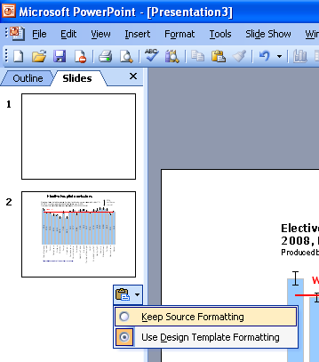
Instructions to copy a slide
To copy a slide for use in a presentation:
1. Right-click on the slide you wish to copy from the list on the left-hand side (the ‘slides’ tab) when in normal view and select ‘Copy’ from the list.
Go to your presentation and right-click where you want the copied slide to appear in the ‘slides’ tab and select ‘paste’ from the list.
On being pasted into your presentation a small clipboard icon with a black arrow will appear near the bottom right-hand corner of the newly pasted slide. Click on the arrow to show the drop-down menu and select “Keep Source Formatting” from the list. The slide will then appear as seen in the original presentation.

Slide 4
Using these slides
These slides form part of the Welsh Index of Multiple Deprivation 2014 revised: Health board maps resource published by the Public Health Wales Observatory. Available: www.wales.nhs.uk/sitesplus/922/page/76683
This presentation can be used as a whole or as individual slides.
Please acknowledge the work of the Public Health Wales Observatory when using these slides
Further information is available:
  Email: publichealthwalesobservatory@wales.nhs.uk
  Website: www.publichealthwalesobservatory.wales.nhs.uk

Slide 5
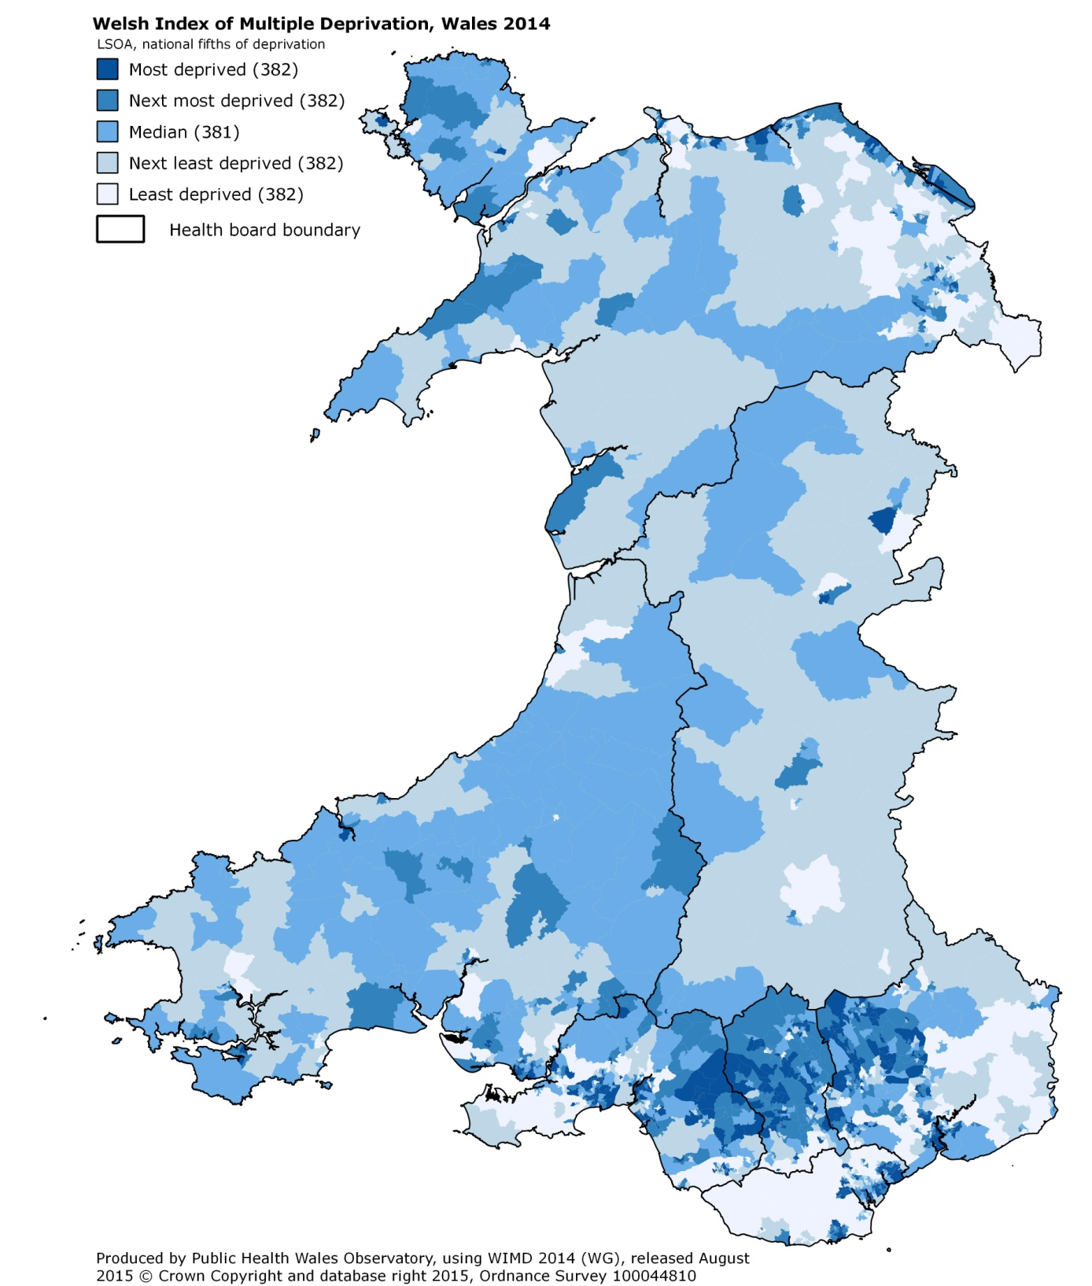
Wales

Slide 6
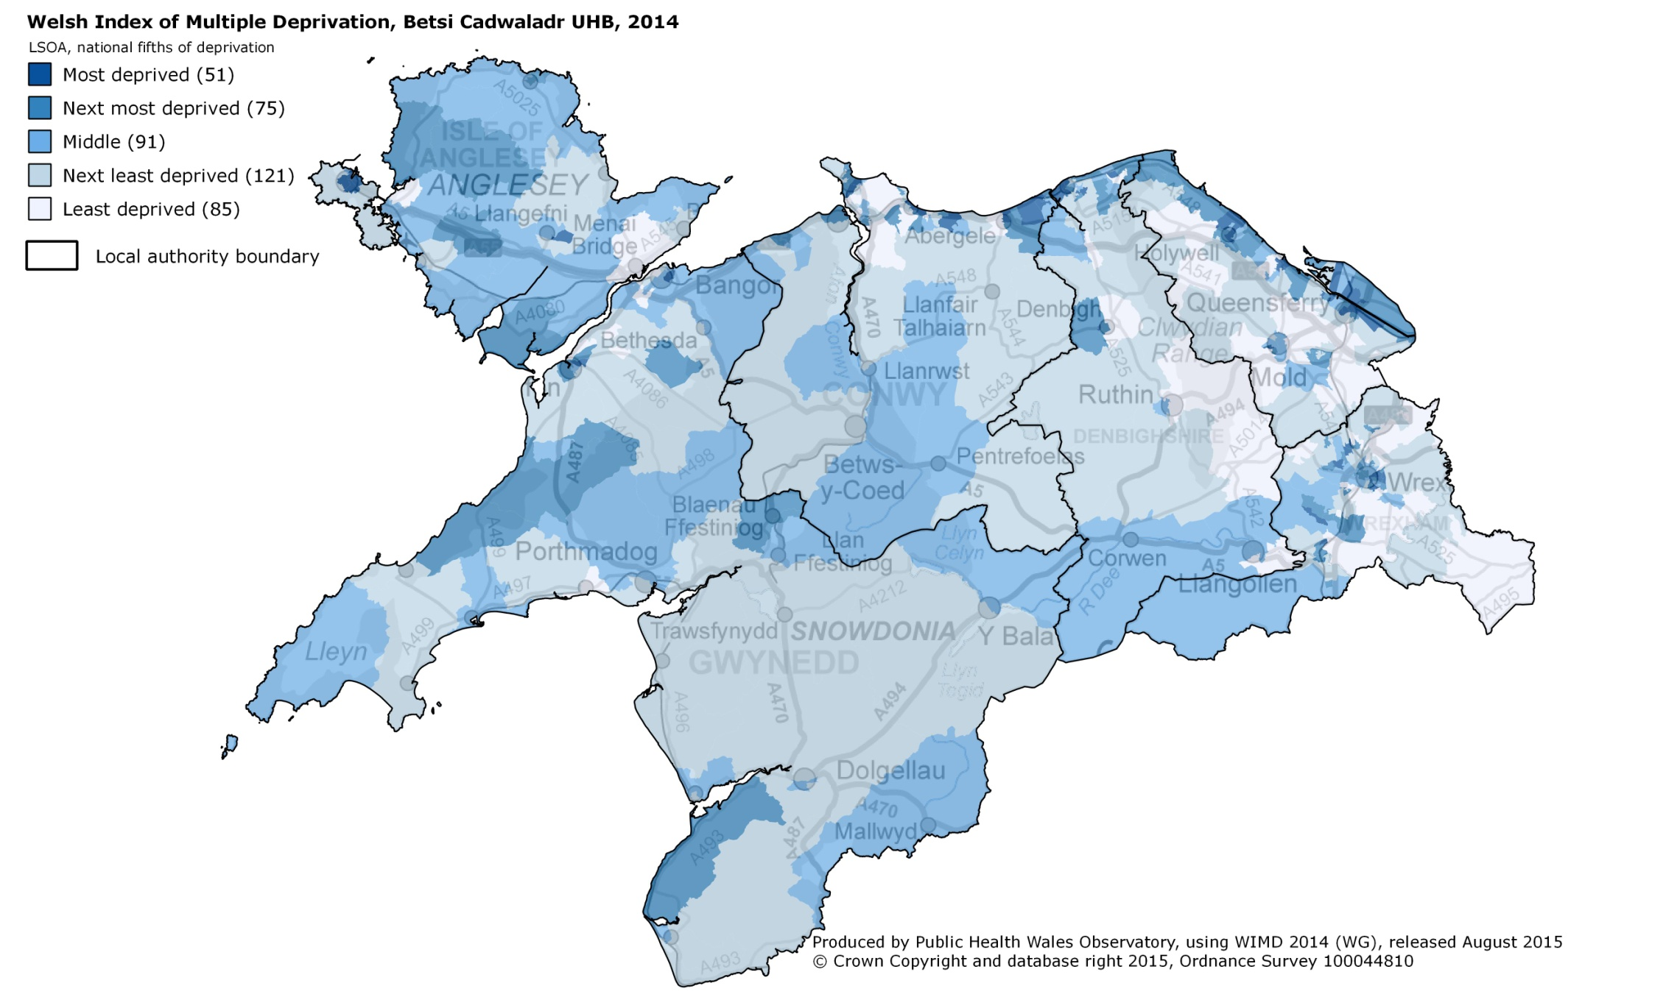
Betsi Cadwaladr University Health Board

Slide 7
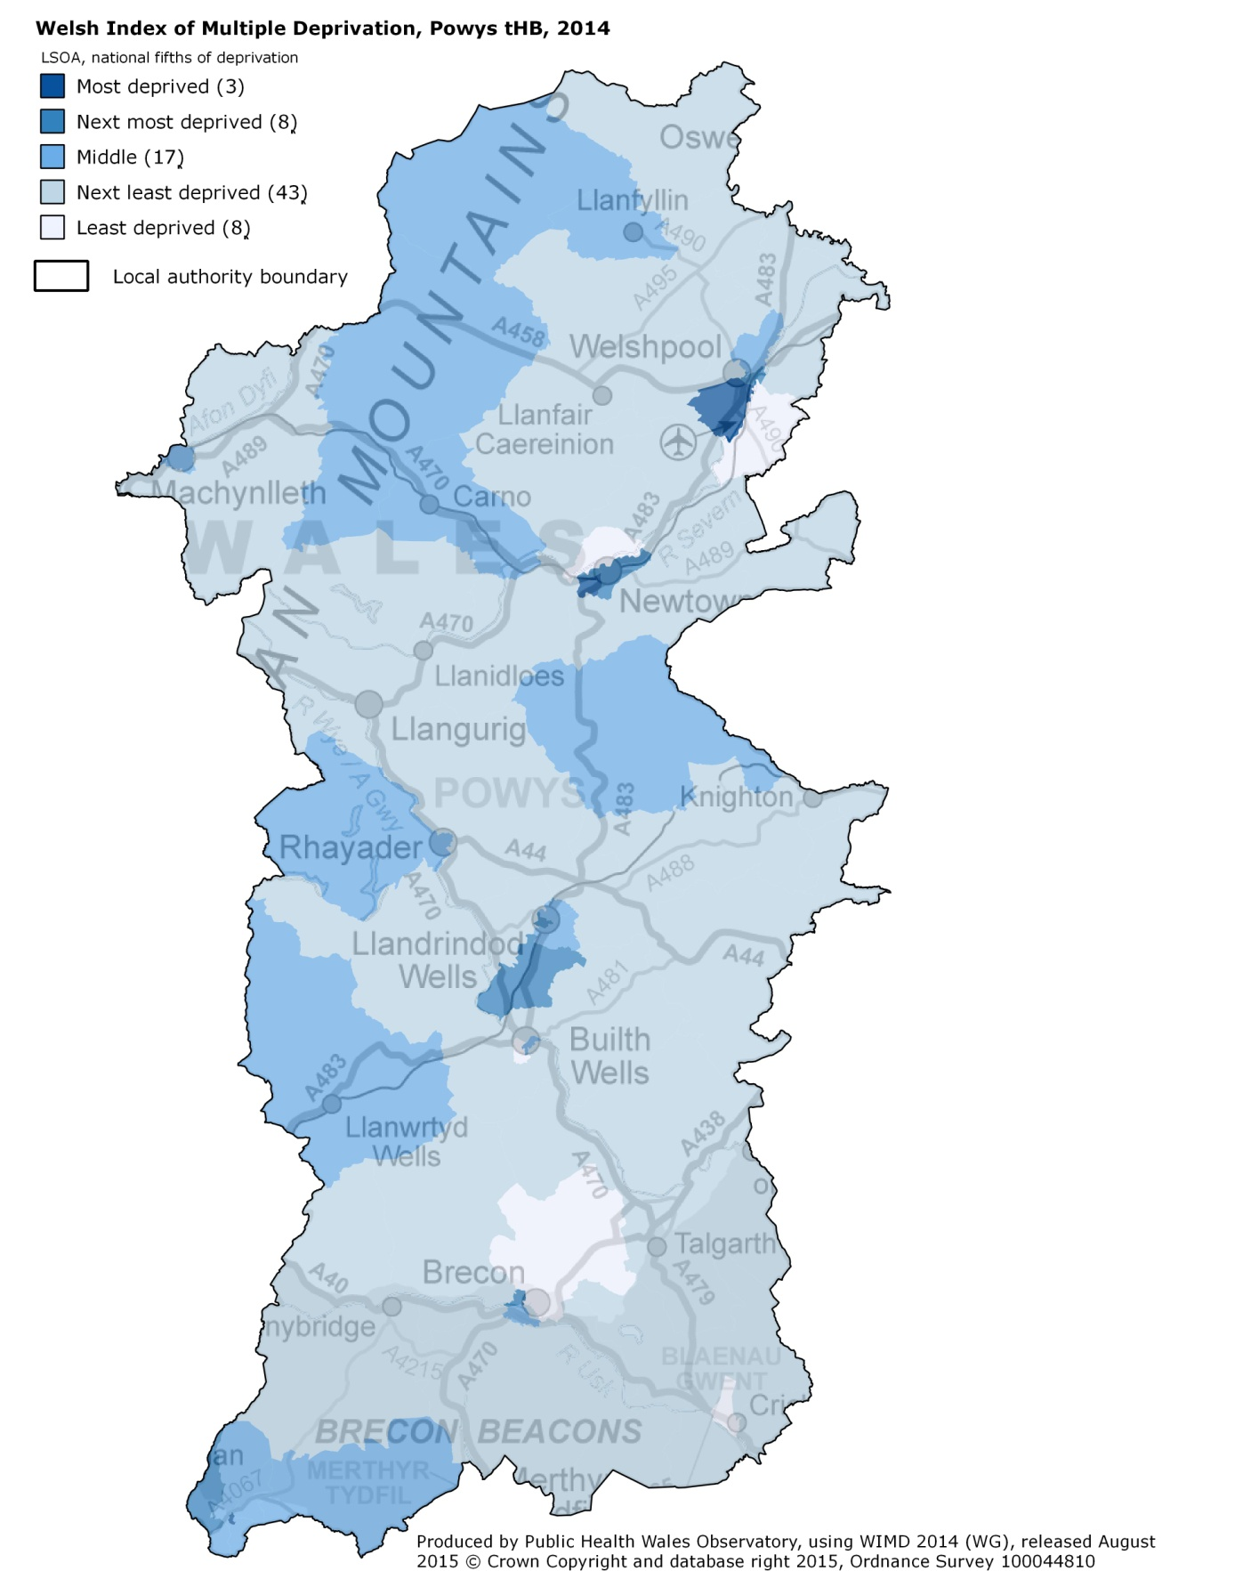
Powys teaching Health Board

Slide 8
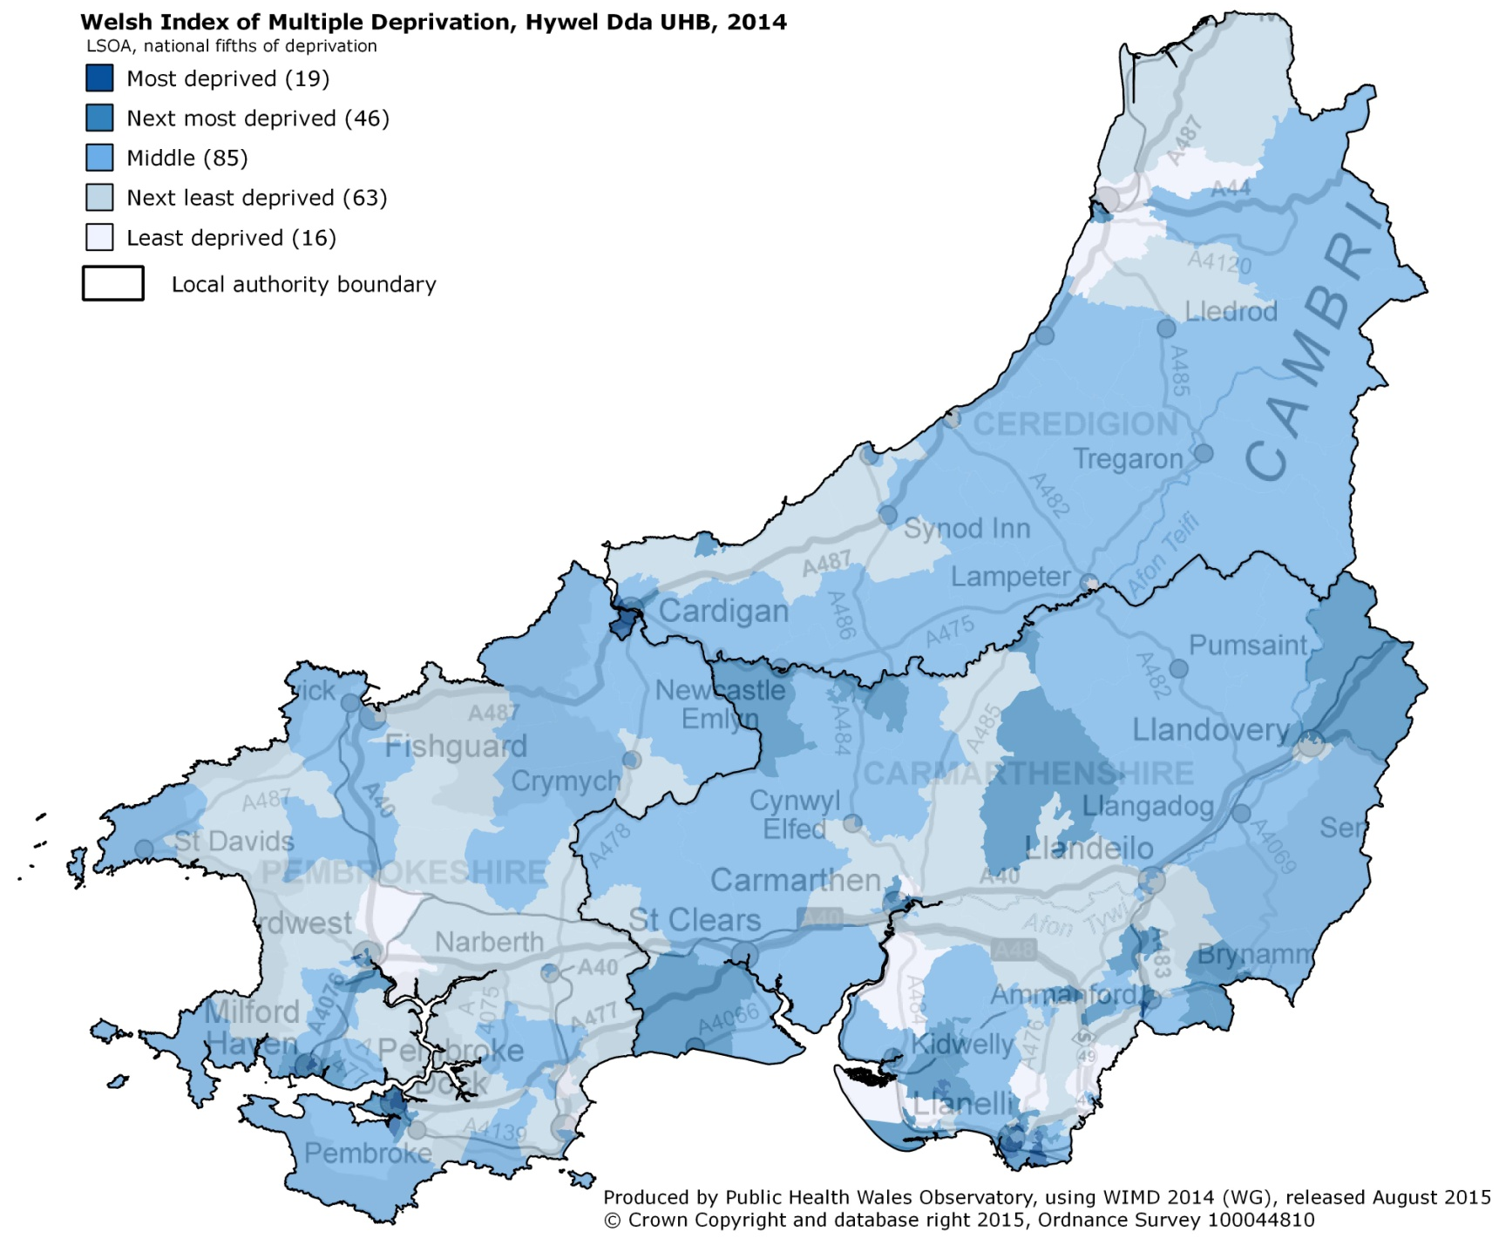
Hywel Dda University Health Board

Slide 9
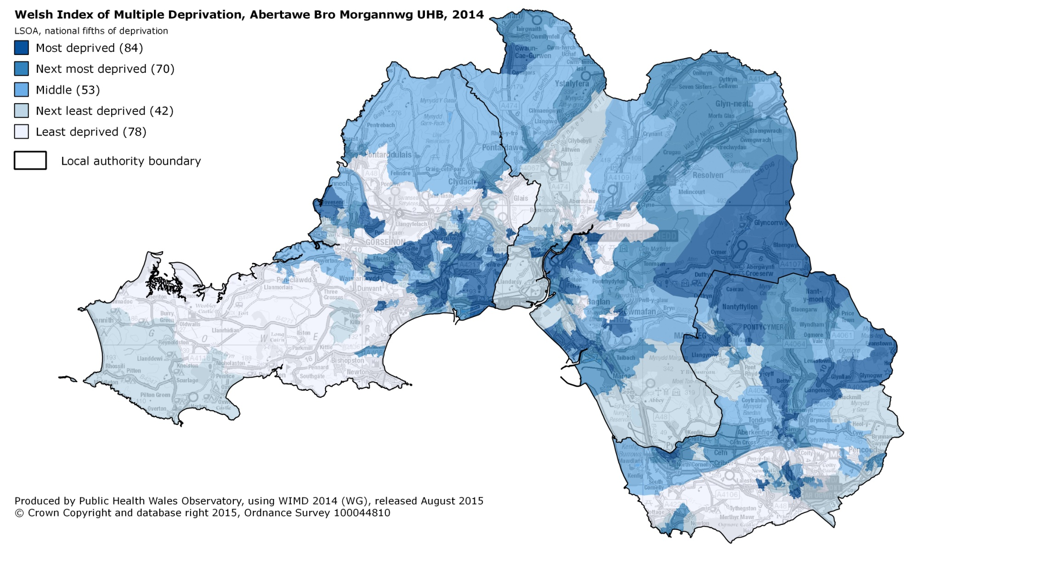
Abertawe Bro Morgannwg University Health Board

Slide 10
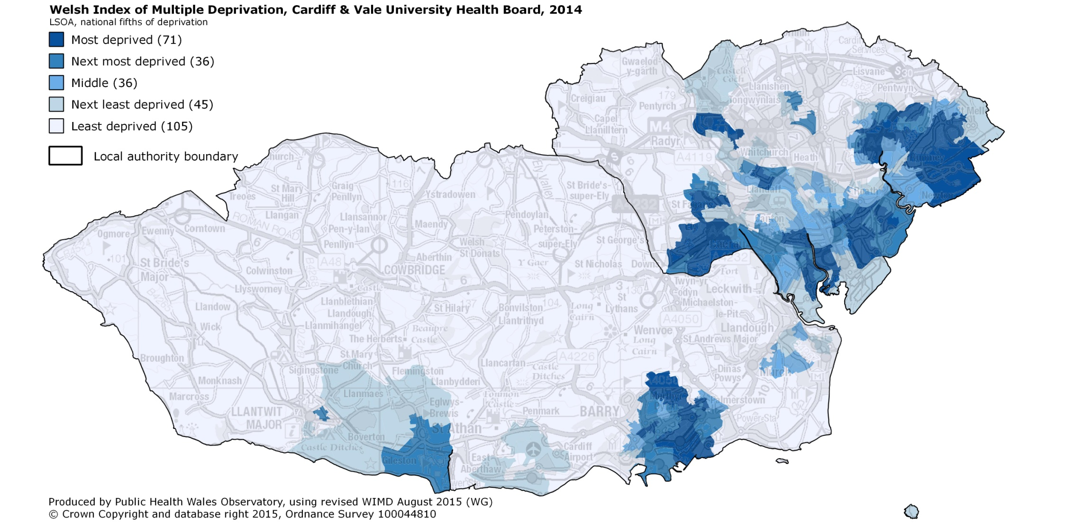
Cardiff and Vale University Health Board

Slide 11
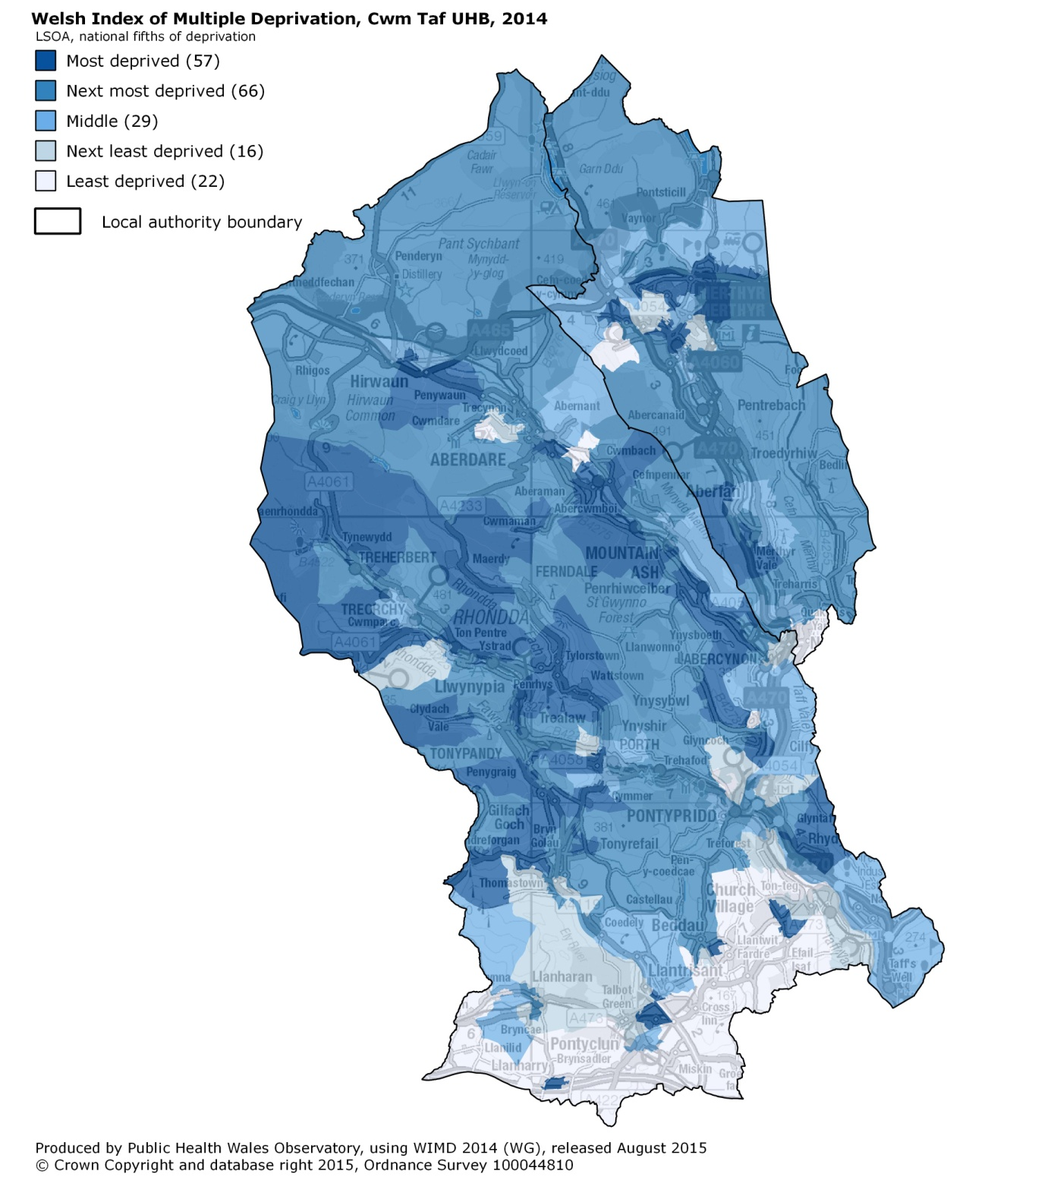
Cwm Taf University Health board

Slide 12
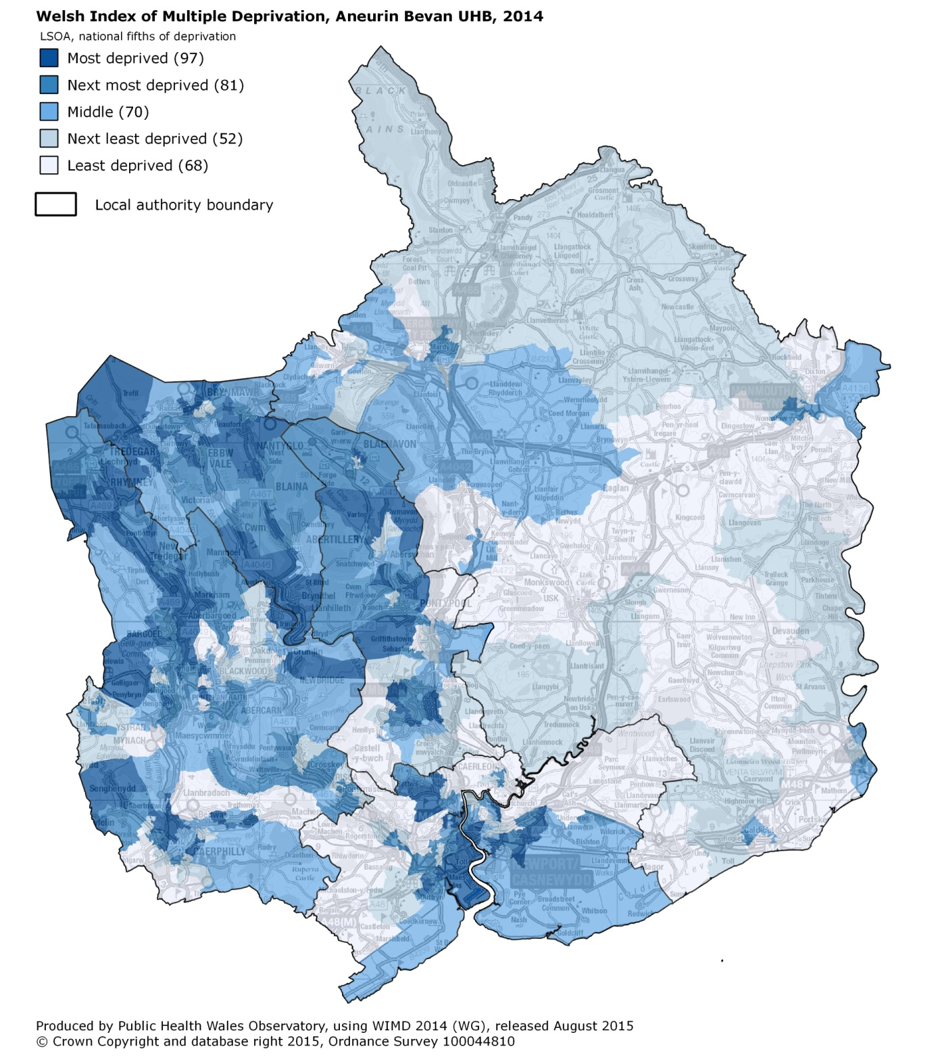
Aneurin Bevan University Health Board

