Slide 1

Wider Determinants of Health: Abertawe Bro Morgannwg University Health Board
April 2012
Public Health Wales Observatory

Slide 2
Copyright
© 2012 Public Health Wales NHS Trust
Material contained in this document may be reproduced without prior permission provided it is done so accurately and is not used in a misleading context.
Acknowledgement to Public Health Wales NHS Trust to be stated.
Copyright in the typographical arrangement, design and layout belongs to Public Health Wales NHS Trust.

Slide 3
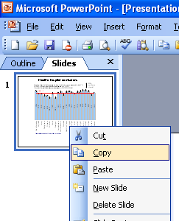
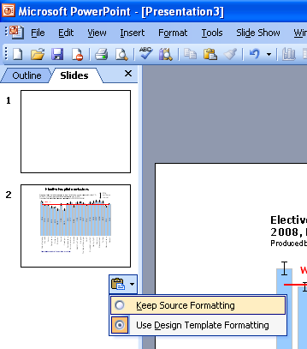
Instructions to copy a slide
To copy a slide for use in a presentation:
1. Right-click on the slide you wish to copy from the list on the left-hand side (the ‘slides’ tab) when in normal view and select ‘Copy’ from the list.
Go to your presentation and right-click where you want the copied slide to appear in the ‘slides’ tab and select ‘paste’ from the list.
On being pasted into your presentation a small clipboard icon with a black arrow will appear near the bottom right-hand corner of the newly pasted slide. Click on the arrow to show the drop-down menu and select “Keep Source Formatting” from the list. The slide will then appear as seen in the original presentation.

Slide 4
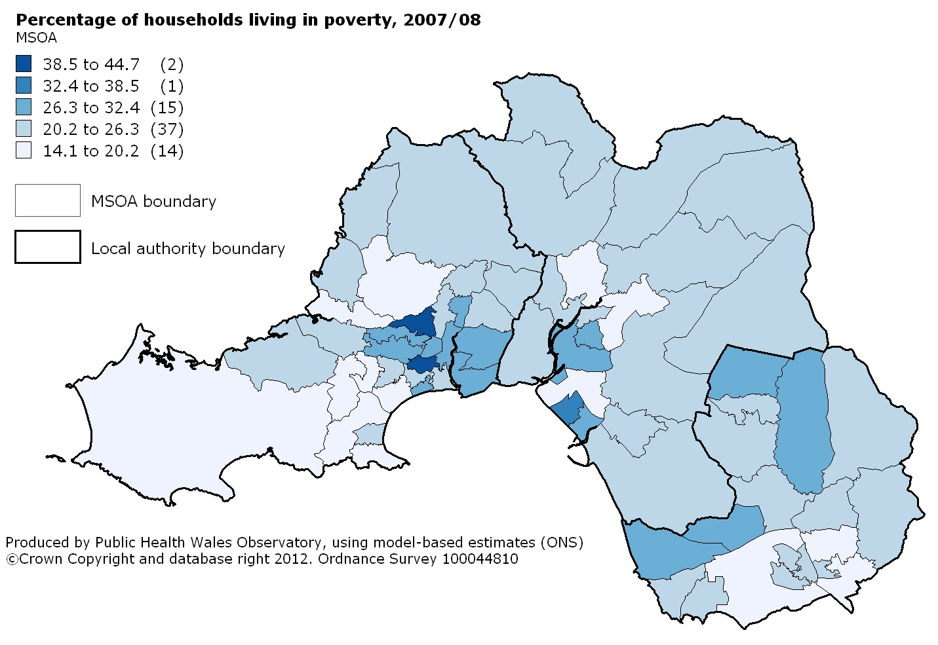
Income: % of persons living in households in poverty, 2007/08

Slide 5
Income: % of persons living in households in poverty, 2007/08
Produced by Public Health Wales Observatory, using model-based estimates (ONS)
MSOA EASR with 95% confidence interval

Slide 6
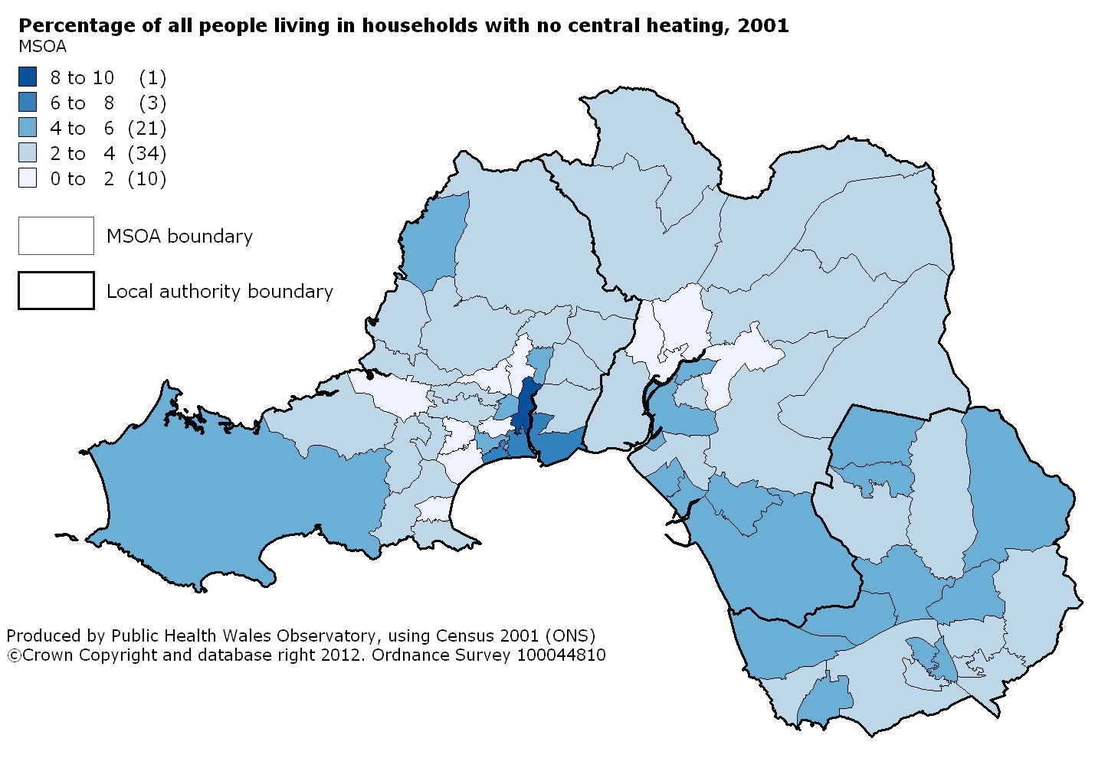
Housing: % of all people living in houses which had no central heating, 2001

Slide 7
Housing: % of all people living in houses which had no central heating, 2001
Produced by Public Health Wales Observatory, using Census 2001 (ONS)

Slide 8
Housing: % of all people living in houses which had no central heating, 2001

Slide 9
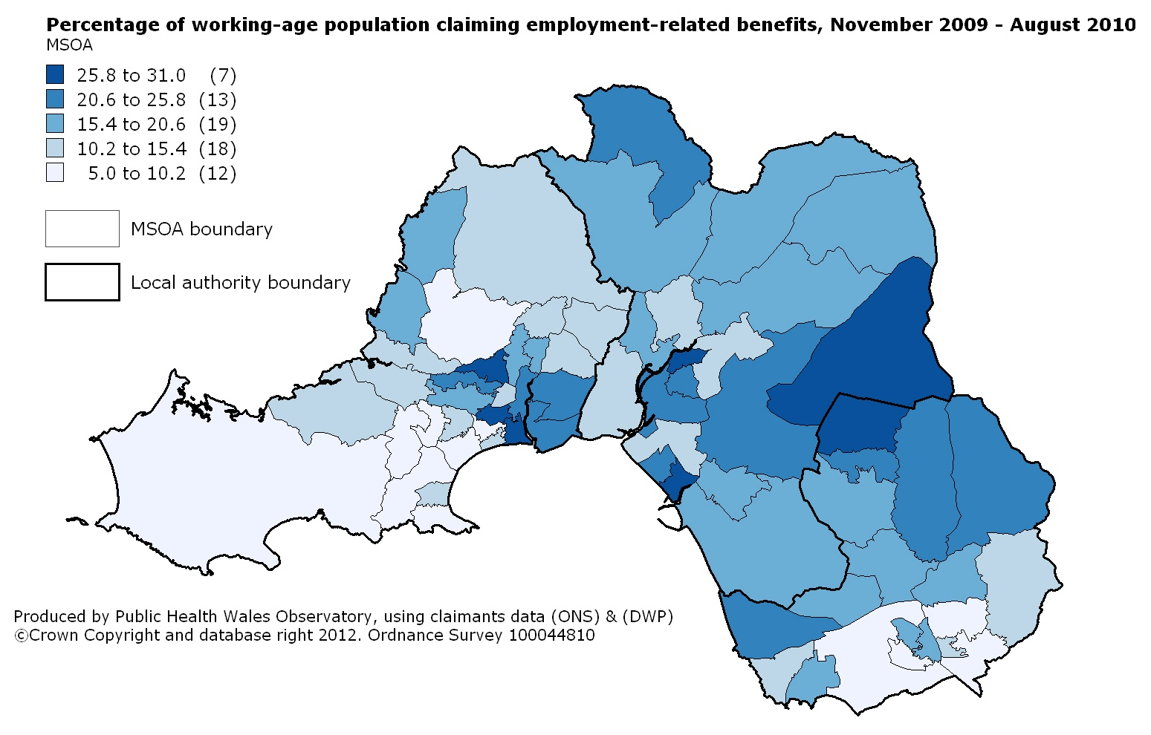
Employment: % of the working-age population claiming employment-related benefits, November 2009 – August 2010

Slide 10
Employment: % of the working-age population claiming employment-related benefits, November 2009 - August 2010
Produced by Public Health Wales Observatory, using claimants data (ONS) & (DWP)

Slide 11
Employment: % of the working-age population claiming employment-related benefits, November 2009 - August 2010

Slide 12
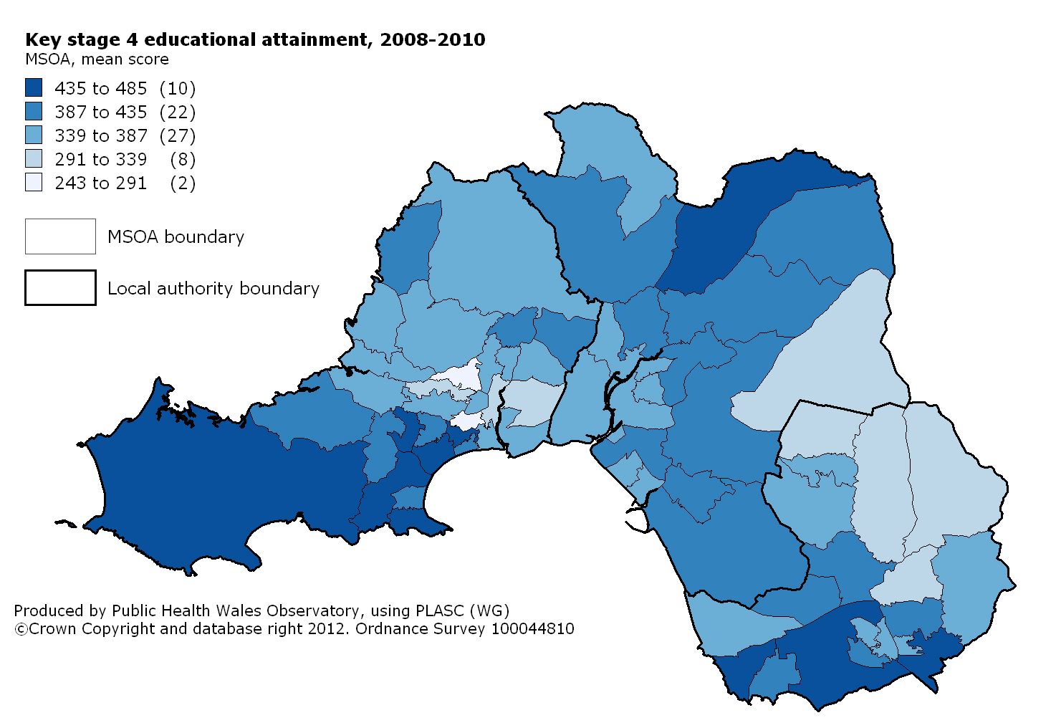
Education: Key Stage 4 educational attainment mean score, 2008-10

Slide 13
Education: Key Stage 4 educational attainment mean score, 2008-10
Produced by Public Health Wales Observatory, using PLASC (WG)

Slide 14
Education: Key Stage 4 educational attainment mean score, 2008-10

Slide 15
% of year 11 school leavers known not to be in education, employment or training (NEET), 2010

Slide 16
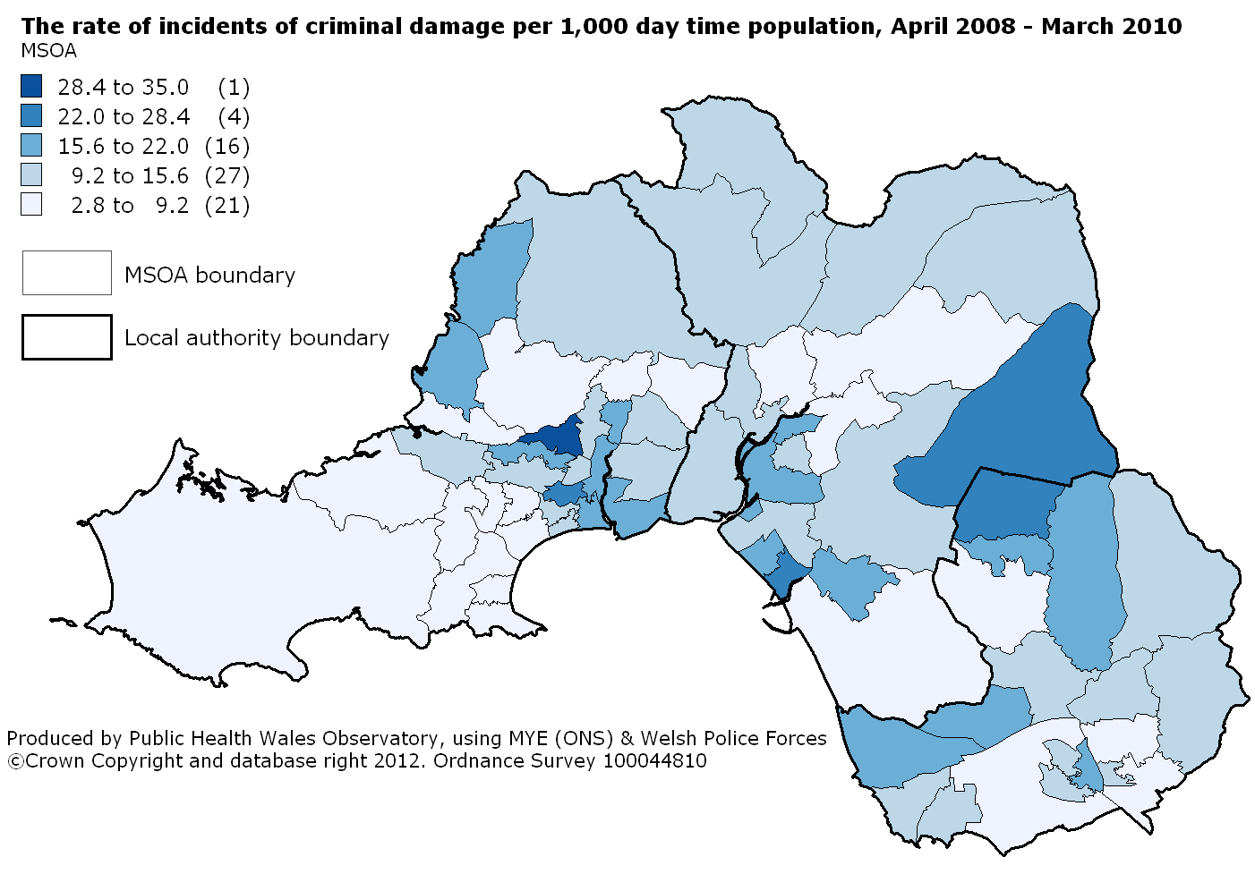
Community safety: criminal damage incidents per 1000 day time population, April 2008 - March 2010

Slide 17
Community safety: criminal damage incidents per 1000 day time population, April 2008 - March 2010
Produced by Public Health Wales Observatory, using data from Welsh Police Forces & MYE (ONS)

Slide 18
Community safety: criminal damage incidents per 1000 day time population, April 2008 - March 2010

