Slide 1

Welsh Health Survey obesity resource: key outputs
Hywel Dda UHB
July 2014

Slide 2
Copyright
© 2014 Public Health Wales NHS Trust
Material contained in this document may be reproduced without prior permission provided it is done so accurately and is not used in a misleading context.
Acknowledgement to Public Health Wales NHS Trust to be stated.
Copyright in the typographical arrangement, design and layout belongs to Public Health Wales NHS Trust.

Slide 3
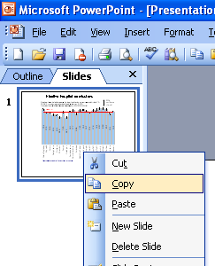
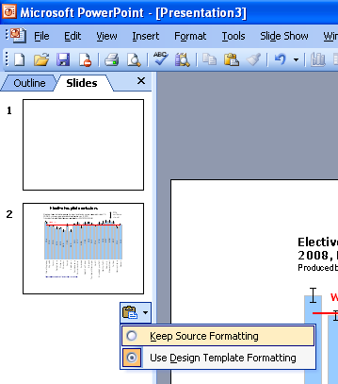
Instructions to copy a slide
To copy a slide for use in a presentation:
1. Right-click on the slide you wish to copy from the list on the left-hand side (the ‘slides’ tab) when in normal view and select ‘Copy’ from the list.
Go to your presentation and right-click where you want the copied slide to appear in the ‘slides’ tab and select ‘paste’ from the list.
On being pasted into your presentation a small clipboard icon with a black arrow will appear near the bottom right-hand corner of the newly pasted slide. Click on the arrow to show the drop-down menu and select “Keep Source Formatting” from the list. The slide will then appear as seen in the original presentation.

Slide 4
Using these slides
These slides form part of the Welsh Health Survey obesity resource published by the Public Health Wales Observatory. All charts and maps in this PowerPoint file relate to Hywel Dda University Health Board area.
The Welsh Health Survey obesity resource can be found at: www.publichealthwalesobservatory.wales.nhs.uk/obesity
This presentation can be used as a whole or as individual slides.
For further information, email the Observatory: publichealthwalesobservatory@wales.nhs.uk

Slide 5
Overweight / obesity by sex: Hywel Dda UHB, BMI 25+
Overweight or obese (BMI 25+): males Overweight or obese (BMI 25+): females
NB the above charts are also available for all persons via the website

Slide 6
Overweight / obesity by sex: Ceredigion, BMI 25+
Overweight or obese (BMI 25+): males Overweight or obese (BMI 25+): females
NB the above charts are also available for all persons via the website

Slide 7
Overweight / obesity by sex: Pembrokeshire, BMI 25+
Overweight or obese (BMI 25+): males Overweight or obese (BMI 25+): females
NB the above charts are also available for all persons via the website

Slide 8
Overweight / obesity by sex: Carmarthenshire, BMI 25+
Overweight or obese (BMI 25+): males Overweight or obese (BMI 25+): females
NB the above charts are also available for all persons via the website

Slide 9
Obesity by sex: Hywel Dda UHB, BMI 30+
Obese (BMI 30+): males Obese (BMI 30+): females
NB the above charts are also available for all persons via the website

Slide 10
Obesity by sex: Ceredigion, BMI 30+
Obese (BMI 30+): males Obese (BMI 30+): females
NB the above charts are also available for all persons via the website

Slide 11
Obesity by sex: Pembrokeshire, BMI 30+
Obese (BMI 30+): males Obese (BMI 30+): females
NB the above charts are also available for all persons via the website

Slide 12
Obesity by sex: Carmarthenshire, BMI 30+
Obese (BMI 30+): males Obese (BMI 30+): females
NB the above charts are also available for all persons via the website

Slide 13
Overweight / obesity by age: Hywel Dda UHB
Overweight or obese (BMI 25+) Obese (BMI 30+)

Slide 14
Overweight / obesity by age: Ceredigion
Overweight or obese (BMI 25+) Obese (BMI 30+)

Slide 15
Overweight / obesity by age: Pembrokeshire
Overweight or obese (BMI 25+) Obese (BMI 30+)

Slide 16
Overweight / obesity by age: Carmarthenshire
Overweight or obese (BMI 25+) Obese (BMI 30+)

Slide 17
Overweight / obesity by deprivation: Hywel Dda UHB
Overweight or obese (BMI 25+) Obese (BMI 30+)

Slide 18
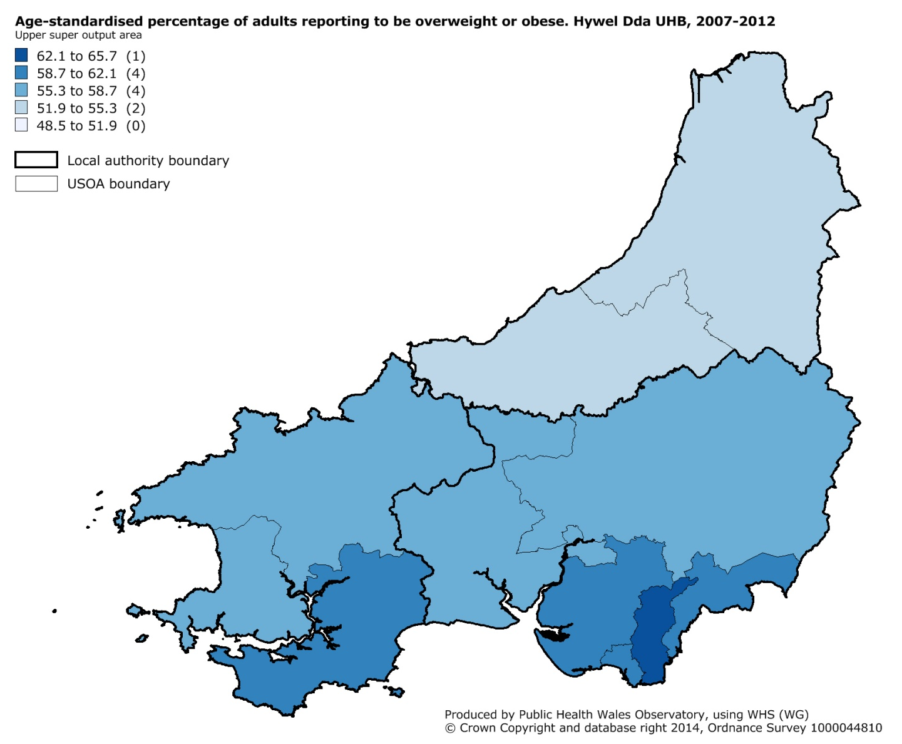
Overweight / obesity by upper super output area (USOA): Hywel Dda UHB (compared to all USOAs in Wales)
1. Overweight or obese (BMI 25+)

Slide 19
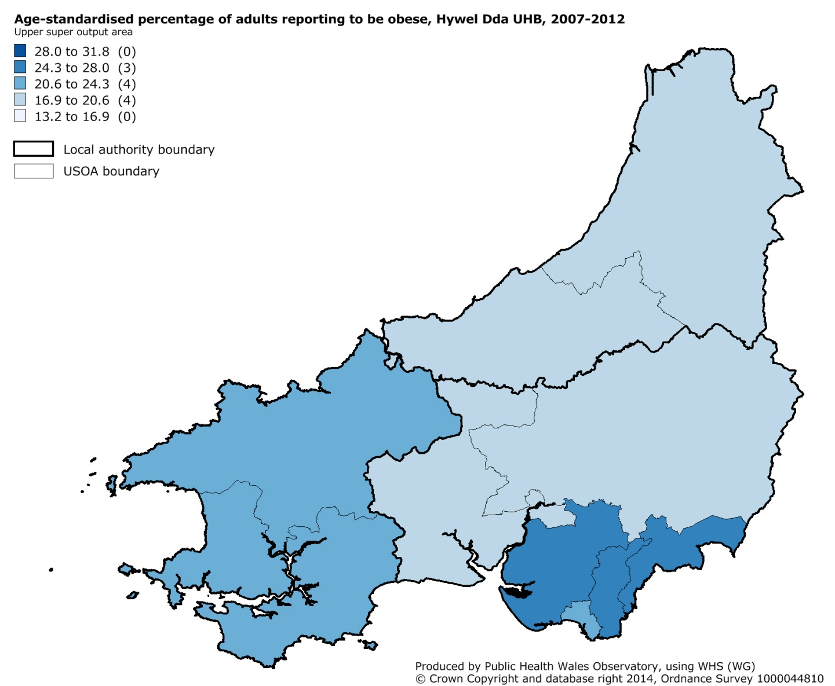
Overweight / obesity by upper super output area (USOA): Hywel Dda UHB (compared to all USOAs in Wales)
2. Obese (BMI 30+)

