Slide 1

Welsh Health Survey obesity resource: key outputs
Cwm Taf UHB
July 2014

Slide 2
Copyright
© 2014 Public Health Wales NHS Trust
Material contained in this document may be reproduced without prior permission provided it is done so accurately and is not used in a misleading context.
Acknowledgement to Public Health Wales NHS Trust to be stated.
Copyright in the typographical arrangement, design and layout belongs to Public Health Wales NHS Trust.

Slide 3
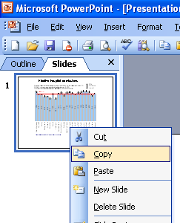
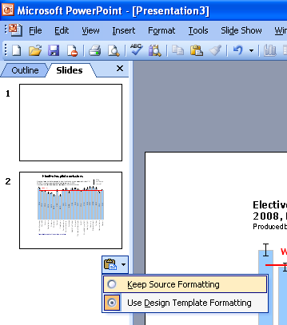
Instructions to copy a slide
To copy a slide for use in a presentation:
1. Right-click on the slide you wish to copy from the list on the left-hand side (the ‘slides’ tab) when in normal view and select ‘Copy’ from the list.
Go to your presentation and right-click where you want the copied slide to appear in the ‘slides’ tab and select ‘paste’ from the list.
On being pasted into your presentation a small clipboard icon with a black arrow will appear near the bottom right-hand corner of the newly pasted slide. Click on the arrow to show the drop-down menu and select “Keep Source Formatting” from the list. The slide will then appear as seen in the original presentation.

Slide 4
Using these slides
These slides form part of the Welsh Health Survey obesity resource published by the Public Health Wales Observatory. All charts and maps in this PowerPoint file relate to Cwm Taf University Health Board area.
The Welsh Health Survey obesity resource can be found at: www.publichealthwalesobservatory.wales.nhs.uk/obesity
This presentation can be used as a whole or as individual slides.
For further information, email the Observatory: publichealthwalesobservatory@wales.nhs.uk

Slide 5
Overweight / obesity by sex: Cwm Taf UHB, BMI 25+
Overweight or obese (BMI 25+): males Overweight or obese (BMI 25+): females
NB the above charts are also available for all persons via the website

Slide 6
Overweight / obesity by sex: Rhondda Cynon Taf, BMI 25+
Overweight or obese (BMI 25+): males Overweight or obese (BMI 25+): females
NB the above charts are also available for all persons via the website

Slide 7
Overweight / obesity by sex: Merthyr Tydfil, BMI 25+
Overweight or obese (BMI 25+): males Overweight or obese (BMI 25+): females
NB the above charts are also available for all persons via the website

Slide 8
Obesity by sex: Cwm Taf UHB, BMI 30+
Obese (BMI 30+): males Obese (BMI 30+): females
NB the above charts are also available for all persons via the website

Slide 9
Obesity by sex: Rhondda Cynon Taf, BMI 30+
Obese (BMI 30+): males Obese (BMI 30+): females
NB the above charts are also available for all persons via the website

Slide 10
Obesity by sex: Merthyr Tydfil, BMI 30+
Obese (BMI 30+): males Obese (BMI 30+): females
NB the above charts are also available for all persons via the website

Slide 11
Overweight / obesity by age: Cwm Taf UHB
Overweight or obese (BMI 25+) Obese (BMI 30+)

Slide 12
Overweight / obesity by age: Rhondda Cynon Taf
Overweight or obese (BMI 25+) Obese (BMI 30+)

Slide 13
Overweight / obesity by age: Merthyr Tydfil
Overweight or obese (BMI 25+) Obese (BMI 30+)

Slide 14
Overweight / obesity by deprivation: Cwm Taf UHB
Overweight or obese (BMI 25+) Obese (BMI 30+)

Slide 15
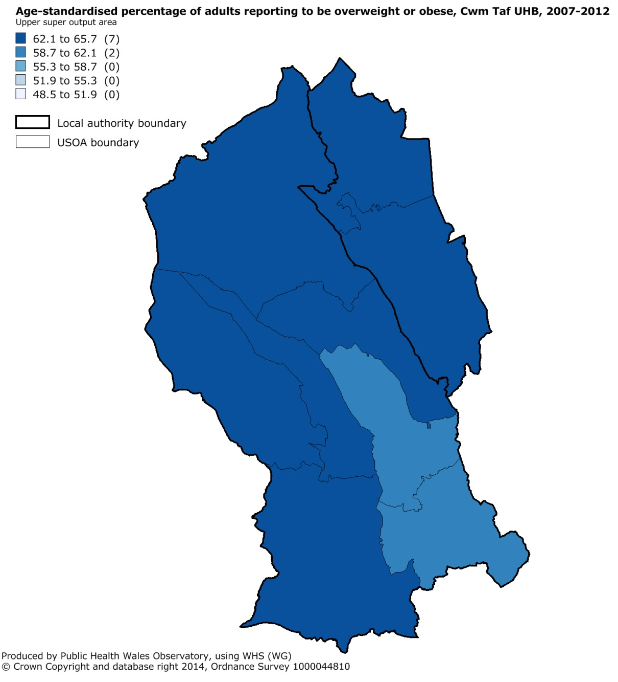
Overweight / obesity by upper super output area (USOA): Cwm Taf UHB (compared to all USOAs in Wales)
1. Overweight or obese (BMI 25+)

Slide 16
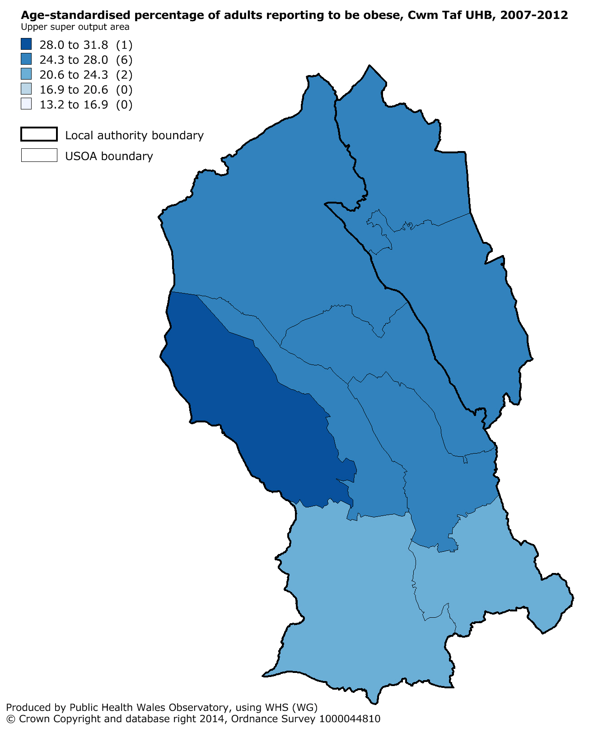
Overweight / obesity by upper super output area (USOA): Cwm Taf UHB (compared to all USOAs in Wales)
2. Obese (BMI 30+)

