Slide 1

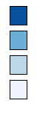
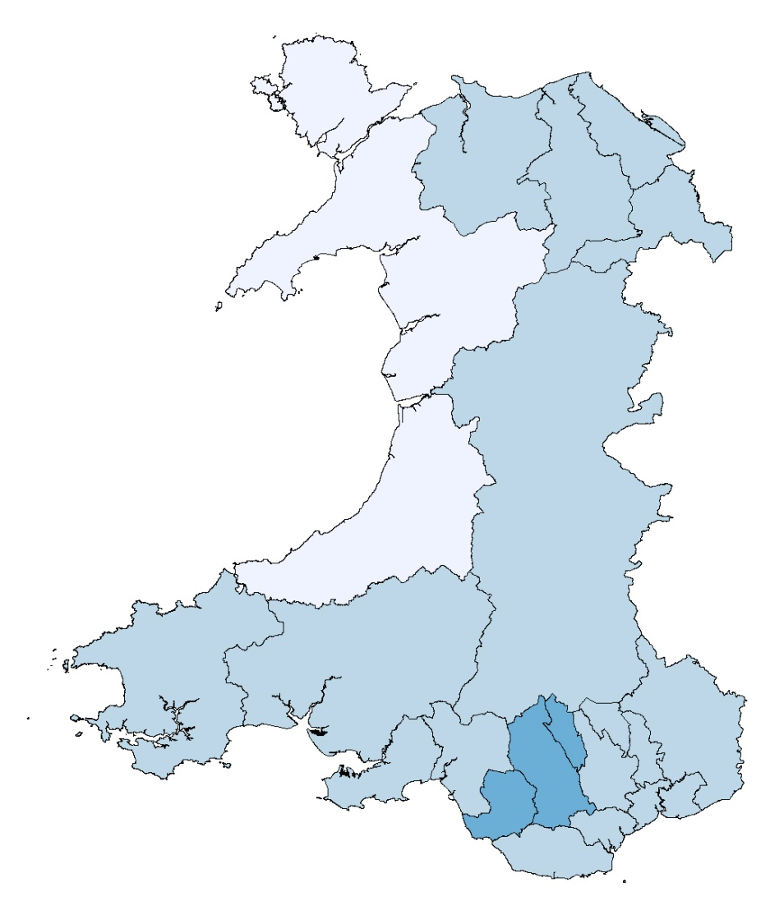
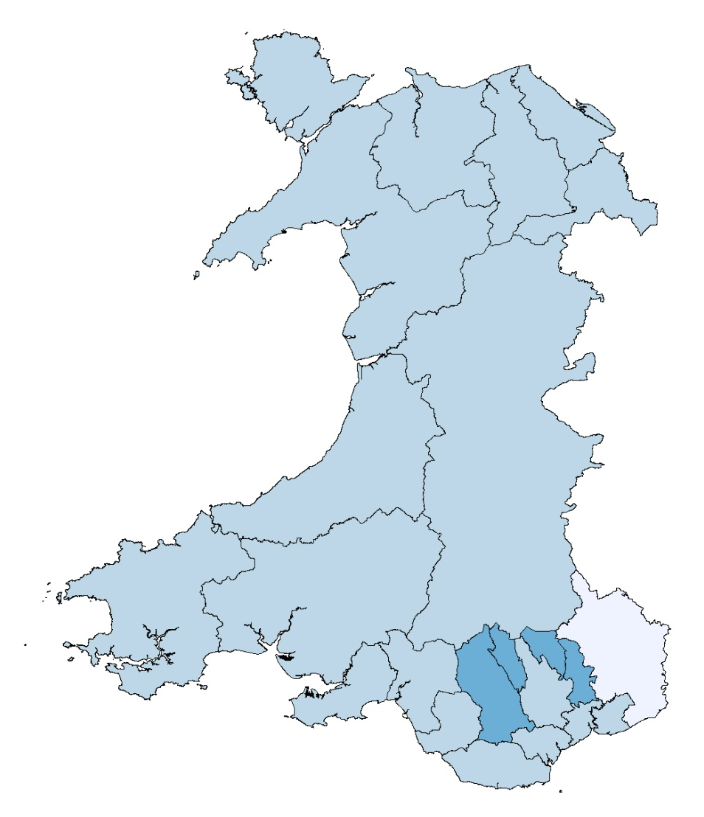
Percentage of adults reporting to be obese, persons aged 16+
Local authority
25 to 30.4
20 to <25
15 to <20
<15
2003/04 – 2004/05
Males
Females
Produced by Public Health Wales Observatory, using Welsh Health Survey (WG). ©Crown Copyright and database right 2014. Ordnance Survey 100044810
Obese: BMI 30+
Percentages are age-standardised using weights adapted from the 2013 European standard population.

Slide 2
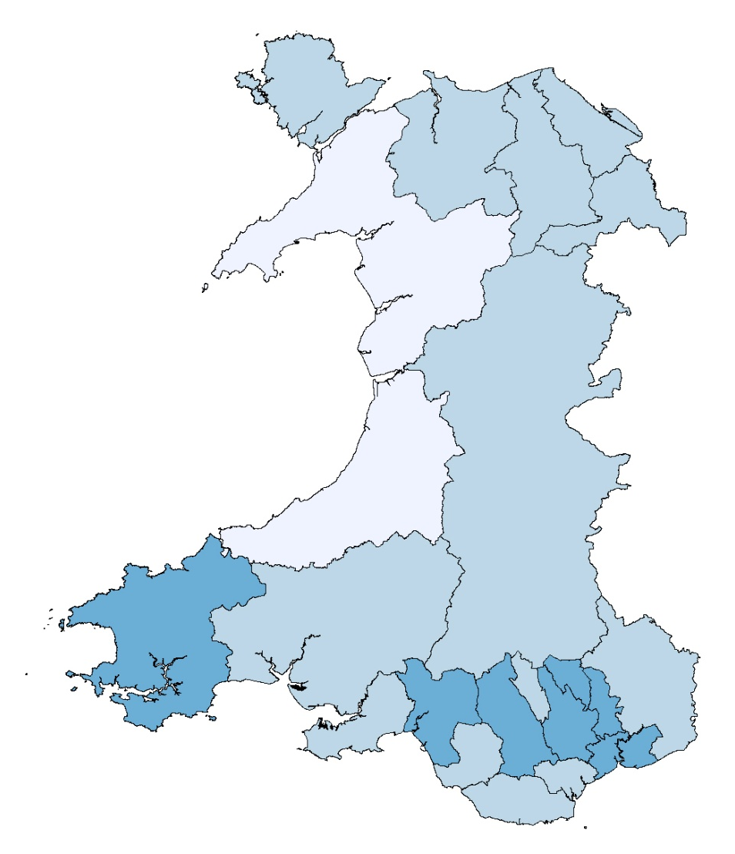
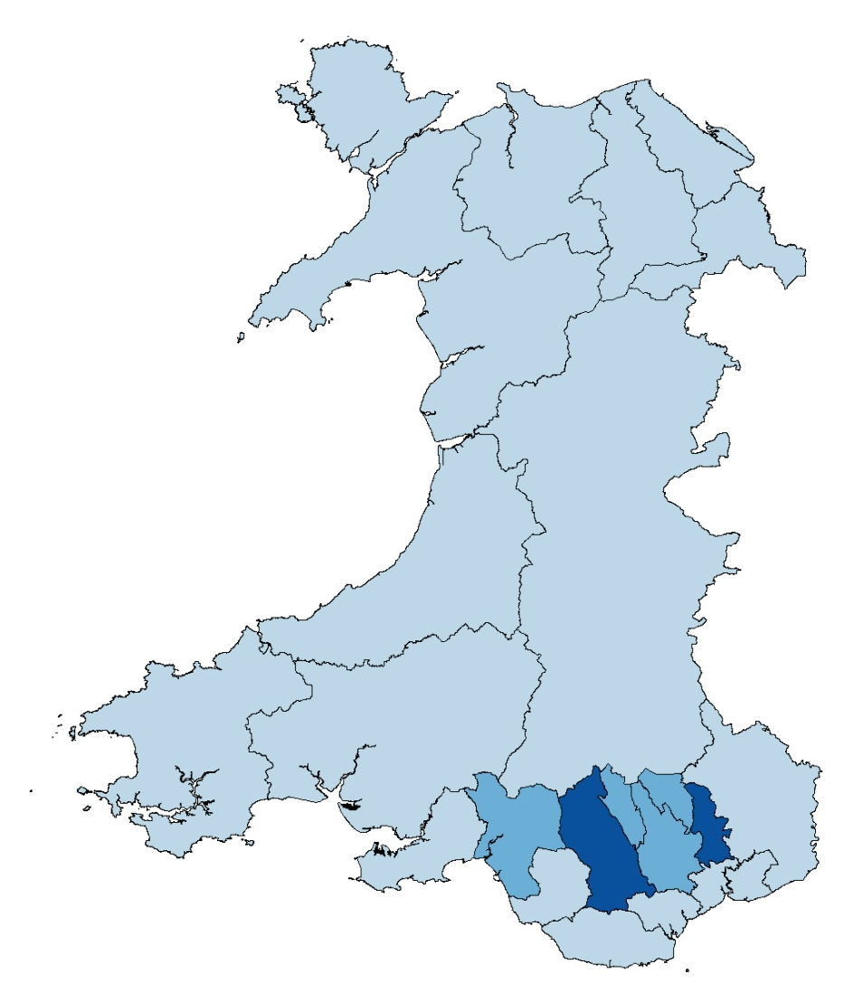
Percentage of adults reporting to be obese, persons aged 16+
Local authority
25 to 30.4
20 to <25
15 to <20
<15
2004/05 – 2005/06
Males
Females
Produced by Public Health Wales Observatory, using Welsh Health Survey (WG). ©Crown Copyright and database right 2014. Ordnance Survey 100044810
Obese: BMI 30+
Percentages are age-standardised using weights adapted from the 2013 European standard population.

Slide 3
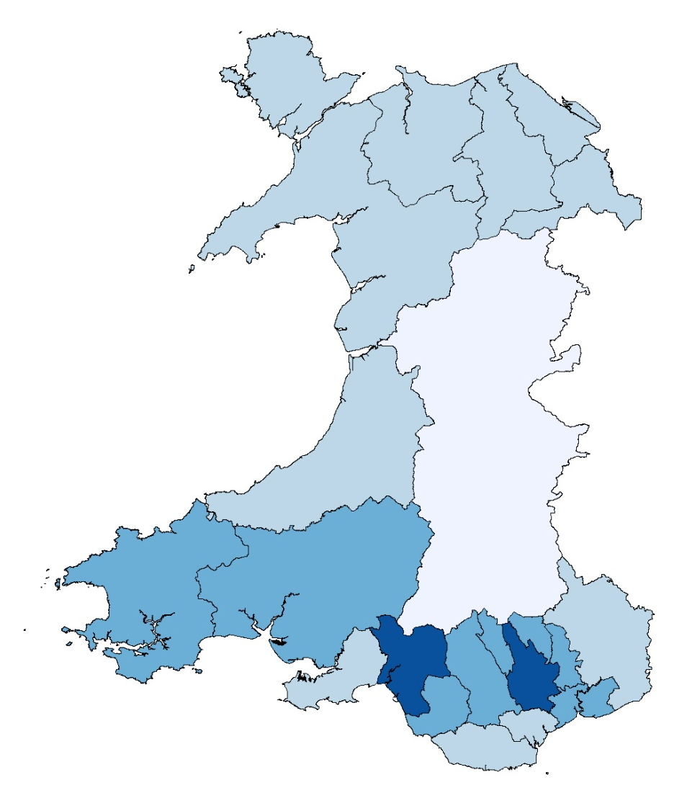
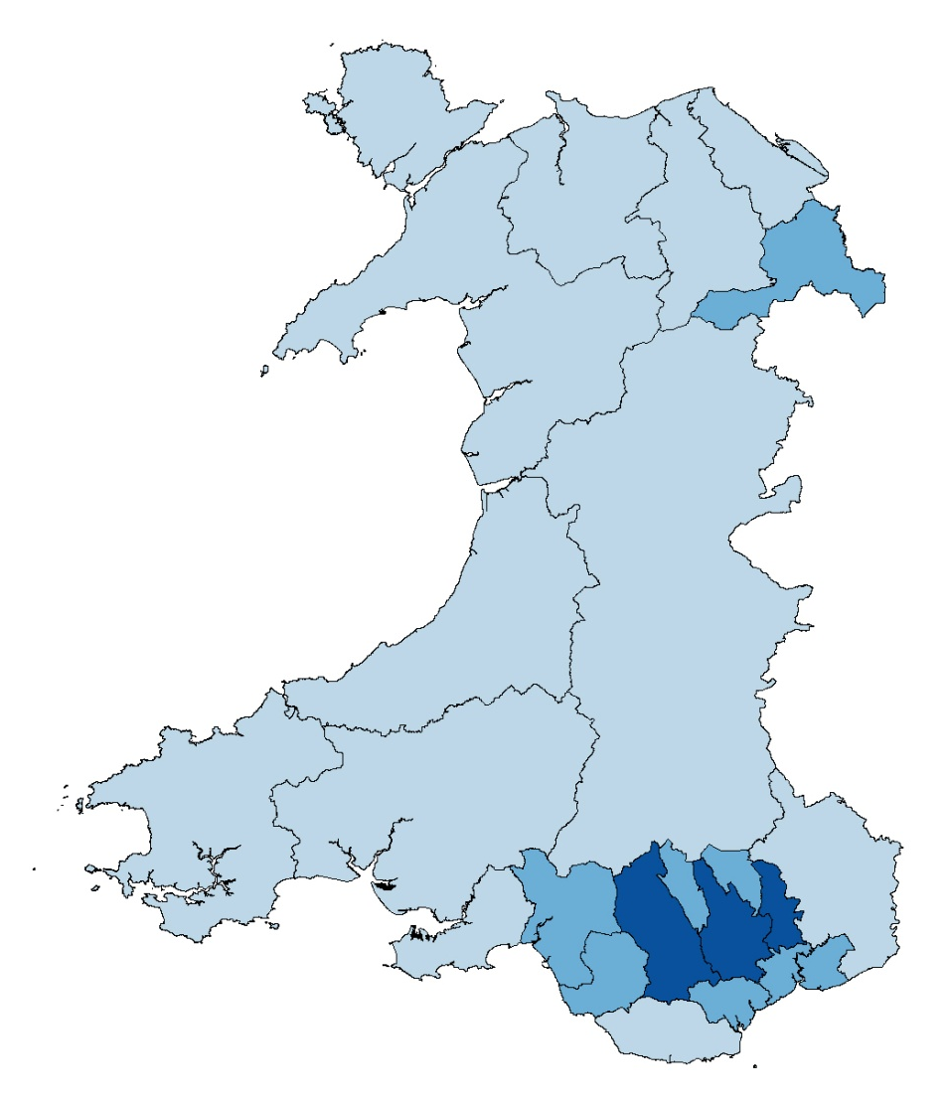
Percentage of adults reporting to be obese, persons aged 16+
Local authority
25 to 30.4
20 to <25
15 to <20
<15
2005/06 – 2007
Males
Females
Produced by Public Health Wales Observatory, using Welsh Health Survey (WG). ©Crown Copyright and database right 2014. Ordnance Survey 100044810
Obese: BMI 30+
Percentages are age-standardised using weights adapted from the 2013 European standard population.

Slide 4
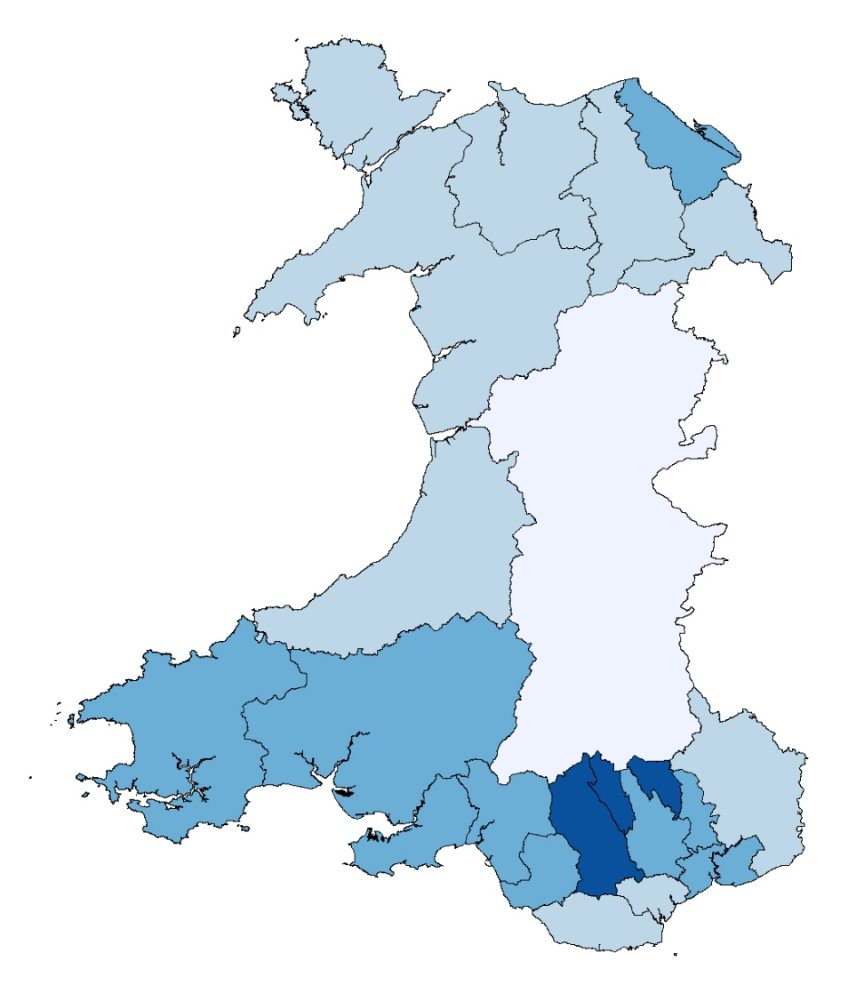
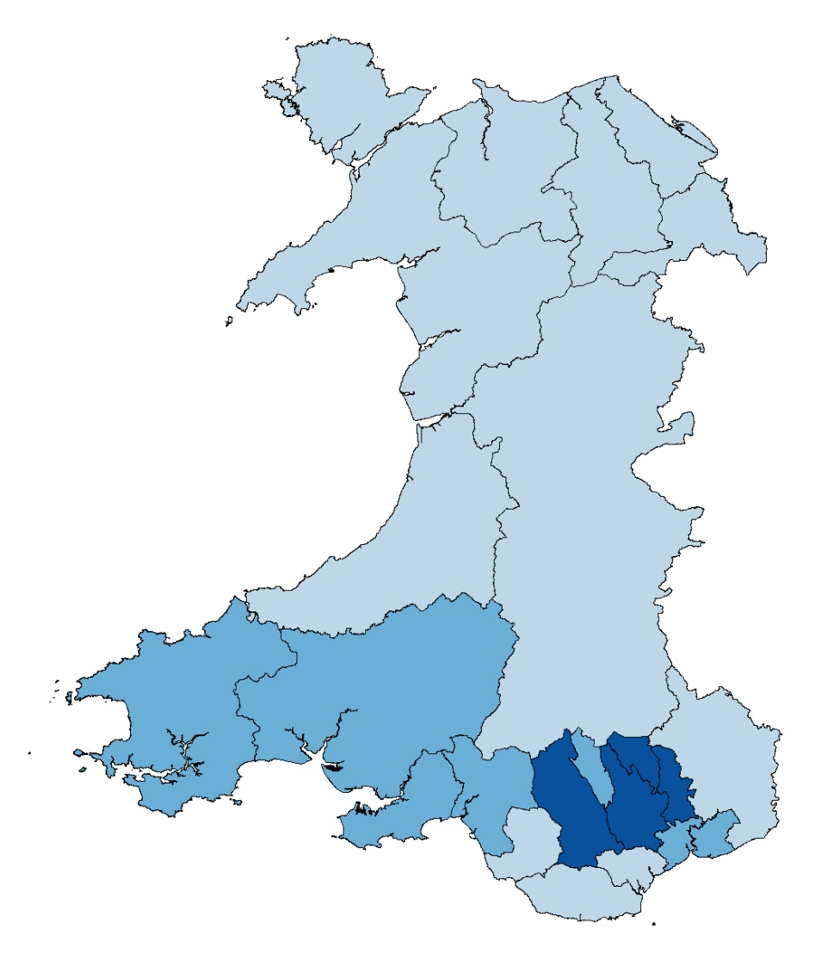
Percentage of adults reporting to be obese, persons aged 16+
Local authority
25 to 30.4
20 to <25
15 to <20
<15
2007 - 2008
Males
Females
Produced by Public Health Wales Observatory, using Welsh Health Survey (WG). ©Crown Copyright and database right 2014. Ordnance Survey 100044810
Obese: BMI 30+
Percentages are age-standardised using weights adapted from the 2013 European standard population.

Slide 5
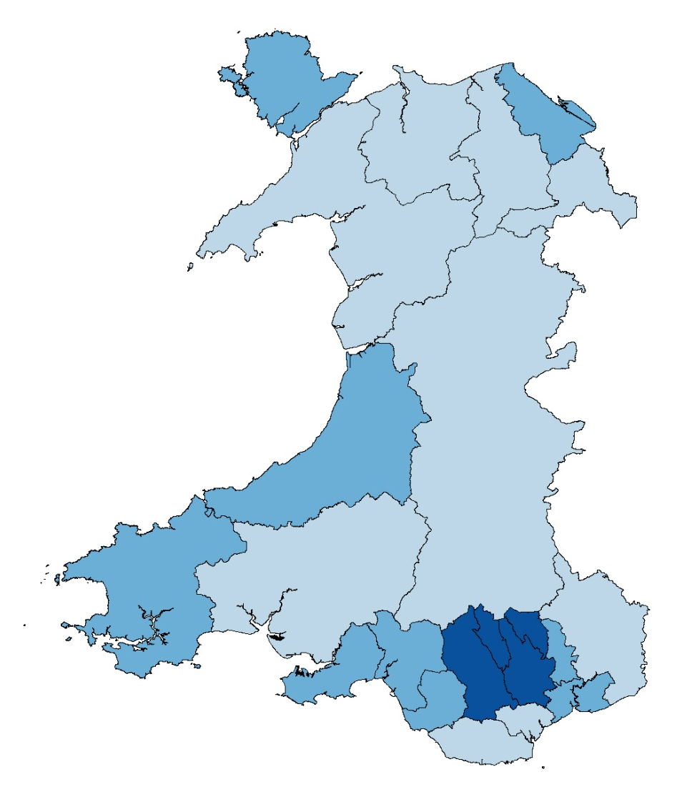
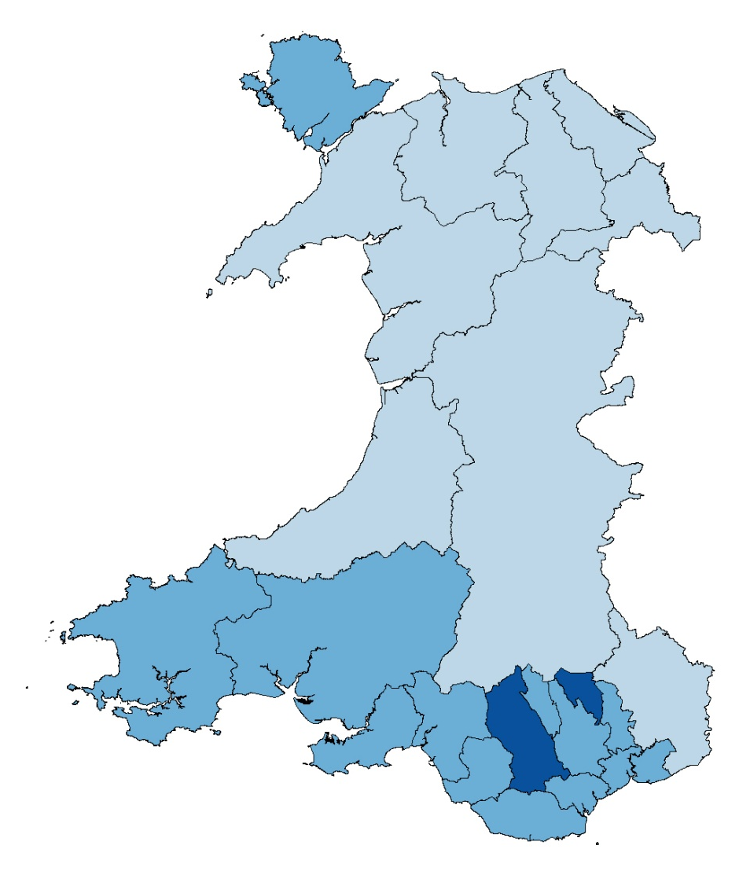
Percentage of adults reporting to be obese, persons aged 16+
Local authority
25 to 30.4
20 to <25
15 to <20
<15
2008 – 2009
Males
Females
Produced by Public Health Wales Observatory, using Welsh Health Survey (WG). ©Crown Copyright and database right 2014. Ordnance Survey 100044810
Obese: BMI 30+
Percentages are age-standardised using weights adapted from the 2013 European standard population.

Slide 6
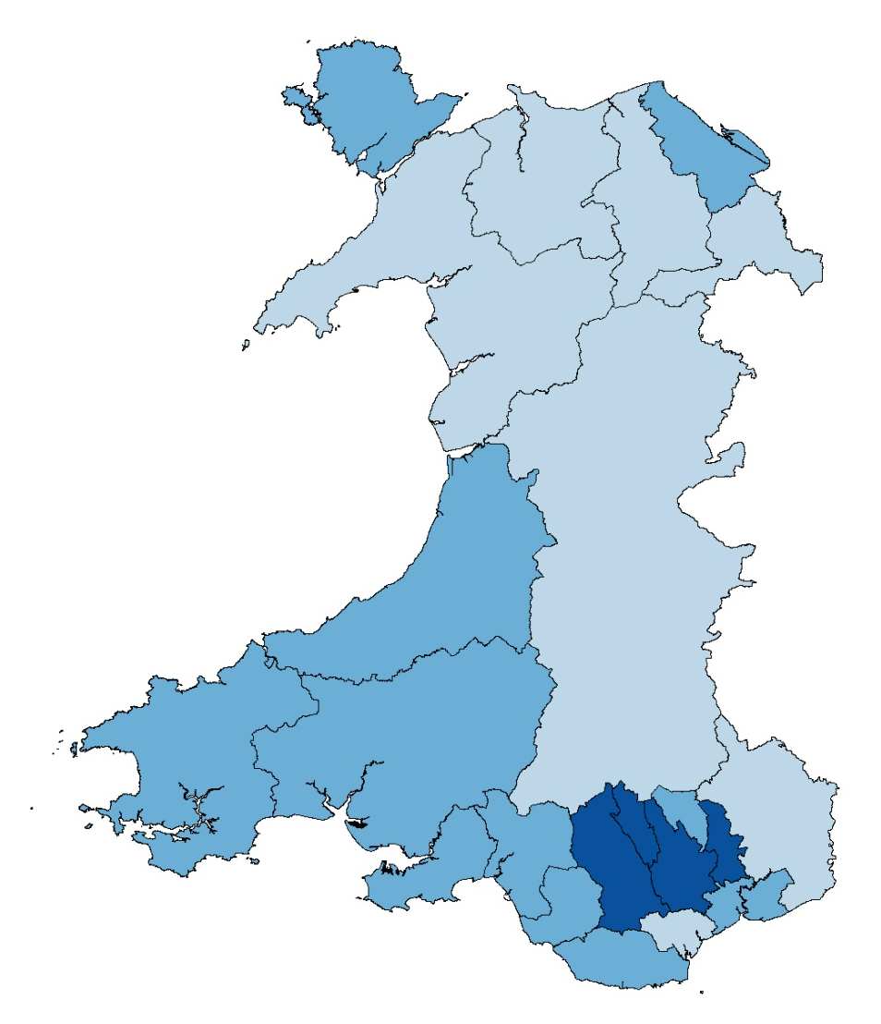
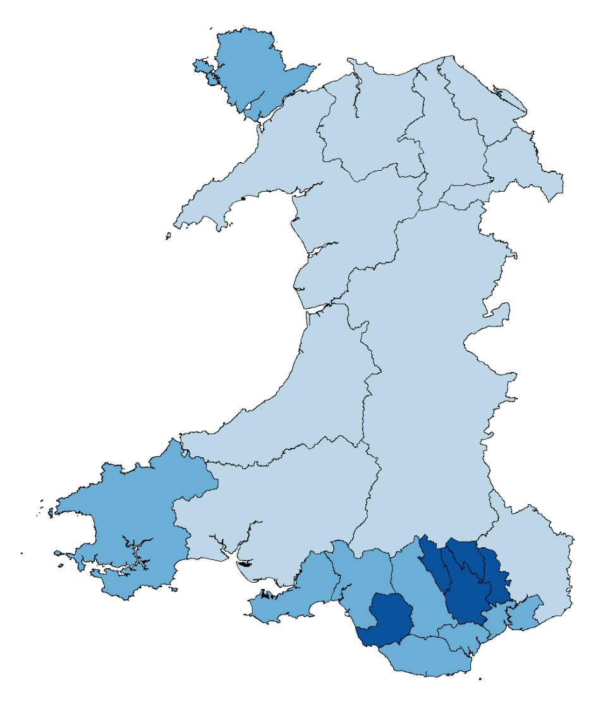
Percentage of adults reporting to be obese, persons aged 16+
Local authority
25 to 30.4
20 to <25
15 to <20
<15
2009 – 2010
Males
Females
Produced by Public Health Wales Observatory, using Welsh Health Survey (WG). ©Crown Copyright and database right 2014. Ordnance Survey 100044810
Obese: BMI 30+
Percentages are age-standardised using weights adapted from the 2013 European standard population.

Slide 7
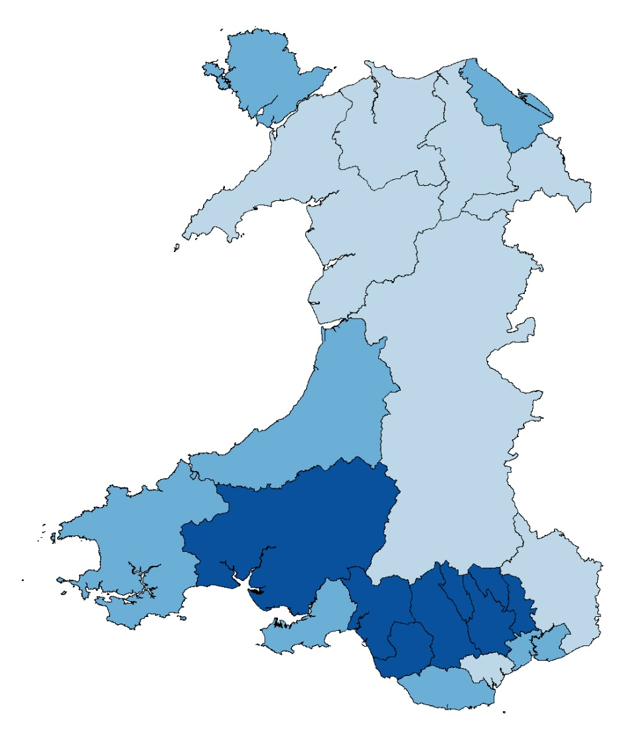
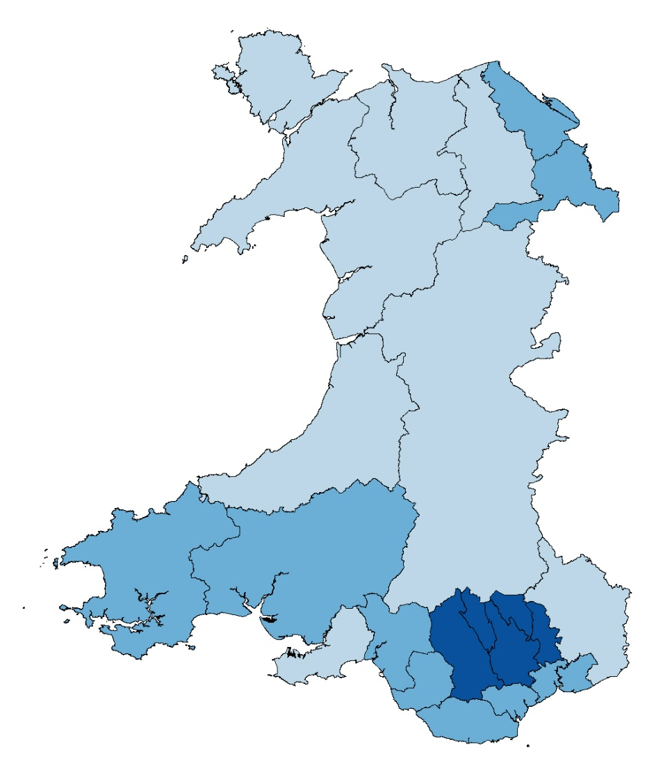
Percentage of adults reporting to be obese, persons aged 16+
Local authority
25 to 30.4
20 to <25
15 to <20
<15
2010 – 2011
Males
Females
Produced by Public Health Wales Observatory, using Welsh Health Survey (WG). ©Crown Copyright and database right 2014. Ordnance Survey 100044810
Obese: BMI 30+
Percentages are age-standardised using weights adapted from the 2013 European standard population.

Slide 8
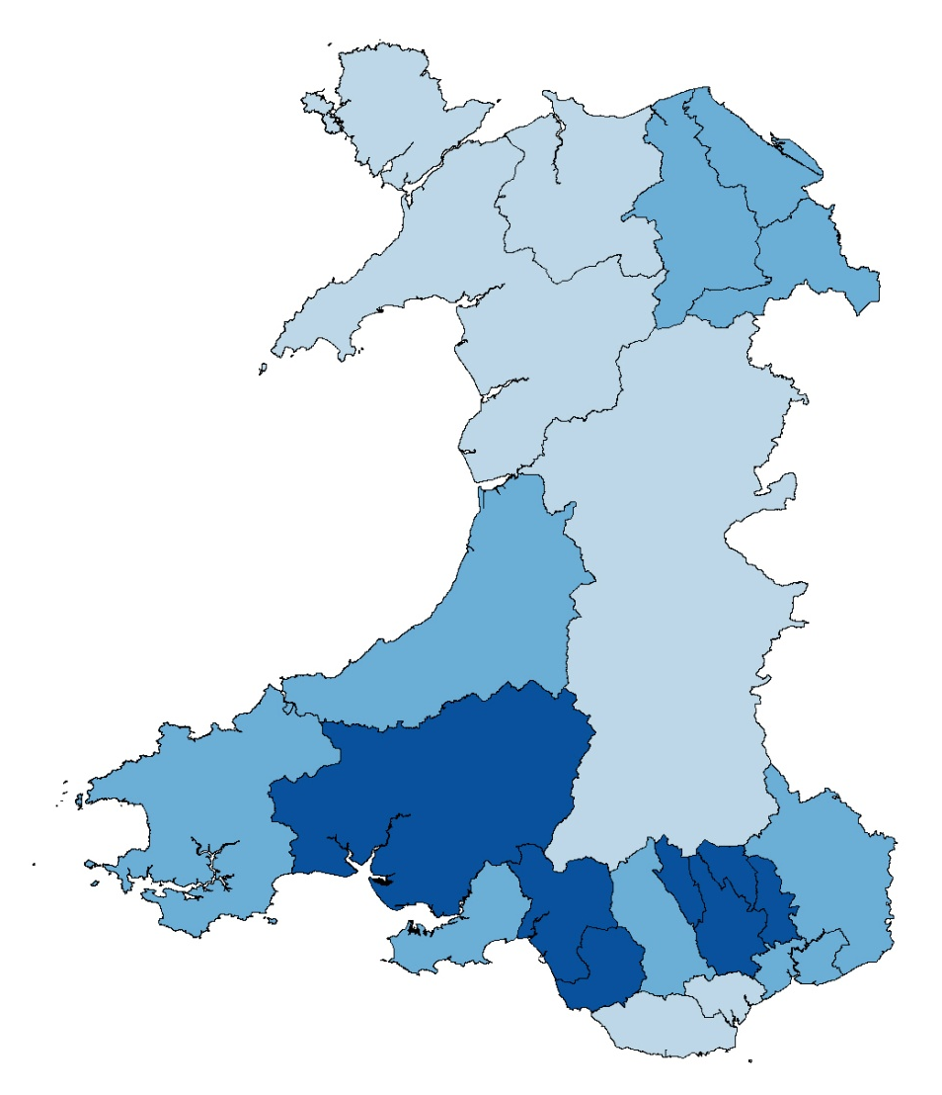
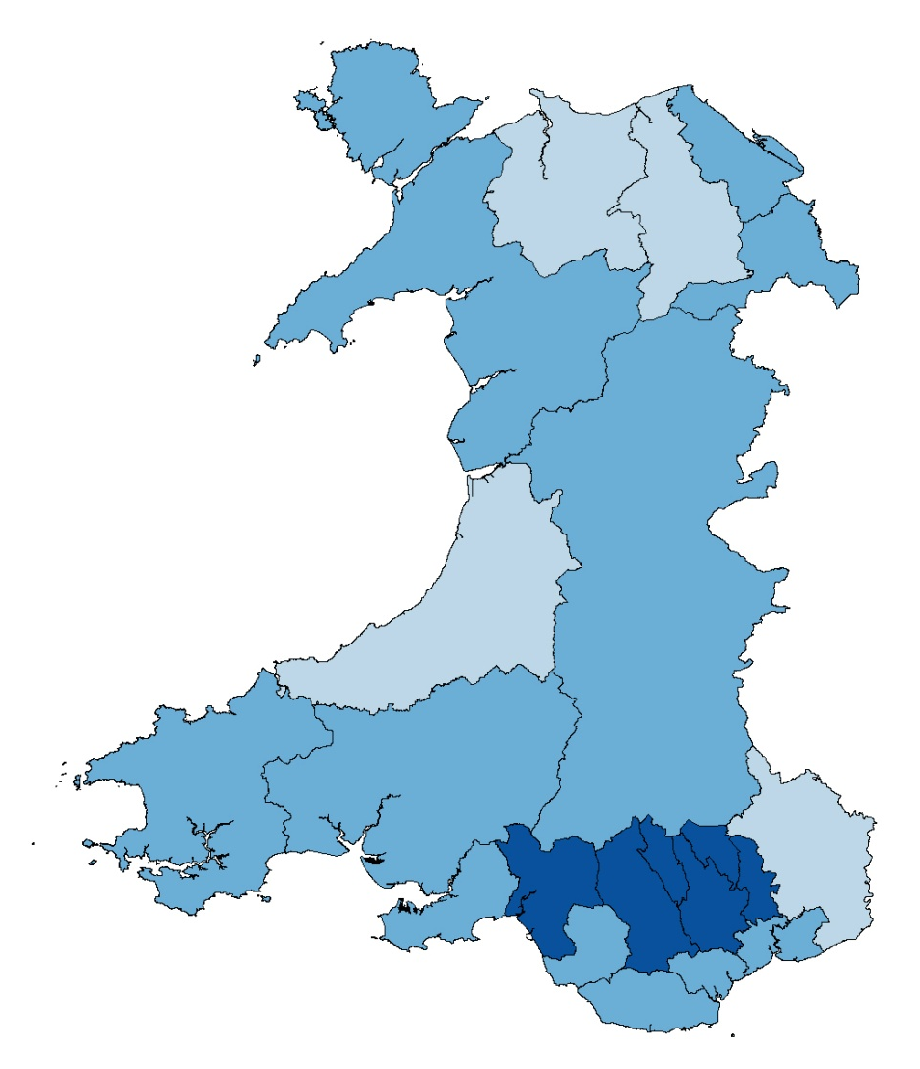
Percentage of adults reporting to be obese, persons aged 16+
Local authority
25 to 30.4
20 to <25
15 to <20
<15
2011 – 2012
Males
Females
Produced by Public Health Wales Observatory, using Welsh Health Survey (WG). ©Crown Copyright and database right 2014. Ordnance Survey 100044810
Obese: BMI 30+
Percentages are age-standardised using weights adapted from the 2013 European standard population.

