Slide 1

Tobacco and health in Wales
June 2012

Slide 2
Using these slides
These slides show excerpts from Tobacco and health in Wales, a joint report published by the Public Health Wales Observatory and Welsh Government
The slides are based on the 11 key messages from the report
The presentation can be used as a whole or as individual slides
Please acknowledge the work of the Public Health Wales Observatory and Welsh Government when using these slides

Slide 3
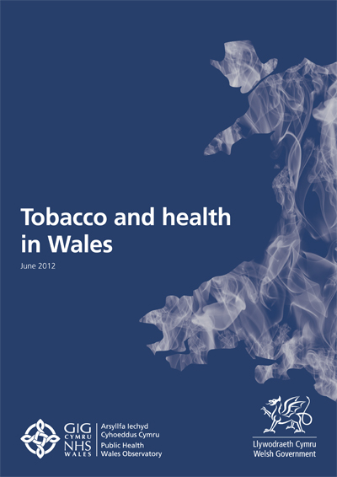

Tobacco and health in Wales
Bilingual document providing a comprehensive summary of statistics on tobacco use and its impact on health and health services
Supported by
Technical guide detailing methods and caveats
Interactive data files
All available at:
www.publichealthwalesobservatory.wales.nhs.uk/tobaccoandhealth

Slide 4
Aims of report
Provide an updated picture of smoking prevalence in Wales
Analyse its impact on health and health services
Appeal to a range of stakeholders, including health boards, local and national government
Assist them in targeting action on tobacco

Slide 5
What’s new?
Proportion of the inequality in mortality that can be attributed to smoking (Wales level)
Smoking-attributable hospital admissions in adults (Wales, health boards, local authorities, Upper Super Output Areas)
Hospital admissions attributable to second-hand smoke exposure in children (Wales level)
Trend in smoking prevalence by i) Welsh Index of Multiple Deprivation and ii) National Statistics Socio-Economic Classification

Slide 6
Key message 1
“Smoking continues to be the greatest single cause of avoidable mortality in Wales. In people aged 35 and over, smoking causes nearly one in five of all deaths and around one third of the inequality in mortality between the most and least deprived areas.”

Slide 7
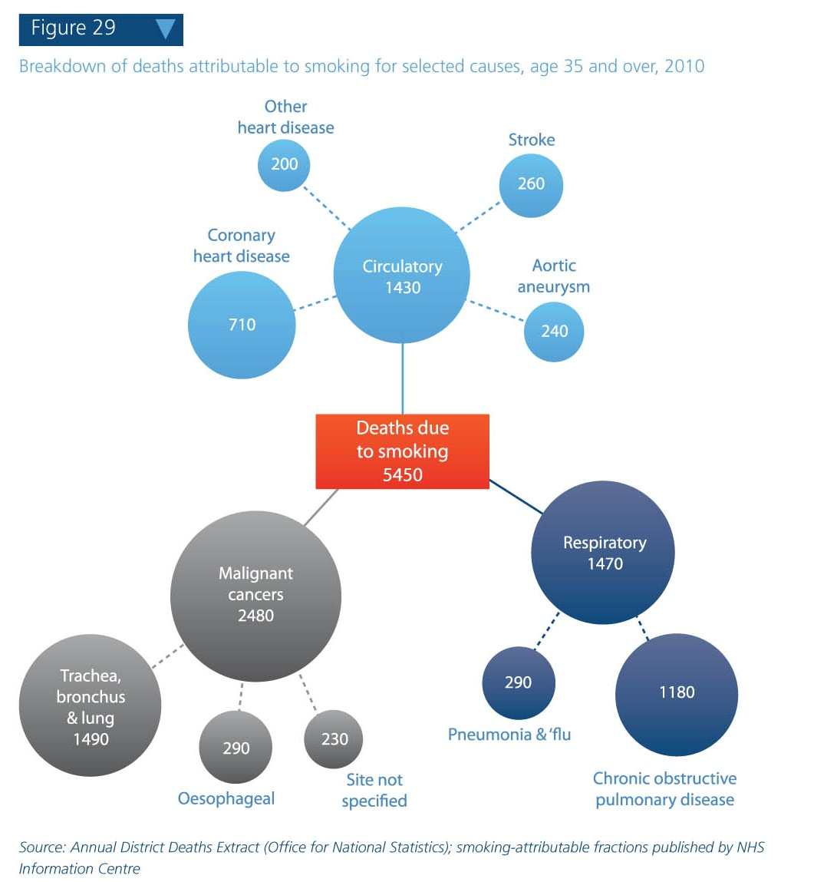
Smoking-attributable mortality, 2010
In 2010, smoking is estimated to have caused 5,450 of 30,550 deaths (nearly one in five) in Wales residents aged 35+
Of these 5,450 deaths, 2,480 were from cancer

Slide 8
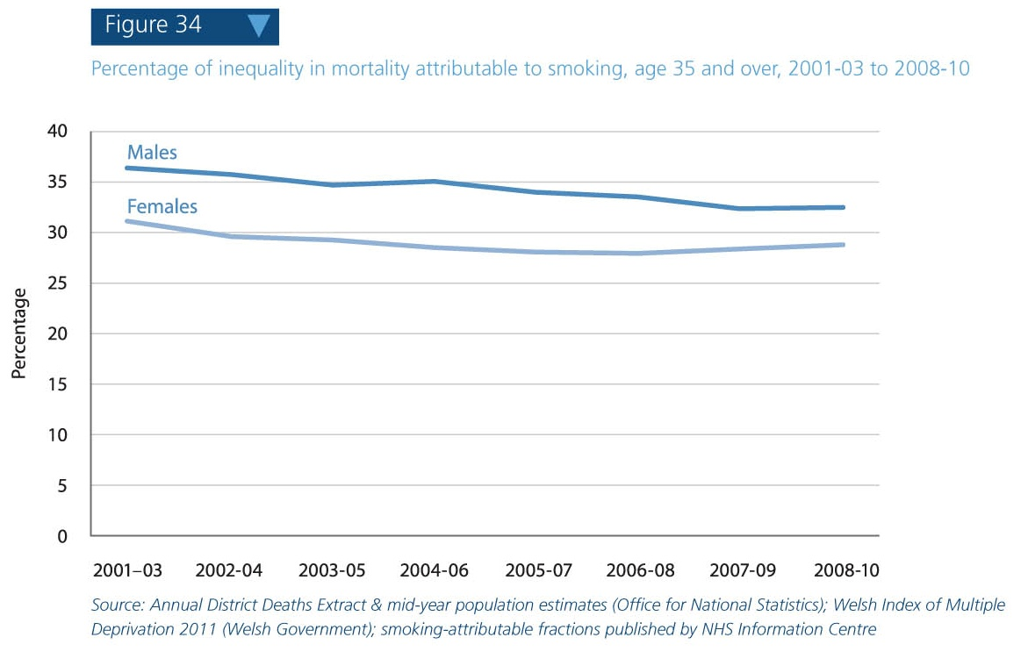
Percentage of inequality in mortality attributable to smoking
An estimated one third of the socio-economic inequality in mortality is caused by smoking, a figure which appears to have fallen slightly in recent years

Slide 9
Key message 2
“Twenty-three per cent of adults described themselves as current smokers in 2010. This is considerably lower than in the 1970s, but the fall in rates has slowed down in recent years. Considerable efforts are therefore required to meet the Welsh Government’s target of 16 per cent by 2020.”

Slide 10
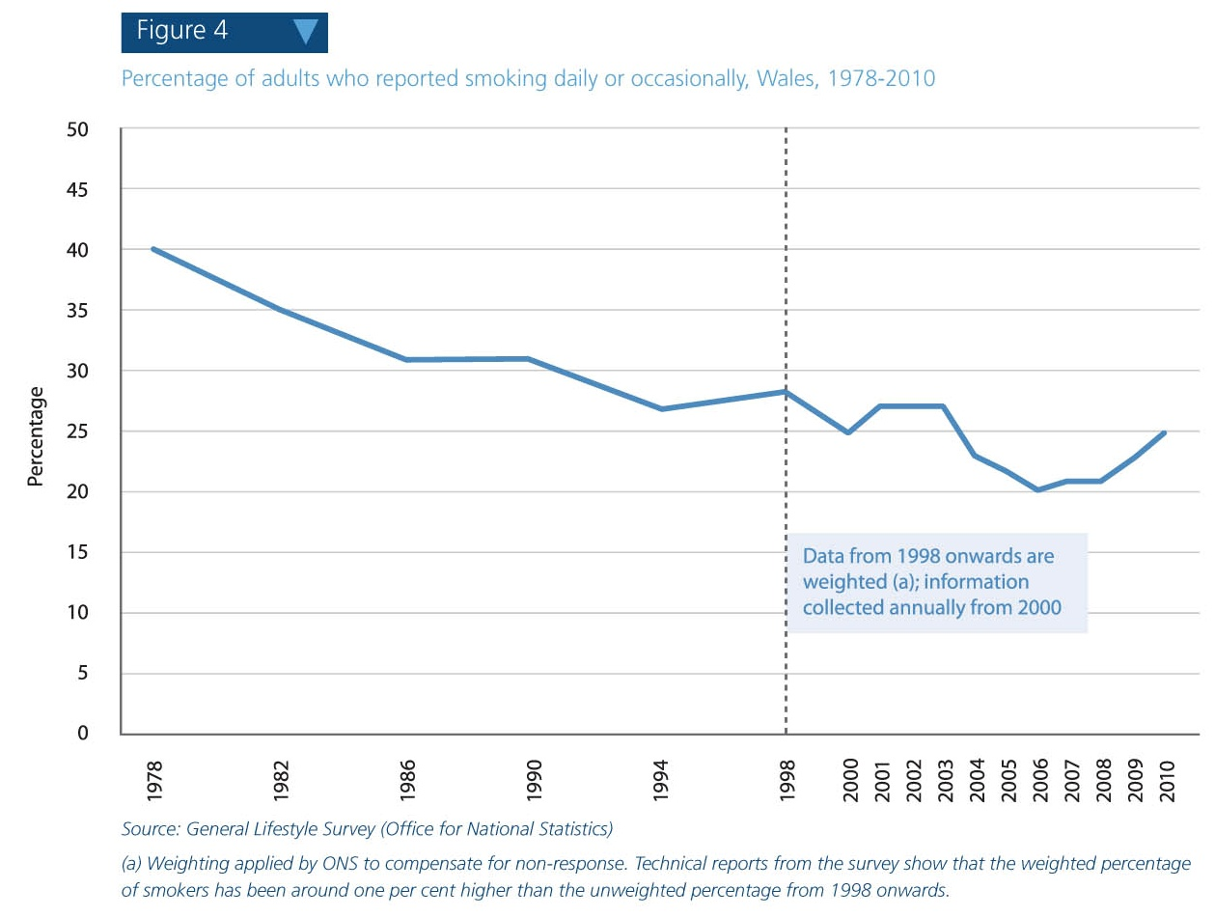
Smoking prevalence 1978-2010 (General Lifestyle Survey)
Smoking prevalence has fallen considerably since the 1970s but the decline has slowed in recent years
Recent estimates of prevalence from the General Lifestyle Survey (figure 4) are less robust than those from the Welsh Health Survey (figure 5, next slide)

Slide 11
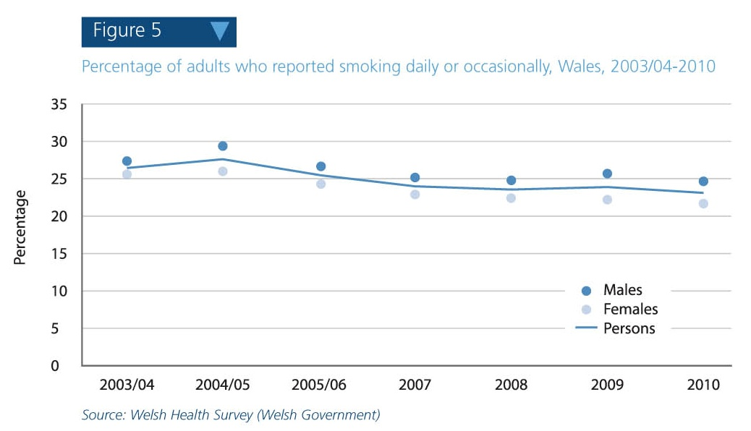
Smoking prevalence 2003/04-2010 (Welsh Health Survey)
Currently around 23 per cent of the adult population of Wales are smoking daily or occasionally
The Tobacco Control Action Plan for Wales sets a target of 16 per cent prevalence by 2020

Slide 12
Key message 3
“Overall, smoking is more common in males than in females, although in children and young people the reverse is true. Rates of smoking in males aged 25-34 and 35-44 are particularly high (37 per cent and 31 per cent respectively) and have not reduced appreciably in the last seven years. Latest estimates suggest that around one in six girls aged 15-16 are regular smokers, compared to one in nine boys. Smokers in this age group reported starting at an average of just 12 years of age.”

Slide 13
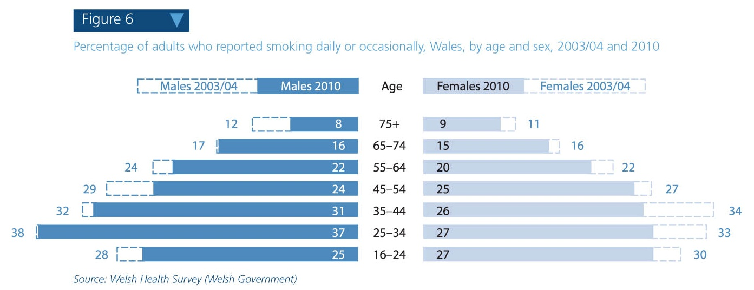
Smoking prevalence by age, 2003/04 and 2010
Smoking prevalence continues to be high in young men, reaching 37 per cent in 25-34s, and shows little sign of decreasing since 2003/04

Slide 14
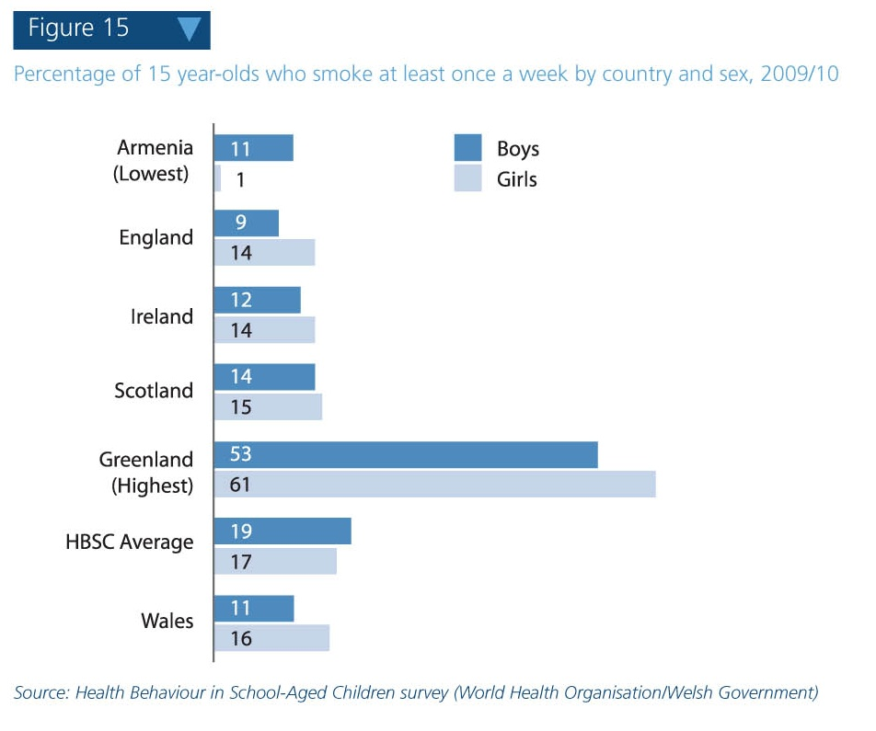
Smoking prevalence in 15 year-olds, 2009/10
16 per cent of girls report to be smoking at least once a week, compared to 11 per cent of boys
Wales figure for girls is highest of all UK nations
The prevalence of smoking in 15 year-old boys and girls has shown a downward trend in recent years

Slide 15
Key message 4
“Smoking rates are highest in the most deprived areas of Wales. More than 40 per cent of people who have never worked or are unemployed are current smokers, with no recent signs of this figure decreasing. Smoking rates in managerial and professional groups continue to fall. These trends are likely to contribute to widening health inequalities in the future.”

Slide 16
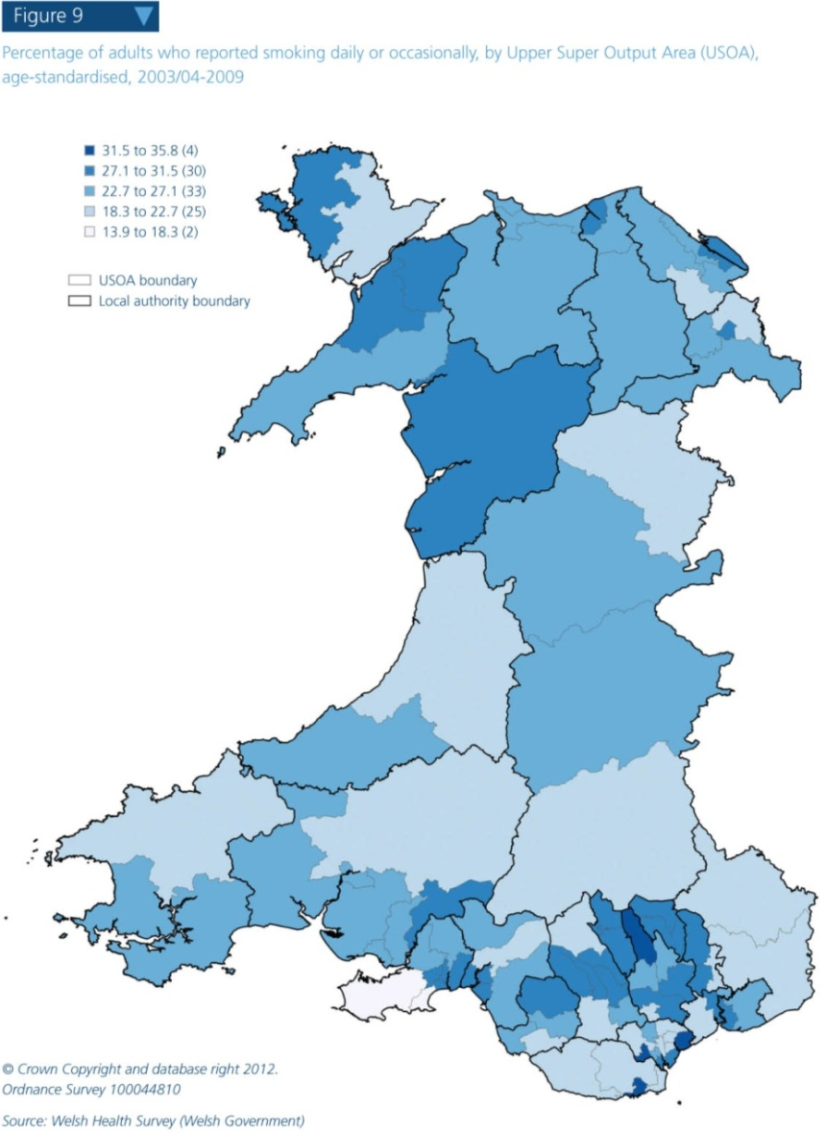
Smoking prevalence at Upper Super Output Area (USOA) level, 2003/04-2010
Smoking prevalence is highest in the most deprived areas of Wales (e.g. South Wales Valleys)
Prevalence is as low as around 14 per cent in the Gower area of Swansea
USOAs are geographically-defined areas used to show statistical information, with an average population of around 30,000

Slide 17
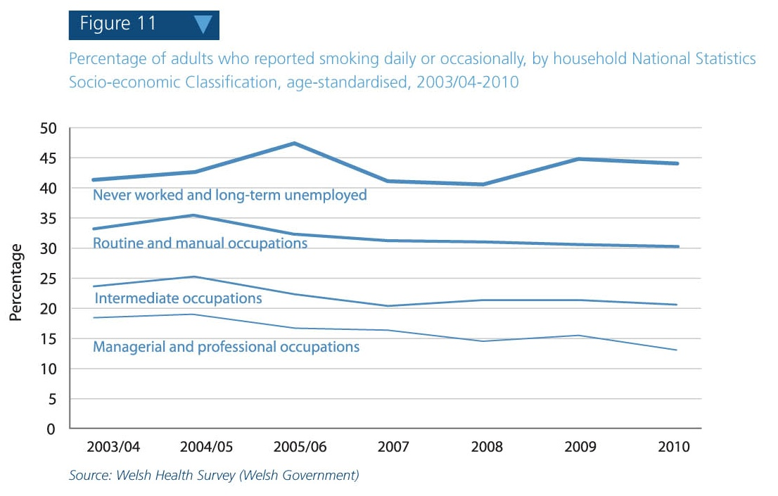
Trend in smoking prevalence by household National Statistics Socio-Economic Classification, 2003/04-2010
Smoking prevalence in the “never worked or are long-term unemployed” group was 44 per cent in 2010, having been 41 per cent in 2003/04.
In the “managerial and professional occupations” group, prevalence fell to 14% in 2010

Slide 18
Key message 5
“Around one in six females living in Wales smoke throughout pregnancy, the highest rate of all UK nations, though this has fallen since 2005. Older mothers and those in managerial and professional groups are most likely to give up smoking during pregnancy.”

Slide 19
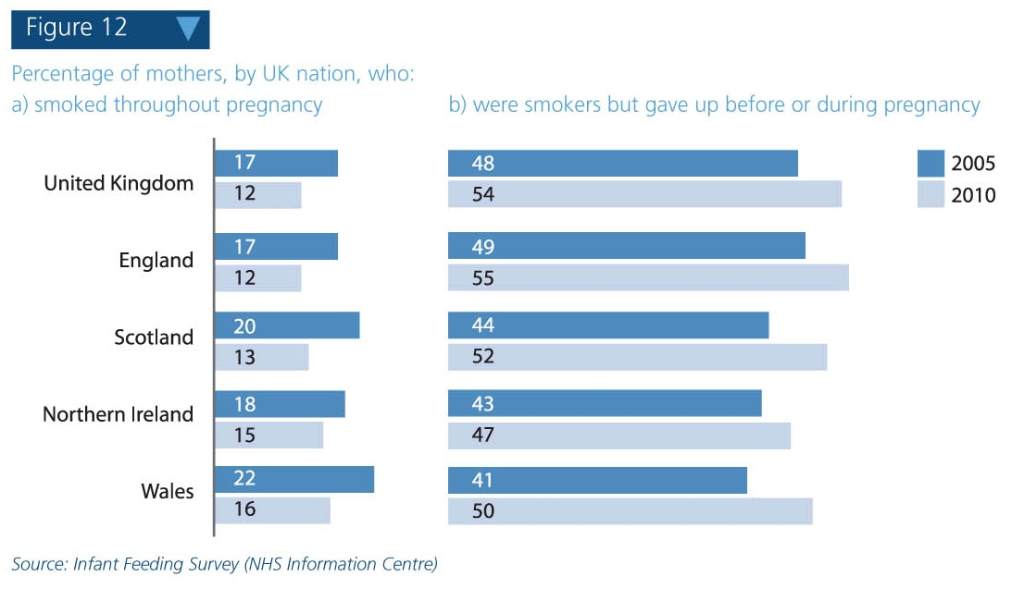
Smoking in pregnancy by UK nation, 2005 and 2010
In 2010, 16 per cent of mothers in Wales smoked throughout pregnancy, the highest rate of all UK nations, though this was higher in 2005 at 22 per cent
Half of mothers who smoked gave up before or during pregnancy in 2010

Slide 20
Key message 6
“The 2007 ban on smoking in enclosed public places has led to considerable falls in people’s exposure to second-hand smoke. However, 39 per cent of children live in households where at least one adult is a current smoker, and 20 per cent report recent exposure to second-hand smoke in cars. Exposure is most likely in children of parents who are unemployed or in routine & manual occupations, and children living in more deprived areas are more likely than their less deprived peers to be admitted to hospital for diseases associated with second-hand smoke.”

Slide 21
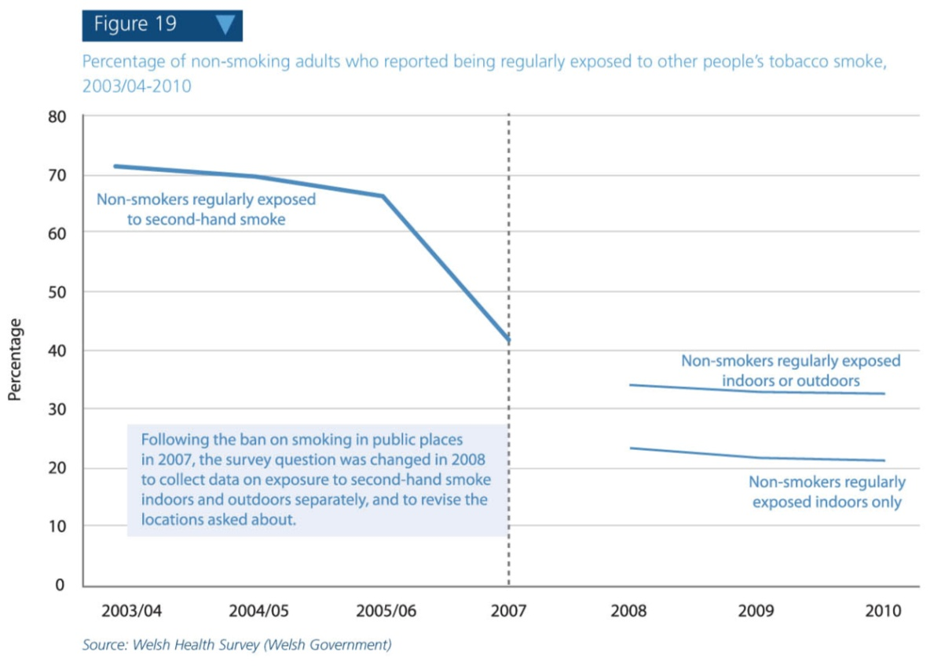
Trend in adults’ exposure to second-hand smoke, 2003/04-2010
The ban on smoking in enclosed public places implemented in 2007 has considerably reduced exposure to second-hand smoke
Around one in three non-smoking adults reported being exposed to second-hand smoke in 2010

Slide 22
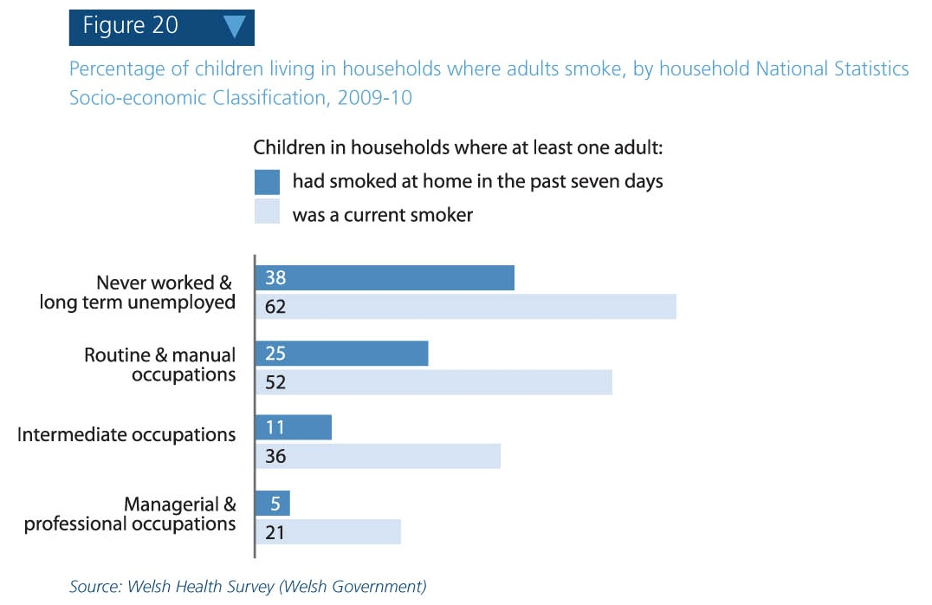
Children living in households where adults smoke, by household National Statistics Socio-Economic Classification, 2009-10
In 2009-10, 62 per cent of children in “never worked and long-term unemployed” households were living with at least one adult who was a current smoker
One in five 11 to 16 year-olds report being exposed to second-hand smoke in cars

Slide 23
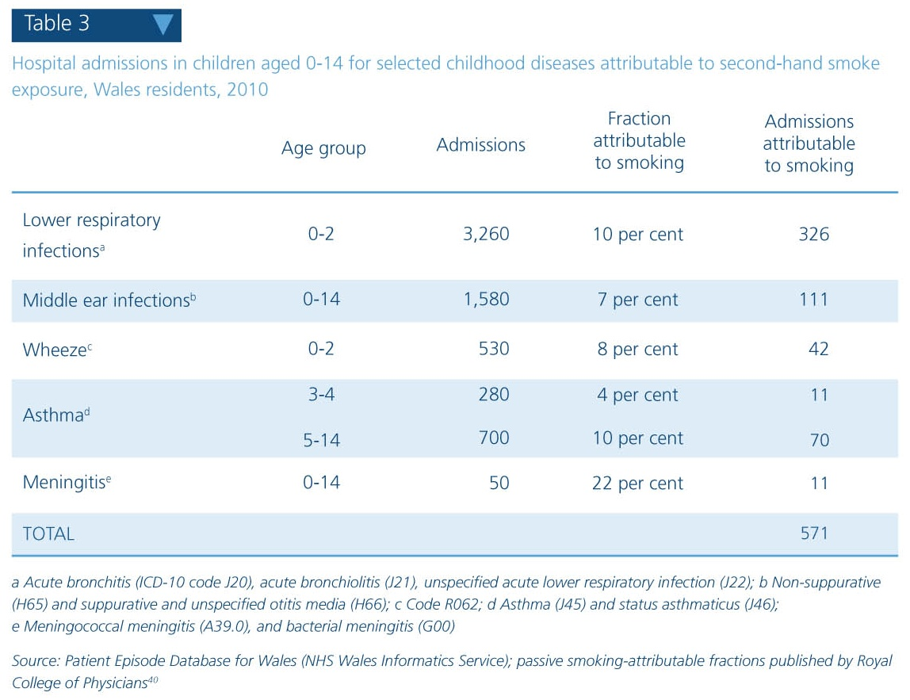
Hospital admissions in children aged 0-14 attributable to second-hand smoke exposure, 2010
It is estimated that around 570 hospital admissions in 2010 were attributable to second-hand smoke exposure in children aged 0-14
Lower respiratory infections cause the majority of these admissions

Slide 24
Key message 7
“In 2010, seven out of ten smokers reported that they would like to give up and around six out of ten smokers receiving support from Stop Smoking Wales reported success at the four-week point.”

Slide 25
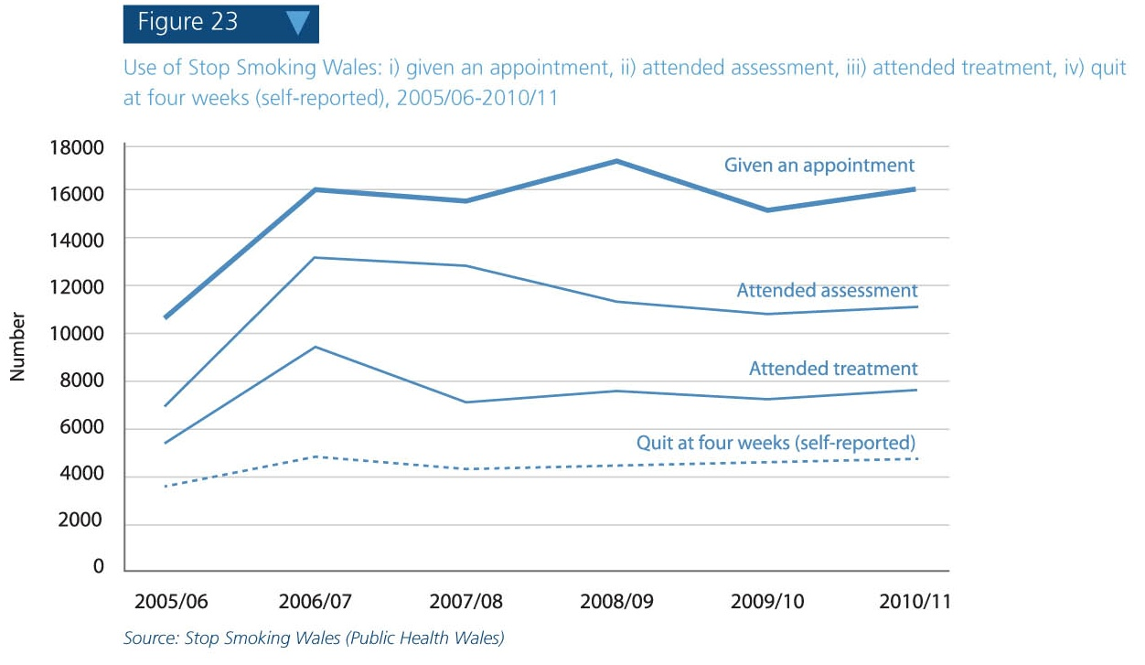
Stop Smoking Wales activity, 2005/06 to 2010/11
Around 16,000 people were given an appointment with the service in the 2010/11 financial year
At around 60 per cent, the self-reported quit rate at 4 weeks is comparable with England’s

Slide 26
Key message 8
“Overall rates of death from smoking are falling, but socio-economic inequalities are widening due to faster falls in the least deprived parts of Wales than in the most deprived. Lung cancer mortality rates in females have risen in Wales and the UK over the last ten years, whereas in males they have fallen slightly. This is likely a reflection of the differences in the historical patterns of smoking between males and females in the late 20th century.”

Slide 27
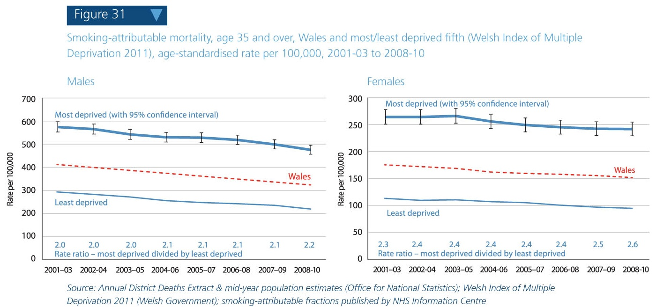
Trends in smoking-attributable mortality, 2001-03 to 2008-10
Overall rates of death from smoking are falling, but rates are more than twice as high in the most deprived fifth compared to the least deprived, and the gap appears to be widening

Slide 28
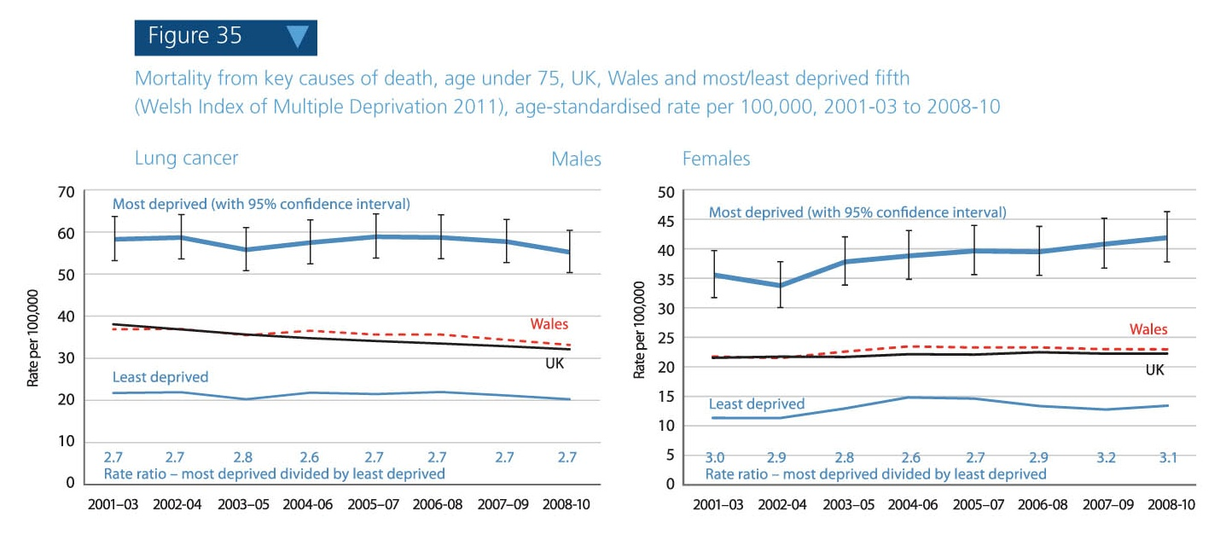
Trends in lung cancer mortality, 2001-03 to 2008-10
Lung cancer mortality rates are falling in men but not in women – likely to be due to the peak of smoking prevalence in women coming later in the 20th century than in men

Slide 29
Key message 9
“Smoking is estimated to cause around 27,700 hospital admissions each year in Wales. This represents a considerable burden on the health service.”

Slide 30
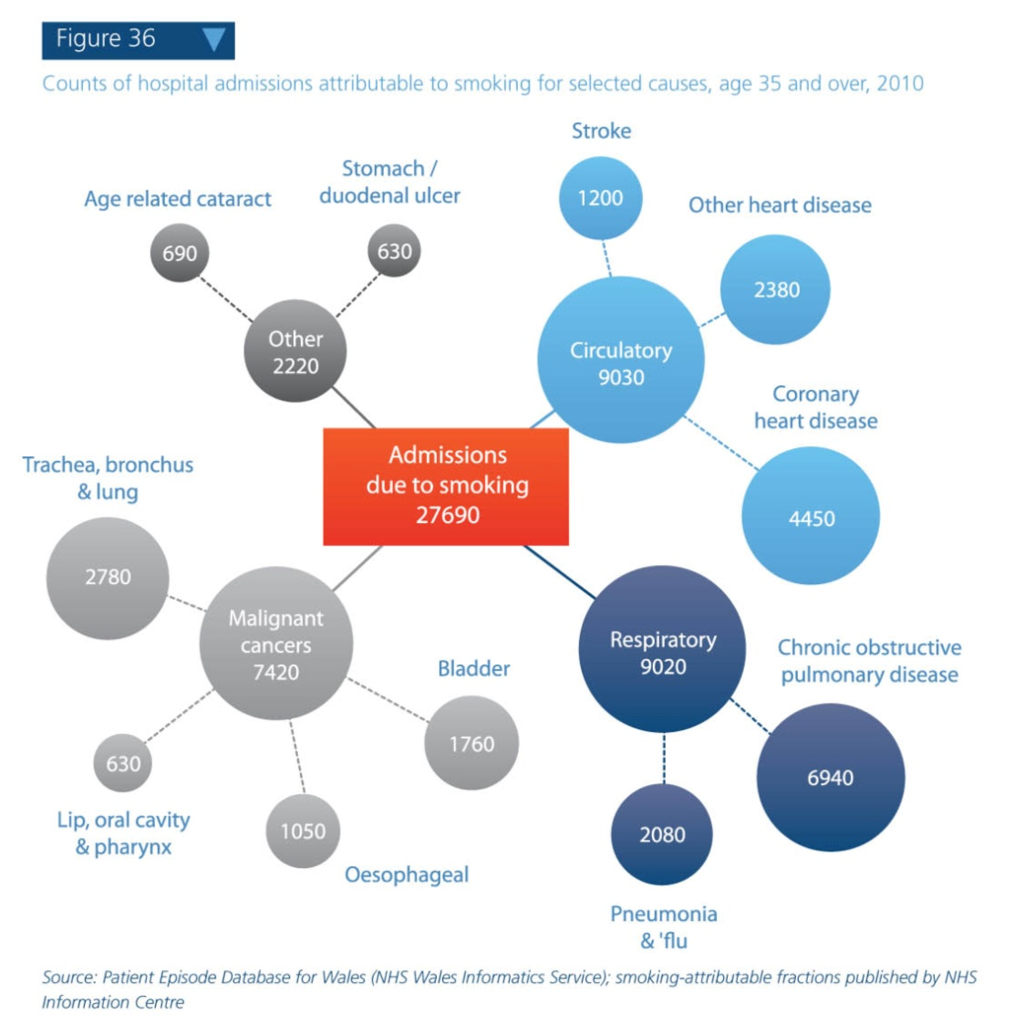
Smoking-attributable hospital admissions, 2010
In 2010, smoking is estimated to have caused around 5 per cent of all hospital admissions in people aged 35 and over
A higher proportion of admissions in men (7 per cent) than women (4 per cent) are attributable to smoking

Slide 31
Key message 10
“Tobacco is around 30 per cent less affordable than in 1980, but the effectiveness of price as a control measure is diminished by continued access to smuggled products.”

Slide 32
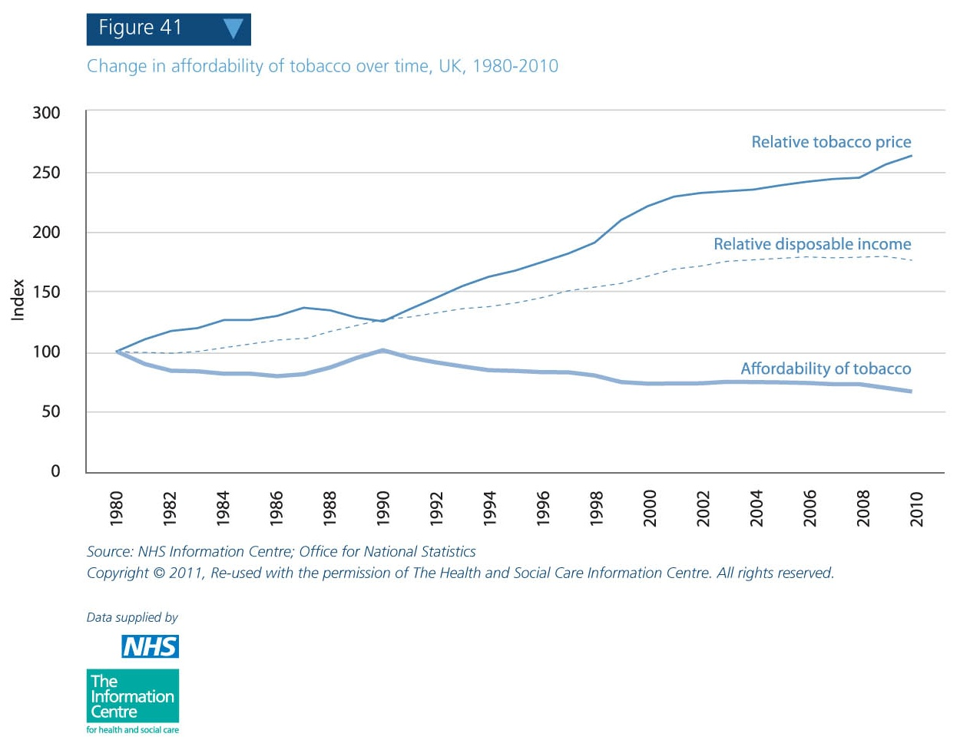
Change in affordability of tobacco over time, UK, 1980-2010
The relative price of tobacco has increased more than disposable income since 1980, making it less affordable
Smuggling continues to make tobacco more affordable, with latest estimates suggesting than one in ten cigarettes and half of all hand-rolling tobacco is illicit

Slide 33
Key message 11
“Major reductions in smoking prevalence are achievable, given evidence from California and Singapore.”

Slide 34
Examples of successful tobacco control policy from California & Singapore
Falls in smoking prevalence achieved through sustained and bold intervention:
California: from 27% in 1985 to 13% in 2009
Singapore: from 20% in 1984 to 13% in 2004
Of 25-cent tax on cigarettes, 5 cents were dedicated to tobacco control by the landmark 1988 California Tobacco Tax and Health Protection Act.
Efforts to promote a smoke-free lifestyle in Singapore started in the 1970s with legislation to ban smoking in public places and prohibit tobacco advertising and promotion

Slide 35
More information
If you have any questions or would like to request printed copies of Tobacco and health in Wales, please contact us on
publichealthwalesobservatory@wales.nhs.uk

Slide 36
Acknowledgements
Project team
Project Board
Hugo Cosh, Gareth Davies, Ioan Francis, Elinor Griffiths, Leon May, Cath Roberts, Claire Tiffany, Margaret Webber
Mererid Bowley, Nathan Lester, Cindy Marsh, Cath Roberts, Jane Wilkinson
Thanks to the following people for their contribution to this report:
Rose Allgeier, Joanna Arthur, Susan Belfourd, Lloyd Evans, Deirdre Hickey, Ciarán Humphreys, Louise Megrath, Isabel Puscas, Salah Sharif (NHS Information Centre)

