Slide 1

Measuring inequalities: Trends in mortality and life expectancy in Powys
December 2011

Slide 2
Using these slides
These slides accompany the presentation slides for the inequalities in Wales profile.
These slides are a resource to demonstrate examples of findings from the Public Health Wales Observatory ‘Measuring Inequalities’ profiles.
The presentation can be used as a whole or as individual slides.
Please acknowledge the work of the Public Health Wales Observatory when using these slides.

Slide 3
Powys

Slide 4
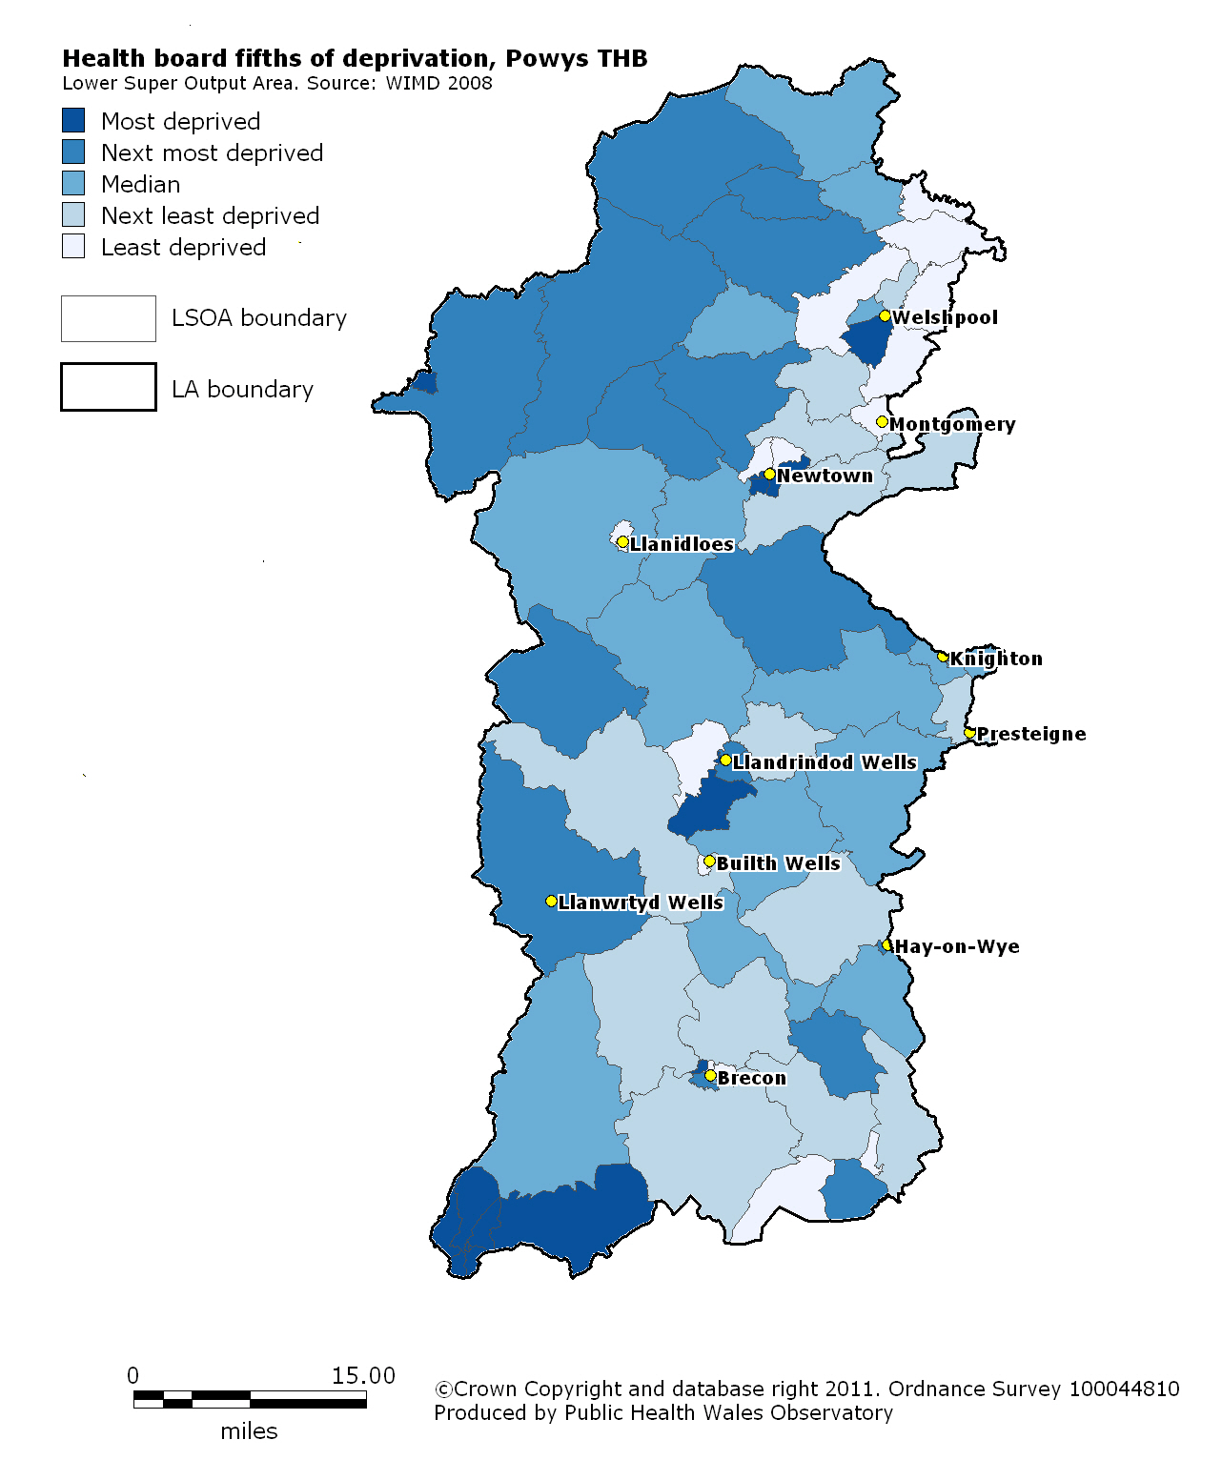
Local fifths of deprivation:
Powys
Notes:
Local deprivation fifths for each health board have been produced by ranking all Lower Super Output Areas (LSOAs) within the area and grouping them into fifths, based on the Welsh Index of Multiple Deprivation (2008). Each health board therefore has its own local fifths depending on the deprivation distribution within that area which are shown here.

Slide 5
Life expectancies in Powys
Produced by the Public Health Wales Observatory, using ADDE/MYE (ONS), WIMD/WHS (WG)
Notes:
This slide shows three measures of life expectancy in males and females.
Life expectancy at birth is a statistical measure of the average expected years of life for a newborn based on currently observed mortality rates and is a measure of mortality across all ages.
In addition to general life expectancy it is important to consider quality of life and so two further measures are represented here.
Healthy life expectancy at birth (HLE) represents the number of years a person can expect to live in good health.
Disability-free life expectancy at birth (DFLE) estimates the number of years of life expected to be free from a limiting long-term illness. or disability.

Slide 6
Mortality in males under 75
in Powys
European age-standardised rates (EASR) per 100,000 population
Produced by the Public Health Wales Observatory, using ADDE/MYE (ONS), WIMD 2008 (WG)
Notes:
This chart shows the mortality trend between 2001-03 and 2007-09 for all causes of death in males under 75 in the health board. The mortality rate in the most and the least deprived fifths is shown together with the rates for Wales and the health board as a whole as a comparison.

Slide 7
Mortality in females under 75
in Powys
European age-standardised rates (EASR) per 100,000 population
Produced by the Public Health Wales Observatory, using ADDE/MYE (ONS), WIMD 2008 (WG)
Notes:
This chart shows the mortality trend between 2001-03 and 2007-09 for all causes of death in females under 75 in the health board. The mortality rate in the most and the least deprived fifths is shown together with the rates for Wales and the health board as a whole as a comparison.

Slide 8
Smoking-attributable mortality in males aged 35+ in Powys
European age-standardised rates (EASR) per 100,000 population
Produced by the Public Health Wales Observatory, using ADDE/MYE (ONS), WHS/WIMD 2008 (WG)
Notes:
This chart shows the mortality trend between 2001-03 and 2007-09 for smoking-attributable deaths in males aged 35 and over in the health board. The mortality rate in the most and the least deprived fifths is shown together with the rates for Wales and the health board as a whole as a comparison.

Slide 9
Smoking-attributable mortality in females aged 35+ in Powys
European age-standardised rates (EASR) per 100,000 population
Produced by the Public Health Wales Observatory, using ADDE/MYE (ONS), WHS/WIMD 2008 (WG)
Notes:
This chart shows the mortality trend between 2001-03 and 2007-09 for smoking-attributable deaths in females aged 35 and over in the health board. The mortality rate in the most and the least deprived fifths is shown together with the rates for Wales and the health board as a whole as a comparison.

Slide 10
Alcohol-attributable mortality in persons
in Powys and Wales
European age-standardised rates (EASR) per 100,000 population
Produced by the Public Health Wales Observatory, using ADDE/MYE (ONS), WIMD 2008 (WG)
Notes:
This chart shows the mortality trend between 2001-03 and 2007-09 for alcohol attributable causes of death in persons in the health board. The mortality rate in the most and the least deprived fifths is shown together with the rates for Wales and the health board as a whole as a comparison.

Slide 11
More information
www.publichealthwalesobservatory.wales.nhs.uk/inequalities

Slide 12
Acknowledgements
Project team
Project Board
Project manager:
Andrea Gartner
Team: Margaret Webber, Hugo Cosh, Gareth Davies, Anna Childs, Bethan Patterson, Claire Tiffany, Ruth Davies
Ciarán Humphreys
Annie Delahunty
Nathan Lester
Public Health Wales: Susan Belfourd, Chris Lines, Carolyn Lester
Others: Welsh Government, Office for National Statistics, London Health Observatory, East Midlands Public Health Observatory

