Slide 1

Measuring inequalities: Trends in mortality and life expectancy in Wales
8 December 2011

Slide 2
Using these slides
These slides are a resource to demonstrate examples of findings from ‘Measuring Inequalities’ published by the Public Health Wales Observatory.
The presentation can be used as a whole or as individual slides.
Please acknowledge the work of the Public Health Wales Observatory when using these slides.

Slide 3
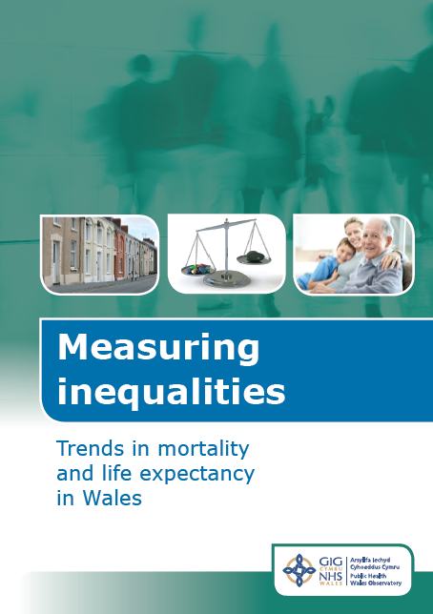
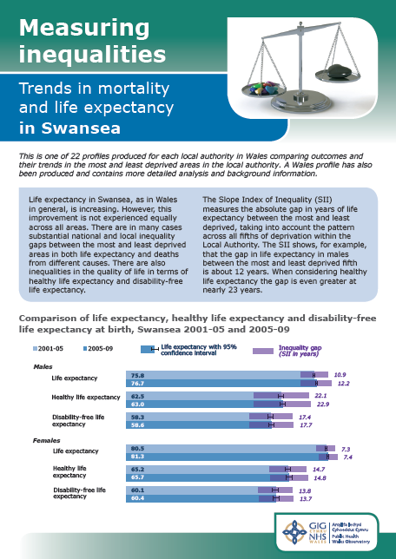
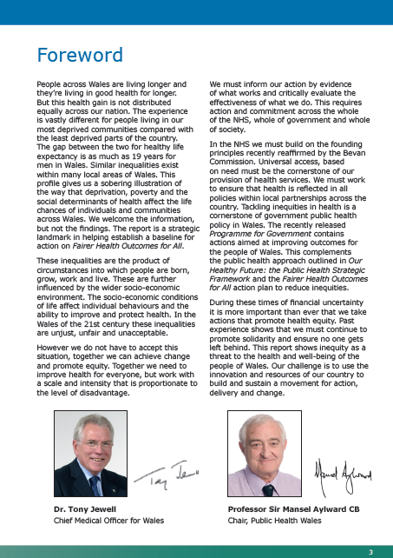
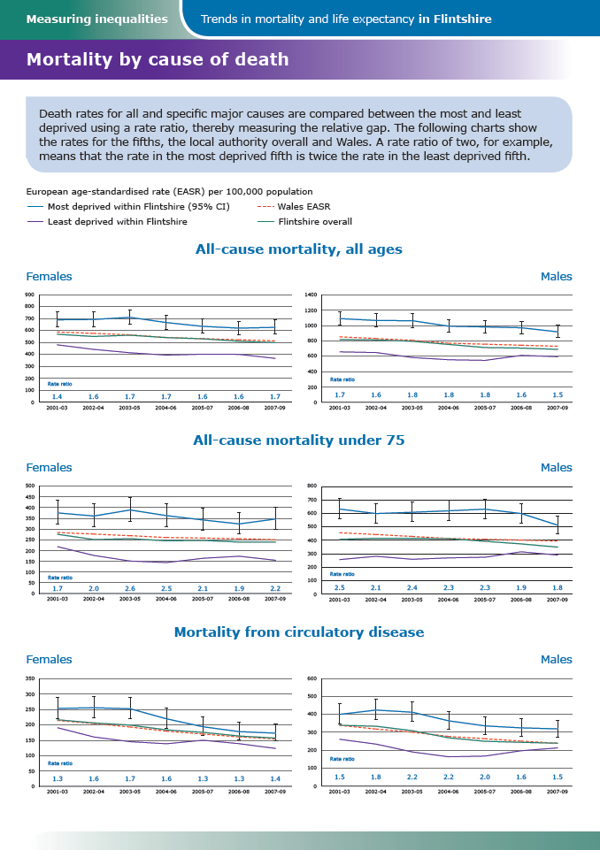
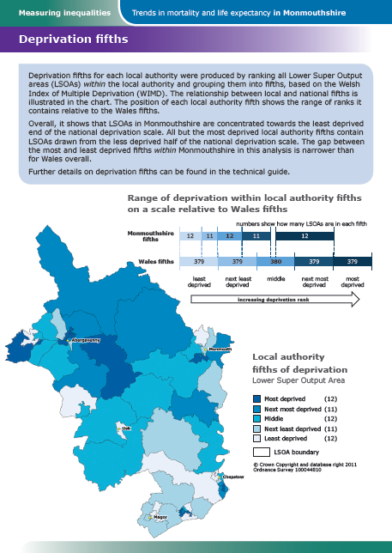
Measuring inequalities
Wales profile
22 local authority profiles
Bilingual documents
Supported by:
Technical guide
Data files

Slide 4
Aims
Measure inequality gap between most and least deprived and change over time
Support local and national action to reduce inequalities through improving understanding of health inequalities and trends

Slide 5
What’s new?
Local inequality trends (LA/HB) using local deprivation fifths
Healthy life expectancy (LA/HB by fifth)
Disability-free life expectancy (LA/HB by fifth)
Slope index of inequality (gap)
Updated smoking-attributable mortality

Slide 6
Mortality trends: All-cause mortality, males, all ages, Wales, 2001-03 to 2007-09
National inequality
gap has widened
over time (all main
causes except
male respiratory)
Local inequality
trends vary
Produced by Public Health Wales Observatory, using ADDE/MYE (ONS), WIMD(WG)

Slide 7
Mortality trends: alcohol-related mortality, males, all ages, Wales, 2001-03 to 2007-09
Widest gap in
alcohol-related
mortality
No clear trend
in gap over time
Produced by Public Health Wales Observatory, using ADDE/MYE (ONS), WIMD(WG)

Slide 8
Life expectancy at birth
“Average expected years of life for a baby born in the time period”
Based on current mortality rates and population estimates
Mortality rates likely to increase during newborn’s lifetime

Slide 9
New: healthy life expectancy at birth (HLE)
“Years of life expected in good health”
Indicator of quality of life
Uses current mortality rates, population estimates and WHS survey data
(Question: In general would you say your health is: Excellent, very good, good, fair, poor (adults))
New at LA/HB level and by fifths

Slide 10
New: disability-free life expectancy at birth (DFLE)
“Years of life expected without a limiting long-term illness or disability”
As for HLE except WHS data
(Question: Do you have any long-term illness,
health problem or disability which limits your daily
activities or the work you can do?)

Slide 11
HLE , ranked local authorities, males, 2005-09
Produced by Public Health Wales Observatory, using ADDE/MYE (ONS), WHS(WG)

Slide 12
DFLE, ranked local authorities, males, 2005-09
Produced by Public Health Wales Observatory, using ADDE/MYE (ONS), WHS(WG)

Slide 13
Life expectancy and healthy life expectancy at birth, ranked health boards, males, 2005-09
Produced by Public Health Wales Observatory, using ADDE/MYE (ONS), WHS(WG)

Slide 14
Life expectancy and disability-free life expectancy at birth, ranked health boards, males, 2005-09
Produced by Public Health Wales Observatory, using ADDE/MYE (ONS), WHS(WG)

Slide 15
Comparison of life expectancy, HLE and DFLE at birth, Wales (also available for each LA/HB)
Produced by Public Health Wales Observatory, using ADDE/MYE (ONS), WIMD/WHS(WG)

Slide 16
The Slope Index of Inequality
Absolute measure of the gap in years between most and least deprived whilst taking all fifths into account
Regression analysis (line of best fit across fifths of deprivation)
Assumes linear distribution (affects CI)
Calculated for life expectancy, HLE, DFLE for Wales, HB and LA

Slide 17
Inequality gap in life expectancy has slightly widened in Wales
Produced by Public Health Wales Observatory, using ADDE/MYE (ONS), WIMD/WHS(WG)

Slide 18
Inequality gap very wide in healthy life expectancy in Wales
Produced by Public Health Wales Observatory, using ADDE/MYE (ONS), WIMD/WHS(WG)

Slide 19
Higher proportion of life expectancy spent in good health in least deprived than most deprived areas
LE, HLE, DFLE by fifth, Wales, males
87%
75%
Produced by Public Health Wales Observatory, using ADDE/MYE (ONS), WIMD/WHS(WG)

Slide 20
Females live 4.4 years longer than males, only 2 years longer HLE/DFLE
Produced by Public Health Wales Observatory, using ADDE/MYE (ONS), WIMD/WHS(WG)

Slide 21
Local inequality gaps are larger in areas with greater range of deprivation levels
Cardiff
Blaenau Gwent
Produced by Public Health Wales Observatory, using ADDE/MYE (ONS), WIMD/WHS(WG)

Slide 22
Limitations
Area-based analysis
Relies on WIMD 2008
Self-reported survey data (HLE/DFLE)
Some small numbers at local level – large confidence intervals

Slide 23
In conclusion
Striking inequalities in mortality and quality of life in Wales
Inequalities widening slightly
Many new measures, e.g. quality of life
New evidence of local inequalities
Opportunity to raise profile for action at local and national levels

Slide 24
More information
www.publichealthwalesobservatory.wales.nhs.uk/inequalities

Slide 25
Acknowledgements
Project team
Project Board
Project manager:
Andrea Gartner
Team: Margaret Webber, Hugo Cosh, Gareth Davies, Anna Childs, Bethan Patterson, Claire Tiffany, Ruth Davies
Ciarán Humphreys
Annie Delahunty
Nathan Lester
Public Health Wales: Susan Belfourd, Chris Lines, Carolyn Lester
Others: Welsh Government, Office for National Statistics, London Health Observatory, East Midlands Public Health Observatory

